Slide 1
Investigating Trends in Atmospheric Compositions of Cool Gas Giant Planets Using Spitzer Secondary Eclipses
Nicole Wallack (Caltech)
Heather Knutson, Caroline Morley, Nancy Thomas, Daniel Thorngren, Jean-Michel Désert, Jonathan Fortney, Joshua Kammer, and Julianne Moses

Slide 2
Using Solar System Trends to Probe Planet Evolution
Increasing atmospheric “metallicity”
C/H ~ 4 x Solar metallicity
C/H ~ 70 x Solar metallicity
(Wong et al. 2004)
(Karkoschka & Tomasko 2011; Sromovsky et al. 2011)
NASA
Decreasing core mass fraction/ Increasing mass

Slide 3
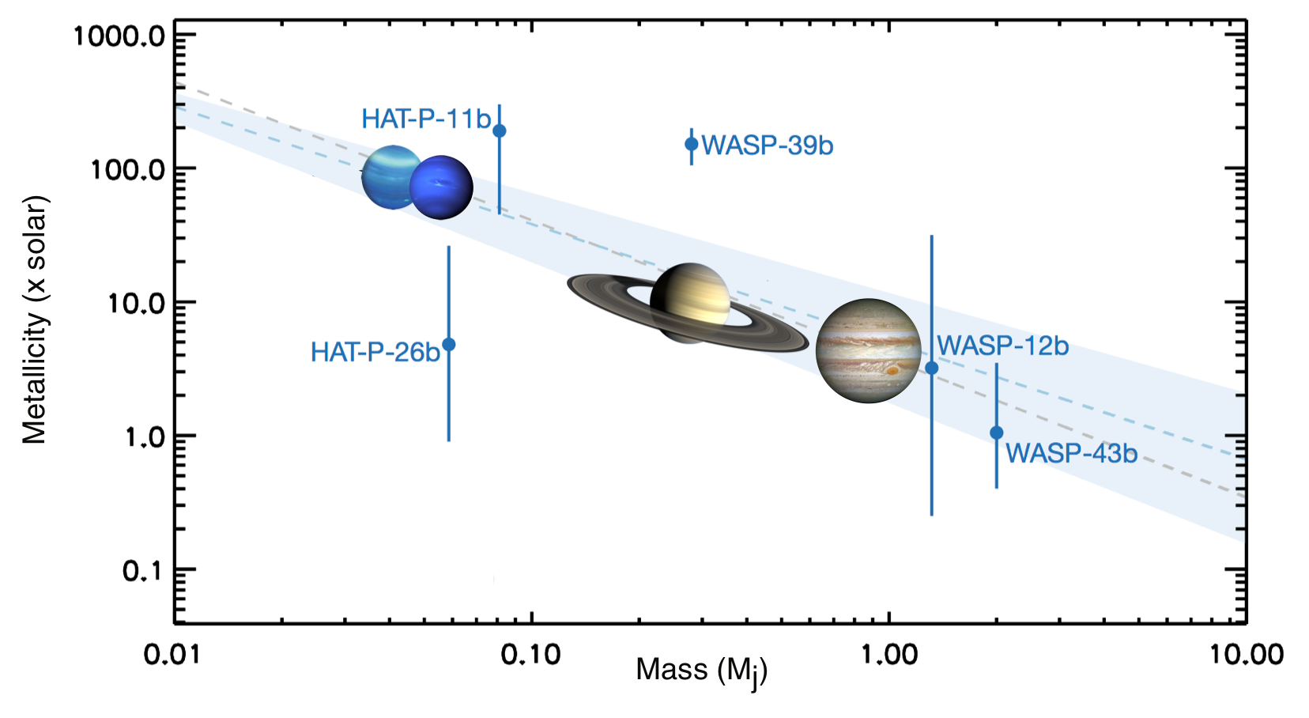
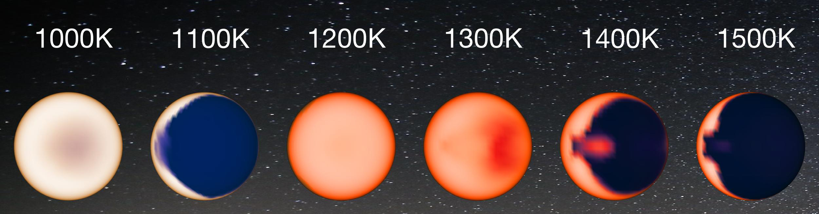
Clouds Affect Our Ability to Detect an Atmospheric Composition-Planet Mass Trend from Transmission Spectra
(Adapted from Wakeford et al. 2018)
(Figure from Parmentier et al. 2016)

Slide 4
Using Spitzer Secondary Eclipses to Determine Atmospheric Composition
WASP-69b
Downward Slope
High CO/CH₄ absorption
Upward Slope
Low CO/CH₄ Absorption
(Moses et al. 2013; Stevenson et al. 2012; Morley et al. 2016)

Slide 5
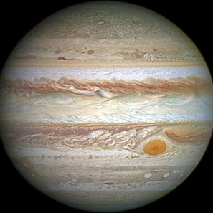
Secondary Eclipses of Cool (T< ~1000 K) Planets
8 Previously Published Planets
2 Planets In-Prep:
GJ 3470b
HAT-P-12b
5 New Planets:
HAT-P-15b
HAT-P-17b
HAT-P-18b
HAT-P-26b
WASP-69b
1.9M_{J}
0.2 M_{J}
0.5 M_{J}
0.06 M_{J}
0.3 M_{J}
900 K
800 K
800 K
1000 K
1000 K
Multiple Visits in Each Spitzer Bandpass

Slide 6
No Trend in Atmospheric Composition With Temperature
CH₄ Rich
CO Poor
Sanity check:
0.8- 26.3 x solar
(Wakeford et al. 2017)
HAT-P-26b
GJ 3470b
Sanity check:
> 200 x solar
(Moses et al. 2013; Morley et al. 2016)
CO Rich
CH₄ Poor
GJ 436b
(Wallack et al. in prep)

Slide 7
No Trend in Atmospheric Composition With Planet Mass
CH₄ Rich
CO Poor
HAT-P-26b
GJ 3470b
CO Rich
CH₄ Poor
GJ 436b
(Wallack et al. in prep)

Slide 8
Possible Trend in Atmospheric Composition With Bulk Metallicity
CH₄ Rich
CO Poor
HAT-P-26b
GJ 3470b
CO Rich
CH₄ Poor
GJ 436b
(Wallack et al. in prep)
Thorngren et al. 2016

Slide 9
Evidence for a Trend in Atmospheric Composition With Stellar Metallicity
CH₄ Rich
CO Poor
HAT-P-26b
GJ 3470b
CO Rich
CH₄ Poor
GJ 436b
(Wallack et al. in prep)

Slide 10
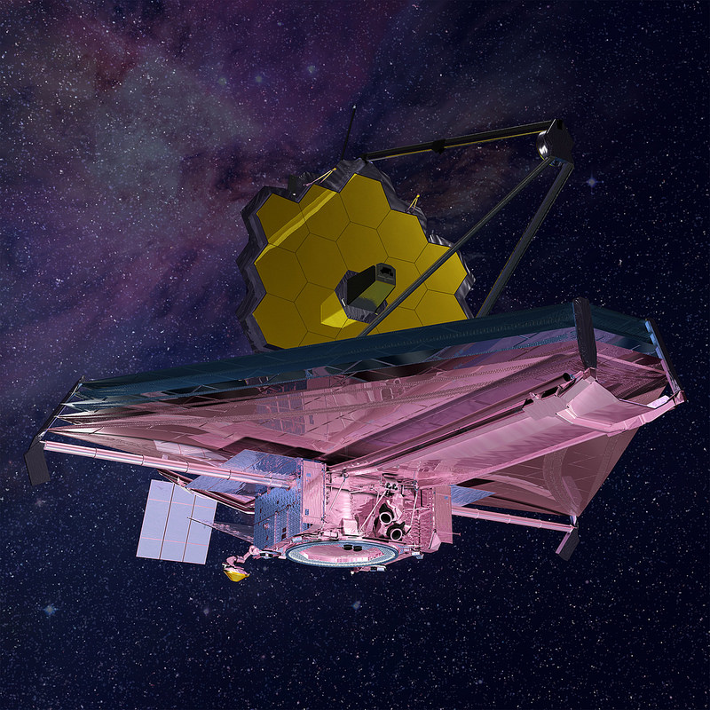
JWST Will Allow Us to Better Constrain Atmospheric Compositions
NASA

