Slide 1
HiCannon: Data-driven spectroscopy of cool stars at high spectral resolution
1
Aida Behmard¹, Erik Petigura^{2,3}, Andrew Howard²
¹Division of Geological and Planetary Science, Caltech
²Cahill Center for Astrophysics, Caltech
³Hubble Fellow
ExSoCal: Sept. 18 2018

Slide 2
2
How do we determine stellar parameters / abundances before?
Synthetic spectral libraries
SpecMatch-Syn (Petigura+2015)
hv
T_{eff} = 5600 K
T_{eff} = 4800 K
T_{eff} = 4000 K
Notes:
Construct model stellar atmospheres, model radiative transfer of photons as they pass through the photosphere towards observer
Synthetic spectra generated from SpecMatch-Syn – they all have identical input parameters other than

Slide 3
3
Synthetic spectral libraries make good abundance / parameter predictions for these stars
10⁶
10
Luminosity (compared to Sun)
These? Not so much.
10⁻⁴
T_{eff} [K]
O B A F G K M
35000 20000 11000 7500 5900 5200 3800
Notes:
Why are M dwarfs a popular choice for exoplanet host stars?
“Coolest stars, in particular, offer observational advantages: larger reflex motions, deeper transits (for well-aligned systems), and better star-planet contrast ratios.”

Slide 4
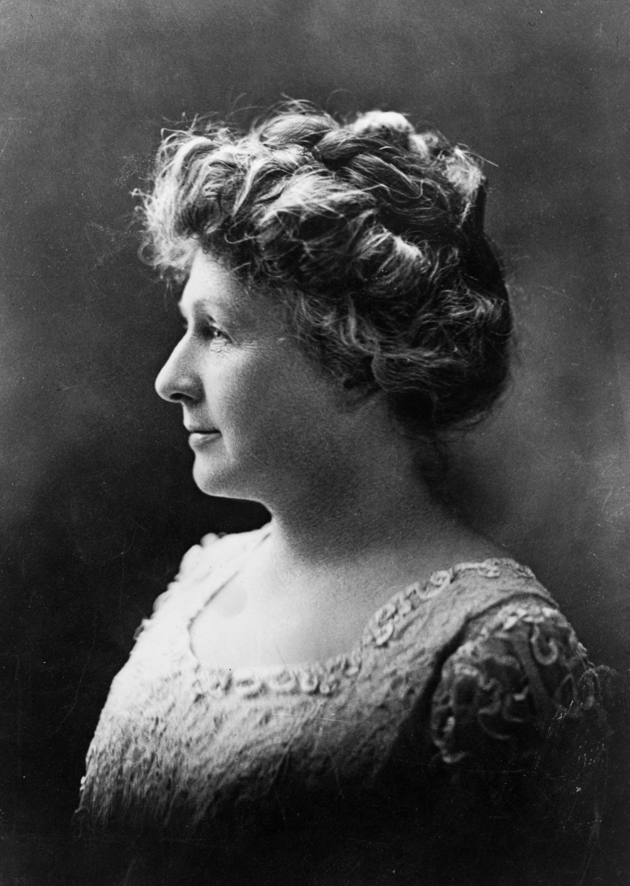
The Cannon
4
Data-driven (ML) approach for predicting stellar parameters + elemental abundances from spectra
Example labels:
Temperature T_{eff}
Bulk metallicity [Fe/H]
Stellar radius R*
Notes:
Makes no use of synthetic spectral models / libraries – good for K and M dwarfs!

Slide 5
The Cannon
5
“Training Step”
Construct flux model
f_{jn} = V(l_{n})• θ_{j} + noise
“Test Step”
Apply f_{jn} to test set spectra

Slide 6
High Resolution Echelle Spectrometer (HIRES) sample
6
141 stars, K and M dwarfs:
T_{eff} < 5200 K
No giants (R* < 1 R)
T_{eff}, R*, [Fe/H]:
Interferometry
SED Modeling
Gaia Parallaxes

Slide 7
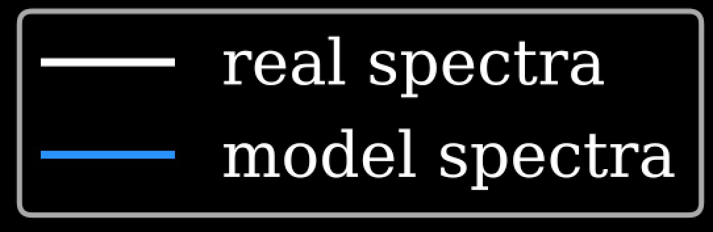
7
The Cannon cannot make predictions for spectra not well-represented in training set!
GL896A: a fast rotator?

Slide 8
8
…diversify the training set!
SpecMatch-Syn (Petigura+2015)
Copy each spectrum in training set and artificially broaden
Here:
+0-20 km/s

Slide 9
9
GL896A
Before:
After:

Slide 10
10
Results

Slide 11
11
Future work
Adapt HiCannon to include prior information (line lists, etc.) – Bayesian framework?
Elemental abundance studies: C/O?

