Slide 1



Unseen companions of V-Hya inferred from periodic ejections
Jesus M. Salas
Advisors: Smadar Naoz & Mark Morris
UCLA Department of Physics and Astronomy
ExoCal 2018

Slide 2
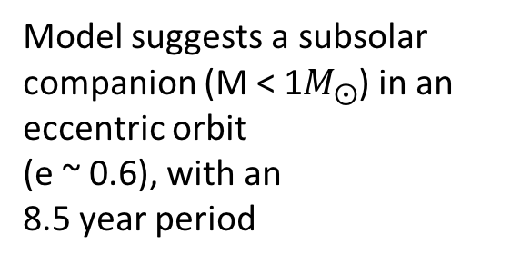
BULLET EJECTIONS FROM V-HYA
Recent study by Sahai et al (2016) present observations of periodic (~8.5 yrs), high-speed (~200 km/s), collimated plasma ejections (“bullets”)
Model suggests a subsolar companion (M < 1$M_{⨀}$) in an eccentric orbit
(e ~ 0.6), with an
8.5 year period
Artist's Illustration Credit: NASA, ESA, and A. Feild (STScI)
Notes:
Late AGB carbon star
Radius ~ 2 AU
Mass ~ 1-2 solar masses
D ~ 400 pc
Explain why bullets are ejected => transient jets from transient accretion disks

Slide 3
OUR MODEL: V-HYA AS PART OF A TRIPLE SYSTEM
Tides can circularize orbits and even cause mergers, thus we wouldn’t expect an initial high eccentricity.
Solution:
We propose a model in which V-hya is part of a triple system

Slide 4
HIERARCHICAL TRIPLE SYSTEMS:
ECCENTRIC KOZAI-LIDOV (EKL) MECHANISM
Kozai (1962) and Lidov (1962), then expanded by Naoz (2013) and others.
Inner orbit’s inclination and eccentricity oscillations on timescales larger than orbital period

Slide 5
Goal: to test if EKL, combined with post-main-sequence stellar evolution, can drive the inner binary to achieve very high eccentricities and undergo Roche lobe crossing.
This would cause the inner companion to accrete material from its companion, and perhaps eject some of this material from it's accretion disk
Notes:
s

Slide 6
EKL COMBINED WITH STELLAR EVOLUTION AND TIDES
We tested a scenario where V-Hya is part of a triple system. Our code includes:
Hierarchical triple secular equations up to the octupole level of approximation (Naoz 2016)
Effects of stellar evolution on stellar radii and masses, following the code SSE by Hurley et al. (2000)
Static tides for both members of the stellar binary (Eggleton et al. 1998; Hut 1980)
The interaction between the EKL mechanism and post-main-sequence stellar evolution has been demonstrated to play an important role in three-body dynamical evolution (Stephan et al. 2018, 2017, 2016; Naoz et al. 2016)

Slide 7
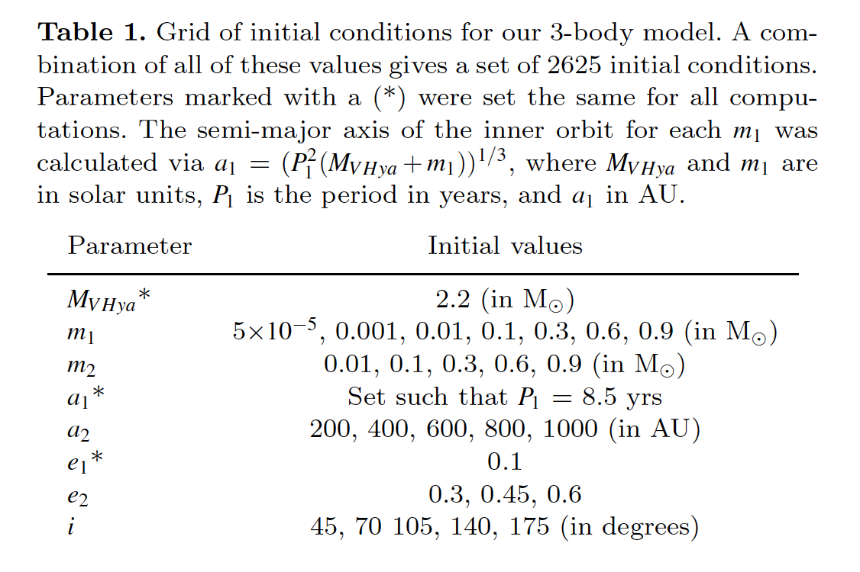
INITIAL CONDITIONS
Run simulations for 1.2 Gyrs

Slide 8
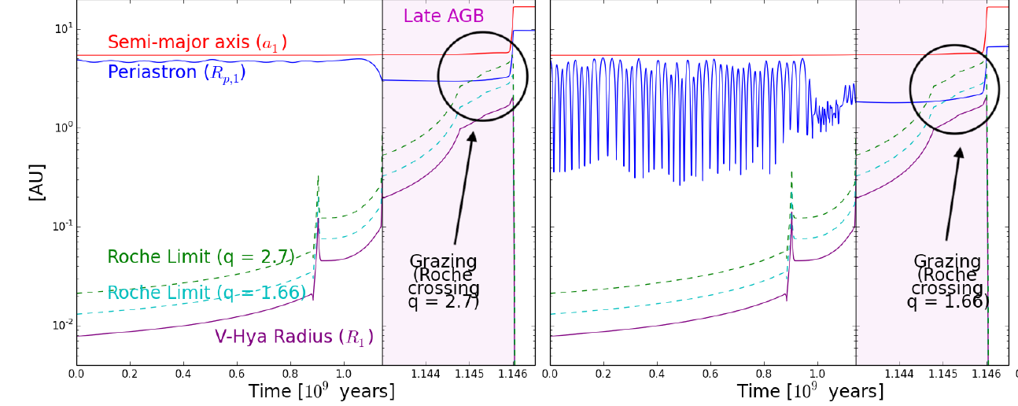
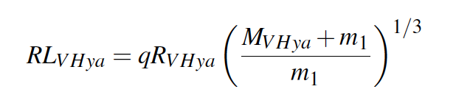
ROCHE CROSSING WITHOUT MERGING
Salas et al 2018 (in prep)
RL_{VHya} = V-Hya’s Roche Limit
R_{VHya} = V-Hya’s radius
M_{VHya} = V-Hya’s mass
m₁ = companion mass
Notes:
Here are two examples

Slide 9
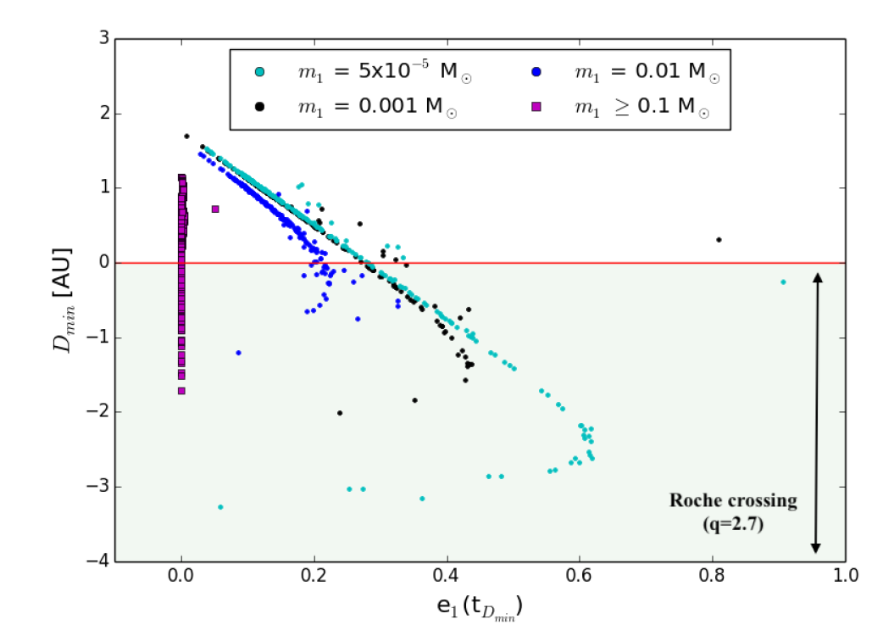
NEPTUNES ACHIEVE HIGHEST ECCENTRICITIES
(periastron – roche limit)
Salas et al 2018 (in prep)

Slide 10
CONCLUSION
The bullet ejections from V Hya may be the result of Jovian planet (or brown dwarf) whose eccentricity was excited by a far away companion and achieved Roche limit crossing.
Notes:
And even if the 3-body model proposed here is not the correct explanation for the real V Hya system, this model could still provide a framework to explain the mechanism behind similar systems.

Slide 11
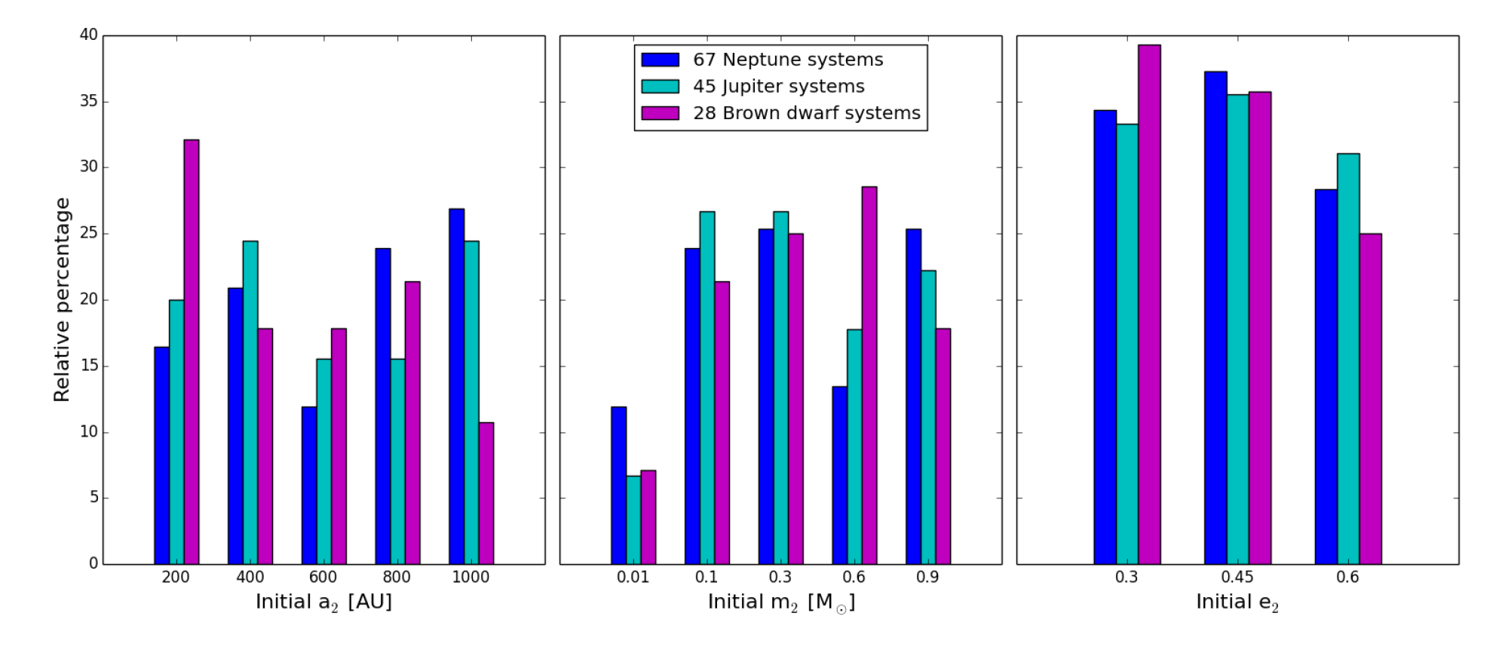
PROPERTIES OF THIRD BODY

