Slide 1
HD 120066 b:
a long-period, highly eccentric
planet discovered with RVs
Sarah Blunt
Caltech -> Harvard-Smithsonian CfA
NSF Graduate Research Fellow
Collaborators: Mike Endl, Lauren Weiss, Bill Cochran, Molly Kosiarek, BJ Fulton, Howard Isaacson, Erik Petigura, Andrew Howard, Glenn Schneider, Kellen Lawson, John Wisniewski, Eric Nielsen, Vanessa Bailey, Bruce Macintosh, and the California Planet Search Team
Notes:
- disclaimer: all results still sort of preliminary, exact numbers we publish may fluctuate a bit

Slide 2
we found a planet with long-term RV monitoring!
Notes:
Long time baseline
Multiple instruments involved

Slide 3
periastron passage was in January
high-cadence monitoring near peri allowed us to
precisely constrain orbital properties

Slide 4
the orbital parameters are wack!
Best-fit Params:

Slide 5
our fit is mostly agnostic to prior choice
this means our data is constraining

Slide 6
planet pi(rate) occupies a unique place
in parameter space
Notes:
Longest-period RV planet discovered to-date
Potentially seeing the outcome of young multi-planet systems that went unstable

Slide 7
planet pi(rate) is poised for
multi-method detections
probability
~10% of orbits detectable in Gaia DR3 alone
imaging possible with next-generation instruments

Slide 8
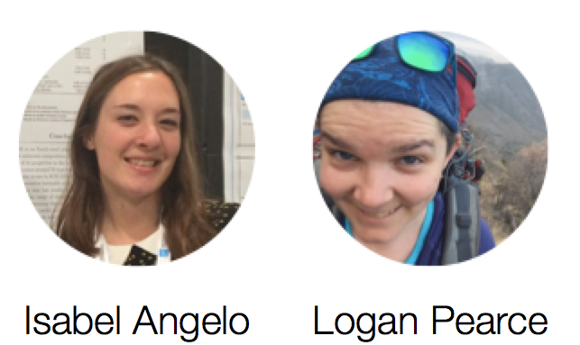
advertisement: extensible, object-oriented
Python packages for orbit-fitting
radvel
orbitize!
for radial velocity
orbit-fitting
for imaging astrometry
orbit-fitting
with BJ Fulton, Erik Petigura,
Sean Mills, and Evan Sinukoff
with Jason Wang, Henry Ngo,
Isabel Angelo, Devin Cody,
Rob De Rosa, and Logan Pearce
sblunt
Notes:
- synergy between two packages

Slide 9

Summary
Are ya ready kids?
Oooooh…..
Who lives round a solar-type star; min mass pi?
Eccentric and wide-sep and massive am I?
If more RV meas’ments be something you wish…
Then drop what you’re doing– my star’s magnitude 6th!
Ready?
HD 120066 b! HD 120066 b! HD 120066 b!
HD 1 22222222222 0066 beeeeeee!!!!!

