Slide 1
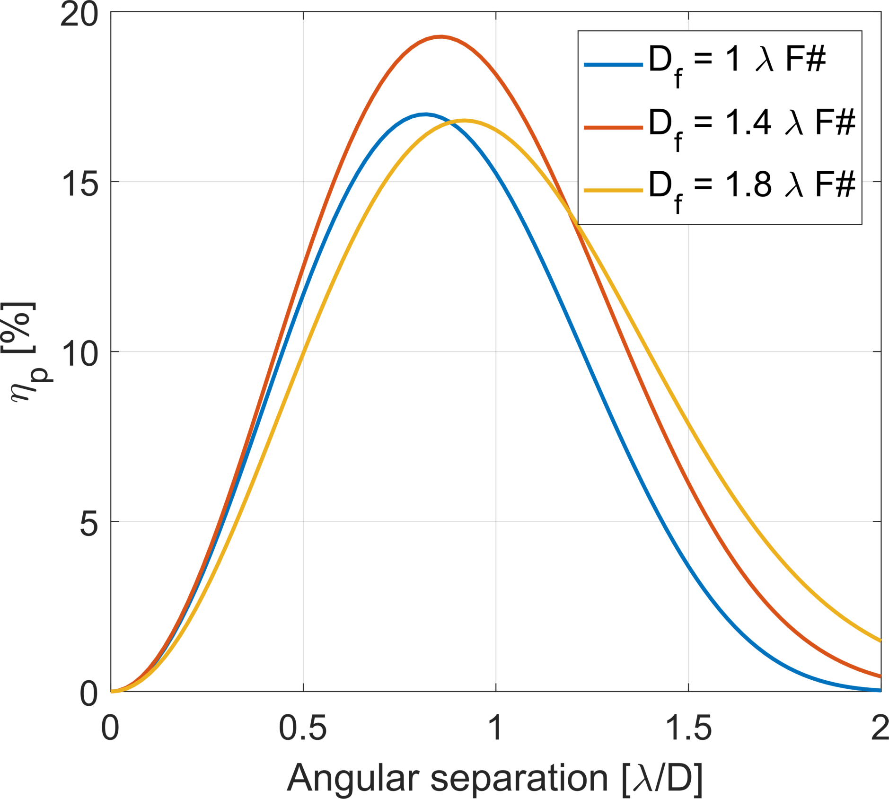
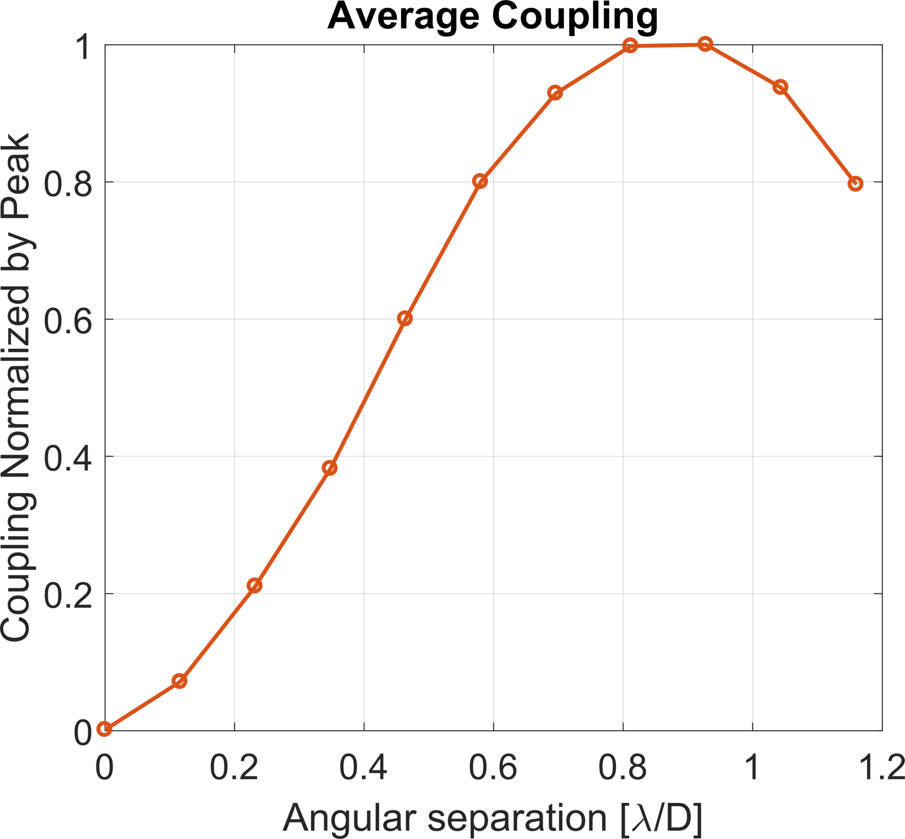
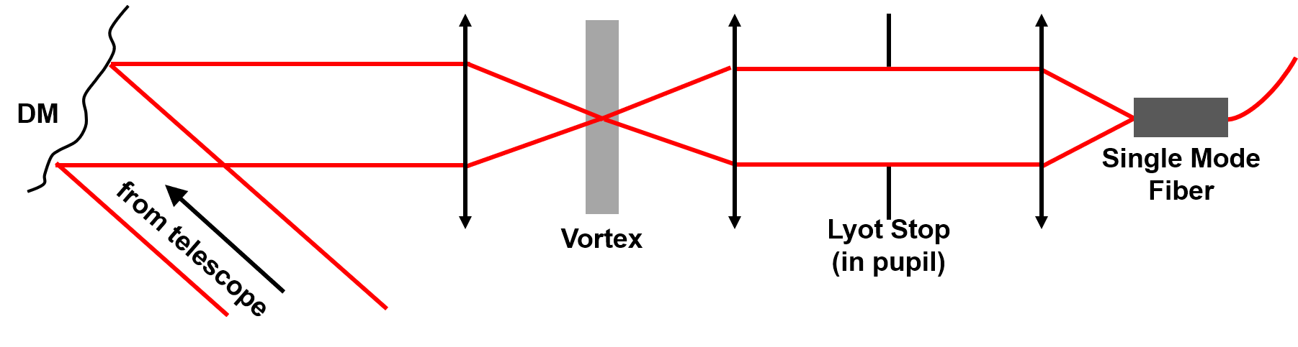
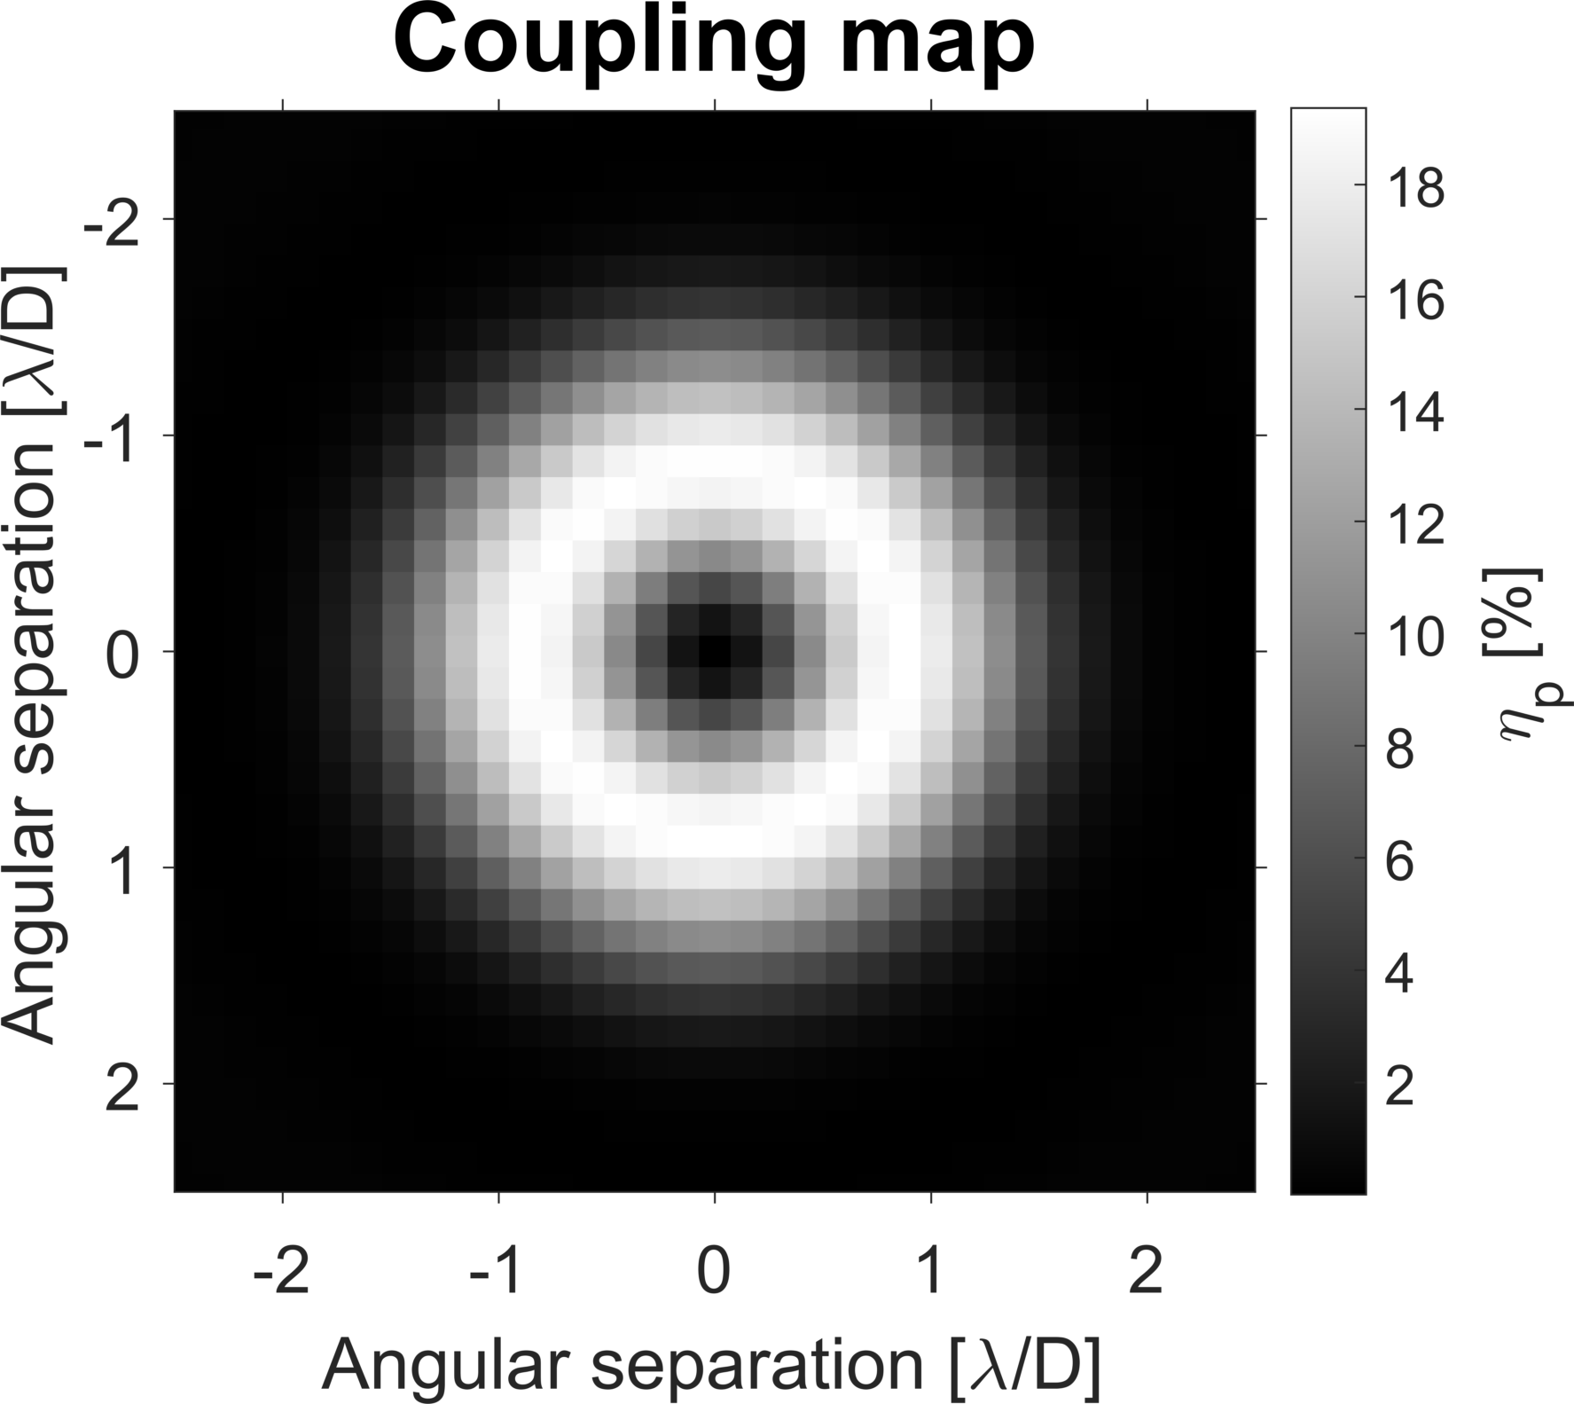
Vortex Fiber Nulling
Theoretical Coupling Curve
Actual Coupling Curve
Optical Layout
Theoretical Coupling Map

