Slide 1
Planet occurrence rate across radii, periods, and metallicity
Eve J. Lee (Caltech)
ExSoCal 2018

Slide 2
Planet occurrence rate across radii, periods, and metallicity
Ahoy! I’m an 1-dimensional pirate!
Eve J. Lee (Caltech)
ExSoCal 2018

Slide 3
Planet occurrence rate across radii, periods, and metallicity
Ahoy! I’m an 1-dimensional pirate!
Now you see me in 3D! Arrrr!
Eve J. Lee (Caltech)
ExSoCal 2018

Slide 4
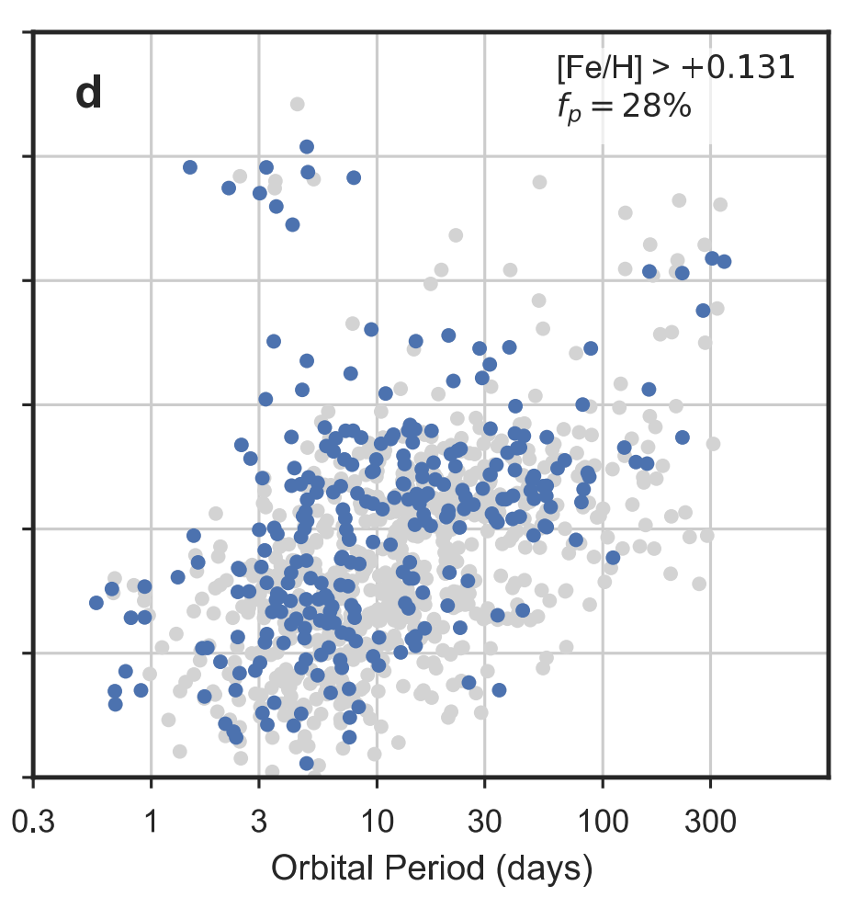
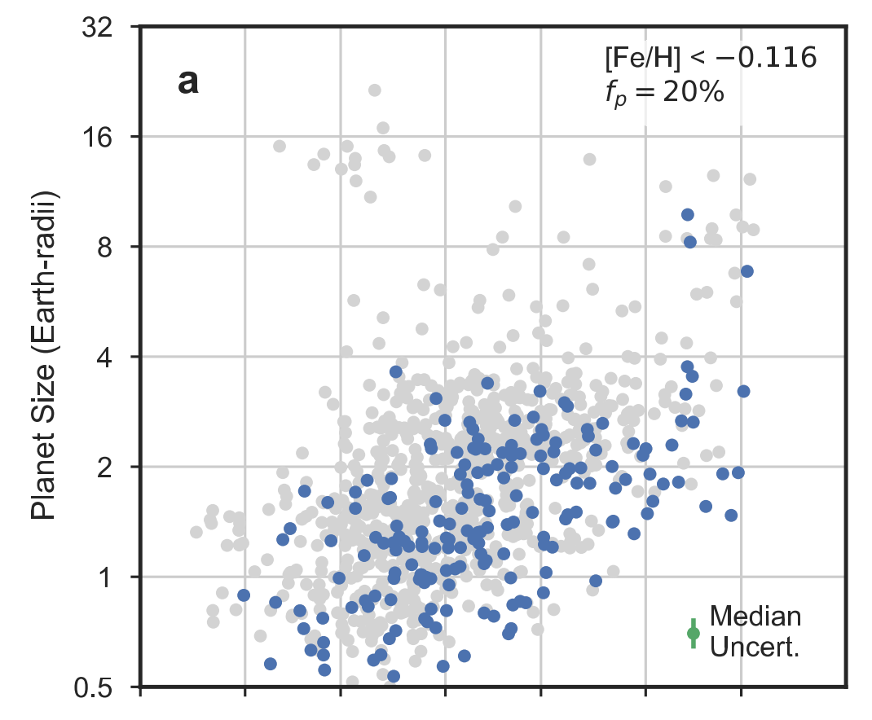
Metal-rich stars host a larger variety of planets
Sub-Solar Metallicity
Super-Solar Metallicity
Petigura et al. (2018)

Slide 5
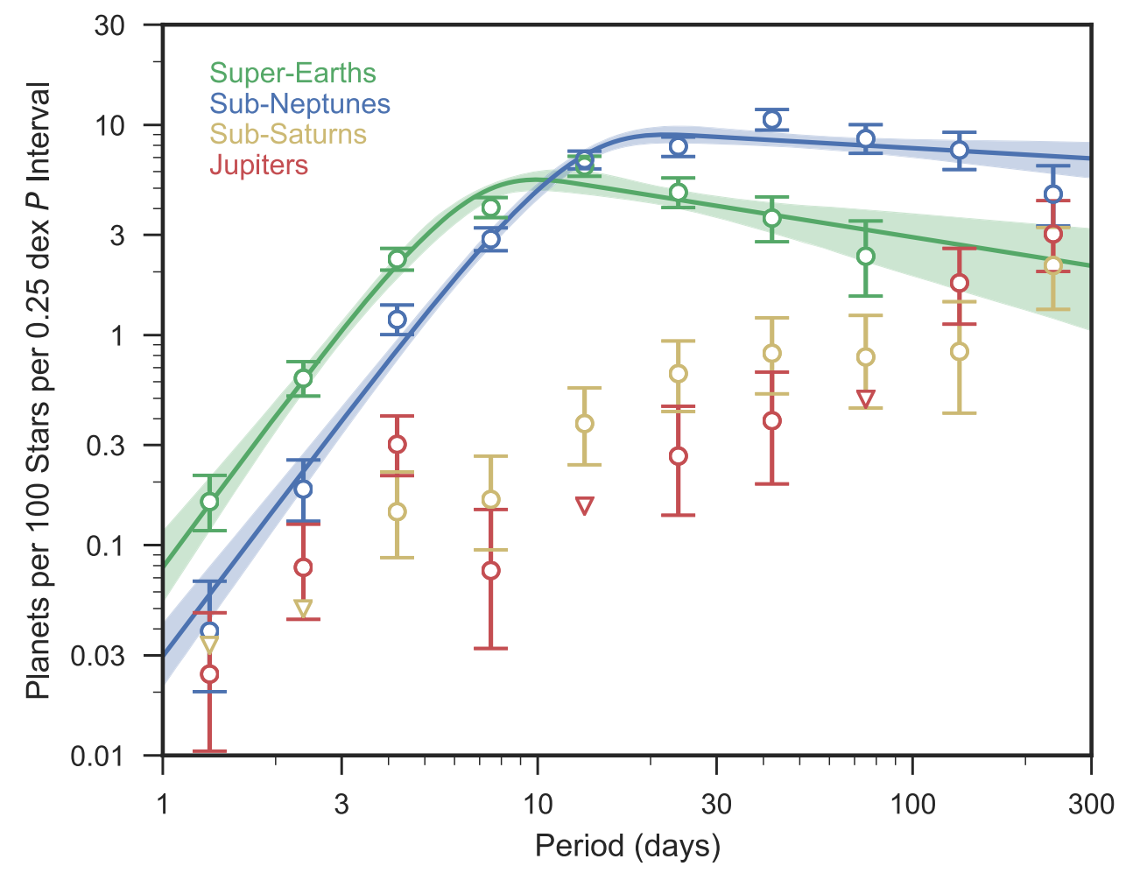
Large planets are distributed differently compared to small planets
Petigura et al. (2018)
See also Dong & Zhu (2013)
Super-Earths / sub-Neptunes: rise out to ~10 days and plateau beyond
Sub-Saturns / Jupiters: continuously rise out to at least ~300 days

Slide 6
1. Late-time Core Assembly
Metal-rich star: solid-heavy disk
$$v_{esc}/Ω$$
$$M_{impact}\sim 2πΣa\frac{v_{esc}}{Ω}$$
Metal-poor star: solid-poor disk
$$M_{impact}∝Z^{1.50}a^{0.22}M_{∗}^{−0.75}$$
Schlichting (2014)

Slide 7
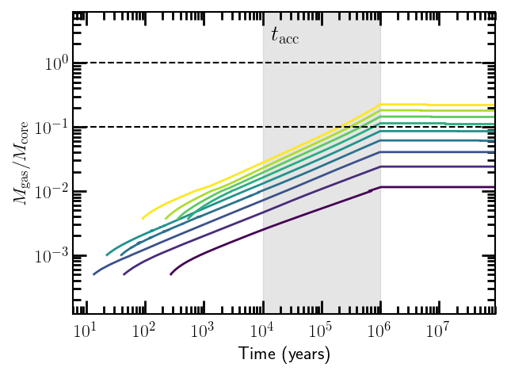
2. Gas accretion in gas-poor environment
Runaway to
Gas giants
Sub-Saturns
$$10M_{⨁}$$
Sub-Neptunes/
Super-Earths
$$3M_{⨁}$$
$$2M_{⨁}$$
EJL (submitted)
Models from EJL, Chiang, & Ormel (2014)
More massive cores: variety of possible outcomes

Slide 8
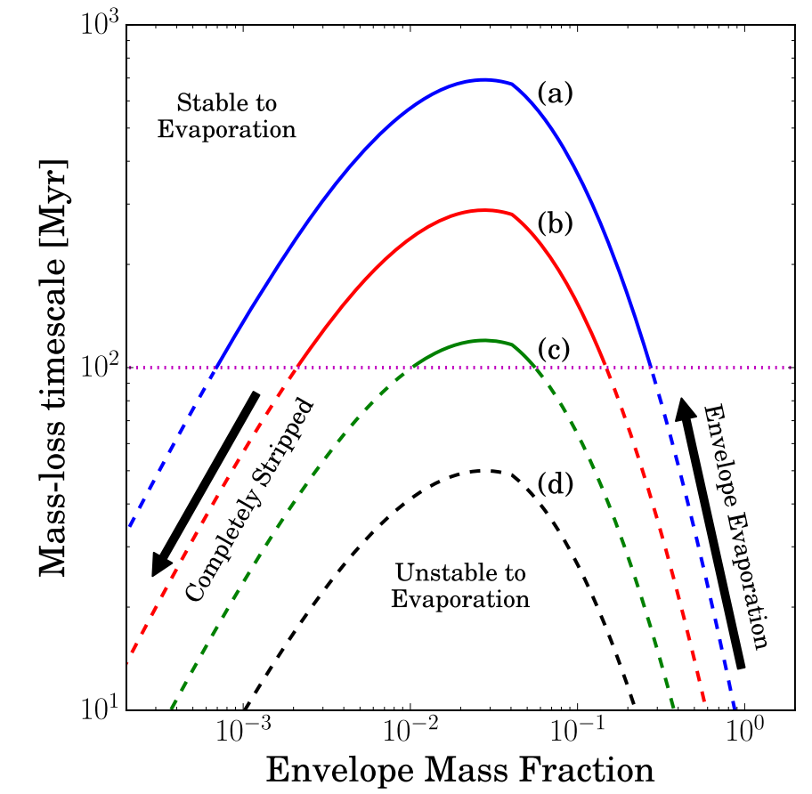
3. Envelope mass loss by photoevaporation
Owen & Wu (2017)

Slide 9
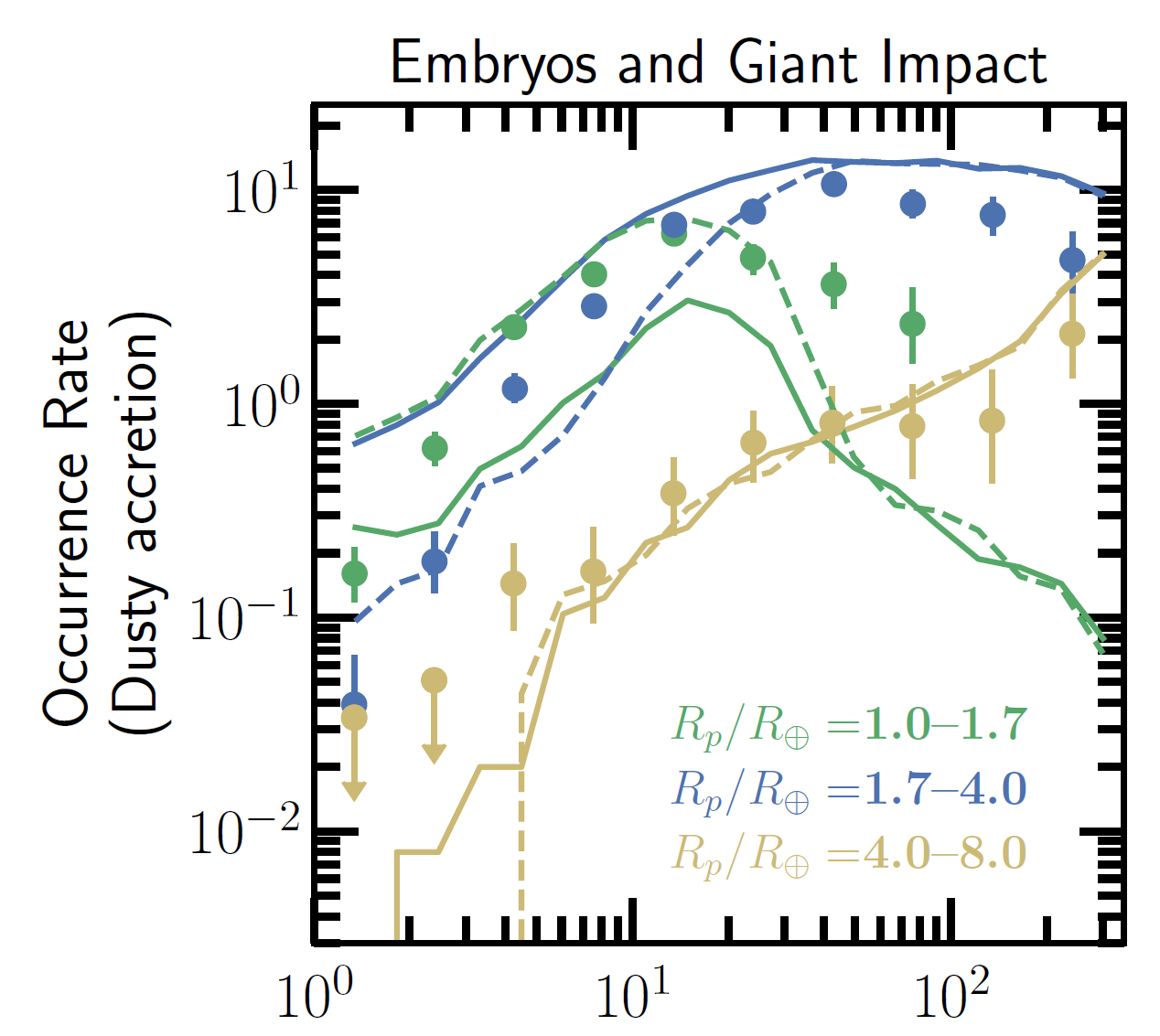
EJL (submitted)
Data from Petigura et al. (2018)

Slide 10
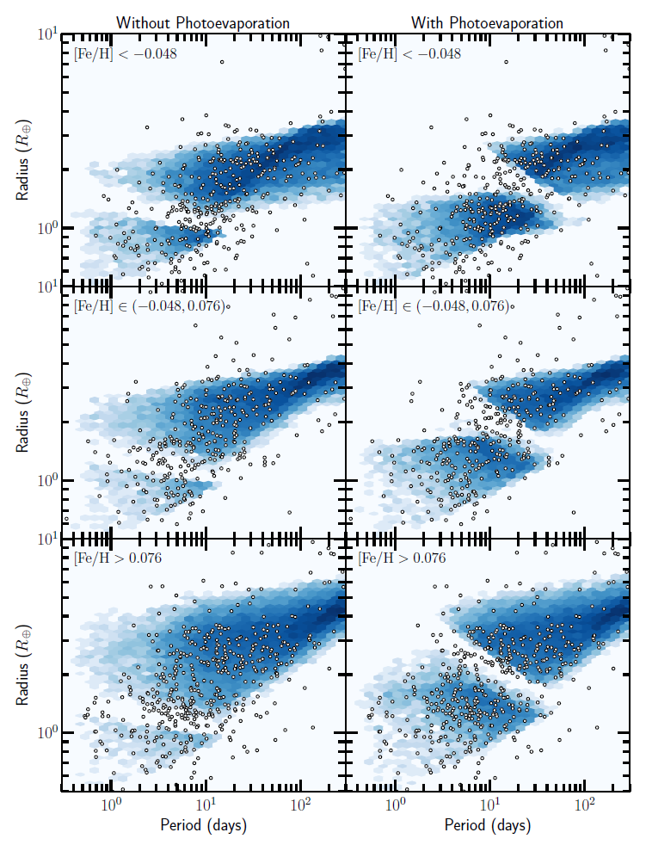
Data from California Kepler Survey
More metal-rich
EJL (submitted)

Slide 11
Data from California Kepler Survey
More metal-rich
EJL (submitted)

Slide 12
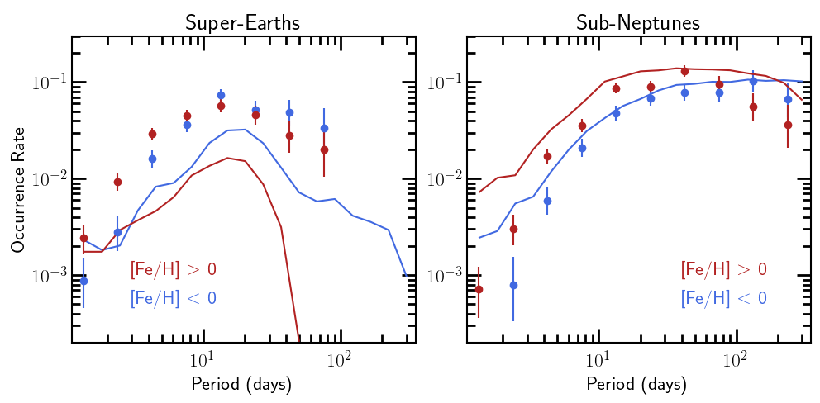
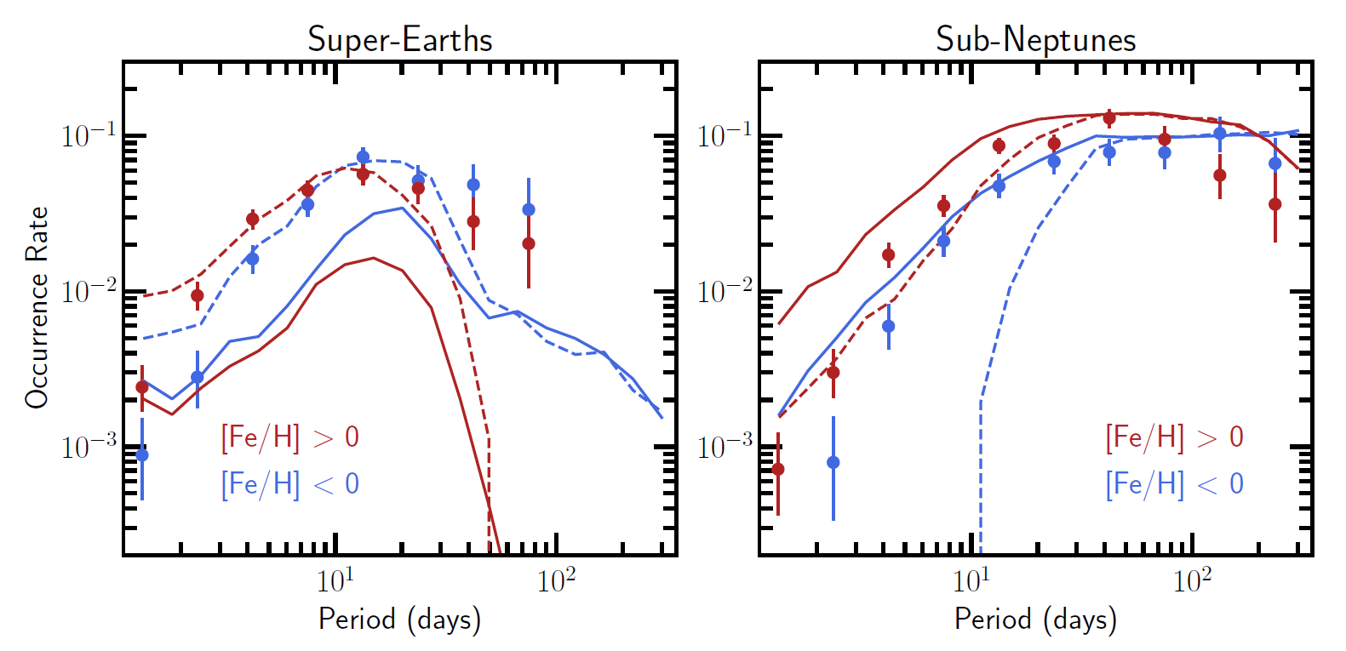
Excess of short-period super-Earths around metal-rich stars:
Stripped cores of excess short-period sub-Neptunes
EJL (submitted)
Data from Petigura et al. (2018)
See also Mulders et al. (2015) and Wilson et al. (2018)

Slide 13
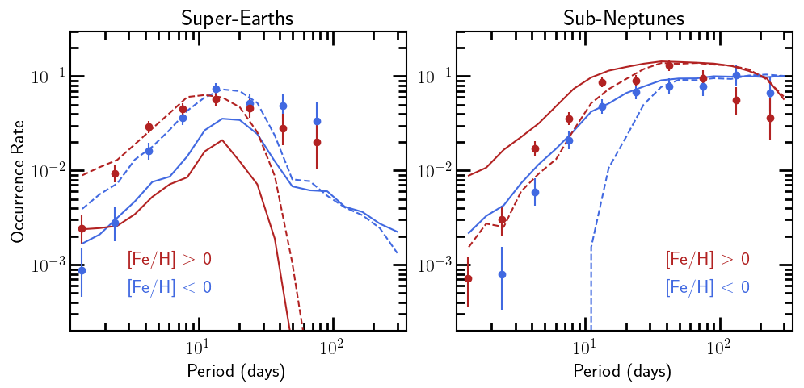
Excess of short-period super-Earths around metal-rich stars:
Stripped cores of excess short-period sub-Neptunes
EJL (submitted)
Data from Petigura et al. (2018)
See also Mulders et al. (2015) and Wilson et al. (2018)

Slide 14
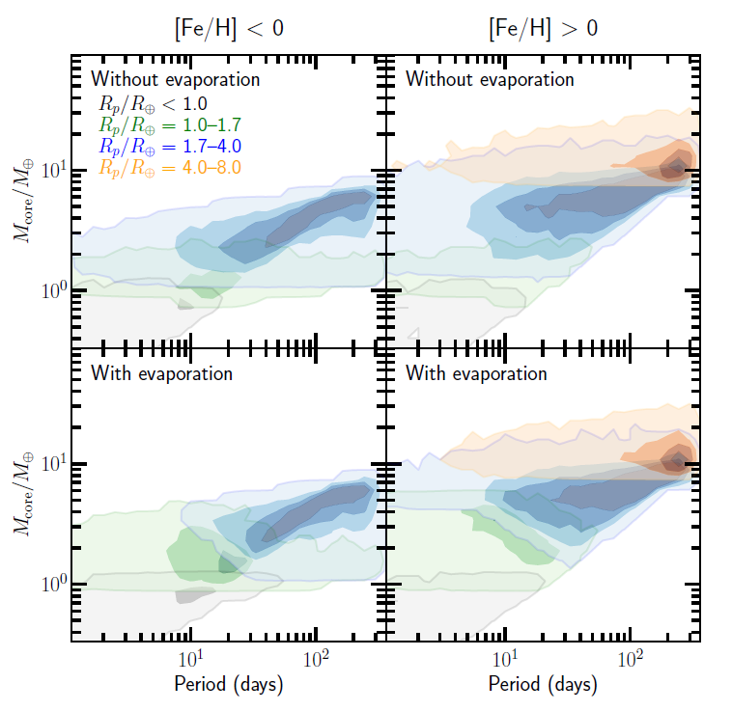
EJL (submitted)

Slide 15
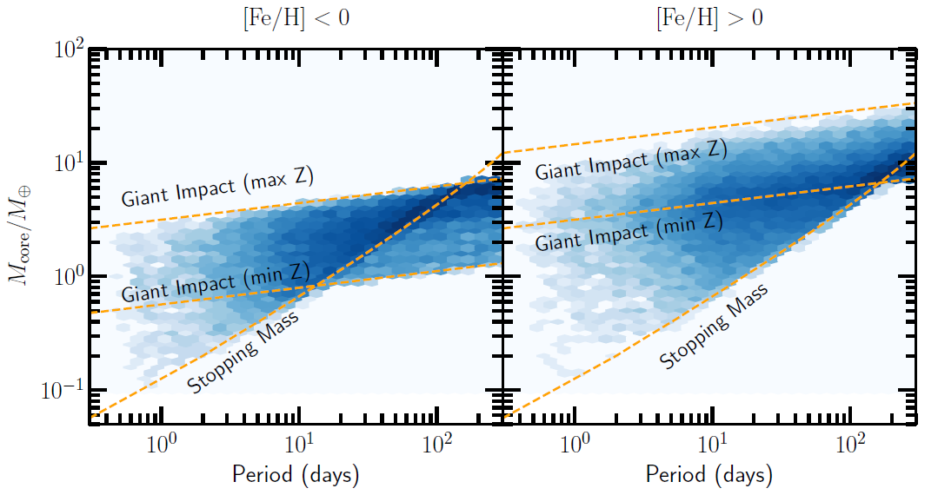
EJL (submitted)

