Slide 1
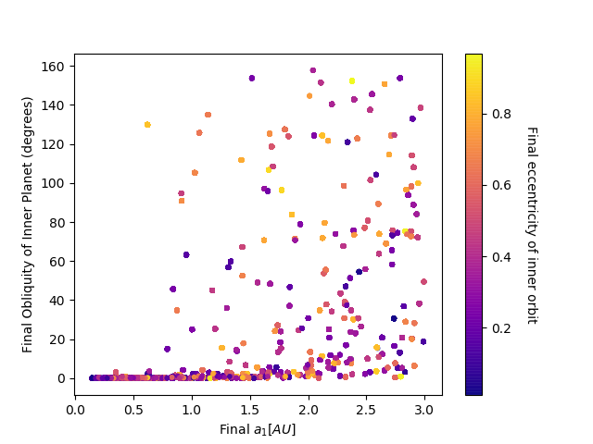
Investigating the Evolution of Planetary Obliquity due to Dynamically Inward Migrating Hot Jupiters
Isabella Goetting, UCLA
Objectives
Investigate the existence of Hot/Warm Jupiters with non-zero obliquity at Gigayear timescales
Implications for atmospheric modeling with upcoming JWST campaigns
Notes:
Using the Kozai-Lidov mechanism, we study the dynamics of a star-Jupiter system in the presence of an additional far-away planet and investigate how the obliquity of the planet changes over time for different planetary masses when tides are introduced to the system. A planet’s obliquity largely influences the flux it receives from its host star, and thus impacts the atmospheric properties. We run large Monte Carlo simulations and study the dependence of the resultant obliquity on the initial conditions. Our findings will determine the orbital configurations of diverse planetary obliquity systems, which will guide atmospheric modeling in the upcoming JWST observational campaigns. This plot shown here demonstrates that planets with a final semi-major axis greater than 1 AU have a larger possibility of having a final non-zero obliquity.

