Slide 1
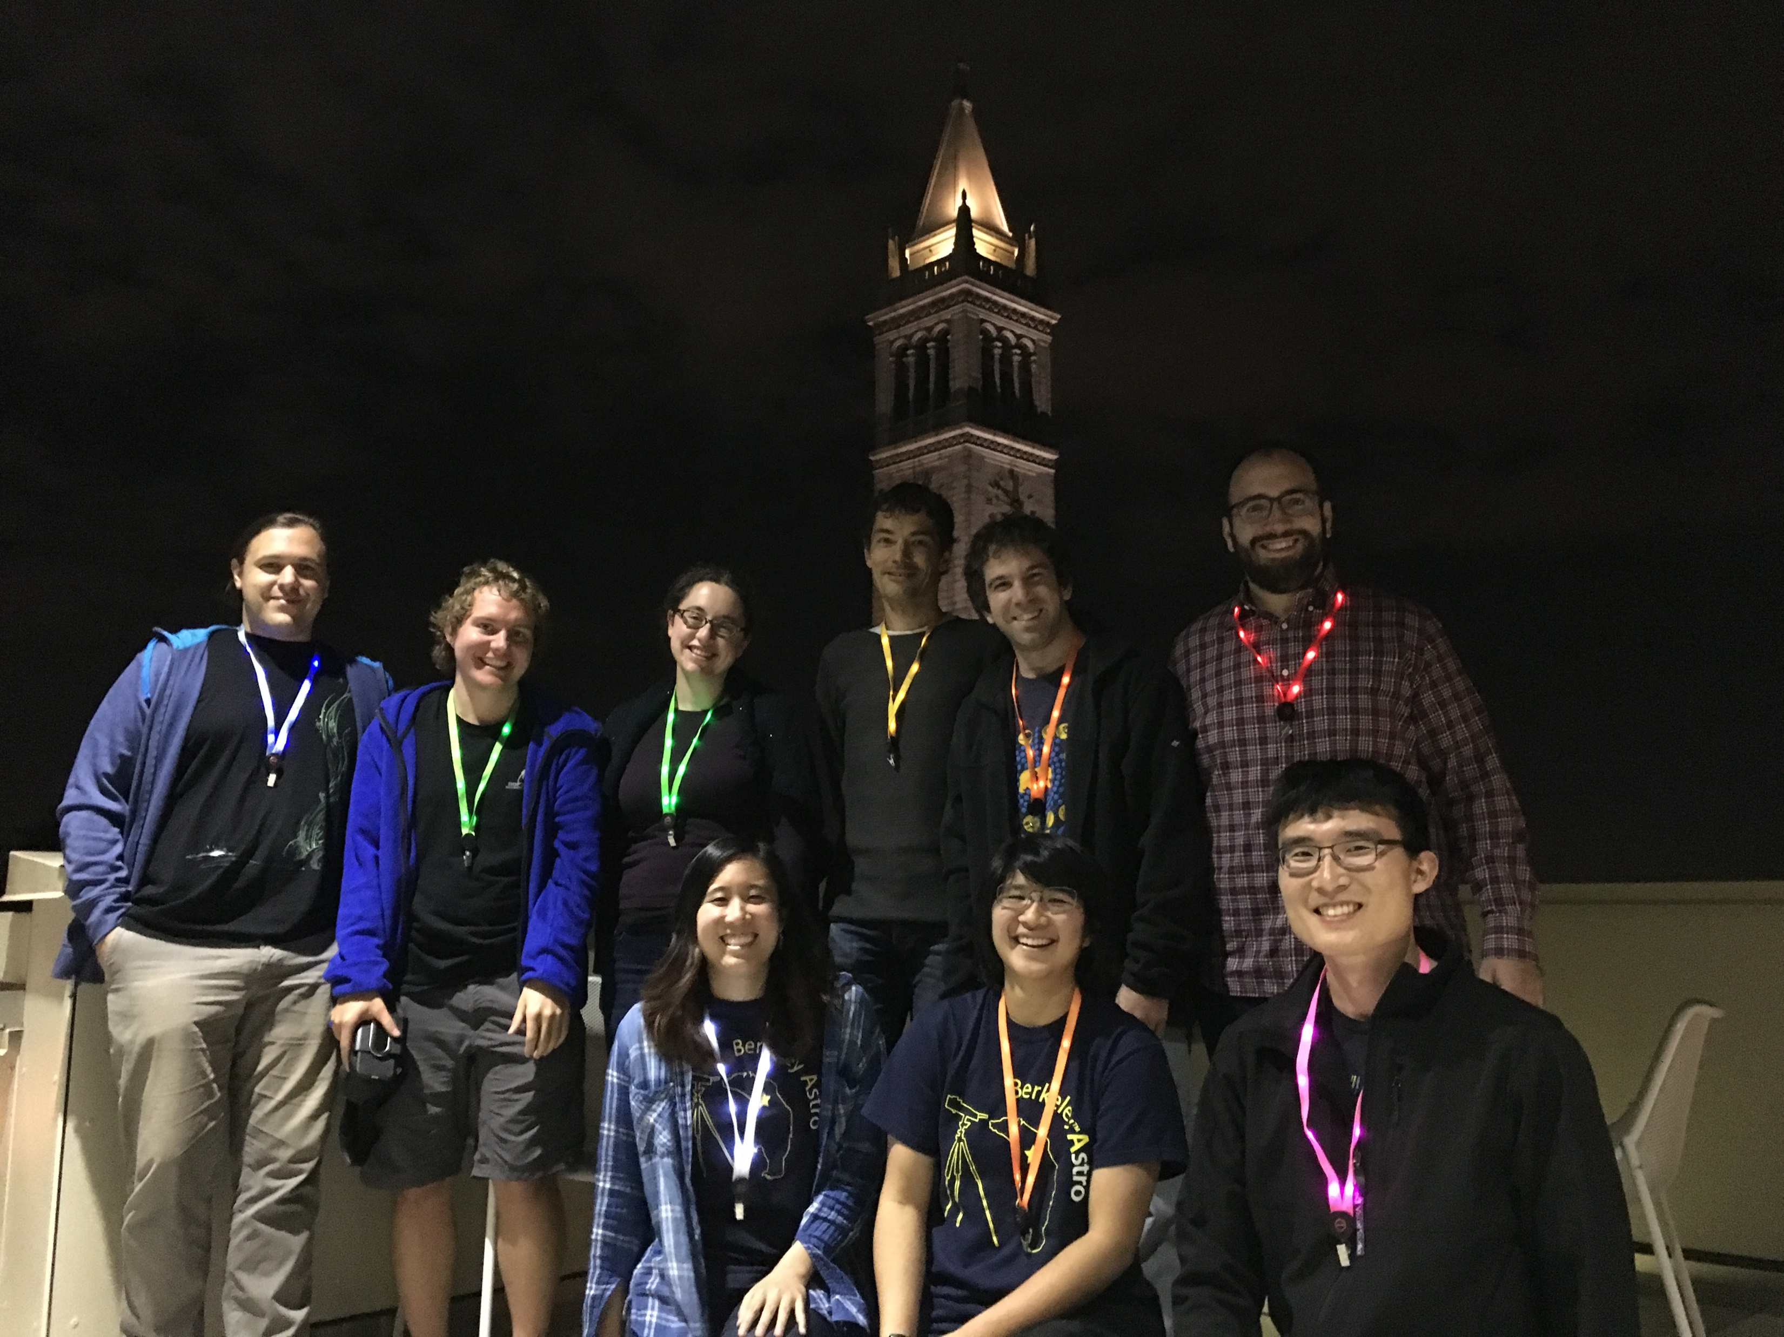
New Outreach Initiatives at UC Berkeley
Jason Wang
Carina Cheng, Tom Zick, and others at UC Berkeley Astronomy (lots of grad students)

Slide 2
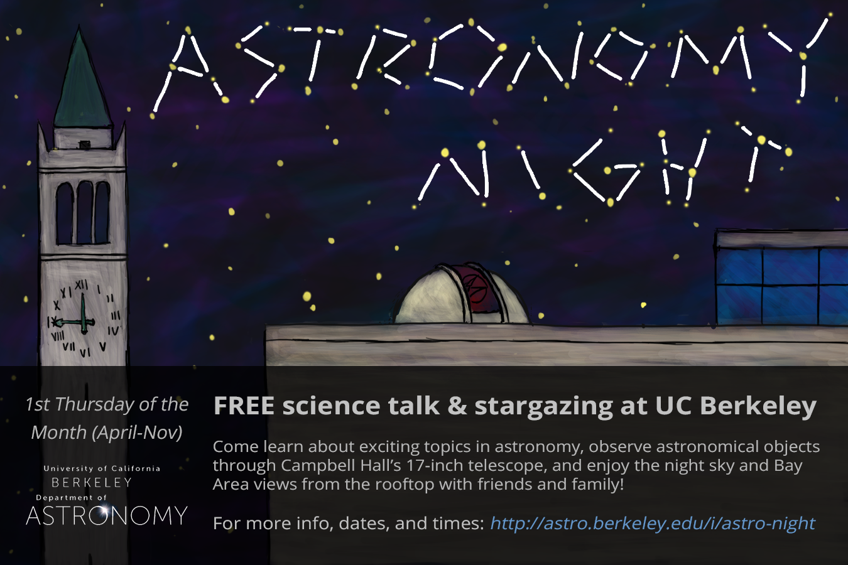

Slide 3
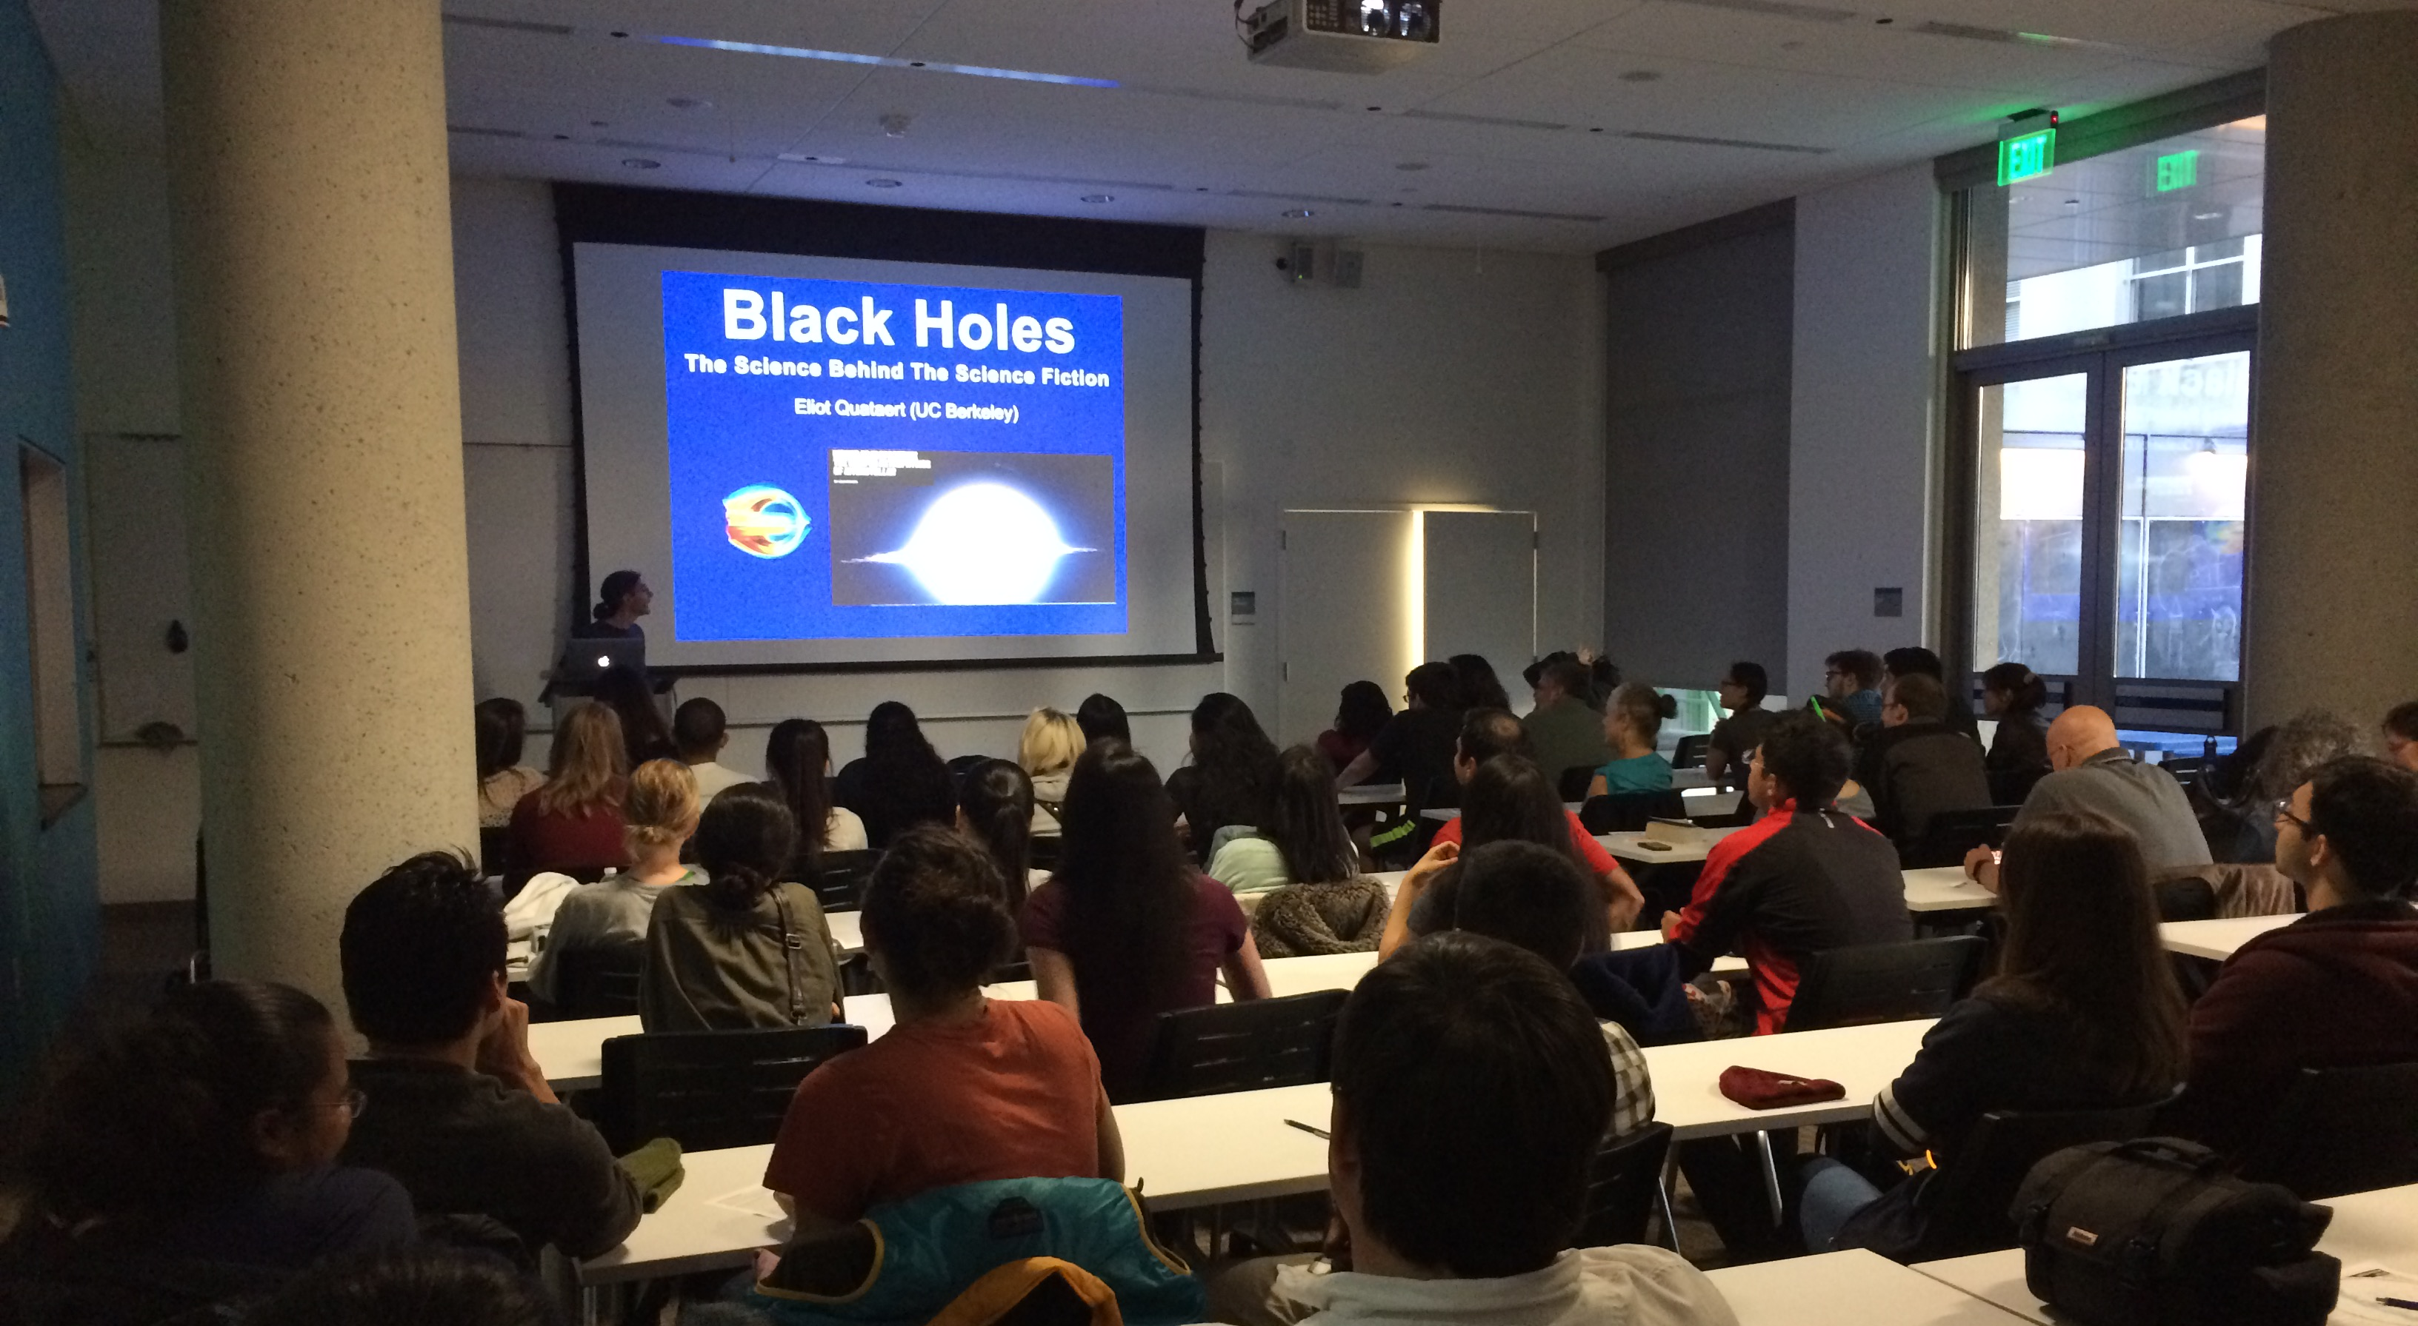
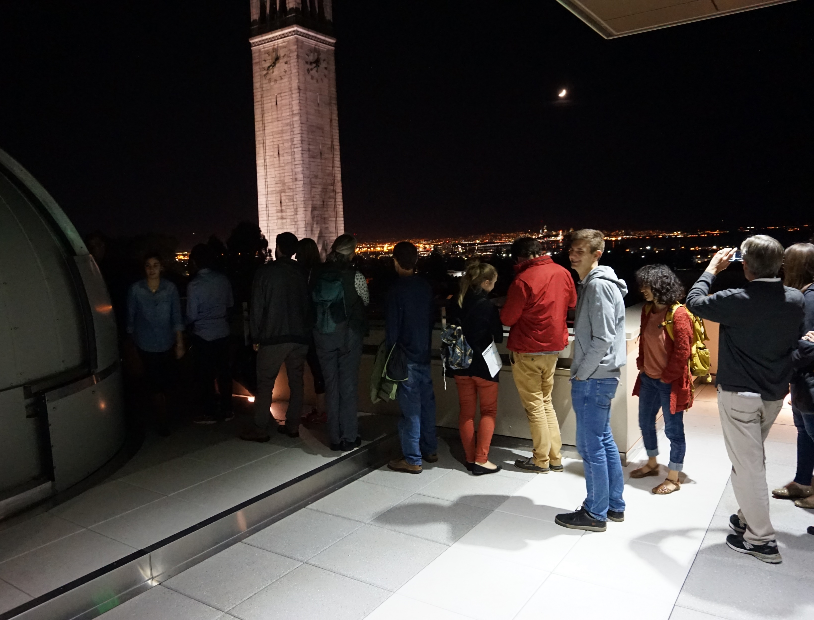
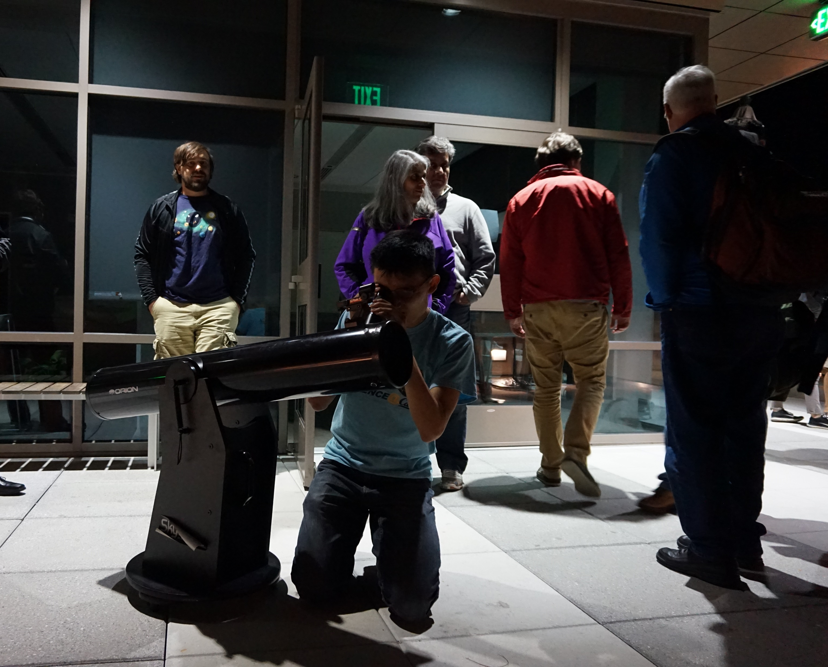
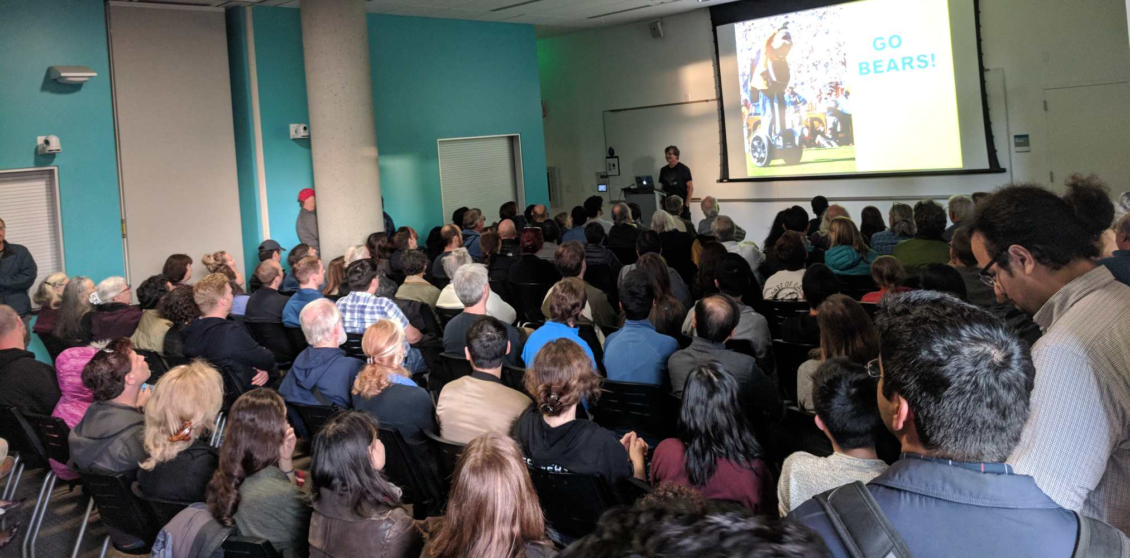

Slide 4
3 Seasons
Grad students, postodcs, researchers, faculty speakers
~110 visitors per month
Self funded (mostly by T-shirts)

Slide 5
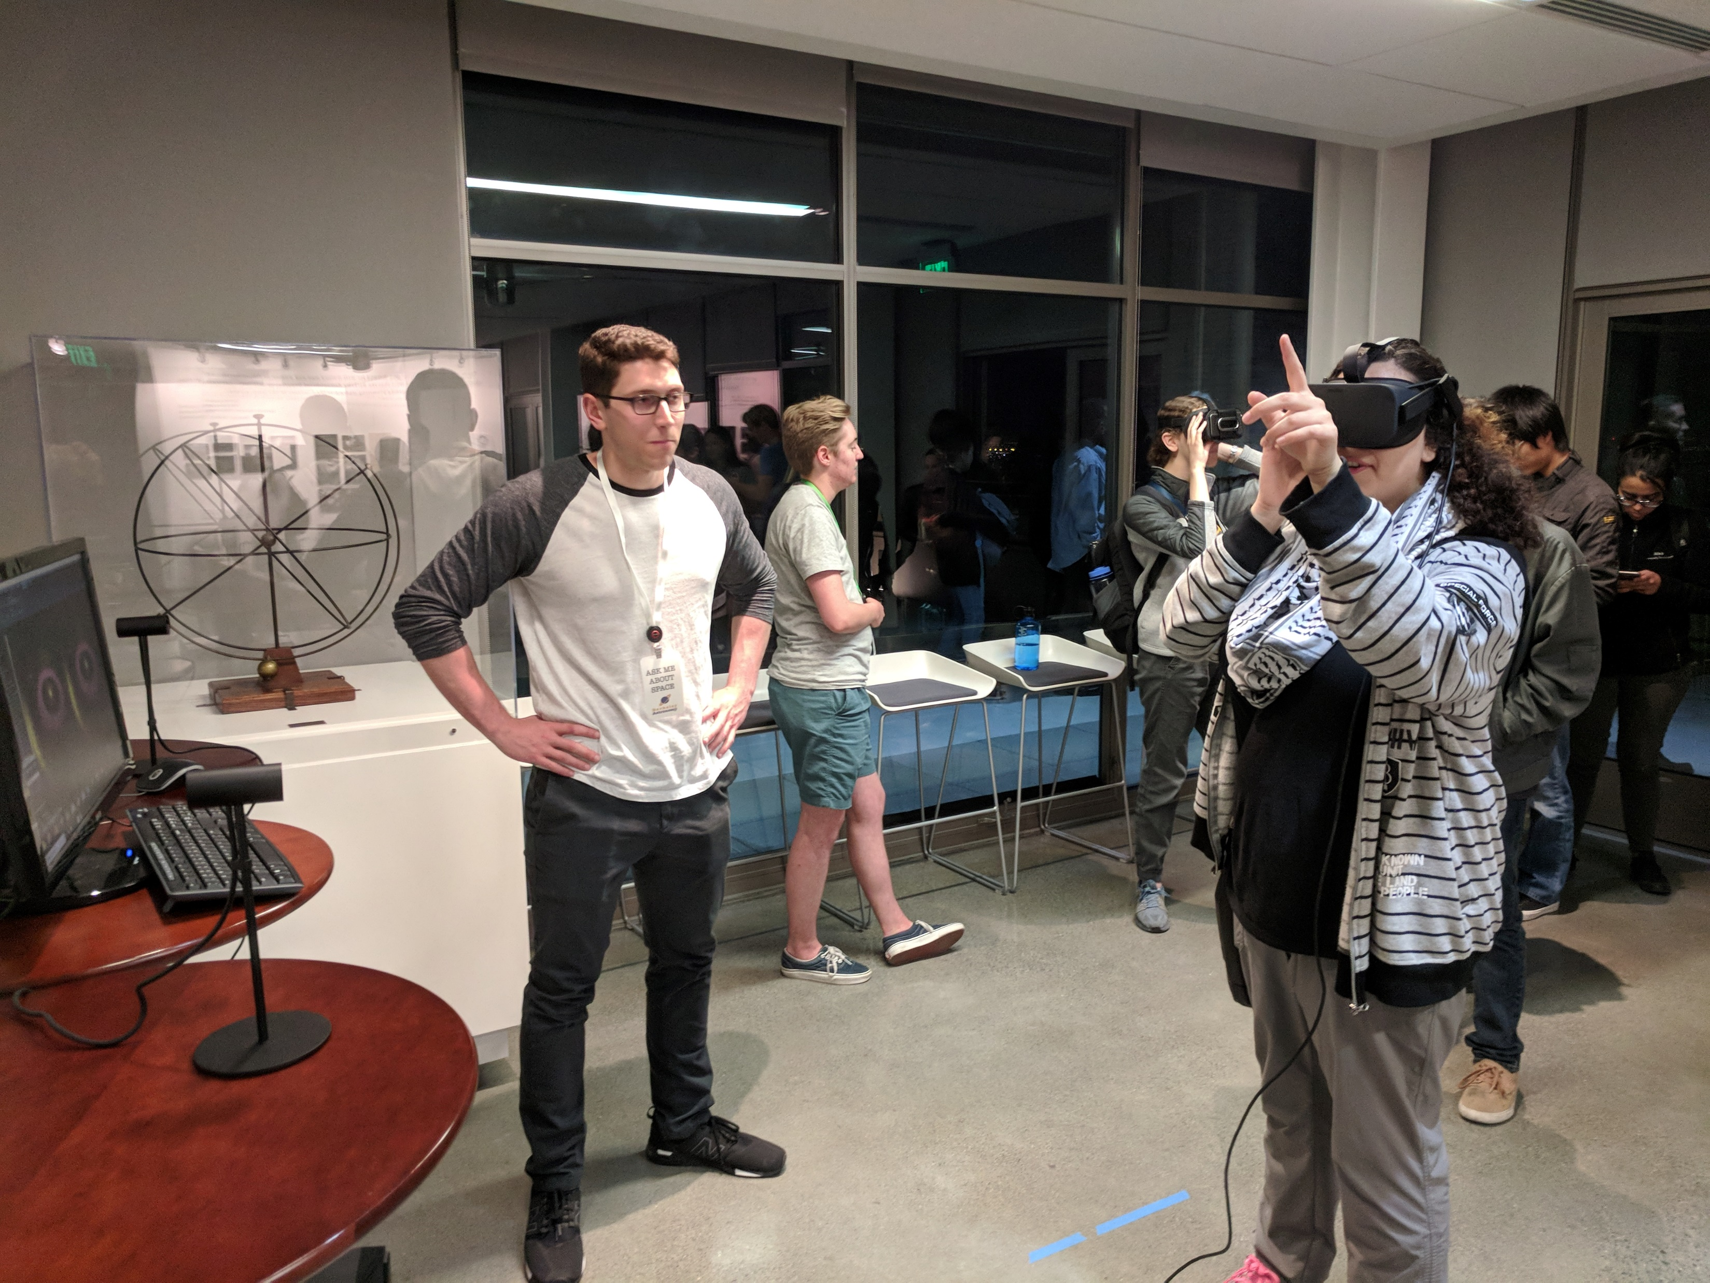
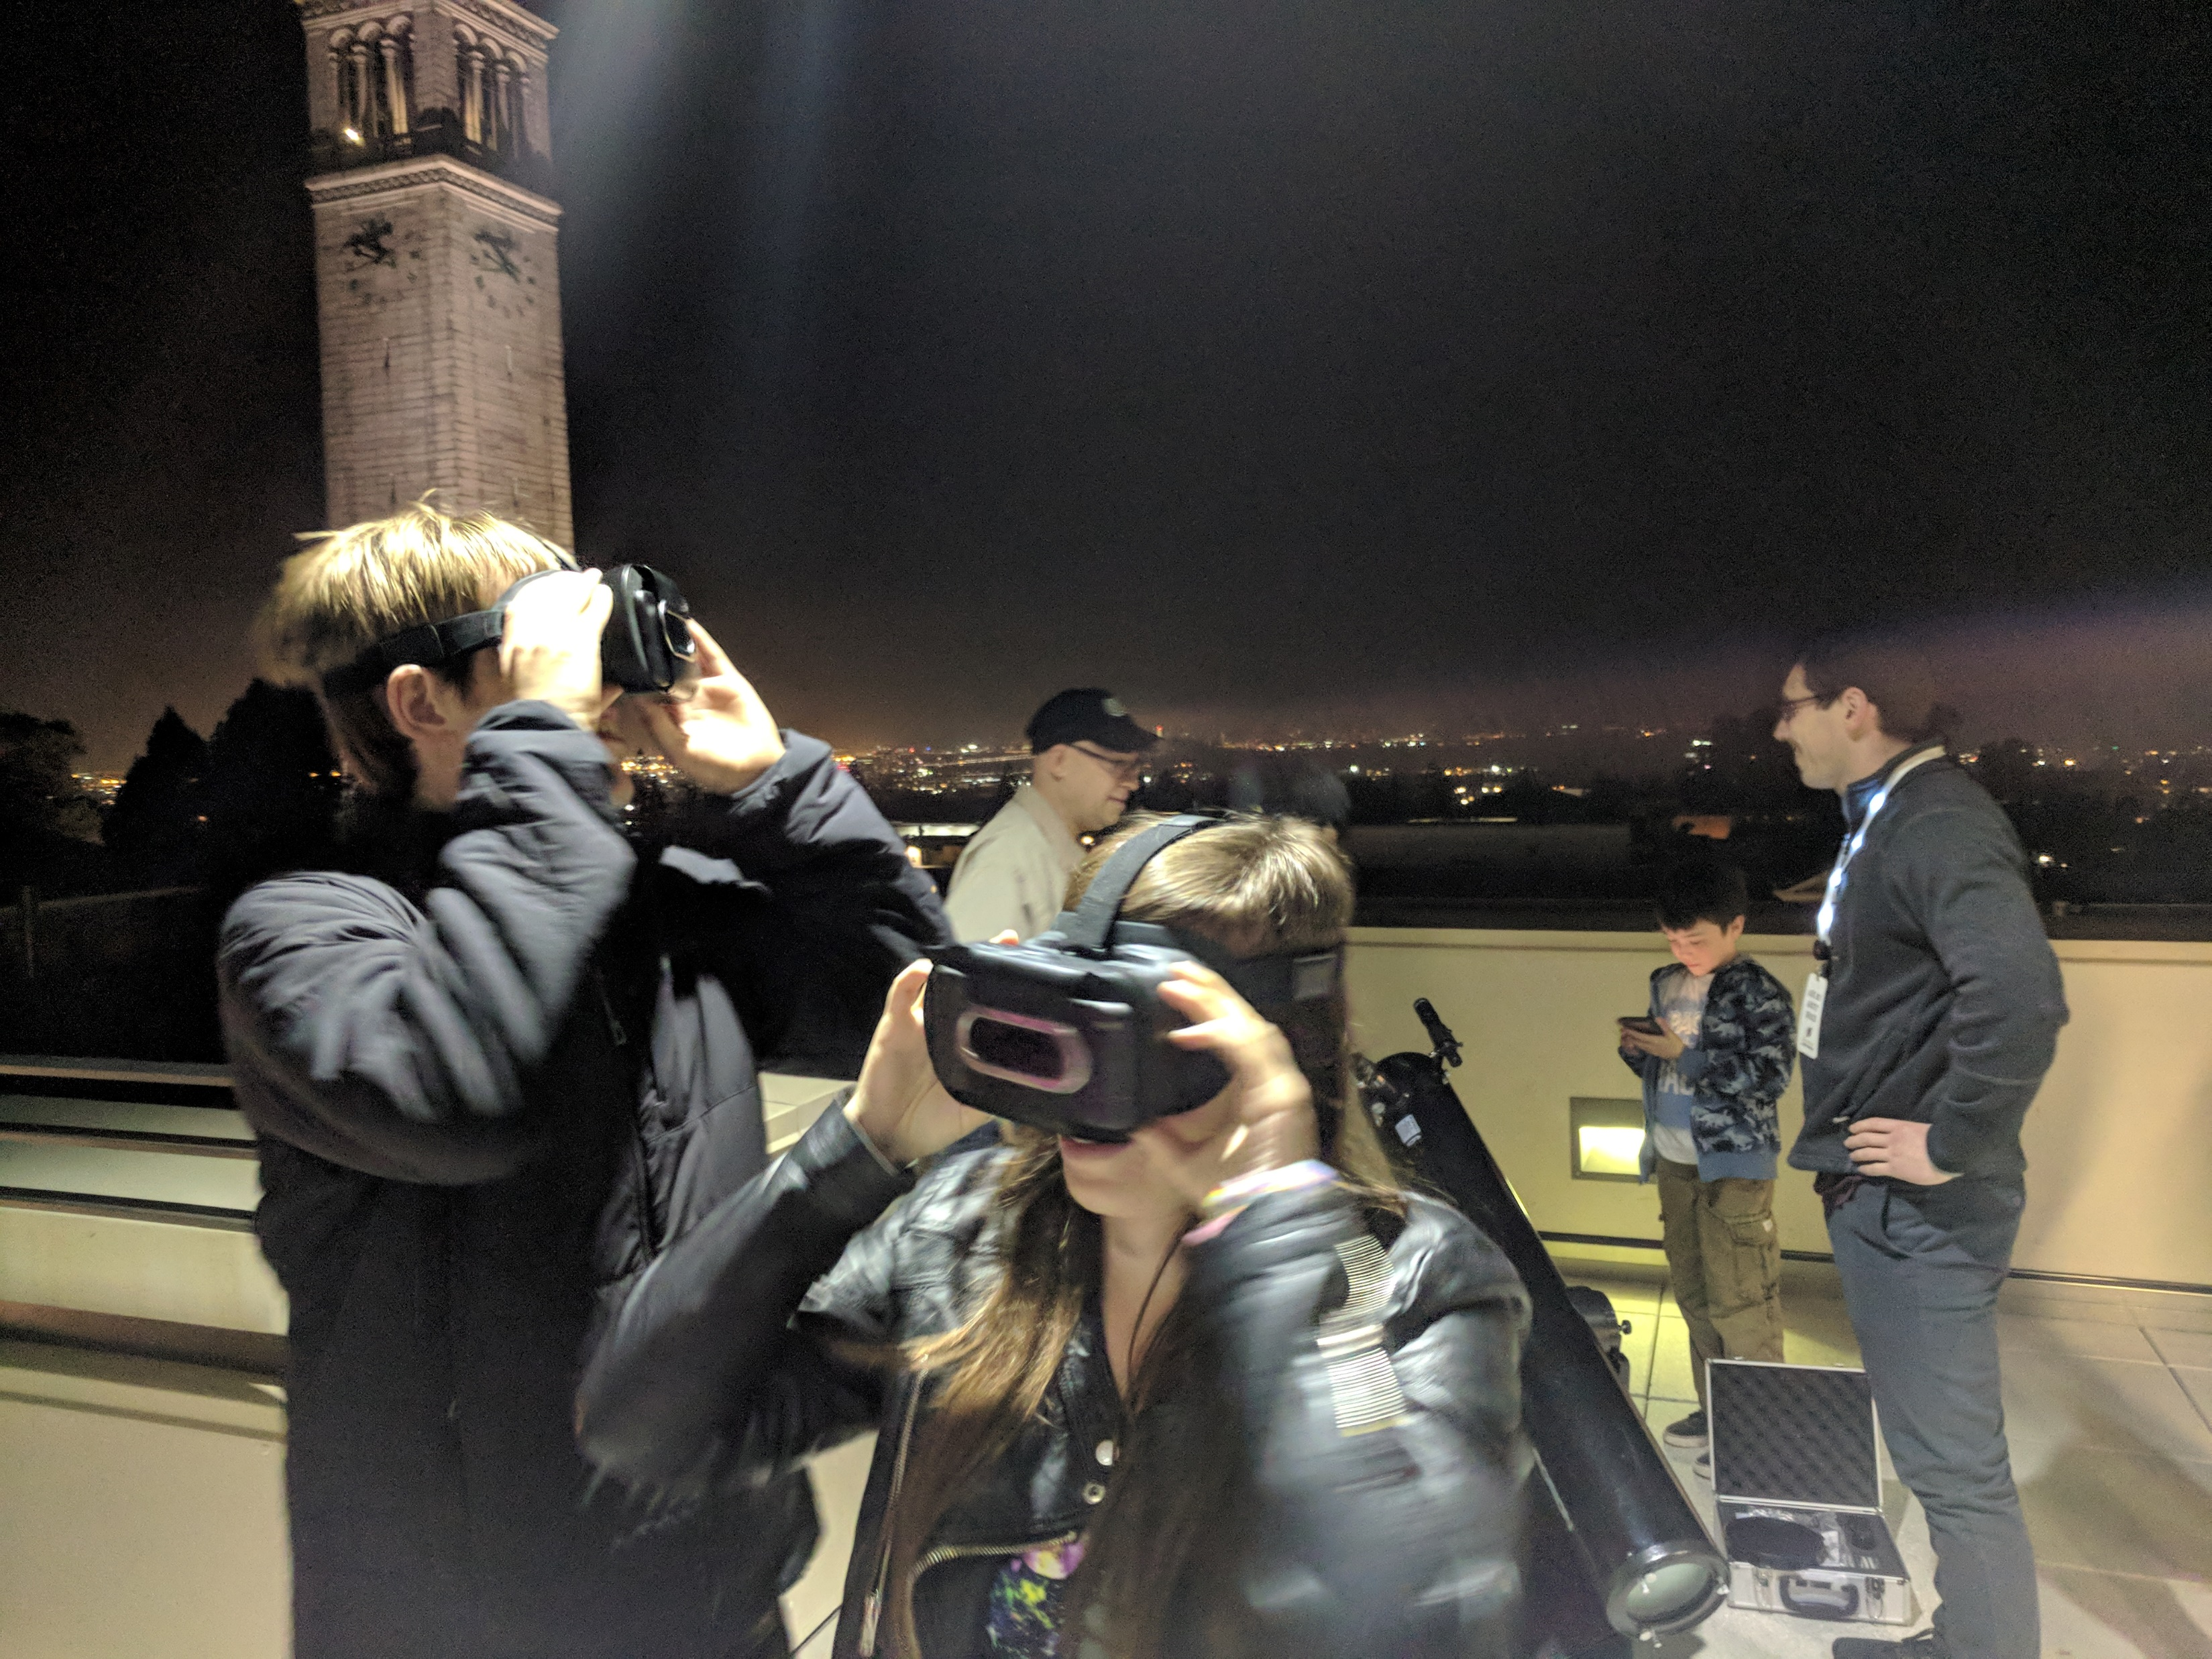
Virtual Reality Demos
Oculus Rift
Great viewing experience, powerful
Google Pixels + Youtube 360
Portable, Lots of content
Great for when the weather doesn’t cooperate!

Slide 6
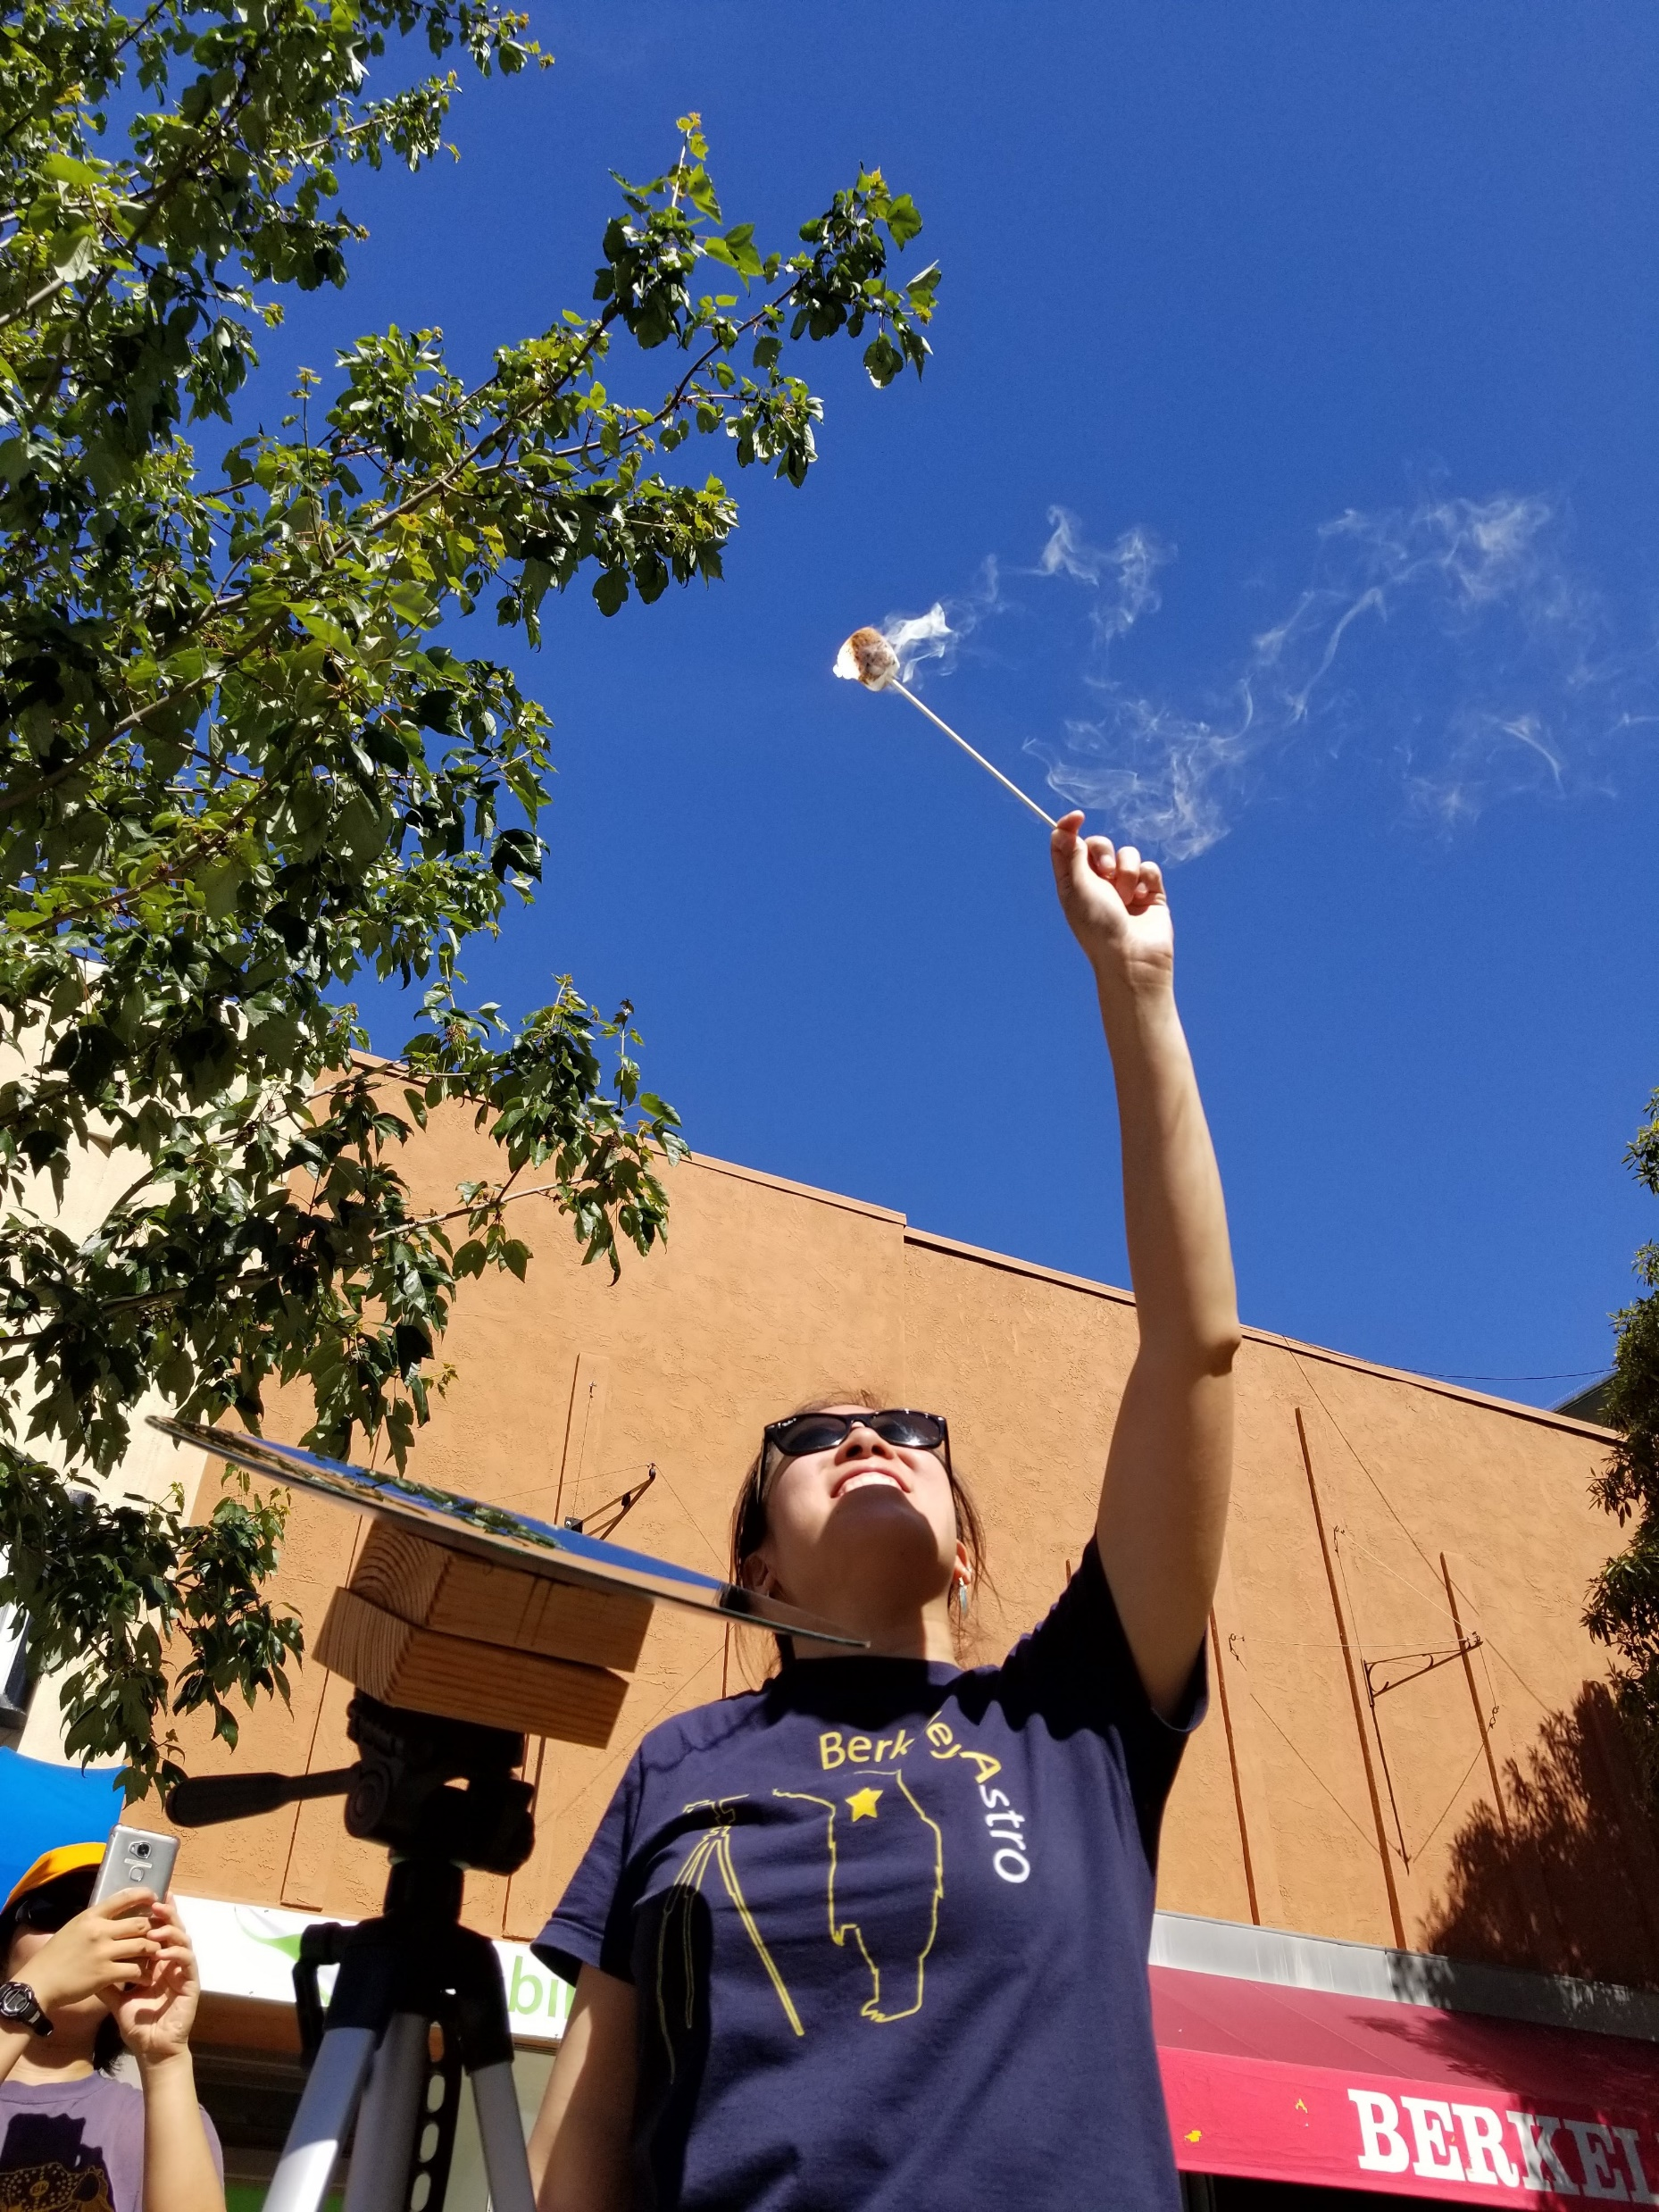
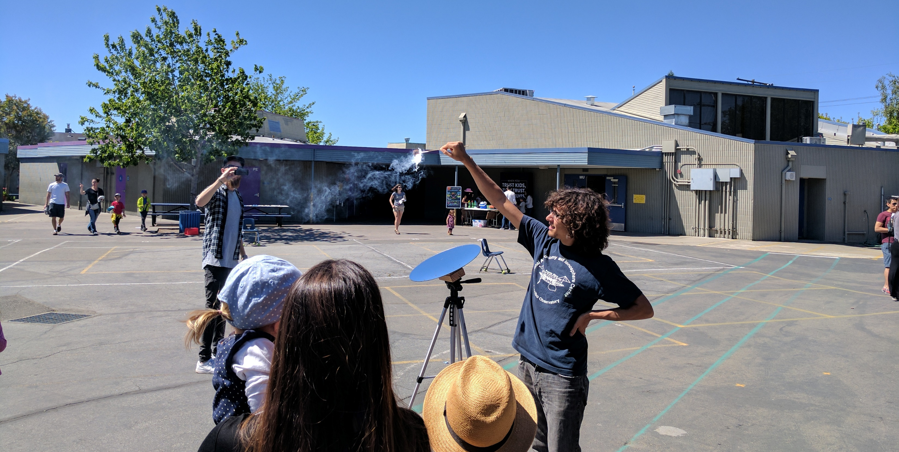
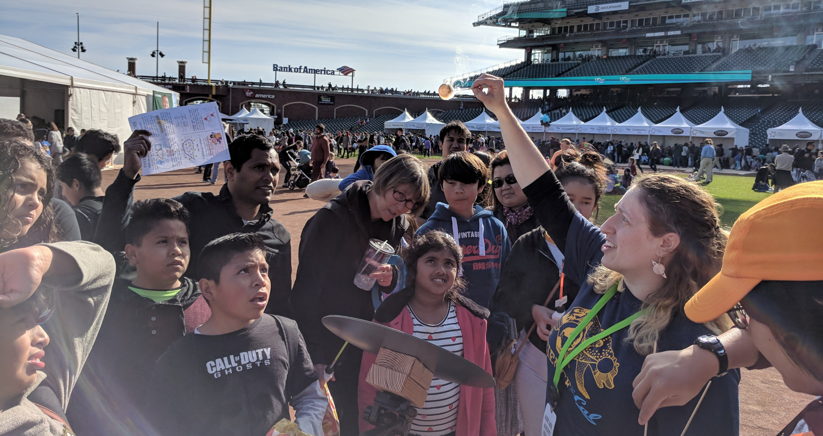
Roasting Marshmallows

Slide 7
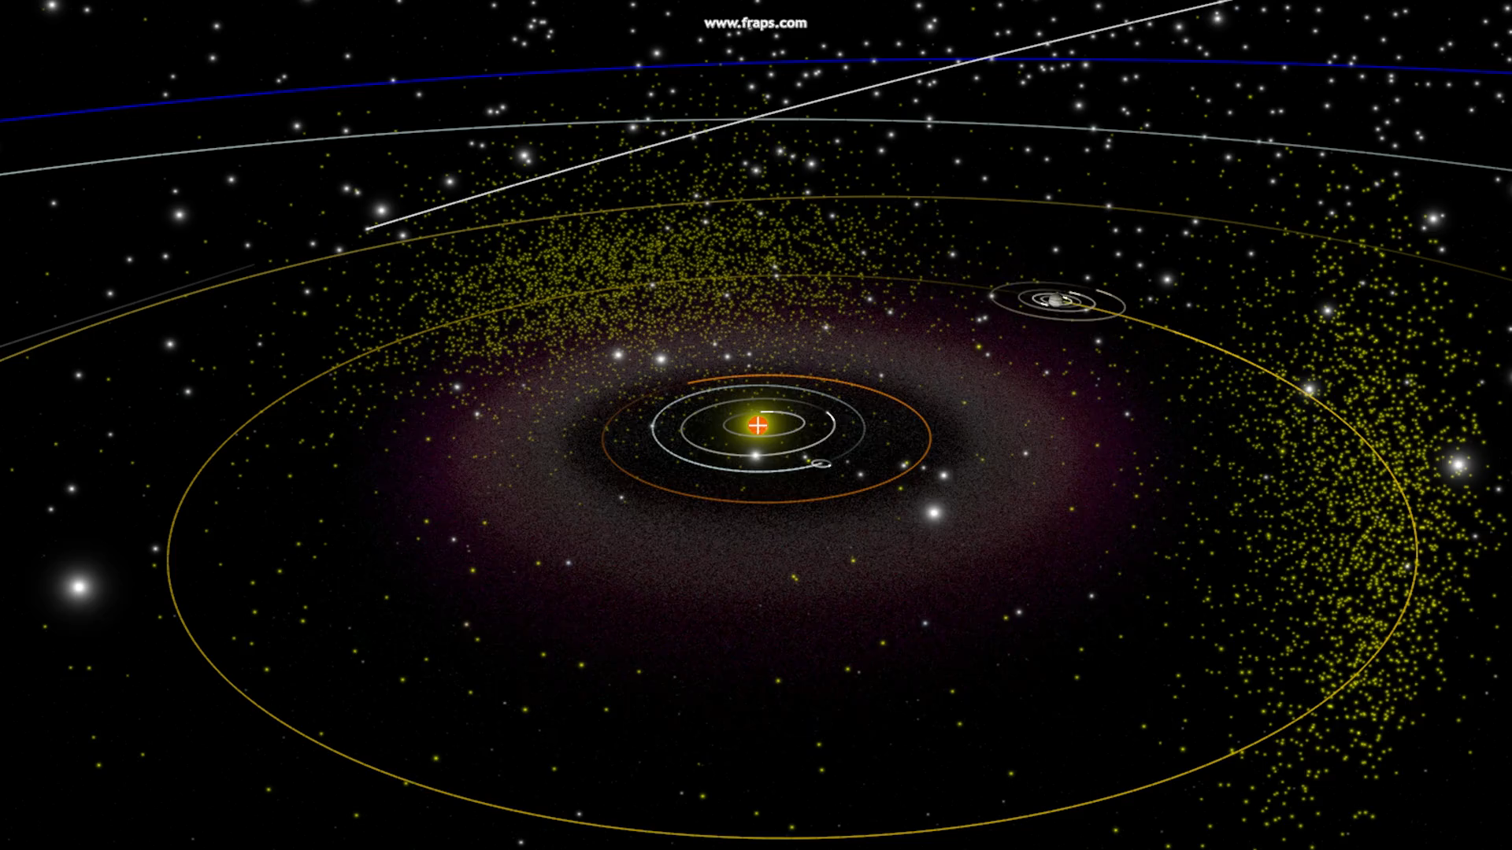
VR Demos
Oculus Rift + World Wide Telescope

