Slide 1
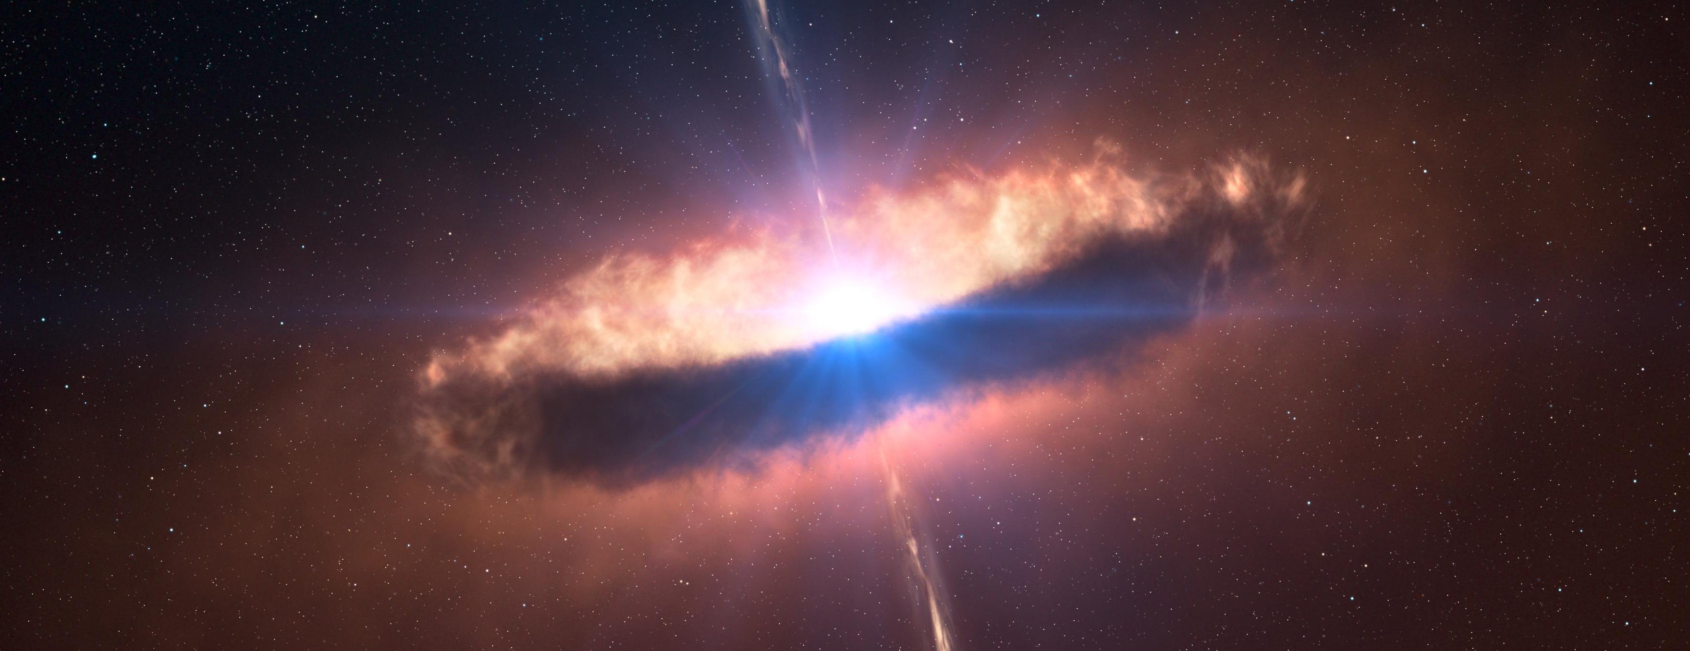
Efficient Monte Carlo Radiative Transfer in Optically-Thick Protoplanetary Disks
John DeVries^{1,2}, Dr. Neal Turner², and Dr. Susan Terebey^{1,2}
¹California State University Los Angeles
²Jet Propulsion Laboratory

Slide 2
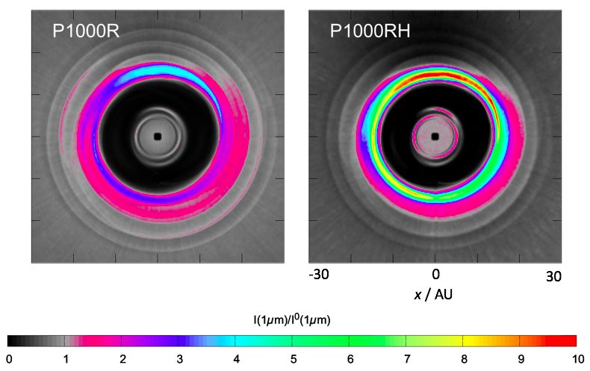
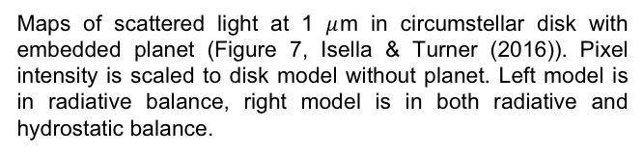
Motivation
Embedded planets in disks can indirectly cause shadowing of the rest of the disk.
The extent of this shadowing depends on the degree to which planet-carved gaps puff up.
Therefore, it is necessary to perform the (computationally difficult) task of calculating midplane temperatures.
Maps of scattered light at 1 $μ$m in circumstellar disk with embedded planet (Figure 7, Isella & Turner (2016)). Pixel intensity is scaled to disk model without planet. Left model is in radiative balance, right model is in both radiative and hydrostatic balance.

Slide 3
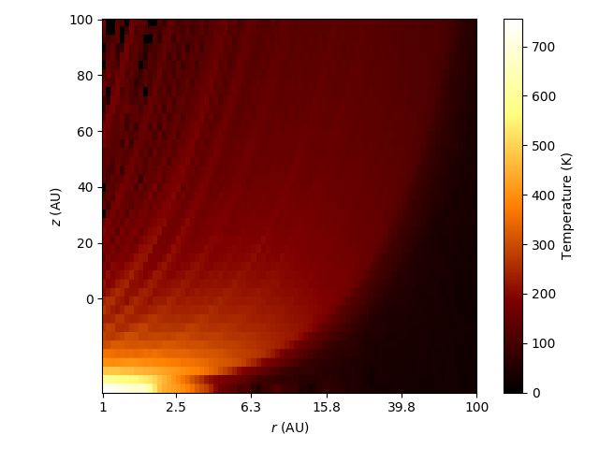
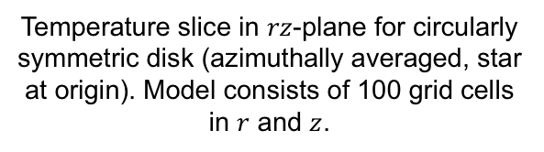
monte
Monte Carlo Radiative Transfer (MCRT) in C
monte was written in C by Dr. Neal Turner
Part of a larger software package that handles hydrostatic & hydrodynamic calculations, continuum imaging, and RT
The purpose of monte is to determine the temperature structure given input parameters (density profile, geometry, etc)
A Monte Carlo technique is used to simulate probabilistic events like distance to next interaction, emission frequency, new travel direction, etc.
Temperature slice in $rz$-plane for circularly symmetric disk (azimuthally averaged, star at origin). Model consists of 100 grid cells in $r$ and $z$.

Slide 4
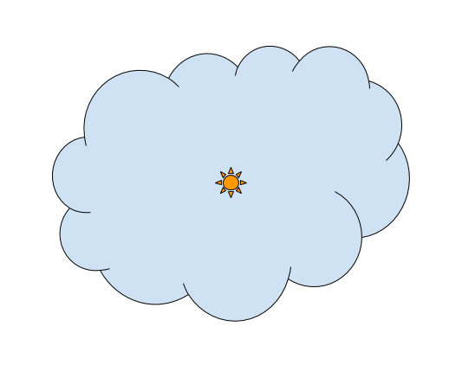

Vanilla MCRT
Emit $N_{γ}$ photon packets with $ν$ sampled from Planck distribution
Cartoon depiction of MCRT

Slide 5
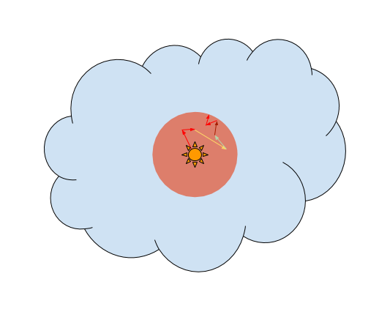
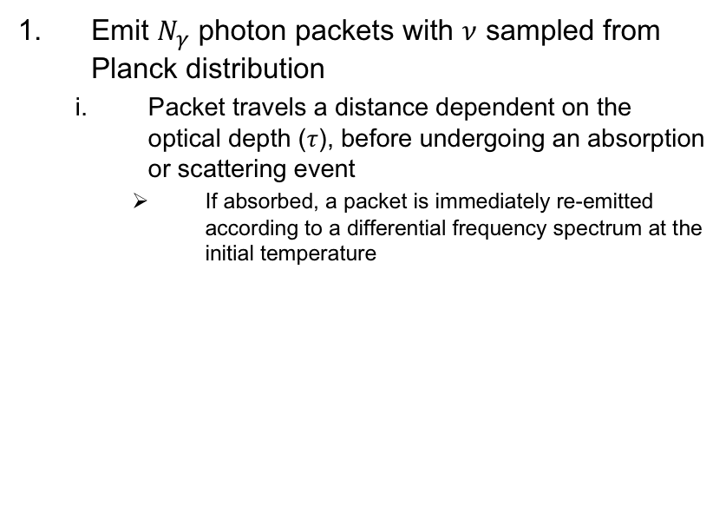
Vanilla MCRT
Emit $N_{γ}$ photon packets with $ν$ sampled from Planck distribution
  Packet travels a distance dependent on the optical depth ($τ$), before undergoing an absorption or scattering event
    If absorbed, a packet is immediately re-emitted according to a differential frequency spectrum at the initial temperature
Packet is emitted and propagated

Slide 6

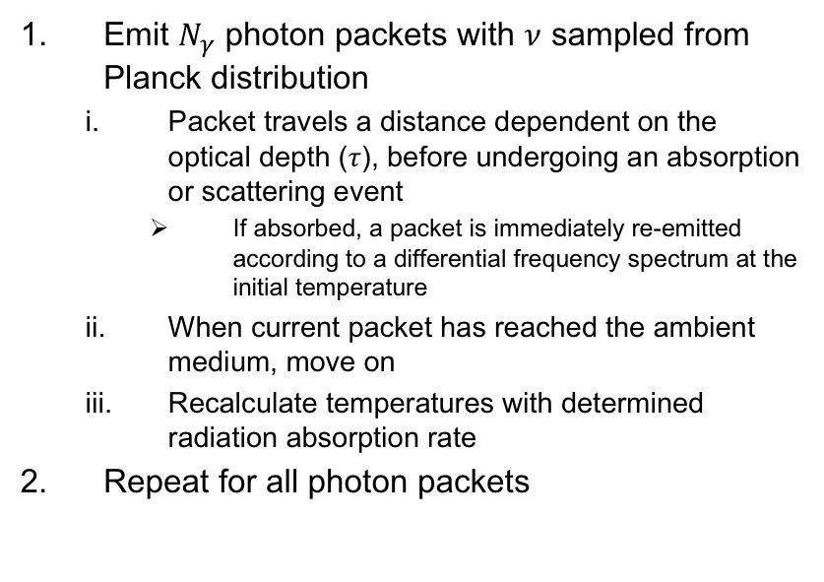
Vanilla MCRT
Emit $N_{γ}$ photon packets with $ν$ sampled from Planck distribution
  Packet travels a distance dependent on the optical depth ($τ$), before undergoing an absorption or scattering event
    If absorbed, a packet is immediately re-emitted according to a differential frequency spectrum at the initial temperature
  When current packet has reached the ambient medium, move on
  Recalculate temperatures with determined radiation absorption rate
Repeat for all photon packets
Packet exits to ambient medium

Slide 7
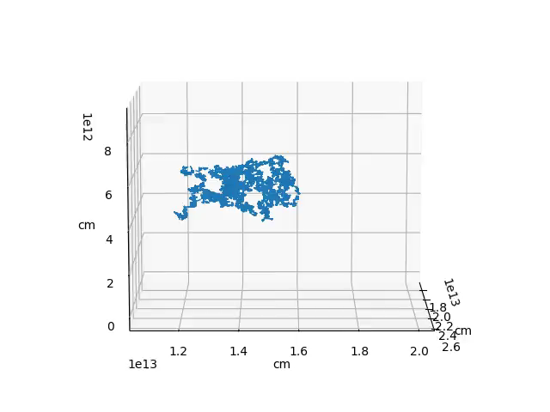
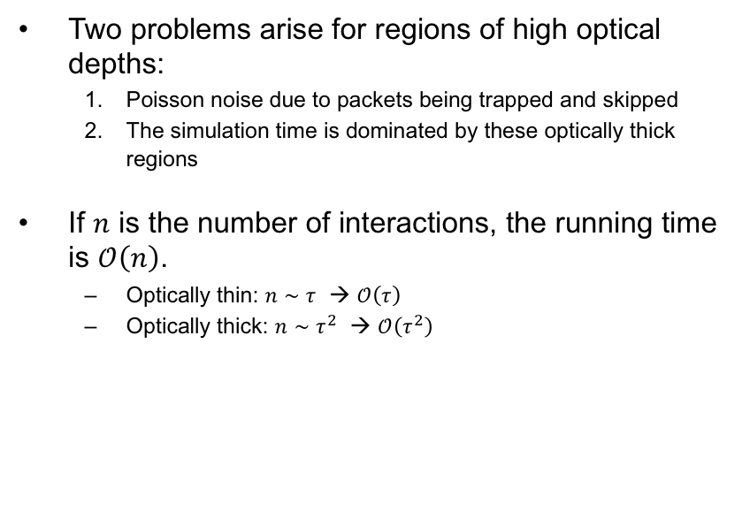

Vanilla MCRT
Pitfalls
Two problems arise for regions of high optical depths:
  Poisson noise due to packets being trapped and skipped
  The simulation time is dominated by these optically thick regions
If $n$ is the number of interactions, the running time is $𝒪\left(n\right)$.
  Optically thin: $n∼τ$ → $𝒪\left(τ\right)$
  Optically thick: $n∼τ^{2}$ → $𝒪\left(τ^{2}\right)$
Vanilla RW with ${\sim 10}^{6}$ interactions

Slide 8
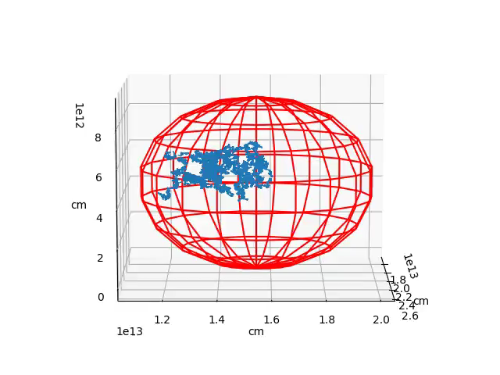
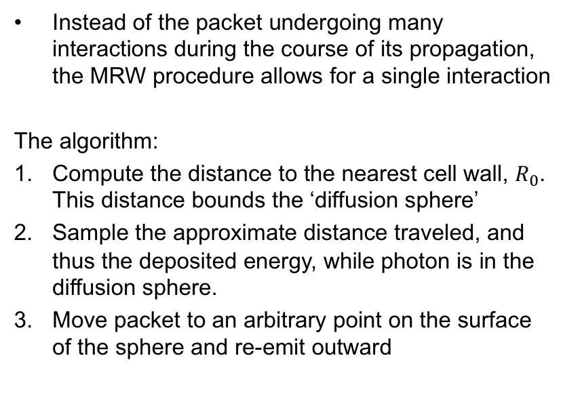
Modified Random Walk (MRW)
How?
Instead of the packet undergoing many interactions during the course of its propagation, the MRW procedure allows for a single interaction
The algorithm:
Compute the distance to the nearest cell wall, $R_{0}$. This distance bounds the ‘diffusion sphere’
Sample the approximate distance traveled, and thus the deposited energy, while photon is in the diffusion sphere.
Move packet to an arbitrary point on the surface of the sphere and re-emit outward
MRW diffusion sphere bounding vanilla RW interactions

Slide 9
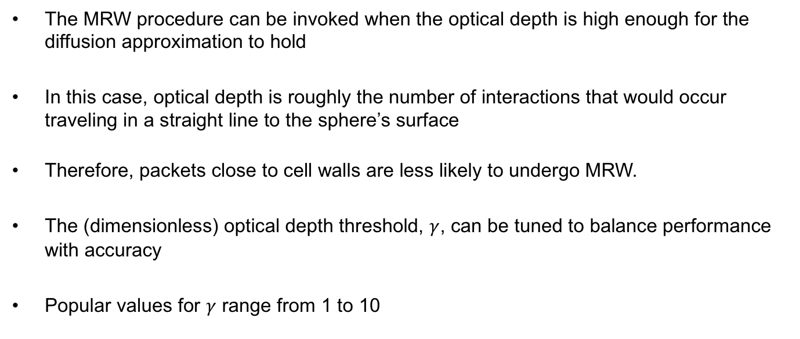
Modified Random Walk (MRW)
When?
The MRW procedure can be invoked when the optical depth is high enough for the diffusion approximation to hold
In this case, optical depth is roughly the number of interactions that would occur traveling in a straight line to the sphere’s surface
Therefore, packets close to cell walls are less likely to undergo MRW.
The (dimensionless) optical depth threshold, $γ$, can be tuned to balance performance with accuracy
Popular values for $γ$ range from 1 to 10

Slide 10
Results / testing
Before testing the performance of the algorithm, the correctness of the implementation had to be assessed
Testing revealed unsatisfactory levels of error

Slide 11
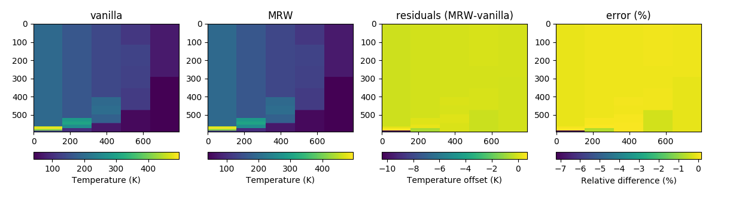
Results / testing
Comparing temperature structure with and without MRW

Slide 12
Further questions / initial conclusions
Modifications to the algorithm must be done to achieve sub-percent level errors.
Rigorous efficacy testing of the MRW procedure has not been documented in the literature.
Performance testing shows that MRW speeds running time up to an order of magnitude.
Faster running times enable new science.

Slide 14
References
Fleck, Jr., J. A., & Canfield, E. H. 1984, Journal of Computational Physics, 54, 508
Min, M., Dullemond, C. P., Dominik, C., de Koter, A., & Hovenier, J. W. 2009, A&A, 497, 155
Robitaille, T. P. 2010, A&A, 520, A70
Bjorkman, J. E., & Wood, K. 2001, ApJ, 554, 615
Lucy, L. B. 1999, A&A, 344, 282
Isella, A., & Turner, N. 2016, ArXiv e-prints, arXiv:1608.05123

Slide 15
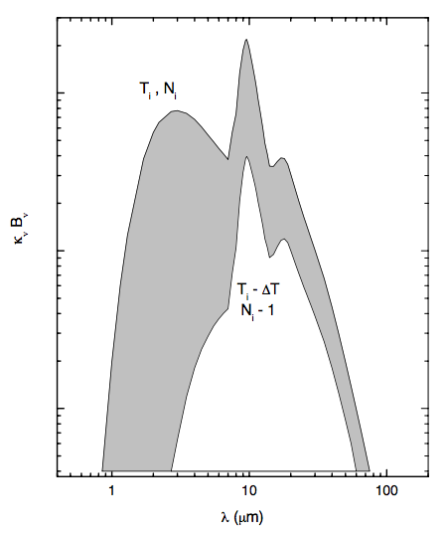

Vanilla MCRT
In a nutshell
$$\frac{dP_{i}}{dν}=\frac{κ_{ν}}{K}{\left(\frac{dB_{ν}}{dT}\right)}_{T=T_{i}}$$
Temperature correction frequency distribution (Figure 1, Bjorkman & Wood (2001))

Slide 16
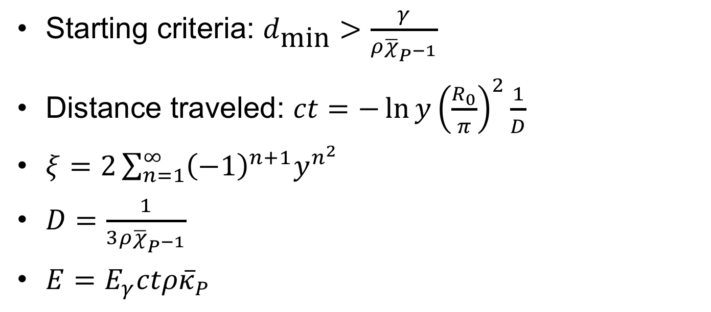
Backup — Relevant equations
Starting criteria: $d_{\text{min}}>\frac{γ}{ρ{\overline{χ}}_{P^{−1}}}$
Distance traveled: $ct=−\ln{y}{\left(\frac{R_{0}}{π}\right)}^{2}\frac{1}{D}$
$ξ=2\sum_{n=1}^{∞}{{\left(−1\right)}^{n+1}y^{n^{2}}}$
$D=\frac{1}{3ρ{\overline{χ}}_{P^{−1}}}$
$E=E_{γ}ctρ{\overline{κ}}_{P}$

Slide 17
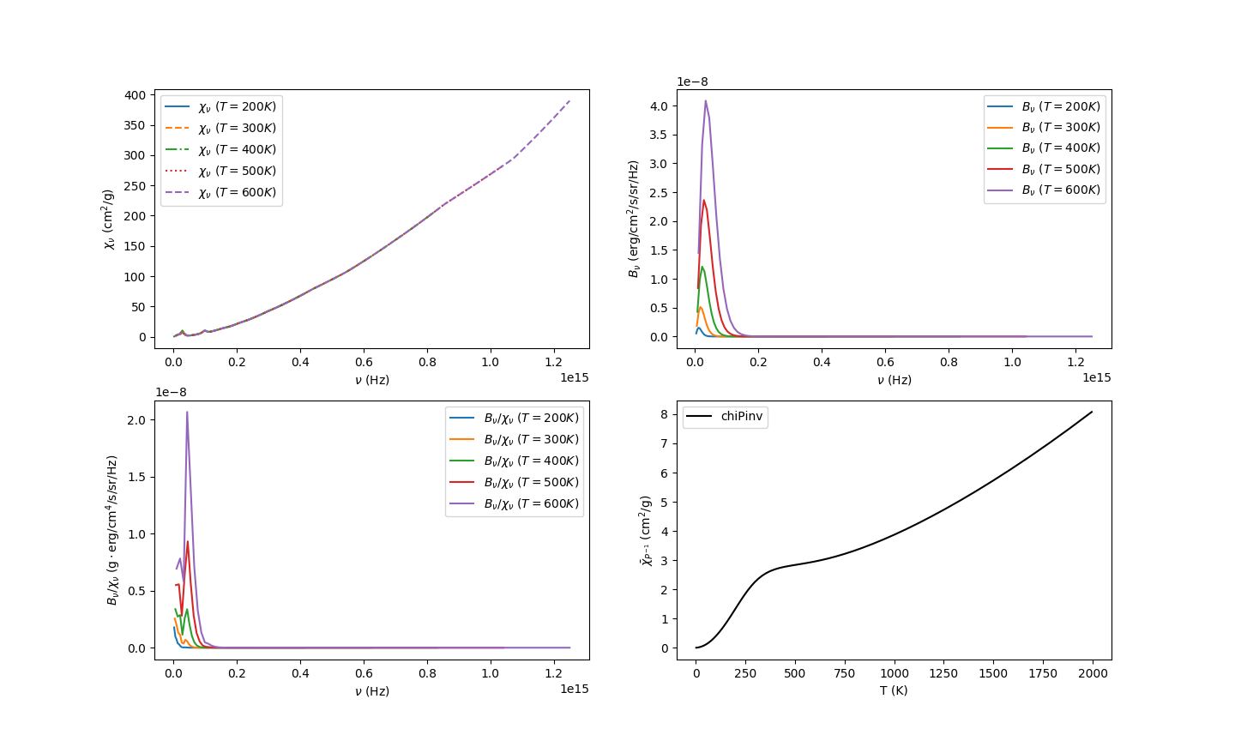
Backup — ${\overline{χ}}_{P^{−1}}$

Slide 18
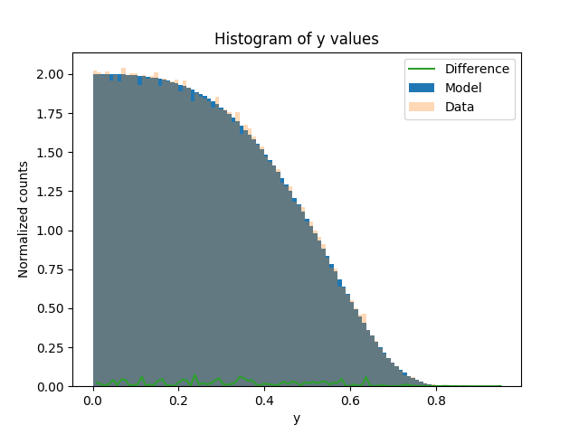

Backup — Testing interpolation
$$ξ=2\sum_{n=1}^{∞}{{\left(−1\right)}^{n+1}y^{n^{2}}}$$

