Slide 1
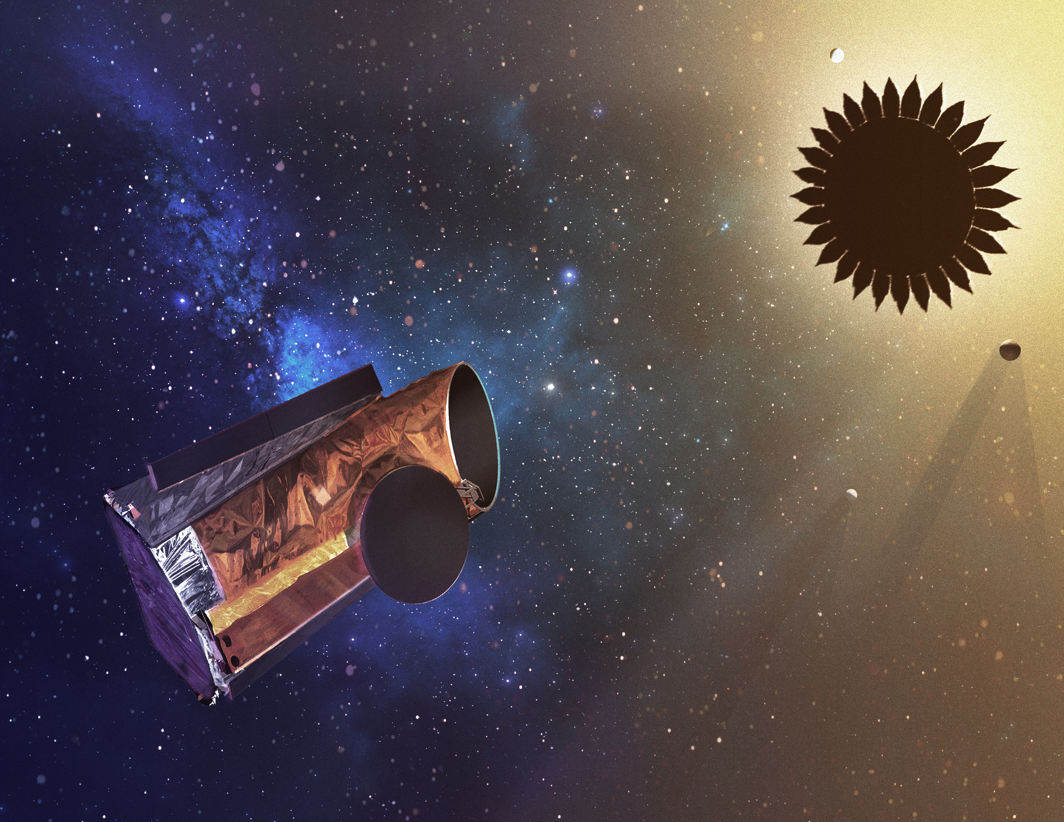
The Habitable Exoplanet Observatory Mission Concept
Exploring Nearby Planetary Systems and Enabling a Broad Range of
General Astrophysics & Solar System Science in the UV through the near-IR
Dimitri Mawet
STDT member,
Coronagraph Technology Working Group
California Institute of Technology
Jet Propulsion Lab
On behalf of the HabEx Study Team
ExSoCal 2018, Pasadena
Pre-Decisional Information -- For Planning and Discussion Purposes Only
Notes:
The name does not ay it all, far frm that

Slide 2
Outline
HabEx study charter, philosophy & science goals
HabEx architecture A: design concept and expected performance
Lessons learned and path forward

Slide 3
Study charter
NASA chartered 4 potential flagship mission concept studies in 2016 to support the 2020 US Decadal Survey
~3-year long concept studies intended to describe missions scientific rationales and design, including cost estimates
The Habitable Exoplanet Imaging Mission (HabEx) community-wide Science and Technology Definition Team (STDT) was appointed by NASA in March 2016, with JPL as lead NASA Center
Interim reports were submitted for all four studies in March 2018 and will be posted this summer at https://www.jpl.nasa.gov/habex/
Final Study Report due to NASA and National Academies in June 2019*
Notes:
each devoted to a specific proposed potential flagship mission to be launched in the post-JWST, post-WFIRST era, i.e for a launch in the mid to late2030’s.
The Habitable Exoplanet Imaging Mission (HabEx) is one of them

Slide 4
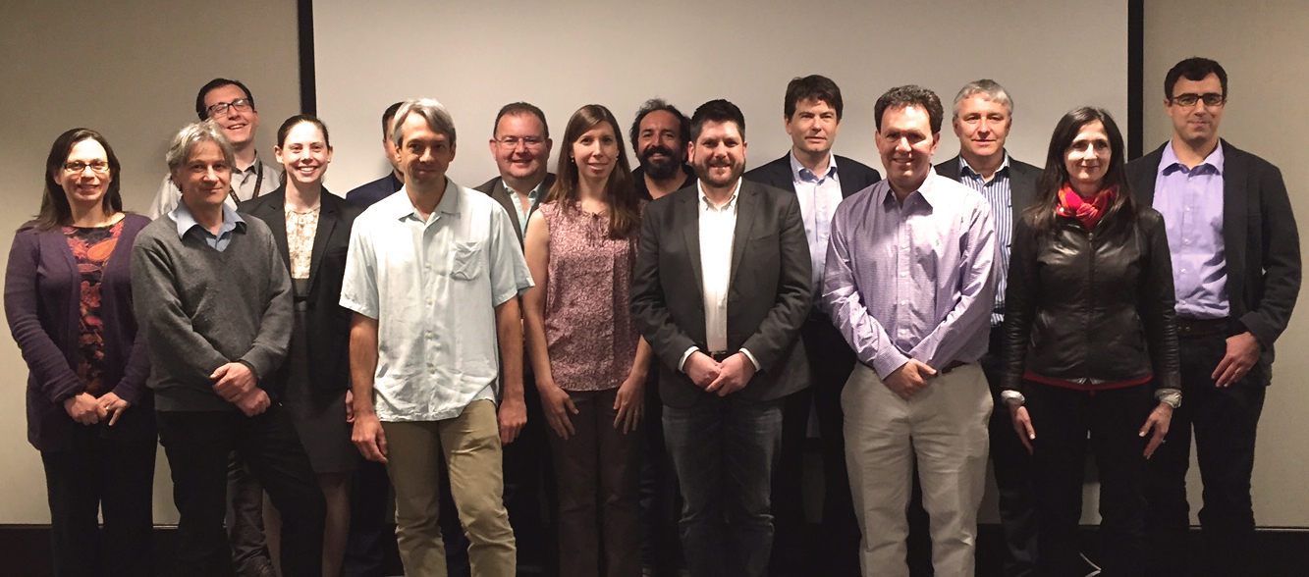
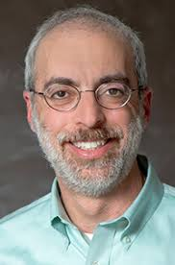
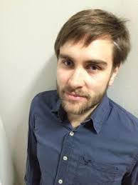
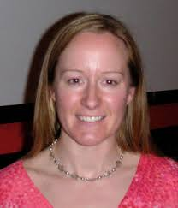
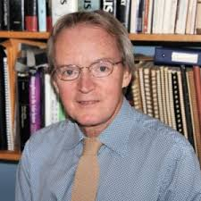
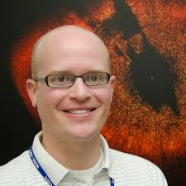
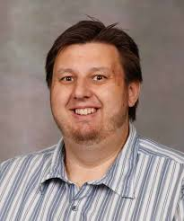
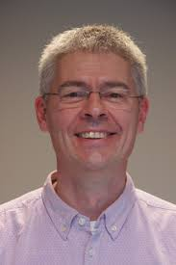
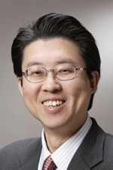
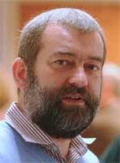
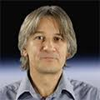
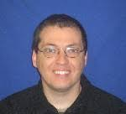
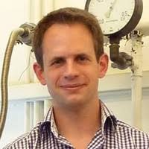
STDT
19 STDT Members 6 International Observers (ESA, JAXA, DLR, CNES, CSA, SRON)
Notes:
each devoted to a specific proposed potential flagship mission to be launched in the post-JWST, post-WFIRST era, i.e for a launch in the mid to late2030’s.
The Habitable Exoplanet Imaging Mission (HabEx) is one of them

Slide 5
Study Philosophy
“Develop an optimal* mission concept for characterizing our nearest planetary systems, and detecting and characterizing a handful of ExoEarths.”
“Given this optimal* concept, maximize the general astrophysics science potential without sacrificing the primary exoplanet science goals.”
What does optimal mean?
Maximizing science yield while maintaining feasibility, i.e., adhering to expected constraints.
Constraints include: Cost, technology (risk), time to develop mission.

Slide 6
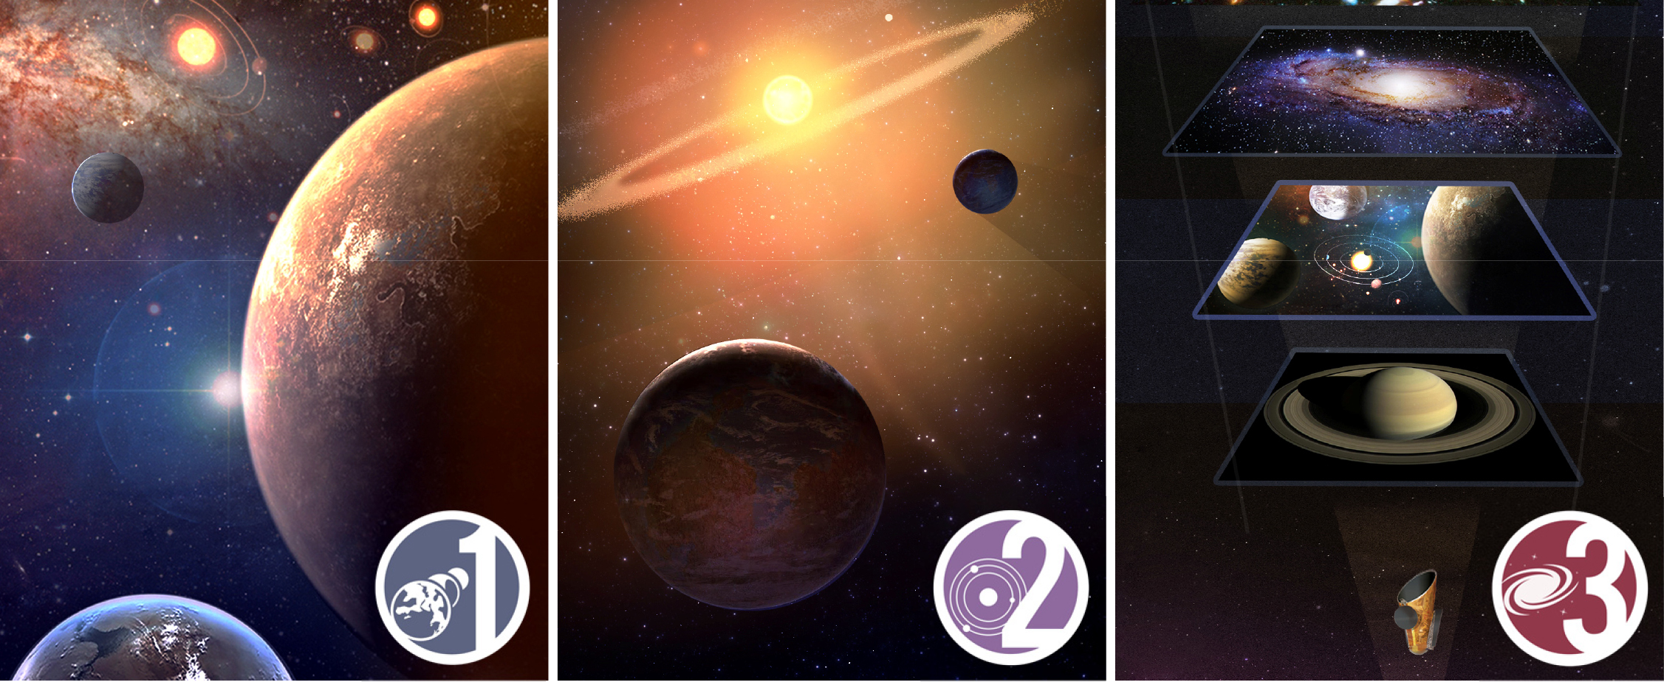
Science Goals
Seek out nearby worlds and explore their habitability
Map out nearby planetary systems and understand their diversity.
Open up new windows in the Universe from the UV to NIR.

Slide 7
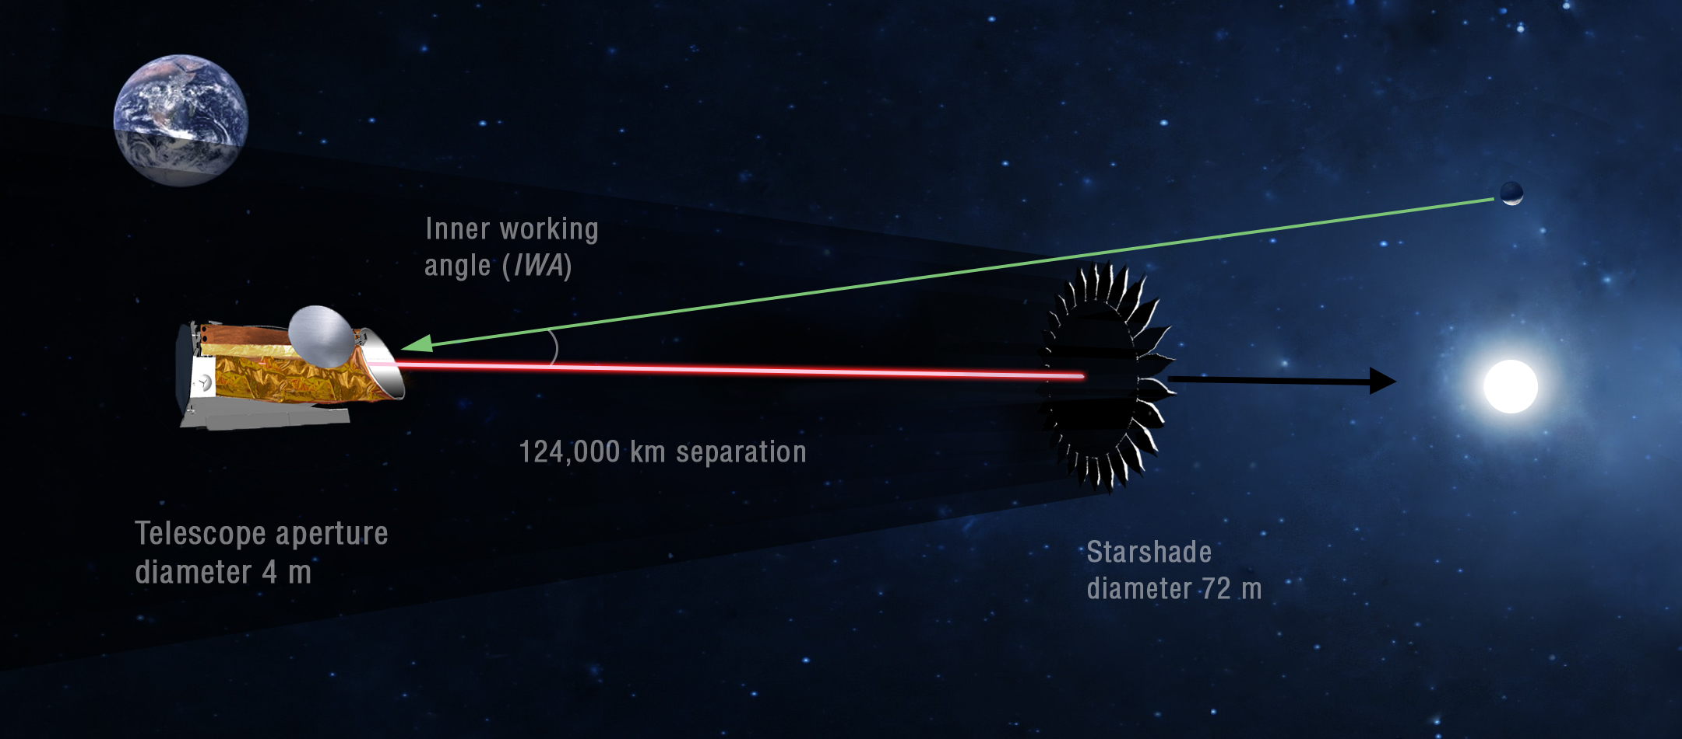
Architecture A at a glance
  Off-axis f/2.5 monolithic primary
  Coronagraph Instrument (0.45 - 1.8 μm)
    R=140 in the visible, R=40 in the NIR
    IWA = 62 mas at 0.5 μm
    High contrast FoV = 2’ x 2”
  Starshade Instrument (0.2 – 1.8 μm)
    R=140 in the visible, R=40 in NIR, R=7 in UV
    IWA = 60 mas over 0.3 to 1.0 μm
    Slew to different distances to cover <0.3 or >1μm
    High contrast FoV: 12” x 12” (Imaging) / 2” x 2” (IFS)
  Co-launch on SLS Block 1B
Notes:
f/2.5

Slide 8
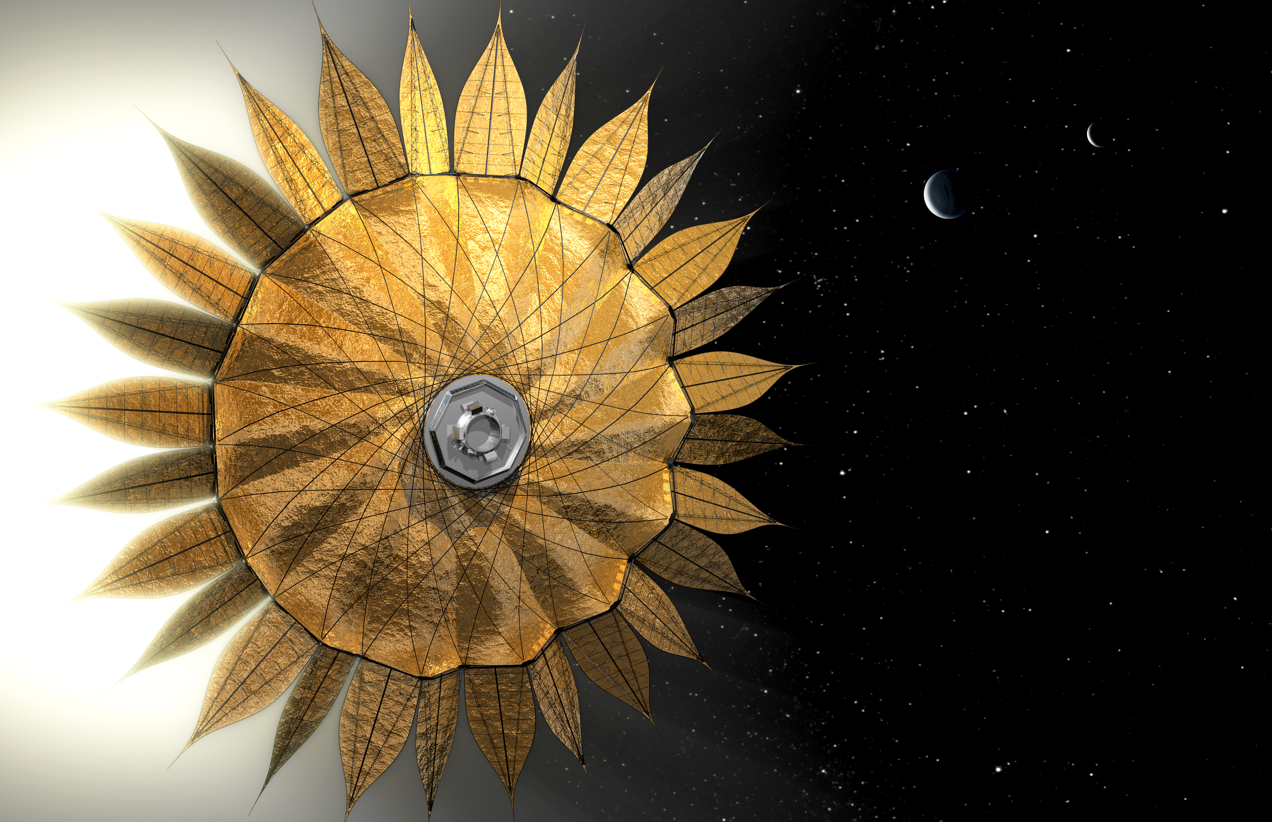
Hybrid Design &
Observing Strategy
Architecture A combines the strengths of two highly complementary starlight suppression systems:
Internal CORONAGRAPH
External STARSHADE
+
Very nimble
Searches for planets around many stars
Takes images at multiple visits to measure orbits
Very “photon” efficient
Accesses closer-in planets at a given λ
Takes broad spectra (300-1000nm) of all planets found in 50-100 most interesting systems

Slide 9
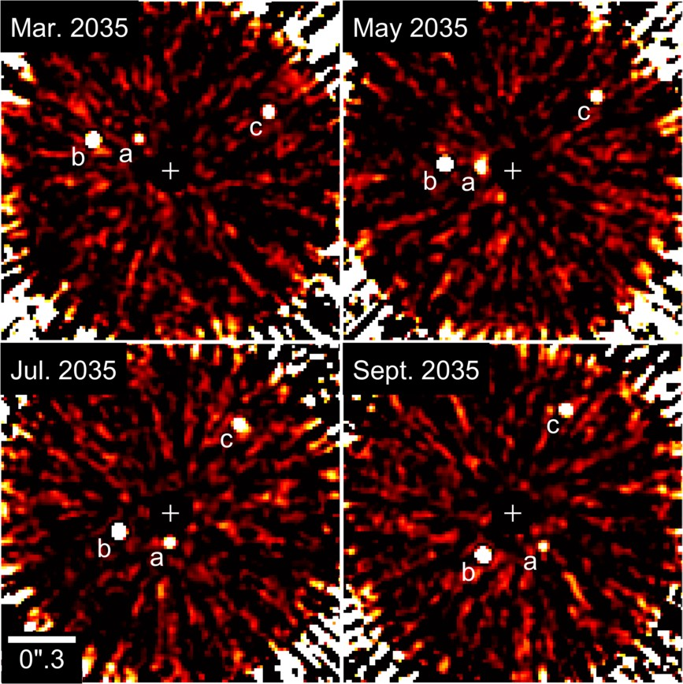
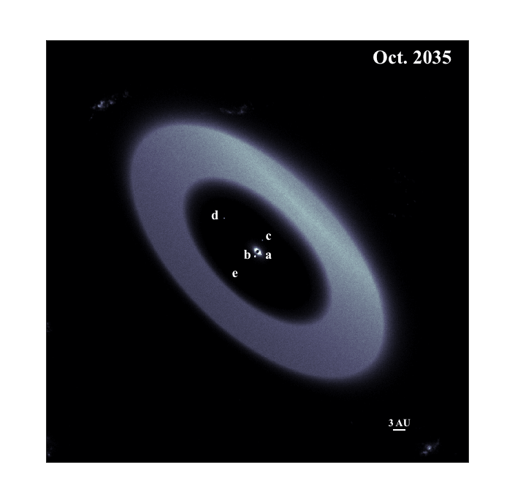
Detecting and Characterizing Potentially Habitable Worlds
HabEx will survey ~110 nearby sunlike stars with the coronagraph to search for potentially habitable worlds and determine their orbits
Interesting systems will be studied further with the starshade (broad-band 12” x 12” image and spectra of individual planets)
Credit: Sergi Hildebrandt (JPL)
Credit: Garreth Ruane (Caltech)
Notes:
Asimulations of a potential planetary system around Bet Hyi, a solar type star 7.5pc away

Slide 10
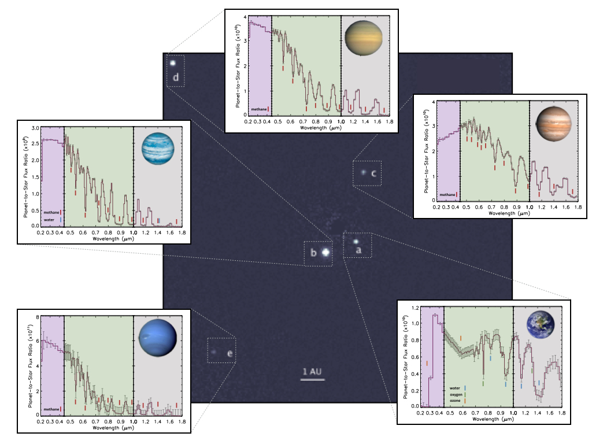
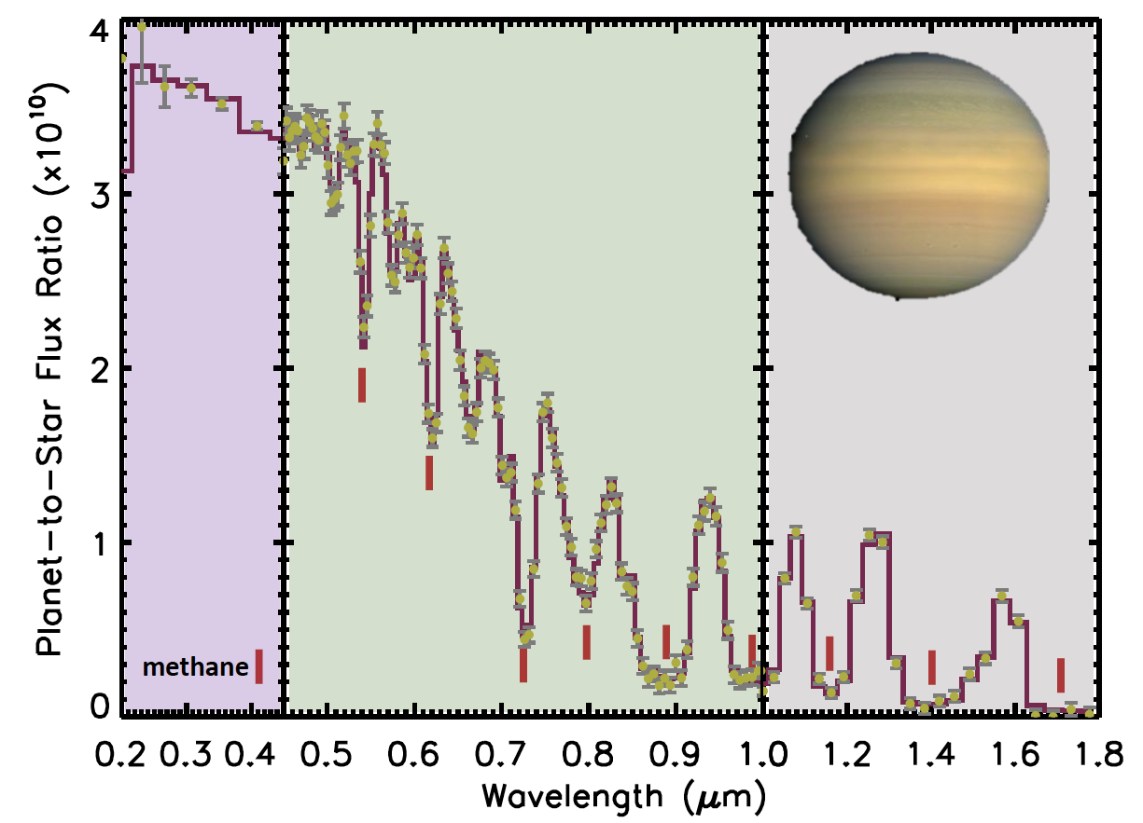
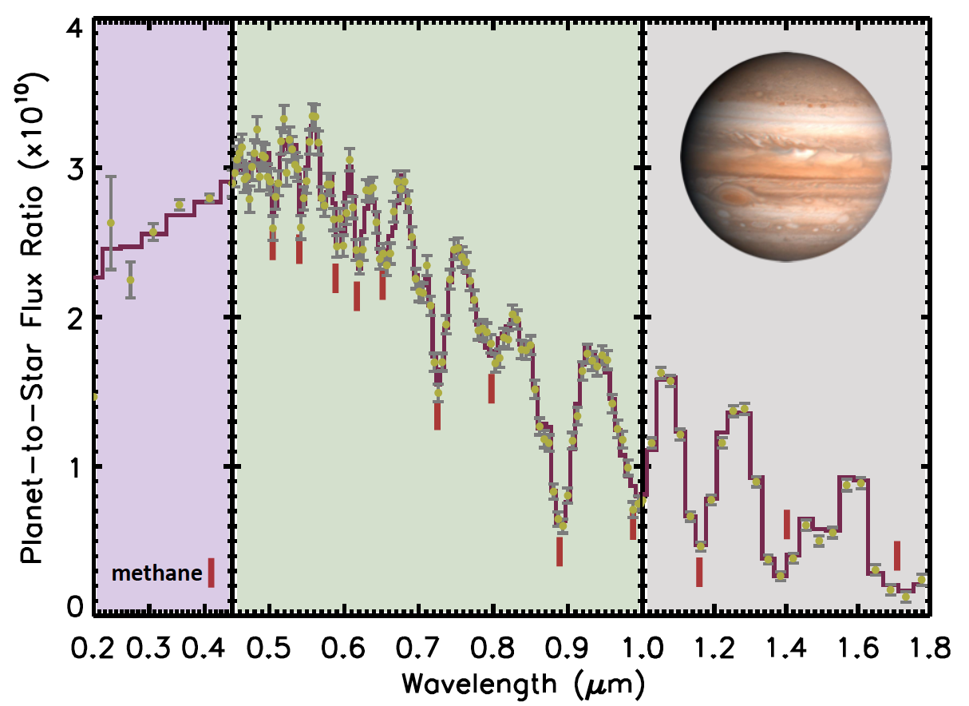
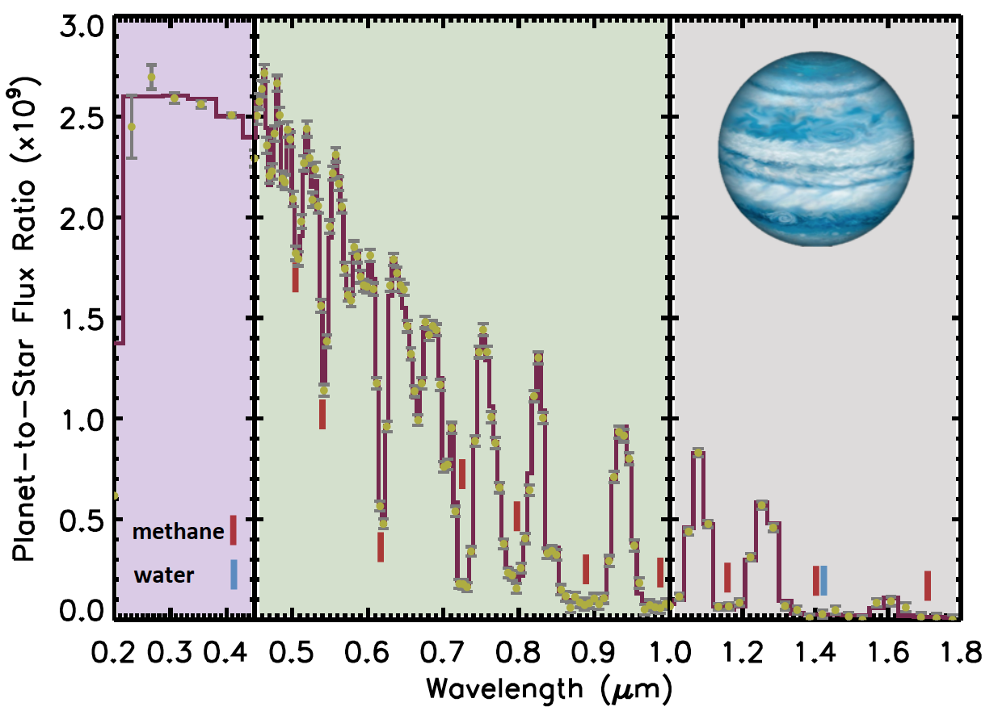
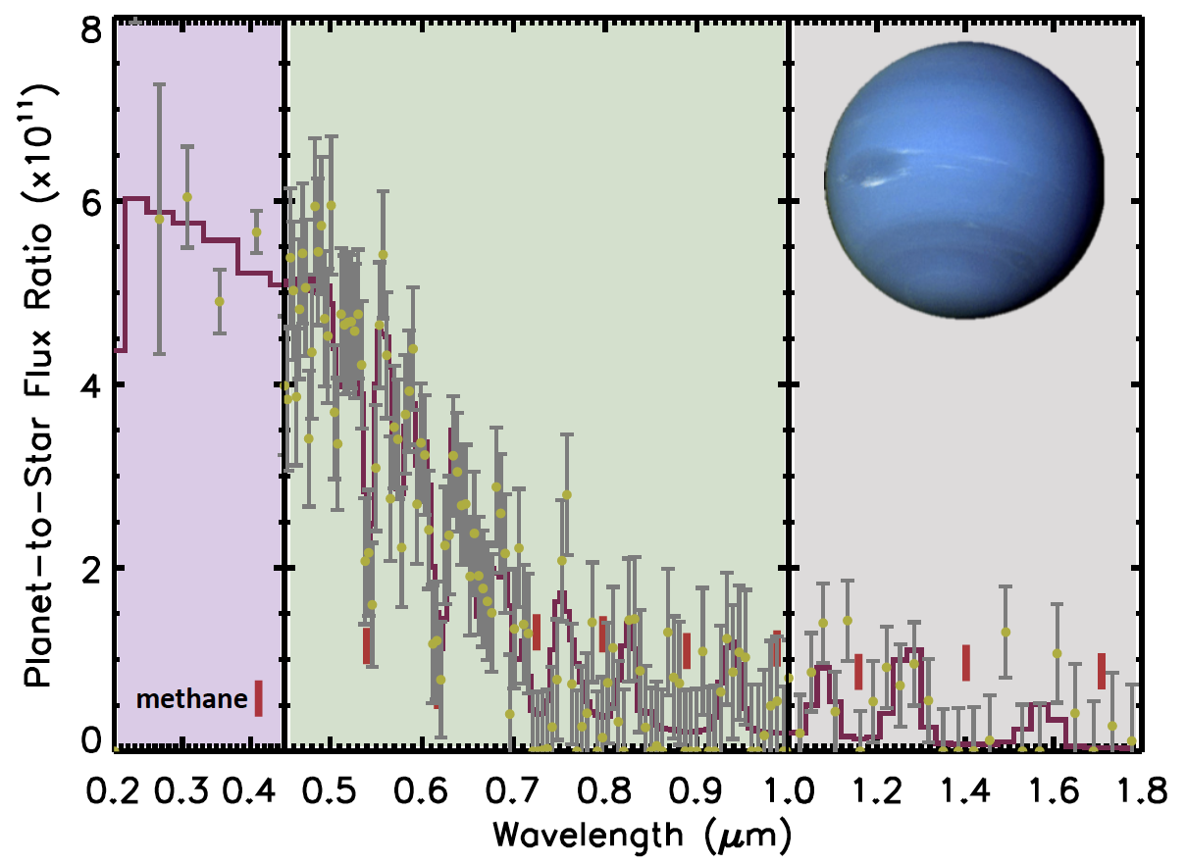
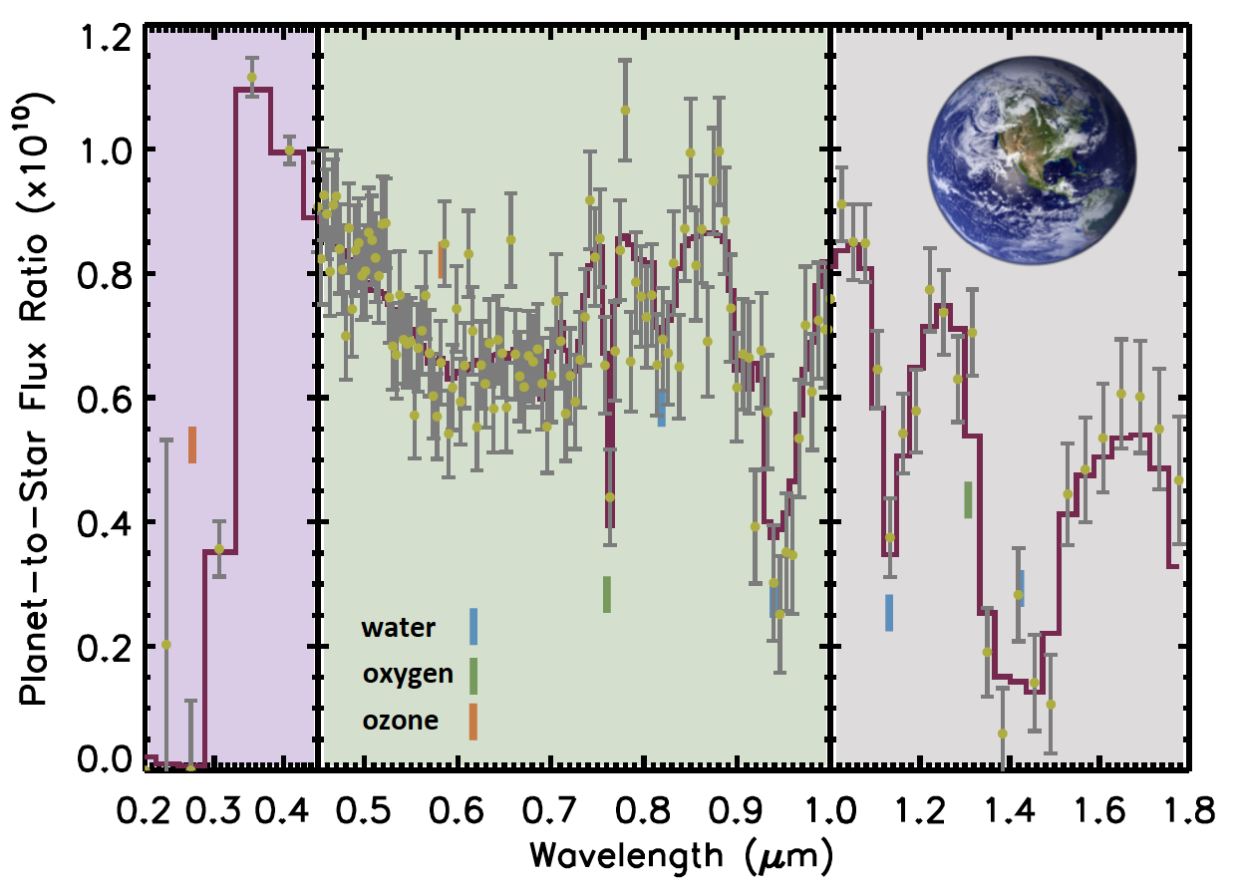
Family Portraits of our Neighboring Planetary Systems
  Spectra over 0.3-1.0 μm at once with starshade for planets within 2” x 2” FoV
  R=7 (grism) 0.3-0.45 μm
  R=140 (IFS) 0.45-1.0 μm
Further UV and/or near UV spectra for select systems
  R=7 (grism) 0.2-0.3 μm
  R=40 (IFS) 1.0-1.8 μm
Credit: Tyler Robinson (NAU) & Sergi Hildebrandt (JPL)
Notes:
7.5pc system, 180h of observations
A: exo-earth at Au, slightly crescent phase
B; sub-nPetune at 2AU at ~full phase
C: Jupiter at 5Au very crecent phase (non Lambertian behavior applied, consistent with models)
D: Saturn at 10 AU seen at quadrature
E: close Neptune analog at 15 AU seen at full phase. Dimest of the 5 plaents in this image

Slide 11
Exo-Earths near UV to near IR Spectra
Atmosphere?
Habitability?
Simulated spectrum of exo-Earth at quadrature assuming 180h of observations (SNR=10 @ 0.76 μm @ R=140)
Life?
Credit: Tyler Robinson (NAU)
Notes:
Figure from Ty 180h of osbervations of a sunlike star at 7.5pc.
Yep, R=140, SNR=10 at 0.55 um continuum. This shouldn't change much when translated to 760 nm, and is sufficient to detect O3 and O2.
I used 3 exozodis.
-Ty-
From: Mennesson, Bertrand (3262) <Bertrand.Mennesson@jpl.nasa.gov>
Sent: Friday, May 25, 2018 1:57:08 PM
To: Tyler D Robinson
Cc: EXTERNAL-Gaudi, Scott (7310-Affiliate)
Subject: Re: Figure for Nature article
Thank you Ty, this is awesome.
So this exposure time is for R=140 SNR=10 at 0.55 micron in the continuum, right? With the expectation that it’d be clsoe to that at 760nm as well?
Also, what is the assumption on exozodi level: 3 zodis?
The exposure time increases closer to a D^4 power law between 7.5pc and 10pc than it does btw 5 and 7.5pc. This is epxected as yu transtion from a stellar shot nosie domianted regime to a background dominated regime (e.g exozodi or detector nosie domnate more for the msot distant stasr).
Scott; I would recommedn that we quote the 7.5pc number (180h of exposure), both for the Nature paper and the interim report figure caption. This would ensure that all 5 planets can be spectrally characterized at once with the SS IFS (at last btw 300 and 1000nm. We would need to move th Ss to access further in the UV and the NIR)
Thanks again,
Bertrand
From: Tyler D Robinson <Tyler.Robinson@nau.edu>
Date: Friday, May 25, 2018 at 12:43 PM
To: "Mennesson, Bertrand (3262)" <Bertrand.Mennesson@jpl.nasa.gov>
Cc: "EXTERNAL-Gaudi, Scott (7310-Affiliate)" <gaudi@astronomy.ohio-state.edu>
Subject: Re: Figure for Nature article
Okay -- and here are the colorized, labeled spectra with faux noise.
Again -- these are designed so that the Earth case has SNR=10 at V-band. This sets the integration time (see table in previous email), and I use this integration time to determine the wavelength-dependent SNRs for all other worlds.
-Ty-
From: Tyler D Robinson
Sent: Friday, May 25, 2018 12:32:43 PM
To: Mennesson, Bertrand (3262)
Cc: EXTERNAL-Gaudi, Scott (7310-Affiliate)
Subject: Re: Figure for Nature article
Here's a grid of integration times to a given V-band SNR vs. target distance for an Earth-twin:
5 pc 7.5 pc 10 pc
SNR = 10 : 48 hr 180 hr 520 hr
SNR = 15 : 110 hr 410 hr 1200 hr
SNR = 20 : 190 hr 740 hr 2100 hr
I will follow up in a moment with SNR=10 faux noisy spectra.
-Ty-

Slide 12
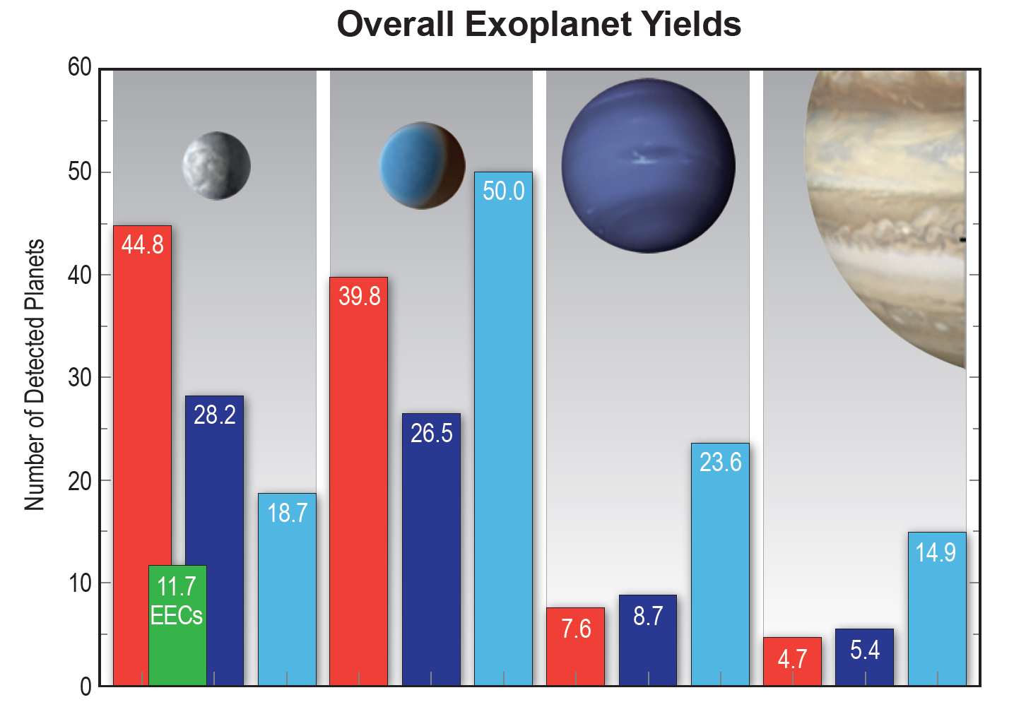
Yields of Characterized Planets (Chris Stark, STScI)
Expected HabEx Yields*
Detect and characterize the orbits and atmospheres of:
Rocky planets:
  92 rocky planets (0.5-1.75 R_{E})
  Including 12 Earth Analogs (0.6-1.4 R_{E})
Sub Neptunes:
  116 sub-Neptunes (1.75-3.5 R_{E})
Gas Giants
  62 gas giants (3.5-14.3 R_{E})
*Assumes SAG13 Nominal Occurrence Rates.

Slide 13
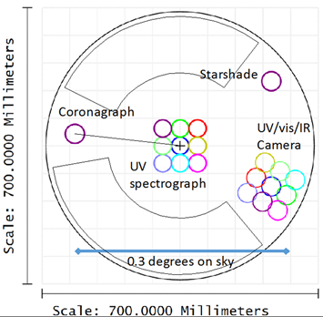
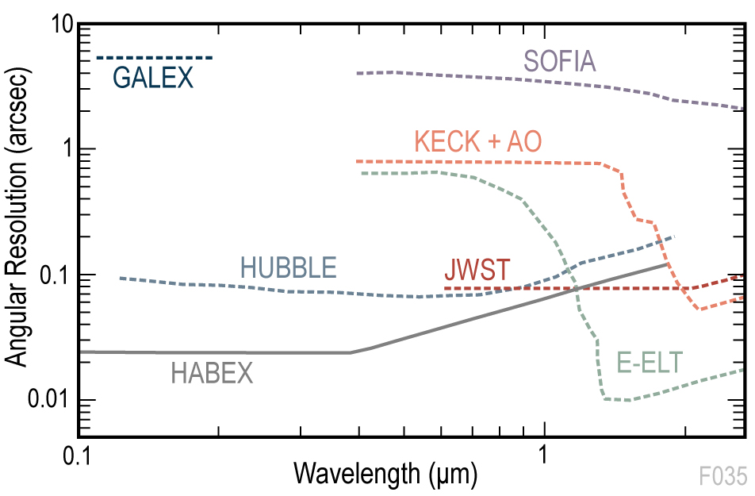
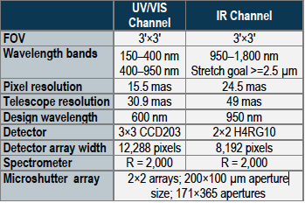
General Observatory Science: Instruments and Capabilities
HabEx Workhorse Camera (HWC)
HabEx will provide the highest-resolution UV/optical images of any current or planned facility
Notes:
HabEx will provide the highest-resolution UV/optical images of any current or planned facility, enabling a broad suite of observatory science. Opportunities range from solar system, to stellar populations, to galaxies, to large-scale structure studies

Slide 14
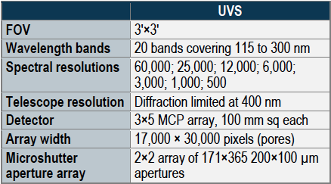
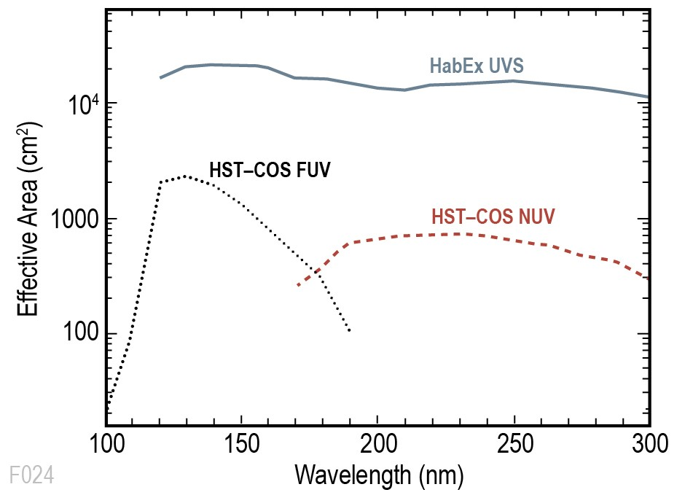
General Observatory Science: Instruments and Capabilities
HabEx High Res UV Spectrograph
> 10x the effective area of HST-COS + microshutter array
Notes:
With more than ten times the effective area of HST-COS, combined with a microshutter array, the HabEx UVS provides several orders of magnitude improved efficiency for UV spectroscopic studies. This will enable the first multiplexed observations of multiple sightlines to a single galaxy, allowing a new probe of the baryon cycle in galaxies.

Slide 15
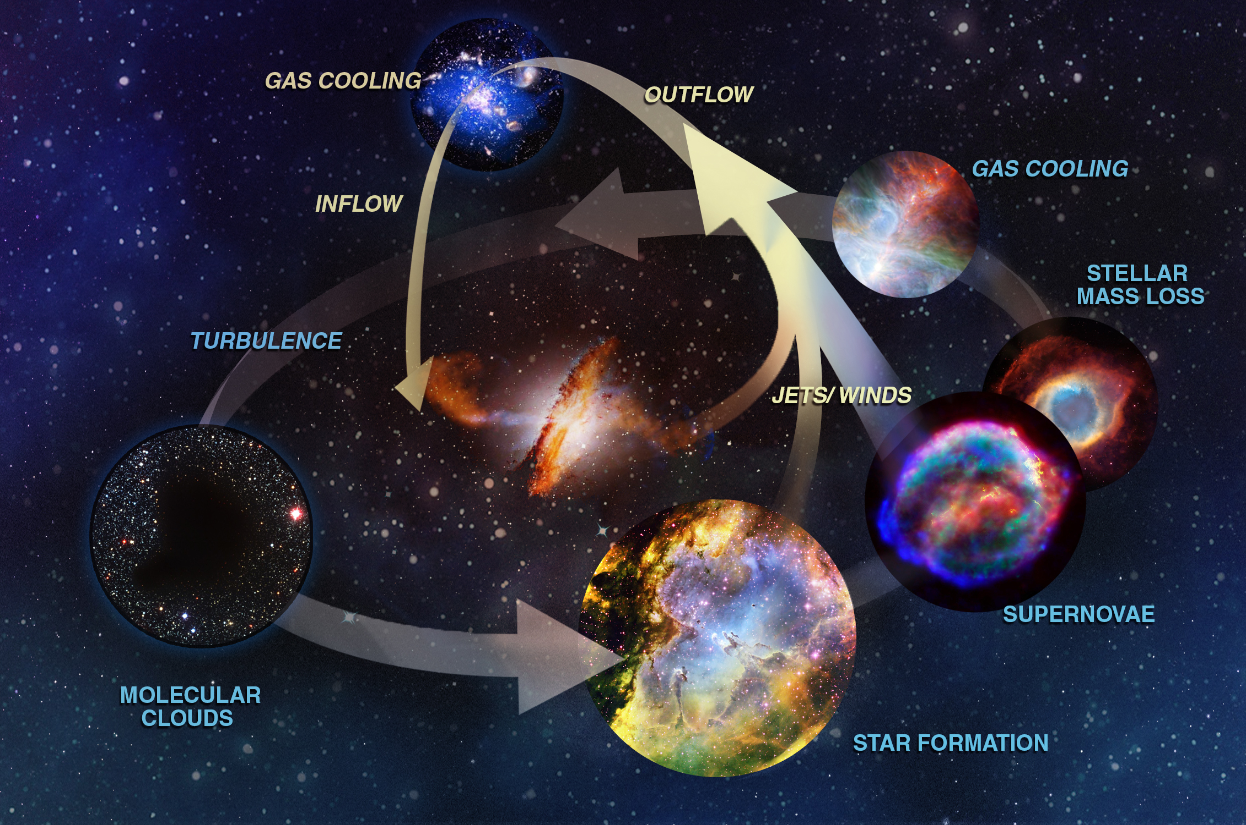
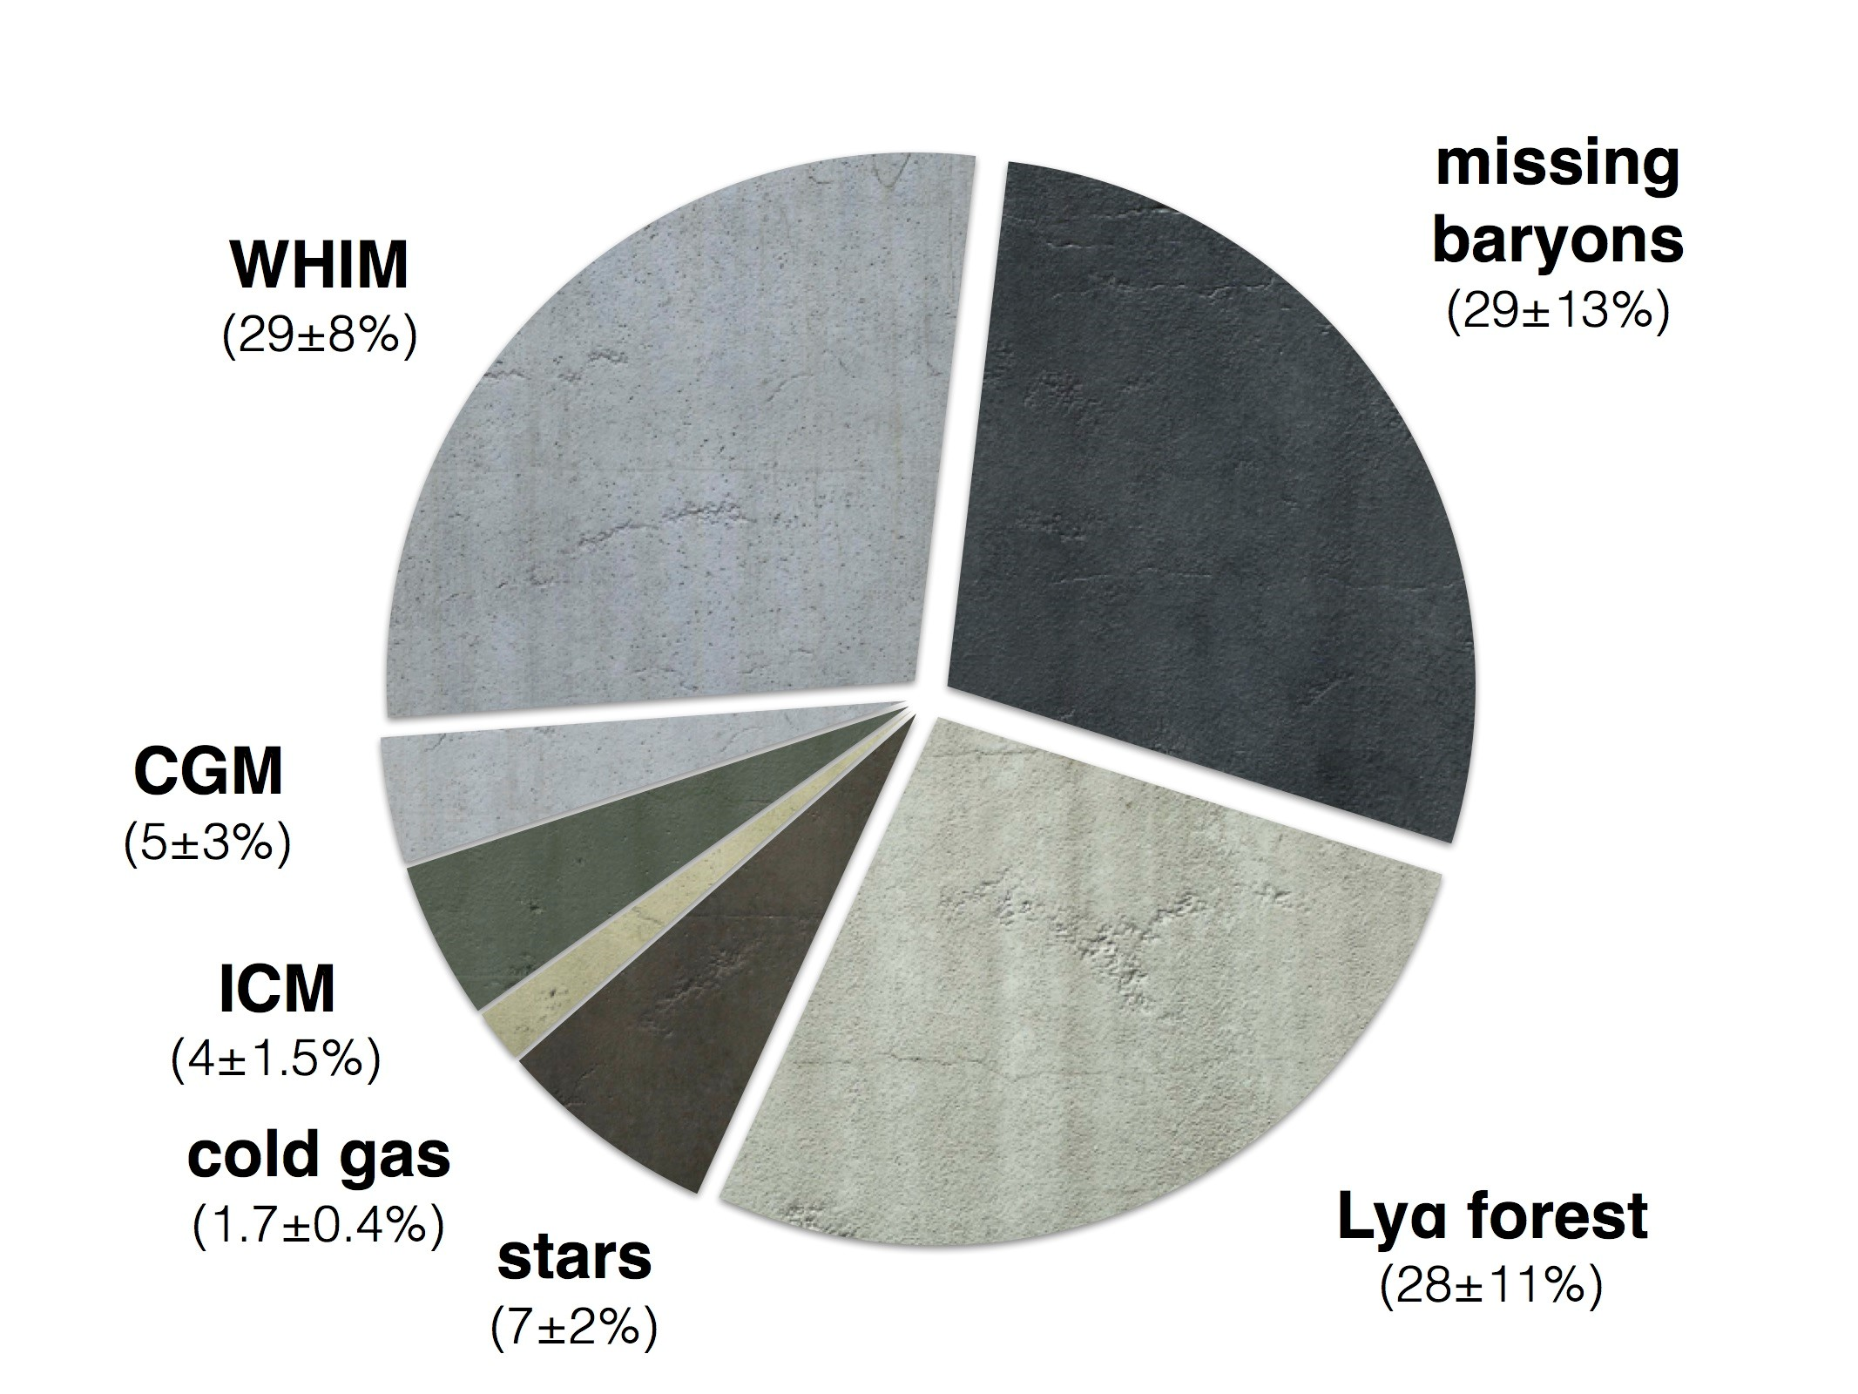
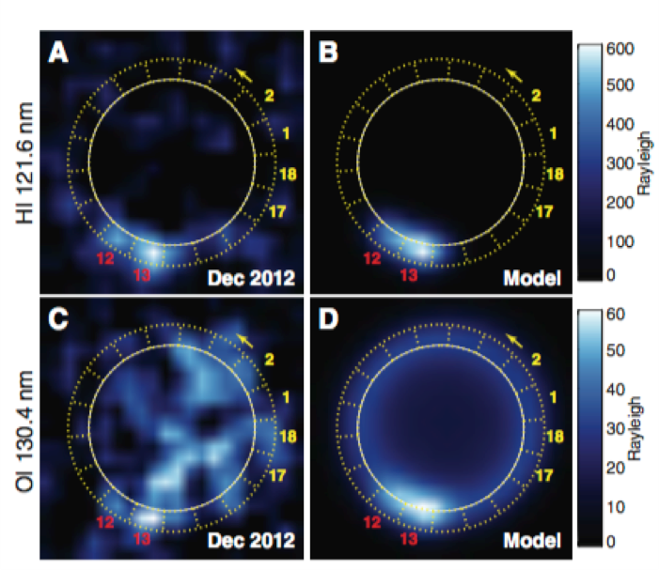
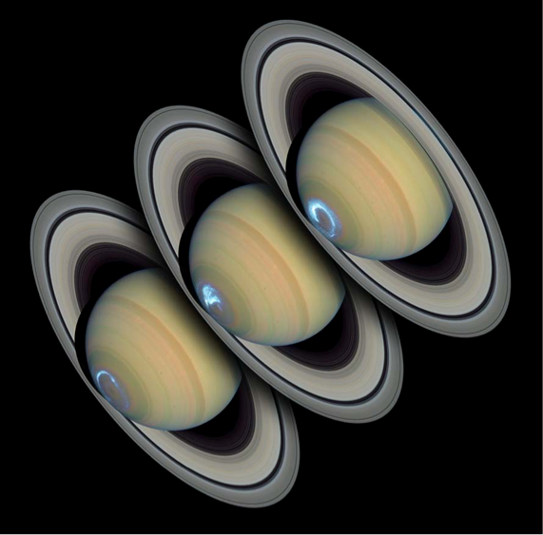
General Astrophysics and Solar System Science Themes
The Life Cycle of Baryons and the Missing Baryons Problem → Probing of CGM and IGM in the UV
Galaxy “leakiness” and reionization
Resolved Stellar Populations of Nearby Galaxies.
Planetary Aurorae, Cryo-volcanism and Exospheres
Constraining the Nature of Dark Matter Using Dwarf Galaxies
Pinning down the local value of the Hubble Constant
….
Science with HabEx Community Meeting to be held at the Flatiron Institute in NY on October 16 & 17 2018
Notes:
Probe the CGM and the baryons life cycle
How do gas and metals cycle in and out of galaxies?
Measure from absorption lines and abundance of H and metals in
various ionization states (e.g. Mg II, SiII, CII, SiIII, SiIV, OVI)
Reqt: R> 10⁴ far UV spectroscopy of low z galaxies
Improve our understanding of galaxy leakiness and reionization
How much H-ionizing LyC radiation escapes from SF galaxies as a function of redshift (z< 3.5) and mass?
Likely to remain an open question by the end of HST’s lifetime
Requires high spatial R to mitigate foreground contamination
Would exploit HabEx potential for much higher UV throughput and detector QE than HST, and for parallel deep field observations
Reqt: UV MOS 1000 - 4000 Å, R=200, ~4’ FoV
the nature of reionization and the escape fraction of ionizing radiation from star-forming galaxies
The major uncertainty for the contribution of galaxies to
reionization is the fraction of ionizing (Lyman continuum)
photons which escape galaxies, and thus can reionize the IGM.

Slide 16
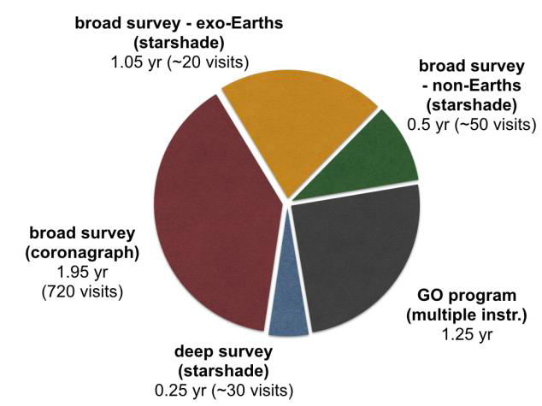
Observing Time Allocations
The HabEx Science and Technology Definition Team (STDT) is re-evaluating the GO time allocation.
There could be as much as 50% GO time without a significant loss to the exoplanet survey program.
Notes:
The last few stars on the target list take by far the most time to observe. By removing the last few stars from the exoplanet survey target list, we can gain back a lot of time, while only reducing the probability of detecting and Earth-like exoplanet minimally. Increasing the GO time to 50% for this architecture reduced the simulated exo-Earth yield by only two – it went from 12 to 10 exo-Earths. So those final two exo-Earths were taking 25% of the HabEx primary 5 year mission to observe. There is an enormous amount of GO science that can be achieved in that same time.

Slide 17
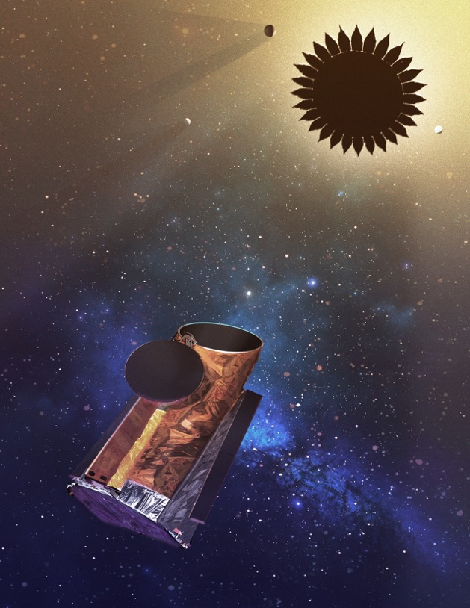
Community Input
HabEx Community Meeting
  15-16 October 2018
  Flatiron Institute, NYC
Seeking contributions toward the HabEx GO program in the form of ~2 page white papers
www.jpl.nasa.gov/habex
Alina.A.Kiessling@jpl.nasa.gov

Slide 18
Findings &
Lessons Learned
A 4m telescope design optimized for high contrast coronagraphic imaging (off-axis monolith, f/2.5, no RW) and using a hybrid starlight suppression approach provides exceptional performance in characterizing the architectures, diversity and habitability of nearby (< 15pc) mature planetary systems
“Aperture, Aperture, Aperture!” → ”Throughput, Instantaneous Bandwidth and Inner Working Angle”
HabEx is a lot more than just exoplanets: a 4m UV-Optical space telescope diffraction limited at 400nm provides unprecedented and unique capabilities for General Astrophysics and Solar System Science in the 2030s.
18
Notes:
In real estate, it’s all about location. The astrophysics equivalent could be all about aperture size.

Slide 19
Path Forward
Refine Architecture A design: starshade downsizing, finalize coronagraph trade & WFC scheme, conduct full STOP modeling, finalize near IR detector trade, further optimize GO time fraction & parallel obs
Further develop Technology Roadmap
Further examine potential foreign contributions (HWC and more)
Study cheaper options with a single starlight suppression system but same UVS and HWC
  Starshade-only with on-axis segmented ~4m with (HabEx-lite, talk by Dave Redding @ 4:30pm) → increased need for precursor exo-Earth detections
  Coronagraph-only with off-axis ~4m with → push down IWA limits (VVC4, new HLC design, DST, VFN?)
19
Notes:
In real estate, it’s all about location. The astrophysics equivalent could be all about aperture size.

Slide 20
Back-up Slides

Slide 21
HabEx Presentations & Posters
SPIE Presentations and Posters
Title | Presenter | Date • Time
HabEx Ultraviolet spectrograph design and DRM | Paul A. Scowen | 10 June 2018 • 10:00 - 10:20 AM
The habitable exoplanet imaging mission (HabEx): science goals and projected capabilities | Scott B. Gaudi | 11 June 2018 • 10:30 - 10:55 AM
Solid state detectors for the Habitable Exoplanet imaging mission (HabEx) and the large UV/optical/infrared (LUVOIR) surveyor mission concepts | Shouleh Nikzad | 10 June 2018 • 11:10 - 11:30 AM
The habitable exoplanet imaging mission (HabEx) | Bertrand Mennesson | 11 June 2018 • 1:20 - 1:40 PM
Overview of the 4m baseline architecture concept of the habitable exoplanet imaging mission (HabEx) study | Gary M. Kuan | 11 June 2018 • 1:40 - 2:00 PM
The HabEx workhorse camera | Paul A. Scowen | 11 June 2018 • 2:00 - 2:20 PM
Technology maturity for the habitable-zone exoplanet imaging mission (HabEx) concept | Rhonda M. Morgan | 11 June 2018 • 2:20 - 2:40 PM
HabEx Space telescope exoplanet instruments | Stefan R. Martin | 11 June 2018 • 2:40 - 3:00 PM
HabEx: high precision pointing architecture using micro-thrusters and fine steering mirror | Oscar S. Alvarez-Salazar | 11 June 2018 • 3:30 - 3:50 PM
Numerically optimized coronagraph designs for the habitable exoplanet imaging mission (HabEx) | A J Eldorado Riggs | 11 June 2018 • 3:50 - 4:10 PM
Overview and performance prediction of the baseline 4-meter telescope concept design for the habitable-zone exoplanet direct imaging mission | H. Philip Stahl | 11 June 2018 • 4:10 - 4:30 PM
HabEx Lite: a starshade-only habitable exoplanet imager alternative | David Redding | 11 June 2018 • 4:30 - 4:50 PM
Terrestrial exoplanet coronagraph image quality: study of polarization aberrations in Habex and LUVOIR update | James Breckinridge, Russell A. Chipman | 13 June 2018 • 10:30 - 10:50 AM
Poster Title | Presenter | Date • Time
HabEx polarization ray trace and aberration analysis | Jeffrey Davis | 11 June 2018 • 5:30 - 7:00 PM
HabEx space telescope optical system overview | Stefan R. Martin | 11 June 2018 • 5:30 - 7:00 PM
HabEx telescope WFE stability specification derived from coronagraph starlight leakage | Bijan Nemati | 11 June 2018 • 5:30 - 7:00 PM
Mirror design study for a segmented HabEx system | James T. Mooney | 11 June 2018 • 5:30 - 7:00 PM
Overview and performance prediction fo the alternative 6.5-meter telescope concept design for the habitable-zone exoplanet direct imaging mission | H. Philip Stahl | 11 June 2018 • 5:30 - 7:00 PM
Would like to learn more? : Bertrand.Mennesson@jpl.nasa.gov or www.jpl.nasa.gov/habex for HabEx general info, interim reports and events
Pre-Decisional Information -- For Planning and Discussion Purposes Only

Slide 22
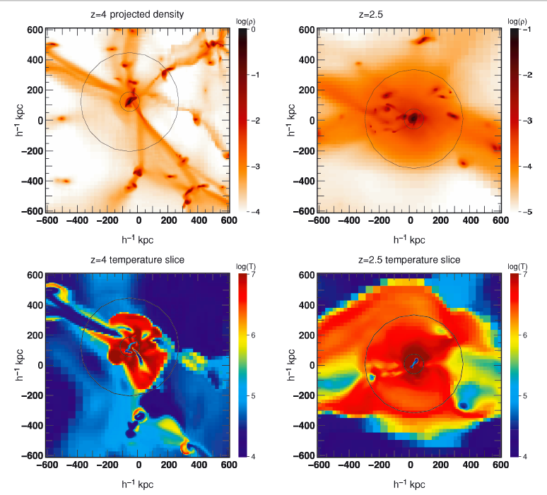
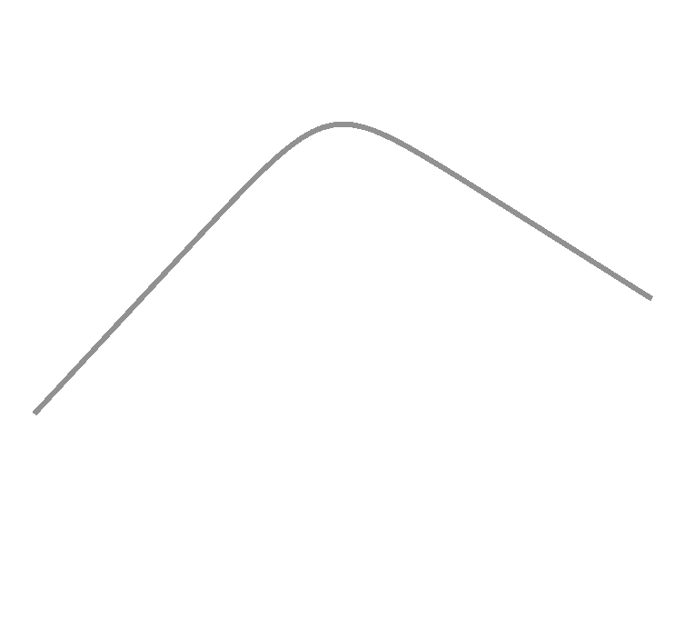
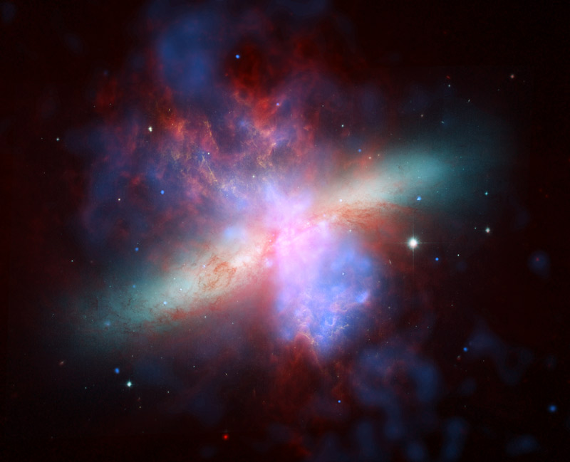
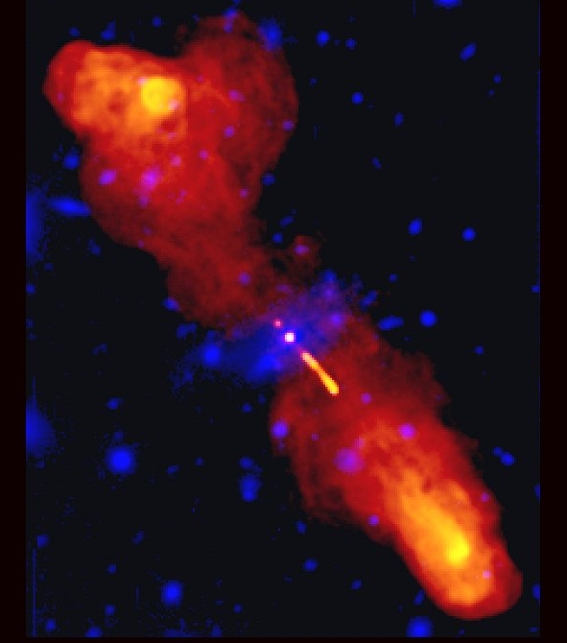
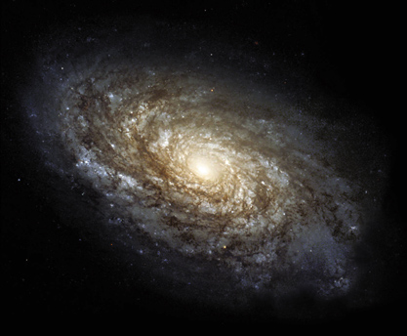
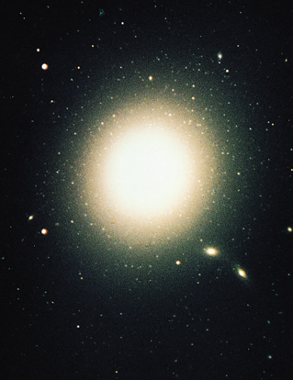
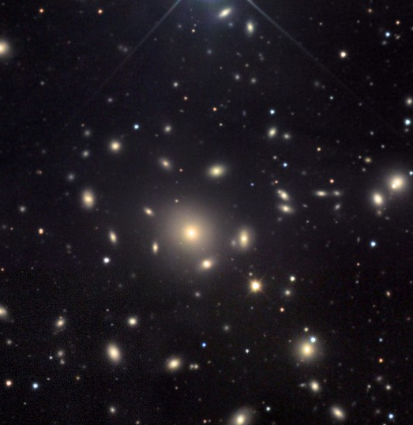
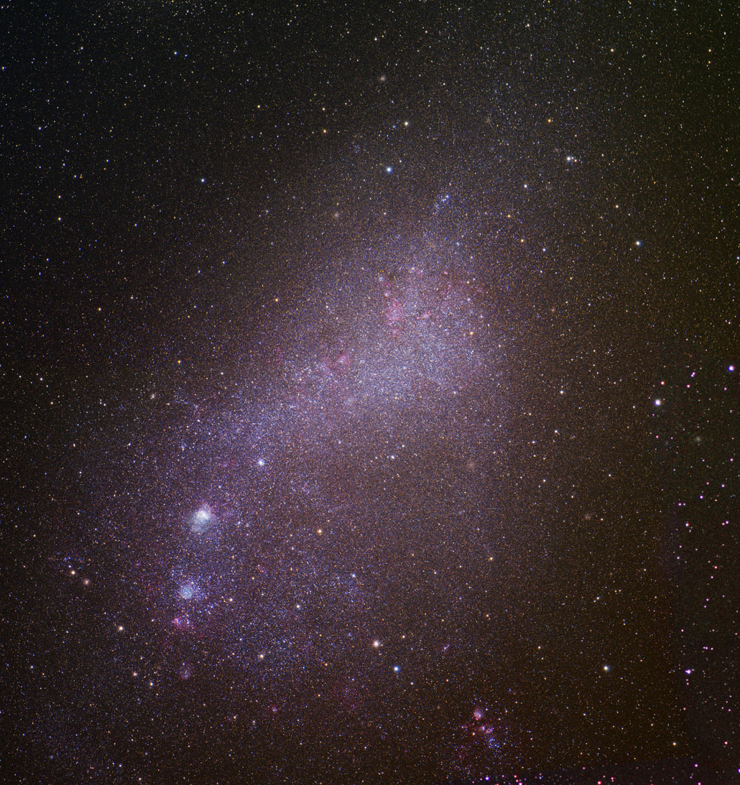
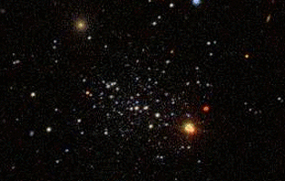
merging
gas accretion
massive stars & SNae
heating and winds
AGN feedback
heating & winds
photoionization/
photoevaporation
gravitational
heating
no HI
cooling
halo mass (M_{sun})
Notes:
although we are still working out the details of many of these processes, there has been progress in at least arriving at a broad consensus about which physical processes are likely to be important for shaping galaxy properties. these include: accretion of gas from the ‘cosmic web’, which dominates the growth of low-mass galaxies, and growth through mergers, which is important for the growth of massive galaxies; heating and winds from stars and supernovae (low-mass), and heating and winds from accreting black holes, important for massive galaxies.

Slide 23
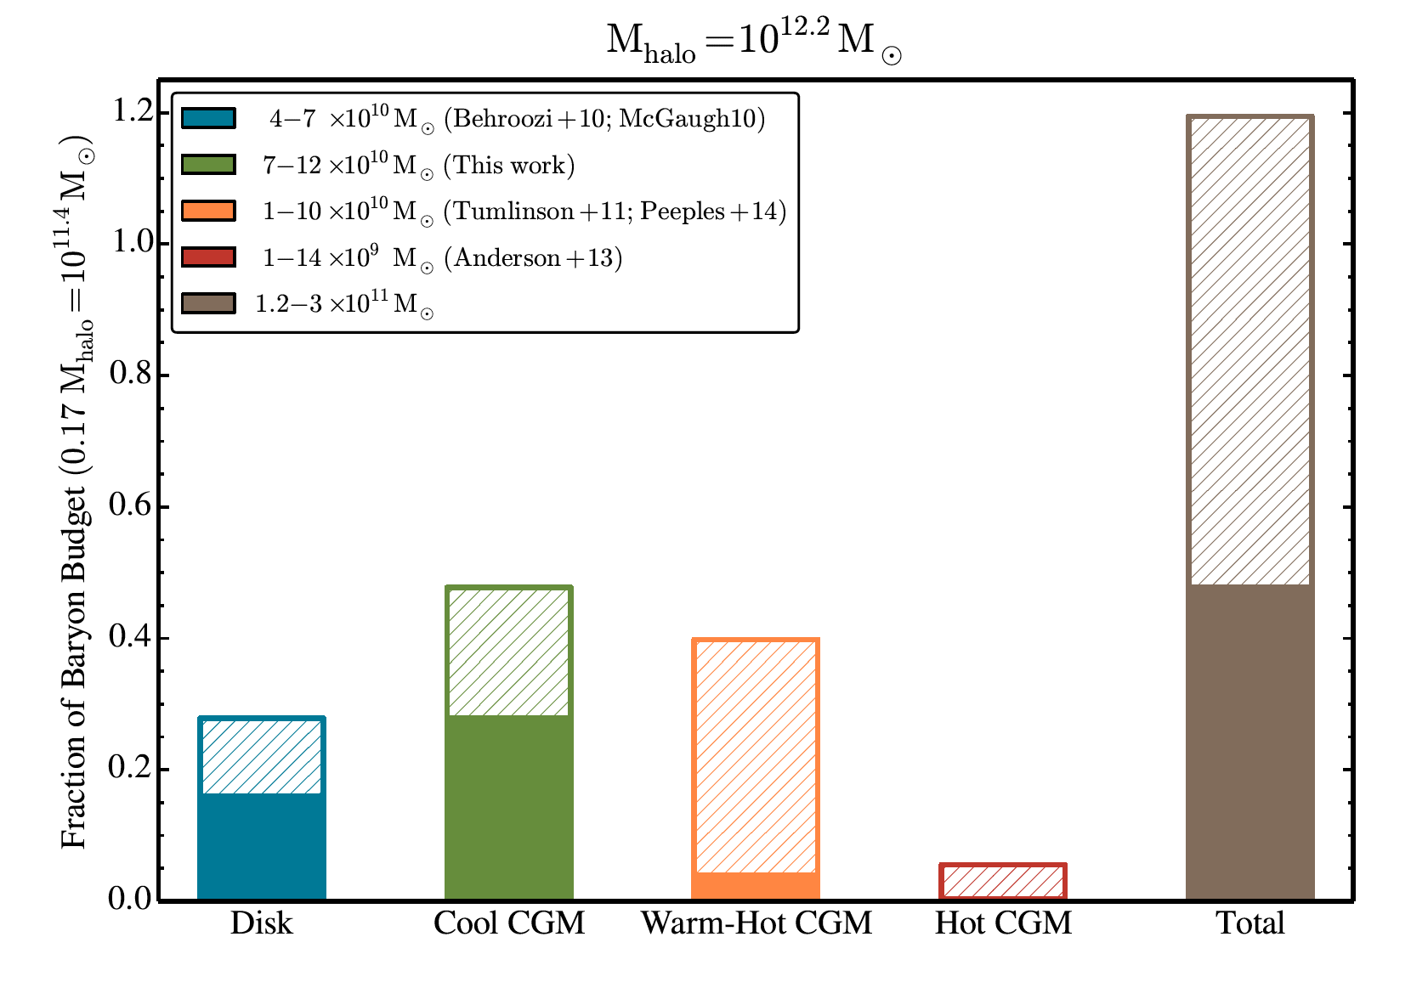
Constraining Galaxy formation and evolution processes with HabEx
Observational studies of stellar and AGN feedback:
  HabEx diffraction limited observations will allow unique morphology studies, resolved spectroscopy
  and high dynamic range studies of galaxies as a function of age and mass
  Will help understand how “small scale” physics and global galaxy properties are connected
  E.g. conduct UV observations of massive stars in the local Universe (20Mpc)
  Reqt: R=10⁴ UV/optical/NIR spectroscopy with <50 mas resolution
Probe the CGM and the baryons life cycle
  How do gas and metals cycle in and out of galaxies?
  Measure from absorption lines and abundance of H and metals in
  various ionization states (e.g. Mg II, SiII, CII, SiIII, SiIV, OVI)
  Reqt: R> 10⁴ far UV spectroscopy of low z galaxies
Improve our understanding of galaxy leakiness and reionization
  How much H-ionizing LyC radiation escapes from SF galaxies as a function of redshift (z< 3.5) and mass?
  Likely to remain an open question by the end of HST’s lifetime
  Requires high spatial R to mitigate foreground contamination
  Would exploit HabEx potential for much higher UV throughput and detector QE than HST, and for parallel deep field observations
  Reqt: UV MOS 1000 - 4000 Å, R=200, ~4’ FoV
J. Werk et al. 2014
Notes:
The major uncertainty for the contribution of galaxies to reionization is the fraction of ionizing (LYC) photons which escape gaalxies, and thus can reionize the IGM
Werk et al. 2014: COS-halos survey: the baryons and metals in the CGM likely exceed those in stars and the ISM. Galaxies (or is it galaxy halos?) may not be baryon-depleted at all relative to the
cosmological baryon fraction (COS: HST Cosmic Origins Spectrograph).
50 mas resoltuion to avoid source confusion and resolve individual stars

Slide 24
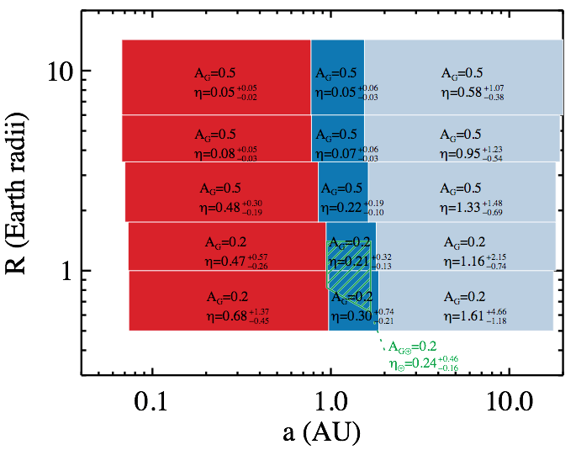
SAG 13 Planet Bins and Occurrence Rates

Slide 25
Starshade spectrum: 0.3 – 1 um at a single SS distance.
SNR=10 at R=140 from 0.45 to 1 um, R=7 from 0.30 to 0.45 um
SS must be moved to extend down to 0.2 um (R=7) and up to 1.8 um (R=40 above 1 um)

Slide 26
Coronagraph Initial spectrum:
SNR=5 at R=70 from 0.45 to 0.55 um (Rayleigh) and from 0.80 to 0.98 um (water bands)
both 20% filters in parallel

Slide 27
Coronagraph Follow-up spectrum (only if water detected in initial spectrum):
SNR=10 at R=140 from 0.695 to 0.85 um (O2), SNR=? at R=70 from 0.53 to 0.67 um (O3?)
Both 20% filters in parallel
Notes:
530-670nm, searching for O3) and a red 20% filter (695-850nm

Slide 28
Coronagraph overall spectrum coverage for sources with water detected in the initial spectrum.
Note: nominally no UV observations
Notes:
530-670nm, searching for O3) and a red 20% filter (695-850nm

Slide 29
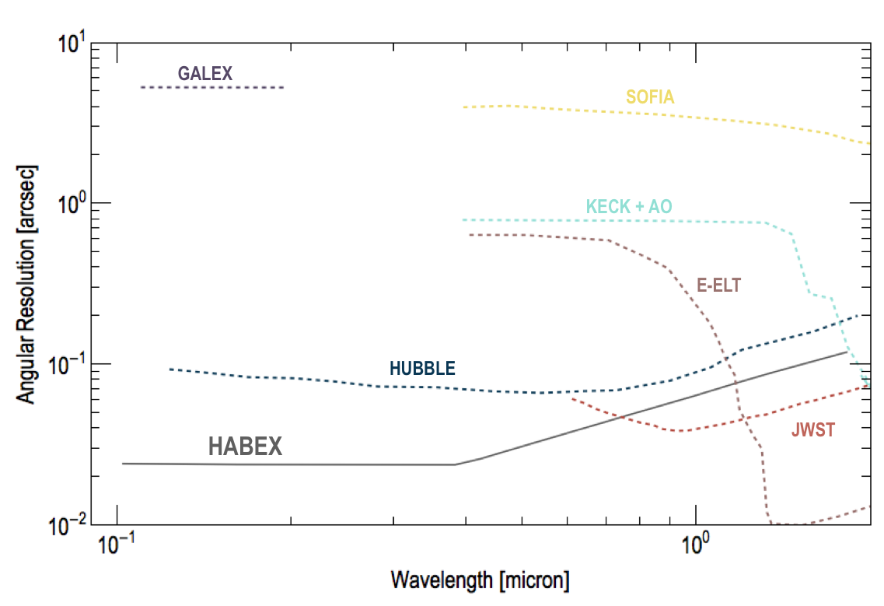
General Astrophysics Instruments: Resolution and Effective Area
Capabilities: Imaging and Spectra
Diffraction limited at 0.4 μm
  Better than all current or planned facilities for λ < 0.7 μm
Non-sidereal tracking.
Wavelength coverage
  115nm-1.8 μm
Effective Area
  >10x better than HST for 115nm-300nm
UVS
  Area 3’ x 3’, 115-300nm, resolution up to R=60,000
HWC
  Area 3’ x 3’
  150-400nm, 400-950nm, 950-1.8nm
  R=2000

Slide 30
The Lifecycle of Baryons

Slide 31
Solar System Science

Slide 32
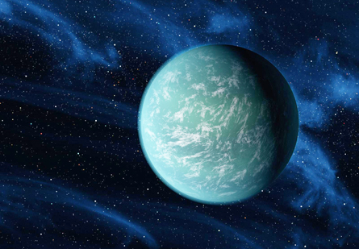


Summary
Architecture studied:
4m off-axis monolith: preliminary design completed.
  Four instruments:
    Coronagraph and Starshade Cameras
    UV spectrograph and Workhorse Camera.
Science Goals:
  Seek out nearby worlds and explore their habitability
  Map out nearby planetary systems and understand their diversity.
  Open up new widows in the Universe from the UV to NIR.
Next Steps:
  Refine our observing strategy
  Create a full Design Reference Mission
  Decide on near-IR capabilities

Slide 33
Starshade Key Advantages for Getting Spectra of Exoplanetary Systems
Enables high contrast at small IWA, emulating a larger telescope
  accesses planets at λ/D separation rather than ~3-4 λ/D
High Throughput, emulating a larger telescope
  dual polarization starlight suppression system, simple telescope optical train, no deformable mirrors, sharp off-axis PSF
Very broad-band high contrast performance, emulating a larger telescope
  can obtain simultaneous spectra with constant IWA over 300-1000nm range at nominal SS distance → very high efficiency spectroscopy system
  over 950-1800nm range at closer SS distance, with constant (larger) IWA
Large field of view
  high contrast field of view (OWA) is limited by detector size rather than # of DM actuators → better suited for studies of outer planets and extended debris disks
For a given bandpass, optical constraints are relaxed at shorter wavelengths
  Better suited to near UV characterization
Low sensitivity to pointing jitter and wavefront drifts
  10’s of nm of Telescope WFE is OK, rather than << nm stability
Low sensitivity to stellar angular size

Slide 34


Solar System Science
Some of the investigations enabled by HabEx high far UV sensitivity , spectral resolution (R up to 40,000) and L2 location (outside of the Earth’s geocorona):
Planetary Aurora : better understand what physical parameters control auroral processes over a wide range of physical scales and planetary conditions. Extending Jupiter’s and Saturn’s aurora studies to Uranus and Neptune.
Planetary Exospheres: understand what physical processes govern the loss of an atmosphere into space (Jean’s escape). Extending Mars/Venus measurements to fainter solar system planets.
Cryo-volcanism (eruptions of water, ammonia or methane) extending current HST observations of Europa, Enceladus & Triton to smaller SS bodies
Isotopic ratios, e.g D/H through Ly α emission measurements. HabEx will probe the history of water across a broader range of objects, from current measurements from Mars, Venus and rare comets to Jupiter, Saturn, Uranus, Neptune, Pluto and many more comets
(Some high contrast imaging applications as well: search for small satellites around Pluto and other Kuiper belt objects)
HST far-UV images of Saturn’s aurora and changes during an auroral storm
HST far-UV images of oxygen airglow emission from cryo-plumes on Europa

Slide 35

Exoplanet Science
Does the distribution of small and giant planets and interplanetary dust in nearby planetary systems resemble that of our Solar System?
What is the diversity of planetary atmospheric conditions in nearby planetary systems?
Are there small, Earth-sized, exoplanets continuously orbiting in the habitable zones of nearby Sun-like stars?
Are there small planets with habitable conditions (atmosphere and water oceans) around nearby Sun-like stars?
Do any of these also display bio-signatures (signs of life)?
To what extent do planet size and stellar insolation drive volatile (e.g. water) condensation and retention?
How do giant planets influence the volatile inventory of inner planetary systems (either through planetesimals scattering or orbital migration)?
How is dust produced and transported in debris disks of different densities ? (e.g. collision vs transport dominated regimes)

Slide 36



Characterizing the Diversity of Exoplanets
A history of surprises in terms of:
  Planet locations, e.g. Hot Jupiters
  Planet sizes: commonly detected super Earths (e.g. Corot 7b, Leger et al. 2009) and mini-Neptunes (e.g. GJ 1214b Charbonneau et al. 2009) have no Solar System analogs
  Planet composition: e.g. what is the nature of Super Earths?
Artist view.
Image Credit: NASA/Ames/JPL/Caltech
B. Fulton et al. 2017
from Kepler data
Super
Earths
Mini
Neptunes
R. Hu et al. 2017

Slide 37


Characterizing the Diversity of Exoplanets
Atmospheric characterization requires access to a broad-range of wavelengths that overlaps with spectral features from key atm species
  EGPs well modeled as being primary H₂ and He primary atmospheres
  A lot more diversity of atm states and composition is expected for smaller planets having secondary atmospheres in many cases (e.g volatiles delivery through cometary bombardment, geological and even possible biological processes) –> be ready for anything!
High interest of reflected light spectra:
  Direct imaging, with its shorter, more direct path length probes deeper into a planetary atmosphere than the glancing path seen in transit transmission
  Direct imaging therefore provides a superior opportunity to probe the bulk of the planetary atm
Model spectra of Mini Neptunes (C. Morley 2015)
Spectra of different planet types at UV/ vis wavelengths. Realistic spectra for Mars (red) and Venus (yellow) are shown, and modeled spectra for an Earth-like planet with a 3 bar atmosphere (blue) and a cool Neptune-like planet (green) are also plotted. Credit: T.D. Robinson.
Notes:
Figure 4.2-8. Model spectra of mini-Neptunes with cloud-free,
soot aerosols or sulfide/salt clouds seen in transit transmission
(top) and direct imaging (bottom). The curves are normalized
to show the ratio of the spectrum to the average flux over the
wavelength range shown. Direct imaging, with its shorter,
more direct path length probes deeper into a planetary
atmosphere than the glancing path seen in transit
transmission. Direct imaging therefore provides a superior
opportunity to probe the bulk of the plnaetary atm

Slide 38



Finding Habitable Worlds
“Follow the water”:
  Water is one of the few requirements shared by all life on Earth,
  Search for exoplanets with global water reservoirs, ideally at the surface where biology might communicate with the planet’s atm.
  Presence of liquid water oceans on exoplanets must be confirmed through direct imaging, photometry and spectroscopy.
  Look for water vapor broad absorption features from 0.9 µm to 1.8 µm
  Identifying liquid water oceans at the surface is another story:
    Requires phase dependent photometry to identify possible “glint” brightening effects or strongly polarized signal from ocean reflection
Turnbull (2006)
  But habitability is much more complicated than just the presence/absence of oceans. Finer assessment requires:
    Characterization of star high energy radiation via UV observations of the host star (HabEx High Res UV spectrograph)
  Inference of geological activity: search for combination of gases and aerosols in the planet’s atmosphere, particularly those related to volcanism
  Assessment of surface climate (and its stability): HabEx should be able to detect all the major greenhouse gases active in the HZ: CH₄, CO₂, H₂O, SO₂, and H₂S. Plus detect clouds and aerosols.
Glint Signature (T. Robinson)
Notes:
Glint figure= photometry in the 1-1.1 micron region
Water is one of the few requirements shared by all life on Earth,
Life is ubiquitous on Earth where appropriate amounts of water can be found
Search for exoplanets with global water reservoirs, ideally at the surface where biology might communicate with the planet’s atm.
Presence of liquid water oceans on exoplanets must be confirmed through direct imaging, photometry and spectroscopy.
Look for water vapor broad absorption features from 0.9 µm to 1.8 µm → seeing l different features also helps confirming detection and measuring abundances.
Identifying liquid water oceans at the surface is another story:
Requires phase dependent photometry to identify possible “glint” brightening effects or strongly polarized signal from ocean reflection

Slide 39
Finding Life: the Search for
Bio-signatures and their Context
Identifying bio-signatures in "wet” Earth-sized planets:
  The presence of an atmosphere can be inferred from Rayleigh scattering at <600nm
  Look for a possible red-edge due to vegetation at > 700nm
  Look for simultaneous absorption features of O₂ (690nm, 760nm), and its photo-chemical byproduct O₃ (<330nm, 580nm)
  CH₄? N₂O? S-based molecules? Other molecules? (Seager et al. work)
Putting bio-signatures in context (constraining the O/H ratio):
  Look for signs that these gases were created by abiotic processes: CO₂ (1.59 μm), CO, O₄ (580nm) features. Will only detect at >> Earth level though (TBR)
  Characterize UV radiation from exoplanet host star (H-escape)
  Look for secondary features inconsistent with abiotic processes: CH₄ (e.g. 1.69 μm feature and weaker visible features). Will only detect at >> Earth level though (TBR)
Turnbull (2006)
Spectral Characterization requirements
  Wavelength range shall at least encompass 300 to 1000nm (O₃ cut-off, Rayleigh scattering, O2, broad H2O features)
  Extension to near IR (CO₂, CH₄, CO): at least up to 1.8 μm
  Extension to near UV (O₃ cutoff vs SO₂ cutoff seen in Venus): at least down to 240nm
  R>5 in the near UV, R>70 in the visible (O₂), R>20 in the near IR (CH₄, CO₂ and overlaps)
Notes:
N2O is nitrous oxide
Read Shawn;s discussion of C to O ratio??
If there is a lot of CO2, codl there be a lot of abiotic O2?
Beyond oxygen, astronomers also consider a wide range of other biosignature gases, including methane, nitrous oxide, dimethyl sulfide,

Slide 40
Technologies

Slide 41

Technologies
Enabling technologies currently at TRL 3 for the 4m architecture to be matured.
Expected to be TRL >= 4 by Final Report
  LOWFS and control
  Starshade starlight suppression
  Starlight age suppression and edge scattering
  Microthrusters
Needs investment to reach TRL >=4 by Final Report
  Petal shape stability and shape accuracy

Slide 42

Capabilities: Direct Imaging
Capabilities: Direct Imaging
Minimum contrast: 4 x 10⁻¹¹
Inner Working Angles:
  0.06” at 0.3-1 μm (starshade, λ dependent)
  0.062” at V band (coronagraph)
Outer Working Angles:
  6” (imaging, starshade)
  1.5” (spectra, starshade)
  1” (imaging, coronagraph)
Spectroscopy
  R=7 from 200 to 450 nm (starshade)
  R=140 from 450 to 1000 nm
  R=40 from 1 to 1.8 μm

Slide 43
Illustrative Observing Strategy
Broad Survey (3.5 year total)
Roughly 110 stars
Roughly 6 observations of each
50% completeness for exo-Earths
Spectra of most interesting systems (and all those with EECs)
  0.3-1.0 μm at once with starshade
  R=7 (grism) 0.3-0.45 μm
  R=140 (IFS) 0.45-1.0 μm
Deep Survey (0.25 year)
Roughly 10 high-priority close-by (<6pc) GK dwarfs
Deep broadband image to the systematic floor
Spectra
Notes:
notional Time allocation pie chart for a 5year primary mission

