Slide 1
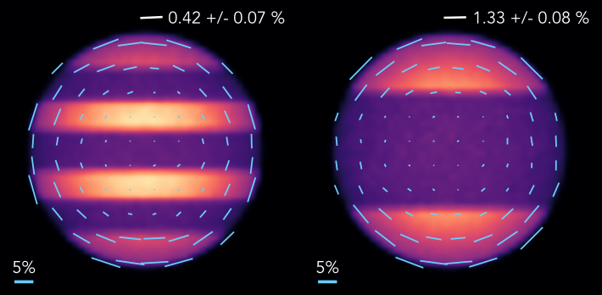

Spectropolarimetry of Brown Dwarfs with WIRC+Pol
Models by Stolker et al. 2017
Max Millar-Blanchaer
Jet Propulsion Laboratory, California Institute of Technology
ExoSoCal Sept. 2018
Copyright 2018 California Institute of Technology

Slide 2
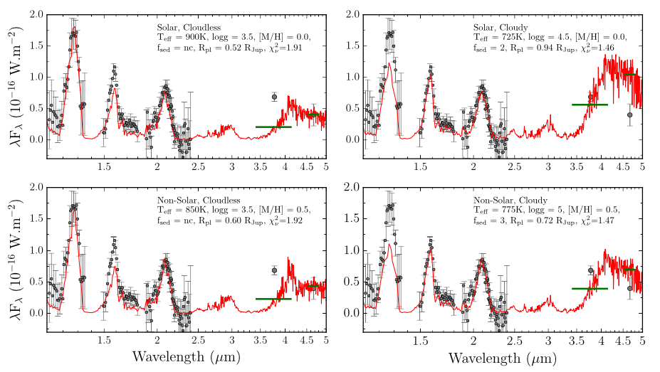
Discrepancies between directly imaged planet spectra and models are attributed to treatments of clouds
Rajan et al. 2017
Notes:
Add controversy from Tremblin.

Slide 3
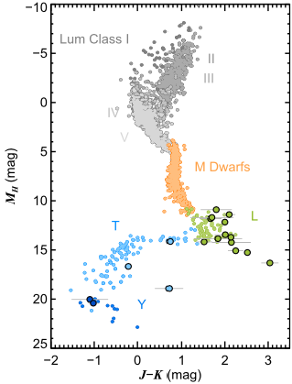
Directly Imaged Planets look a lot like Brown Dwarfs
Gemini Planet Imager Spectra
Credit: J. Rameau
Bowler et al. 2016
Notes:
Slide time: 30s
First, it appears that giant planets have similar luminosities as brown dwarfs, but appear redder in colour.
Here we can see a colour magnitude diagram, with higher mass stars in grey and M-dwarfs in orange.
The three different brown dwarf subclasses L, T and Y, down here. Bold circles here show the directly imaged planets, and you can see that while some of them fall on top of the brown dwarf sequence, there appears to be a general shift to redder colours.

Slide 4
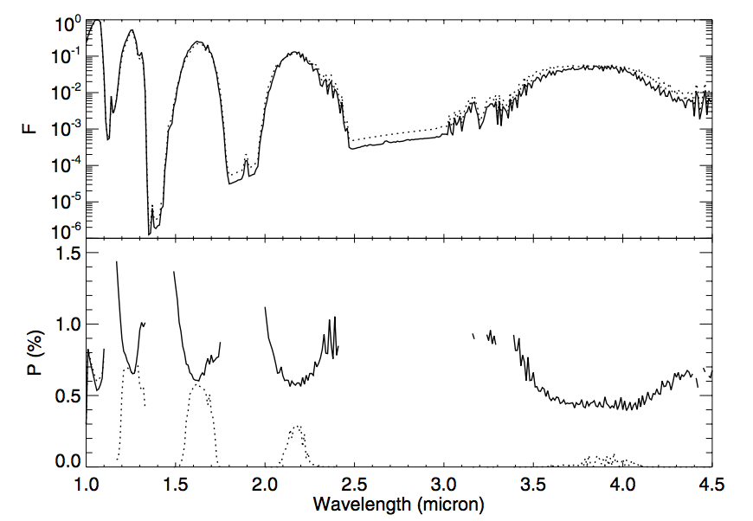
Why polarimetry?
Clouds at top of atmosphere
Lower clouds – 0.015 bar
de Kok et al 2011
Notes:
Add information about cloud properties!

Slide 5
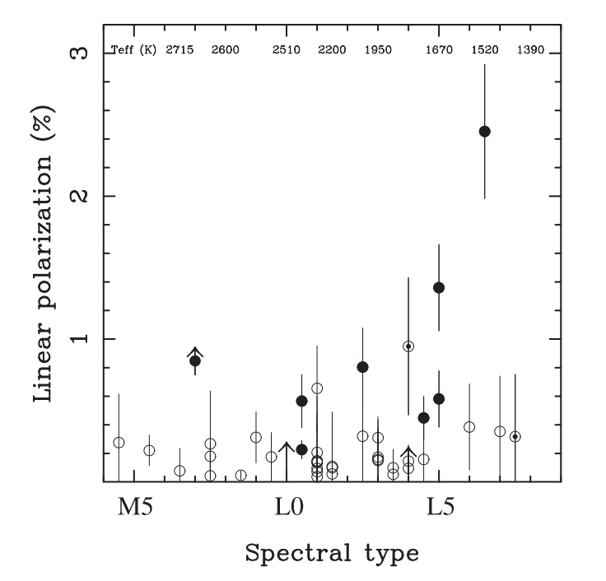
Brown Dwarfs are polarized
Several dozen detections in the visible and NIR
Generally <3% polarized
  Usually < 1% polarized
BUT: broadband measurements are degenerate with cloud height, surface gravity, scattering properties, rotation rate, cloud patchiness etc.
Occurrence Rates:
  L0-L3: ~15% -20%
  L3.5-L8: ~ 40-50%
Zapatero Osorio et al. 2005

Slide 6

The WIRC+Pol Brown Dwarf Survey
A spectropolarimetric survey at Palomar to study the diversity of cloud signatures in BDs
Tinyanont et al. 2018

Slide 7
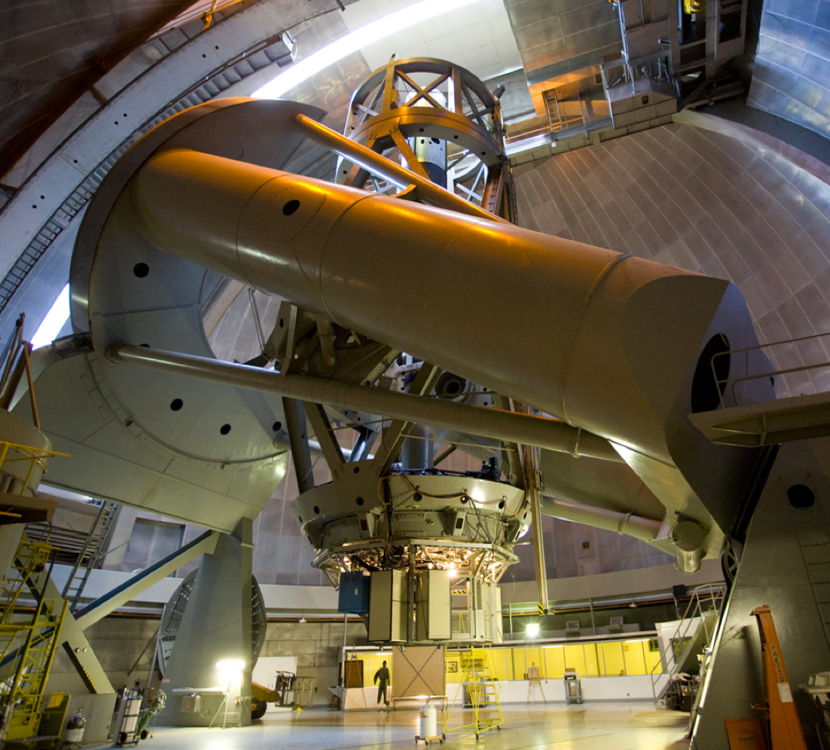
Spectropolarimetry w/ WIRC+Pol
Palomar Hale 5-m equatorial telescope in southern California
J, H-band R~100 slitless spectropolarimetry
4.35’ x 4.35’ FOV
Simultaneous Q and U

Slide 8
Spectropolarimetry with WIRC+Pol
WIRC+Pol’s Spectral Coverage
Clouds at top of atmosphere
Lower clouds – 0.015 bar
de Kok et al 2011
Notes:
Add information about cloud properties!

Slide 9
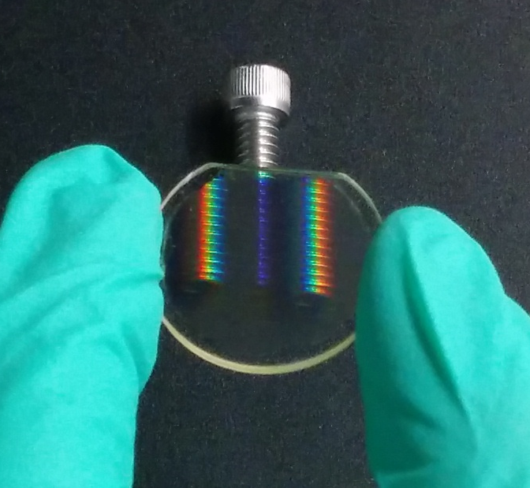
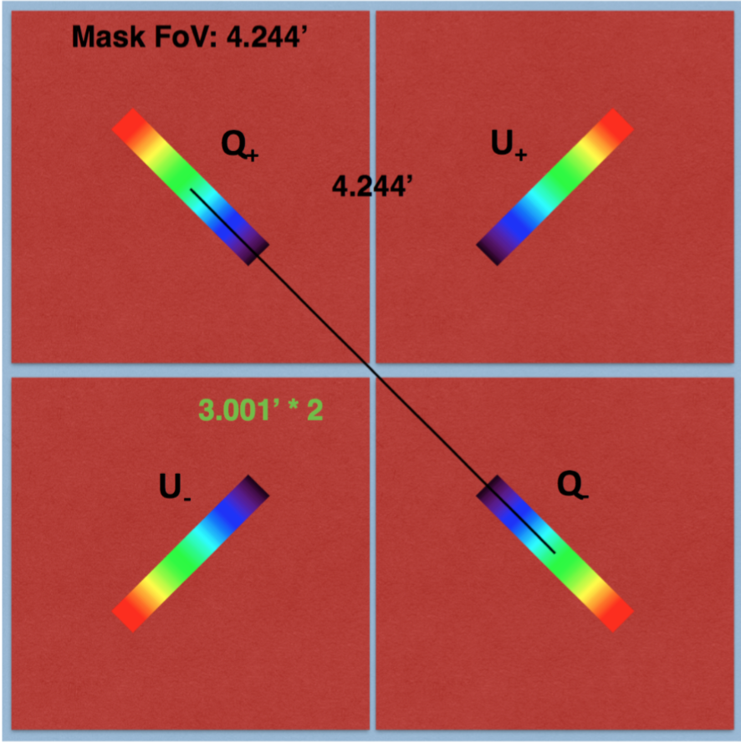
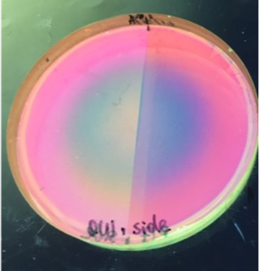
Polarization Gratings
Millar-Blanchaer et al 2016b
Notes:
A polarization grating novel piece of technology I worked with extensively during my PhD.
These devices are thing film optics, made of patterned birefringent liquid crystals, that can act simultaneously as a polarization beam splitter and a spectral dispersing element, making them ideal for spectropolarimetry. Further they can be designed to exhibit a diffraction efficiency greater than 95% across a very broad wavelength range.
Here you can see the grating splits the light of the screw into the first two diffraction orders while at the same time dispersing the light like a standard diffraction grating.
As part of my thesis I designed an in-lab testing setup and a prototype instrument that I took on-sky, to prove the efficacy of these devices.

Slide 10
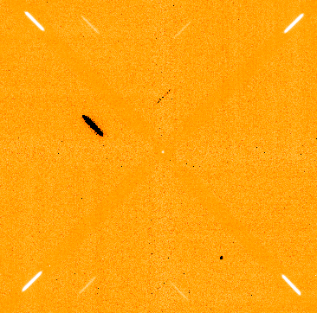
Status
On-Sky Data!
On-sky as of Feb 2017
Commissioning and Science Verification on-going
Approx. 20 BDs observed so far
Current Polarimetry Accuracy of ~1%

Slide 11
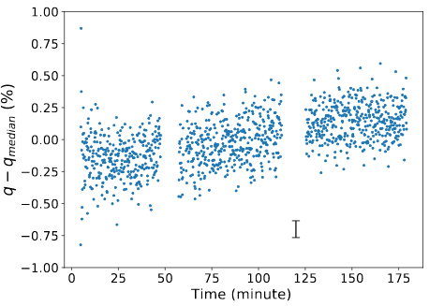
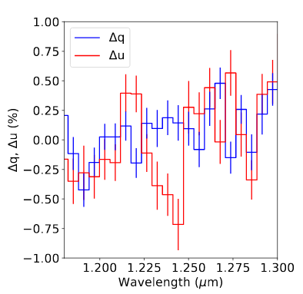
Spatially and temporally varying systematics
Changes of up to ~0.75% between ABAB pointing nods
Drift of ~0.5% over 3 hours on one target
Tinyanont et al., in prep

Slide 12
How can we fix this?
A HWP to modulate the swap of incident polarization!

Slide 13
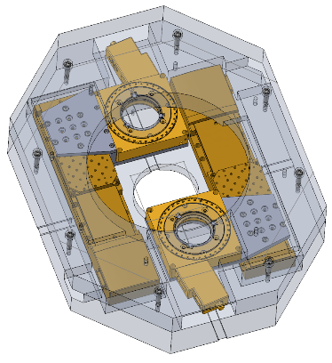
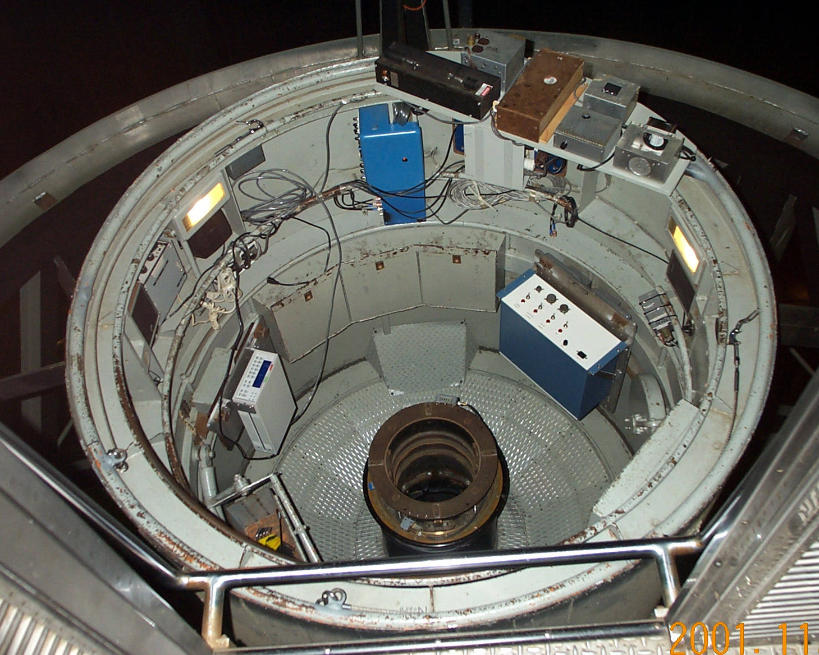
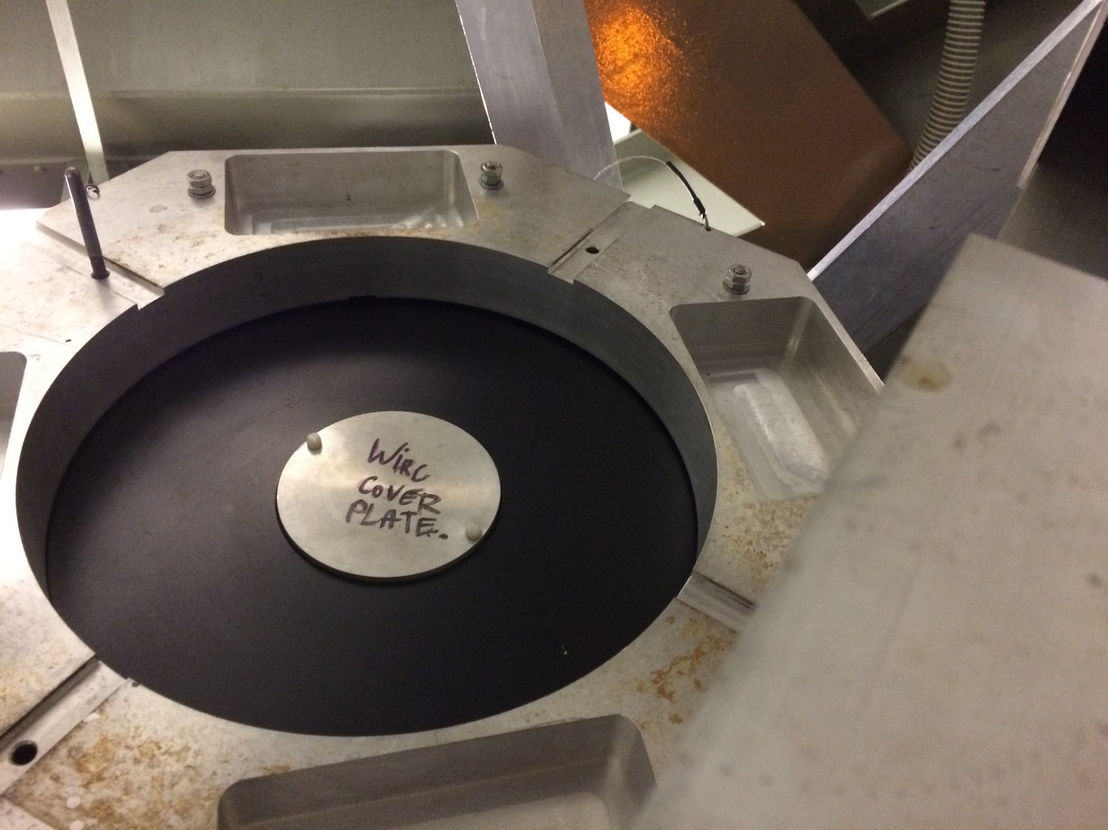
HWP Upgrade Coming Soon
Design by Nem Jovanovic

Slide 14
Conclusions
Spectropolarimetry is a powerful tool for the study of Brown Dwarf (and hopefully one day exoplanet) atmospheres.
We have pirated the WIRC Camera, to upgrade it to a spectropolarimeter
The spectropolarimeter can provide R~100 spectropolarimetry in J and H bands, with an polarimetric accuracy of 1%.
A new HWP upgrade will improve this to at least 0.1%, with goals of 0.01%, allowing us to carry out the brown dwarf survey.

Slide 15
Supplementary Slides

Slide 16
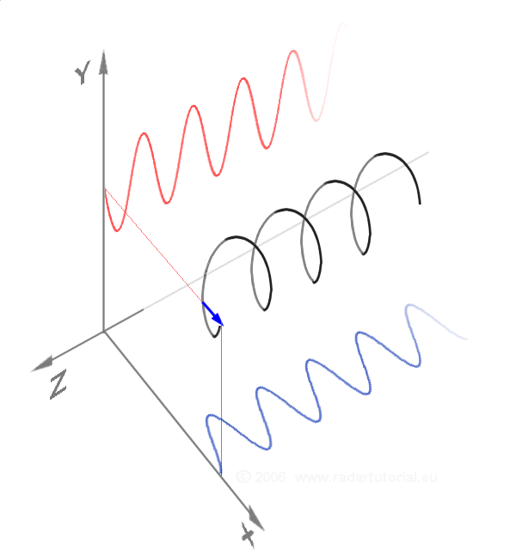

Polarimetry Refresher
Notes:
Scattering animation didn't work.

Slide 17
Polarization = a preferred direction
Q
P =SQRT (Q²+U²)
U
V

Slide 18
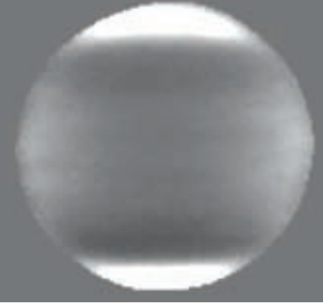
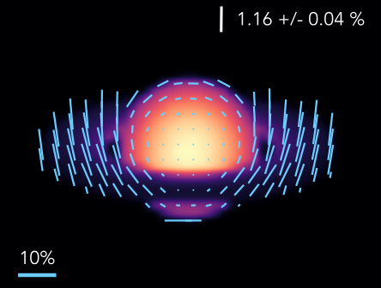
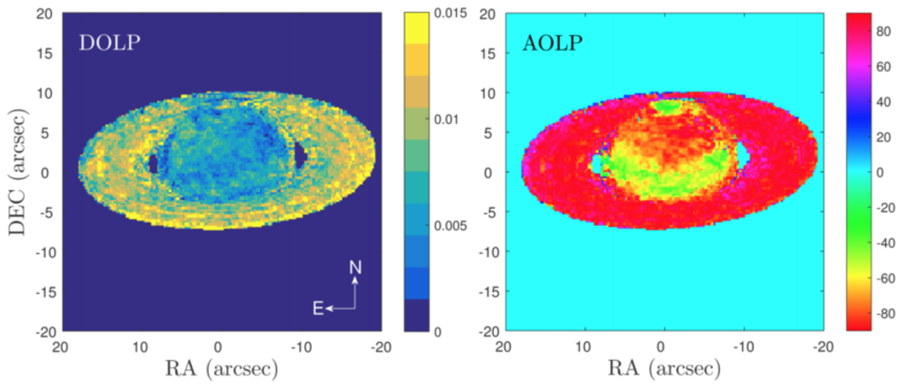
Inhomogeneities in the solar system
Simulated NIR thermal emission from cloud bands and rings:
Polarized Solar System (visible) scattered light observations
Joos et al. 2007
Stolker et al. 2017
Vorobiev et al. 2017

Slide 19
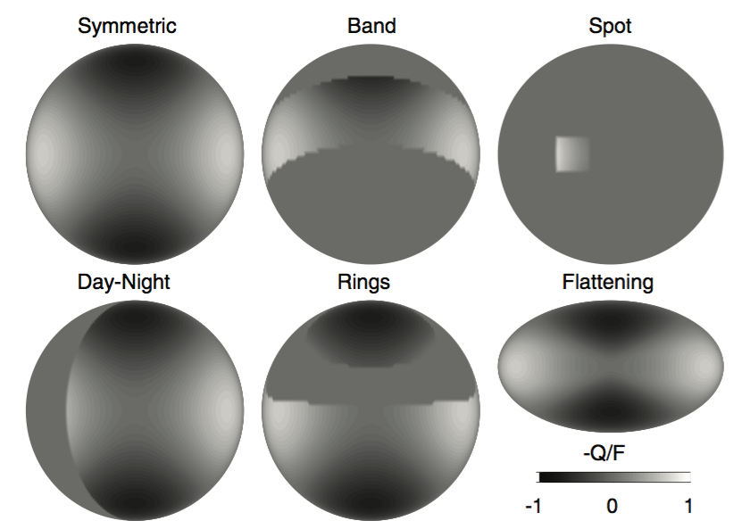
Some sort of asymmetry is needed
De Kok et al. 2011

Slide 20
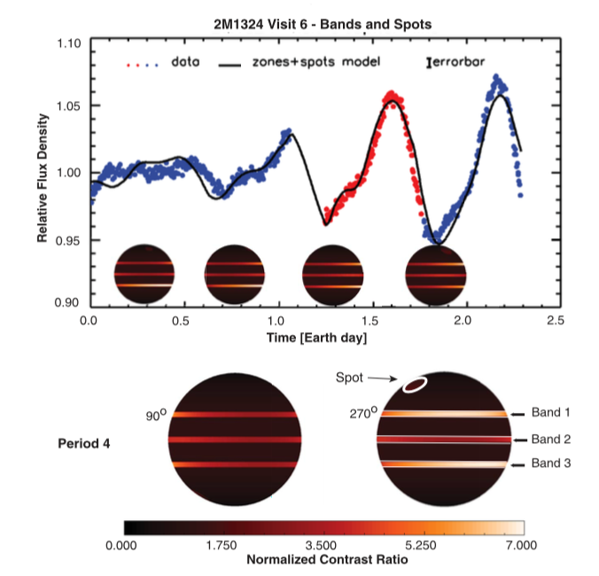
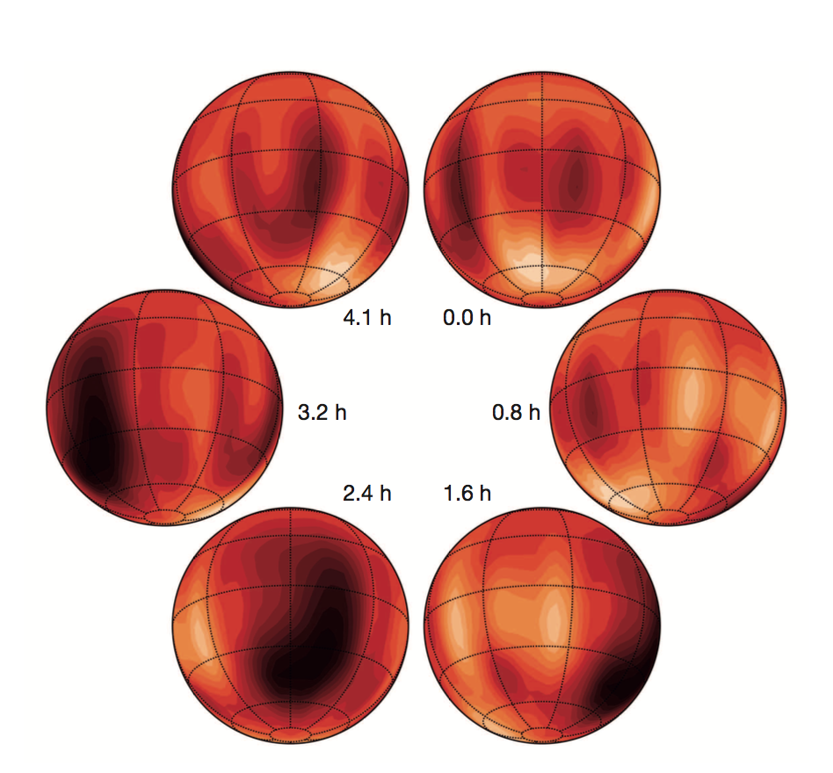
Signs of brown dwarf weather
Luhman 16B: Crossfield et al. 2014 (also Karalidi et al. 2016)
Plus a wealth of variability studies (see Biller et al. 2017 and references therein)
2M2139, 2M1324 & SIMP0136 : Apai et al. 2017

