Slide 1
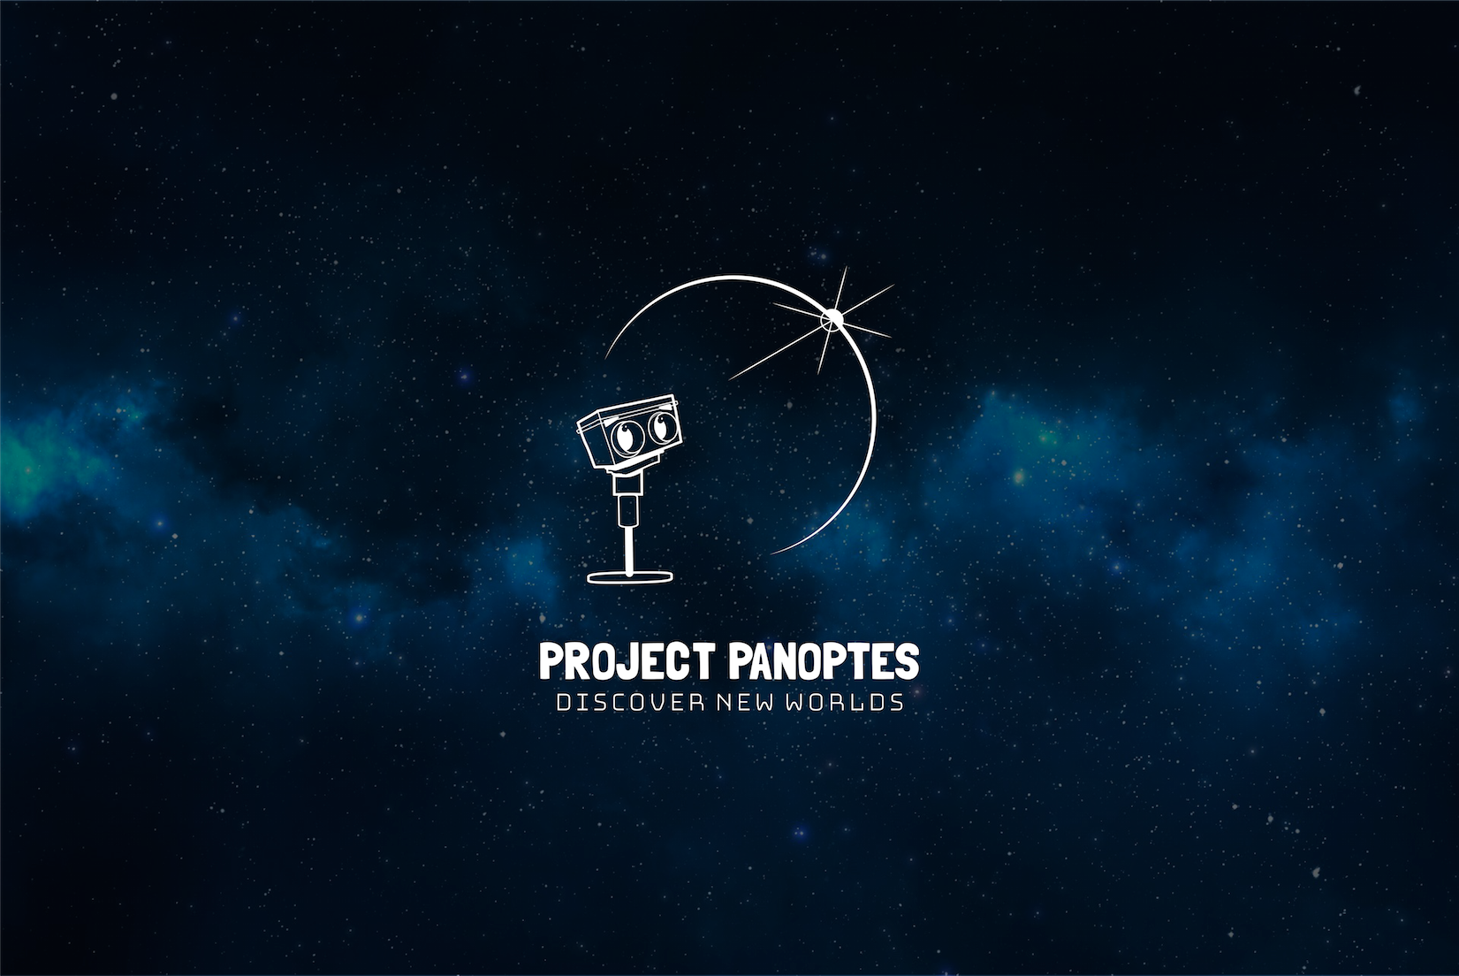
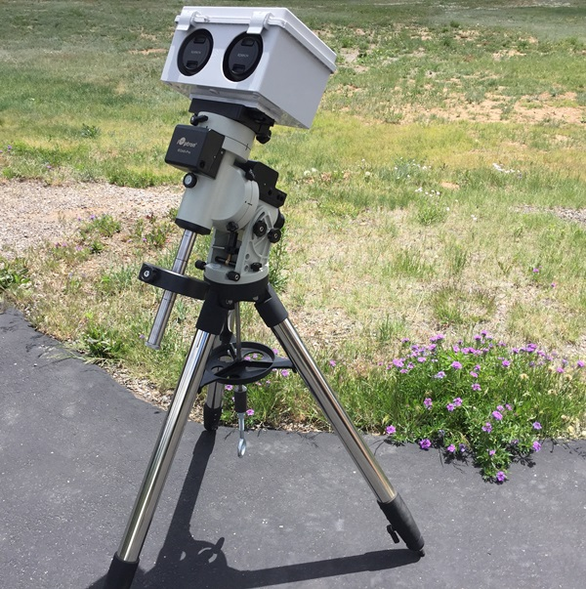
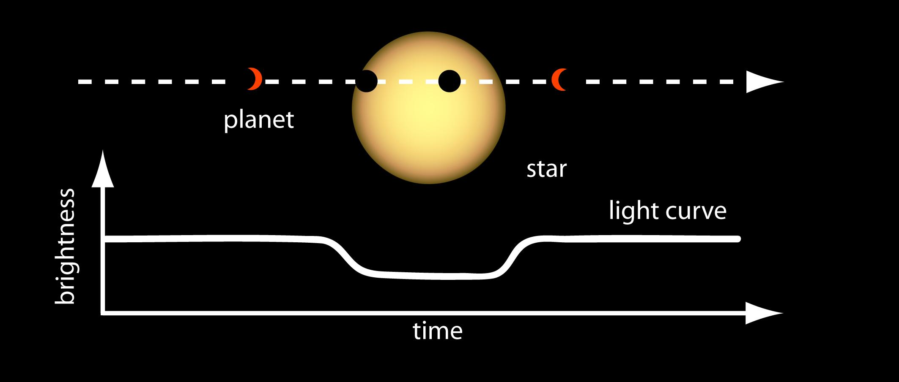
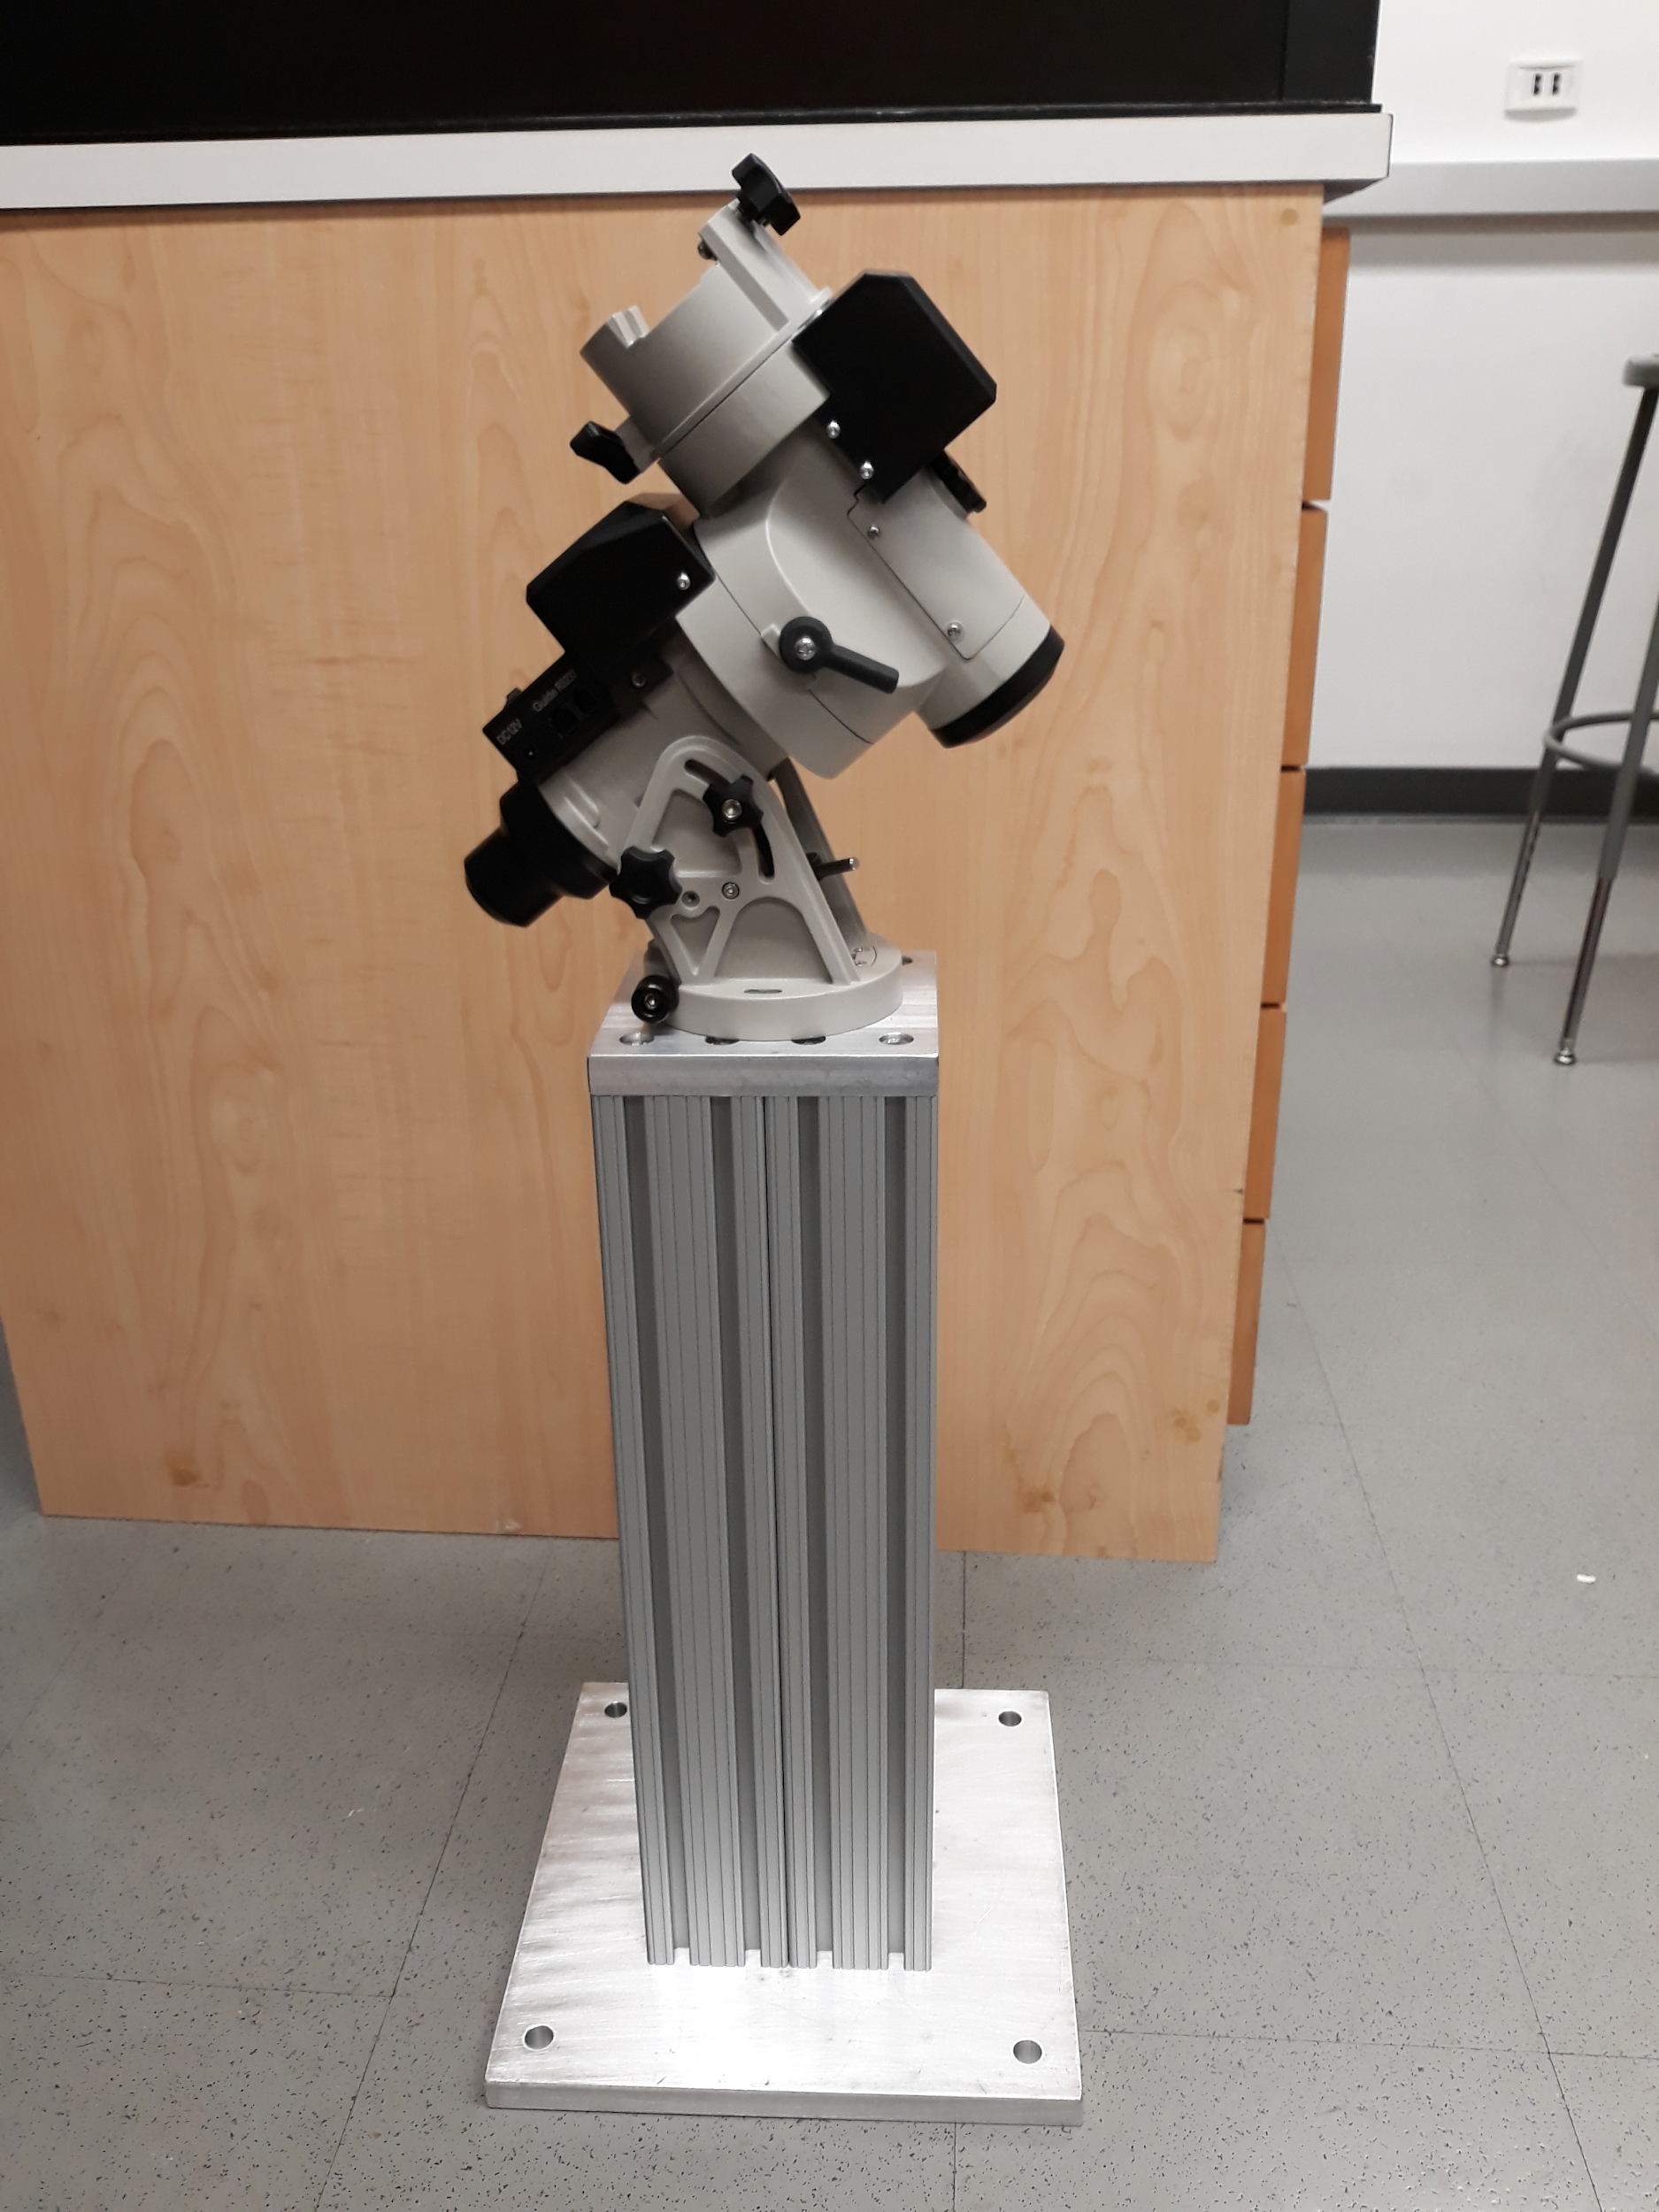
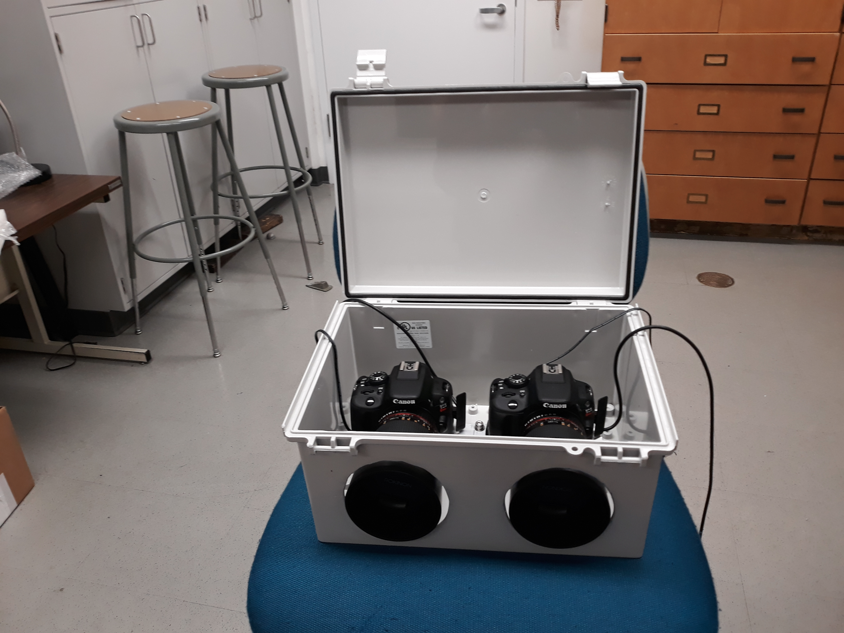
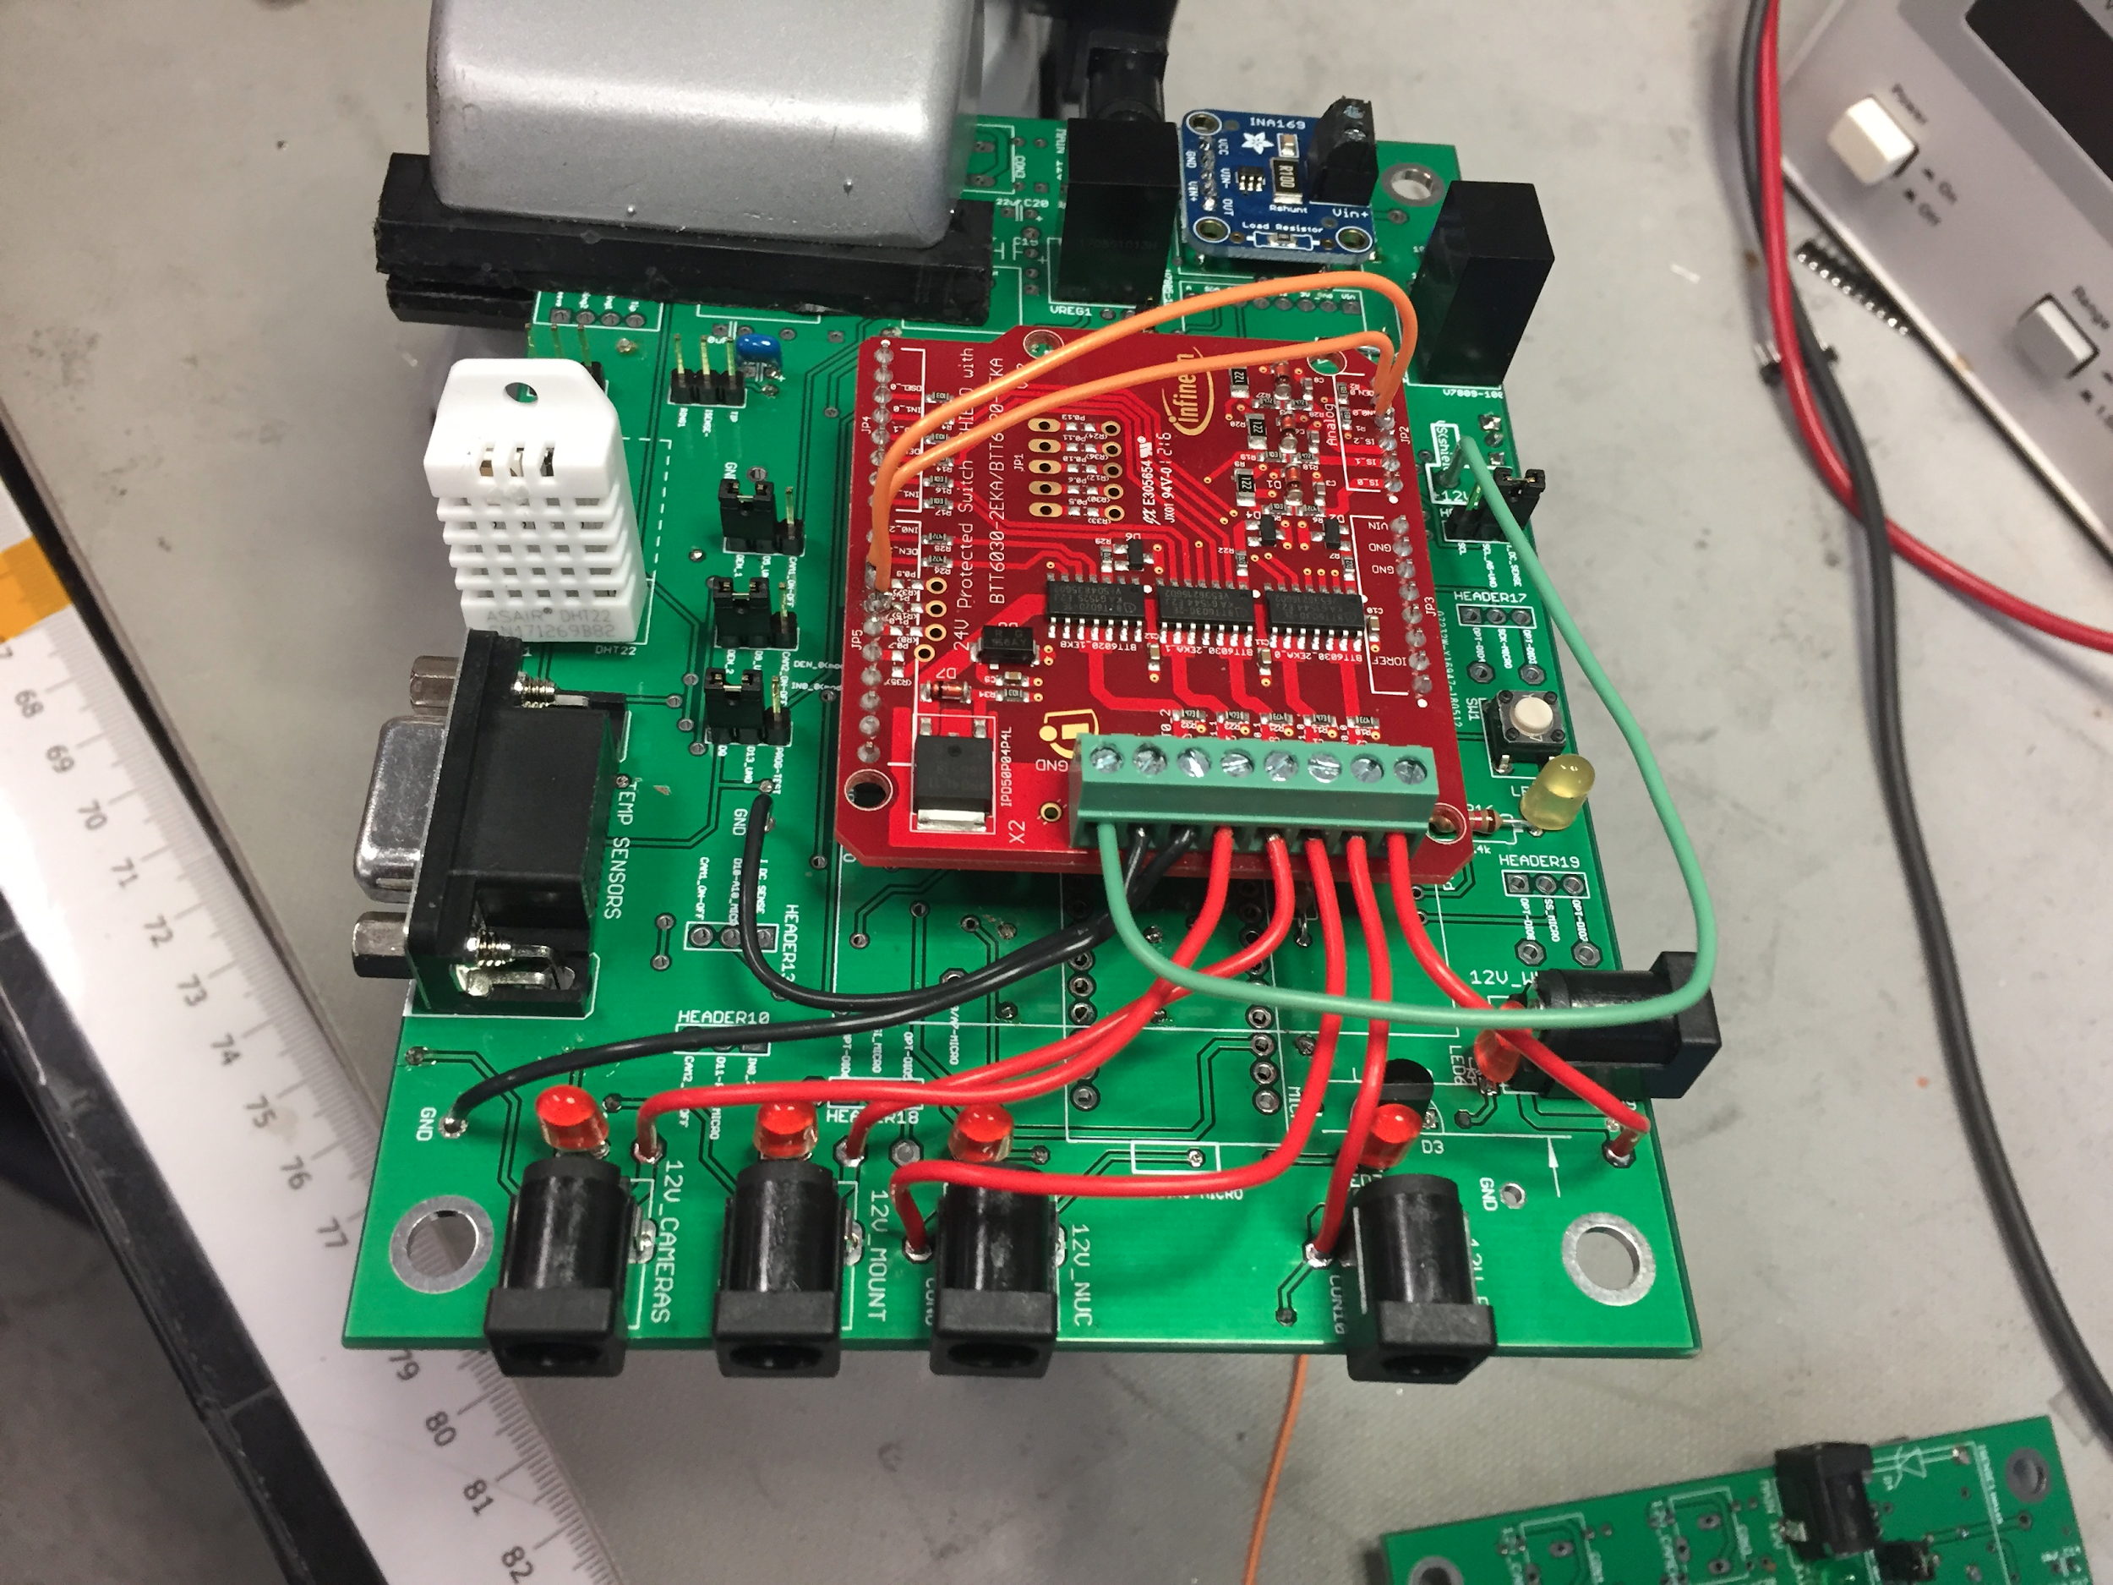
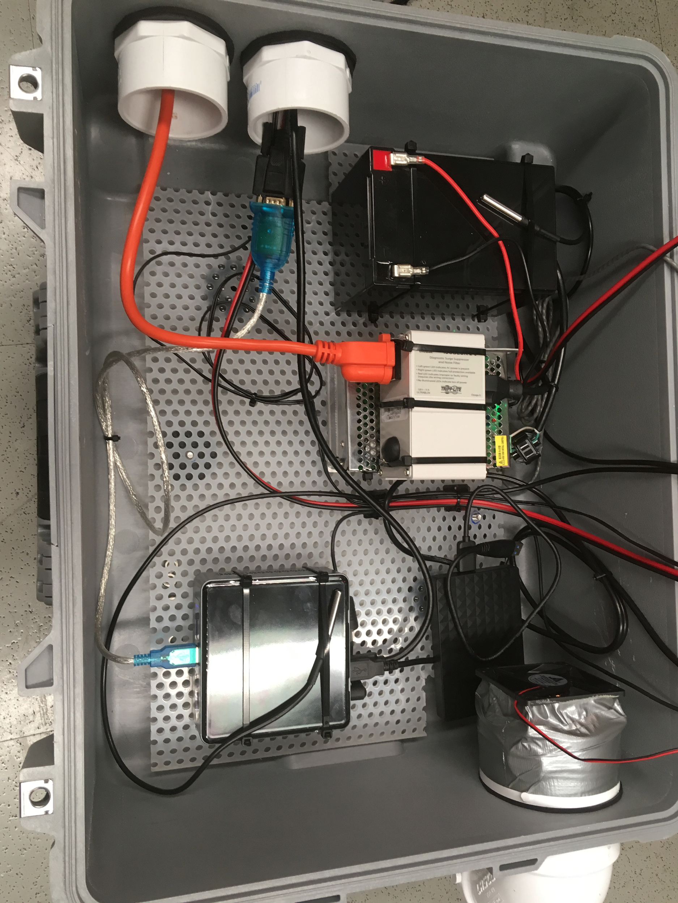
Project PANOPTES: Detecting Transiting Exoplanets with a Low-Cost Robotic Observatory
by A. Ganesh, D. Mawet, G. Ruane, N. Jovanovic, A. Mukherjea, J. Synge, W. Gee, and L. Boucher
Building the unit
Obtain a transit curve
Build a fully functional unit in 10 weeks

Slide 2
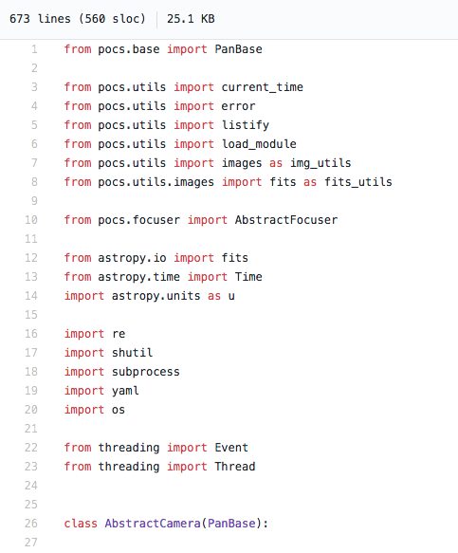
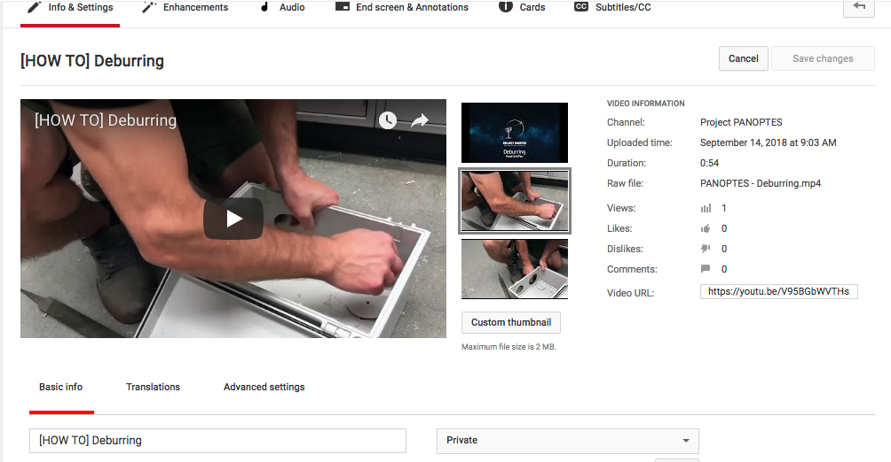
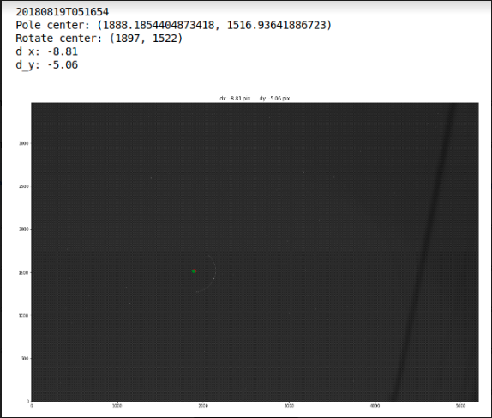
Instructional Videos on Project PANOPTES Youtube Channel
Image Difference from Polar Aligning
Software from Github

Slide 3
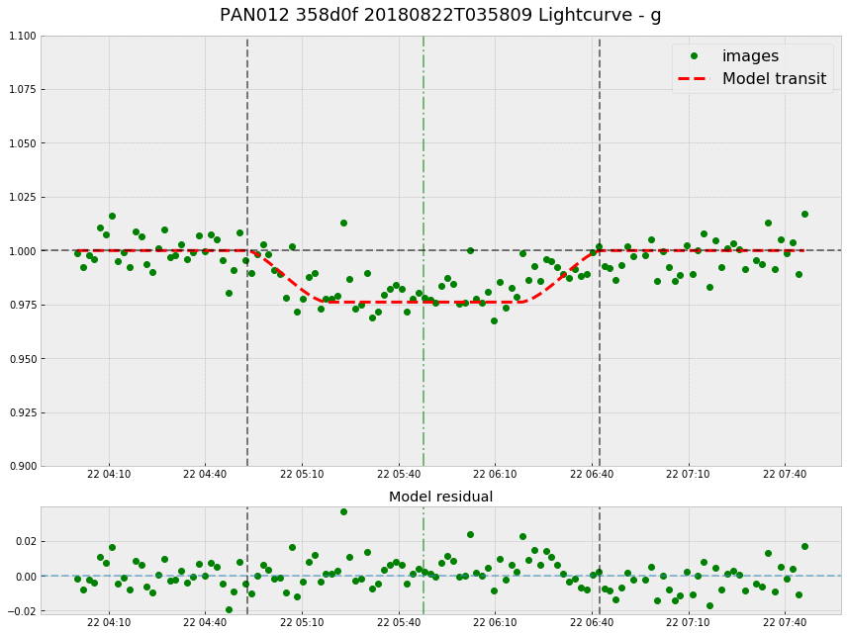
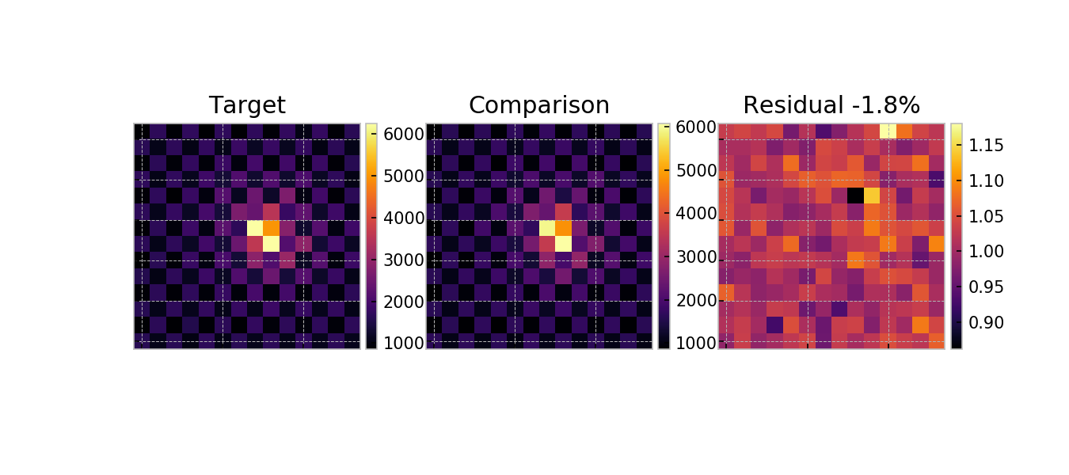
Target star, comparison, and residual showing great accuracy with reference
Successfully obtained a transit curve of HD189733

