Slide 1
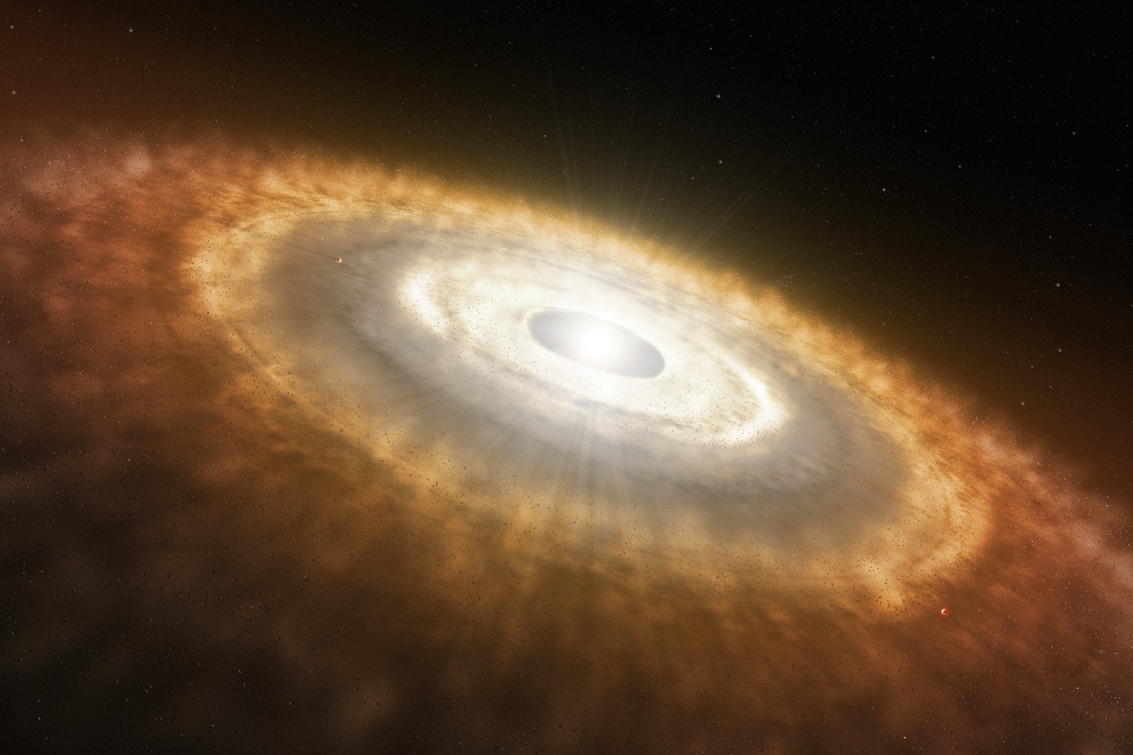

Searching for protoplanets with the Keck/NIRC2 vortex coronagraph
Garreth Ruane
NSF Astronomy and Astrophysics Postdoctoral Fellow
California Institute of Technology
ExSoCal | Sept 12, 2018
Notes:
I am going to tell you about an ongoing imaging survey that seeks to detect planets undergoing formation around stars with protoplanetary disks.

Slide 2
Team, collaborators, and support
Collaborators:
Olivier Absil (U. Liège)
Carlos Alvarez (W.M. Keck Observatory)
Michael Bottom (NASA/JPL)
Élodie Choquet (NASA/JPL)
Valentin Christiaens (U. Chile/U. Liège)
Carlos Gomez Gonzalez (U. Liège)
Greta Guidi (INAF Arcetri)
Elsa Huby (U. Liège)
Rebecca Jensen-Clem (UC Berkeley)
Joel Kastner (RIT)
Dimitri Mawet (Caltech)
Tiffany Meshkat (Caltech/IPAC)
Henry Ngo (NRC-Herzberg)
Maddalena Reggiani (U. Liège)
A J Eldorado Riggs (NASA/JPL)
Eugene Serabyn (NASA/JPL)
Jonathan Williams (IfA, U. Hawaii)
Zhaohuan Zhu (UNLV)
Students:
Nicole Wallack (Caltech)
Wenhao Xuan (Pomona College)
Therese Cook (PHS / UCLA)
Zoe Zawol (PHS / UC Berkeley)
Support:
NSF Astronomy & Astrophysics Fellowship
W.M. Keck Foundation
California Institute of Technology
European Research Council (ERC)
Image credit: Rick Peterson/W.M. Keck Observatory
Notes:
I’d just like to acknowledge up front that this work is made possible by contributions from many of me mateys from across the seven seas. I’m just showing off the spoils.

Slide 3
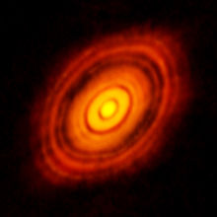
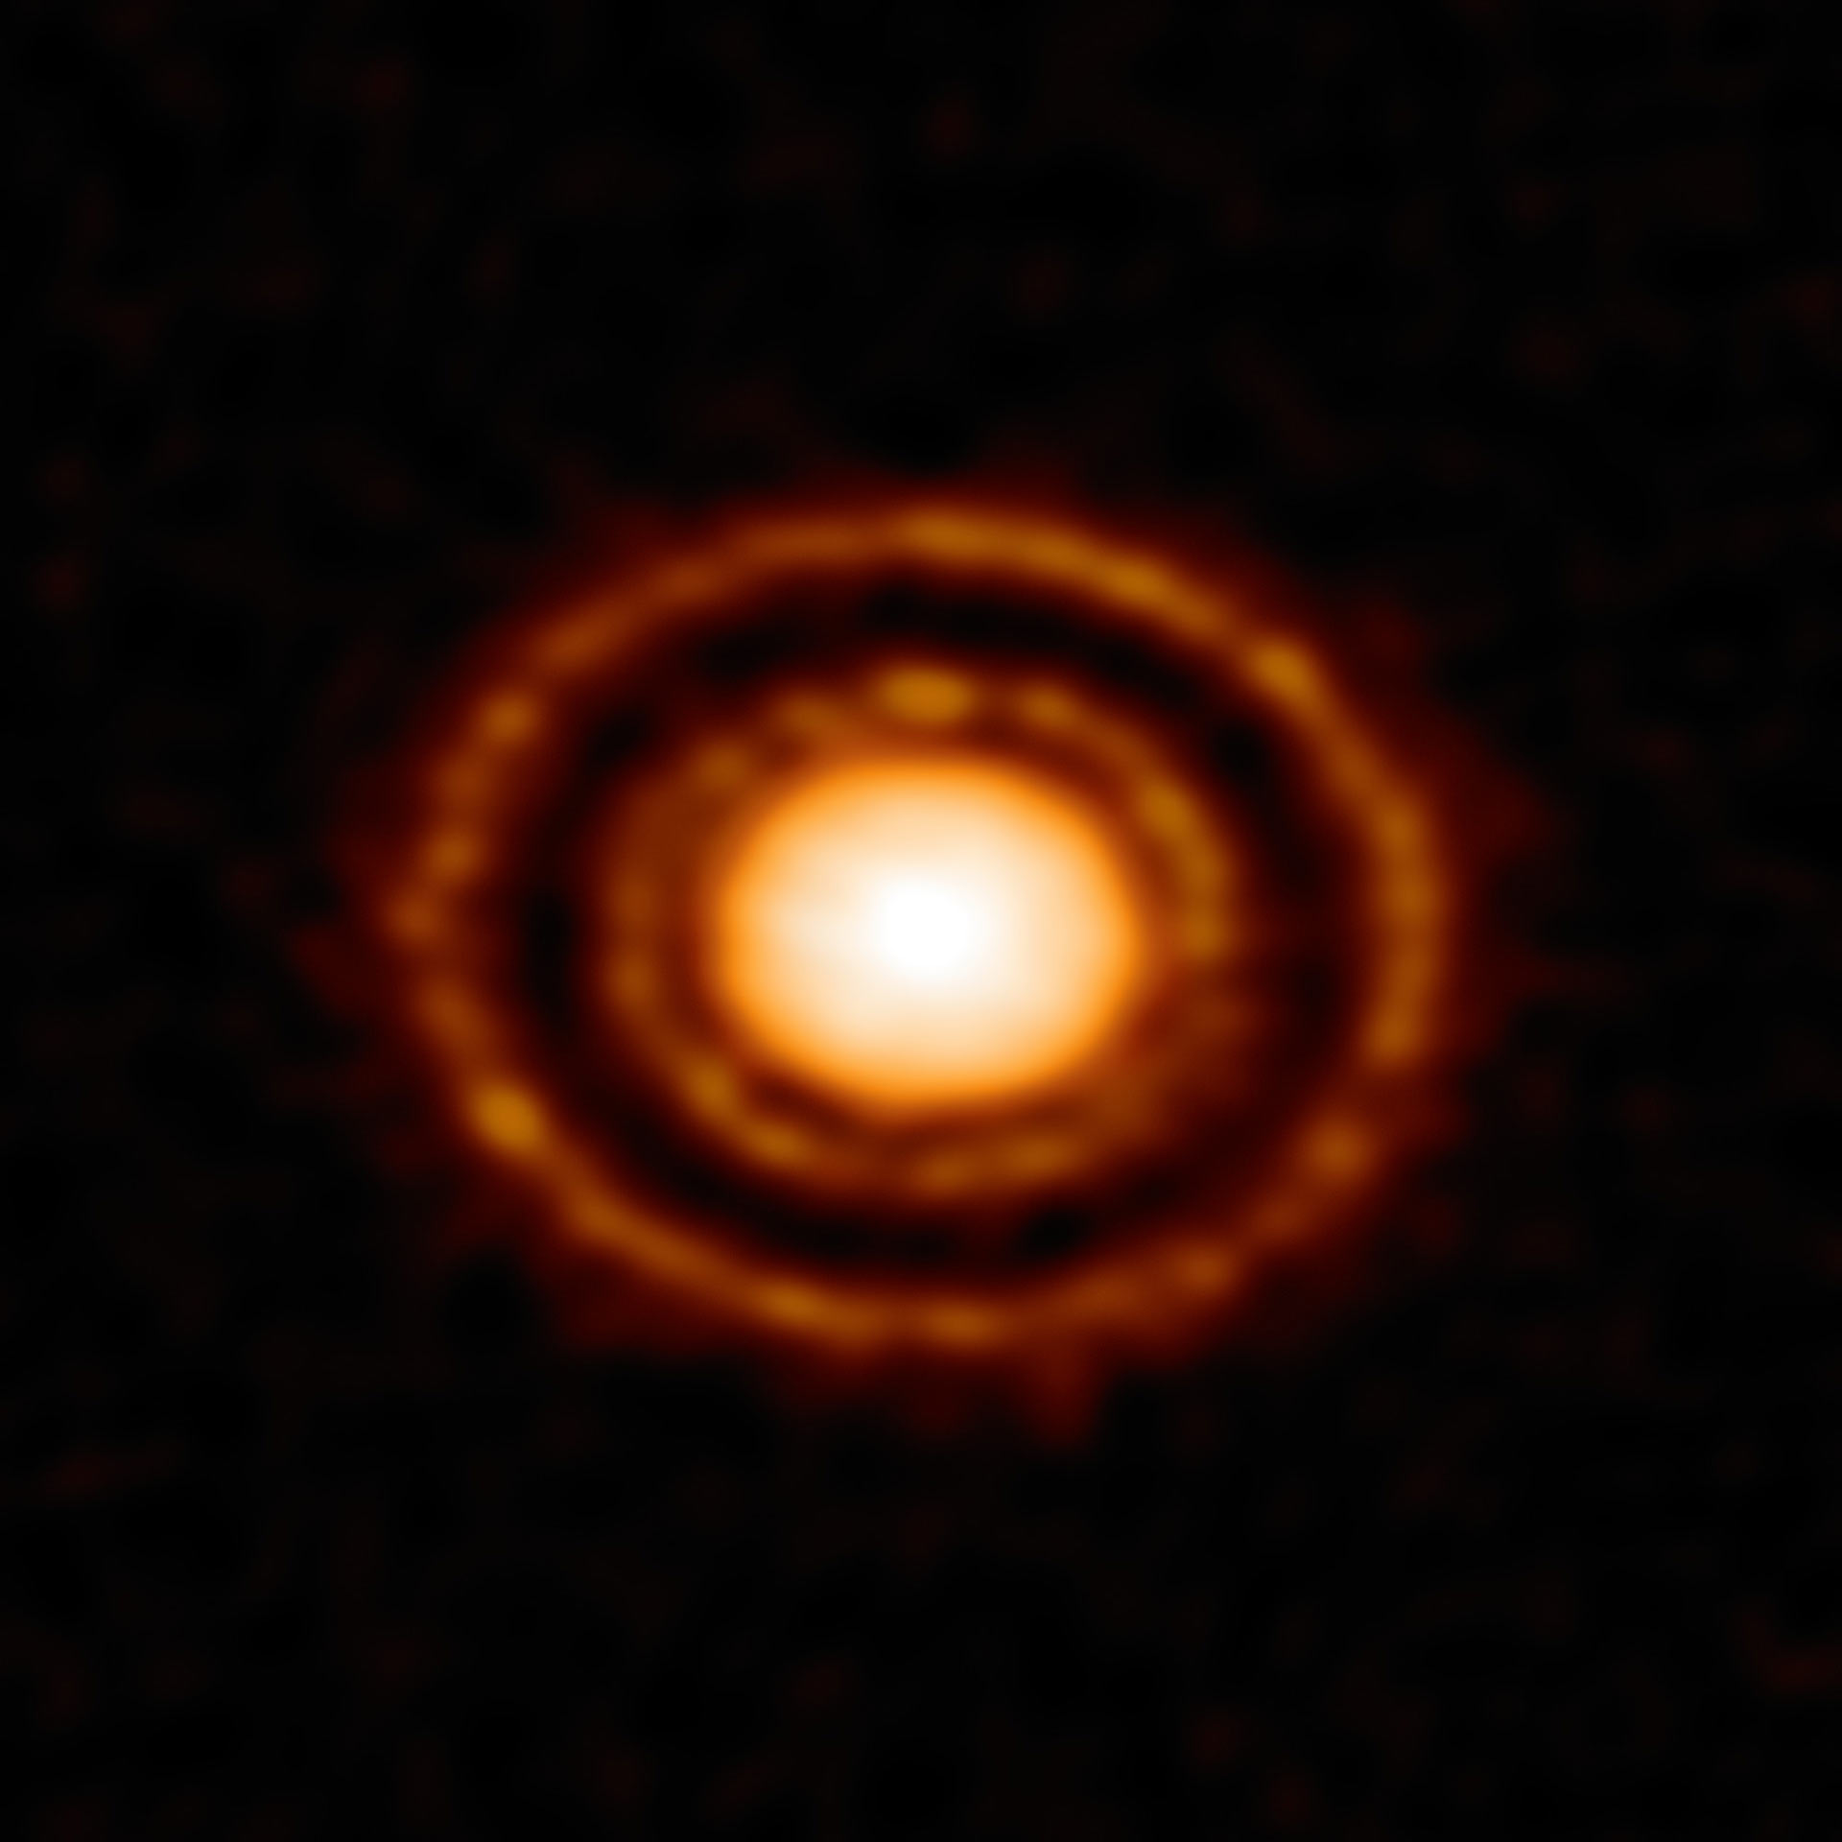
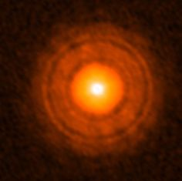
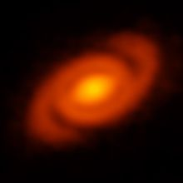
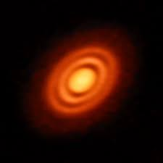
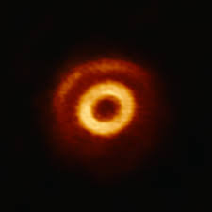
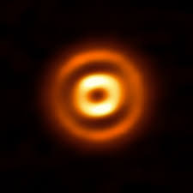
Protoplanetary disks in the eyes of ALMA (mm continuum)
HL Tau
Elias 2-24
AS 209
TW Hya
HD 163296
V1247 Ori
HD 169142
Notes:
High angular resolution observations of protoplanetary disks show a wide diversity of structures. Here is a gallery of submillimeter continuum observations from ALMA, which trace dust in the disk midplane. ALMA has revealed that most, if not all, protoplanetary disks are not smooth and often show bright and dark rings suggesting that these features trace some kind of universal process.

Slide 4
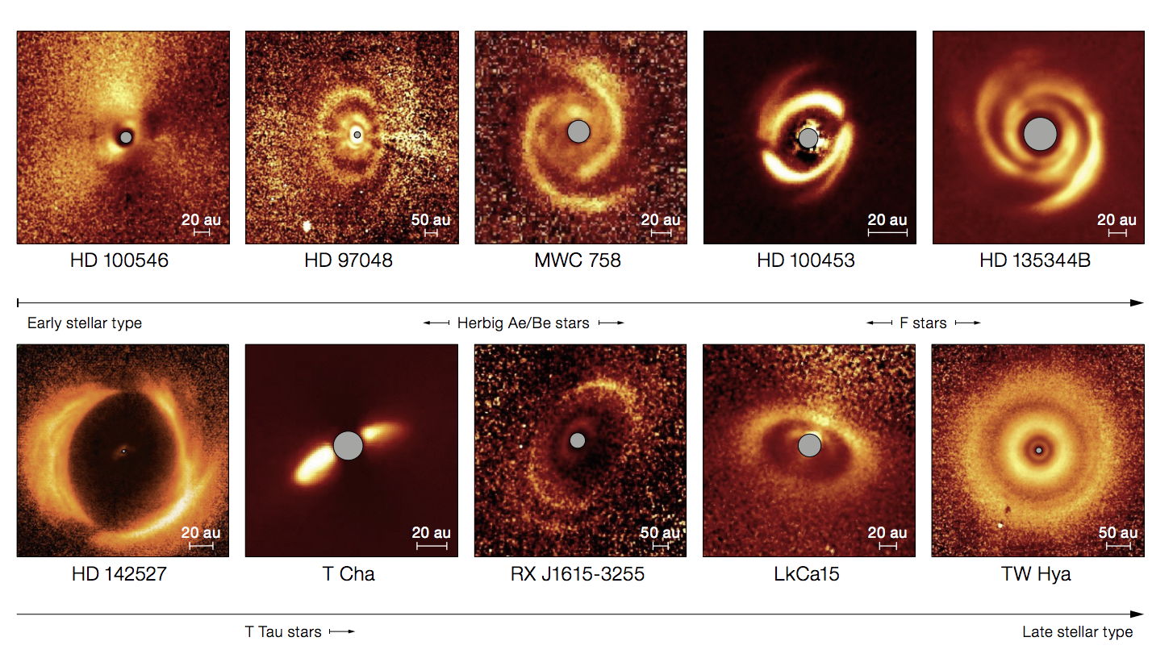
Protoplanetary disks from SPHERE (polarized scattered light)
Garufi+ 2017
Notes:
Scattered light images, such as these from VLT/SPHERE in polarized intensity, trace the micron size dust. We see an even more diverse array of structures, including rings, gaps, and multiple spirals.
There are many possible mechanisms that can produce the features we see in both thermal emission and scattered light. However, most of these features may also be the signature of planet-disk interactions. I assume that this group is also most excited by that explanation.

Slide 5
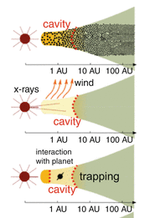
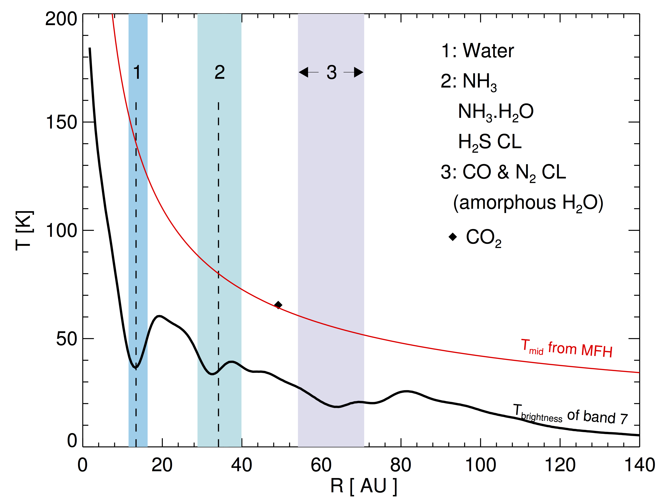
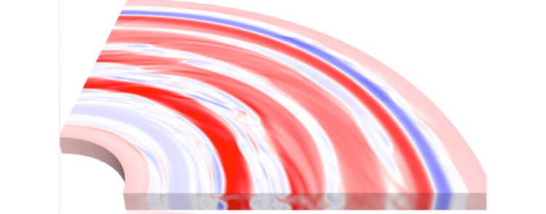
Potential origins of cavities and gaps
Condensation fronts
Zonal flow
Grain growth
Photoevaporation
Companion
van der Marel 2015
Zhang+ 2015
Béthune+ 2018
Notes:
There are many possible mechanisms that can produce such features, including grain growth, photoevaportation, condensation fronts, and zonal flows. However, most of these features may also be the signature of a planet clearing material along its orbit.
grain growth could locally reduce scattered light from small grains.
photoevaporation can clear gas and dust simultaneously from the inside out.
condensation fronts and zonal flows have also been invoked to explain apparent gaps in disks.

Slide 6
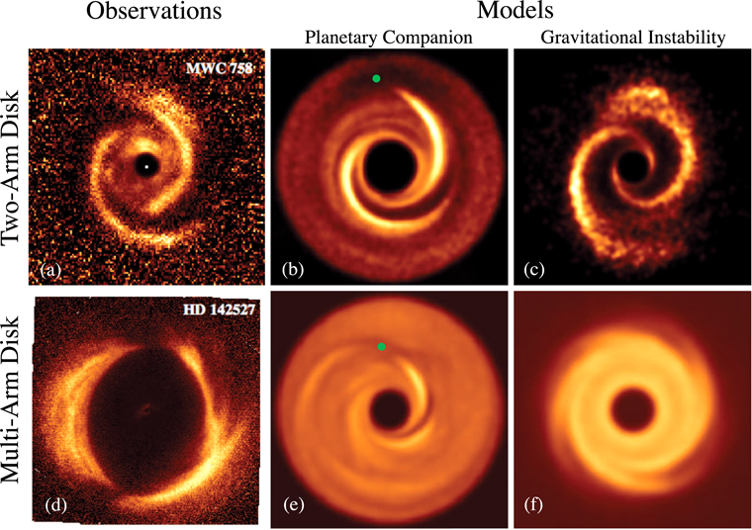
Potential origins of spiral arms
Dong+ 2018
Notes:
Spirals arms have a slightly different set of possible explanations, including illumination effects and gravitational instability. But, again, spirals may also be the signature of planet-disk interactions as demonstrated in these simulations from Ruobing Dong et al.

Slide 7
Are cavities, gaps, and spirals in protoplanetary disks signposts of ongoing planet formation?
Notes:
Therefore, I’d like to focus on a particular question: “Are cavities, gaps, and spirals in protoplanetary disks signposts of ongoing planet formation?”

Slide 8
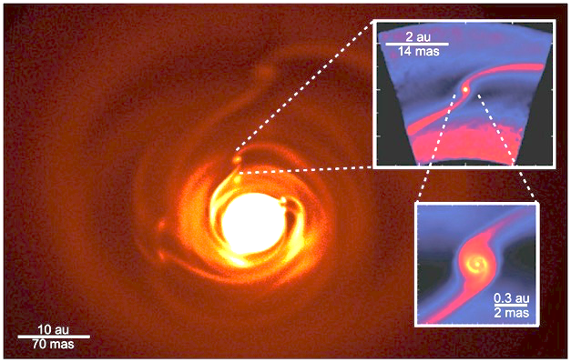
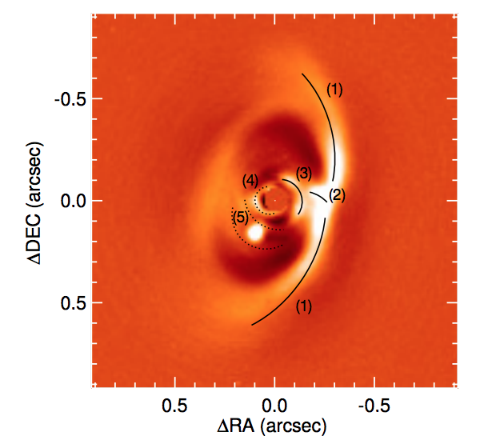
Potential solution: Image the planets
PDS 70 (Keppler+ 2018, Müller+ 2018)
VLT/SPHERE K band image
Thermal emission (10 μm) of a disk with four planets.
Kraus+ 2014; Monnier+ 2016; Simulations by Ayliffe, Bate, Dong, Whitney, and Zhu.
Notes:
One possible way to answer this is to simply catch the planets red-handed. It has long been predicted that we should be able to image the thermal emission from young planets and protoplanets in the infrared. This notion was recently validated by the SPHERE high contrast imager team through their famous detection of PDS 70 b.

Slide 9
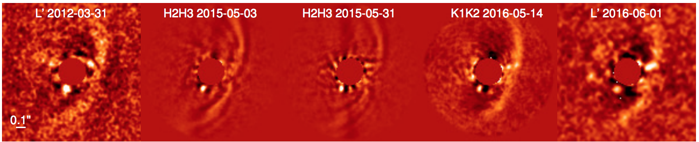
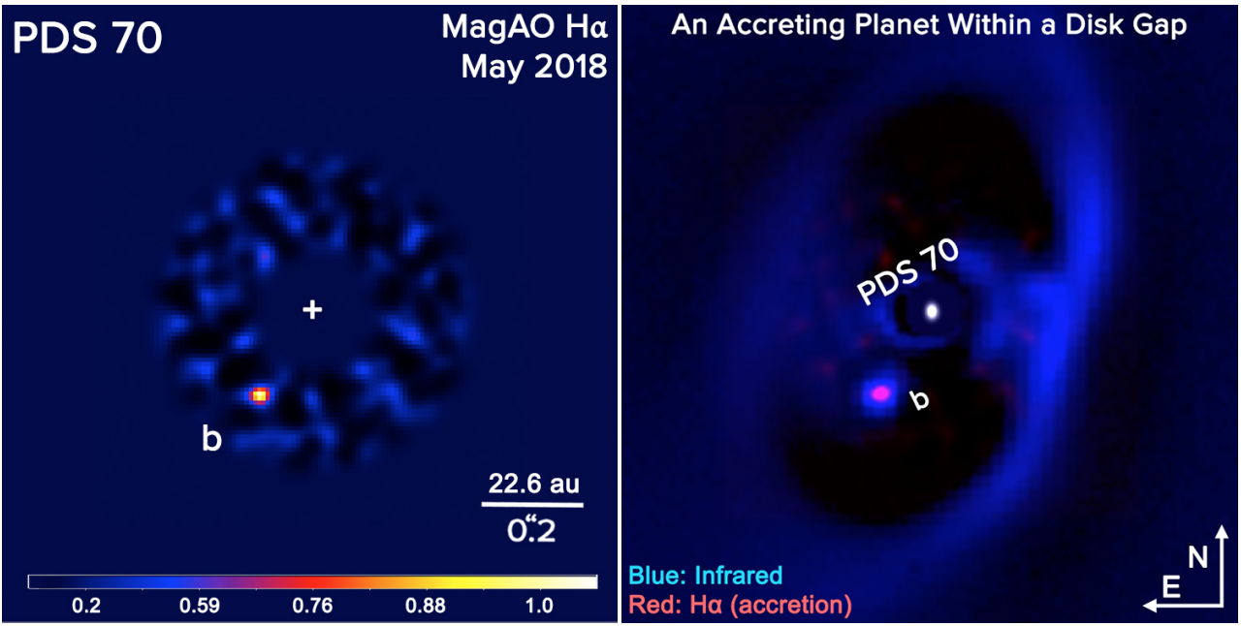
Discovery images of PDS 70 b
Actively accreting protoplanet at 22 au (200 mas)
VLT
ΔL′ = 6.6
ΔH = 9
ΔK = 7.7
ΔL′ = 6.8
MagAO Hα
Keppler+ 2018
Wagner+ 2018

Slide 10
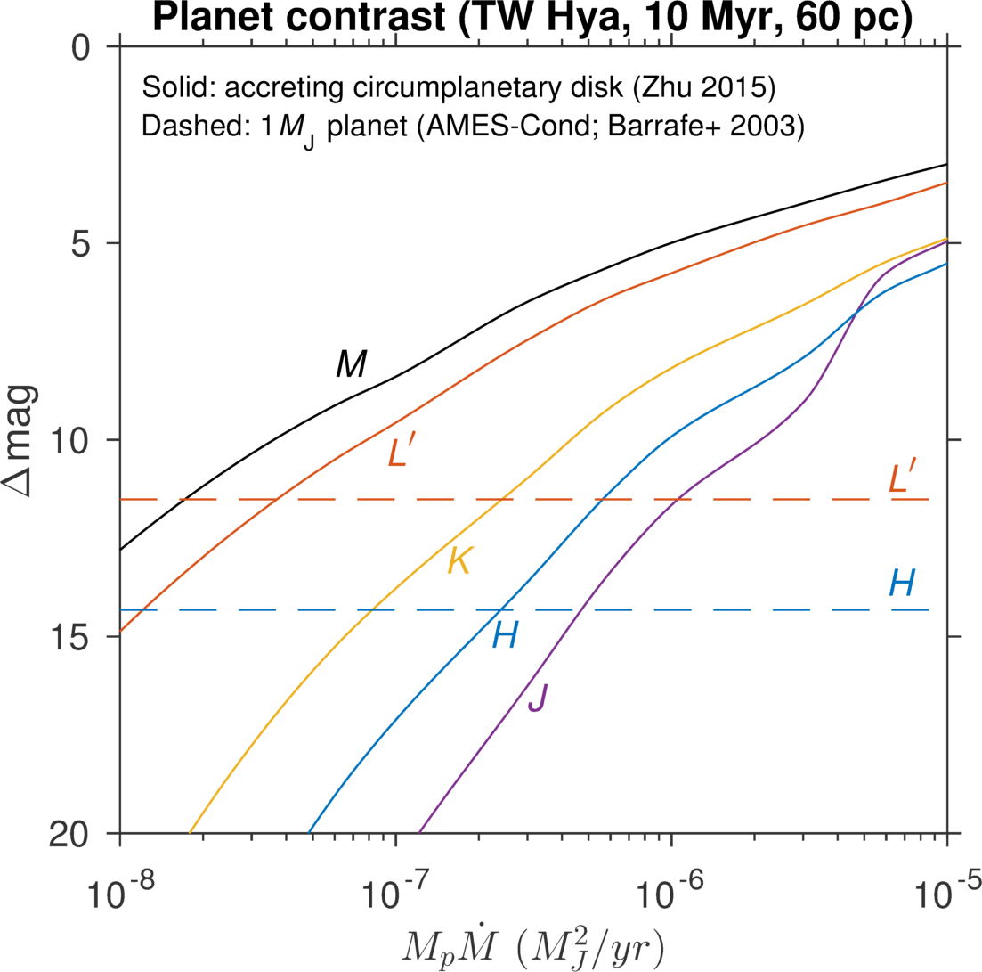
Young planets and protoplanets are very bright in the infrared
1 Jupiter mass based on contraction luminosity
T_{max}~400 K
T_{max}~2300 K
Notes:
How bright? This plot shows the planet contrast in the TW Hya system in delta magnitude.
The dashed lines indicates the contrast of a 1 Jupiter mass planet around 10 Myr old.
The solid lines correspond to the contrast of accreting circumplanetary disks, based on models from Zhu (2015).
The contrast requirement for detecting the thermal emission from the protoplanet is significantly relaxed at longer wavelengths particularly in L’ and M bands, with respect to JHK.

Slide 11
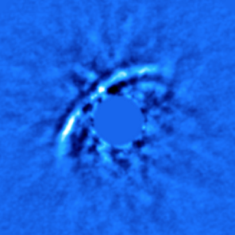
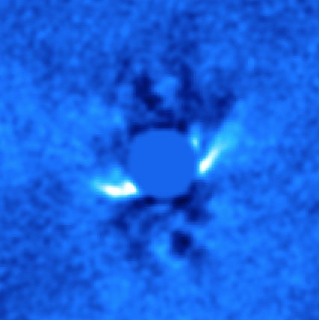
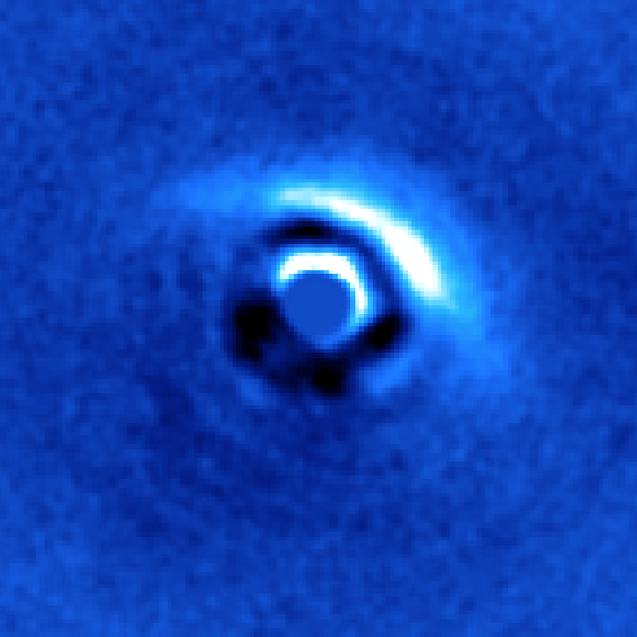
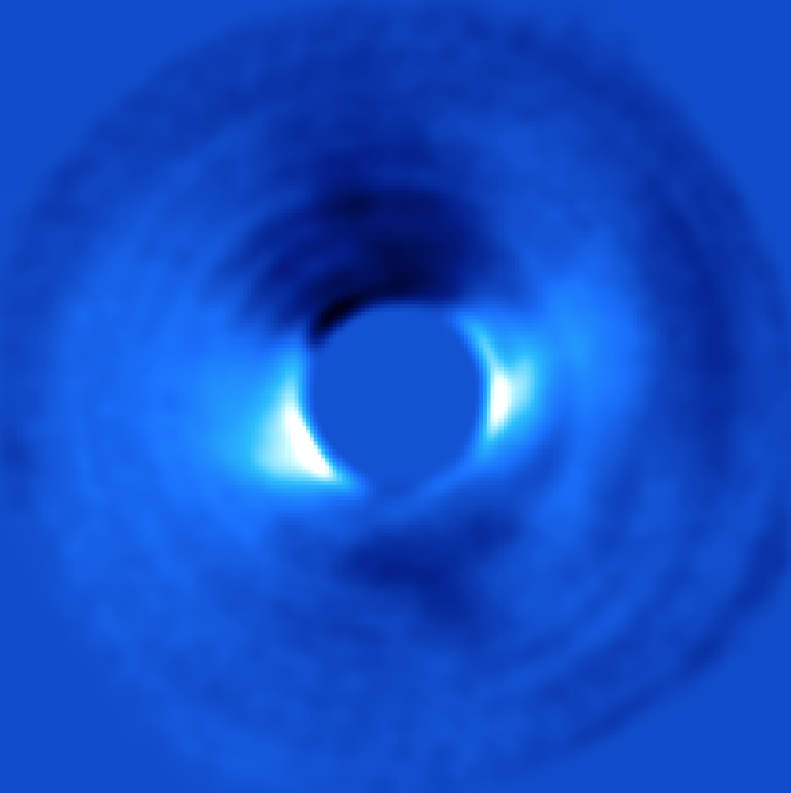
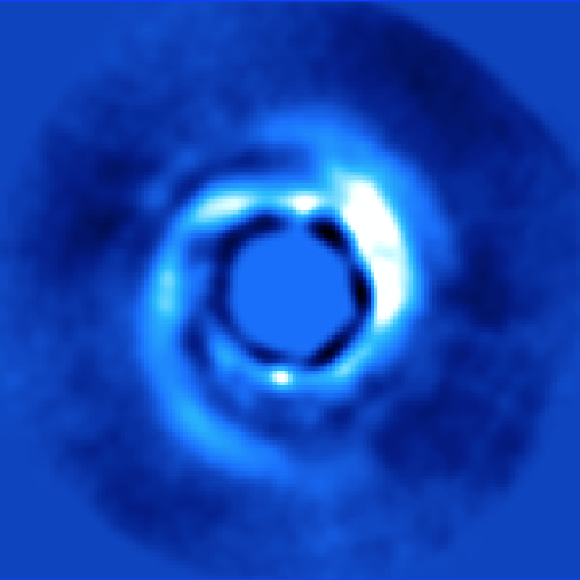
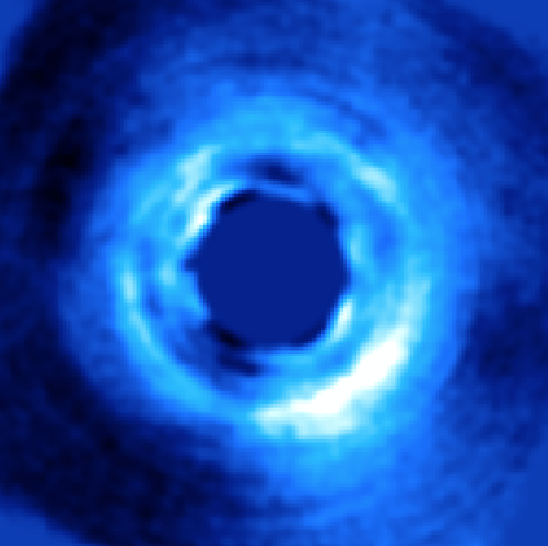
Keck/NIRC2 L′-band survey of protoplanetary disks (PI: Ruane)
Notes:
This is the motivation behind our survey of protoplanetary disk systems with Keck/NIRC2. Over the past two years we have observed about 20 of the most favorable systems with the vortex coronagraph mode and reference star differential imaging to peer as close as possible to the host star in L’ filter (~4 μm). Its not the best wavelength to image disks, but in our search for planets we often end up with disk images in scattered light. But these observations are uniquely sensitive to infant giant planets (or protoplanets) forming in these systems.

Slide 12
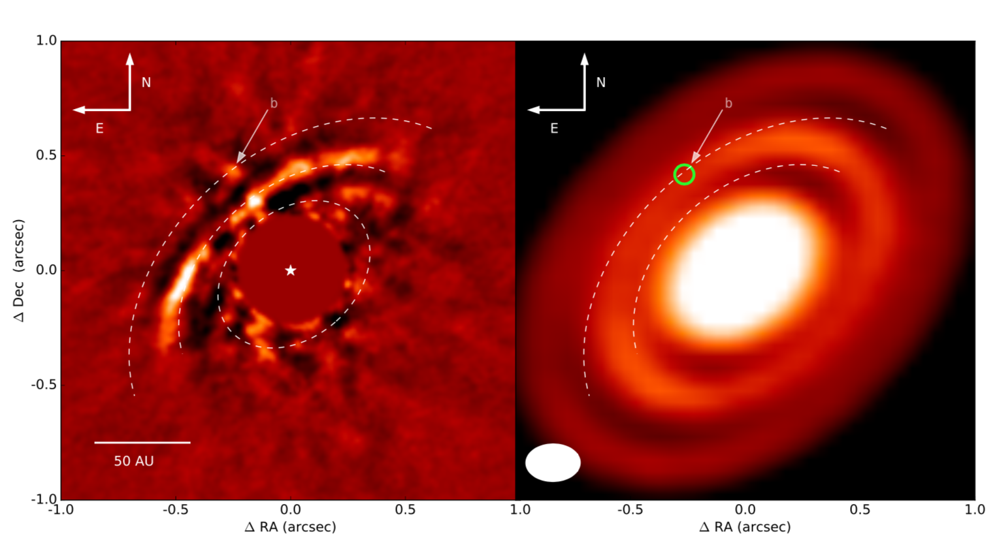
HD 163296 (Guidi, Ruane, et al., 2018)
NIRC2 Image
ALMA Image
HD 163296 (Guidi et al., MNRAS, in press)
Distance: 101±1 pc
Age: 5 Myr
Inclination: 42°
Gaps at 50, 80, and 130 au
HD 163296 (Guidi et al., MNRAS, in press)
Distance: 101±1 pc
Age: 5 Myr
Inclination: 42°
Gaps at 50, 80, and 130 au
We detect a point-like source (∆L′ = 11) at a separation of 0.5″ in the NE direction, close to the inner edge of the second gap in the mm images. Assuming the object is non-accreting planet, we obtain a mass of 6-7 M_{J}. If the detected emission originates from a 0.46 M_{J} protoplanet, which may be responsible for clearing the second gap (Liu et al., 2018), it is currently accreting at a rate of 1.3×10⁻⁶ M_{J}/yr. We also set upper limits for the masses of giant planets of 8-15 M_{J}, 4.5-6.5 M_{J}, and 2.5-4.0 M_{J} at the locations of the three gaps.
We detect a point-like source (∆L′ = 11) at a separation of 0.5″ in the NE direction, close to the inner edge of the second gap in the mm images. Assuming the object is non-accreting planet, we obtain a mass of 6-7 M_{J}. If the detected emission originates from a 0.46 M_{J} protoplanet, which may be responsible for clearing the second gap (Liu et al., 2018), it is currently accreting at a rate of 1.3×10⁻⁶ M_{J}/yr. We also set upper limits for the masses of giant planets of 8-15 M_{J}, 4.5-6.5 M_{J}, and 2.5-4.0 M_{J} at the locations of the three gaps.
Notes:
Distance: 101±1 pc
Age: 5 Myr
Inclination: 42°
Gaps at 50, 80, and 130 au
We detect a point-like source (∆L′ = 11) at a separation of 0.5″ in the NE direction, close to the inner edge of the second gap in the mm images. Assuming the object is non-accreting planet, we obtain a mass of 6-7 M_{J}. If the detected emission originates from a 0.46 M_{J} protoplanet, which may be responsible for clearing the second gap (Liu et al., 2018), it is currently accreting at a rate of 1.3×10⁻⁶ M_{J}/yr. We also set upper limits for the masses of giant planets of 8-15 M_{J}, 4.5-6.5 M_{J}, and 2.5-4.0 M_{J} at the locations of the three gaps.

Slide 13
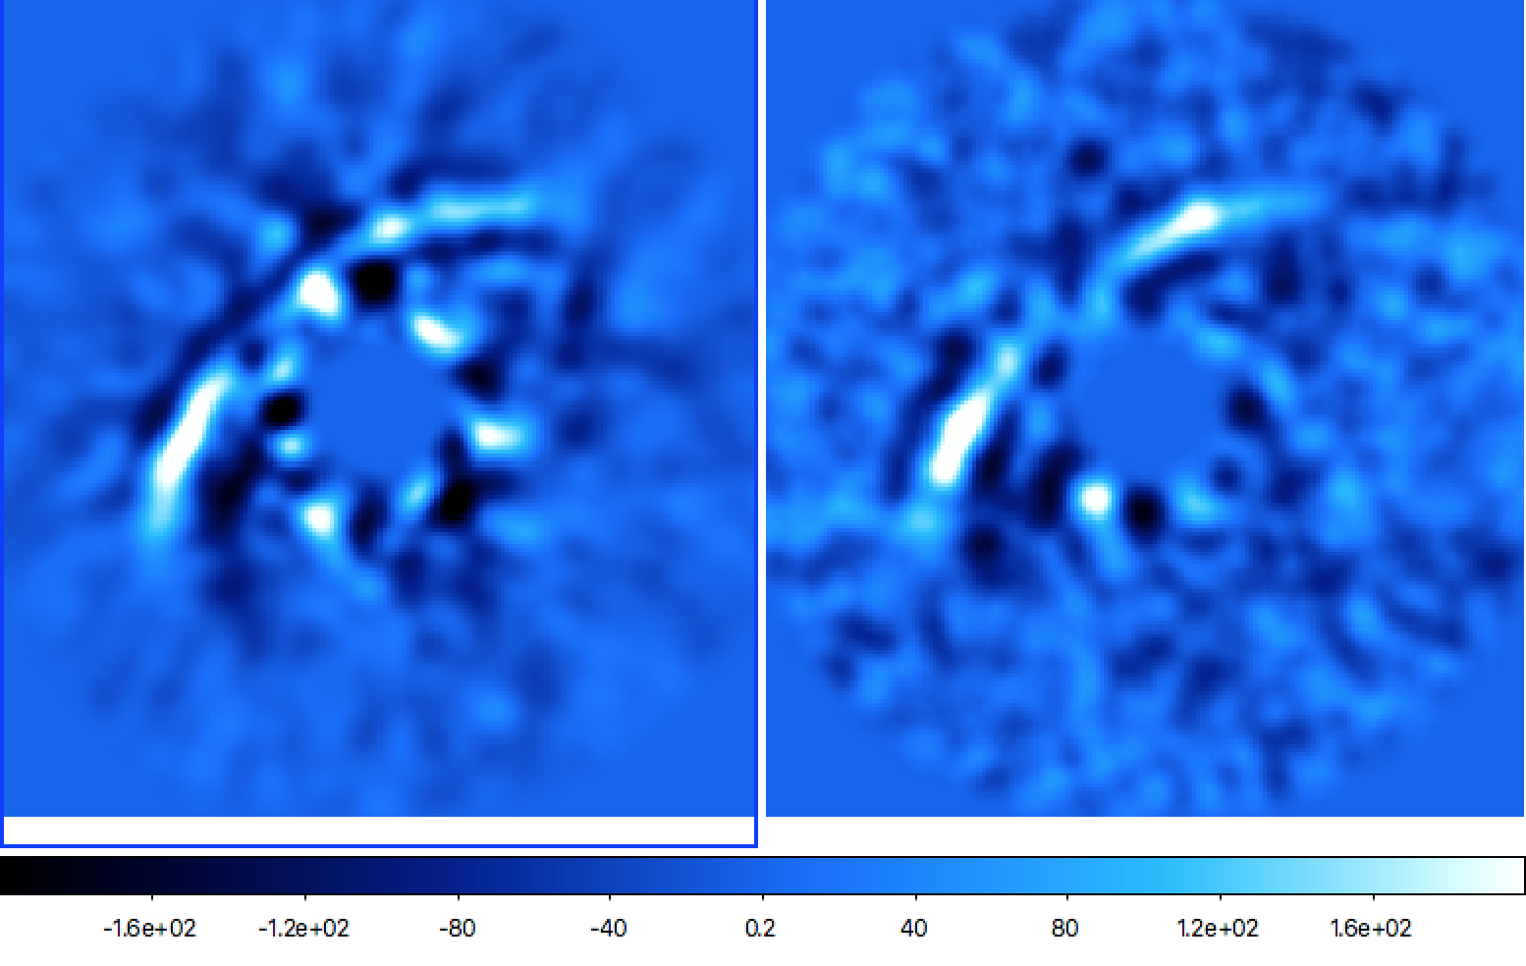

HD 163296: Follow up observations at M_{s} band (λ = 5 μm)
L′ band
M_{s} band
N
E

Slide 14
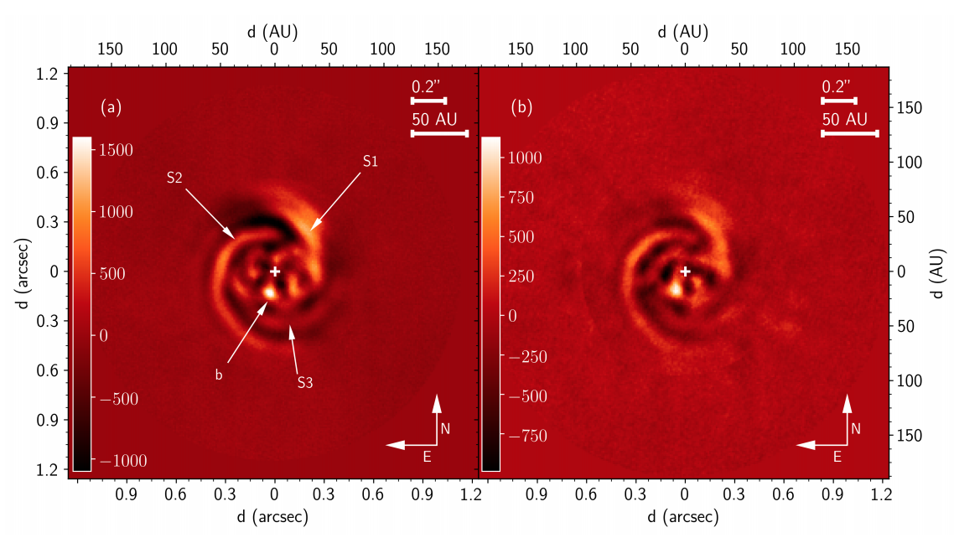

MWC 758 (Reggiani et al., 2017)
NIRC2 (24 Oct 2015)
NIRC2 (24 Oct 2016)
Notes:
Distance: 151±9 pc
Age: 3.5 Myr
Inclination: 21°
Three spirals
We detect a bright (∆L′ = 7) point-like source, south of MWC 758 at a separation of 20 au. The source is consistent with a 0.5 M_{J} planet accreting at a rate of 4×10⁻⁵ M_{J}/yr. No additional companions were detected in the system down to 5 M_{J} beyond 0.6″ from the star.

Slide 15
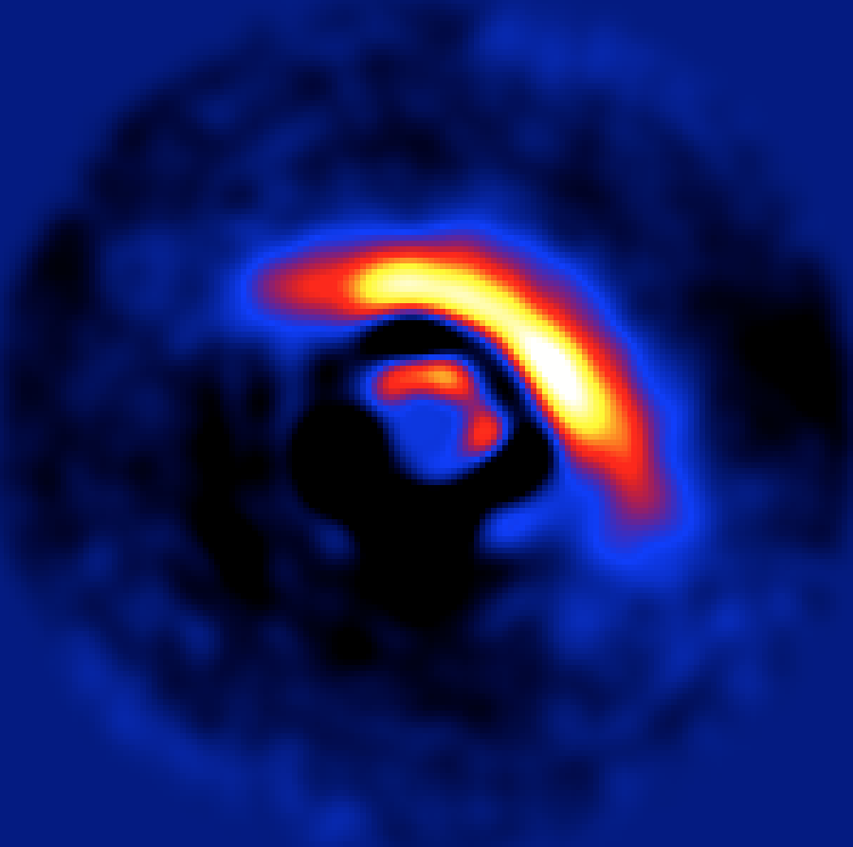
LkCa 15 (Wallack et al., submitted very soon!)
NIRC2 Image
Inner and outer disk
model subtracted
Previous detection
Sallum+ 2015
N
N
0″.1
E
0″.2
E
Notes:
We believe we have independent verified the existence of the L’ band source. We are able retrieve astrometry and photometry with a disk model subtracted out.

Slide 16
The survey continues and more results are on the way!
Notes:
Potentially up to three examples of accreting protoplanets. Only about 20 favorable targets with such features. Occurrence rate may be quite high.
These may be the precursors to many exciting discoveries with future ground-based giant segmented mirror telescopes.
In addition to the three systems I highlighted, we have a several more in the pipeline will be investigated in similar detail. We also have quite a few non-detections, which will be published in combination with a larger survey led by Prof. Dimitri Mawet, which includes many fresh targets from ALMA.

Slide 17
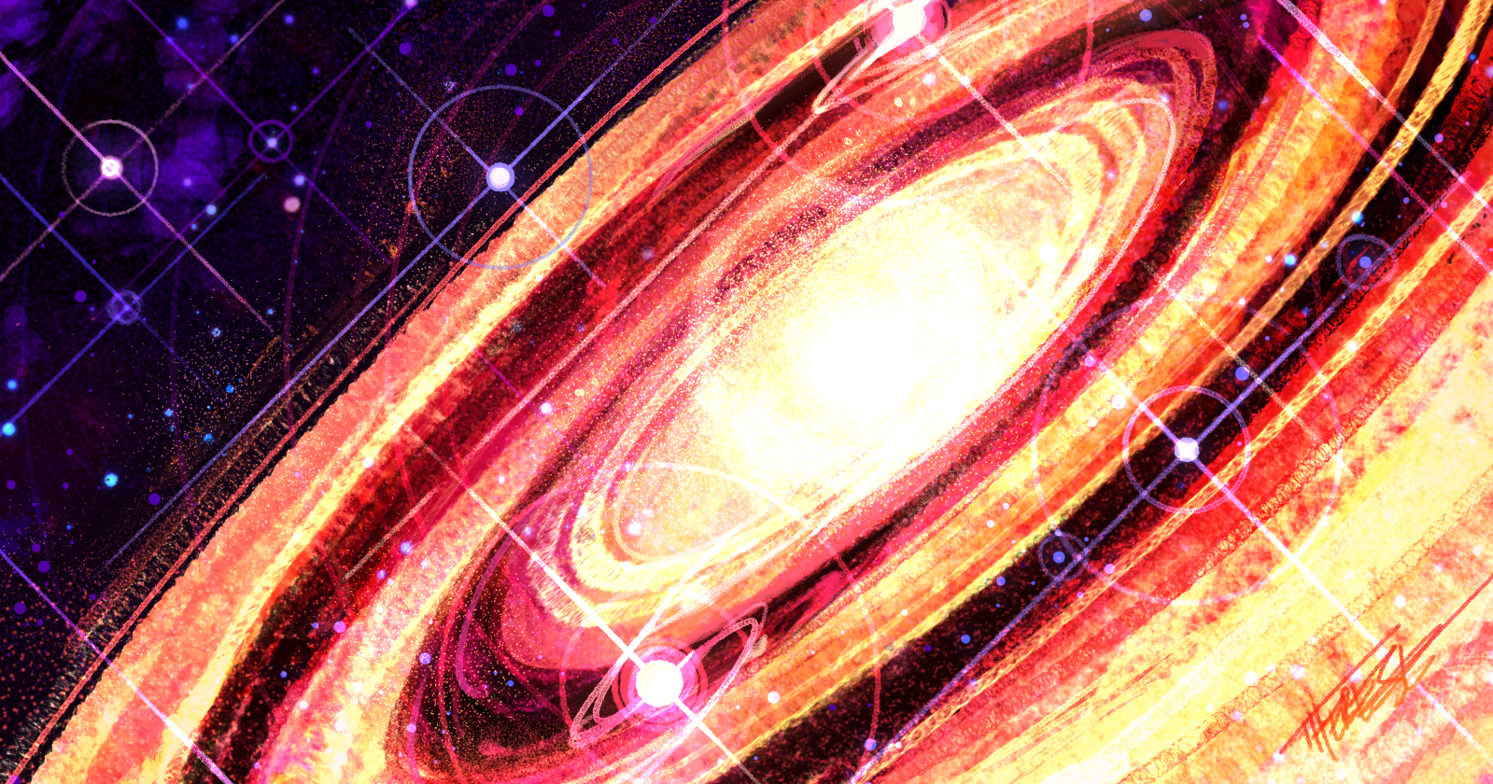
Artwork by
Therese Cook (UCLA)
Notes:
I’ll just leave you with this protoplanetary artwork by Therese Cook from UCLA.

Slide 18
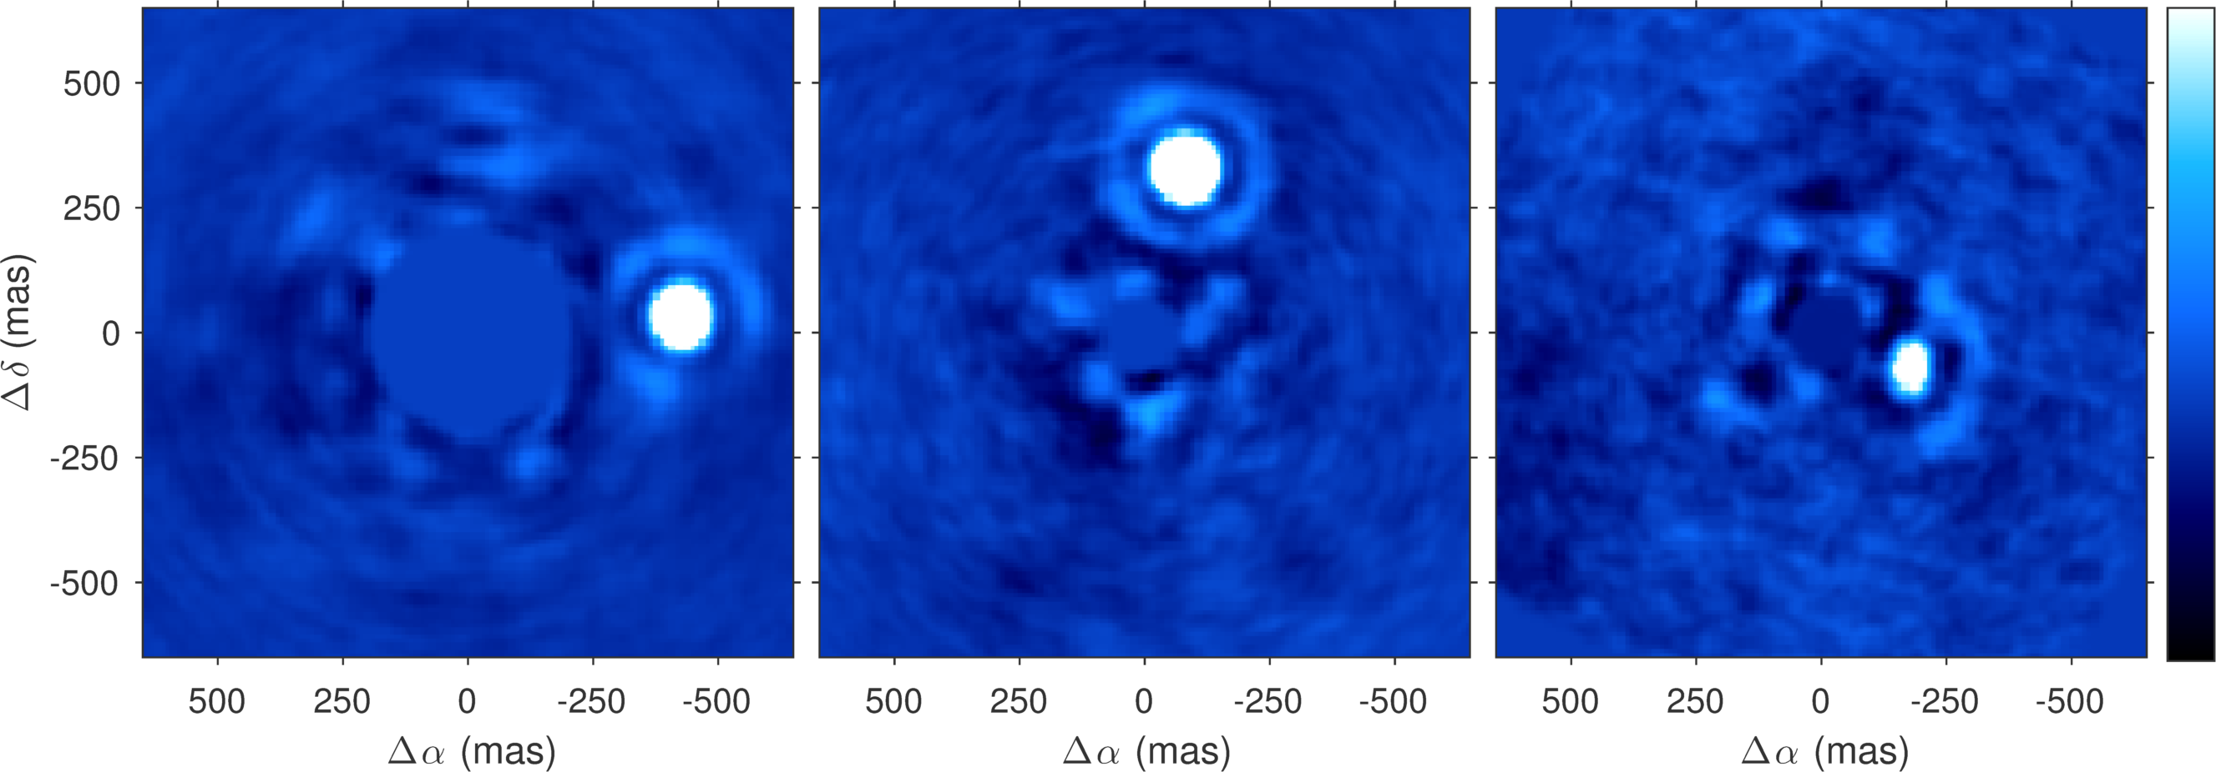
VC + RDI is great for small angular separations
Example images of close-in companions with the Keck NIRC2 vortex coronagraph
star
Notes:
Potentially up to three examples of accreting protoplanets. Only about 20 favorable targets with such features. Occurrence rate may be very high.
Very exciting prospect for future giant segmented mirror telescopes on the ground.

