Slide 1
ROCKE-3D Climate Model

Slide 2
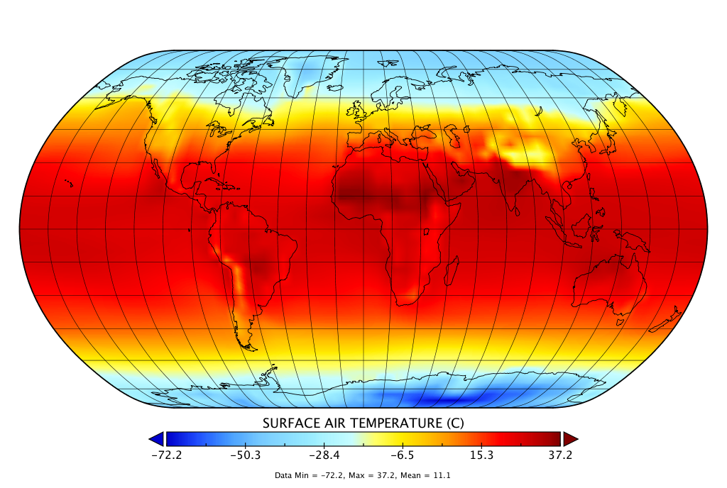
ROCKE-3D Climate Model

Slide 3
The Biokinetic Spectrum for Temperature

