Slide 1
Stochastic Speckle Discrimination with Microwave Kinetic Inductance Detectors
Clint Bockstiegel
ExSoCal, Sept 2018

Slide 2
Direct imaging with MKIDs
DARKNESS
  Commissioned at Palomar in 2016 with P3K (AO system) & SDC (coronagraph)
  Going to Magellan w/ MagAOx 2019-ish
  1.2 µm
MEC
  Commissioning ongoing at Subaru, started in March 2018 with SCExAO
  1.2 µm
PICTURE-C
  Scheduled to fly in Fall 2019-ish
  Looking at debris disks in the optical
  600 nm

Slide 3
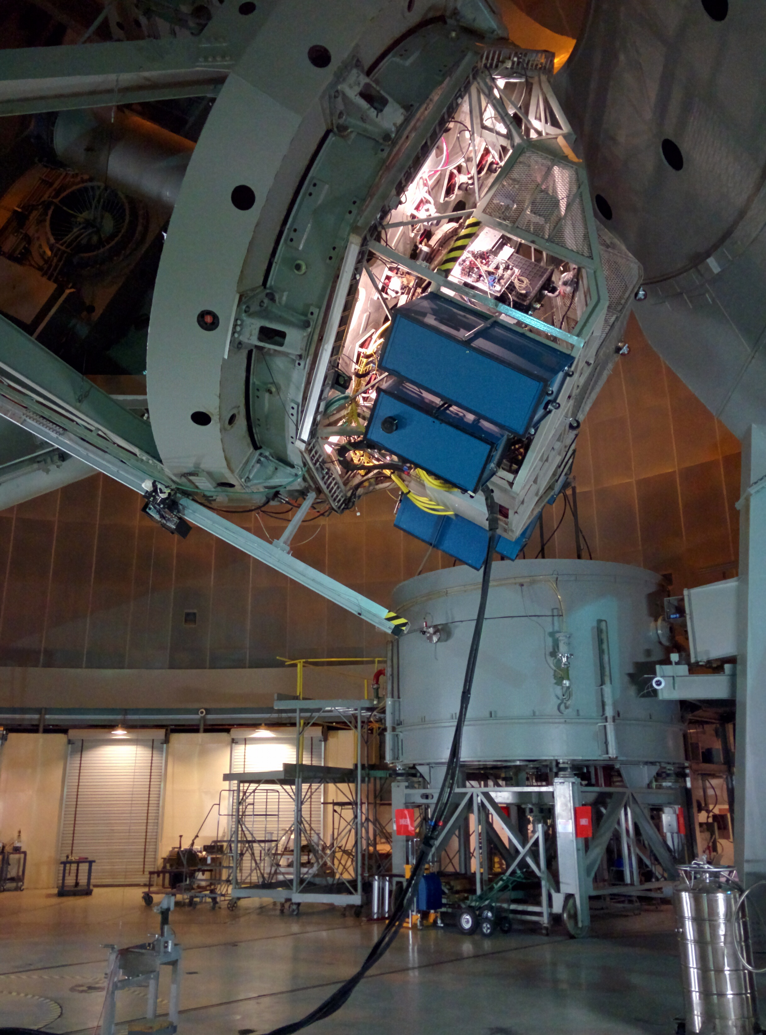
DARKNESS

Slide 4
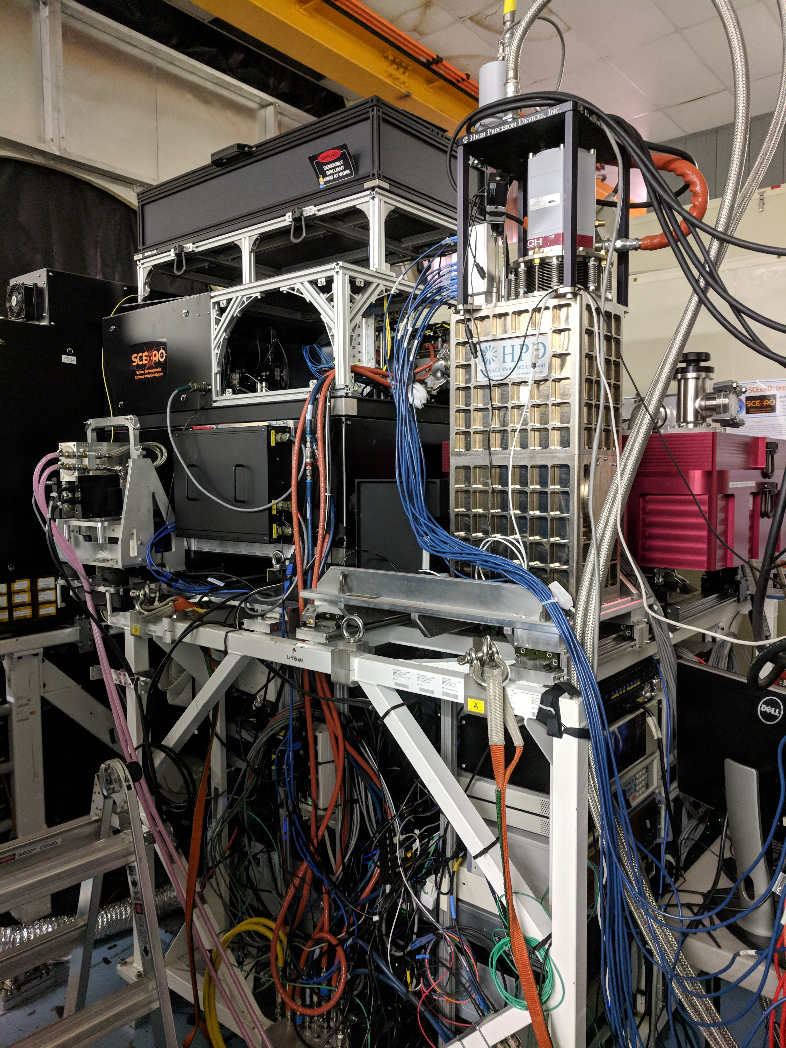
MEC

Slide 5
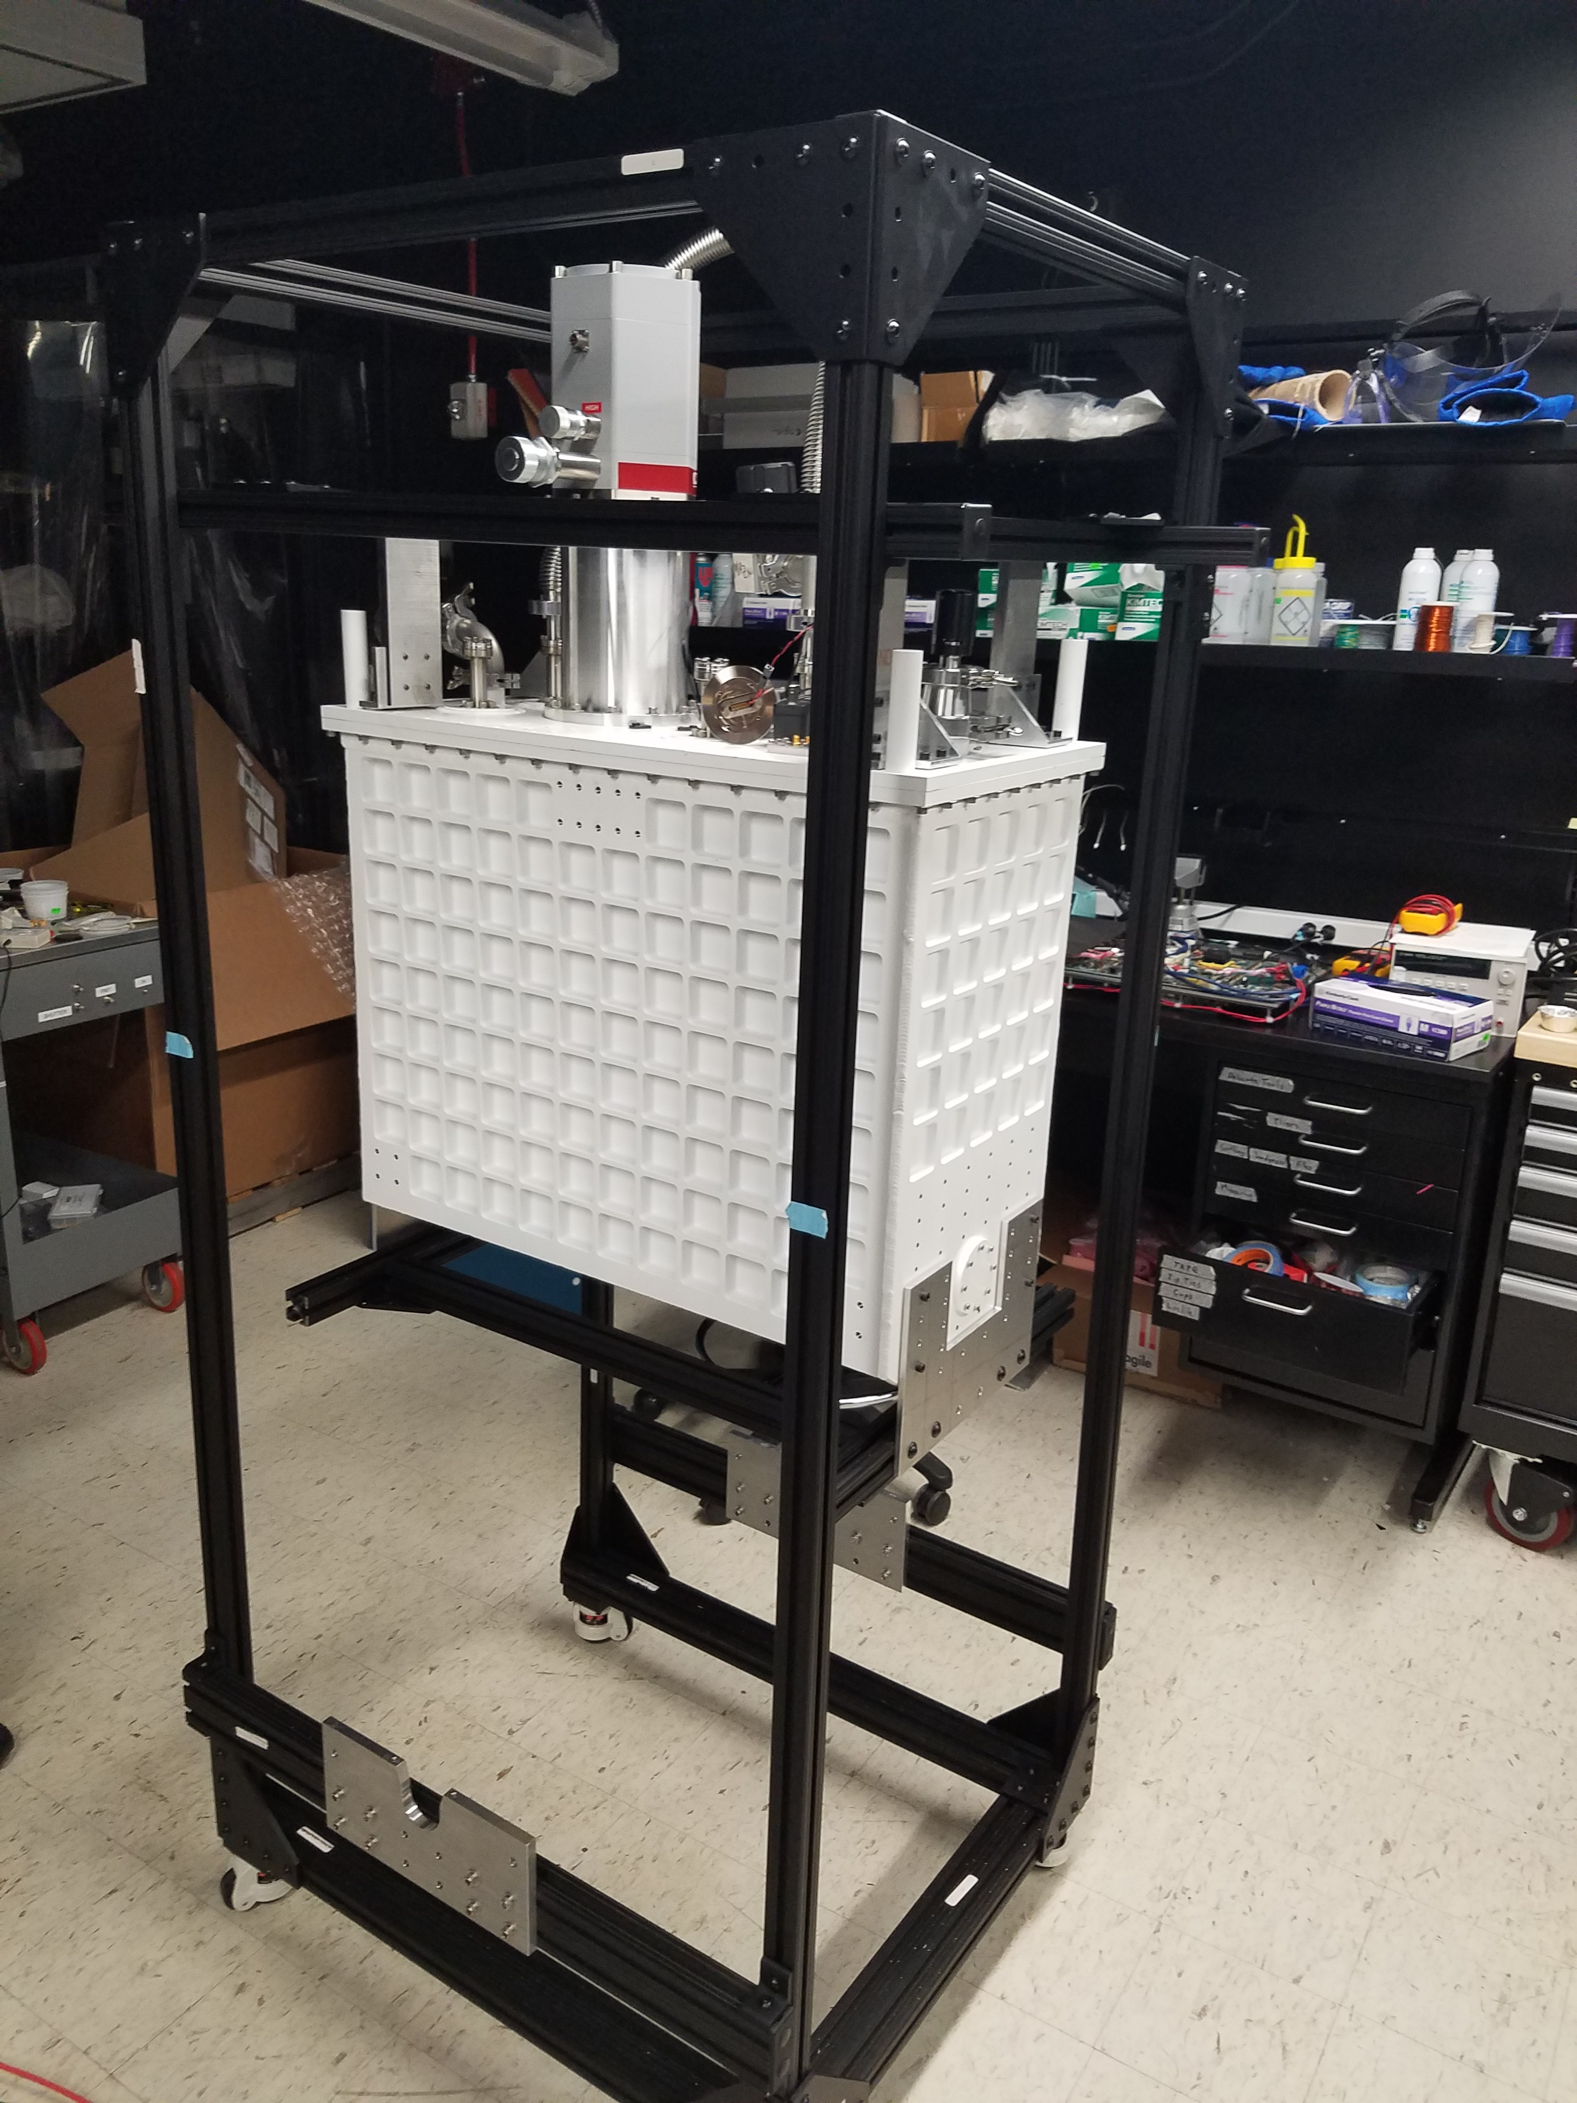
PICTURE-C

Slide 6
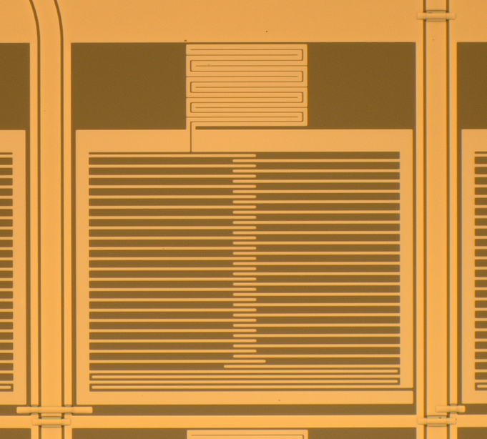
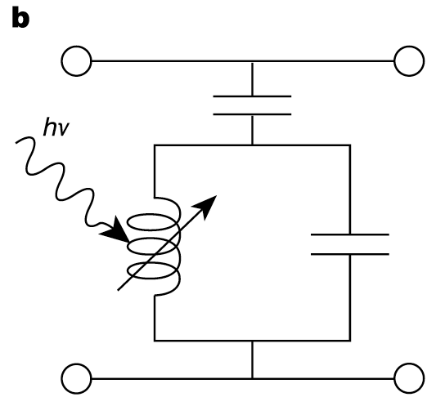
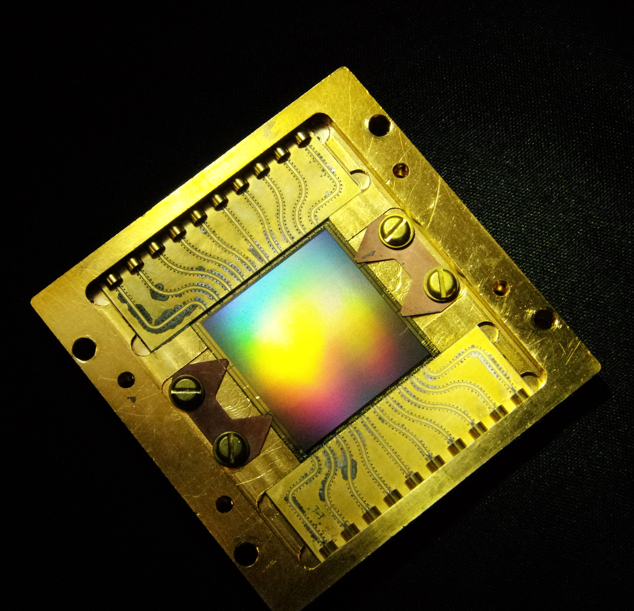
inductor
30 μm
capacitor
coupling capacitor
Microwave feedline
MKIDs are Photon Counting and Energy Resolving
Notes:
Resonator material: TiN
T_{c} = 1K
Film Thickness: 60 nm
Surface Inductance: 24 pH/sq
total Q = 30,000
Groundplane and feedline: Nb

Slide 7
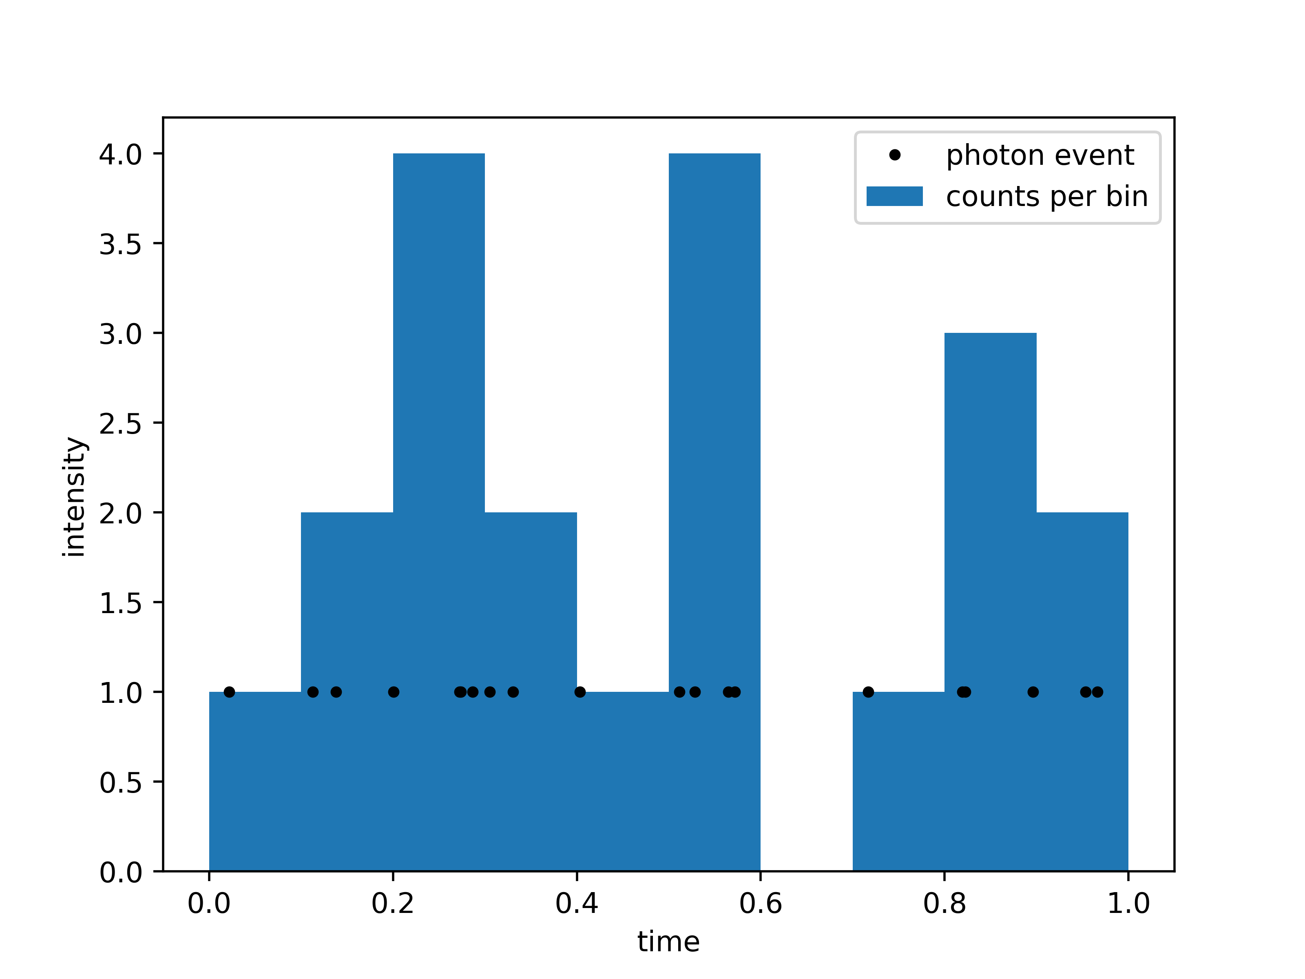

Slide 8
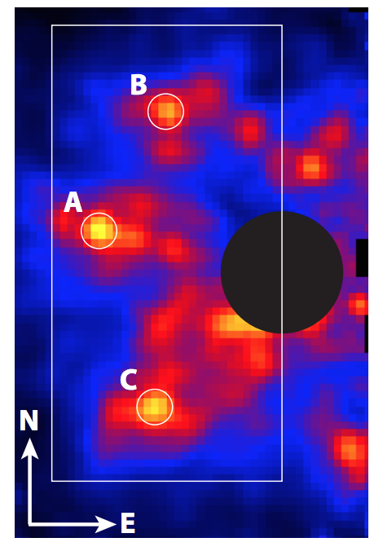
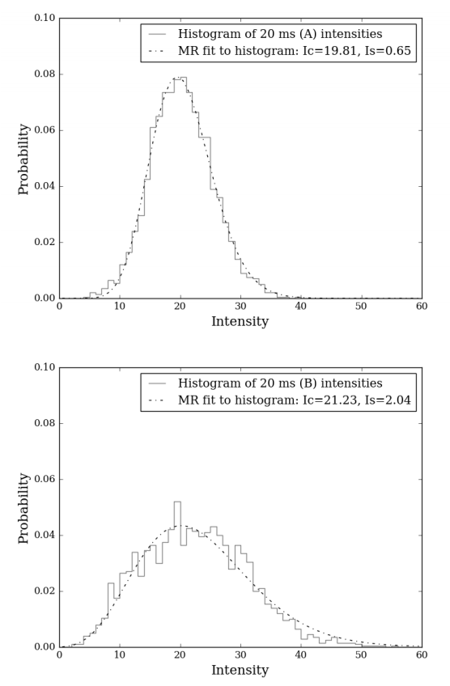
32 Peg b at location “A”
Meeker+ 2018
Notes:
Include histogram of darkness data

Slide 9
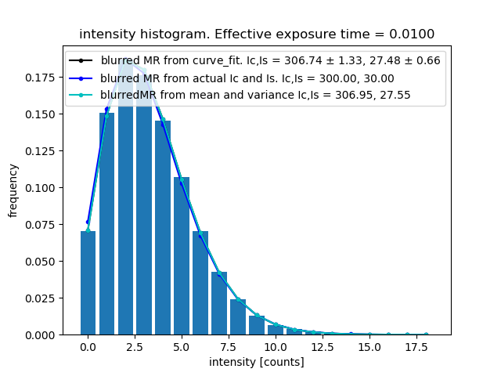
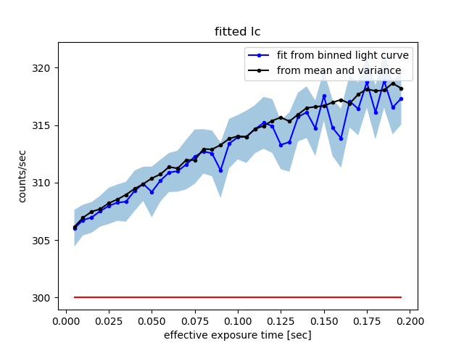
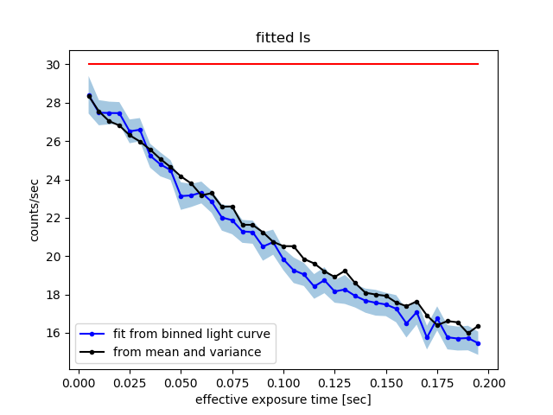
Notes:
20180711
Ic, Is, total time, decorrelation time = [300., 30., 300., .1]. Curve fit seeded

Slide 10
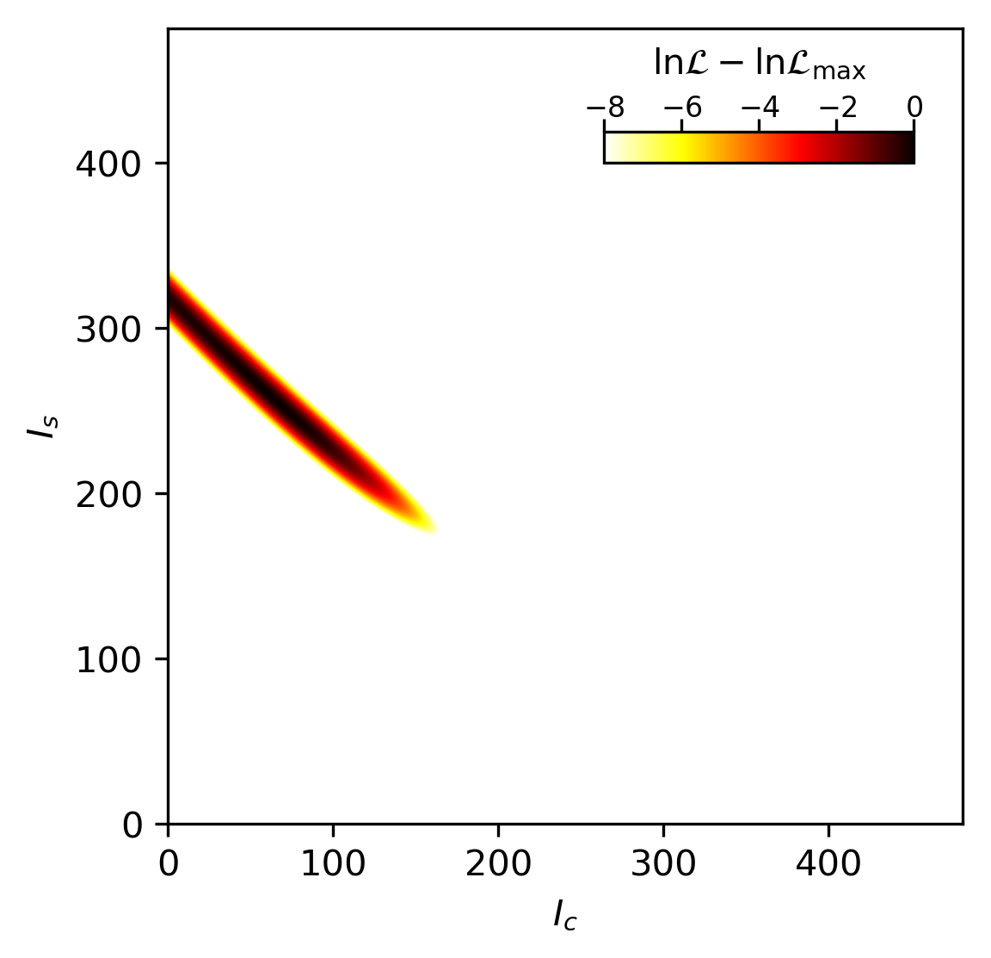
Bin-free maximum likelihood
Ic = 30
Is = 300

Slide 11
Alex Walter
Tim Brandt
Right to Left:
PI: Ben Mazin
Sarah Stieger
Isabel Lipartito
Gregoire Coiffard
Alex Walter
Nicholas Zobrist
Noah Swimmer
Miguel Daal
Neelay Fruitwala
Clint Bockstiegel
Not Pictured:
Jeb Bailey
Jenny Smith
Kristina Davis
Rupert Dodkins
Emeriti:
Seth Meeker
Paul Szypryt
Paschal Strader
Gerhard Ulbricht
Julian van Eyken

