Slide 1

Beyond the Lecture: Finding the Intersections between Science and the Community
Jessie Christiansen
@aussiastronomer
Caltech/IPAC-NExScI
ExSoCal 2018

Slide 2
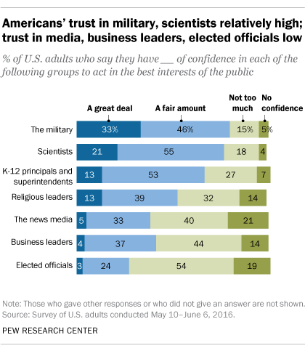
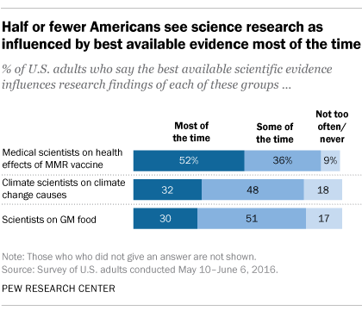

Slide 3

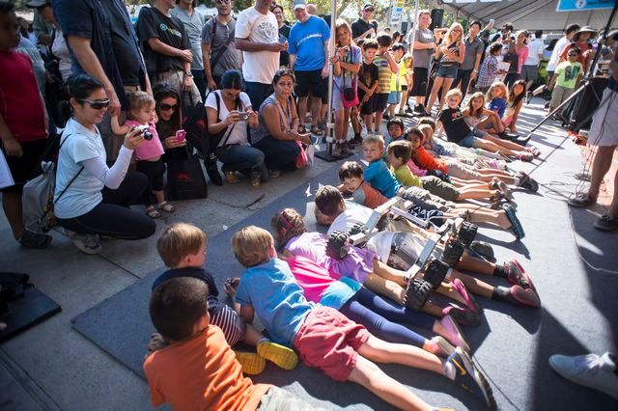
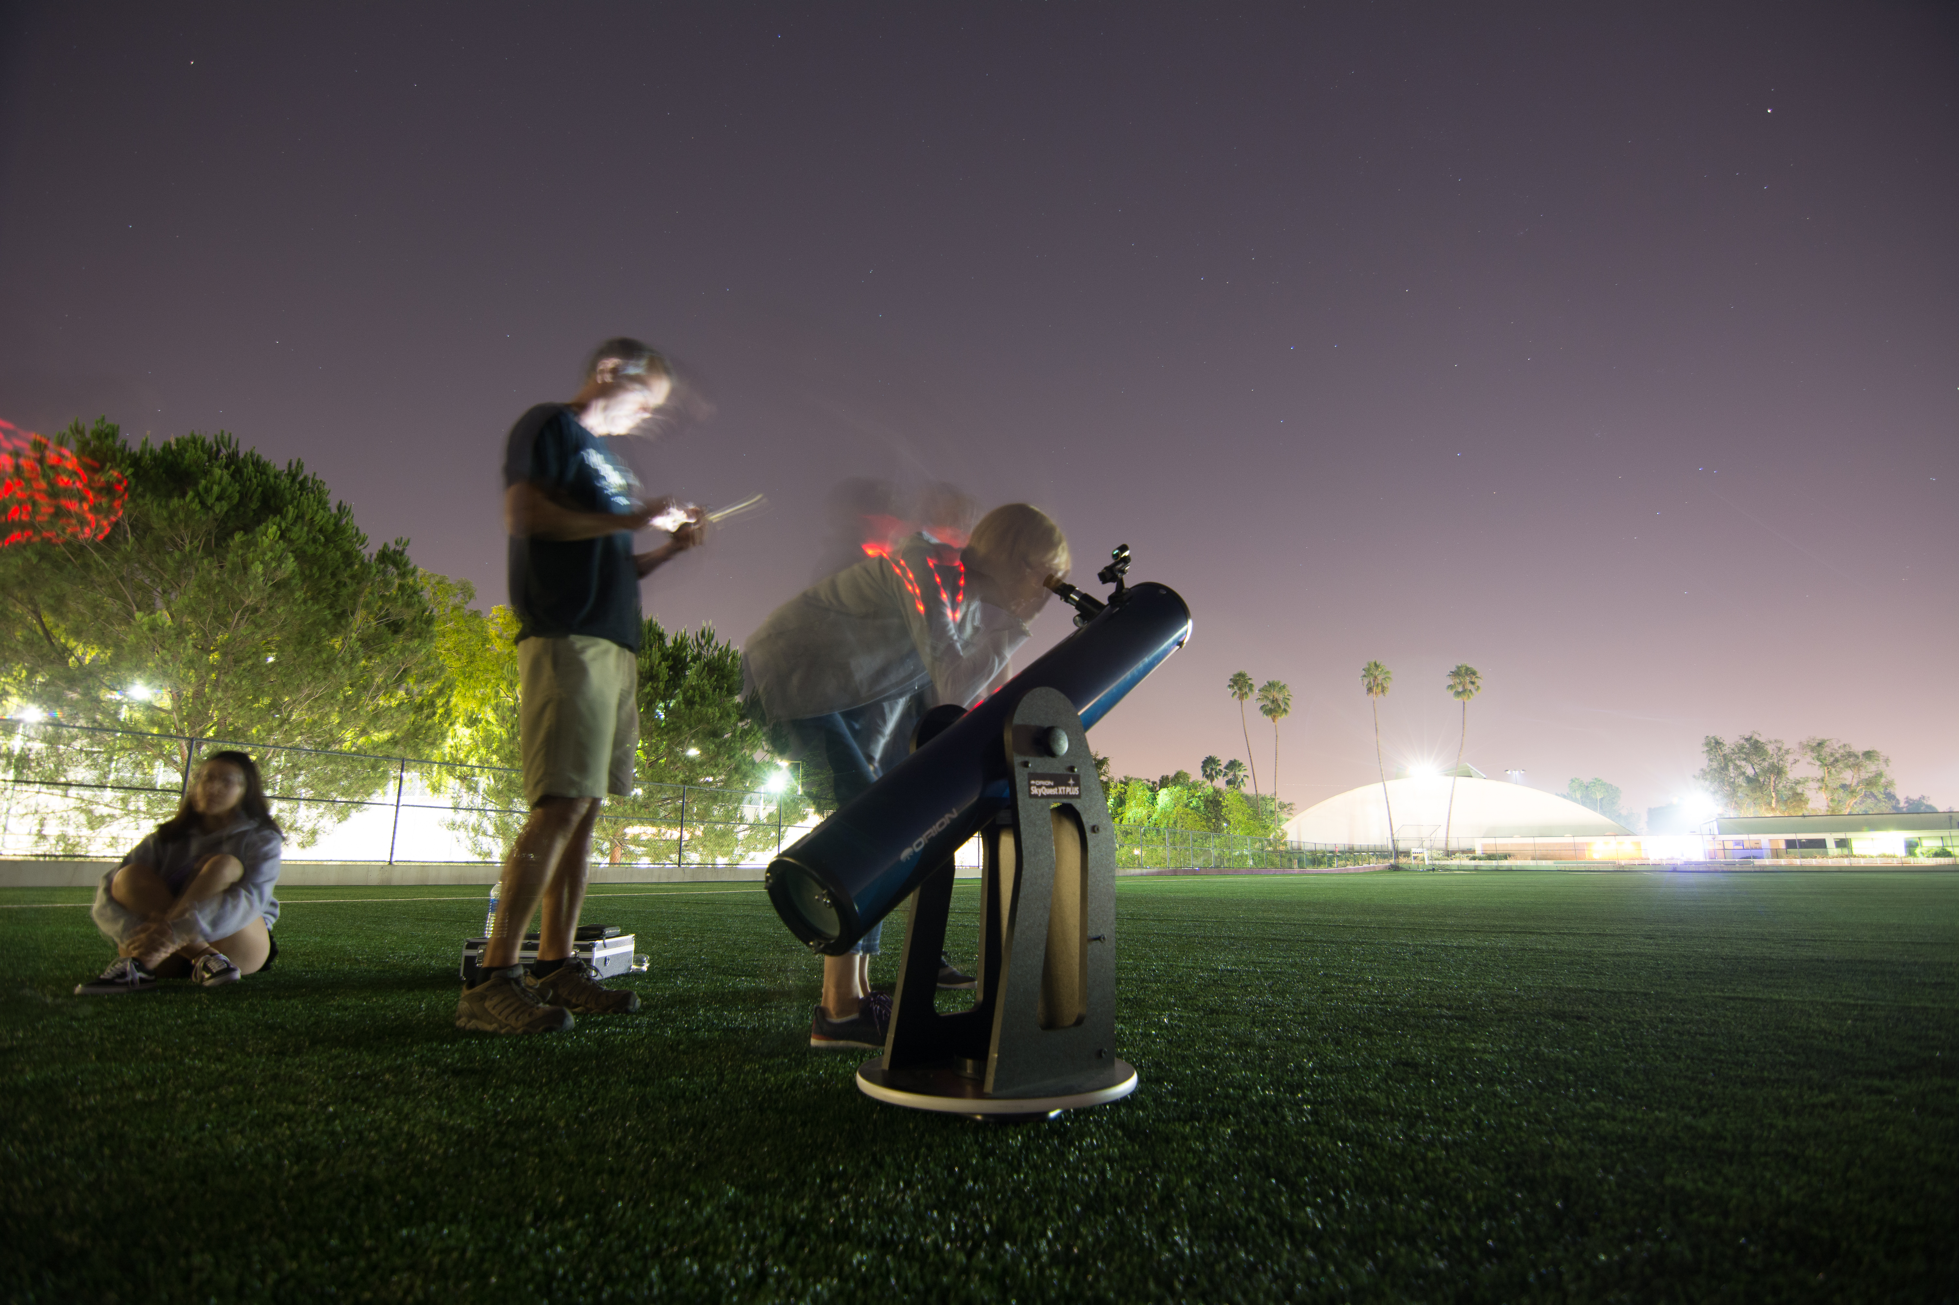
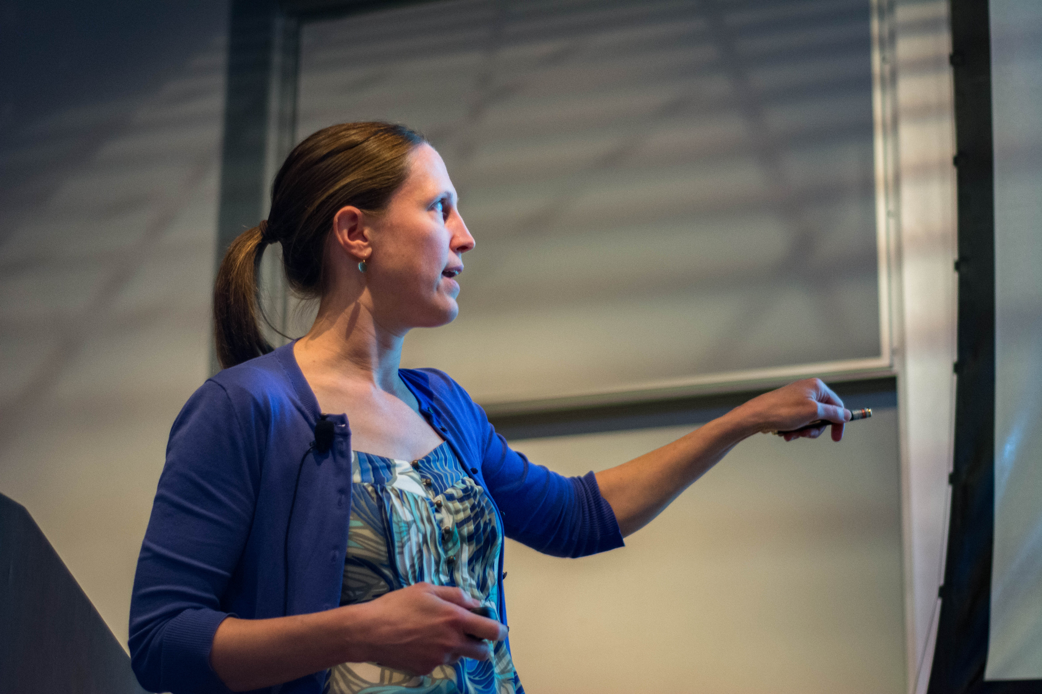
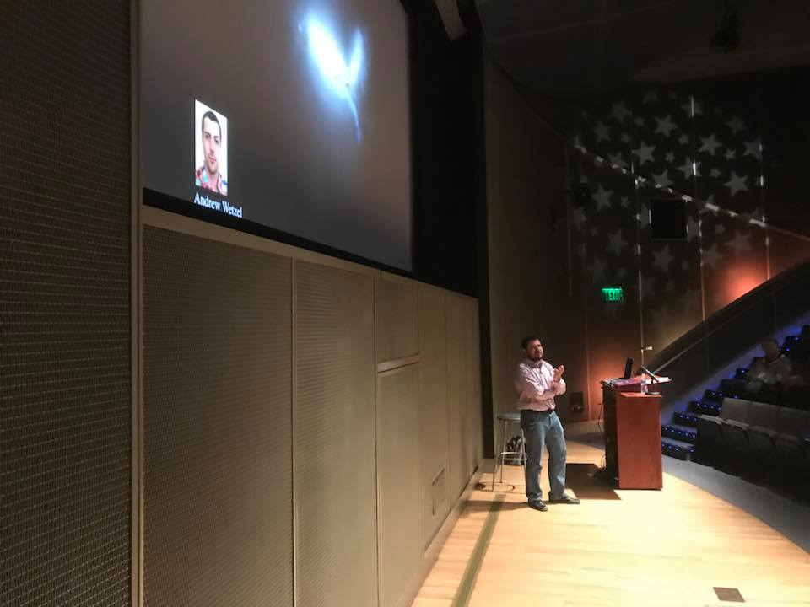

“Inreach”
Public lectures
- Caltech
- Huntington
Stargazing parties
Open houses
Podcasts
Amateur astronomy clubs
- LAAS (LA)
- Local Group (SCV)
- SAS (Ontario)
- RAS (Riverside)
Mentoring
- 1000 Girls, 1000 Futures
- Letters to a Pre-Scientist
www.prescientist.org
Credit: Christophe Marcadé / Caltech Astronomy Outreach
www.listentospacepod.com
Sarah Reingewirtz/Pasadena Star-News
Credit: Geo Samoza / Los Angeles Astronomical Society
Credit: Christophe Marcadé / Caltech Astronomy Outreach

Slide 5
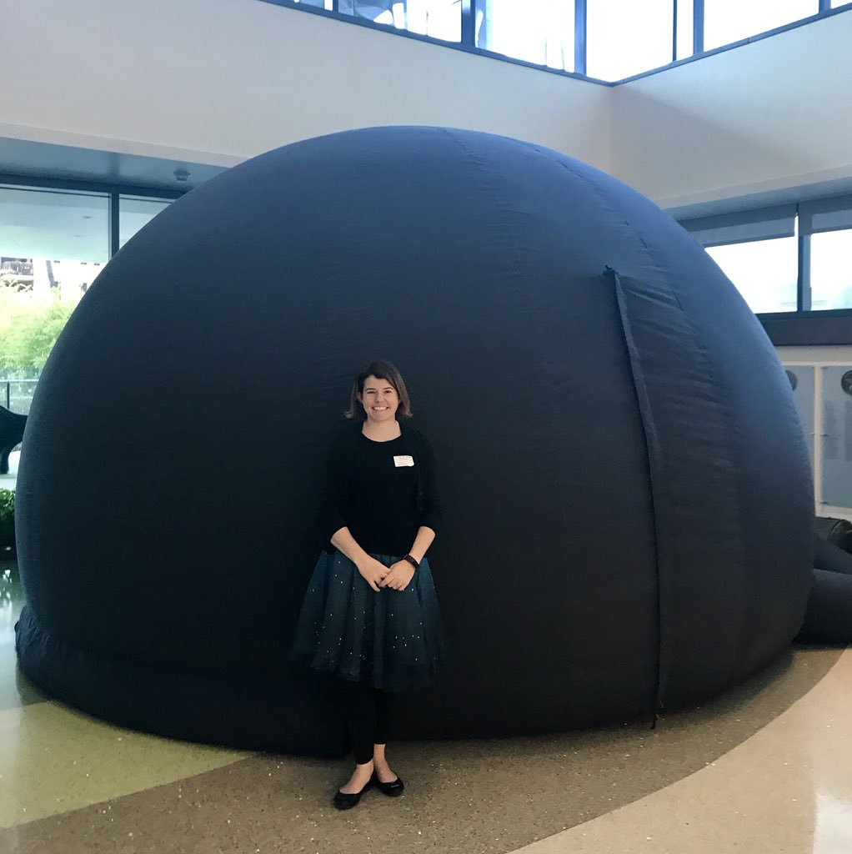
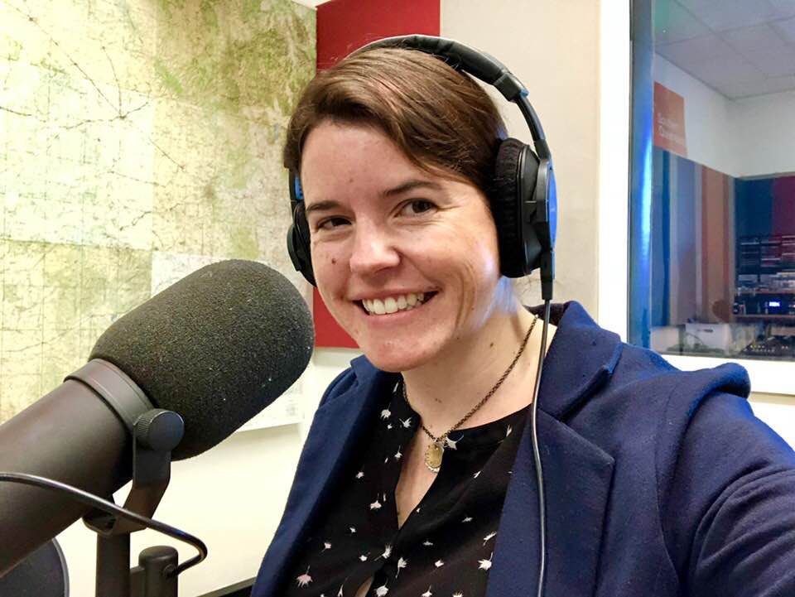
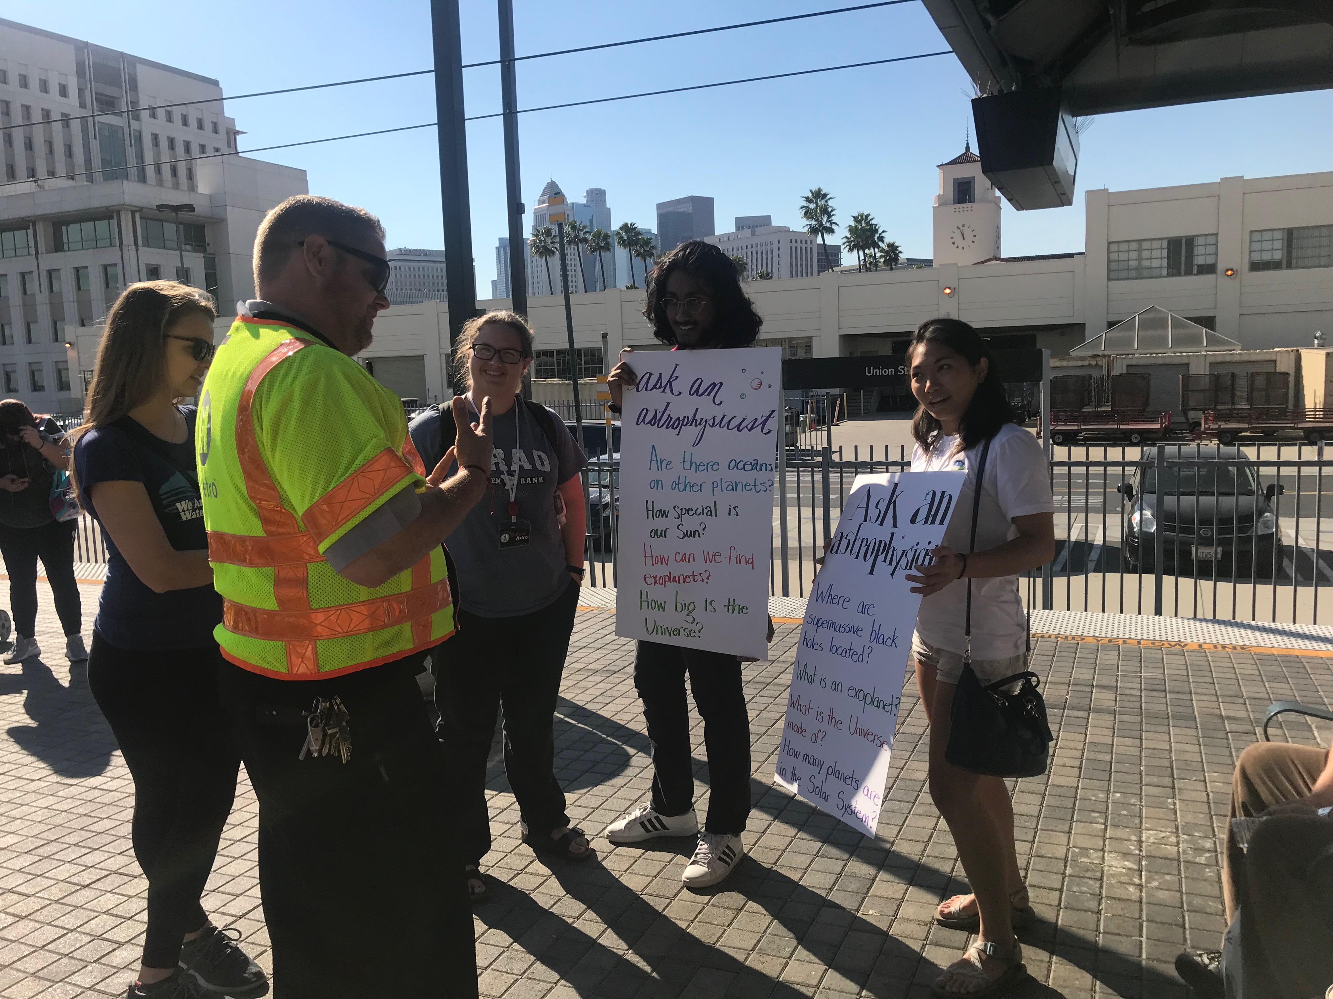
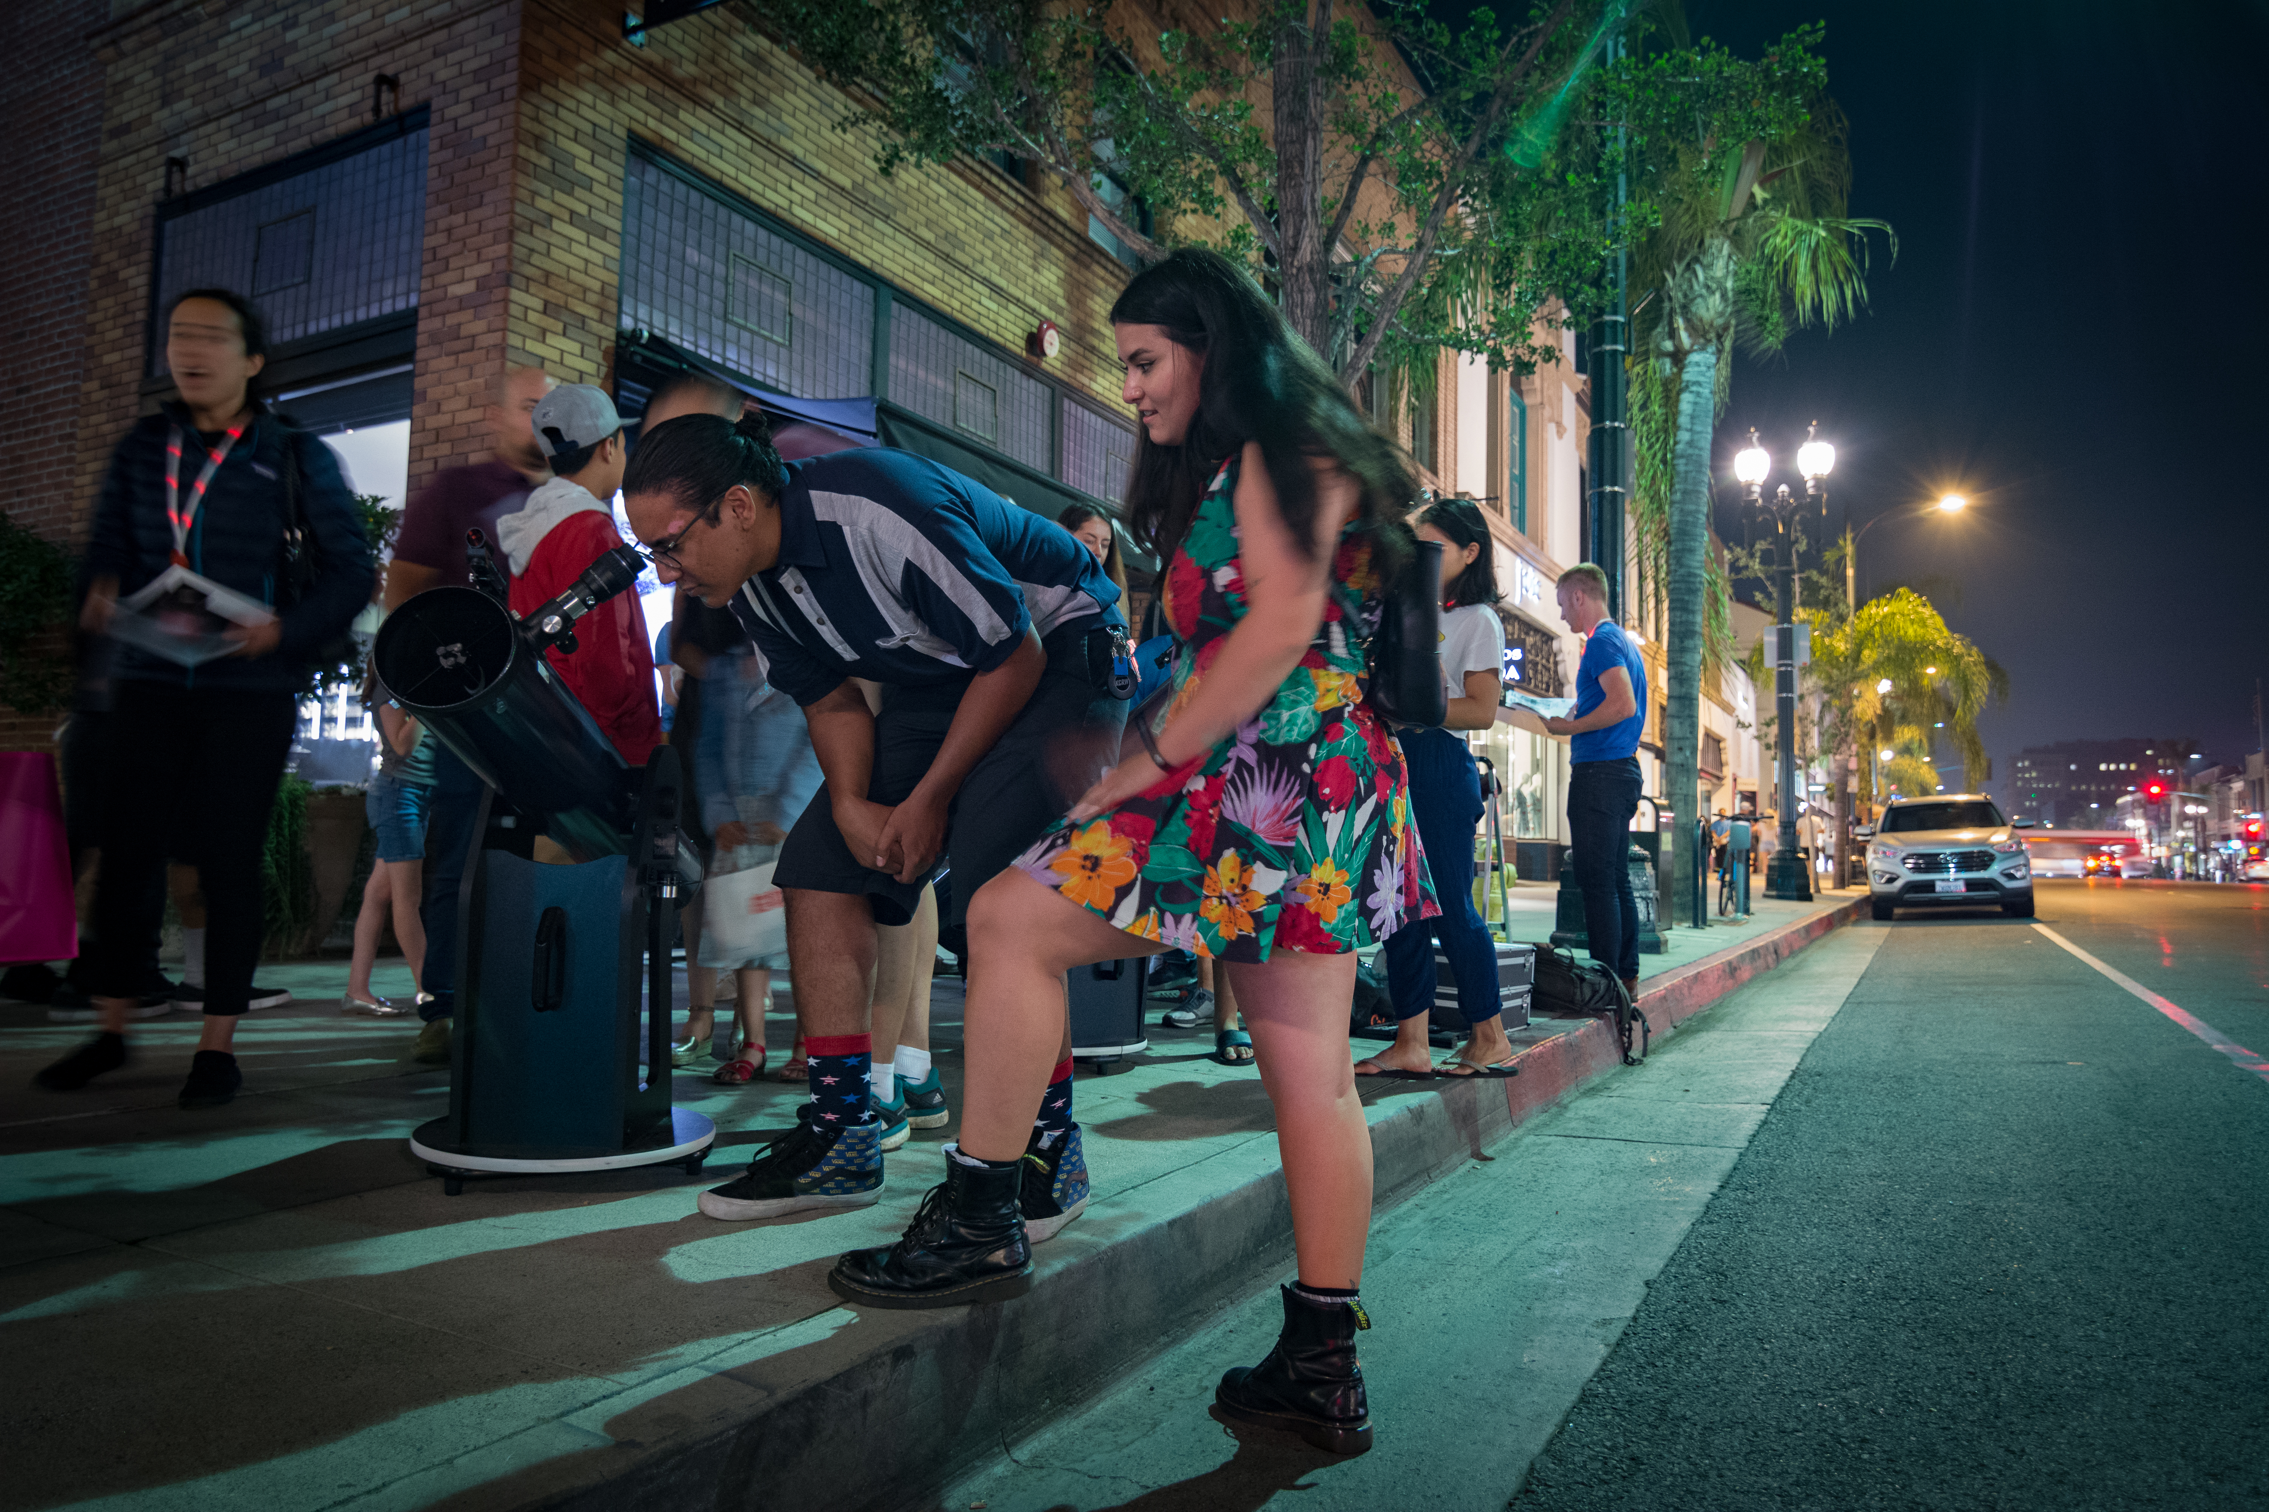
“Inreach”
Science train
Public lectures
- Caltech
- Huntington
Pop-up stargazing
Stargazing parties
School visits
- Learning Works
- Longfellow
Open houses
Podcasts
Portable planetarium children’s hospital visits
Amateur astronomy clubs
- LAAS (LA)
- Local Group (SCV)
- SAS (Ontario)
- RAS (Riverside)
Radio shows (e.g. NPR)
Mentoring
- 1000 Girls, 1000 Futures
- Letters to a Pre-Scientist
Credit: Caltech Astro Outreach
Credit: Christophe Mercade / Caltech Astro Outreach
“Outreach”

Slide 6
“Inreach”
Science train
Public lectures
- Caltech
- Huntington
Pop-up stargazing
Stargazing parties
School visits
- Learning Works
- Longfellow
Open houses
Podcasts
Science and…
Portable planetarium children’s hospital visits
Amateur astronomy clubs
- LAAS (LA)
- Local Group (SCV)
- SAS (Ontario)
- RAS (Riverside)
Radio shows (e.g. NPR)
Mentoring
- 1000 Girls, 1000 Futures
- Letters to a Pre-Scientist
“Outreach”

Slide 7
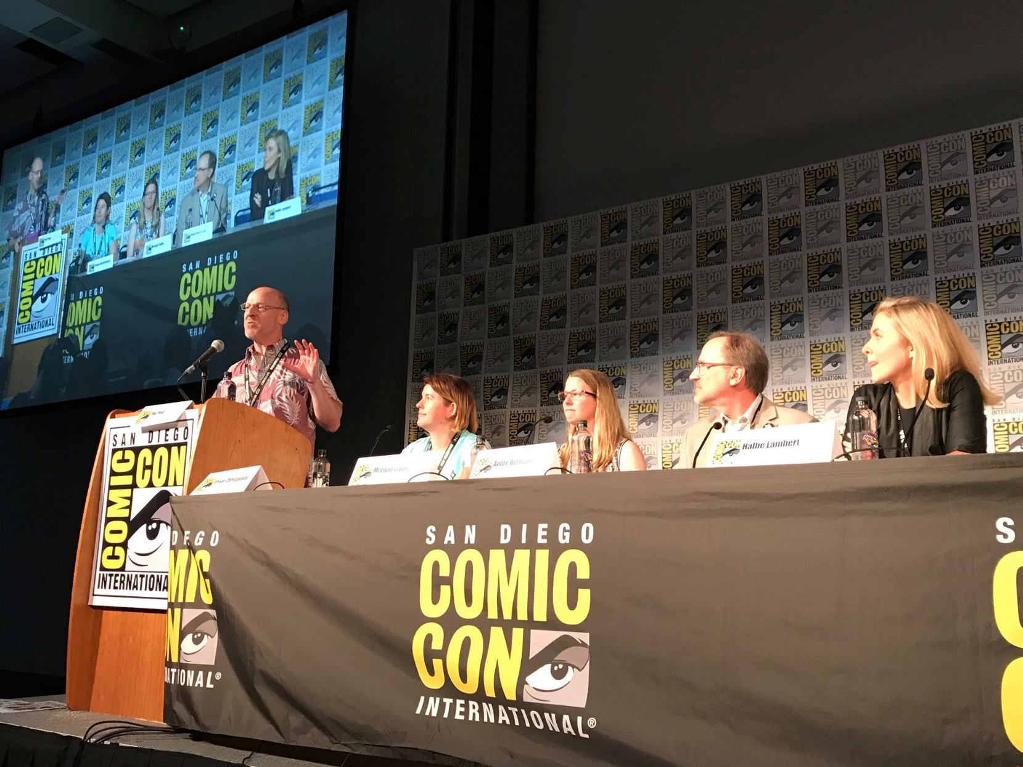
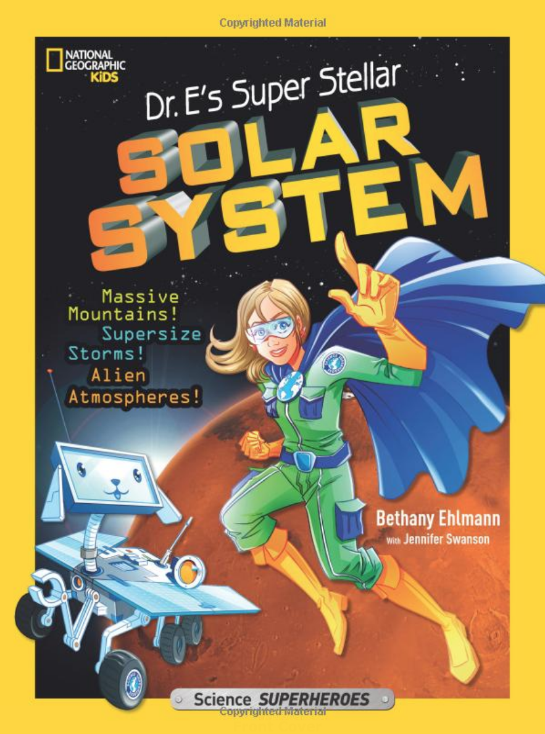
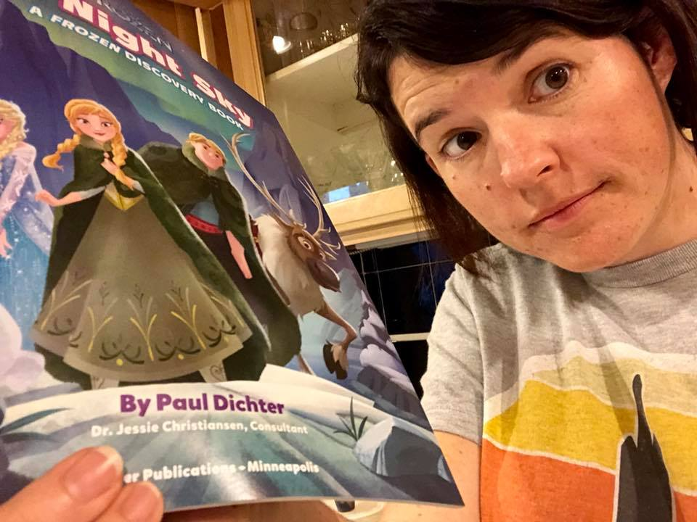
Write one!
Talking head
… books
Live panels
…television
Consulting
Consulting
Science and…
Social mediarrr
Magazines
…kids
…gifs
Games

Slide 8
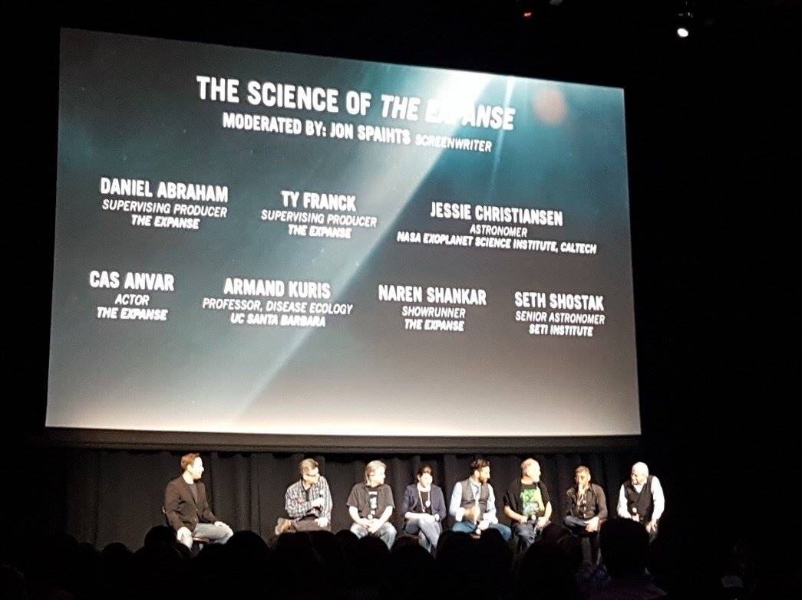
Science & Entertainment Exchange http://scienceandentertainmentexchange.org/
TV show consulting
  e.g. Big Bang Theory
  “Think tanks” CBS <redacted>
Live Hollywood events
  Panels, seminars
  ‘Science speed dating’
Scifi author consulting
  “What would someone on the surface of the planet see?”

Slide 9

Social media
Decide in advance
  What platform to use
  What you will share (or not)
  What your ‘brand’ is
Manage your goals
  It’s a time sink – what are your expectations?
  Exploit platform-specific analytics

Slide 10
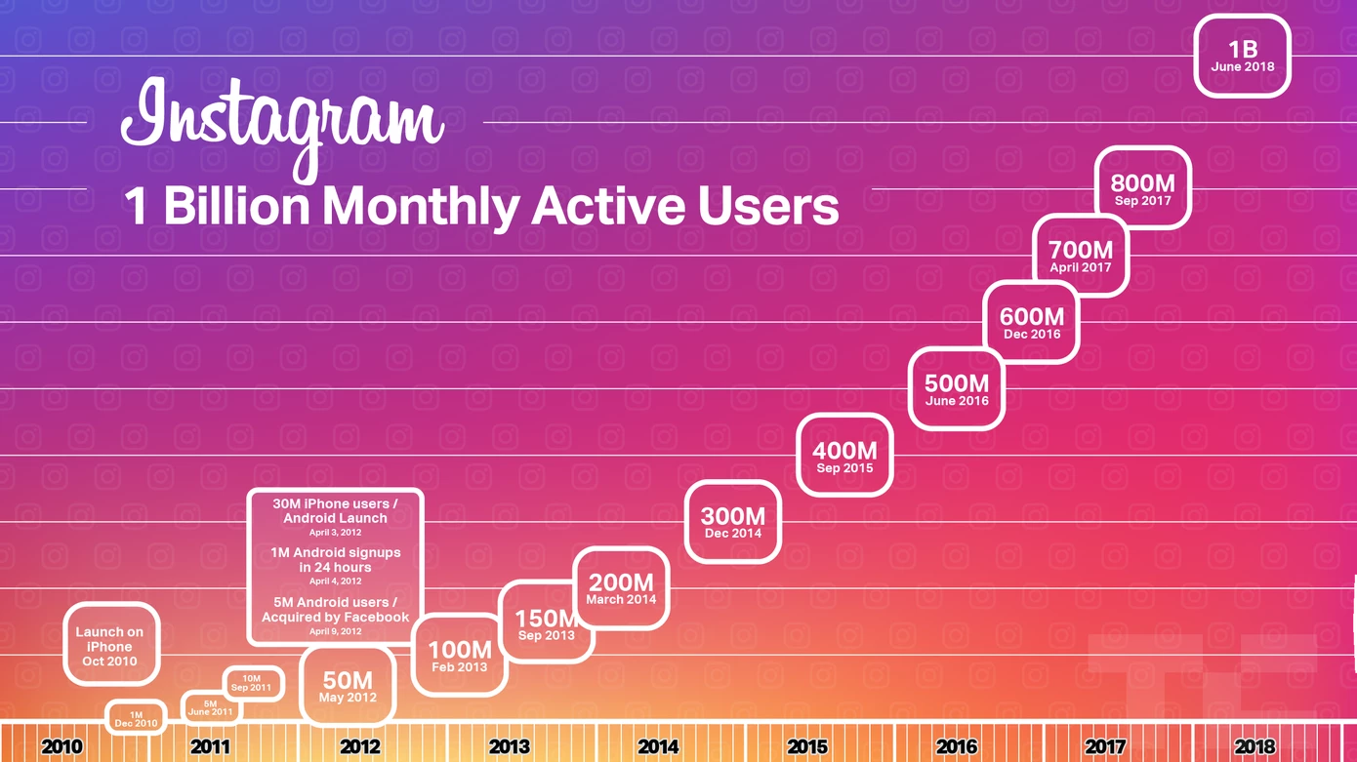
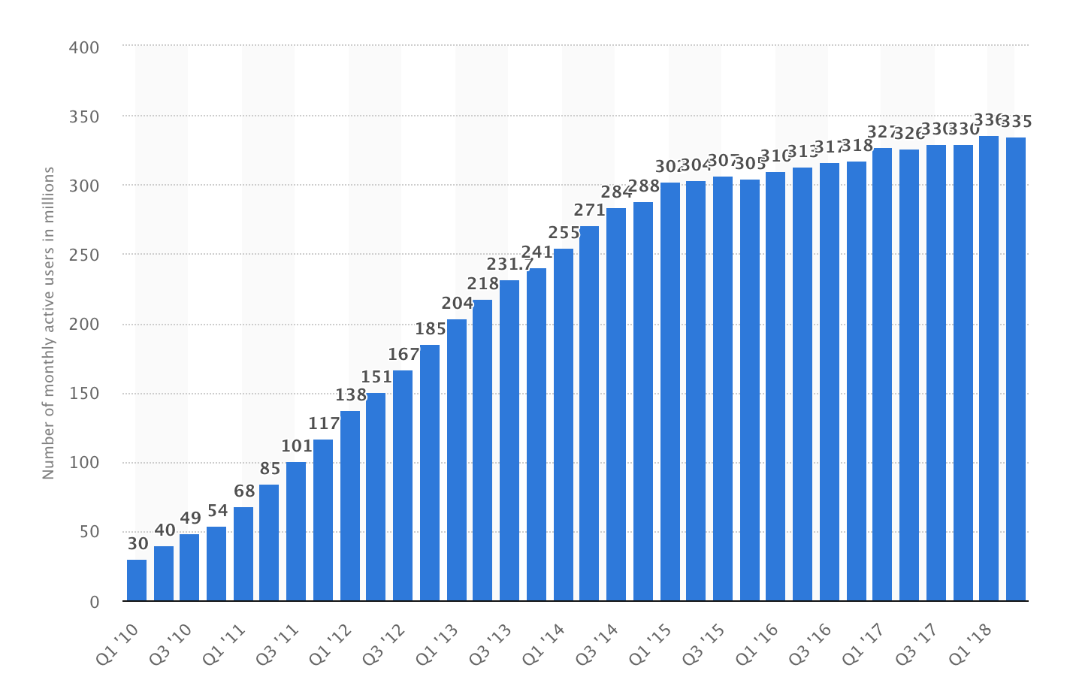
Social media

Slide 11
… music
… the outdoors
… art
… alcohol
Science and…
… history
… dance
… ???

