Slide 1
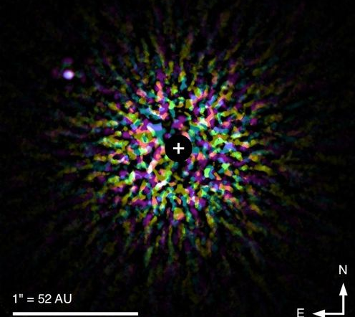
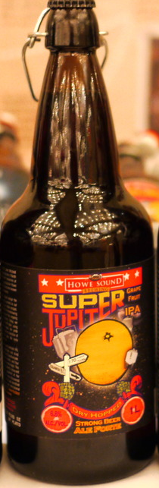
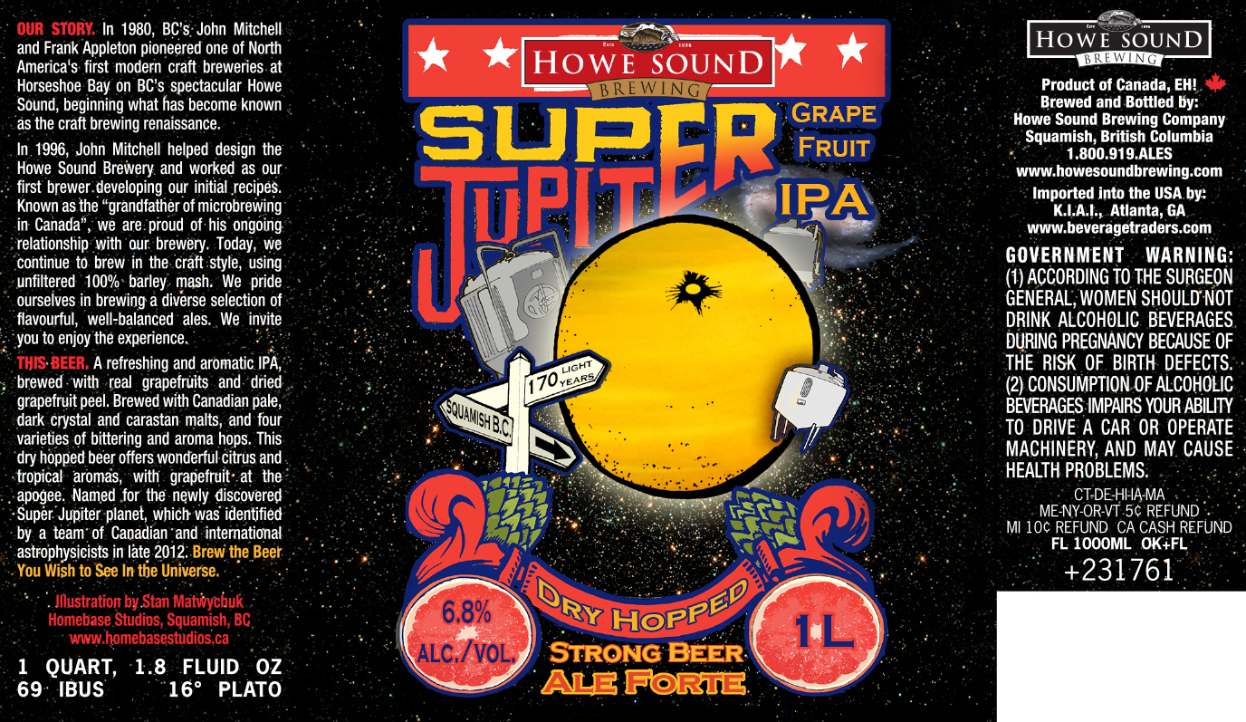
SCExAO/CHARIS Direct Spectroscopy of kappa And b
Thayne Currie (NASA-Ames/Subaru),
Tim Brandt (UCSB), Taichi Uyama (U. Tokyo), Eric Nielsen (Stanford), Sarah Blunt (CfA),
Olivier Guyon (Subaru), Motohide Tamura (U. Tokyo), Christian Marois (NRC-Herzberg) + 25 additional coauthors

Slide 2
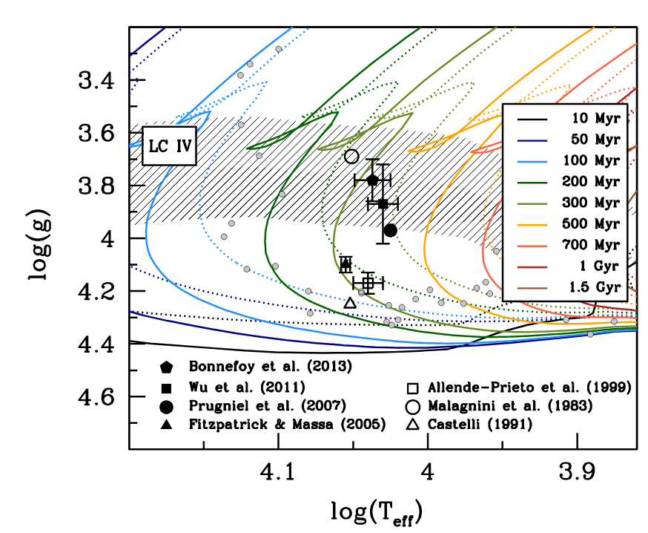
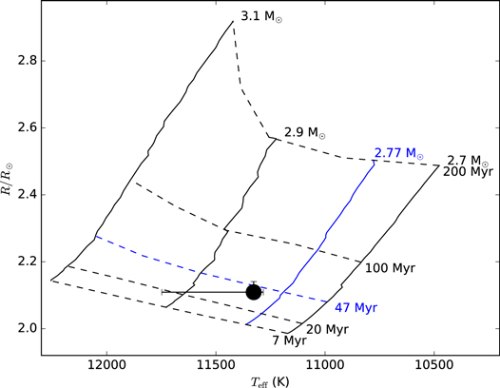
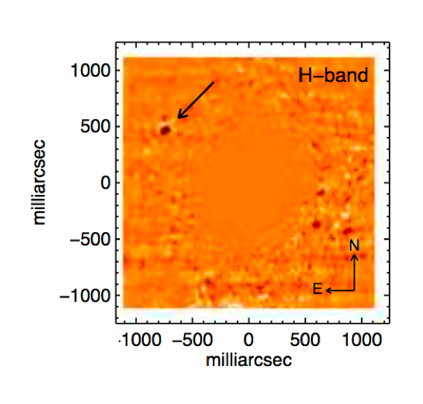
kappa And b: A Superjovian Planet or Brown Dwarf?
Old
Brown Dwarf
Porter?
P1640 YJH direct spectroscopy of kappa And b
CHARA interferometry of star
L1 +/- 1 spectrum, range of gravities
Star’s age: ~220 Myr w/ caveats (rotation)
Kappa And b is higher mass → ~50 Mj , not 13 Mj?
Rapid rotator, age ~7-74 Myr (~7-110 Myr) for solar metallicity (full range of metallicities)
Kappa And b could be lower mass
Need new kappa And b spectra to clarify properties…
(Hinkley et al. 2013; Jones et al. 2016)

Slide 3
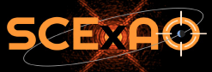
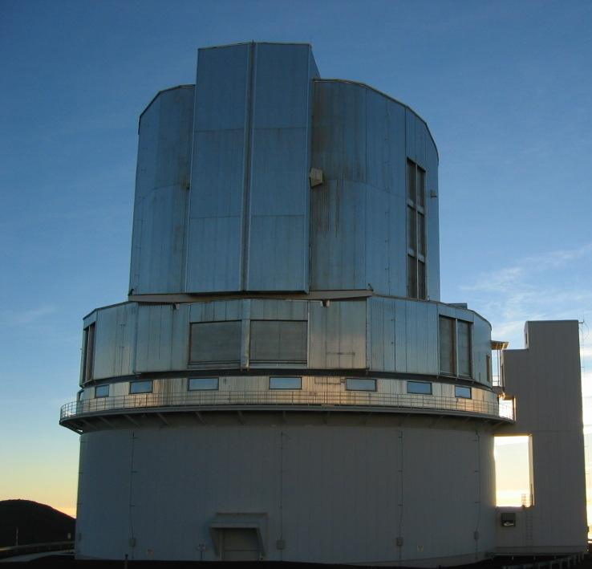

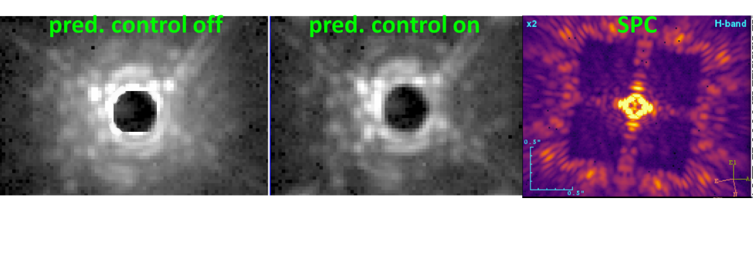
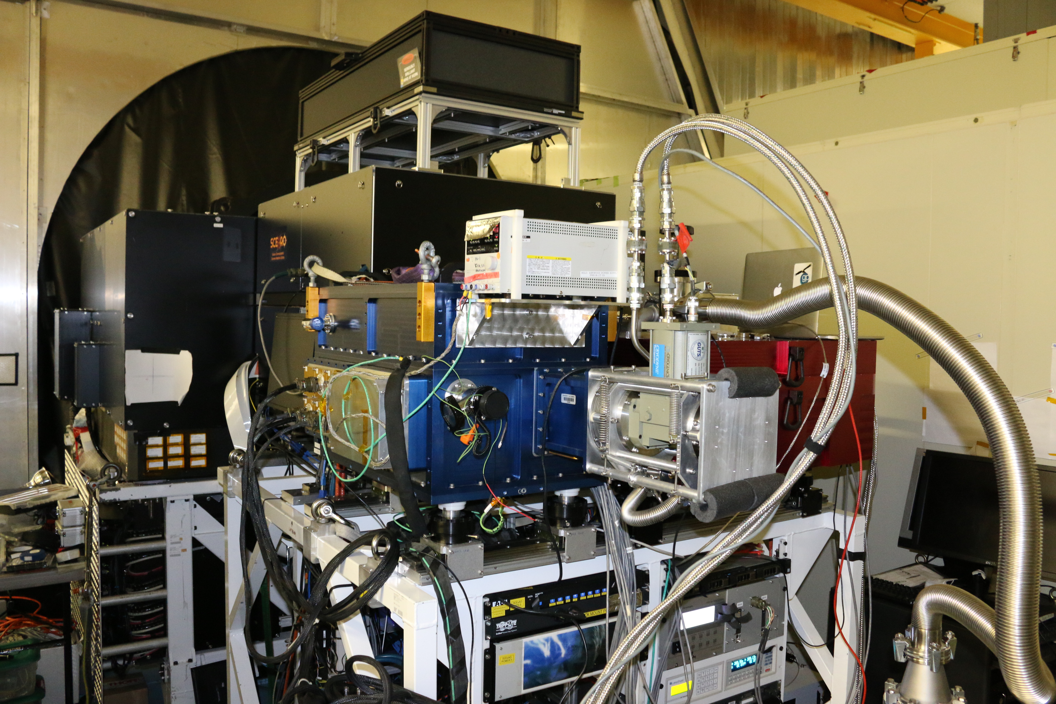
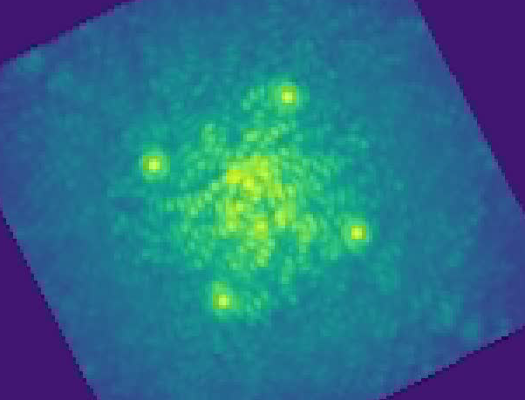
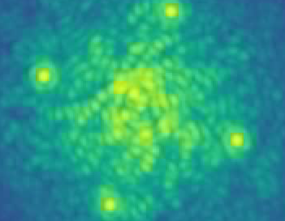
SCExAO Project
Extreme AO System for Subaru (PI Olivier Guyon)
Pyramid Wavefront sensor, 2000 actuators
Rapidly Corrects for Atmospheric Blurring: 1080 modes, 3.5+ kHz
S.R. > 90% at H band
Planet Imaging/Spectra: CHARIS integral field spectrograph
Notes:
Predictive control using Empirical Orthogonal Functions (extension of Principal Component Analysis). Turbulence spatially-temporally correlated. Non-atmos wavefront aberration dominated by specific patterns/modes.

Slide 4
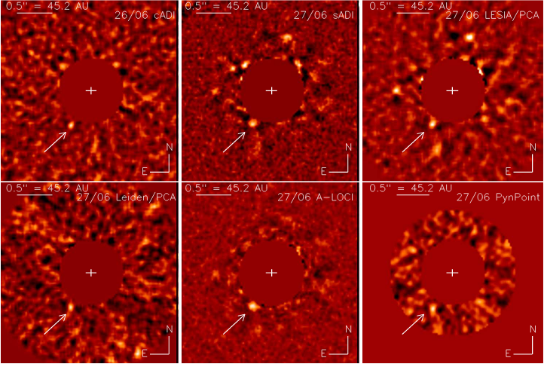


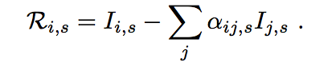
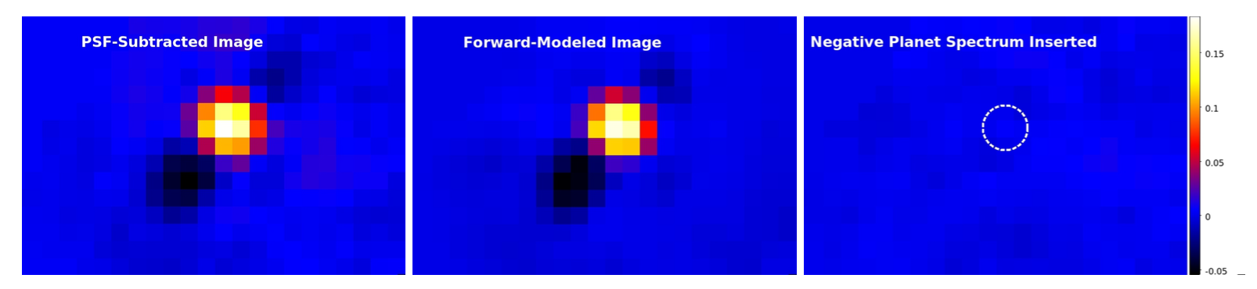
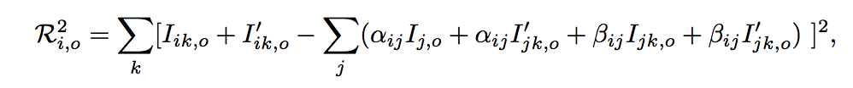


PSF Subtraction, Forward-Modeling, and Spectral Extraction
A-LOCI
PSF Subtraction
(Currie et al. 2012—2017)
A-LOCI
KLIP
Forward-Modeling
(analogous to KLIP-FM; Pueyo 2016)

Slide 5
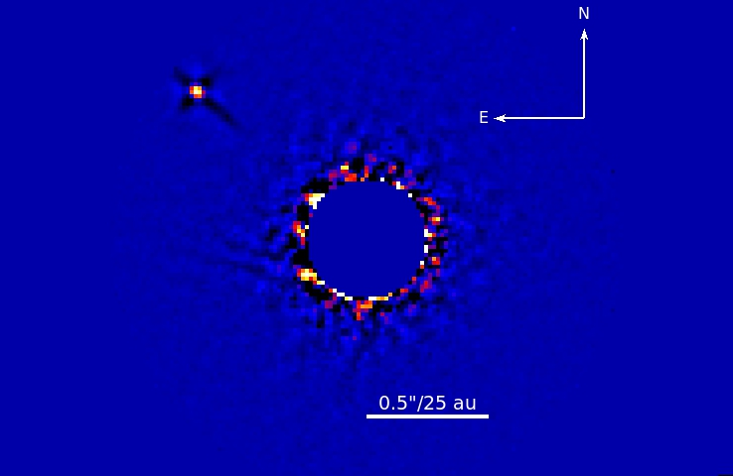
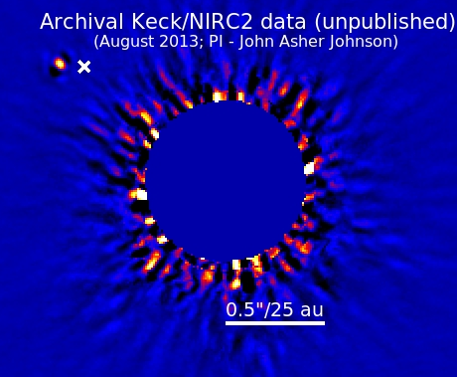
Detections of kappa And b
SCExAO/CHARIS
Strehl Ratio ~0.9-0.92; SNR ~ 210
Combined with archival Keck/NIRC2 data …
Clockwise orbital motion, angular separation is decreasing
Decisive detection despite shallow data
No other companions down to 15 au
~ 5% typical spectrophotometric calibration error/channel
(Currie et al. 2018)
Notes:
Decisive detection despite shallow data
No other companions down to 15 au
~ 5% typical spectrophotometric calibration error/channel
Combined with archival Keck/NIRC2 data …
Clockwise orbital motion, angular separation is decreasing

Slide 6
Near-IR Spectrum of kappa And b
Kappa And b: a L0-L1 low surface gravity (gamma) object
(Currie et al. 2018)

Slide 7
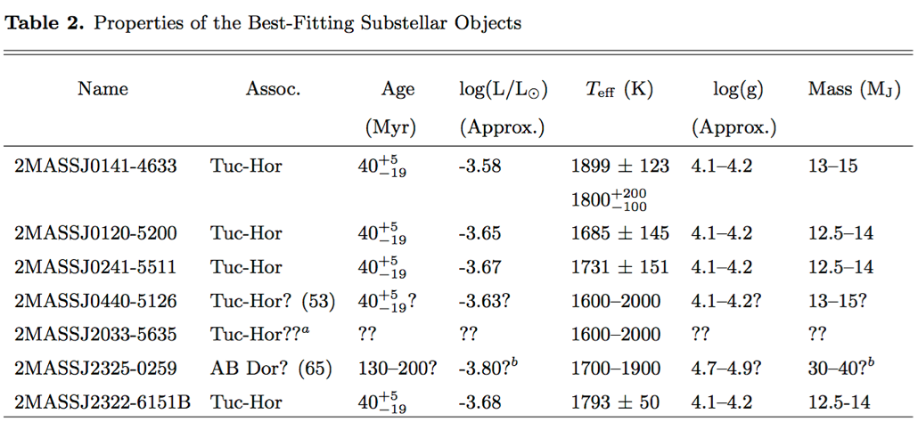
Near-IR Spectrum of kappa And b
Estimated properties: Age ~ 40 Myr, Teff ~ 1700-2000K, log(g) ~ 4—4.5, Mass ~ 13 (+12,-2) Mj
(Currie et al. 2018)

Slide 8
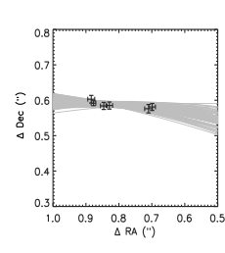
The Orbit of Kappa And b
Eccentric
likely large semimajor axis (a > 75 au)
Possibly aligned with rotation axis of star
(Currie et al. 2018)

Slide 9
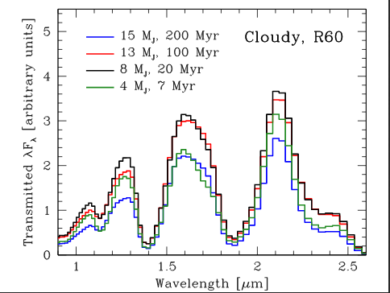
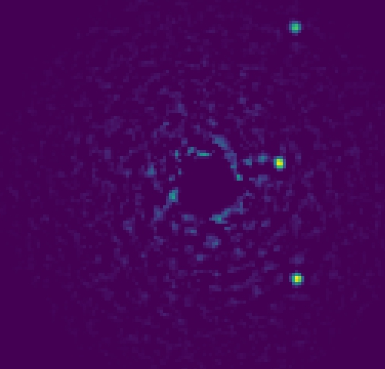
Future Studies with SCExAO
HR 8799
SCExAO/CHARIS (T. Currie 2017)
Similar studies for other objects
Slightly higher resolution spectroscopy in J, H, and K bands
Higher resolution gives getter diagnostic of spectral type and surface gravity

Slide 10
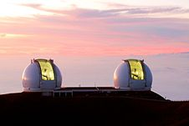
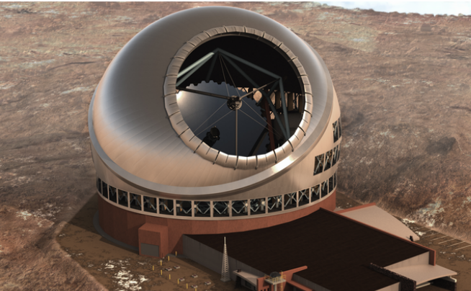
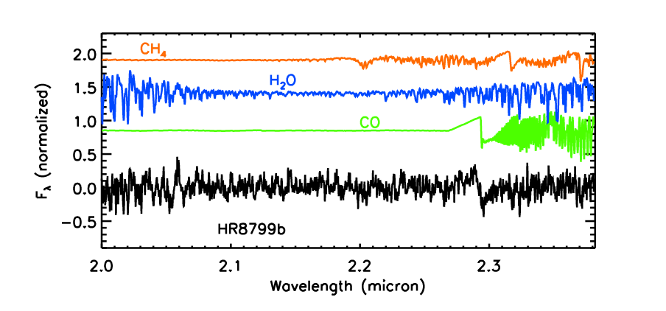
Future Studies at Higher Resolution …
Barman et al. 2015

Slide 11
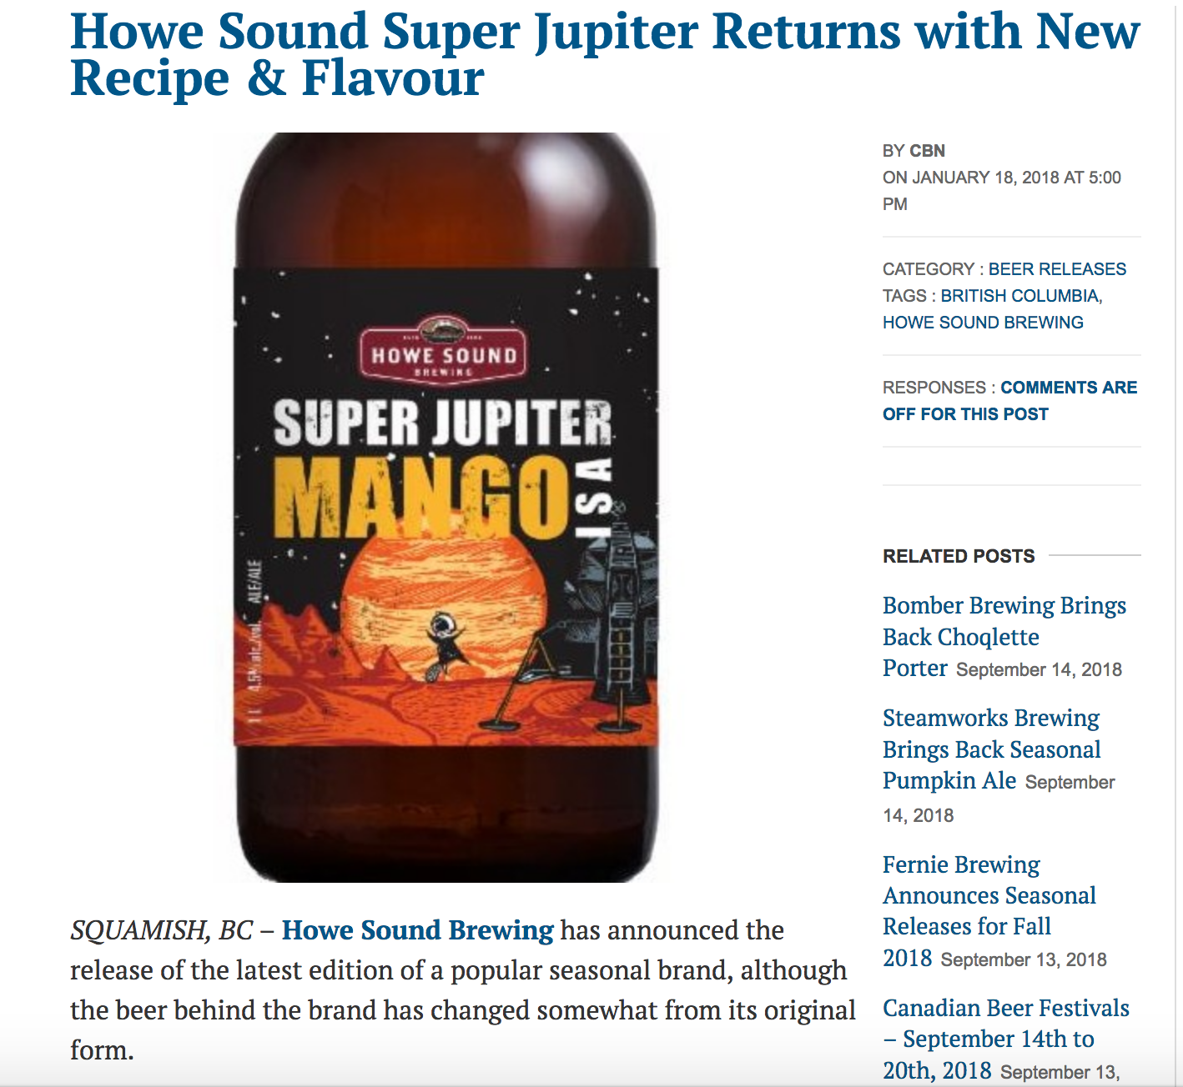
… and Future Beer

Slide 14
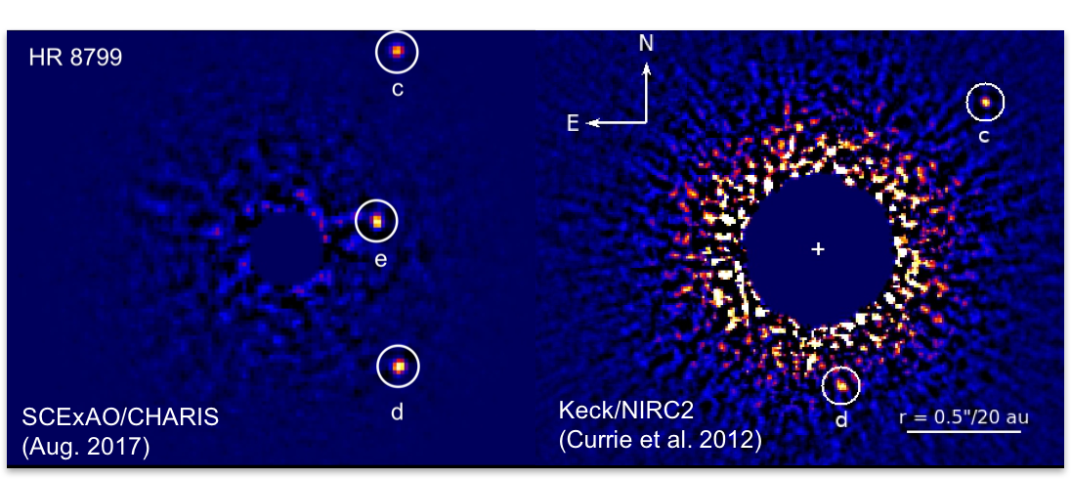
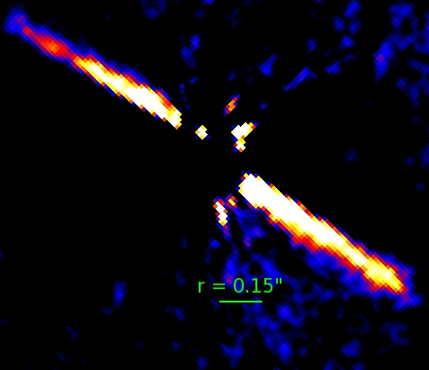
AO Performance
S.R. ~ 0.9 for bright stars under average to good conditions
x-AO correction demonstrated down to I ~ 9

Slide 15
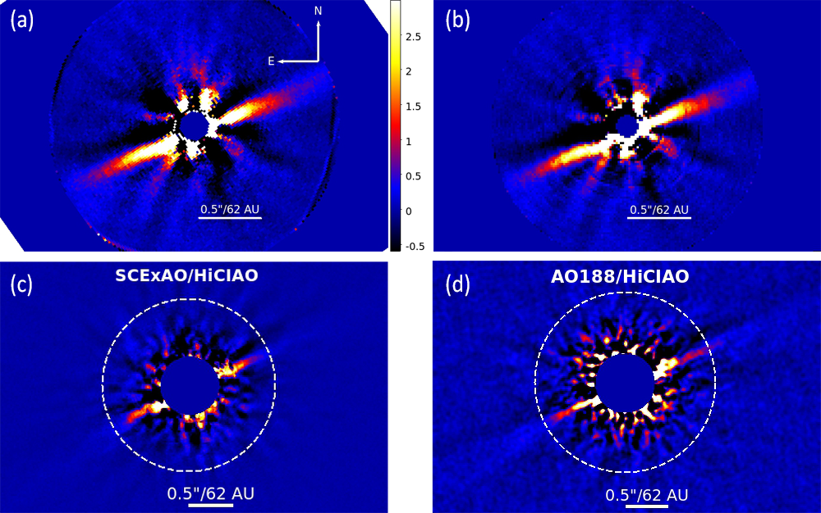
Xxxx Debris Disk Imaged with SCExAO
SCExAO/CHARIS
Goebel, Currie, & Guyon et al. 2018, under review

Slide 16
