Slide 1
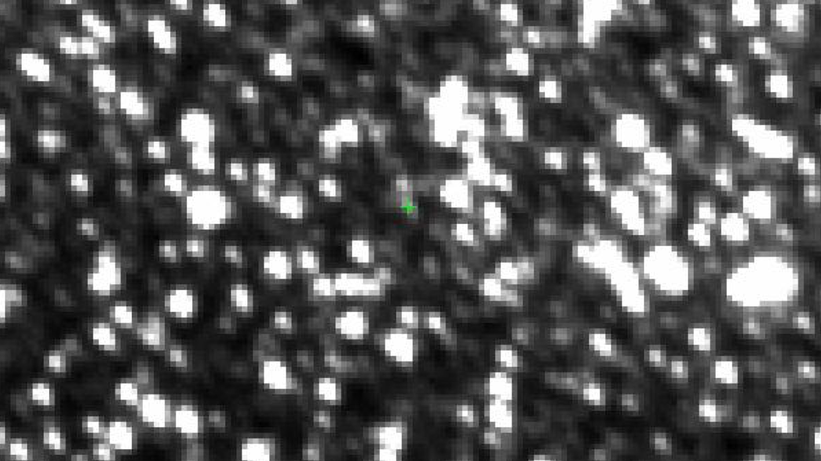
Know Thy Starrrrr (and not-thy-starrrrr), Know Thy Planet
Primary
Collaborators
Chas Beichman (NExScI)
Chris Gelino (NExScI)
Yossi Shvartzvald (JPL)
Jessica Lu (UC Berkeley)
JP Beaulieu (IAP)
David Bennett (Goddard)
Caltech/IPAC-NExScI
Calen B. Henderson
ExSoCal 2018

Slide 2
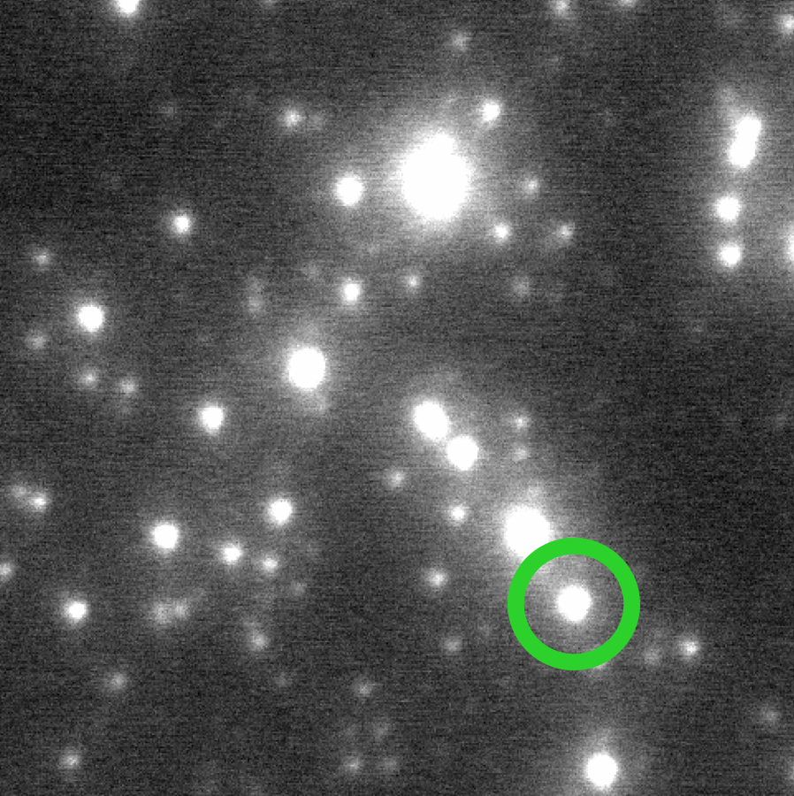
Know Thy Starrrrr (and not-thy-starrrrr), Know Thy Planet
Primary
Collaborators
Chas Beichman (NExScI)
Chris Gelino (NExScI)
Yossi Shvartzvald (JPL)
Jessica Lu (UC Berkeley)
JP Beaulieu (IAP)
David Bennett (Goddard)
Caltech/IPAC-NExScI
Calen B. Henderson
ExSoCal 2018

Slide 3

Know Thy Starrrrr (and not-thy-starrrrr), Know Thy Planet
Primary
Collaborators
Chas Beichman (NExScI)
Chris Gelino (NExScI)
Yossi Shvartzvald (JPL)
Jessica Lu (UC Berkeley)
JP Beaulieu (IAP)
David Bennett (Goddard)
Caltech/IPAC-NExScI
Calen B. Henderson
ExSoCal 2018
Calen B. Henderson

Slide 4
Know Thy Starrrrr (and not-thy-starrrrr), Know Thy Planet
Anyone who dislikes pirate puns
(me)
Primary
Collaborators
Chas Beichman (NExScI)
Chris Gelino (NExScI)
Yossi Shvartzvald (JPL)
Jessica Lu (UC Berkeley)
JP Beaulieu (IAP)
David Bennett (Goddard)
Caltech/IPAC-NExScI
Calen B. Henderson
ExSoCal 2018
Calen B. Henderson

Slide 5
Microlensing Exoplanet Properties:
Mass and Distance
(θ_{E})²
M_{l} =
(1) Einstein Radius:
κ π_{rel}
finite-source effects (ρ)
astrometry

Slide 6
Microlensing Exoplanet Properties:
Mass and Distance
(θ_{E})²
M_{l} =
(1) Einstein Radius:
κ π_{rel}
finite-source effects (ρ)
astrometry
π_{rel}
M_{l} =
(2) Microlens Parallax:
κ (π_{E})²
orbital motion
observer separation

Slide 7
Microlensing Exoplanet Properties:
Mass and Distance
(θ_{E})²
M_{l} =
(1) Einstein Radius:
κ π_{rel}
finite-source effects (ρ)
astrometry
π_{rel}
M_{l} =
(2) Microlens Parallax:
κ (π_{E})²
orbital motion
observer separation
M_{l} =
f(H_{l}, A_{H,l}, M_{l}-L_{l})
(3) Lens Flux:
“prompt” follow-up
spatially resolve lens

Slide 8
Microlensing Exoplanet Properties:
Mass and Distance
(θ_{E})²
M_{l} =
(1) Einstein Radius:
κ π_{rel}
finite-source effects (ρ)
astrometry
π_{rel}
M_{l} =
(2) Microlens Parallax:
κ (π_{E})²
orbital motion
observer separation
M_{l} =
f(H_{l}, A_{H,l}, M_{l}-L_{l})
(3) Lens Flux:
“prompt” follow-up
After event is over!
spatially resolve lens

Slide 9
Microlensing Exoplanet Properties:
Mass and Distance
(θ_{E})²
M_{l} =
(1) Einstein Radius:
κ π_{rel}
finite-source effects (ρ)
astrometry
π_{rel}
Know Thy Starrrrr…
Know Thy Planet!
M_{l} =
(2) Microlens Parallax:
κ (π_{E})²
orbital motion
observer separation
M_{l} =
f(H_{l}, A_{H,l}, M_{l}-L_{l})
(3) Lens Flux:
“prompt” follow-up
After event is over!
spatially resolve lens

Slide 10
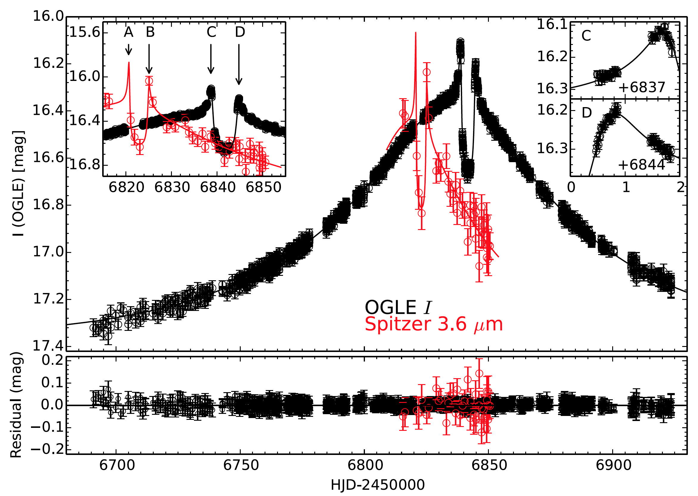
OB140124: Spitzer Target
Udalski+ (2015) ApJ, 799, 237

Slide 11
OB140124: Mass-distance Relations (I)
Udalski+ (2015) ApJ, 799, 237

Slide 12
OB140124: Mass-distance Relations (II)
Udalski+ (2015) ApJ, 799, 237

Slide 13
OB140124: Mass-distance Relations (III)
Udalski+ (2015) ApJ, 799, 237
Beaulieu+ [incl. Henderson] (2018) AJ, 155, 78

Slide 14
OB140124: Mass-distance Relations (III)
Know Thy Starrrrr…
Know Thy Planet!
Udalski+ (2015) ApJ, 799, 237
Beaulieu+ [incl. Henderson] (2018) AJ, 155, 78

Slide 15
OB140124: Mass-distance Relations (III)
Know *Not-Thy* Starrrrr…
Know Thy Planet!
Know Thy Starrrrr…
Know Thy Planet!
Udalski+ (2015) ApJ, 799, 237
Beaulieu+ [incl. Henderson] (2018) AJ, 155, 78

Slide 16
OB161190: Spitzer and K2C9
Ryu+ [incl. Henderson] (2018) AJ, 155, 40

Slide 17
OB161190: Mass-distance Relations (I)
Ryu+ [incl. Henderson] (2018) AJ, 155, 40

Slide 18
OB161190: Mass-distance Relations (II)
Ryu+ [incl. Henderson] (2018) AJ, 155, 40

Slide 19
OB161190: Mass-distance Relations (III)
m_{H} = 18.3
→ lens flux!
Ryu+ [incl. Henderson] (2018) AJ, 155, 40
Henderson+ (preliminary…)

Slide 20
OB161190: Mass-distance Relations (III)
+ 0.5 M☉ M-dwarf
@ 5 kpc (disk)
Ryu+ [incl. Henderson] (2018) AJ, 155, 40
Henderson+ (preliminary…)

Slide 21
OB161190: Mass-distance Relations (III)
+ 0.8 M☉ K-dwarf
@ 8.3 kpc (bulge)
Ryu+ [incl. Henderson] (2018) AJ, 155, 40
Henderson+ (preliminary…)

Slide 22
OB161190: Mass-distance Relations (III)
+ 0.8 M☉ K-dwarf
@ 8.3 kpc (bulge)
Know Not-Thy Starrrrrs…
Know Thy Planet!
Ryu+ [incl. Henderson] (2018) AJ, 155, 40
Henderson+ (preliminary…)

Slide 23
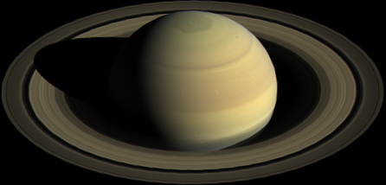
Using Stellar Properties to
Understand Planet Properties
…but:
Isochrones versus empirical mass-luminosity relations
Stellar age is generally unknown
Direct measure of NIR extinction toward lens
Systematic uncertainty in absolute photometric calibration
Blend flux contribution from ambient stars
Blend flux contribution from companion(s) to lens or source
How to reconcile with θ_{E} and π_{E} methodologies?!?

