Slide 1

The NASA/IPAC Teacher Archive Research Program
L. M. Rebull
17 Sep 2018

Slide 2
NITARP: NASA/IPAC Teacher Archive Research Program
Teachers get an authentic research experience using real data and tools.
A small group of educators are paired with mentor astronomer;
Write a proposal (peer reviewed!);
Do research;
Write up results;
Take it to AAS, present in science sessions.
→ Model entire research process (in 13 mo!).
Operating since 2005.
Application for 2019 due last Wednesday!

Slide 3
NITARP trips
Three trips:
  (1) Jan AAS to start (kickoff workshop),
  (2) visit Caltech/JPL for 4 days in Summer,
  (3) Jan AAS to present results
Can bring up to two students per educator on the second 2 trips.
  Raise money for additional 2 students.
Work remotely on project between trips.

Slide 4
Educators first
Aimed primarily at high school teachers.
  Have also had middle school, community college, informal educators benefit.
We work with educators for the leveraging potential and long-term impact.
(We only work with students through their teachers.)

Slide 5
We are Unique (as far as we know)
Our program is aimed at educators.
We select participants from a nation-wide application process.
Our program involves educators for at least 13 months (Jan→ Jan).
Our participants do real research. No cookbooks.
Our participants present their results in the same sessions as professional astronomers, and they must ‘hold their own’ in that domain.
Our participants are encouraged (but not required) to involve students in the entire process.
(Each team has a mentor astronomer, a mentor educator, and 3-4 new educators.)
Notes:
Several programs I know of (in astronomy) can claim subsets of this list, but none I know of hit all of them.

Slide 6
Education Research
FOUR refereed articles in education research in 2018!
One: Overview of NITARP, including lessons learned. (1804.08743)
Two: Overview of programs that get real data & research into the classroom. (1804.08747)
Three: Motivations of Educators for Participating in NITARP. (1805.01381)
Four: Major Outcomes of NITARP. (1805.01387)

Slide 7
Simplest citizen science – reaches many people; hints of bigger picture, but don’t need programming or astrophysics.
Least interested
“Funnel” of interest
Working with real data – reaches fewer people; starting to need deeper technical/programming or astrophysics understanding.
Contributing real data – reaches even fewer people; need to understand what you are doing at least with your own data and how your data fit in.
Original research – very few people; need deep understanding of what you’re doing and why.
Most interested
(Grad school)
(Rebull+ 1804.08747)

Slide 8
Feedback: Making It Better
We get a LOT of good ideas from the participants. We have a big discussion at the AAS where people make suggestions.
We also collect individual surveys (feedback forms) at 4 waypoints (which are also very useful):
  Before first AAS
  After first AAS
  After Summer visit
  After second AAS
(Because of $) have 51 educators from 2010-2013, but only 33 from 2014-2018.
OTOH, have weak surveys 2010-2013, and have much better surveys 2014-2018.

Slide 9
Feedback: Interpretation
Word choice is everything.
Look at the words people use to answer our open-ended questions.
Are they mostly talking about:
  Students (theirs or others on their team)?
  Teachers (that they will share with @home)?
  Their team?
  Colleagues (like-minded teachers)?
  Themselves?
(Rebull+ 1805.01381)

Slide 10
Feedback: Interpretation
Students, teachers: they are thinking about sharing with others – outward focused.
Colleagues, self: they are thinking about their personal learning goals and opportunities – inward focused.
Team: both inward (my team, my project) and outward (working with others on team).
(Rebull+ 1805.01381)

Slide 11
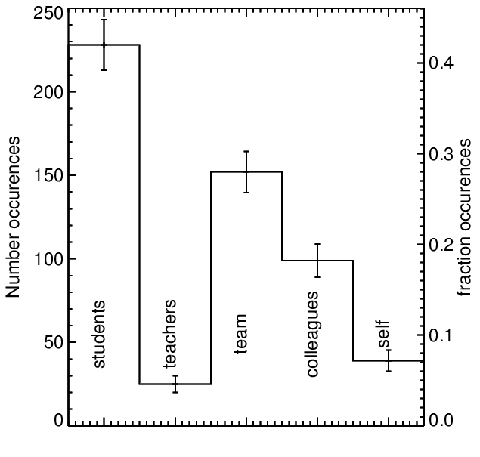
42% - students
28% - team
(Rebull+ 1805.01381)

Slide 12
Important things about interpreting that plot …
(1) These are people for whom being a teacher is more of a calling than a job. They draw strength and motivation from watching their students learn.
(2) These are people who largely work in isolation. They don’t share things regularly with other teachers, and they rarely have an opportunity to work with like-minded colleagues (certainly not across state lines).
(3) Motivation (and how we can help them) may come mostly from their own progress, or from watching students learn.
(Rebull+ 1805.01381)

Slide 13
Teamwork & Sharing
Astronomers collaborate on teams and share results easily and often.
This is not common for teachers.
Teamwork and sharing skills are an important ‘product’ that NITARP gives these teachers.
Sharing happens among team, class, alumni, wider community.
30% of educators list having learned that collaboration is important for being a scientist… and now it is part of their toolkit.
“I now seek out other teachers and opportunities outside of my own school.”
(Rebull+ 1805.01387)

Slide 14
Nature of Science
74% (+/-13%) of educators report some or a major change in their understanding of the nature of science.
  “This experience has completely changed my once shallow view of astronomy and astronomers.”
  My understanding didn’t really change, but …
    More programming than I thought
    Younger people than I thought
    More backgrounds than I thought (...etc.)
(Rebull+ 1805.01387)

Slide 15
Products: Comfort with the Unknown
Astronomers feel stupid all the time. It’s (literally) part of our job description. (And, is also why some people leave science.)
Teachers are the smartest one in (their class) room, and are not used to learning stuff like this, rapidly, in tandem with their students.
NITARP teachers learn how to learn in a new way, provides ‘materials to grow with.’
‘Comfortable frustration level.’
At least 42% explicitly express this in their answers, unprompted.
“I now have the tools to begin seeking out ways to expand this work on my own.”
Want higher quality PD, more like NITARP afterwards!
(Rebull+ 1805.01387)

Slide 16
Products: Life changing!
Unprompted, 11% used the words “life changing” in describing NITARP impact.
“My NITARP experience has made me rethink my entire approach to science education.”
“I know that ‘life-changing experience’ was not one of the outcomes that you hoped for when you planned the program, but it is what happened with me.”
(Rebull+ 1805.01387)

Slide 17
Take-Away Messages
NITARP partners small groups of educators with a research astronomer for a year-long authentic research project in astronomy.
We model the entire research process: proposal→poster
We work with teachers, and through them, students.
We don’t have a big footprint, but we do change lives.
We have been operating since 2005 (so we’ve shaken the bugs out).
(Look for them at the AAS! Ask them good questions!)
Want to work with us on E/PO for your project? Talk to me! rebull@ipac.caltech.edu

