Slide 1

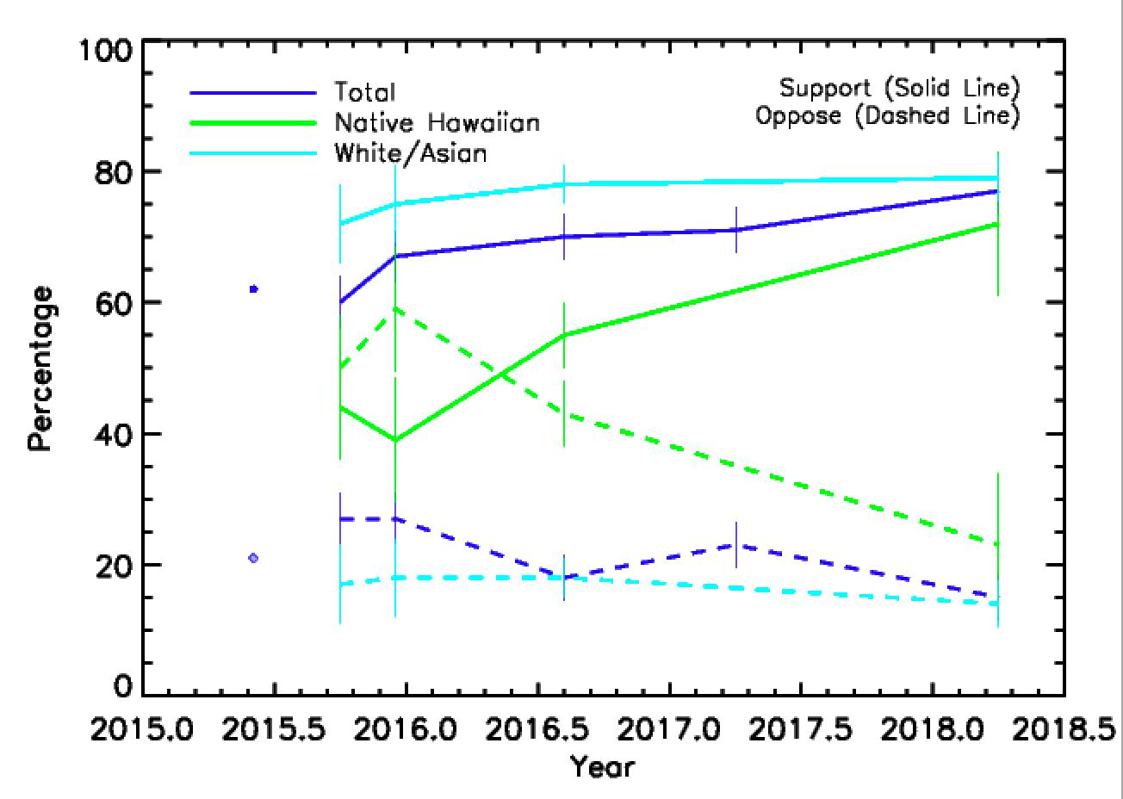
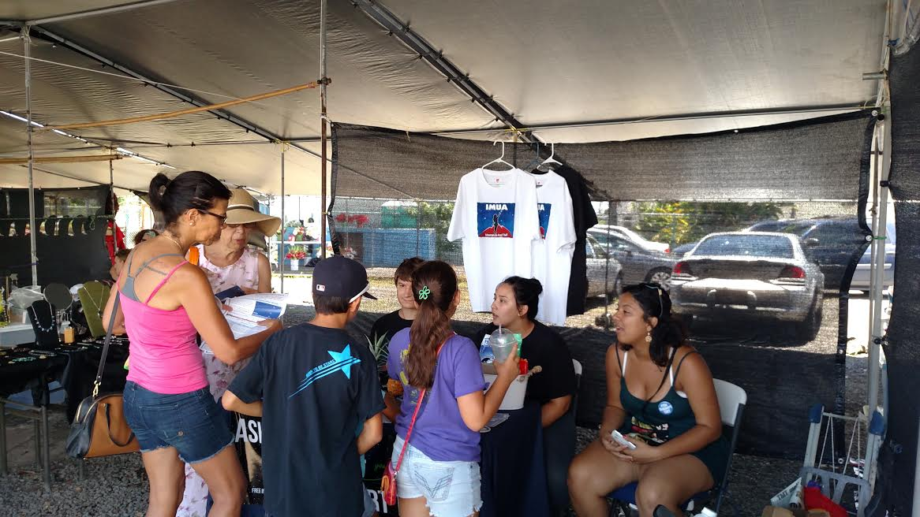
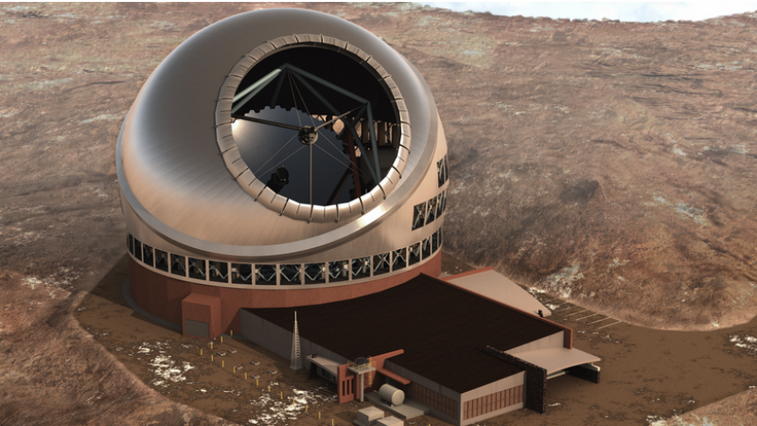
Local Community Advocacy for the Thirty Meter Telescope:
How does Hawaii Really Feel about TMT?And b

