Slide 1
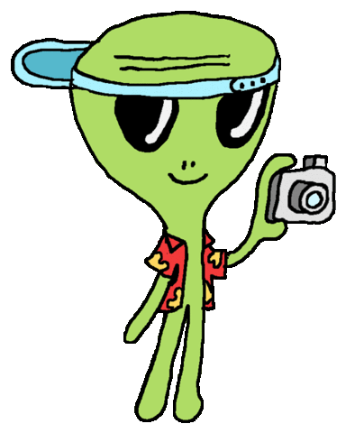
Optimizing
PSF Subtraction Techniques for Exoplanet Imaging
Therese Cook
Mentors: Dr. Dimitri Mawet, Dr. Garreth Ruane

Slide 2
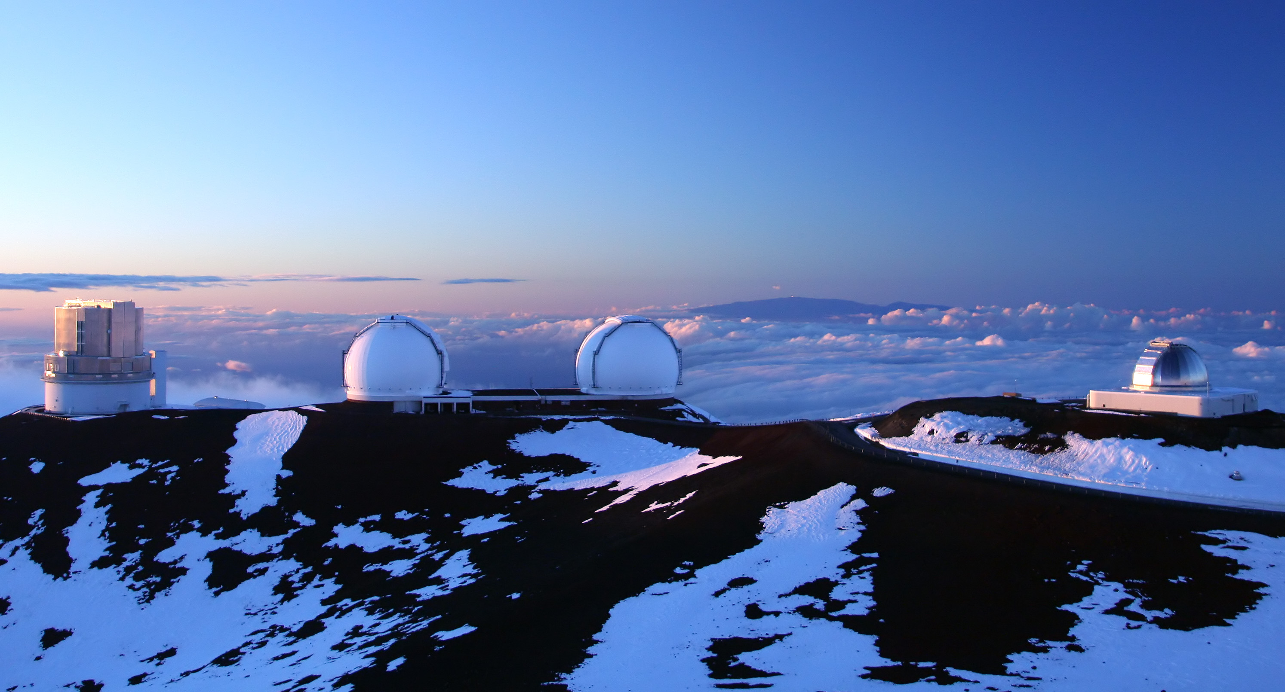
Notes:
- we do HCI using Keck
---
The Vortex team does high contrast imaging using one of the Keck telesopes

Slide 3
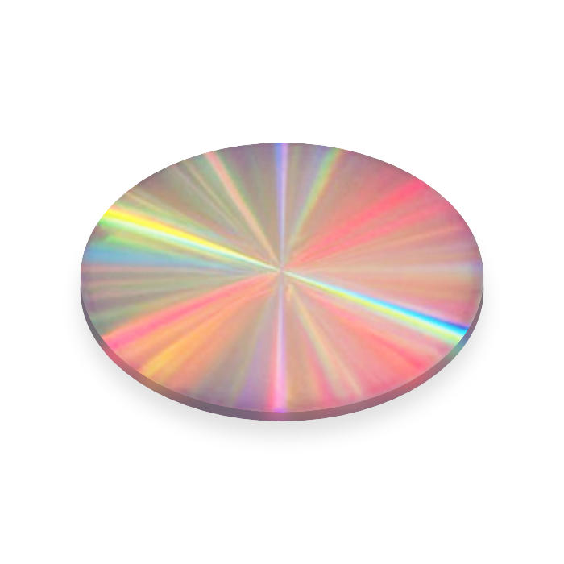
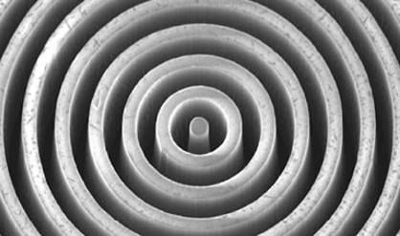
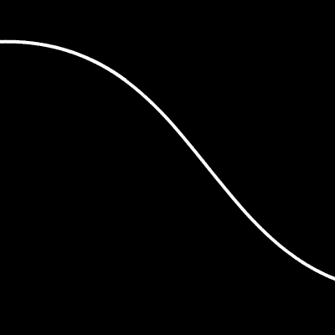
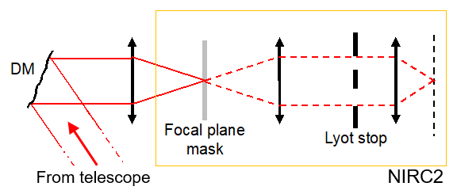
vortex coronagraph
Mid-infrared
L’: 3.4 - 4.1 μm
Notes:
-obs in mid-IR using NIRC2 camera
-use vortex coronagraph
-which blocks enough of a star’s light so we can detect the much fainter planets going around it
---
Our observations are made in the mid-infrared using the NIRC2 camera.
We use the vortex coronagraph, shown here, which blocks enough of a star’s light so we can detect the much fainter planets going around it.

Slide 4
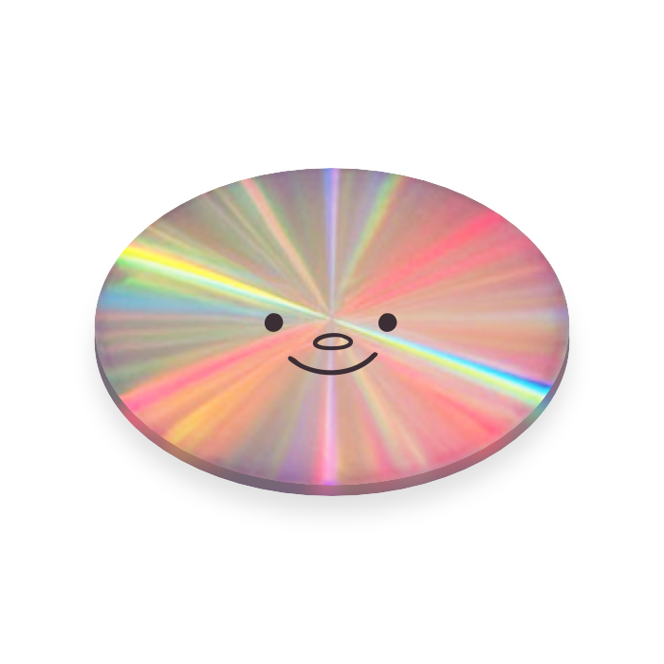
Notes:
So the vortex is cool and all….

Slide 5
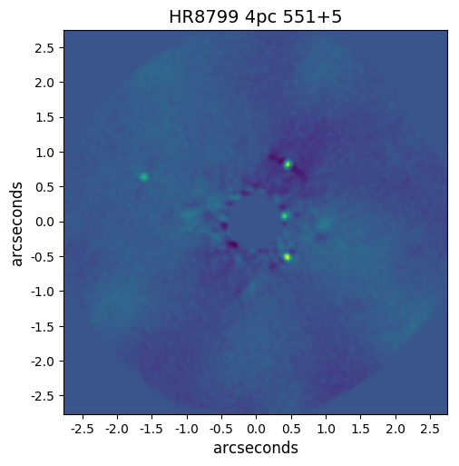
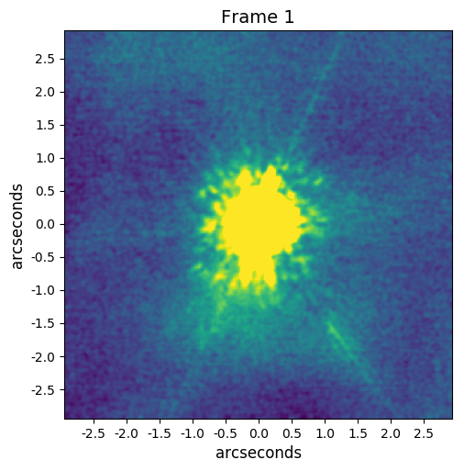
Expectation
Reality
Notes:
….but it isn’t perfect

Slide 6
Expectation
Reality
planets!
“speckles”
Notes:
When we get our photos back, we don’t immediately see any planets.
And that’s because some speckles of starlight manage to make it through the vortex, and we see something like the pic on the right instead.

Slide 7
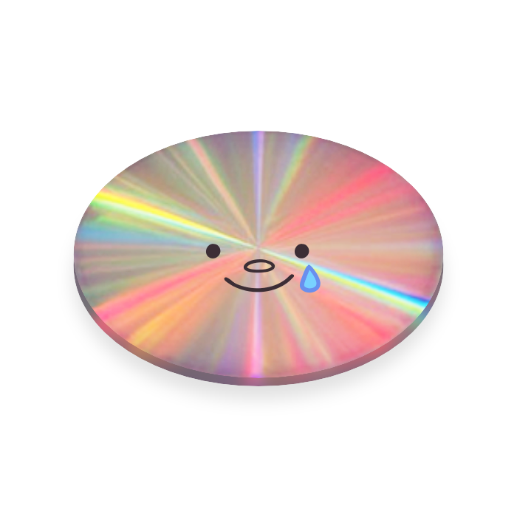
Expectation
Reality
planets!
“speckles”
we need post-processing!
Notes:
Which isn’t what we want! :(
So to get rid of them, we need to perform post-processing on our images.

Slide 8
Expectation
Reality
planets!
“speckles”
(no, not Photoshop)
Notes:
There are a number of different algorithms for this.
(1 min mark!)

Slide 9

ADI
Angular Differential Imaging
Post-processing algorithm
Notes:
This project focuses on ADI, which stands for angular differential imaging.
Here’s how we collect ADI data.

Slide 10

Notes:
ADI makes use of the fact that as the Earth turns, the sky appears to rotate.
[LASER] Let’s say this is the star you want to observe, and this is a planet around it.

Slide 11

Notes:
ADI targets like this star are observed over a couple hours…

Slide 12

Notes:
as they get higher…

Slide 13

Notes:
…then lower in the sky.

Slide 14

Notes:
So over the course of the night, from a camera mounted on an alt-az telescope….

Slide 15
what our camera sees
Notes:
…anything near the star will appear to rotate around it.
ADI takes advantage of this!

Slide 16
ADI
Post-processing steps
Notes:
After we collect the data, we perform ADI to subtract the speckle PSF.

Slide 17
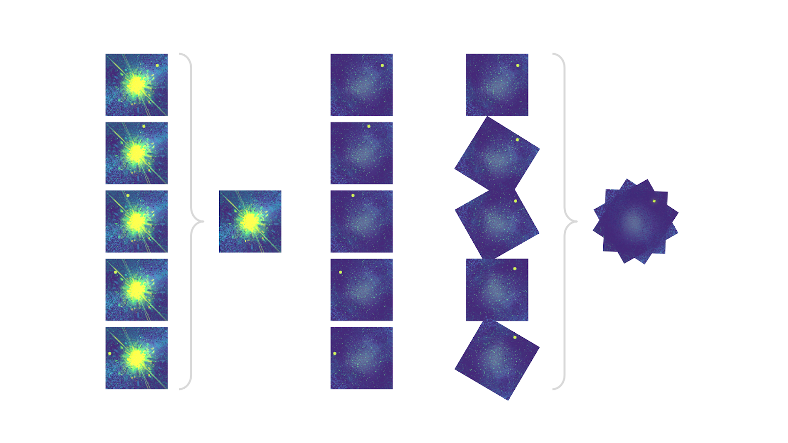
ADI
General Algorithm Steps
create model
of the PSF
(speckle pattern)
stack all post-processed frames to get stronger planet signal!
all science frames
of target star
subtract PSF from all frames
de-rotate to align planet
Notes:
Here’s all the data we got over the night. *click*

Slide 18
ADI
General Algorithm Steps
the planet!
(everything else remains constant)
create model
of the PSF
(speckle pattern)
stack all post-processed frames to get stronger planet signal!
all science frames
of target star
subtract PSF from all frames
de-rotate to align planet
Notes:
Note that the speckle pattern remains constant, while anything real, like a planet, will rotate from frame to frame.

Slide 19
ADI
General Algorithm Steps
create
model PSF
stack all post-processed frames to get stronger planet signal!
all science frames
of target star
subtract PSF from all frames
de-rotate to align planet
Notes:
A general ADI algorithm works like this:
It first combines the speckle noise data from your science frames to create a model PSF.

Slide 20
ADI
General Algorithm Steps
create
model PSF
stack all post-processed frames to get stronger planet signal!
subtract PSF
from all frames
all science frames
of target star
de-rotate to align planet
Notes:
It then subtracts this model from each of the frames. Now, theoretically, only the planet should remain.

Slide 21
ADI
General Algorithm Steps
create
model PSF
stack all post-processed frames to get stronger planet signal!
subtract PSF
from all frames
de-rotate
to align planet
all science frames
of target star
Notes:
Next you de-rotate these frames to align the planet….

Slide 22
ADI
General Algorithm Steps
create
model PSF
stack frames
for stronger signal!
subtract PSF
from all frames
de-rotate
to align planet
all science frames
of target star
Notes:
Then stack everything to get a stronger planet signal!

Slide 23
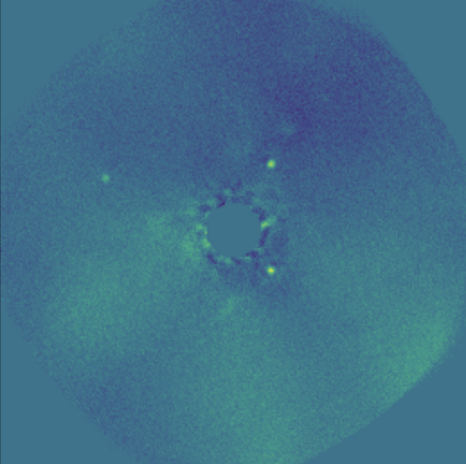
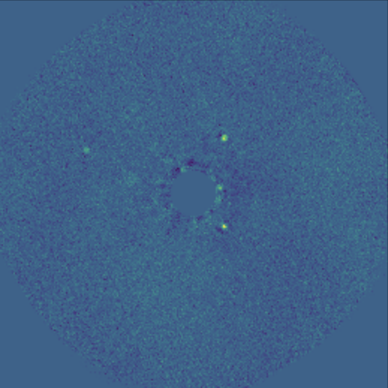
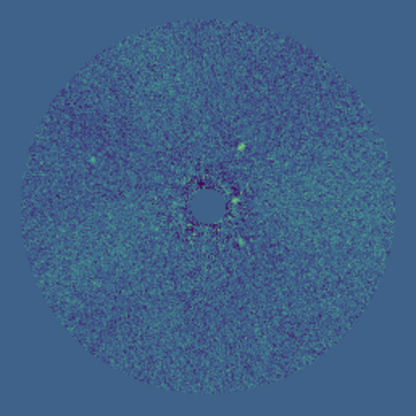
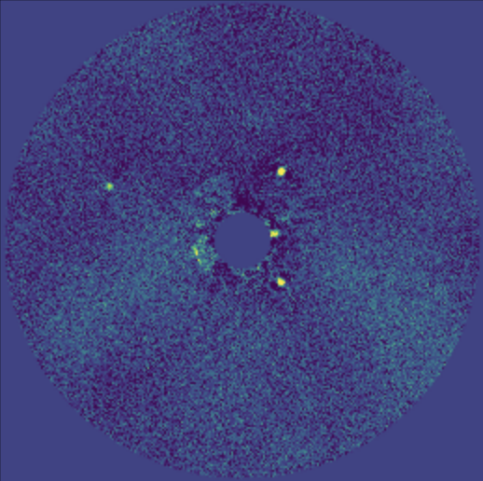
What I Tested:
Variations of ADI
full-frame median sub
full-frame PCA
annular median sub
annular PCA
*different scaling used
Notes:
This project tested some variations of ADI.
(example reductions shown here…warning: image scaling not the same!)

Slide 24
How can ADI change?
Notes:
There are two ways the general steps can be changed.

Slide 25
How can ADI change?
How the image is broken up during post-processing
full-frame
vs.
annular
Notes:
First, you can choose how images are broken up during post-processing.
You can either use the full-frame, or start by cutting the images into circular annuli and do separate post-processing on those.

Slide 26
How can ADI change?
How the image is broken up during post-processing
full-frame
vs.
annular
How the PSF (speckle pattern) is modeled, statistically
perform
PCA
(Principal Component Analysis)
take the
median
of all pixels
or
Notes:
Secondly, you can pick how to statistically model the PSF.
You could take the median of all pixels, or do PCA.

Slide 27
How can ADI change?
How the image is broken up during post-processing
full-frame
vs.
annular
How the PSF (speckle pattern) is modeled, statistically
perform
PCA
(Principal Component Analysis)
take the
median
of all pixels
or
(faster)
(more powerful)
Notes:
PCA takes longer but is powerful since it customizes the PSF you’re subtracting for each frame, resulting in a better fit.

Slide 28
How can ADI change?
ADI methods I tested:
How the image is broken up during post-processing
full-frame
vs.
annular
How the PSF (speckle pattern) is modeled, statistically
perform
PCA
(Principal Component Analysis)
take the
median
of all pixels
or
Notes:
So combining each of these settings, you can create 4 different types of ADI….

Slide 29
How can ADI change?
ADI methods I tested:
+ median sub
Full-frame median subtraction
How the image is broken up during post-processing
full-frame
vs.
annular
How the PSF (speckle pattern) is modeled, statistically
perform
PCA
(Principal Component Analysis)
take the
median
of all pixels
or
Notes:
Full-frame with median subtraction

Slide 30
How can ADI change?
ADI methods I tested:
+ median sub
Full-frame median subtraction
Full-frame PCA
How the image is broken up during post-processing
full-frame
vs.
+ PCA
annular
How the PSF (speckle pattern) is modeled, statistically
perform
PCA
(Principal Component Analysis)
take the
median
of all pixels
or
Notes:
Full-frame with PCA

Slide 31
How can ADI change?
ADI methods I tested:
+ median sub
Full-frame median subtraction
Full-frame PCA
Annular median subtraction
How the image is broken up during post-processing
full-frame
vs.
+ PCA
annular
How the PSF (speckle pattern) is modeled, statistically
+ median sub
perform
PCA
(Principal Component Analysis)
take the
median
of all pixels
or
Notes:
Annular with median subtraction

Slide 32
How can ADI change?
ADI methods I tested:
+ median sub
Full-frame median subtraction
Full-frame PCA
Annular median subtraction
Annular PCA
How the image is broken up during post-processing
full-frame
vs.
+ PCA
annular
How the PSF (speckle pattern) is modeled, statistically
+ median sub
perform
PCA
(Principal Component Analysis)
take the
median
of all pixels
or
+ PCA
Notes:
And annular with PCA.

Slide 33
How can ADI change?
ADI methods I tested:
+ median sub
Full-frame median subtraction
Full-frame PCA
Annular median subtraction
Annular PCA
How the image is broken up during post-processing
full-frame
vs.
what our pipeline does
+ PCA
annular
How the PSF (speckle pattern) is modeled, statistically
+ median sub
perform
PCA
(Principal Component Analysis)
take the
median
of all pixels
or
+ PCA
Notes:
Our pipeline uses full-frame with PCA, so we understand it pretty well.

Slide 34
How can ADI change?
ADI methods I tested:
+ median sub
Full-frame median subtraction
Full-frame PCA
Annular median subtraction
Annular PCA
How the image is broken up during post-processing
full-frame
vs.
+ PCA
annular
How the PSF (speckle pattern) is modeled, statistically
+ median sub
perform
PCA
(Principal Component Analysis)
take the
median
of all pixels
are the annular methods better?
or
+ PCA
🤔
Notes:
So we were interested in comparing this to the performance of newer, annular methods during testing.
(3 min mark!)

Slide 35
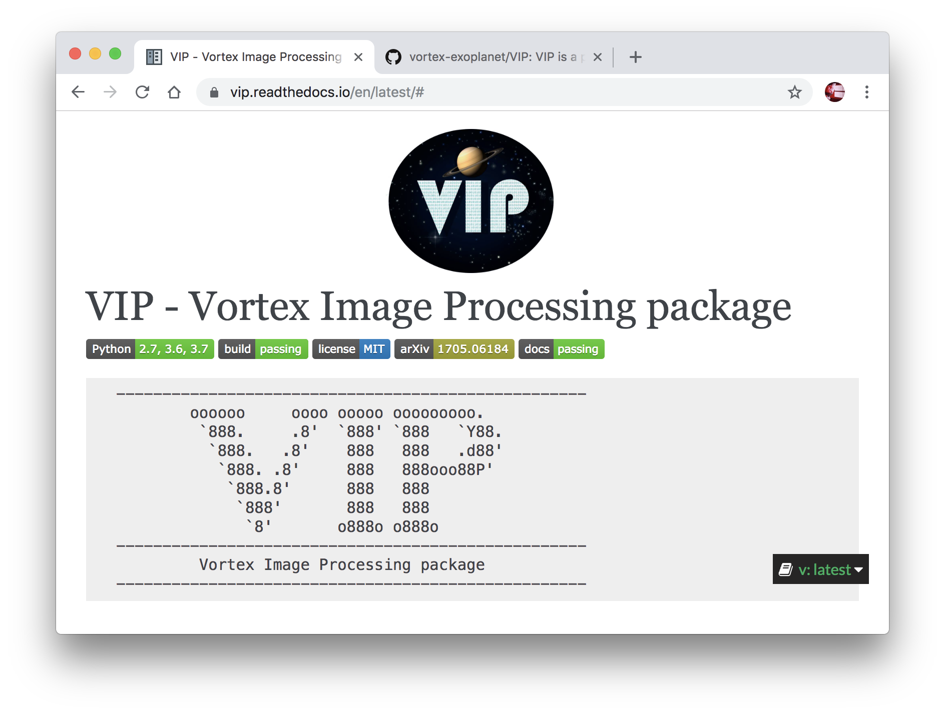

The VIP Annular ADI
Function Variables
pseudocode.py
1 vip.adi(
2 mode = “annular PCA”,
3 data = [ ],
4
5 # Optimize these!
6 delta_rot = 0.5,
7 asize = 4,
8 radius_int = 3,
9 ncomp = 20
10 )
Notes:
To do ADI, we use functions from the VIP python library.
The goal was to optimize the parameters taken by the annular ADI functions.
[CIRCLE EM W/ LASER]

Slide 36
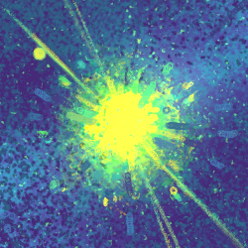
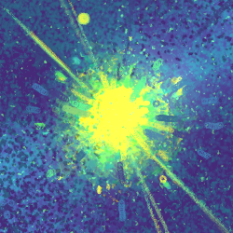
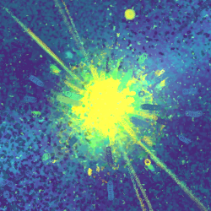
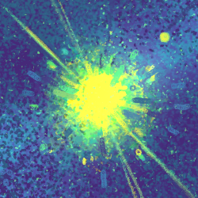
The VIP Annular ADI
Function Variables
pseudocode.py
1 vip.adi(
2 mode = “annular PCA”,
3 data = [ ],
4
5 # Optimize these!
6 delta_rot = 0.5,
7 asize = 4,
8 radius_int = 3,
9 ncomp = 20
10 )
insufficient rotation. discard! 🤖
delta_rot
Sets minimum sky rotation
between science frames
when modelling the PSF.
Notes:
The first parameter is delta rotation.
It sets a minimum amount the sky needs to rotate between adjacent frames when creating the model PSF.
If necessary, frames will be discarded to meet this threshold, resulting in fewer frames being used during the modelling process.
🙅🏻‍♀️ “Not enough rotation. Discard!”

Slide 37
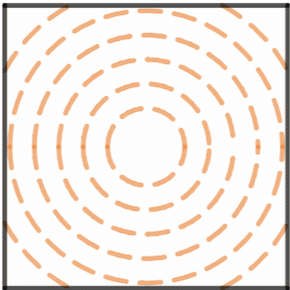
The VIP Annular ADI
Function Variables
pseudocode.py
1 vip.adi(
2 mode = “annular PCA”,
3 data = [ ],
4
5 # Optimize these!
6 delta_rot = 0.5,
7 asize = 4,
8 radius_int = 3,
9 ncomp = 20
10 )
asize
Sets annulus width.
Notes:
Next, asize sets the annulus width.
You can see how adjusting this value changes the annuli.

Slide 38
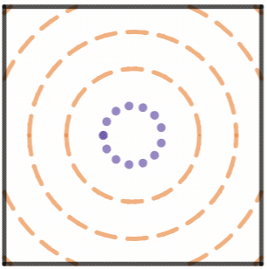
The VIP Annular ADI
Function Variables
pseudocode.py
1 vip.adi(
2 mode = “annular PCA”,
3 data = [ ],
4
5 # Optimize these!
6 delta_rot = 0.5,
7 asize = 4,
8 radius_int = 3,
9 ncomp = 20
10 )
radius_int
Sets central radius
to mask off and ignore.
Notes:
Then there’s radius_int, which specifies how much of the image centers to mask off and ignore.

Slide 39
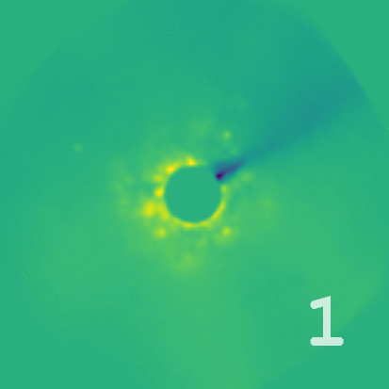
The VIP Annular ADI
Function Variables
pseudocode.py
1 vip.adi(
2 mode = “annular PCA”,
3 data = [ ],
4
5 # Optimize these!
6 delta_rot = 0.5,
7 asize = 4,
8 radius_int = 3,
9 ncomp = 20
10 )
HR8799
ncomp
Sets # of
principal components
to use in PCA.
Notes:
Finally, for PCA methods, ncomp sets the # of principal components to be used.
You can how increasing the number helps make the planets more visible.

Slide 40
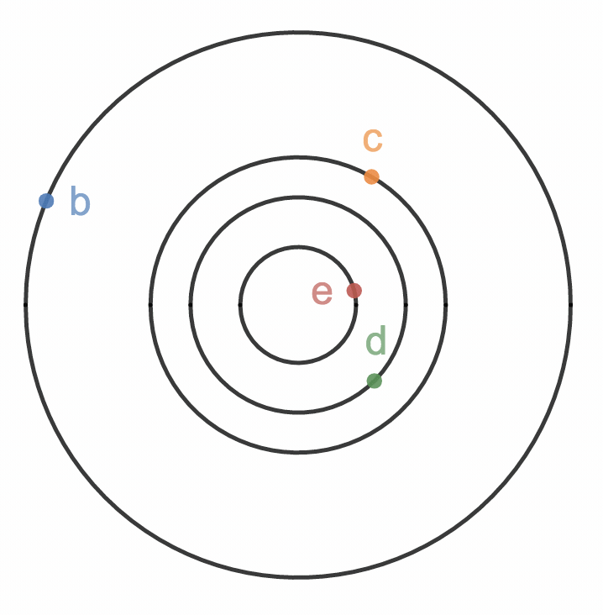
Test case: HR8799 dataset
HR8799 (2016)
Four planets
NIRC2 vortex observation has lots
of science frames + sky rotation
The planet SNRs were maximized
by tuning delta_rot, asize,
radius_int, and ncomp.
Notes:
As a test case, the HR8799 dataset was used,
because it has four planets at various separations and our observation had lots of science frames + sky rotation.
During testing, the SNR of each planet was maximized by tuning the VIP parameters.
(4 min mark!)

Slide 41
Summary of Findings
for Annular Methods
Notes:
So here are the annular ADI results.

Slide 42
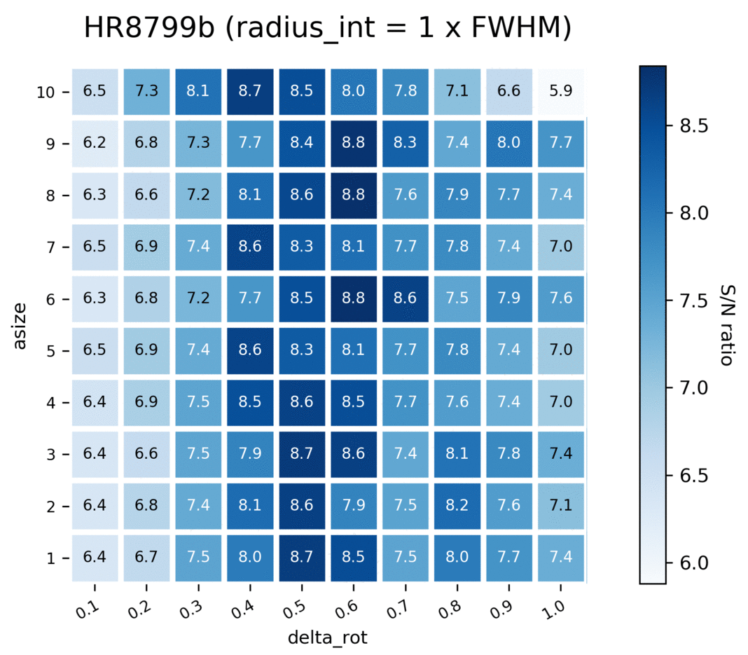
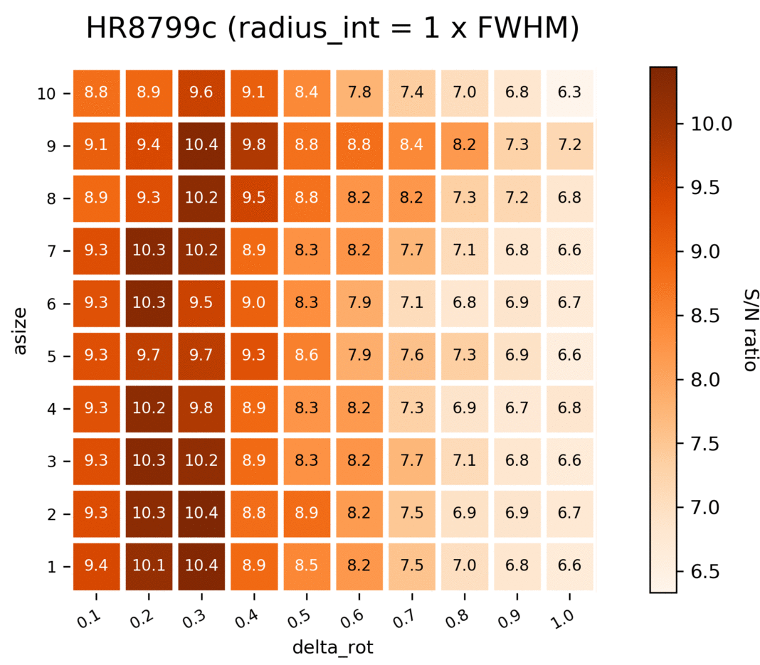
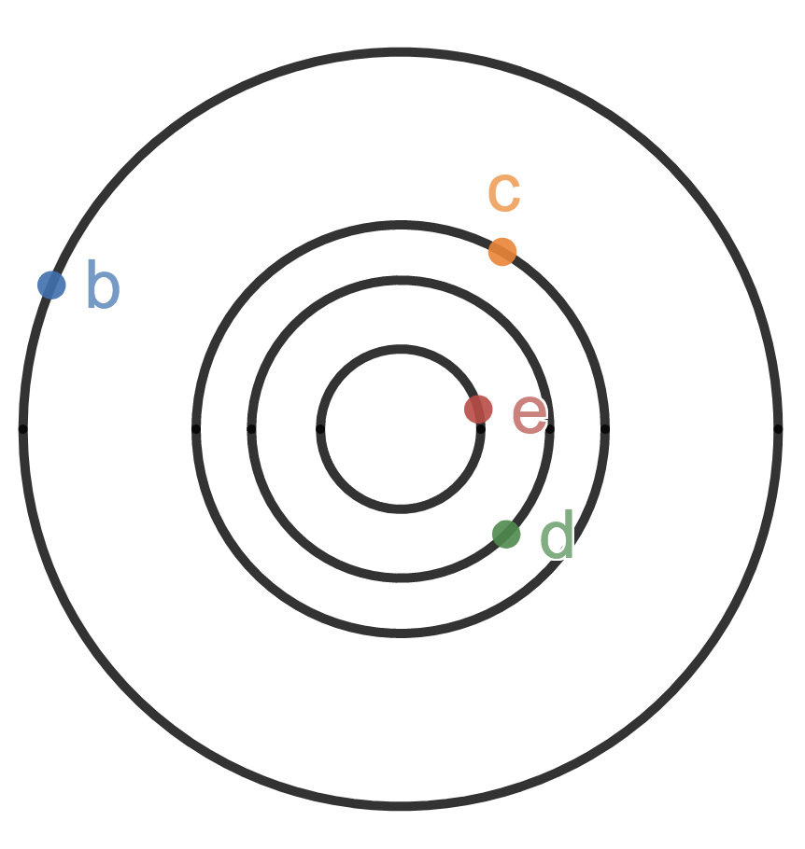
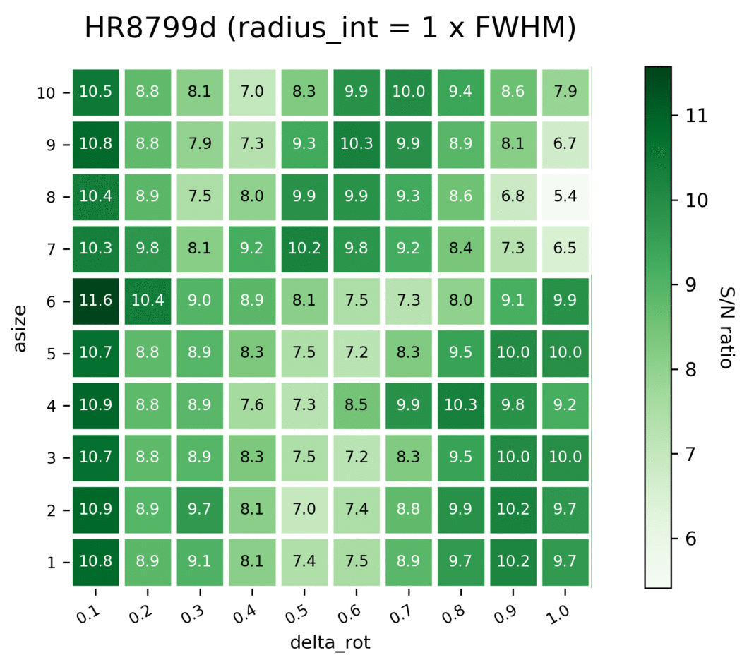
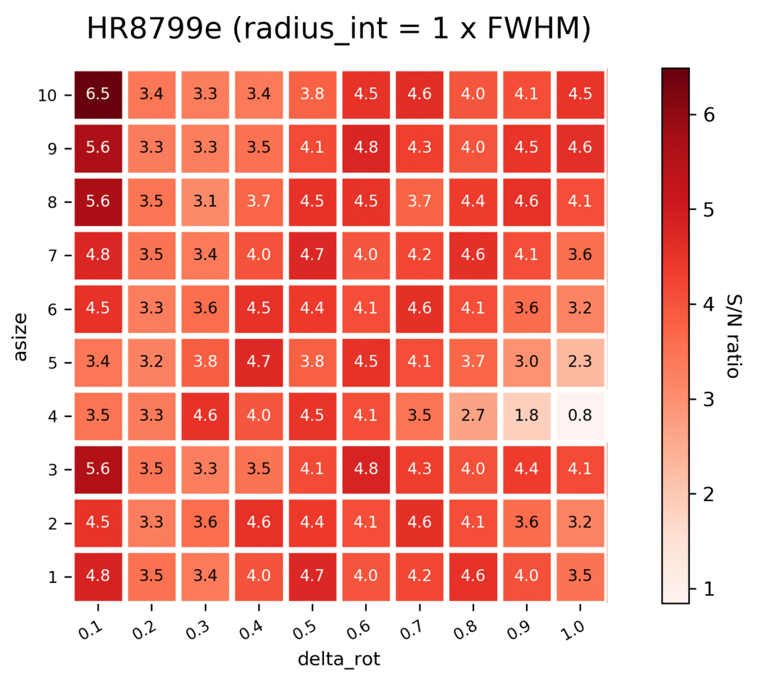
Performance of Annular ADI
+ median sub
Notes:
First, here’s the performance of annular ADI with median subtraction.
These heatmaps show the impact of different variables on the SNR of each planet.
[indicate w/ laser]
This is delta rotation, with higher values meaning more frames are discarded when modelling the PSF.
This is asize, with higher values meaning larger annuli.
And, each frame is set to a different radius_int, with higher values meaning more was masked off from the center of each image during ADI.
For each planet, notice there are columns where the SNR is pretty good.
This shows that delta_rot has a big effect on the SNR of a planet, while asize and radius_int don’t.
(note: the FWHM for Keck NIRC2 is about 8 pixels)

Slide 43
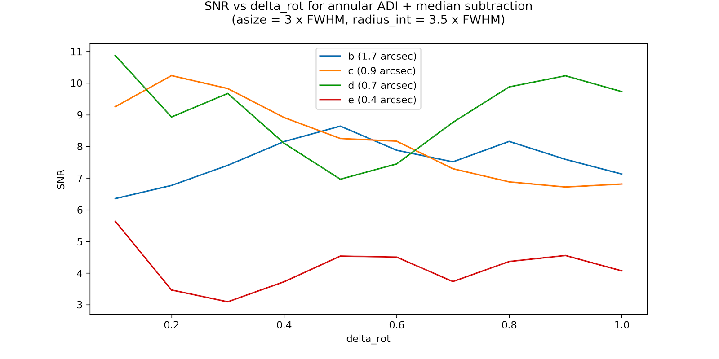
Typical SNR vs. delta_rot
for annular ADI + median subtraction
Planet SNR
asize = 3 radius_int = 3.5
.
in terms of NIRC2 FWHM, ~ 8 px
delta_rot
Notes:
Here’s what a typical SNR vs. delta_rot graph would look like for each planet to illustrate this point.
Add max SNR markers 📍
Get rid of legend, re-do it nicely
Literally highlight fact that low delta_rot is ideal (on duplicated slide maybe)
Note: test delta_rot = 0 😐 someday not now lmao.. Also go out to like 5???

Slide 44
Typical SNR vs. delta_rot
for annular ADI + median subtraction
Planet SNR
asize = 3 radius_int = 3.5
.
in terms of NIRC2 FWHM, ~ 8 px
Low delta_rot (0.1-0.5) is ideal
delta_rot
Notes:
Note that the SNR tends to be best for low delta_rot values (0.1-0.5).
Add max SNR markers 📍
Get rid of legend, re-do it nicely
Literally highlight fact that low delta_rot is ideal (on duplicated slide maybe)
Note: test delta_rot = 0 😐 someday not now lmao.. Also go out to like 5???

Slide 45
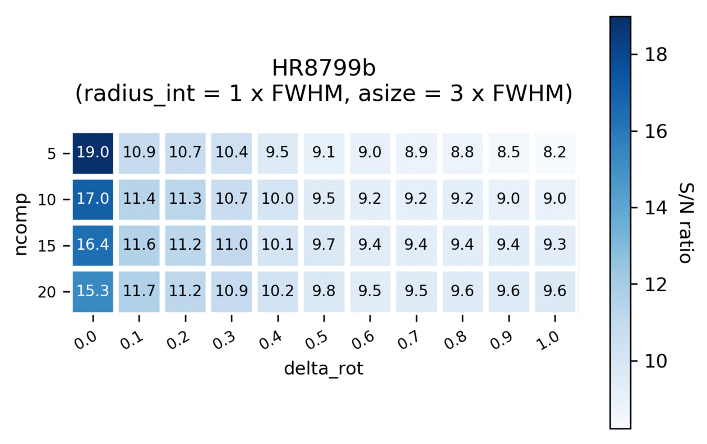
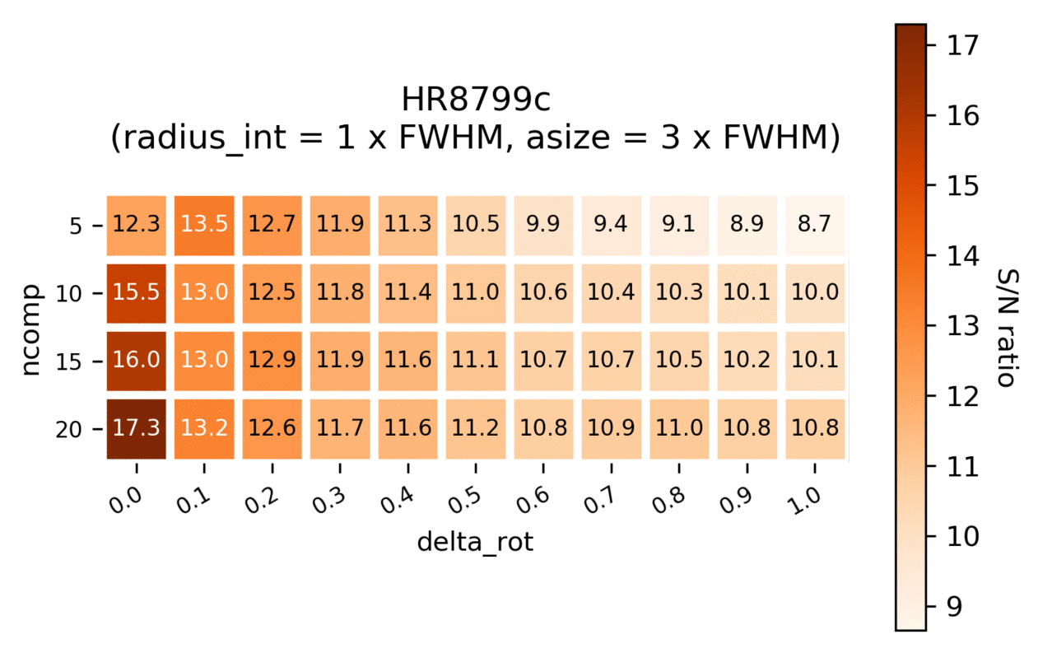
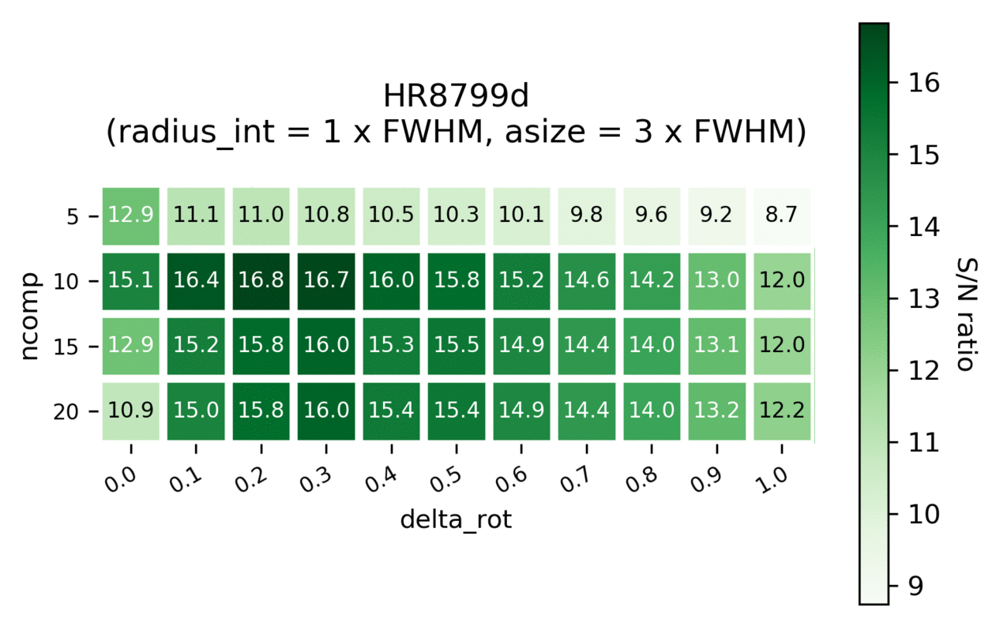
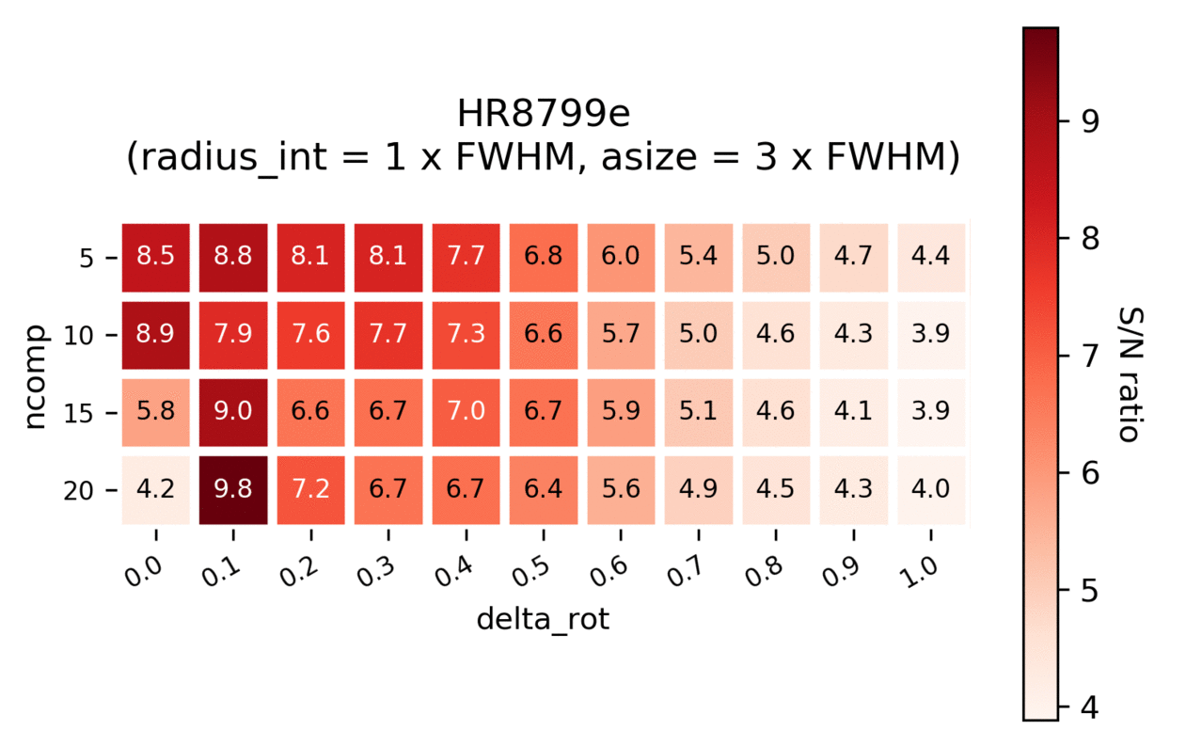
Performance of Annular ADI
+ PCA
Notes:
Next, here is the performance of annular ADI with PCA.
Note delta_rot is still along the bottom axis, but now asize is held at a constant 3.
The vertical axis is the # of components used in PCA.
Each frame still represents a new radius_int size.
Here, it turns out both the number of components and delta_rot have a big effect on the SNR for annular ADI with PCA.

Slide 46
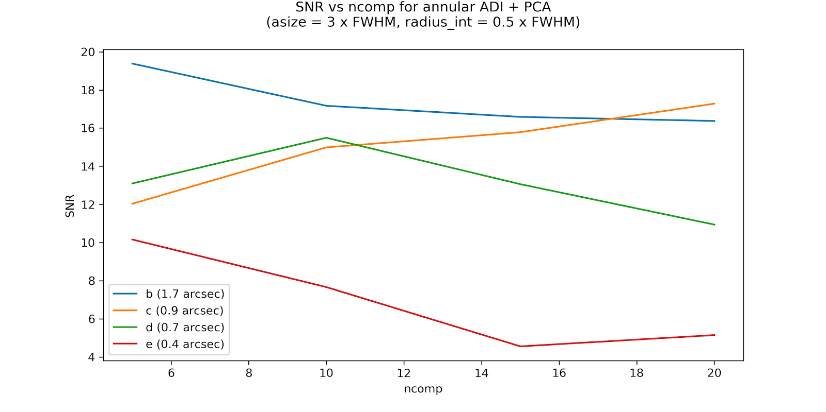
Typical Annular ADI + PCA SNR
delta_rot = 0
Notes:
Here it shows how big an of an impact ncomp has on the SNR of each planet. [indicate w/ laser]
Note that delta_rot is held constant at 0, meaning all science frames were used to model the PSF, as this value was ideal for most cases.

Slide 47
Optimal SNR achieved across methods
full-frame median
full-frame PCA
annular median
annular PCA
b
2.3 | 16.8 | 9.0 | 19.6
5.0 | 13.4 | 10.5 | 17.3
6.2 | 16.6 | 11.6 | 17.1
2.8 | 9.6 | 6.7 | 10.2
c
d
e
Notes:
Here’s some optimized planet SNRs measured for each ADI method.
Annular PCA was the best for all of the planets! It beat full-frame PCA (which our pipeline currently uses) by quite a bit. However, it takes about twice as long to run.
(6:15ish mark!)

Slide 48
Future Plans for Annular ADI
Notes:
Annular ADI can be added to our data reduction pipeline, so it can be used not only for future observations, but for the hundreds we already have from the past 3 years of NIRC2 vortex observing.
We may find planets that the full-frame methods missed!
---
Add annular smiley omg
MAKE IT BLINK
WITH PLANETS WOW
and vortex too just chillin :o)

Slide 49


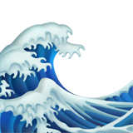

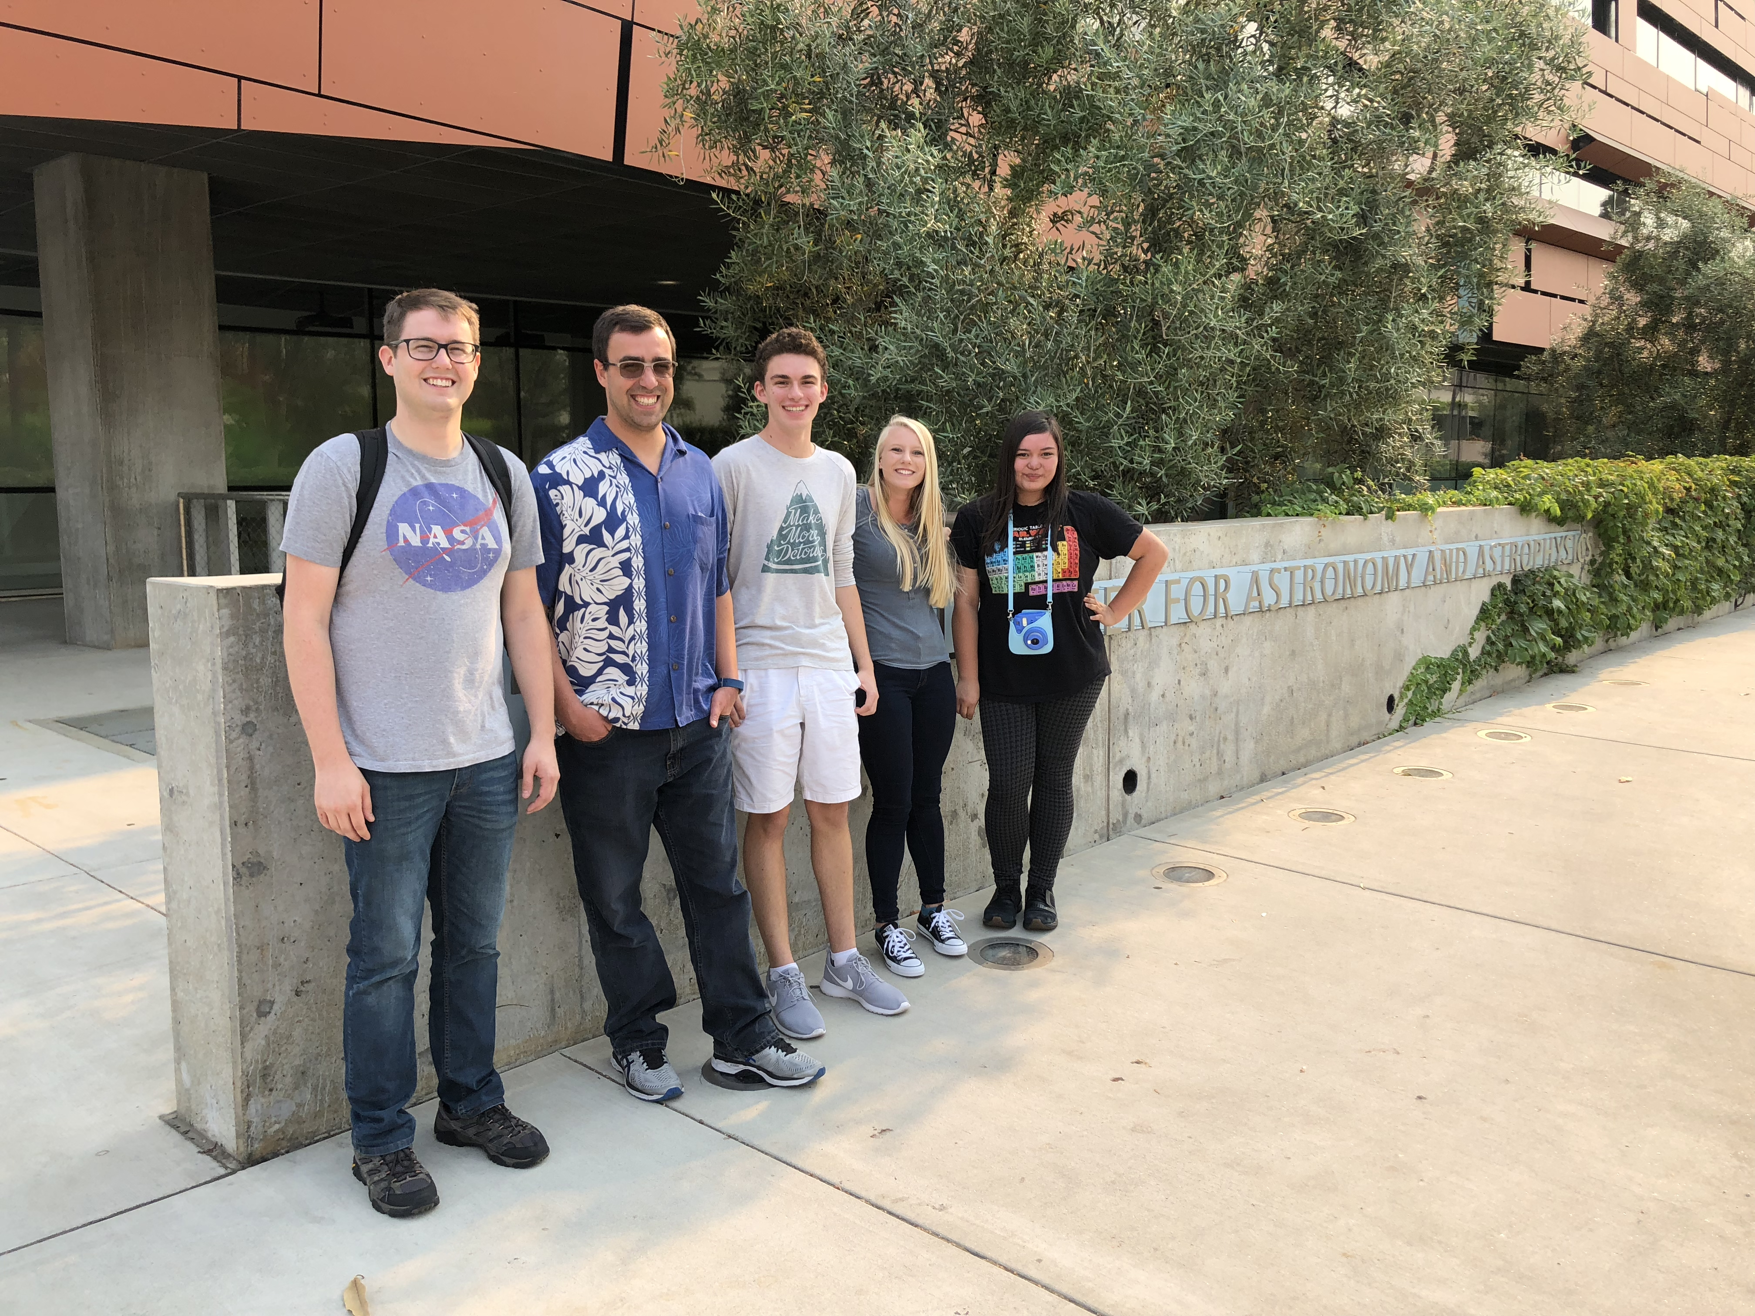
Dr. Mawet, Dr. Ruane,
and the Vortex team
SFP and SURF
Thank You!
Notes:
I’m very grateful to the vortex team and the SURF program for giving me the opportunity to be here!

Slide 50

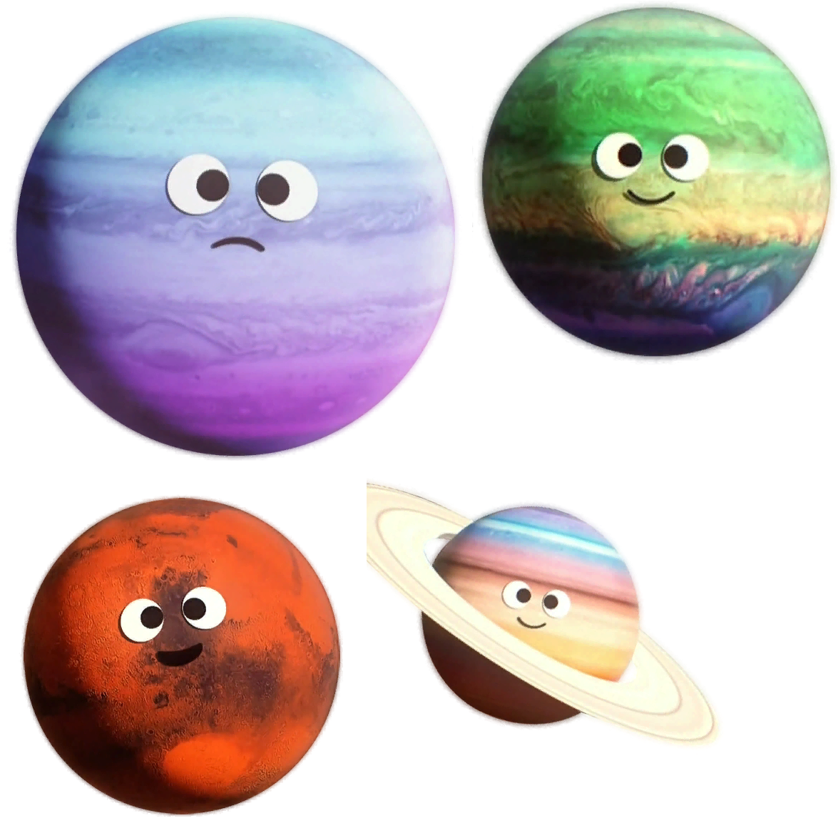
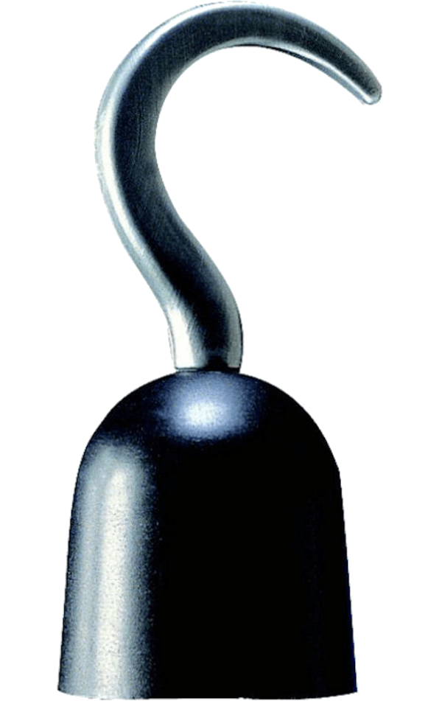
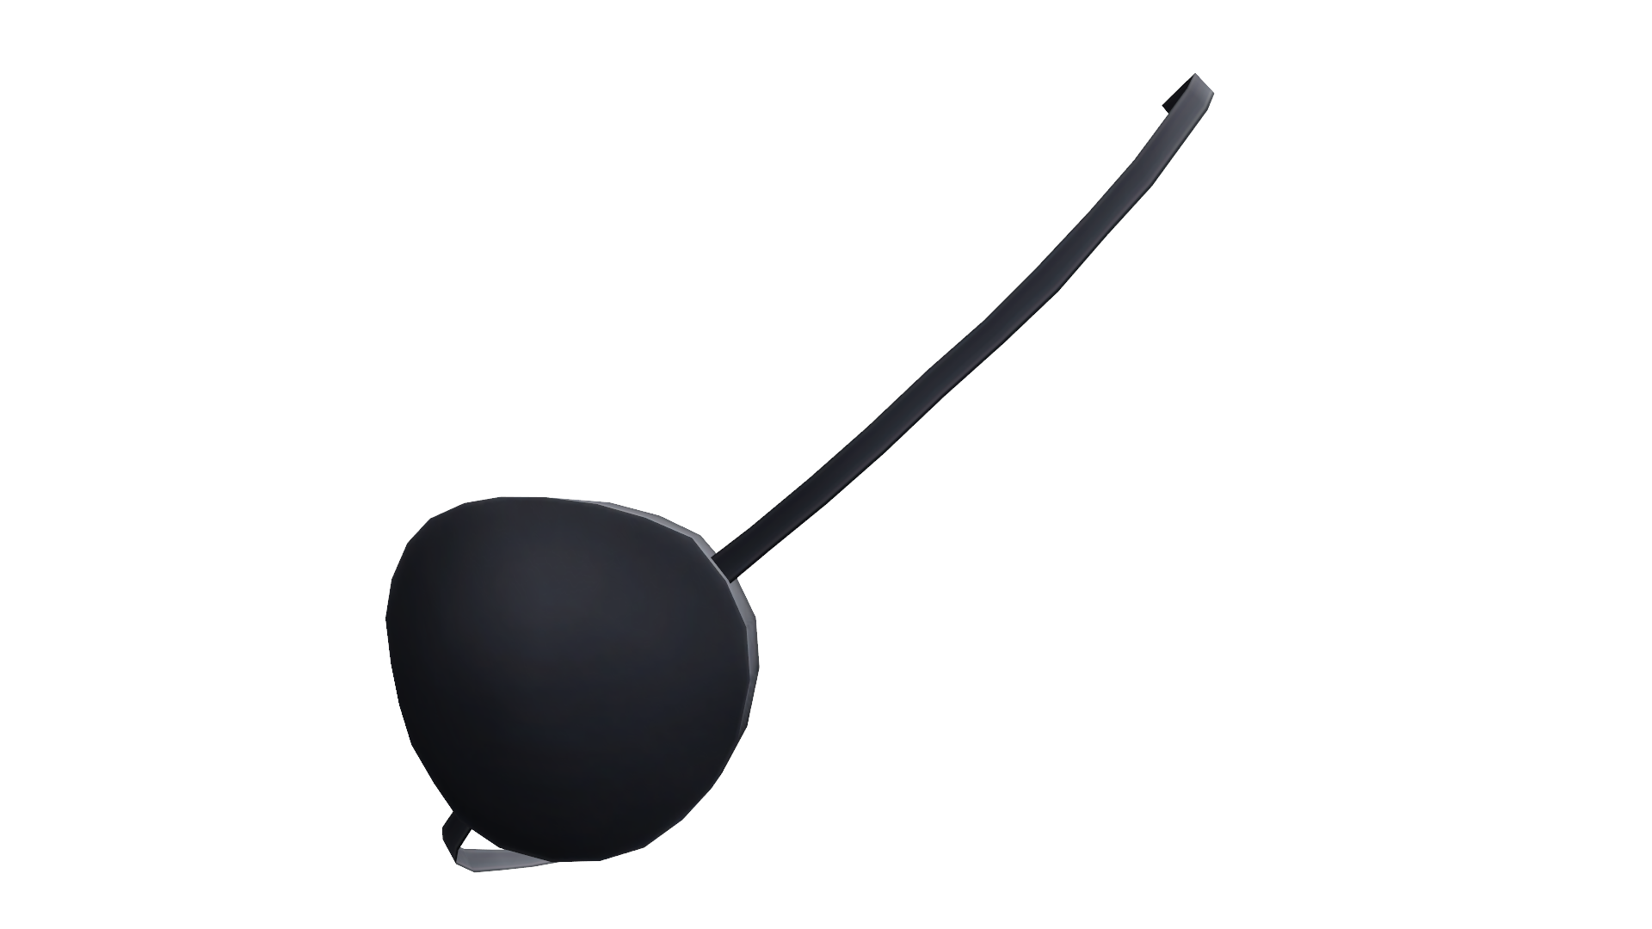

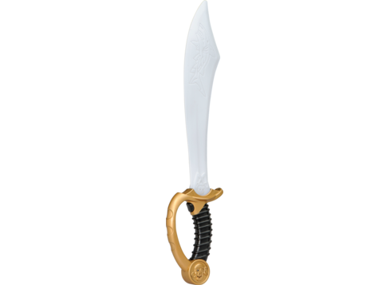
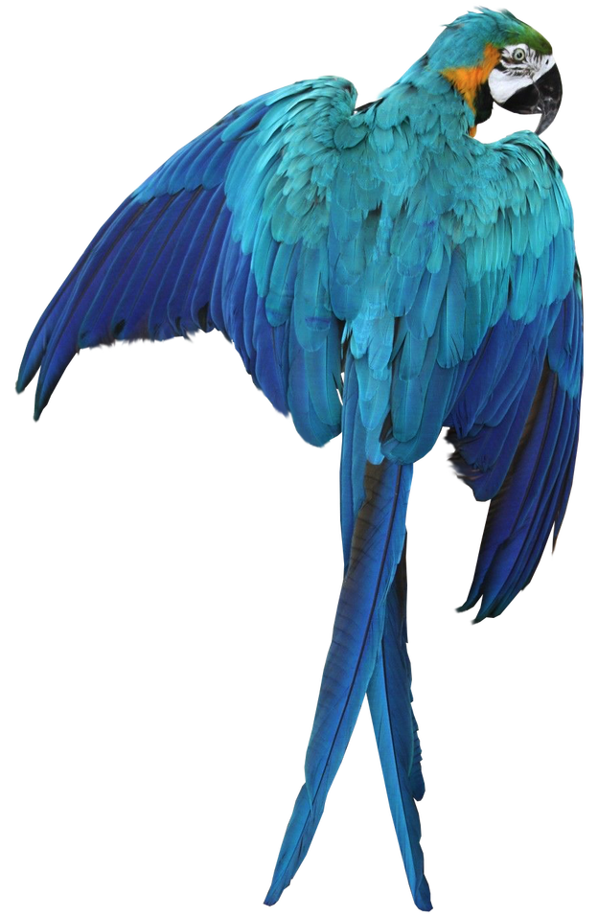
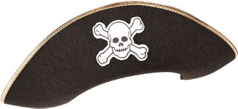
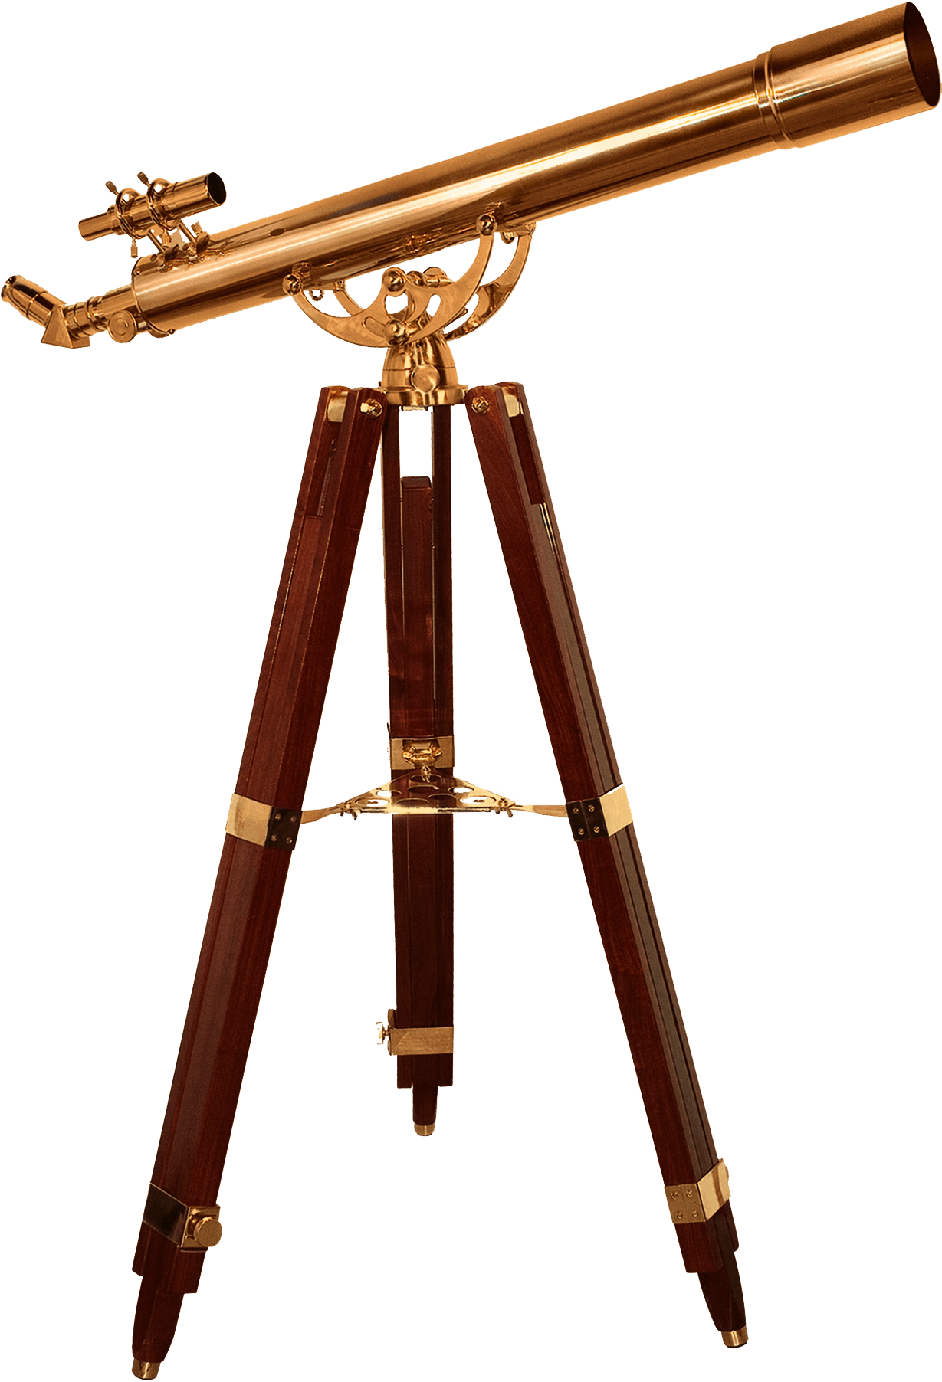
Any riddles
fer me?
(ask me questions)
Notes:
Thank you very much. ☺

