Slide 1
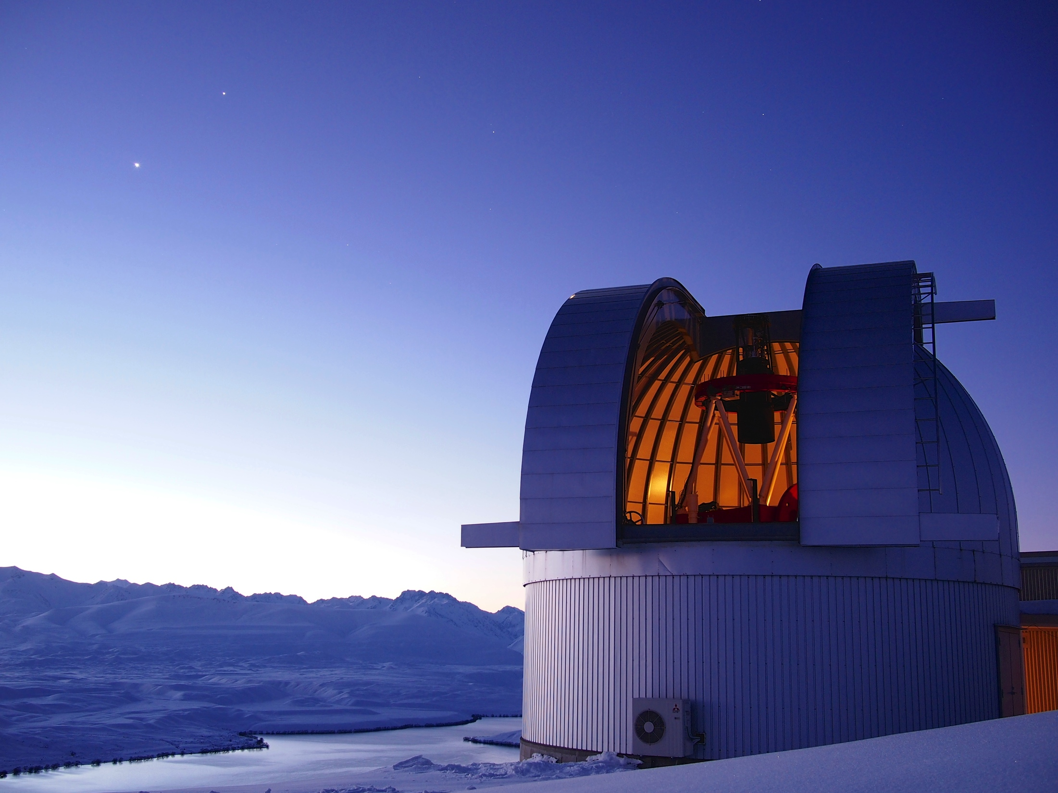
2017 Sagan Summer Workshop
Microlensing in the Era of WFIRST
The Mass Function of Planets Measured from Microlensing
Daisuke Suzuki
ISAS / JAXA
the MOA collaboration
August 8, 2017
Notes:
I’m Daisuke Suzuki, from ISAS/JAXA.
I’ll talk about the mass function of planets measured from microlensing.

Slide 2
Exoplanets Discoveries VS Snow Line
Transit
Kepler (KOIs)
Radial Velocity
Direct Imaging
Microlensing
  No constraints
  Some constraints
  Mass Measurements
a_{snow} = 2.7 (M/M_{Sun}) AU
http://exoplanet.eu/
http://exoplanetarchive.ipac.caltech.edu/
Notes:
This figure shows the distribution of detected planets so far on the semi-major axis and planets mass plane.
But the semi-major axis is normalized by the snow line, beyond which it is cold enough for water to condense into solid ices.
Then as you can see, microlensing planets which are plotted with red circles are mainly located just beyond the snow line.
So, the microlensing method is very sensitive to planets in this region, which is the most efficient planet birth place.
Also the other detection methods are not sensitive to the small planets in this region.
So, each detection of microlensing planet is very important.
But to compare these detections with planet formation theory such as population synthesis model, we have to consider survey completeness or detection efficiency.
----- Meeting Notes (8/2/15 21:02) -----
most efficient planet birth place

Slide 3
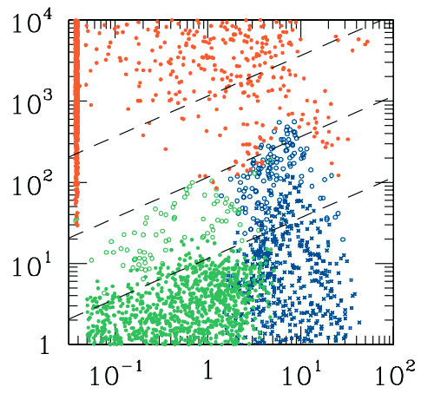
Exoplanets Discoveries VS Snow Line
Transit
Kepler (KOIs)
Radial Velocity
Direct Imaging
Microlensing
  No constraints
  Some constraints
  Mass Measurements
Mass (M_{Earth})
a_{snow} = 2.7 (M/M_{Sun}) AU
http://exoplanet.eu/
http://exoplanetarchive.ipac.caltech.edu/
Semi major axis (AU)
Ida & Lin04
Notes:
This figure shows the distribution of detected planets so far on the semi-major axis and planets mass plane.
But the semi-major axis is normalized by the snow line, beyond which it is cold enough for water to condense into solid ices.
Then as you can see, microlensing planets which are plotted with red circles are mainly located just beyond the snow line.
So, the microlensing method is very sensitive to planets in this region, which is the most efficient planet birth place.
Also the other detection methods are not sensitive to the small planets in this region.
So, each detection of microlensing planet is very important.
But to compare these detections with planet formation theory such as population synthesis model, we have to consider survey completeness or detection efficiency.
----- Meeting Notes (8/2/15 21:02) -----
most efficient planet birth place

Slide 4
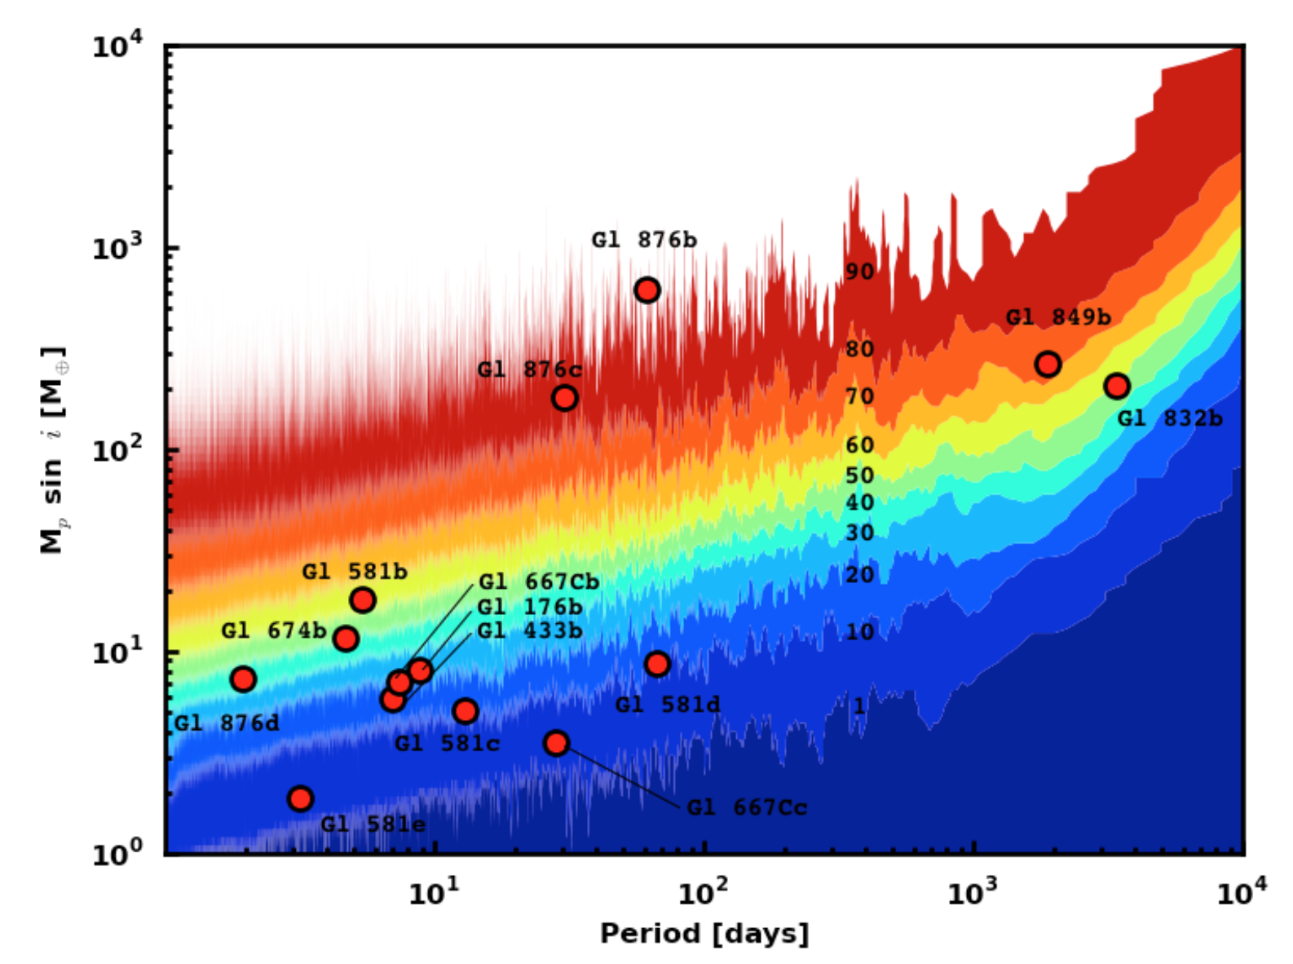
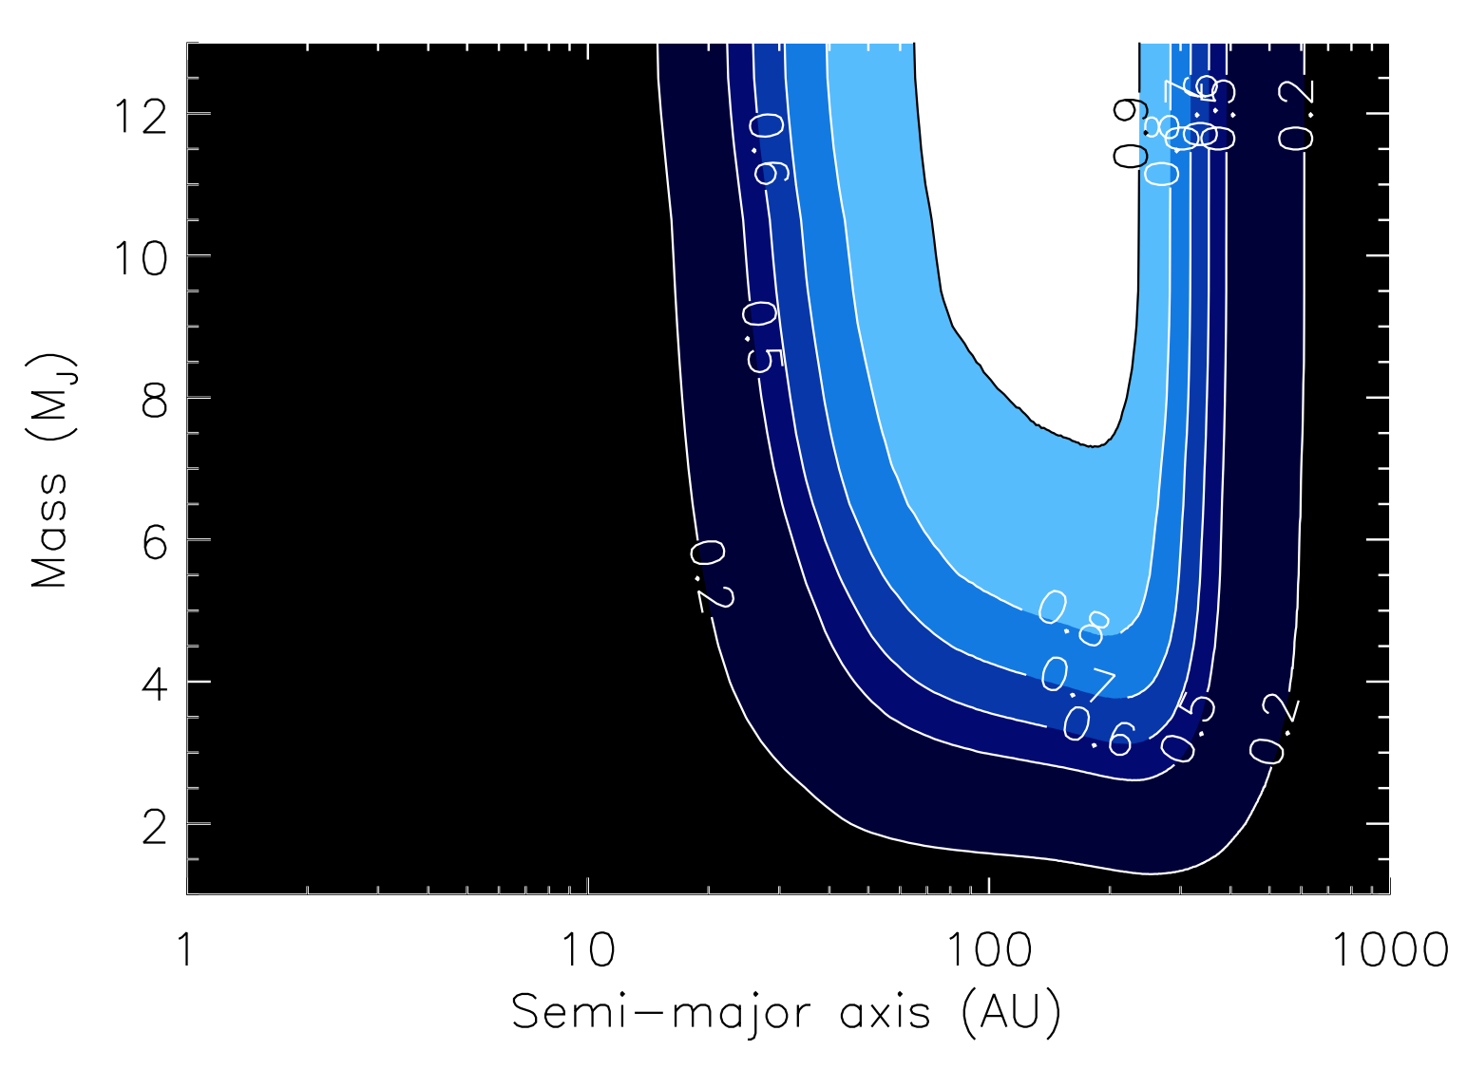
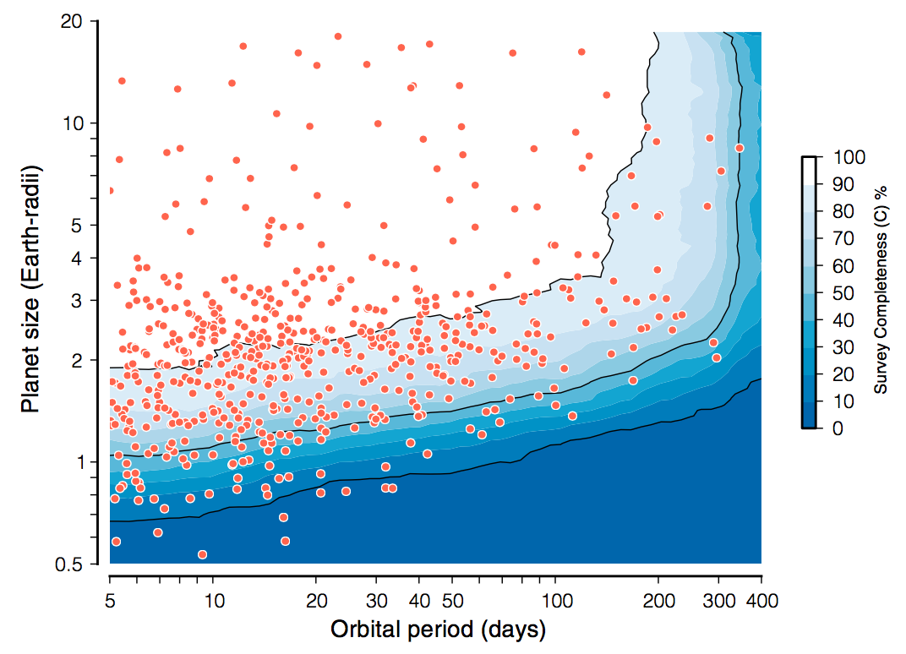
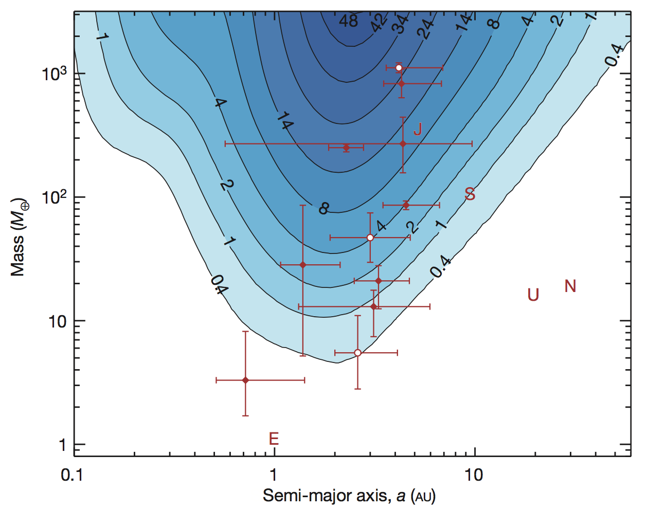
Detection Efficiency (completeness)

Slide 5
Detection Efficiency (completeness)
RV
DI
Transit
µLens

Slide 6
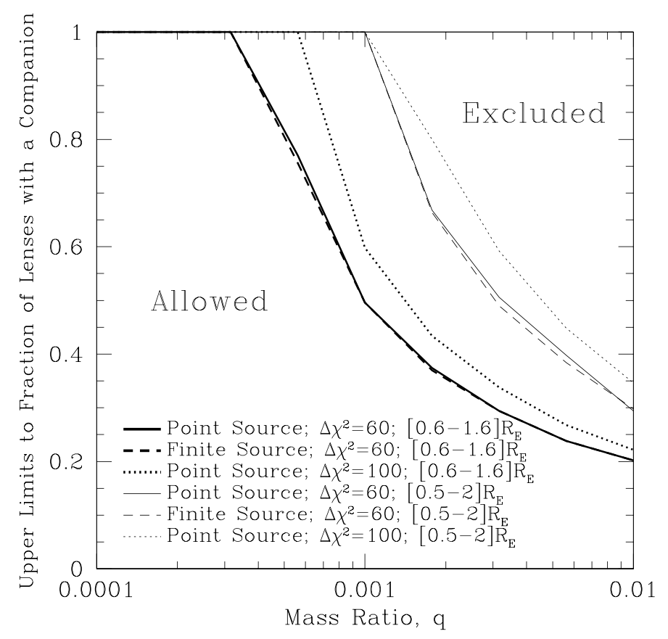
Planet Frequency from Microlensing
Before the first detection of planetary microlensing event
5yr (95-99) PLANET data based on EROS, MACHO, OGLE survey alerts
No planet detection: upper limit on the planet frequency
Gaudi+02
2002

Slide 7
Planet Frequency from Microlensing
Robust estimate using two different type of detections (low and high mag channels for OB05390 (0.22 M_{Sun}) and OB05169 (0.69 M_{Sun})
f = 0.38^{+0.31}_{-0.22} (90%C.L.) at q = 8×10⁻⁵
Gould+06
Gaudi+02
2002
2006

Slide 8
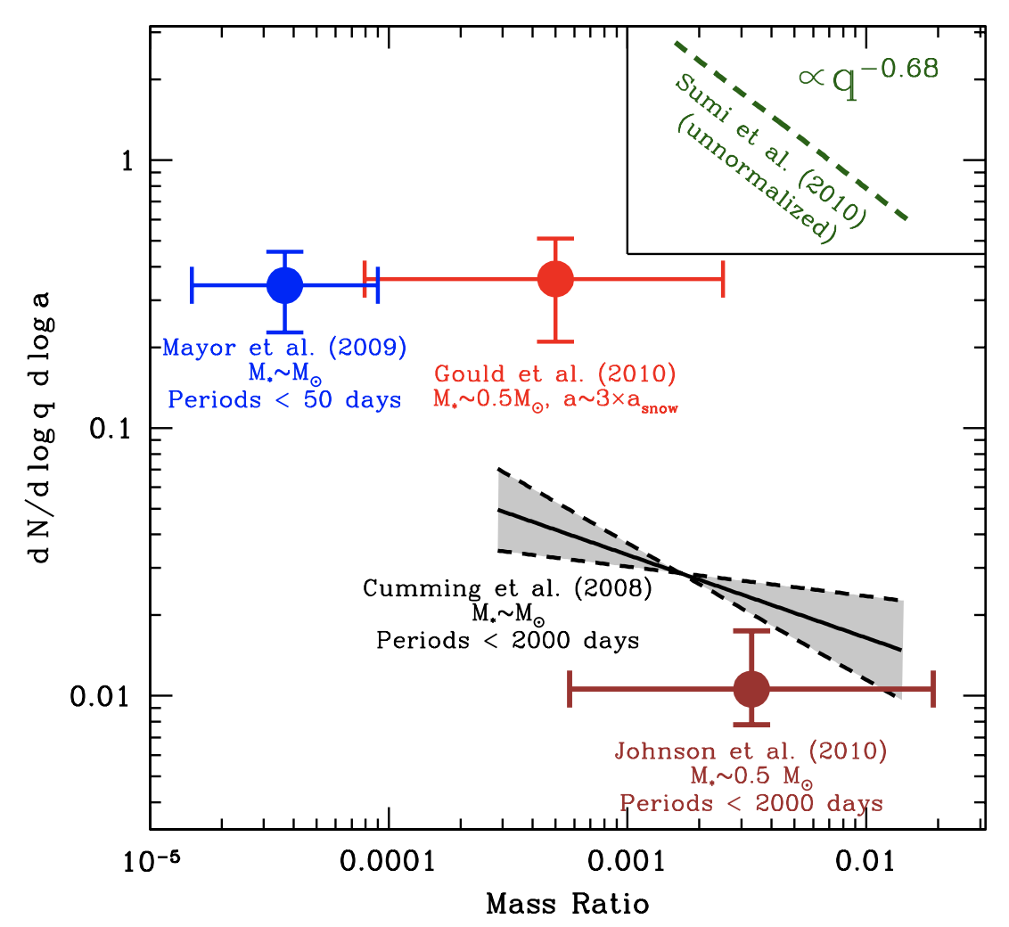
Planet Frequency from Microlensing
Gould et al. 2010: 0.36±0.15 @q~ 5x10⁻⁴ with 6 planets
Sumi et al. 2010: f ∝q^{-0.68±0.2} with 10 planets
Gould+10
2002
2010

Slide 9
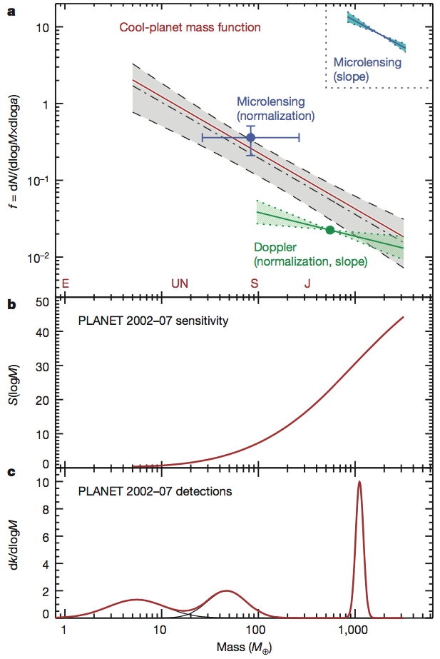
Planet Frequency from Microlensing
Combined Gould et al. 2010 and Sumi et al. 2010
  With 8 planets, the planet mass function is
  0.24±0.13(M/M_{Sat})^{-0.73±0.17}
Cassan+12
2002
2012
2010

Slide 10
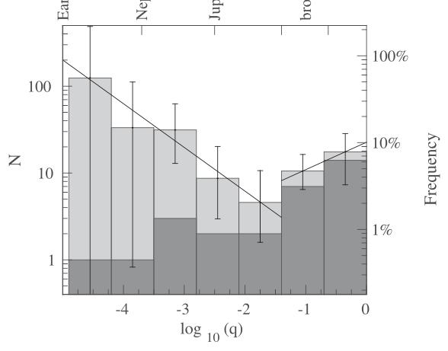
Planet Frequency from Microlensing
OGLE, MOA and WISE surveys for 4 bulge seasons
-0.50±0.17 and 0.32±0.38 for slope of planetary and stellar binary mass ratio
9 planets for the mass ratio function
Shvartzvald+16
2002
2012
2016
2010

Slide 11
Planet Frequency from Microlensing
23 (MOA) + 7 (G10, C12) = 30 planets
A break around Neptune mass (q~1.7×10⁻⁴)
Median of planetary hosts is 0.56 M_{Sun}
2012
2016
2002
2010
2017

Slide 12
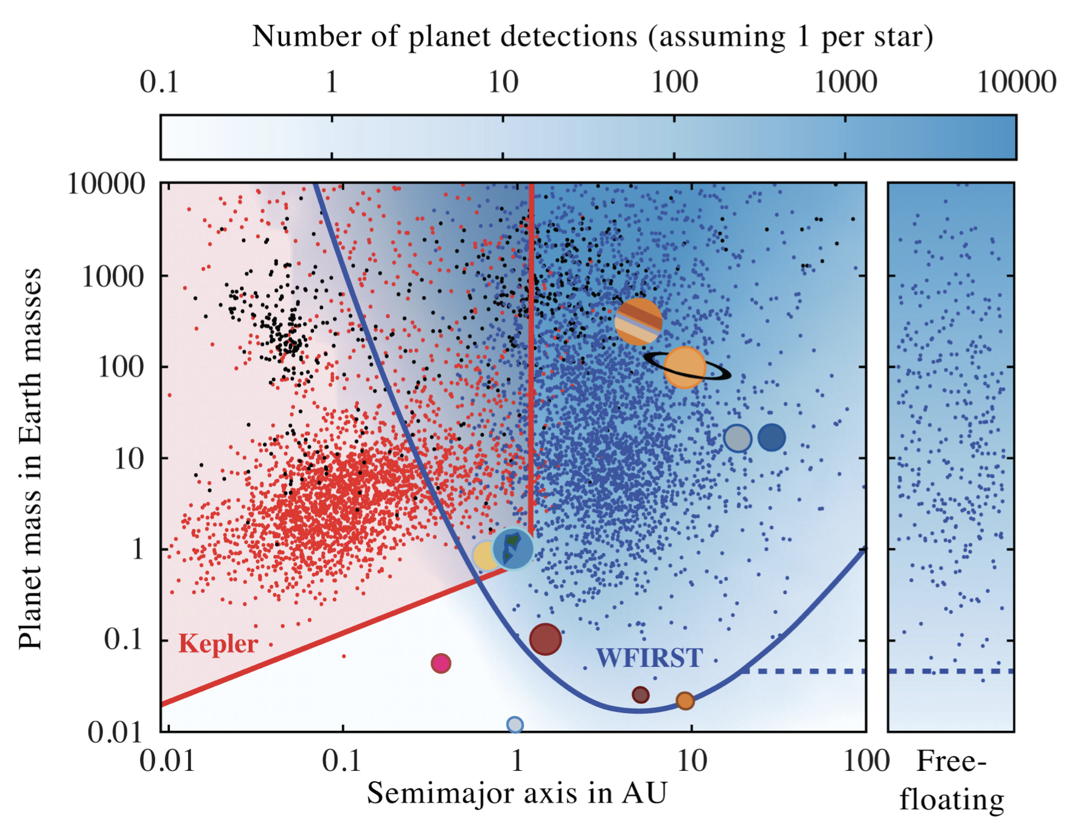
Planet Frequency from Microlensing
A few thousand cold planets with mass and distance measurements.
2012
2016
2002
2010
2017
2025

Slide 13
Planet Frequency from Microlensing
A few thousand cold planets with mass and distance measurements.
MOA, OGLE-IV, KMTNet, PRIME surveys…
K2 and Spitzer µlensing programs
Before WFIRST
2012
2016
2002
2010
2017
2025

Slide 14


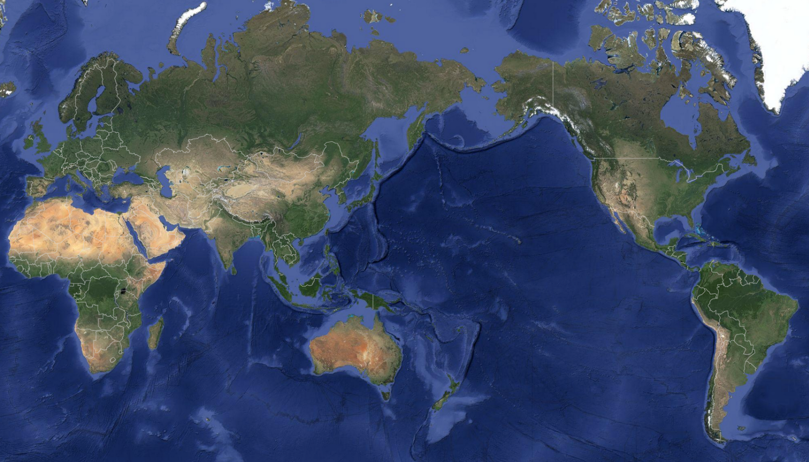
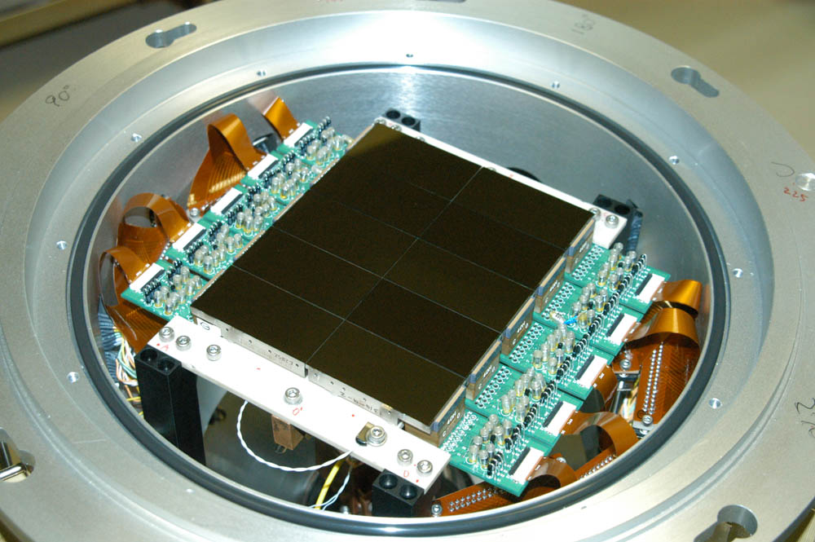
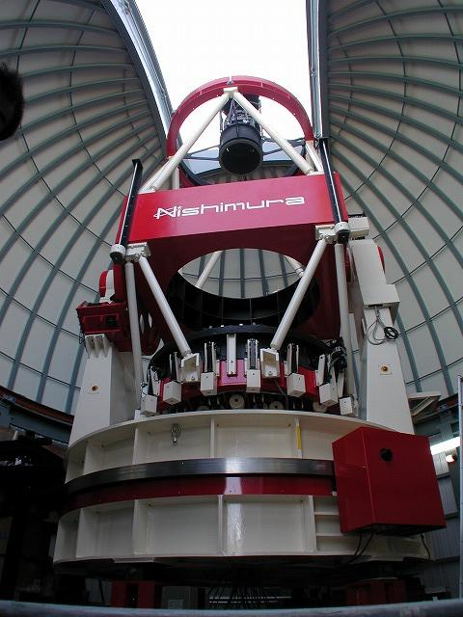
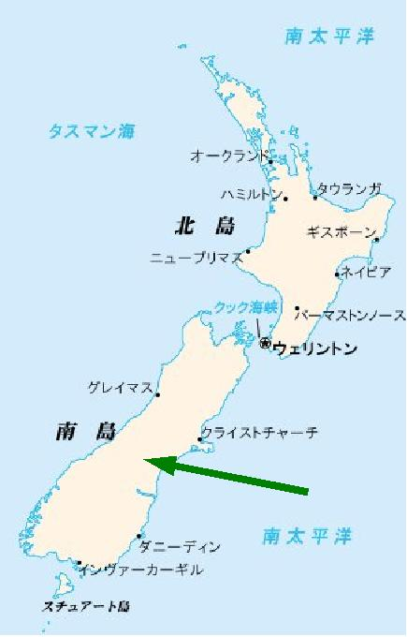
MOA-II (since 2006)
（Microlensing Observations in Astrophysics）
（ Mt. John Observatory in New Zealand, Latitude： 44°S, Alt: 1029m ）
We are here
Mirror: 1.8m
CCD : 80M pix.
FOV : 2.2 deg.²
Filter : MOA-Red
(R + I)
MOA
Notes:
The MOA group is Japan-NZ-US collaboration conducting the microlensing survey observations toward the Galactic bugle.
MOA-II is the 2nd phase of the MOA group using the dedicated 1.8m telescope with 2.2 deg^2 FOV at Mt.John Observatory in New Zealand.
Such a wide FOV survey enables us to find planetary microlensing events more efficiently.

Slide 15
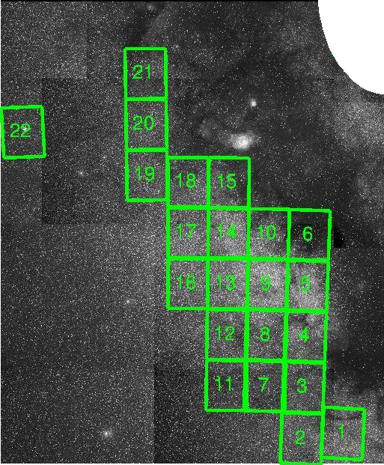
Galactic Bulge Fields (~42 deg²)
G.C.
# of μlens alerts
  2007: 488
  2008: 477
  2009: 563
  2010: 607
  2011: 485
  2012: 680
  2013: 668
  2014: 621
  2015: 576
  2016: 618
  2017: 415
cadence event fraction
1/night.(>M_{Jup})(2%)
1/95min.(M_{Jup})(19%)
1/47min.(M_{Nep})(25%)
1/15min. (M⊕) (54%)
3300 events in 6 yrs
http://www.massey.ac.nz/~iabond/moa/alerts
Notes:
Microlensing is very rare phenomena, so we’re observing the dense stellar field to find much more events.
The planetary signals in the micolensing light curves occurs in a short time scale, so we need high cadence observation.
These red rectangles are showing the most high cadence field observed every 15 minutes, thanks to the wide FOV telescope.
Using this survey strategy, the MOA survey find about 600 microlensing events every year.
In this work, we use the total 3300 microlensing events alerted in the first 6 years.

Slide 16
Event Selection
3300 microlensing alerts by MOA (2007-2012)
http://www.massey.ac.nz/~iabond/moa/alerts
Δχ² ≡ χ²_{Single} – χ²_{Binary} > 100 (Detection): MOA survey data
Mass Ratio, q < 0.03 (Characterization): All available data
Stellar binary events
1451 Single lens events
1 Ambiguous event
(planet / stellar binary)
22 Planetary events
MOA-2010-BLG-340
MOA-2008-BLG-379
MOA-2011-BLG-336
Suzuki+14
Δχ² ~ 18
Shin+12
Notes:
To estimate the planet frequency, we need to construct a sample of well defined single lens and planetary lens events.
Fist, we removed non-microlensing events, and events with insufficient data points by applying our event selection criteria.
Then, we set the detection threshold to find the deviation from the single lens light curves due to the stellar binary or planetary companion to the lens star.
If the chi2 improvement is larger than 100 for binary lens model compared to single lens model using the MOA survey data, then we assume the companion object is detected.
And if the mass ratio of the detected companion is less than 0.03 using all available data including follow-up data, we assume the companion object is characterized as a planet.
Otherwise, we reject the event as the stellar binary event.
As a result of this event selection, we find 1449 single lens events, 22 planetary events and 1 ambiguous events, which could be planetary or stellar binary event.
We include this ambiguous event, by weighting the number of detections based on the chi2 improvement of18 for the planetary model from the stellar binary model, and the prior probability of the companion frequency for the both possible scenarios.
So we find almost 23 planets in this sub-sample, but to estimate the planet frequency, we should consider the detection efficiency.
MOAは6年間のサーベイで、全部で3300個のマイクロレンズアラートを出しました。
これらの中には、惑星が検出されなかったシングルレンズイベント、惑星イベント、連星イベント、また、マイクロレンズイベントではない、変光星も含まれています。
惑星存在頻度を求めるには、惑星シグナルに十分に感度のあるマイクロレンズイベントを選びたいので、
光度曲線をフィッティングした際にモデルパラメーターがよく決まるような、光度曲線の観測クオリティーが良いイベントを、セレクションクライテリアを設けて抽出しました。
それらのイベントにおいて、MOAのonlineデータを用いて、レンズ天体が一つの質点だとするシングルレンズモデル、レンズ天体が二つの質点であるとするバイナリーレンズモデルでフィッティングをして、シングルレンズモデルに比べてバイナリーレンズモデルのchi^2が100以上小さければ、伴星の検出としました。
また、伴星が検出された場合は、他のサーベイグループやフォローアップグループのデータも用いてイベントを解析し、
質量比が0.03より小さければ惑星の検出とし、そうでなければ、連星イベントとしました。
イベントセレクションの結果、1449個のシングルレンズイベント、22個の惑星イベント、また、惑星か連星かの断定が難しいambiguousなイベントを一つ抽出しました。
このambiguousイベントは、惑星モデルのchi^2が18良いことと、連星モデル/惑星モデルのそれぞれの質量比の場合で伴星の存在確率を考慮し、統計的に解析に含めました。

Slide 17
Detection Efficiency, ε(logs, logq)
Single lens (t₀ = 7517.5, t_{E} = 17, u₀ = 0.083)

Slide 18
Detection Efficiency, ε(logs, logq)
q = 0.006, s = 1.26, α = 0.35 (20deg)
Not detectable

Slide 19
Detection Efficiency, ε(logs, logq)
q = 0.006, s = 1.26, α = 3.91 (224deg)
Detectable

Slide 20
Detection Efficiency, ε(logs, logq)
q = 0.006, s = 1.26, α = 4.05 (232deg)
Not detectable

Slide 21
Detection Efficiency, ε(logs, logq)
q
s
Source
α
q : mass ratio
s : separation
α : angle from the lens axis
Data quality
ρ : finite source effect
ρ = θ*/θ_{E} = θ*/(t_{E}μ_{rel})
  θ* : angular source star radius
  μ_{rel}: lens-source proper motion
  μ_{rel}=<μ_{rel}>=5.6mas/yr
Detection:
ε(logs, logq):
Fraction of detections within 0 < α < 2π
(Rhie+00, Holtzman+ 98, Nataf+13, Bennett+14)
Notes:
The detection efficiency to the planet signals in the microlensing light curves depends on the mass ratio, planet position on the sky, data quality, and finite source star size.
We simulate the artificial light curves by injecting planet signals into the real data, changing the mass ratio and planet position.
For the finite source effect, which could smooth out the planet signals, we can robustly estimate the angular source star radius in each event.
But we don’t know much about the lens-source proper motion in each event, so we just use its mean value.
So the estimated finite source effect has some uncertainty, but this dose not change our final result.
These figures indicate the simulated planet signals.
For the upper case, the injected planet signal is detected, but for the bottom case the planet signal is too weak
We use the same detection threshold as we used for the event selection.
The detection efficiency at given separation and mass ratio is estimated as the fraction of detections for all possible angles between the planet-host star axis and source star trajectory.
To estimate the planet frequency, we calculated the detection efficiency in each event based on Rhie et al.
The detection efficiency is depending on the mass ratio and position of the planet, data quality, and finite source effect.
In the most of single lens events, the finite source effect can’t be measured. So, we need to estimate it. The estimate of theta_star, the angular source star radius has some uncertainty. And we assume the relative proper motion is the average value and this uncertainty might be larger. But these uncertainty should not change the final result.
Theses figures are simulated light curves, the upper panel is detected case, and the bottom is no-detection case.
We set our detection criteria as 100, and define the efficiency as a fraction of detections with 0 to 2pi.

Slide 22
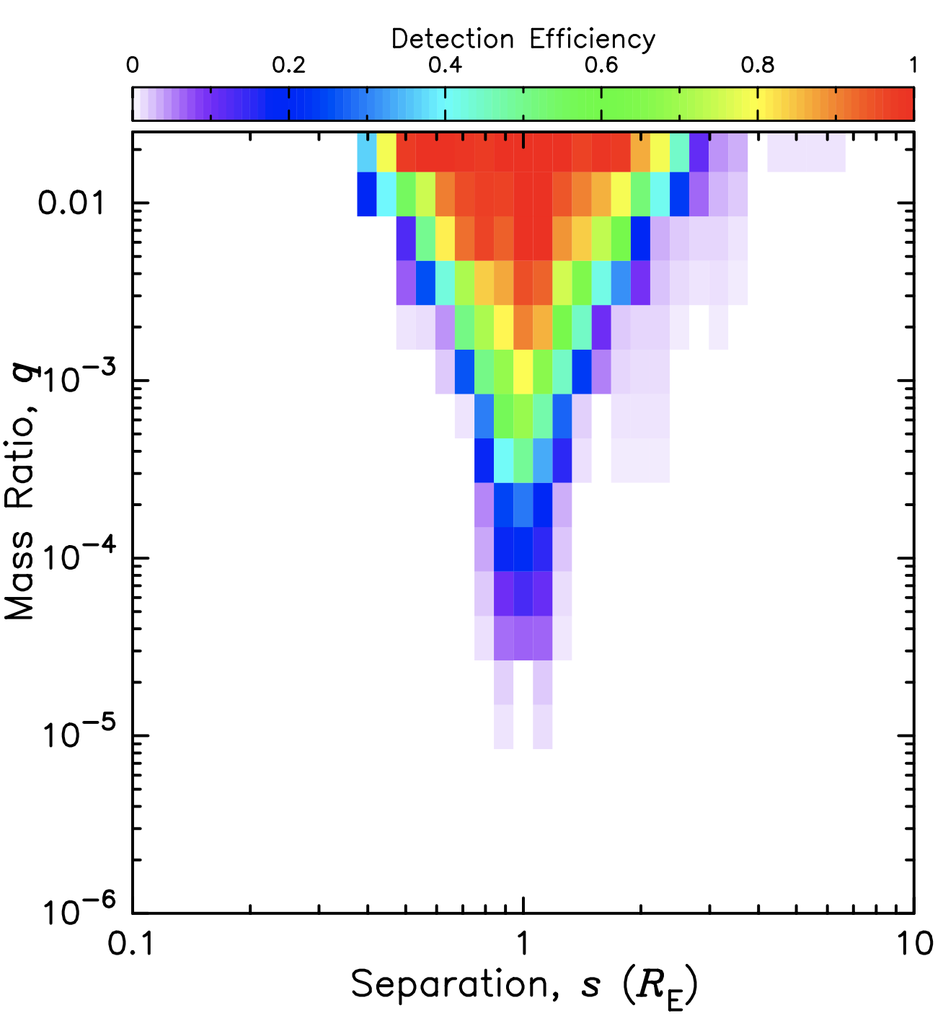
Detection Efficiency, ε(logs, logq)

Slide 23
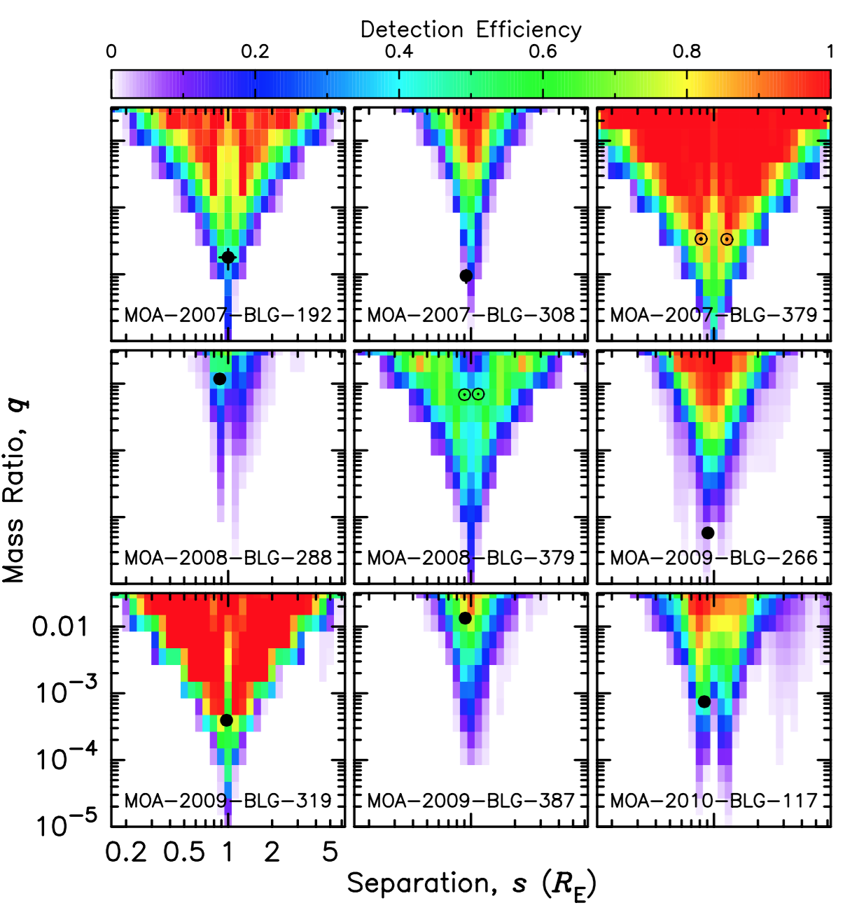
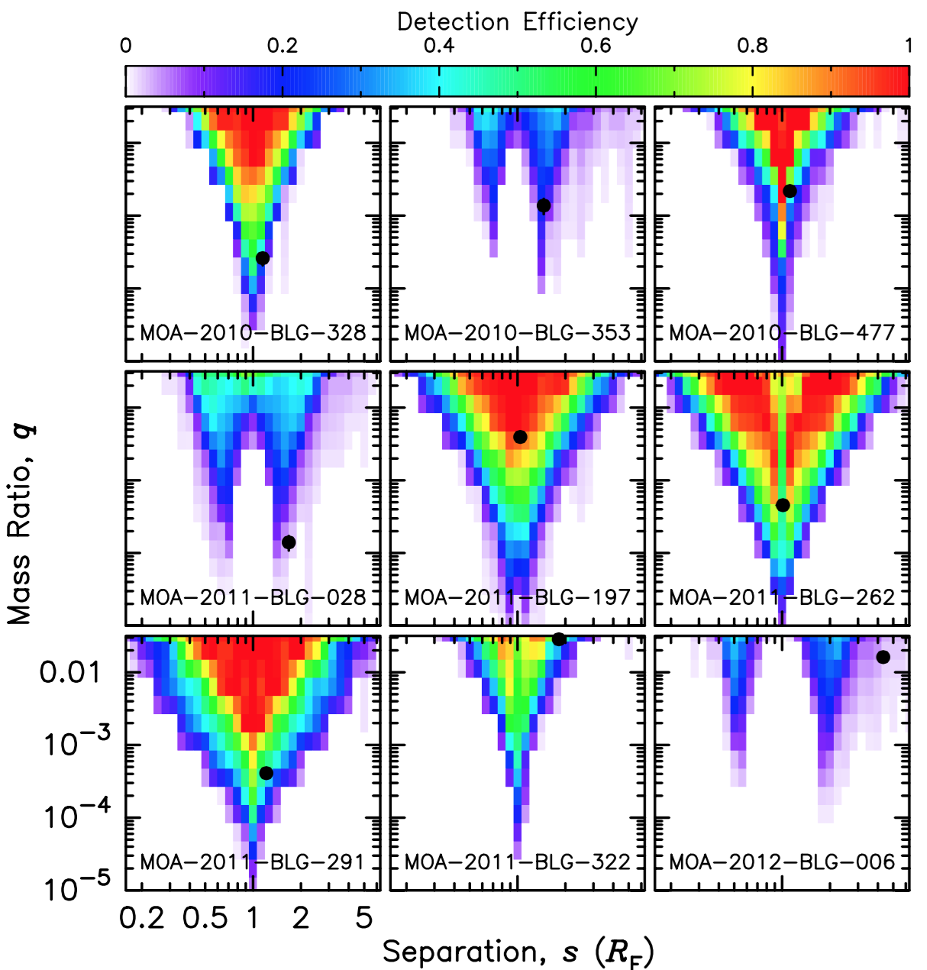
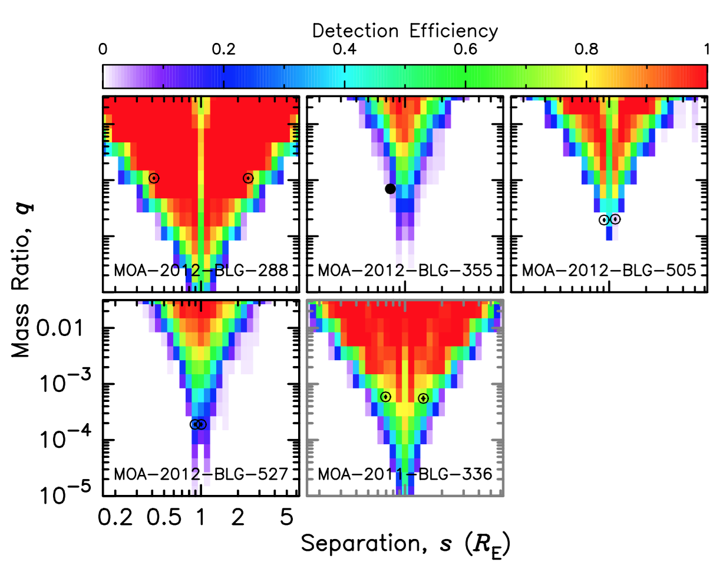
Detection Efficiencies for 23 Planetary Events

Slide 24
Planet Detections and Survey Sensitivity
23 planets from MOA-II sample plotted with survey sensitivity contours.
Contour numbers indicate the number of expected detections if every star has such a planet.
Open circles are high mag events with
s ⬄ 1/s degeneracy
Notes:
Then, this figure indicates the survey sensitivity, which is the sum of the detection efficiency in each event, assuming the logarithmically flat planet distribution in this parameter space.
Then, we plot the 23 planets detected in our survey data.
The open circles are indicating planets detected in high mag events, which usually suffer from separation degeneracy.
But, more than half of our planets are found in low-mag events plotted with the filled circles, and these events contribute to the planet frequency as a function of the separation.

Slide 25
Efficiency Corrected # of Planets VS q
Observed distribution is flat in log q
Efficiency correction including poisson noise
Flatten out below q ~ 1.0e-4
MOA-II
23-planet sample
Notes:
Let’s see the mass ratio distribution of the detected planets.
The black histogram shows the observed 23 planets.
This is logarithmically almost flat down to 3x10^-5.
The red histogram is the efficiency corrected distribution, considering the Poisson noise.
These arrows are 68 and 95% upper limits.
We fit this efficiency-corrected distribution with a broken power law, then we found the best fit model using the maximum likelihood method.

Slide 26
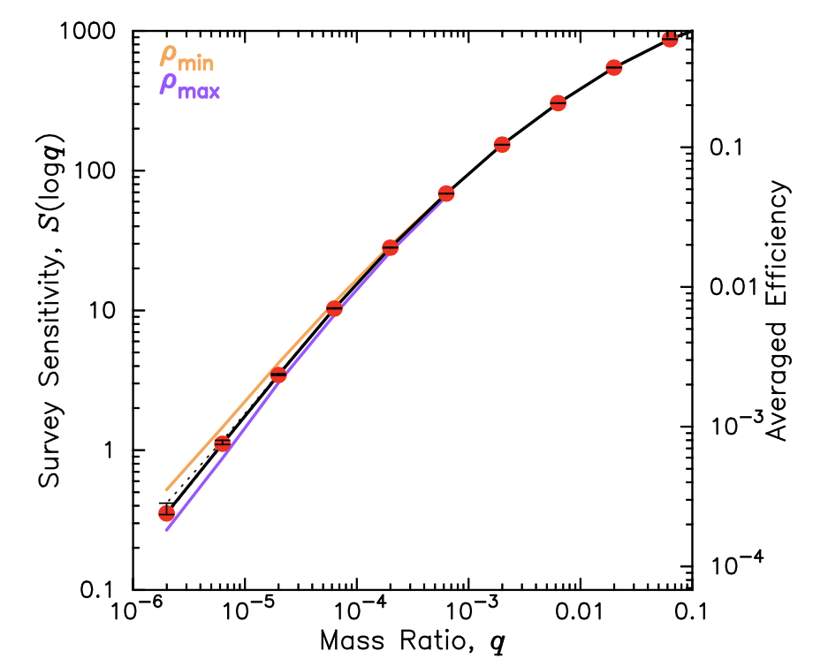
Efficiency Corrected # of Planets VS q
Observed distribution is flat in log q
Efficiency correction including poisson noise
Flatten out below q ~ 1.0e-4
MOA-II
23-planet sample
Notes:
Let’s see the mass ratio distribution of the detected planets.
The black histogram shows the observed 23 planets.
This is logarithmically almost flat down to 3x10^-5.
The red histogram is the efficiency corrected distribution, considering the Poisson noise.
These arrows are 68 and 95% upper limits.
We fit this efficiency-corrected distribution with a broken power law, then we found the best fit model using the maximum likelihood method.

Slide 27
Efficiency Corrected # of Planets VS q
Observed distribution is flat in log q
Efficiency correction including poisson noise
Flatten out below q ~ 1.0e-4
MOA-II
23-planet sample
Notes:
Let’s see the mass ratio distribution of the detected planets.
The black histogram shows the observed 23 planets.
This is logarithmically almost flat down to 3x10^-5.
The red histogram is the efficiency corrected distribution, considering the Poisson noise.
These arrows are 68 and 95% upper limits.
We fit this efficiency-corrected distribution with a broken power law, then we found the best fit model using the maximum likelihood method.

Slide 28
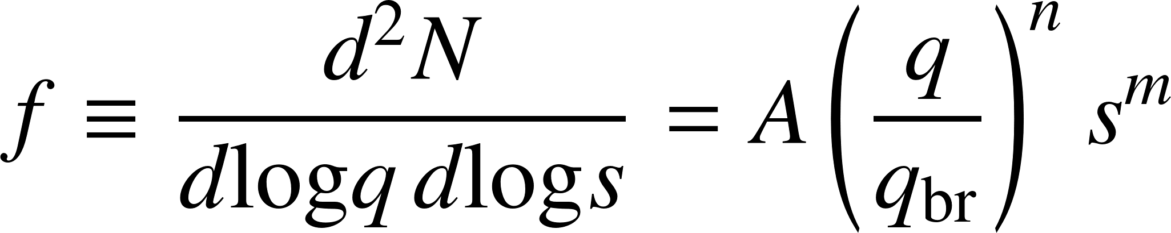
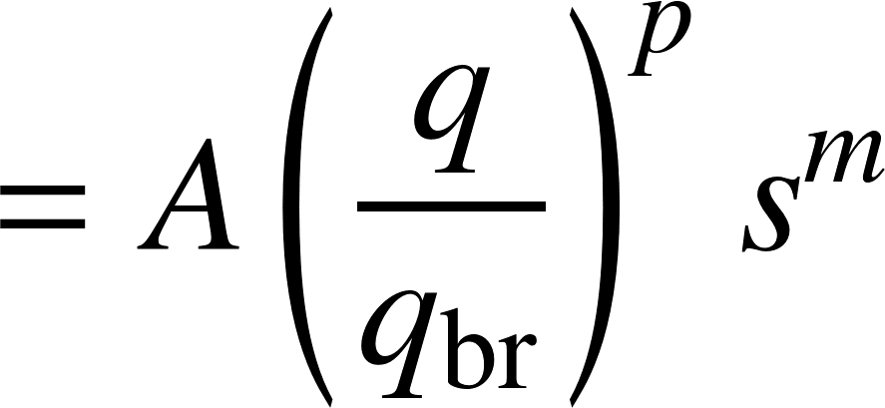
Efficiency Corrected # of Planets VS q
Observed distribution is flat in log q
Efficiency correction including poisson noise
Flatten out below q ~ 1.0e-4
[q ≥ q_{br}]
[q < q_{br}]
q_{br}~1.7×10⁻⁴
MOA-II
23-planet sample
Notes:
Let’s see the mass ratio distribution of the planets.
The black histogram shows the observed 23 planets.
This is logarithmically almost flat down to 3x10^-5.
The red histogram is the efficiency corrected distribution, considering the Poisson noise.
These arrows are 68 and 95% upper limits.
We fit this efficiency-corrected distribution with a broken power law, then we found the best fit model using the maximum likelihood method.
The best fit model shows the break at the mass ratio of 1.6*10^-4, and this is Neptune mass if the host star is M-type star.
We added the previous two microlensing results, Gould et al. and Cassan et al., and we got the almost same result using total 30-planet sample.

Slide 29
Planet Frequency vs Semi-Major Axis
[q ≥ q_{br}]
MOA-II
23-planet sample
Planets beyond the snow line are more common (per log a) as planets inside the snow line
M-star, K-star
G-star
Notes:
This figure shows the planet frequency as a function of semi-major axis normalized by the snow line.
The microlens result is plotted assuming that the microlens planets are located three times of the snow line.
So, this slope is our best fit slope on the separation.
#Our result is consistent with the previous study Gould et al, but factor 2 smaller.
#This could be due to small biases in Gould et al, like publication date bias, because they found less planets after their paper.
Our slope is consistent with the extrapolation of the RV result, Cumming et al, at this mass ratio.
We should note that microlensing planets have mostly M-type host stars, but Cumming et al. is result for Solar type stars.
So, if their slope is applicable to low mass stars, we could describe the planet frequency with single power law from inside to outside the snowline.

Slide 30
Comparison to the Previous Microlensing Results
MOA-II
23-planet sample
q_{br}~1.7×10⁻⁴
Ice Giants are ~8 times more common than Jupiters
A break in mass ratio function at q ~ 1.7e-4
Notes:
Again, this is our mass ratio function with the break using 30-planets.
Here we compare this to various RV results.
Mayor et al, Howard et al., and Cumming et al. are results around solar-type stars, also their planets are well inside the snow line.
More interestingly, Johnson et al, Bonfils et al., and Montet et al., are results around M-stars.
Johnson et al is including some cold planets, but little bit inside the most efficient region of microlensing.
But, Bonfils et al. and Montet et al. are results from the exactly same parameter space as microlensing, except for that microlensing planets are very far away.
So, cold gas giant planet frequency estimated in our work is consistent with these two RV results, and this consistency is also found by Clanton et al. as I said beginning.

Slide 31
Comparison to the Previous Microlensing Results
MOA-II
23-planet sample
q_{br}~1.7×10⁻⁴
Ice Giants are ~8 times more common than Jupiters
A break in mass ratio function at q ~ 1.7e-4
Notes:
Again, this is our mass ratio function with the break using 30-planets.
Here we compare this to various RV results.
Mayor et al, Howard et al., and Cumming et al. are results around solar-type stars, also their planets are well inside the snow line.
More interestingly, Johnson et al, Bonfils et al., and Montet et al., are results around M-stars.
Johnson et al is including some cold planets, but little bit inside the most efficient region of microlensing.
But, Bonfils et al. and Montet et al. are results from the exactly same parameter space as microlensing, except for that microlensing planets are very far away.
So, cold gas giant planet frequency estimated in our work is consistent with these two RV results, and this consistency is also found by Clanton et al. as I said beginning.

Slide 32
Combined Microlensing Results
Full 30-planet microlensing sample
q_{br}~1.7×10⁻⁴
Ice Giants are ~8 times more common than Jupiters
A break in mass ratio function at q ~ 1.7e-4
Notes:
Again, this is our mass ratio function with the break using 30-planets.
Here we compare this to various RV results.
Mayor et al, Howard et al., and Cumming et al. are results around solar-type stars, also their planets are well inside the snow line.
More interestingly, Johnson et al, Bonfils et al., and Montet et al., are results around M-stars.
Johnson et al is including some cold planets, but little bit inside the most efficient region of microlensing.
But, Bonfils et al. and Montet et al. are results from the exactly same parameter space as microlensing, except for that microlensing planets are very far away.
So, cold gas giant planet frequency estimated in our work is consistent with these two RV results, and this consistency is also found by Clanton et al. as I said beginning.

Slide 33
Microlensing vs RV Surveys
G star
Full 30-planet microlensing sample
Mayor+09 (a<0.27AU), Howard+10 (a<0.27AU), Cumming+08(a<3.1AU)
Ice Giants are ~8 times more common than Jupiters
A break in mass ratio function at q ~ 1.7e-4
Notes:
Again, this is our mass ratio function with the break using 30-planets.
Here we compare this to various RV results.
Mayor et al, Howard et al., and Cumming et al. are results around solar-type stars, also their planets are well inside the snow line.
More interestingly, Johnson et al, Bonfils et al., and Montet et al., are results around M-stars.
Johnson et al is including some cold planets, but little bit inside the most efficient region of microlensing.
But, Bonfils et al. and Montet et al. are results from the exactly same parameter space as microlensing, except for that microlensing planets are very far away.
So, cold gas giant planet frequency estimated in our work is consistent with these two RV results, and this consistency is also found by Clanton et al. as I said beginning.

Slide 34
Microlensing vs RV Surveys
G star
M star
Full 30-planet microlensing sample
Mayor+09 (a<0.27AU), Howard+10 (a<0.27AU), Cumming+08(a<3.1AU)
Johnson+10(a<2.5AU), Bonfils+13(a=1.3-6.1AU), Montet+14(a<20AU)
Ice Giants are ~8 times more common than Jupiters
A break in mass ratio function at q ~ 1.7e-4
Notes:
Again, this is our mass ratio function with the break using 30-planets.
Here we compare this to various RV results.
Mayor et al, Howard et al., and Cumming et al. are results around solar-type stars, also their planets are well inside the snow line.
More interestingly, Johnson et al, Bonfils et al., and Montet et al., are results around M-stars.
Johnson et al is including some cold planets, but little bit inside the most efficient region of microlensing.
But, Bonfils et al. and Montet et al. are results from the exactly same parameter space as microlensing, except for that microlensing planets are very far away.
So, cold gas giant planet frequency estimated in our work is consistent with these two RV results, and this consistency is also found by Clanton et al. as I said beginning.

Slide 35
Comparison to Kepler planets
M-star
GK-star
by L.Rogers, using the probabilistic M-R relation (Wolfgang+14) and
Kepler planets around M stars (Dressing & Charbonneau15), GK stars (Petigura+13)
Mass function break for inner planets(Kepler): 6-8 M_{Earth}
Mass function break for outer planets(µlens): 10-40 M_{Earth}
Notes:
Let me compare the microlensing result to the kepler planets.
This is not easy because transit technique measures the planet radus, actually radius ratio, and microlensing measure the mass ratio.
The left plot is the kepler planet mass distribution for low mass stars and solar type stars, estimated by applying the probabilistic Mass-Radius relation to the planet radius distribution.
This indicate that the break in the mass function of inner planets is 6-8 earth mass.
On the other hand, the mean host star mass of the planetary microlensing events is 0.6 solar mass, so the break of the mass ratio function we found implies that the mass break for microlensing planets will be about 20 earth masses.
Considering the factor 2 of uncertatinty, the mass break of outer planets is 10-40 earth mass.
So, still uncertainty is large, but the break of the planet mass function for outer planets might be higher than that of inner planets.

Slide 36
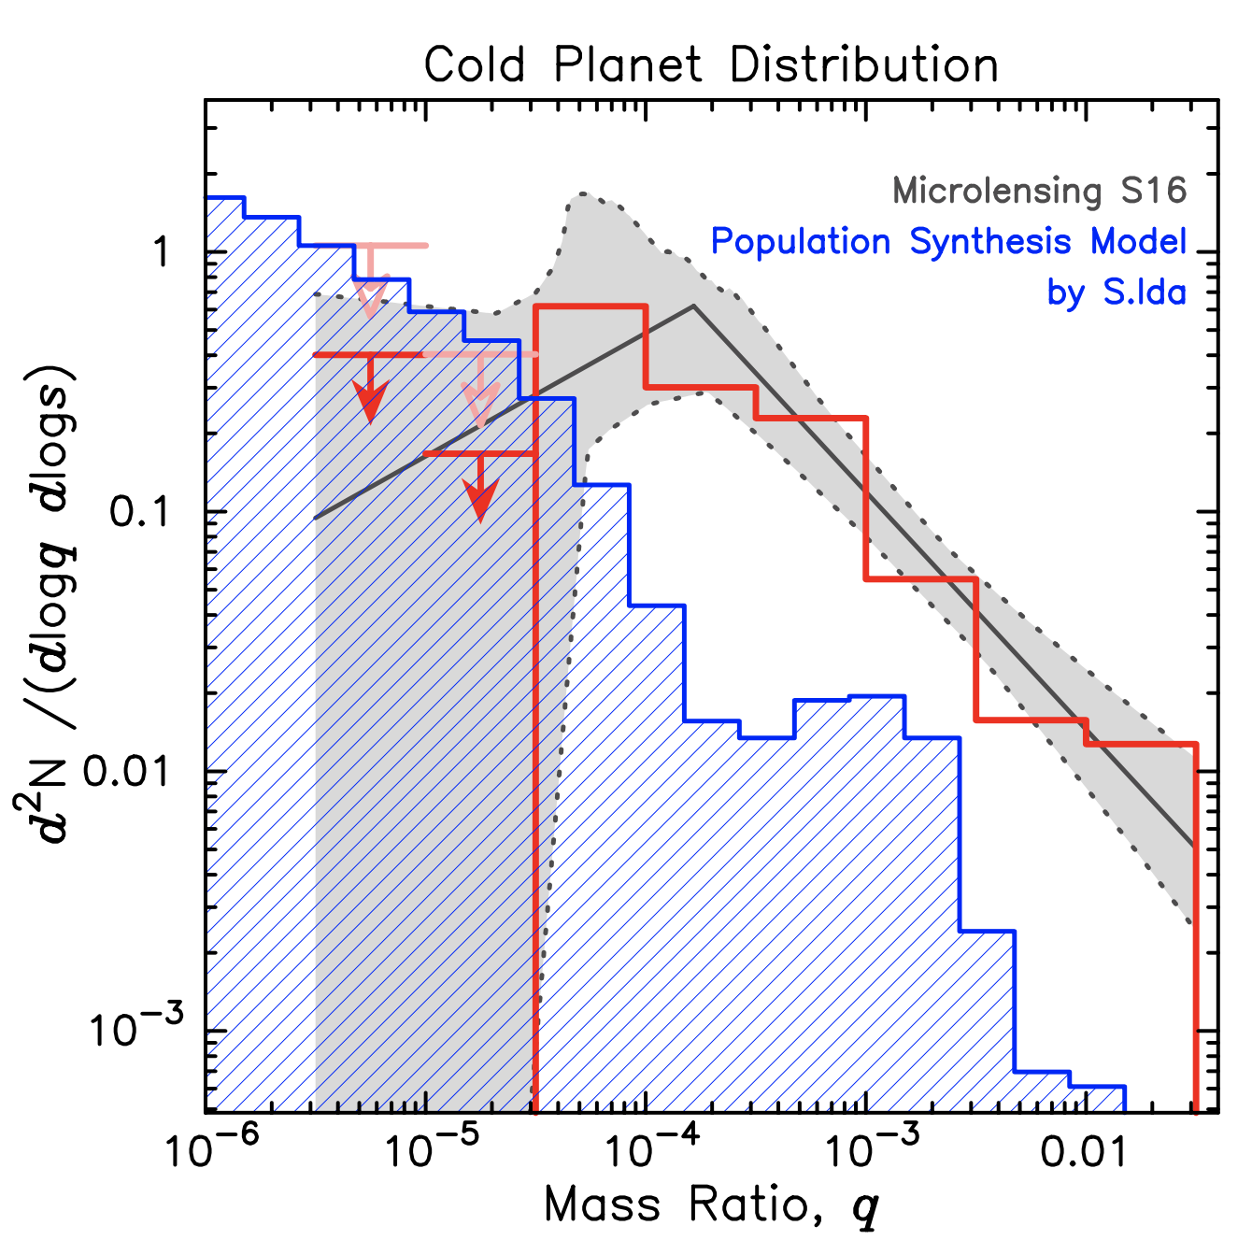
Comparison to Population Synthesis
Host star mass in the synthesis model is log M = {-0.10, -0.25, …, -1.15, -1.30}
Assumed that host stars of each event in S16 follow the Galactic model
Used the constraints on lens mass/distance for the planetary events
Preliminary
Notes:
Finally, we compare the microlensing result to the planet formation models.
The blue histogram is showing the expected planet frequency from the planet population synthesis model by Shigeru Ida.
Ida-san prepared optimized population synthesis to produce more cold planets with various host star masses.
We combined the simulated results assuming that each host star in the microlensing sample has the mass distribution according to the Galactic model.
We found that the population synthesis model expects less stars compared to the observations.
There are huge gaps for the gas giant planets and sub-Saturn mass planets.
This is a preliminary result and we are still working on this comparison.

Slide 37
Summary
Mass ratio function from 6yr MOA microlensing survey data shows a break at q~1.7x10⁻⁴ (Suzuki+16)
  The mass of the break seems to be more massive than that of inner planets found by Kepler
Planet population synthesis model does not reproduce the microlensing results.
Open questions:
  Cold planet mass function depends on
    Semi-major axis?
    Host star mass?
    Distance to the lens system?

