Slide 1
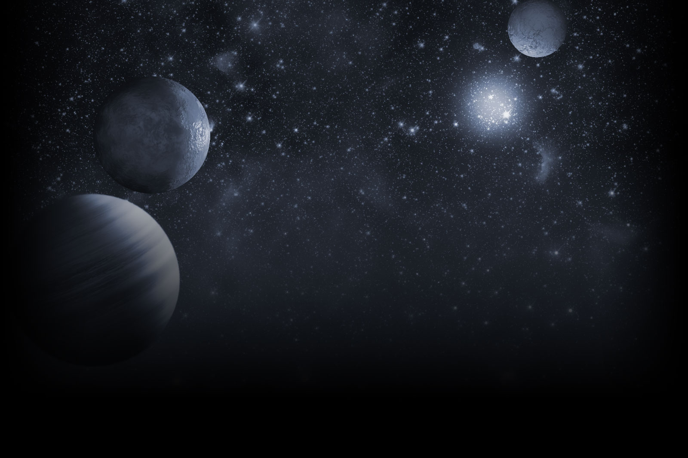





A Tour of the NASA Exoplanet Archive
Calen B. Henderson
Caltech/IPAC-NExScI
Rachel Akeson (→ David Ciardi);
Solange V. Ramírez;
Jessie Christiansen, Julian van Eyken, Sergio Fajardo-Acosta; and
the NASA Exoplanet Archive Team!
Sagan Summer Workshop, Aug 7—11 2017, Caltech

Slide 2
The Exoplanet Archive
Data Sets:
  Literature (planet and stellar parameters)
  Ground-based (Super WASP, KELT, HATNet, TrES, XO)
    UKIRT (coming soon!)
  Space missions (Kepler, K2, CoRoT)
  Kepler pipeline products
  Other contributed data sets
Tools:
  Interactive tables, plotting tool, pre-made plots
  Time Series Viewer
  Periodogram
  Transit Ephemeris
  Predicted Observables for Exoplanets tool
  EXOFAST (new!)
  pyLIMA fitting tool (coming soon!)
➤ https://exoplanetarchive.ipac.caltech.edu

Slide 3
The Confirmed Planets Table

Slide 4
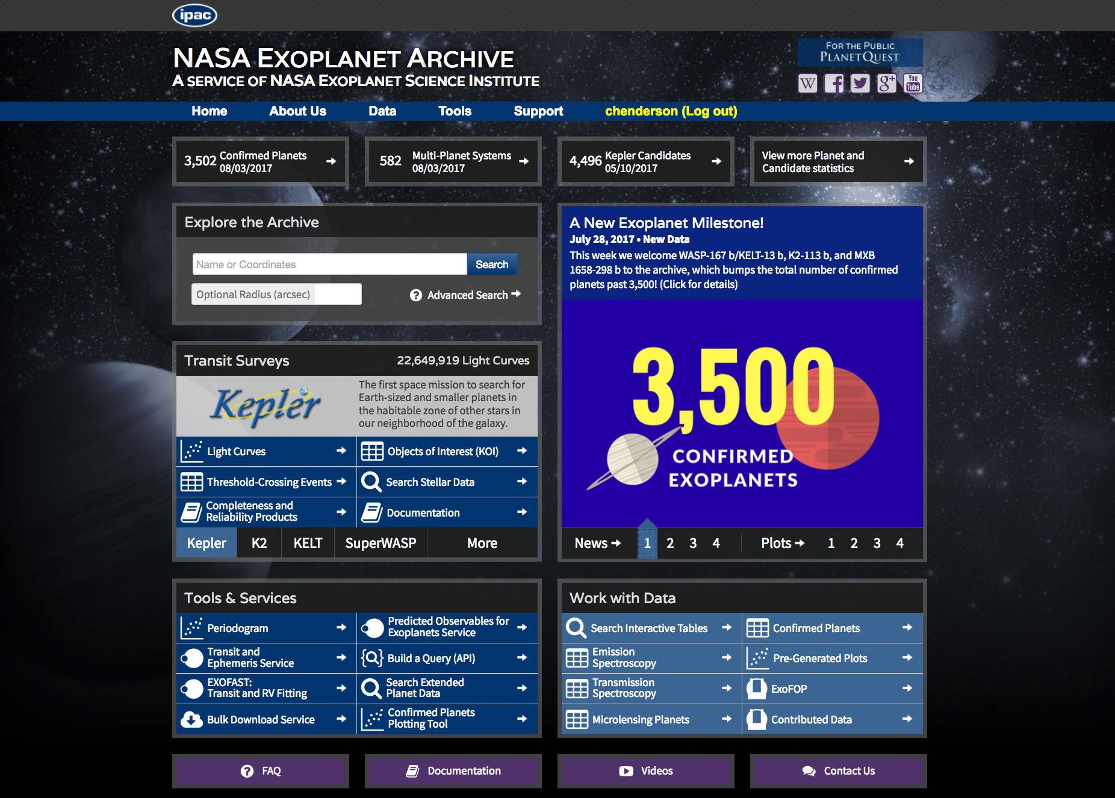
👉
👈

Slide 5
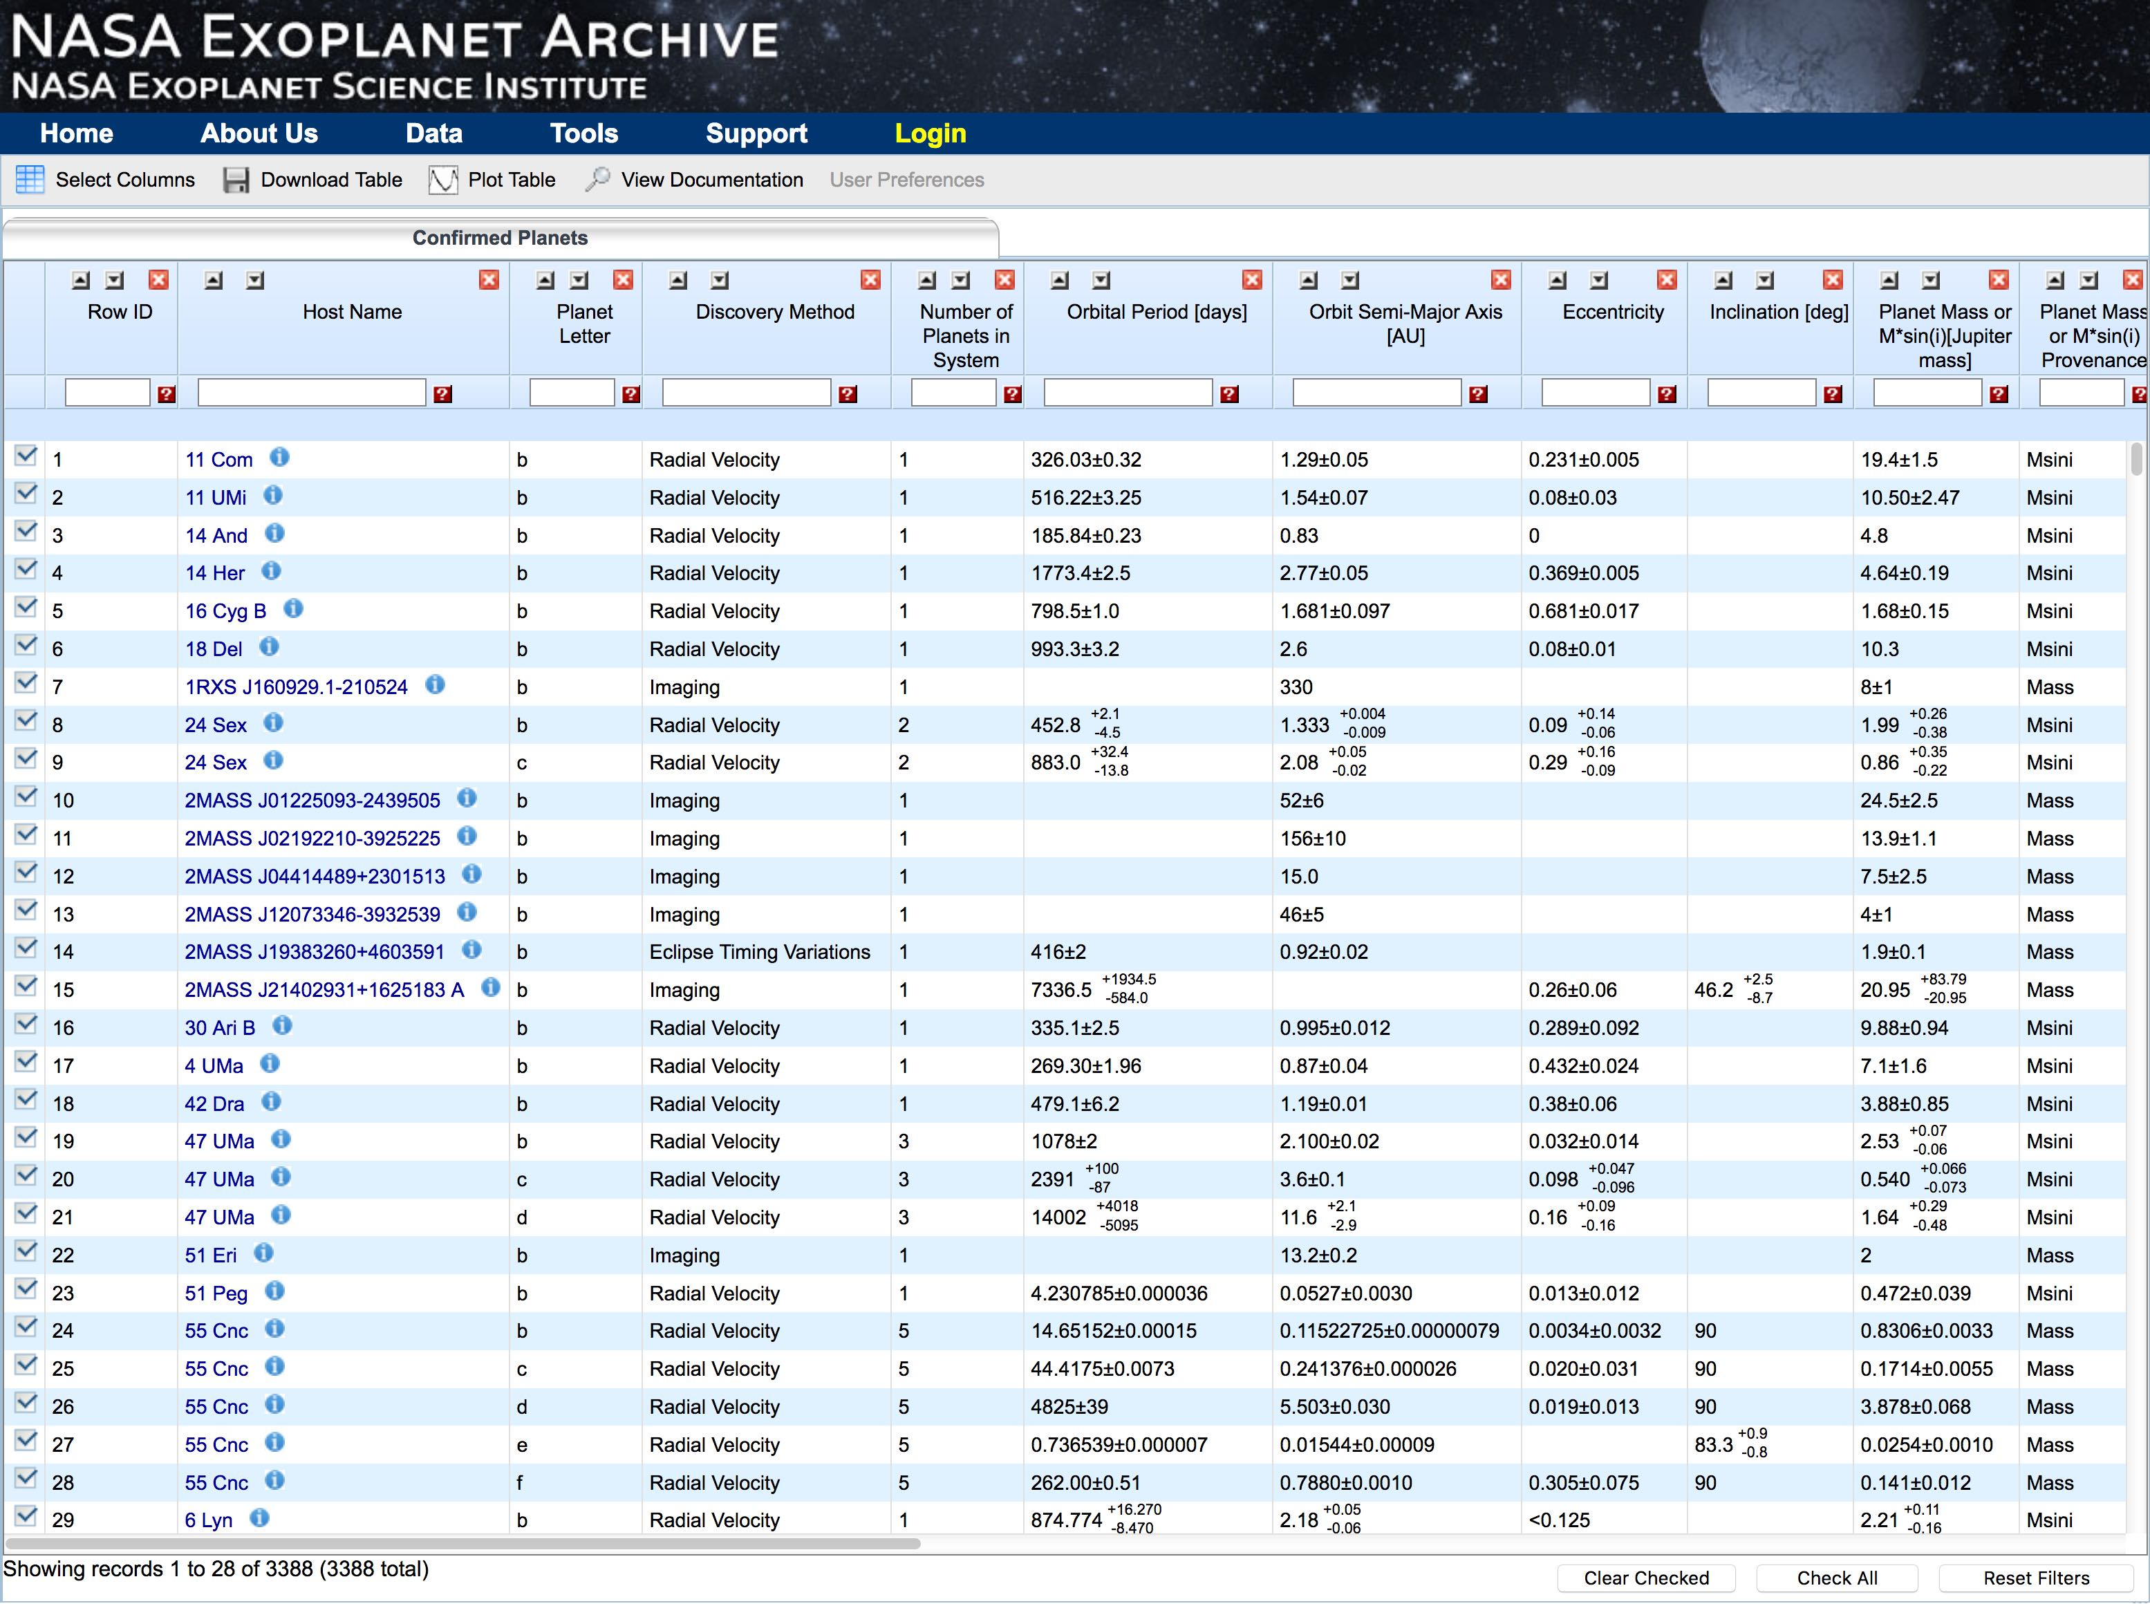
👈
Can sort by any column!
e.g., sort by # of planets in system to see
multi-planet systems

Slide 6
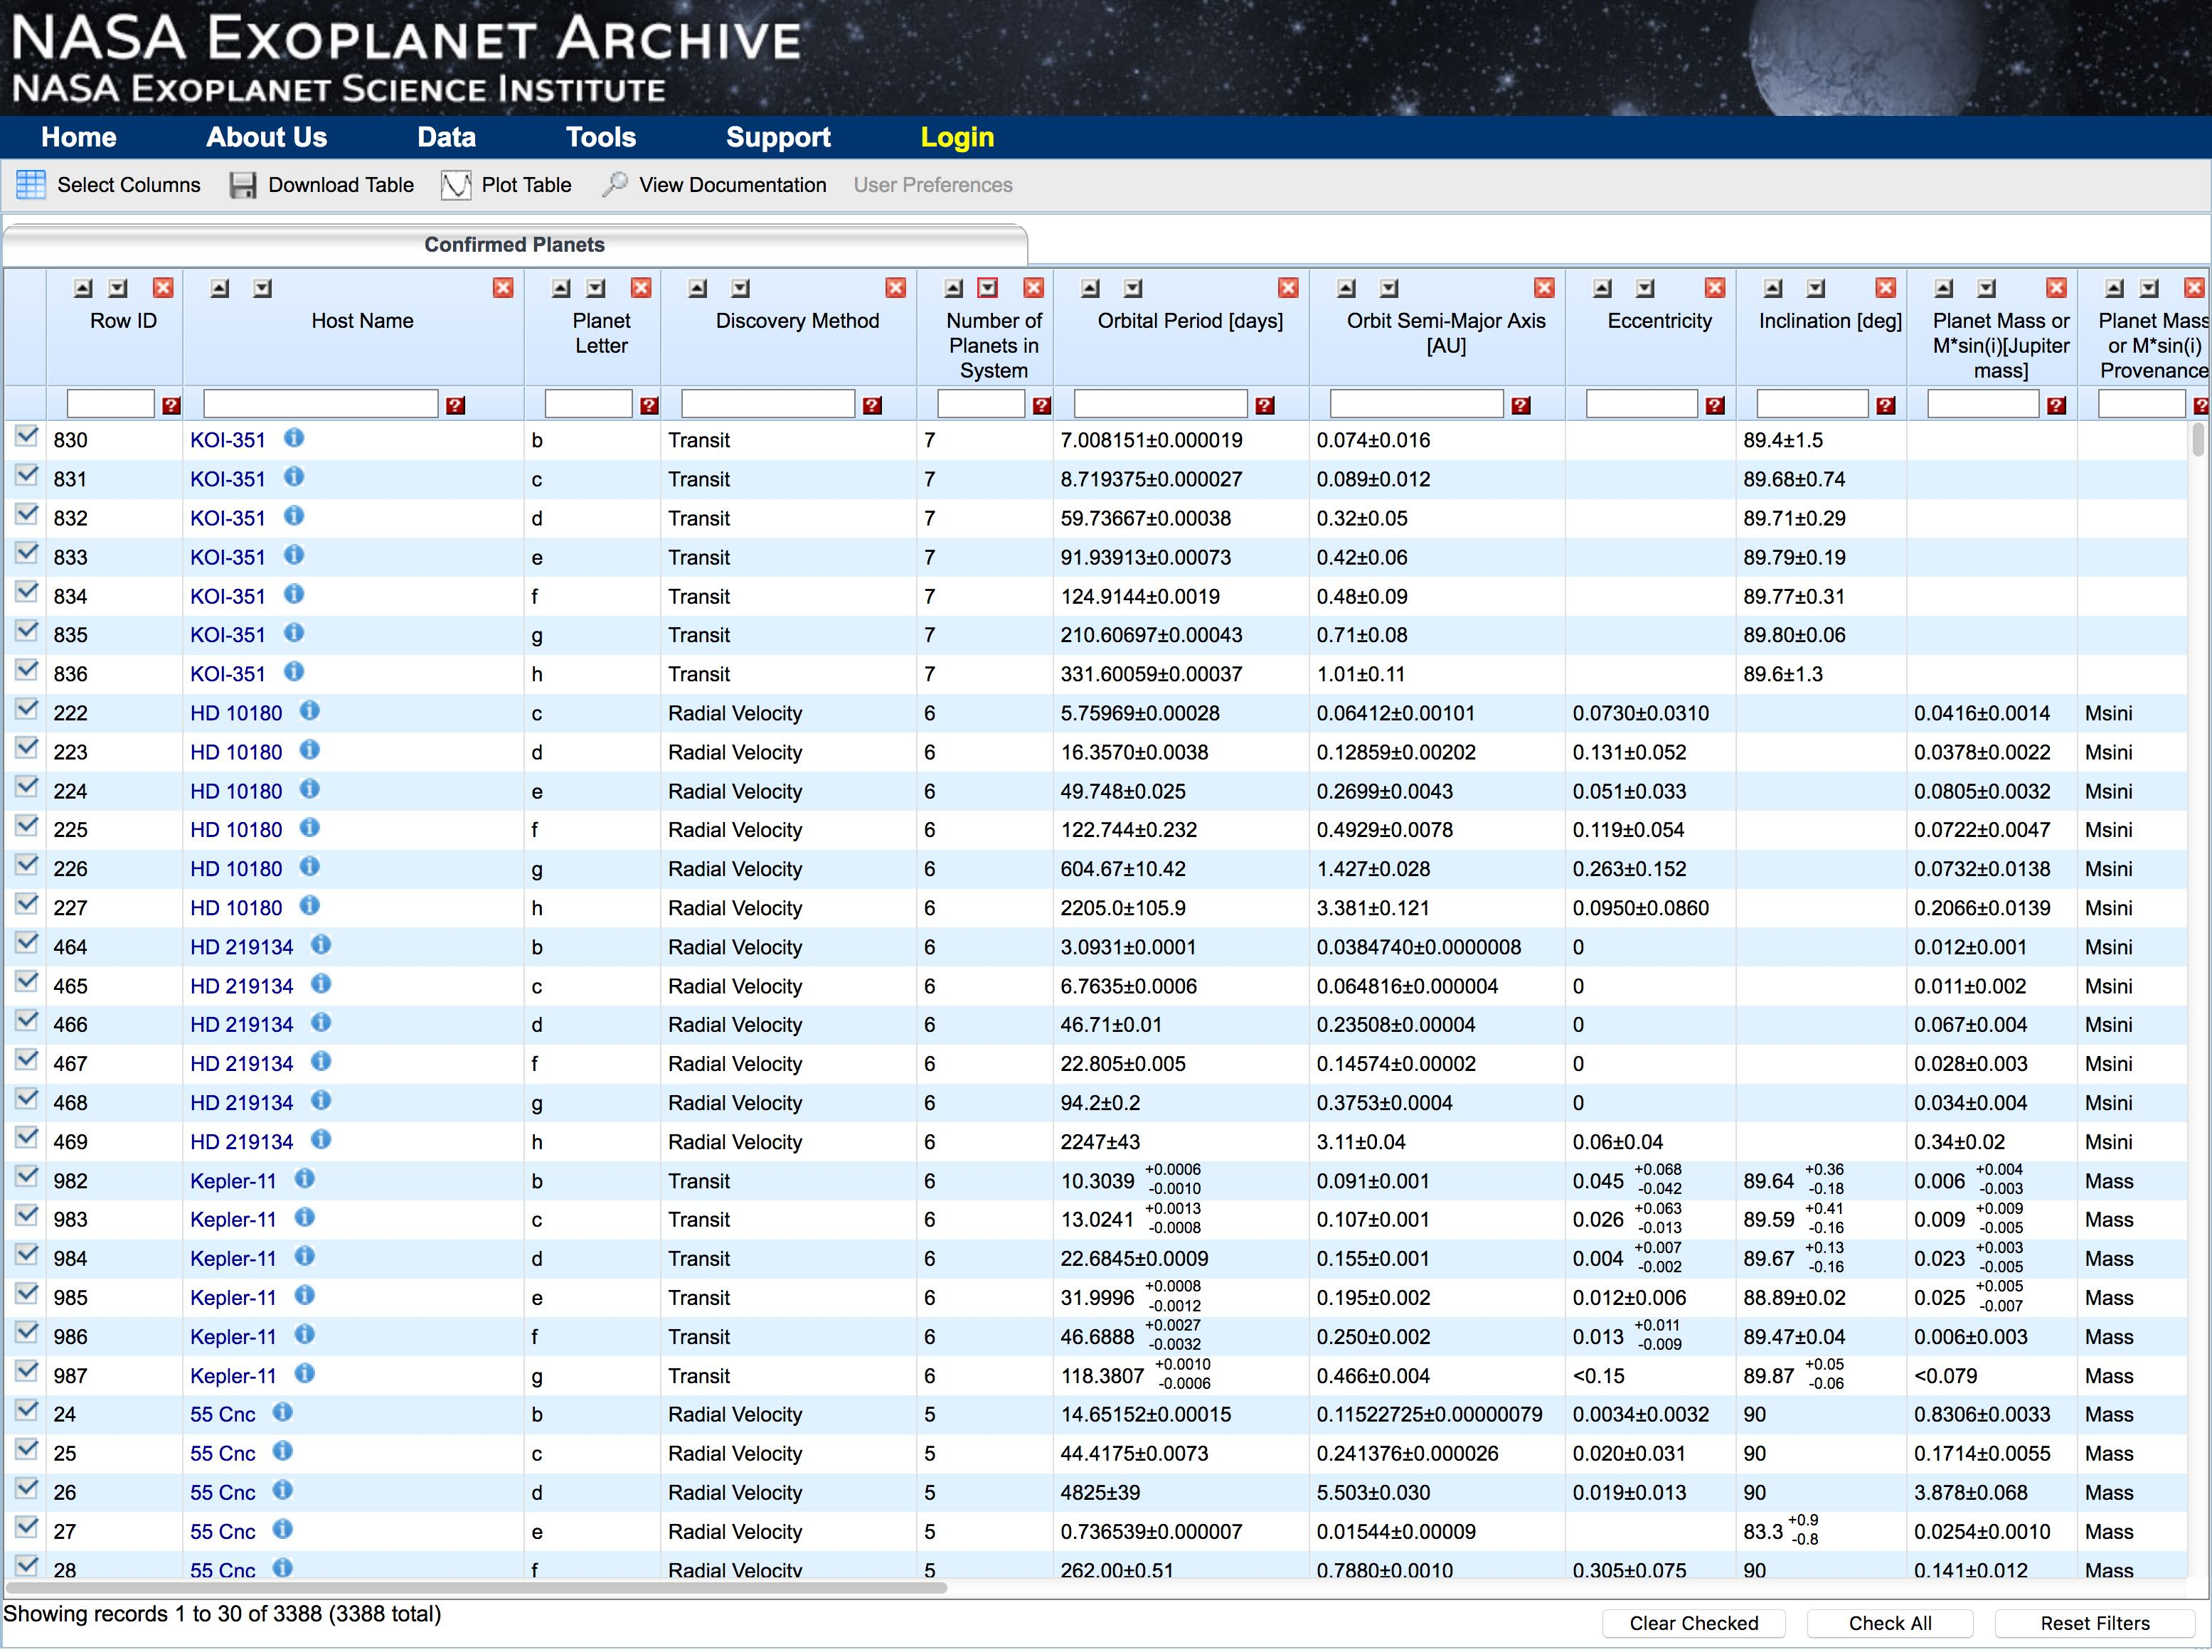
Can filter columns!
e.g., find hot Jupiters
with measured eccentricities

Slide 7
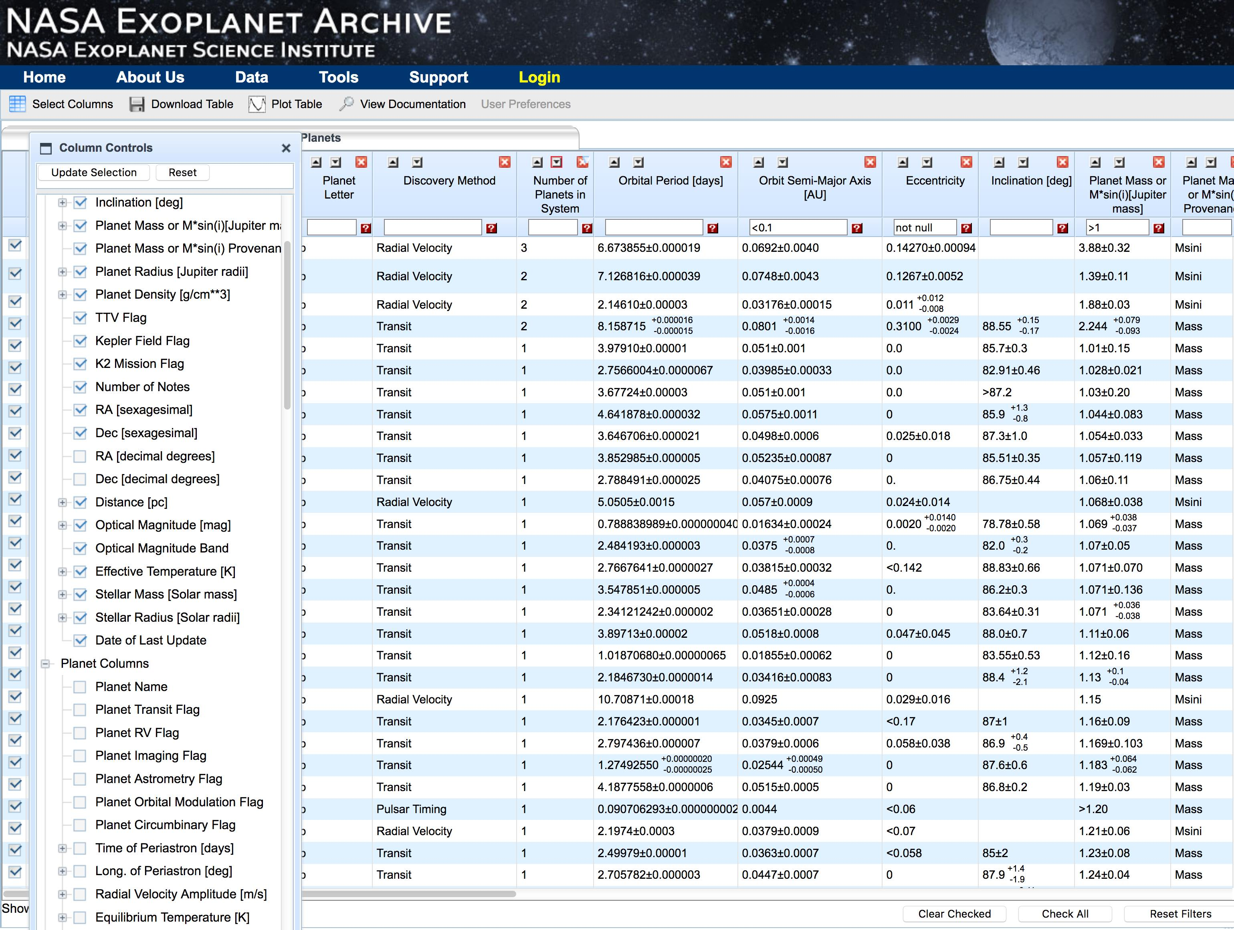
👆
Many more columns can be added
Columns can also rearranged, removed….
And saved!

Slide 8
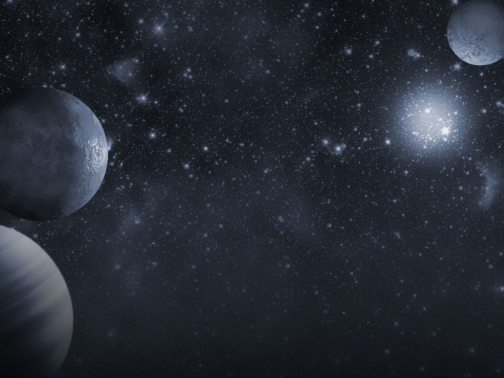
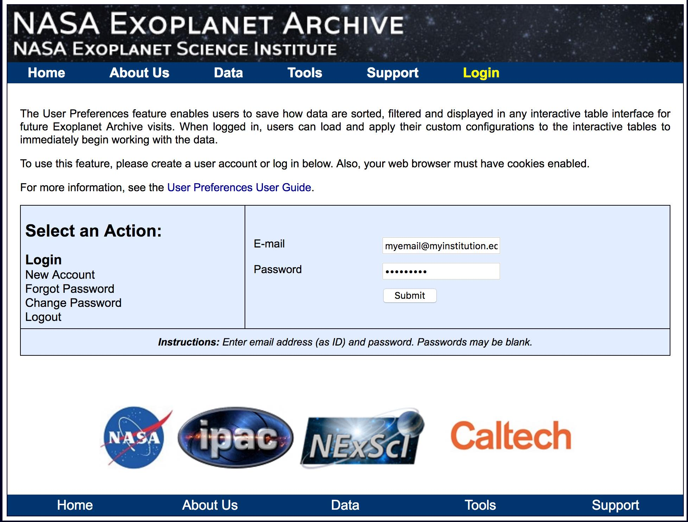
Can set user preferences!

Slide 9
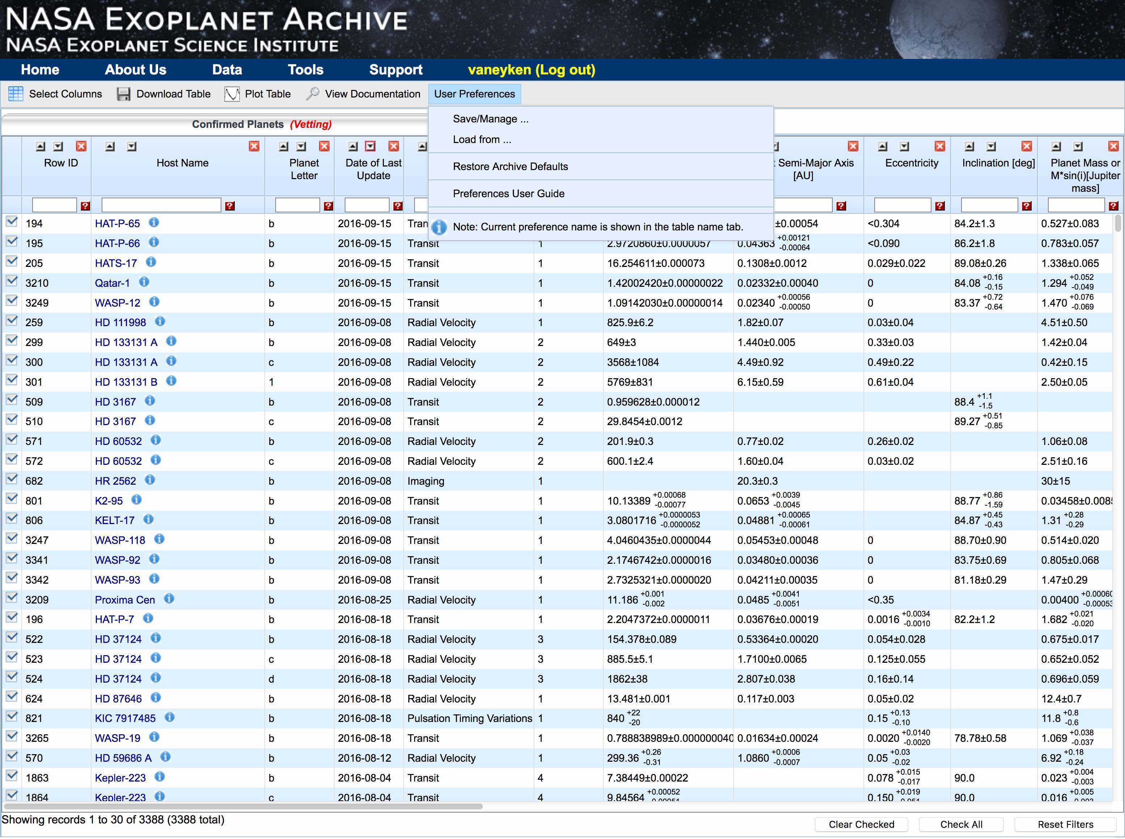
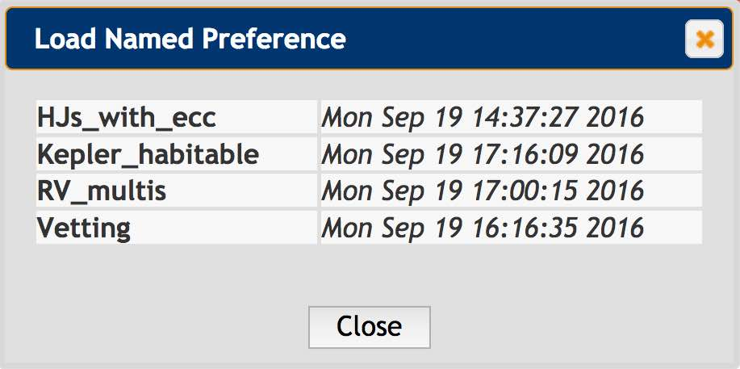
👈
👉

Slide 10
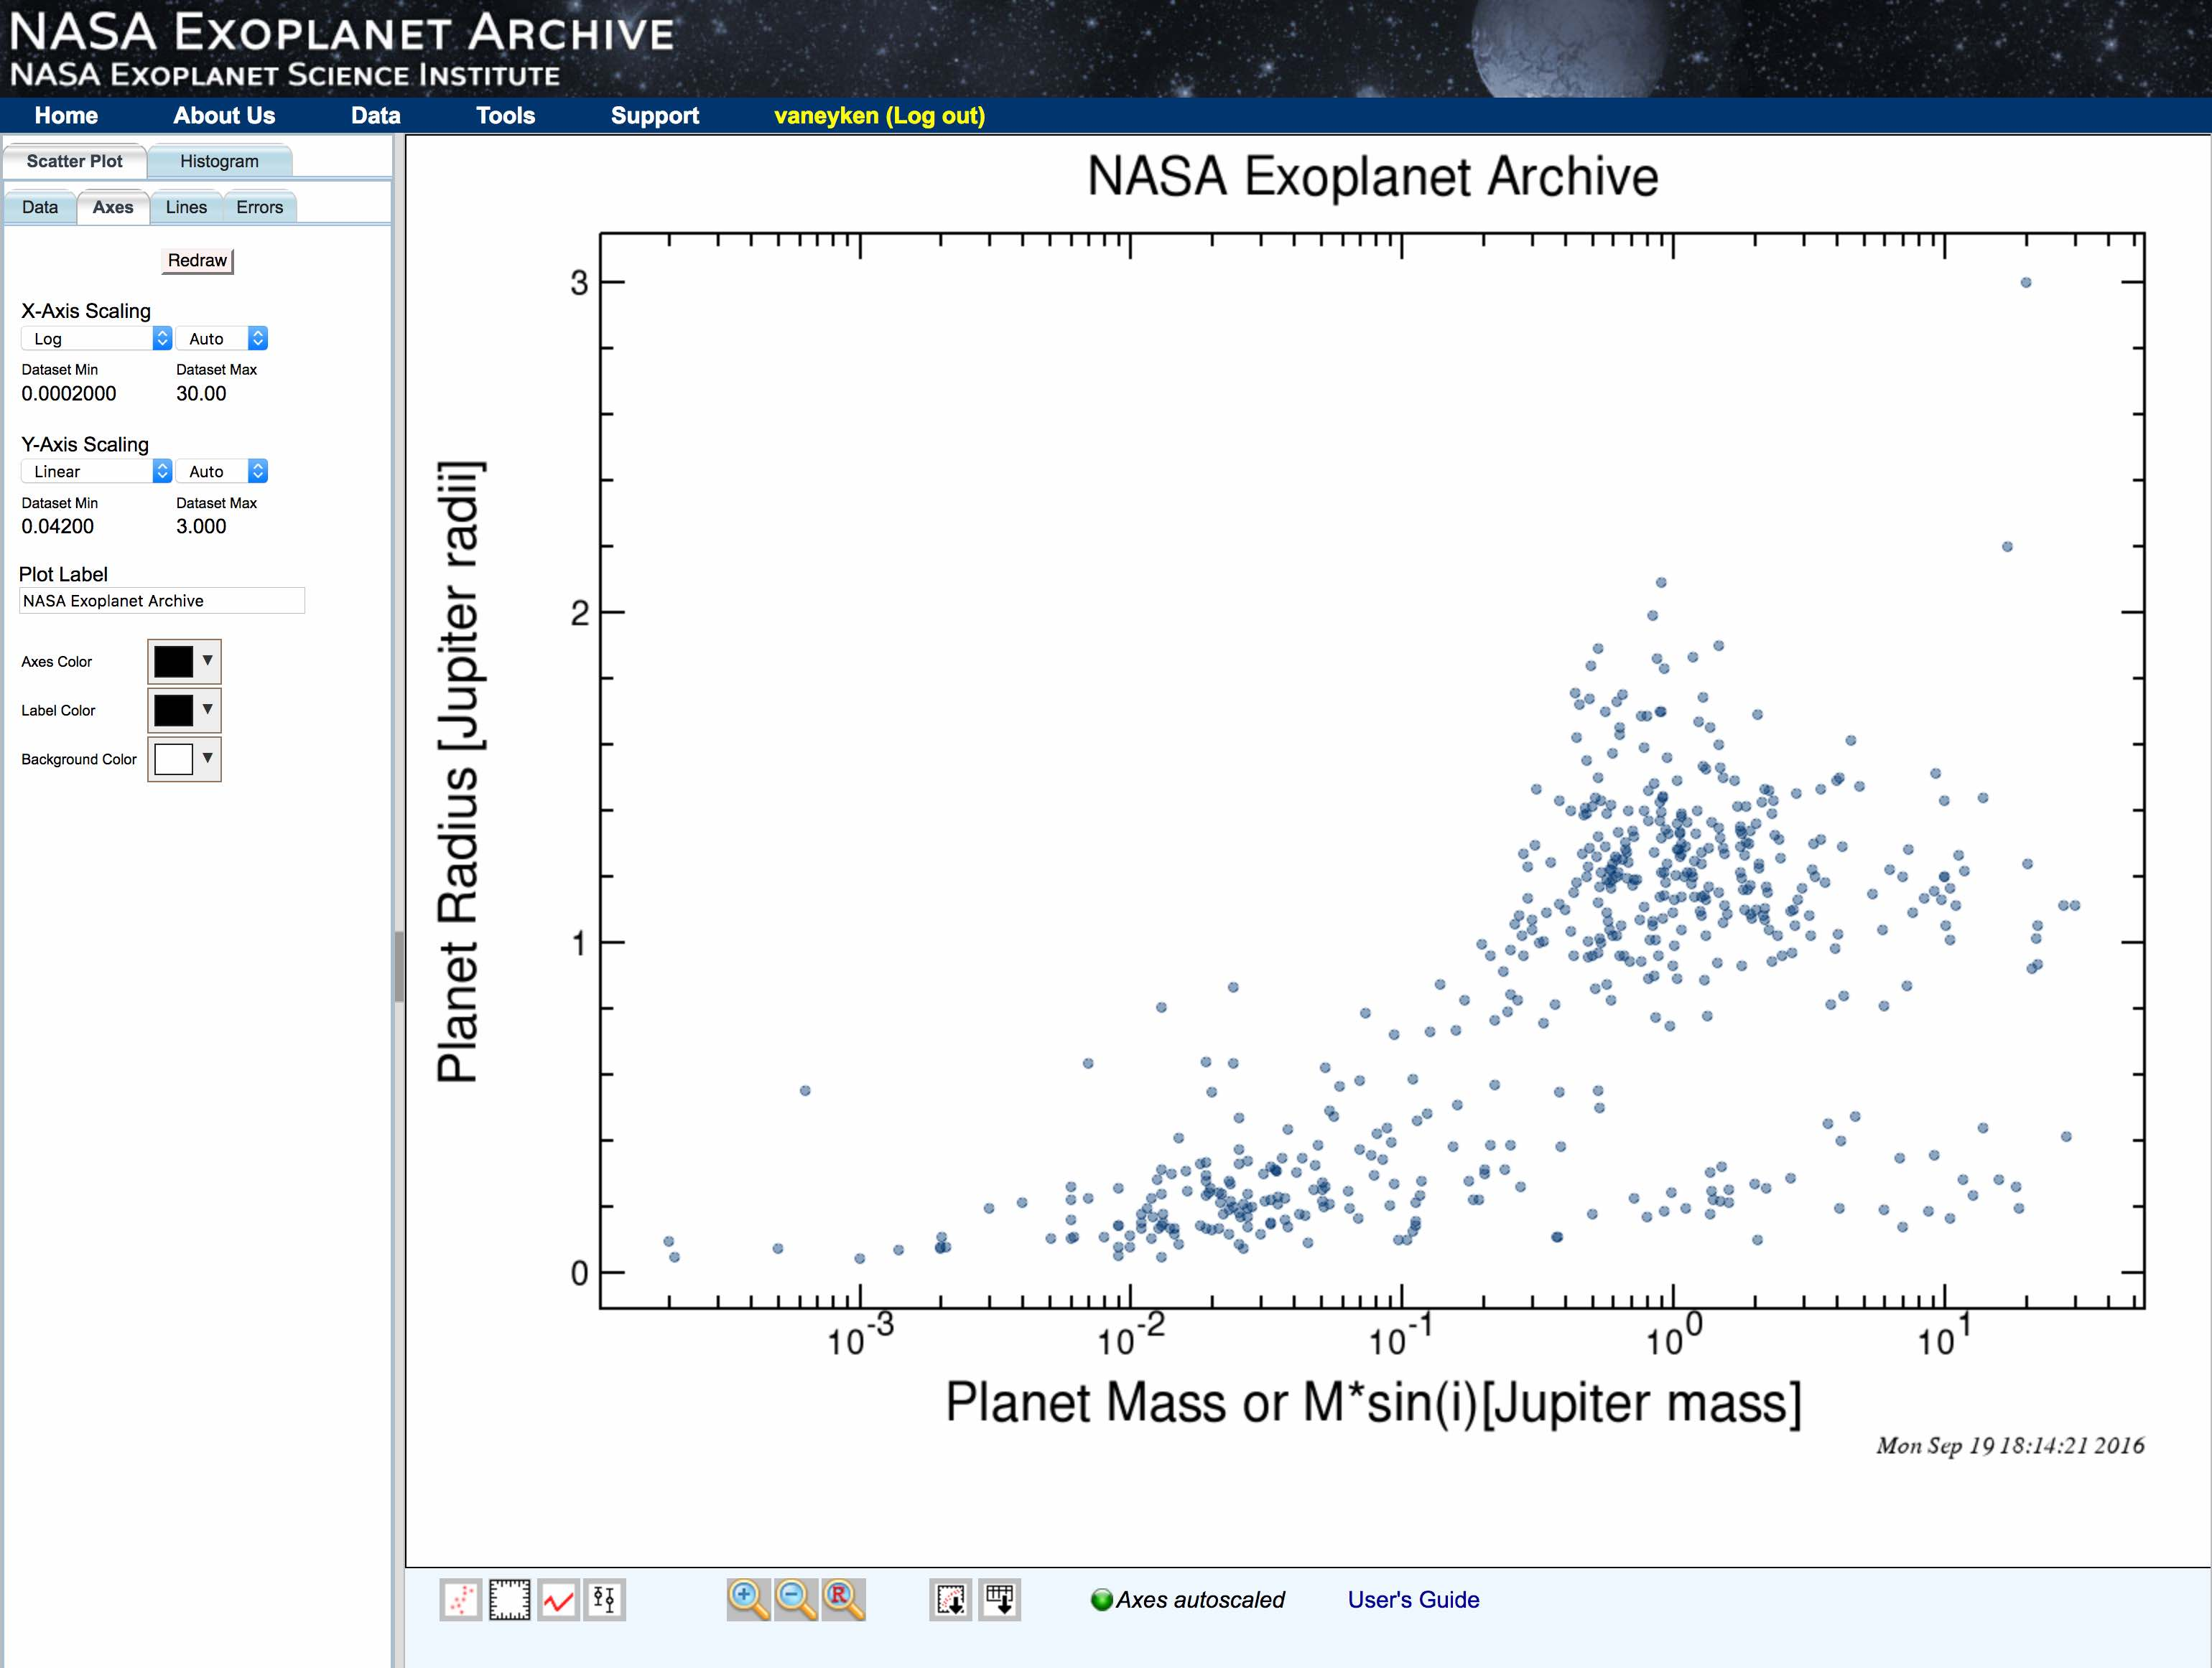
E.g., radius vs. mass, full confirmed planets table
Generalized tool for many of the interactive tables

Slide 11
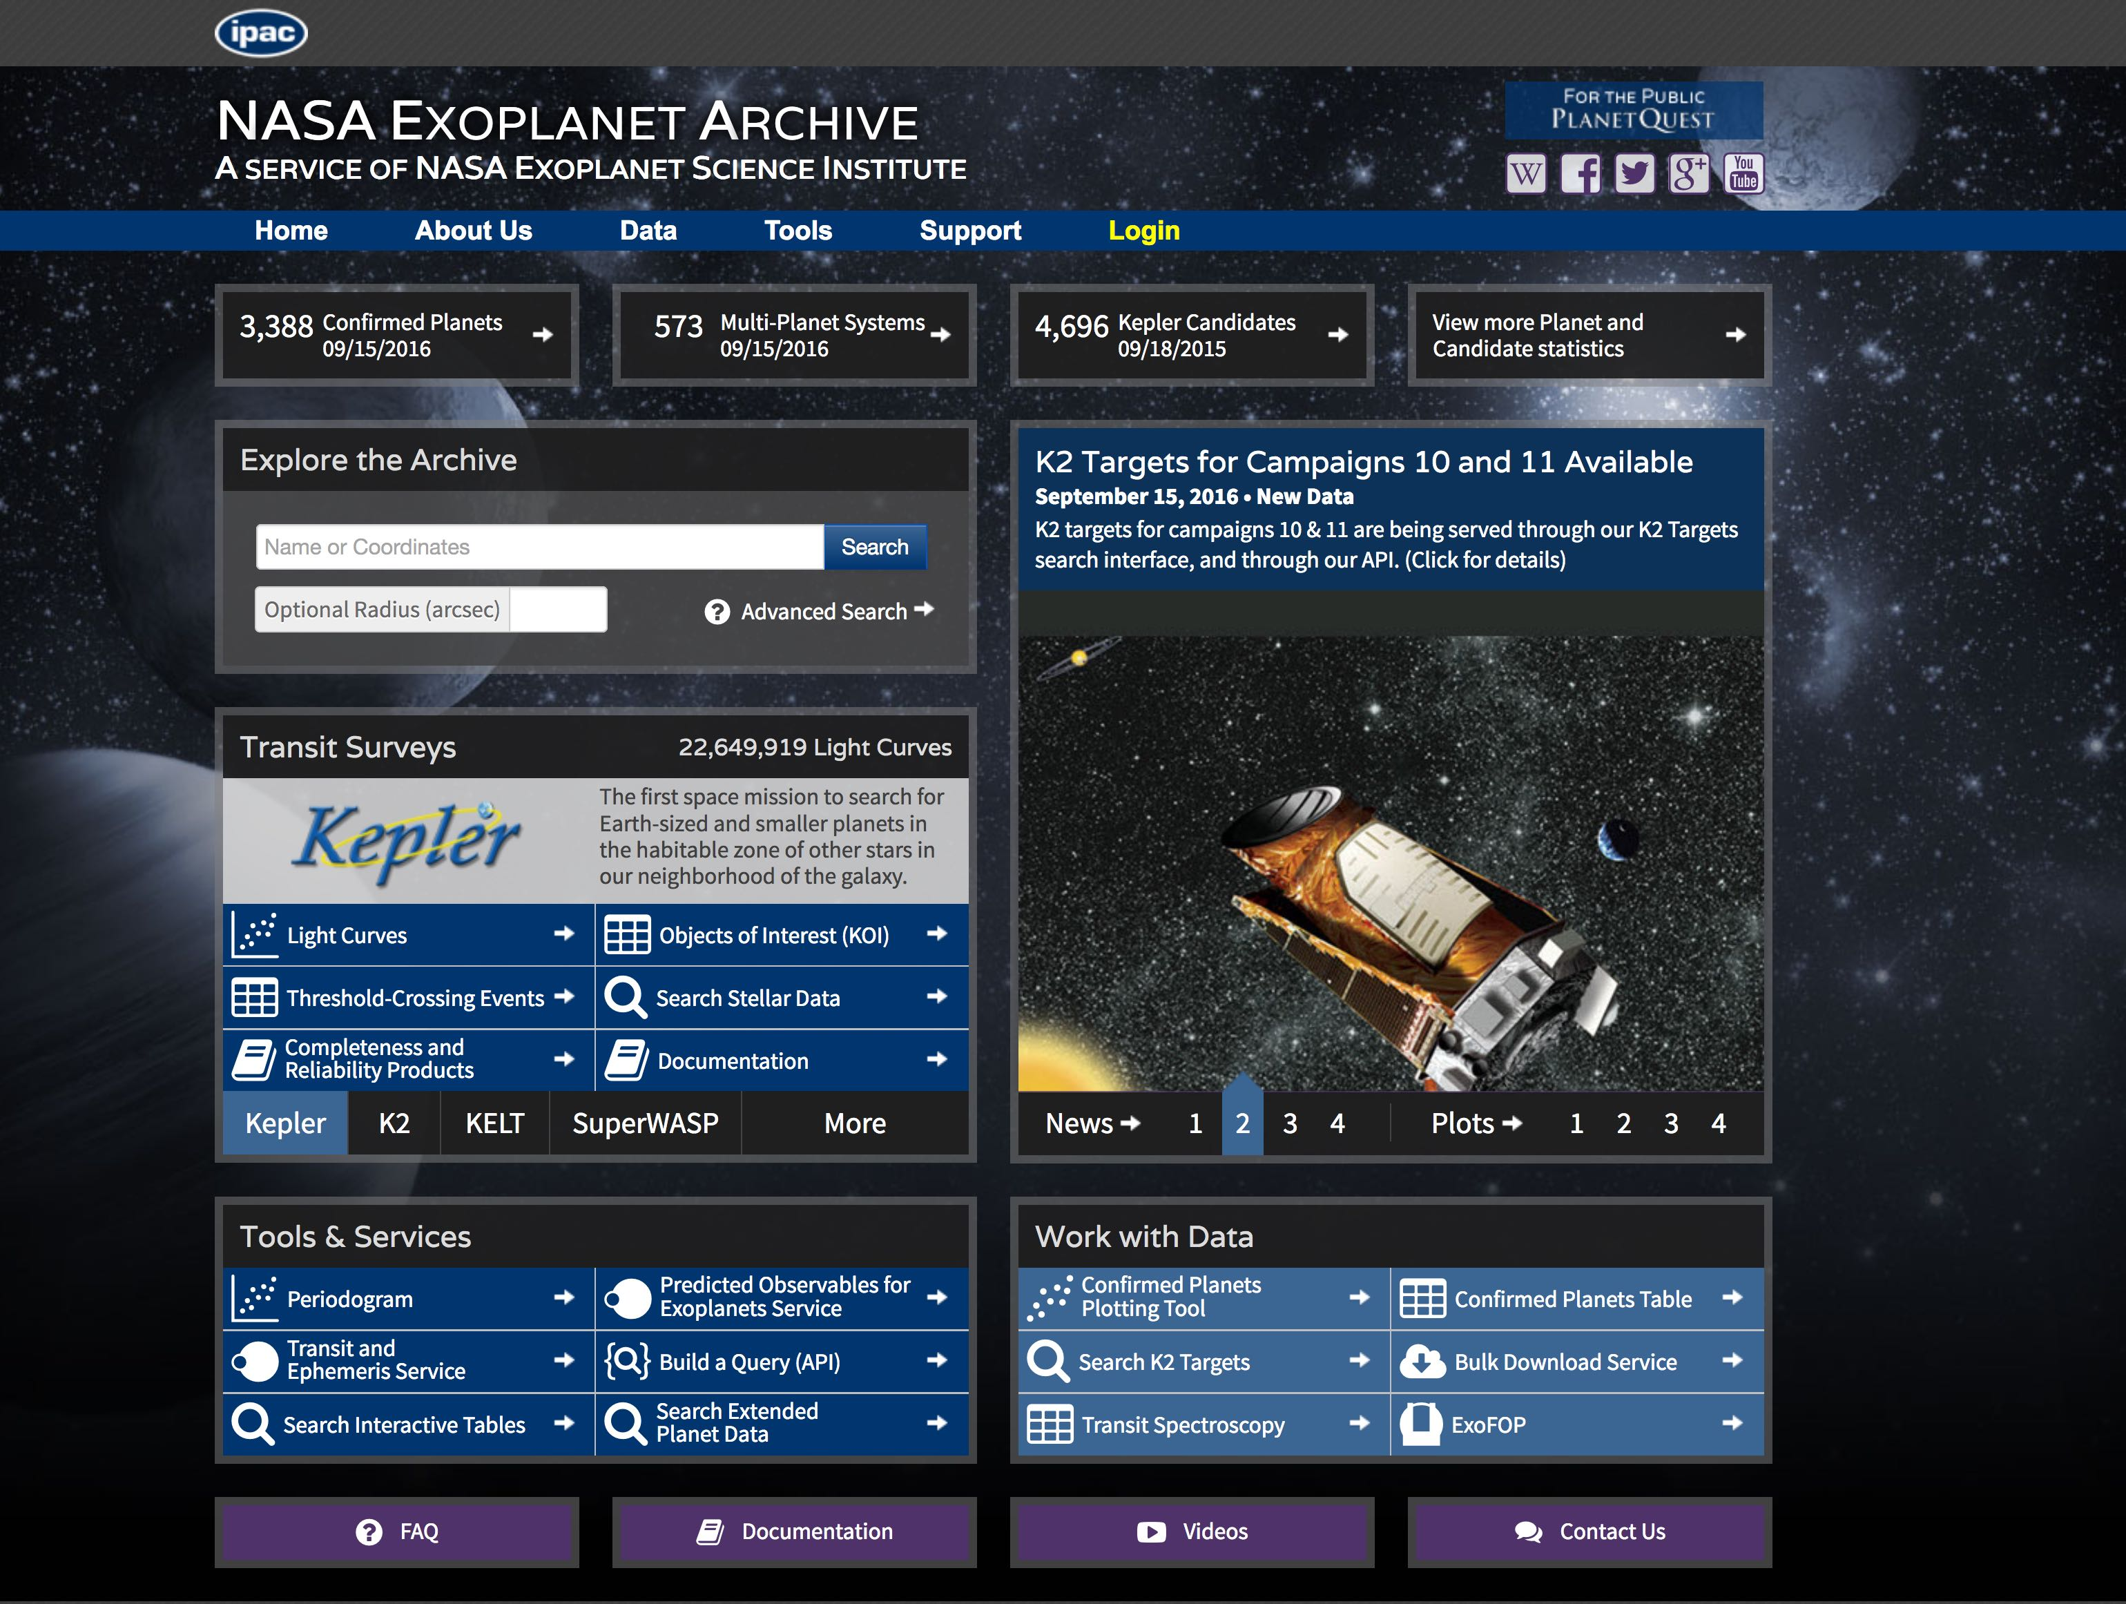
Pre-built plots also available….
👆

Slide 12
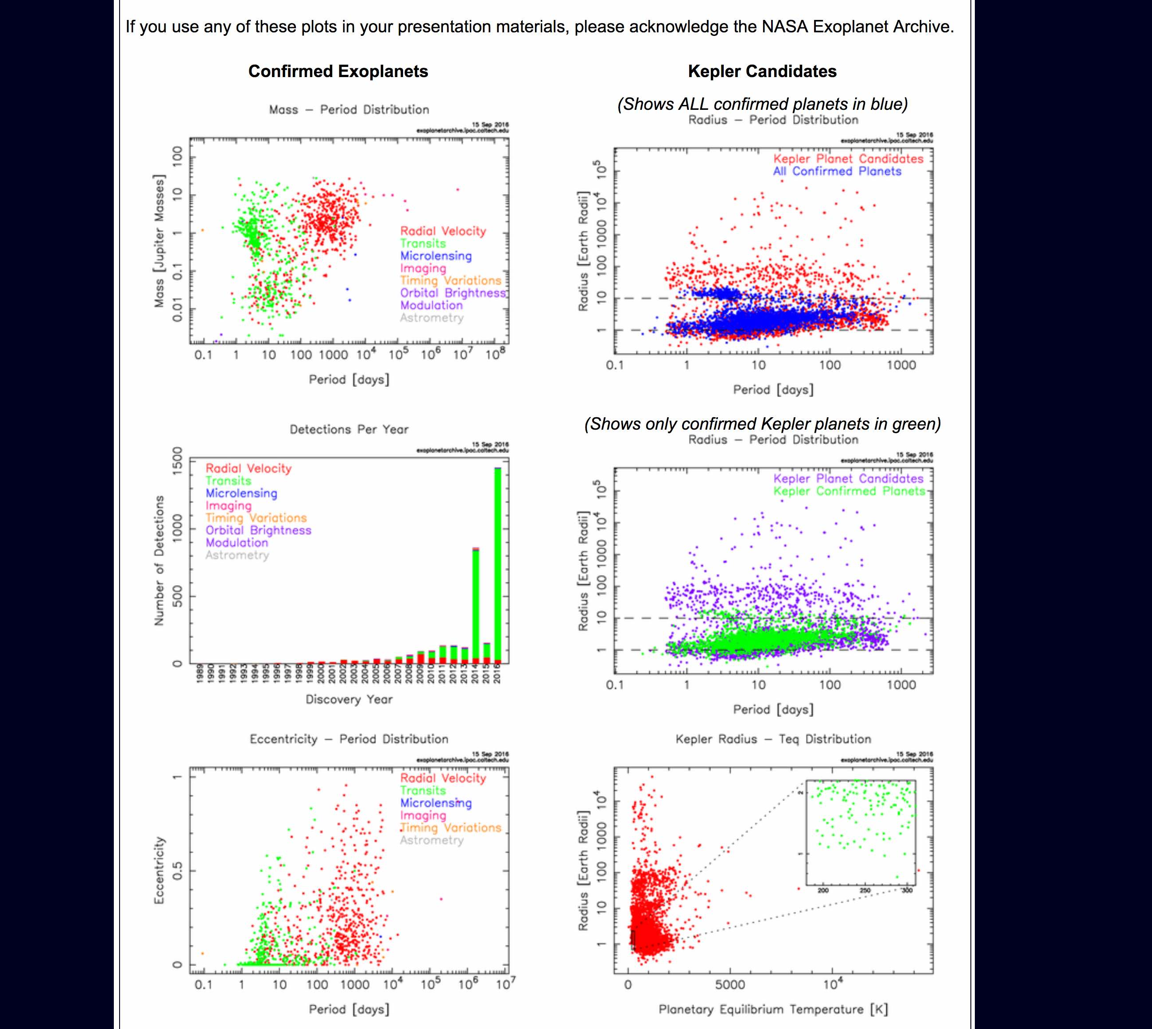
Updated weekly along with archive database
…. Etc.

Slide 13
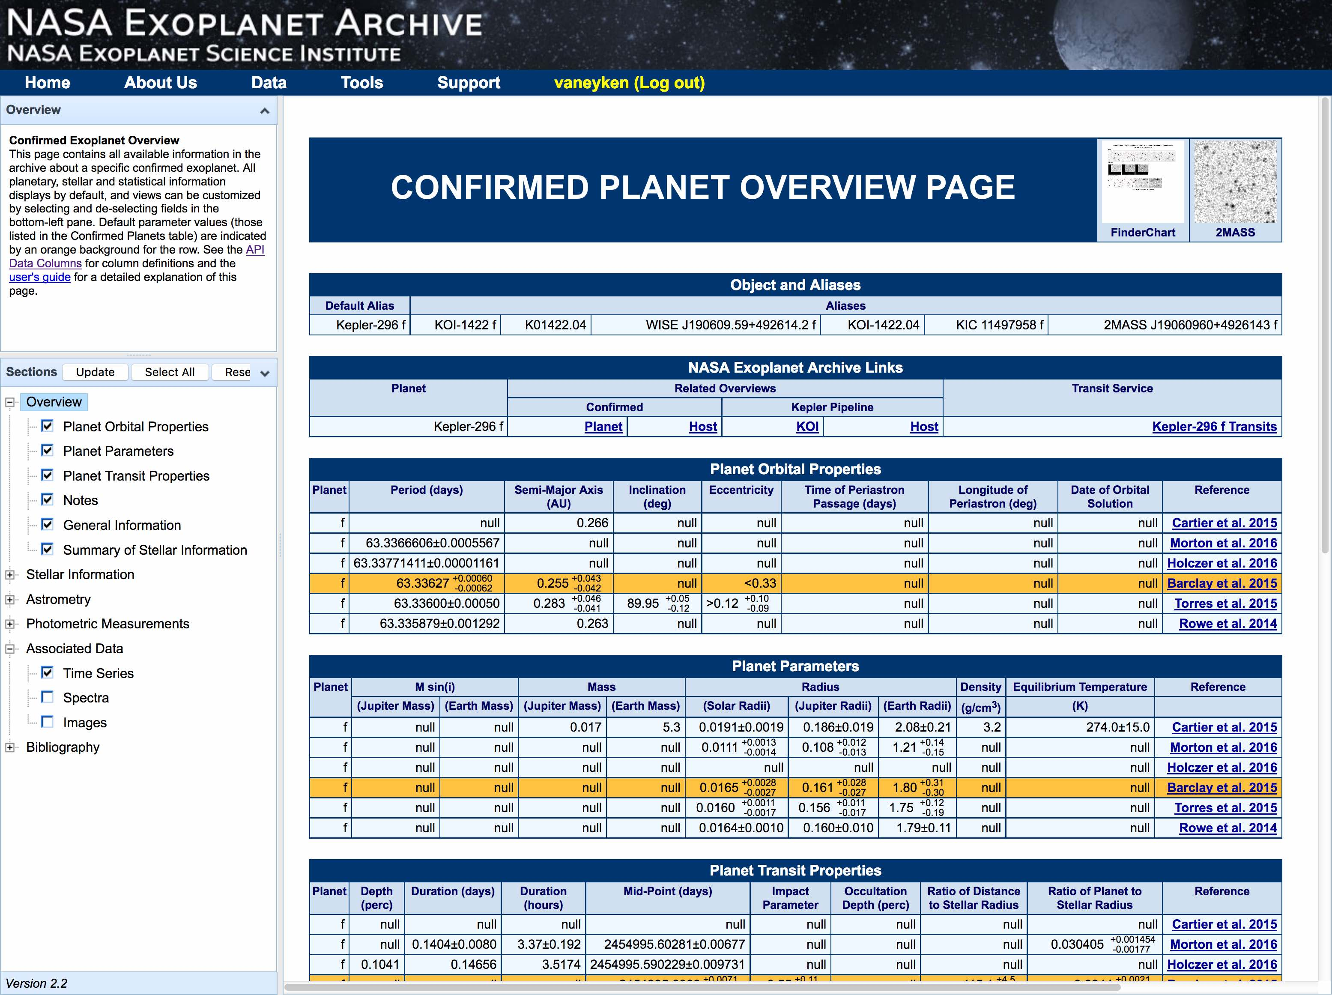
Finder charts from IRSA!
Note data from multiple references
Highlight marks “default reference”: this one appears in the Confirmed Planets table
Much more info available!
…All data from all references can be found in Extended Planet-Data table

Slide 14
Extended Planet
Data Table

Slide 15
Extended Planet-Data
👈

Slide 16
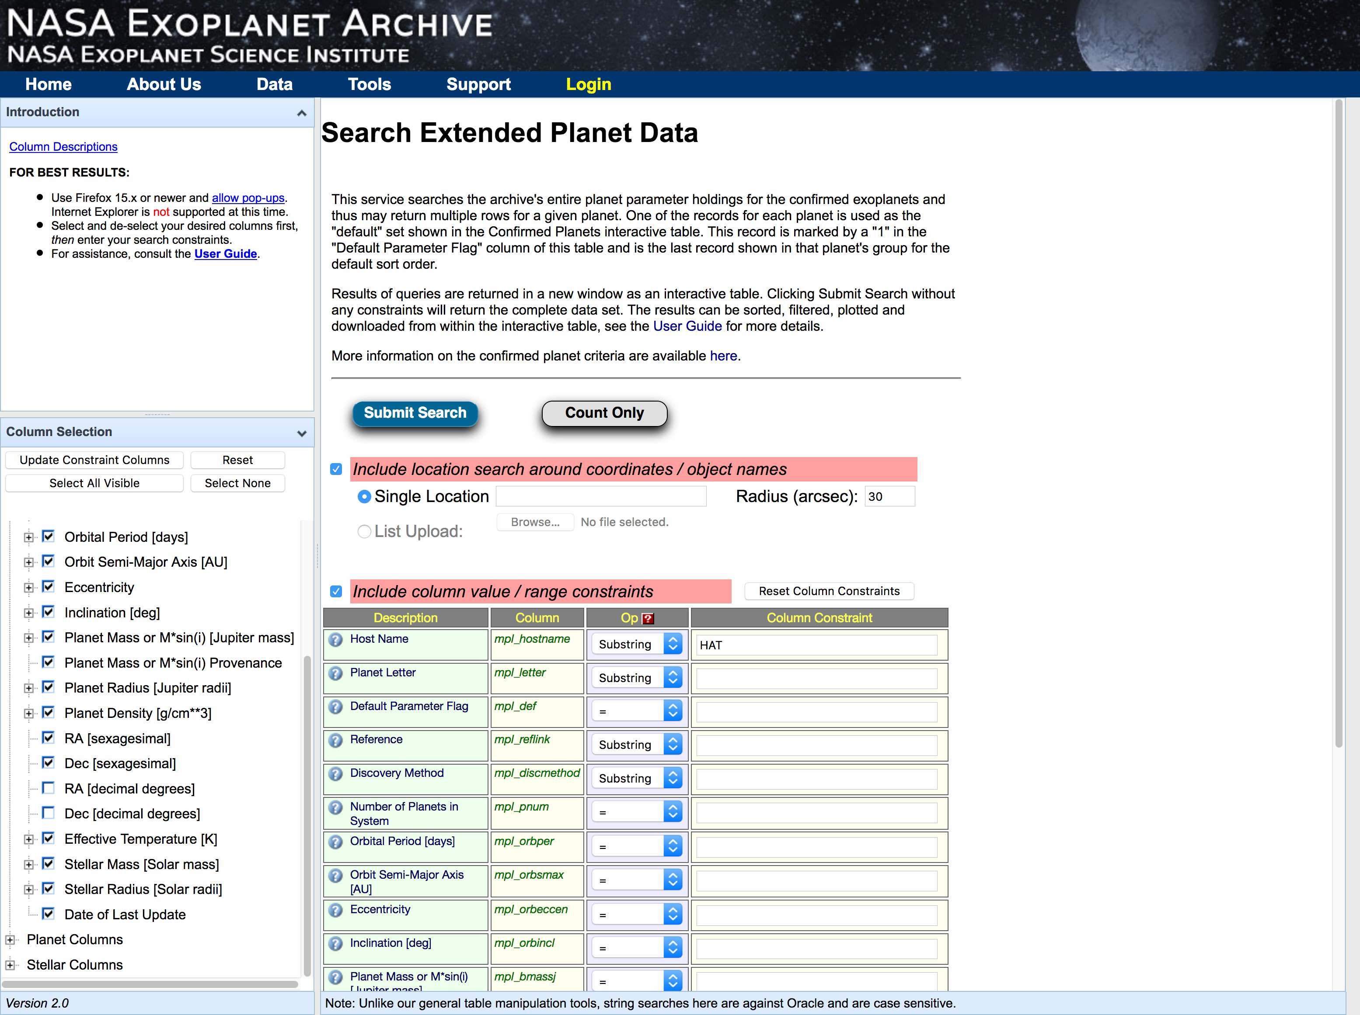
👆

Slide 17
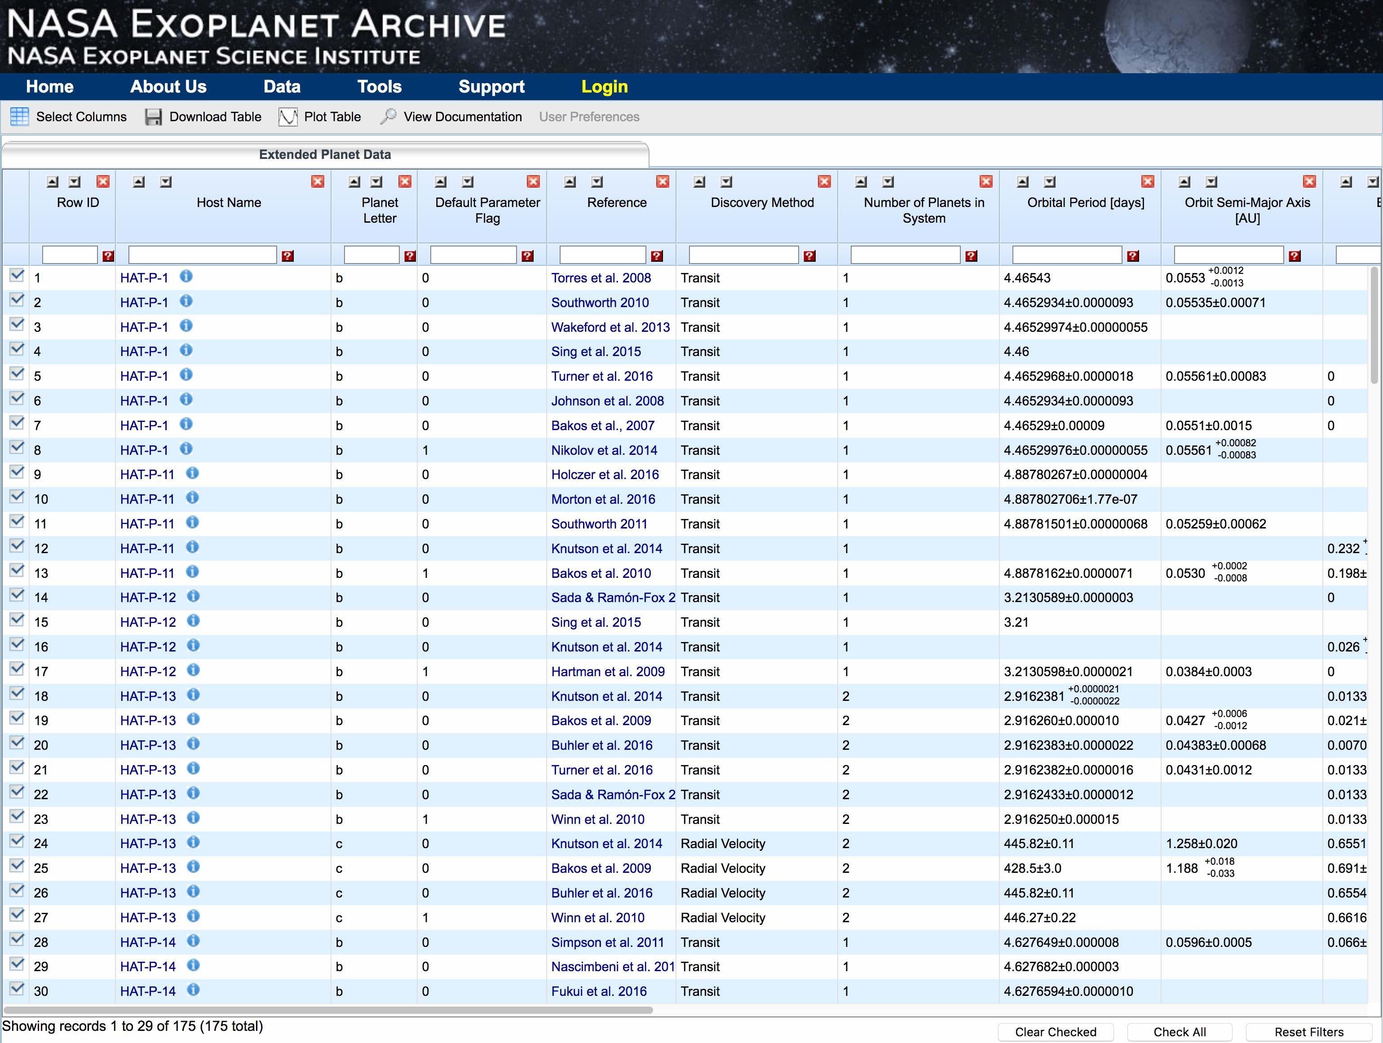
Similar to Confirmed Planets table
But includes data from all ingested references for all confirmed planets

Slide 18
The Microlensing Planets Table

Slide 19
👈

Slide 20
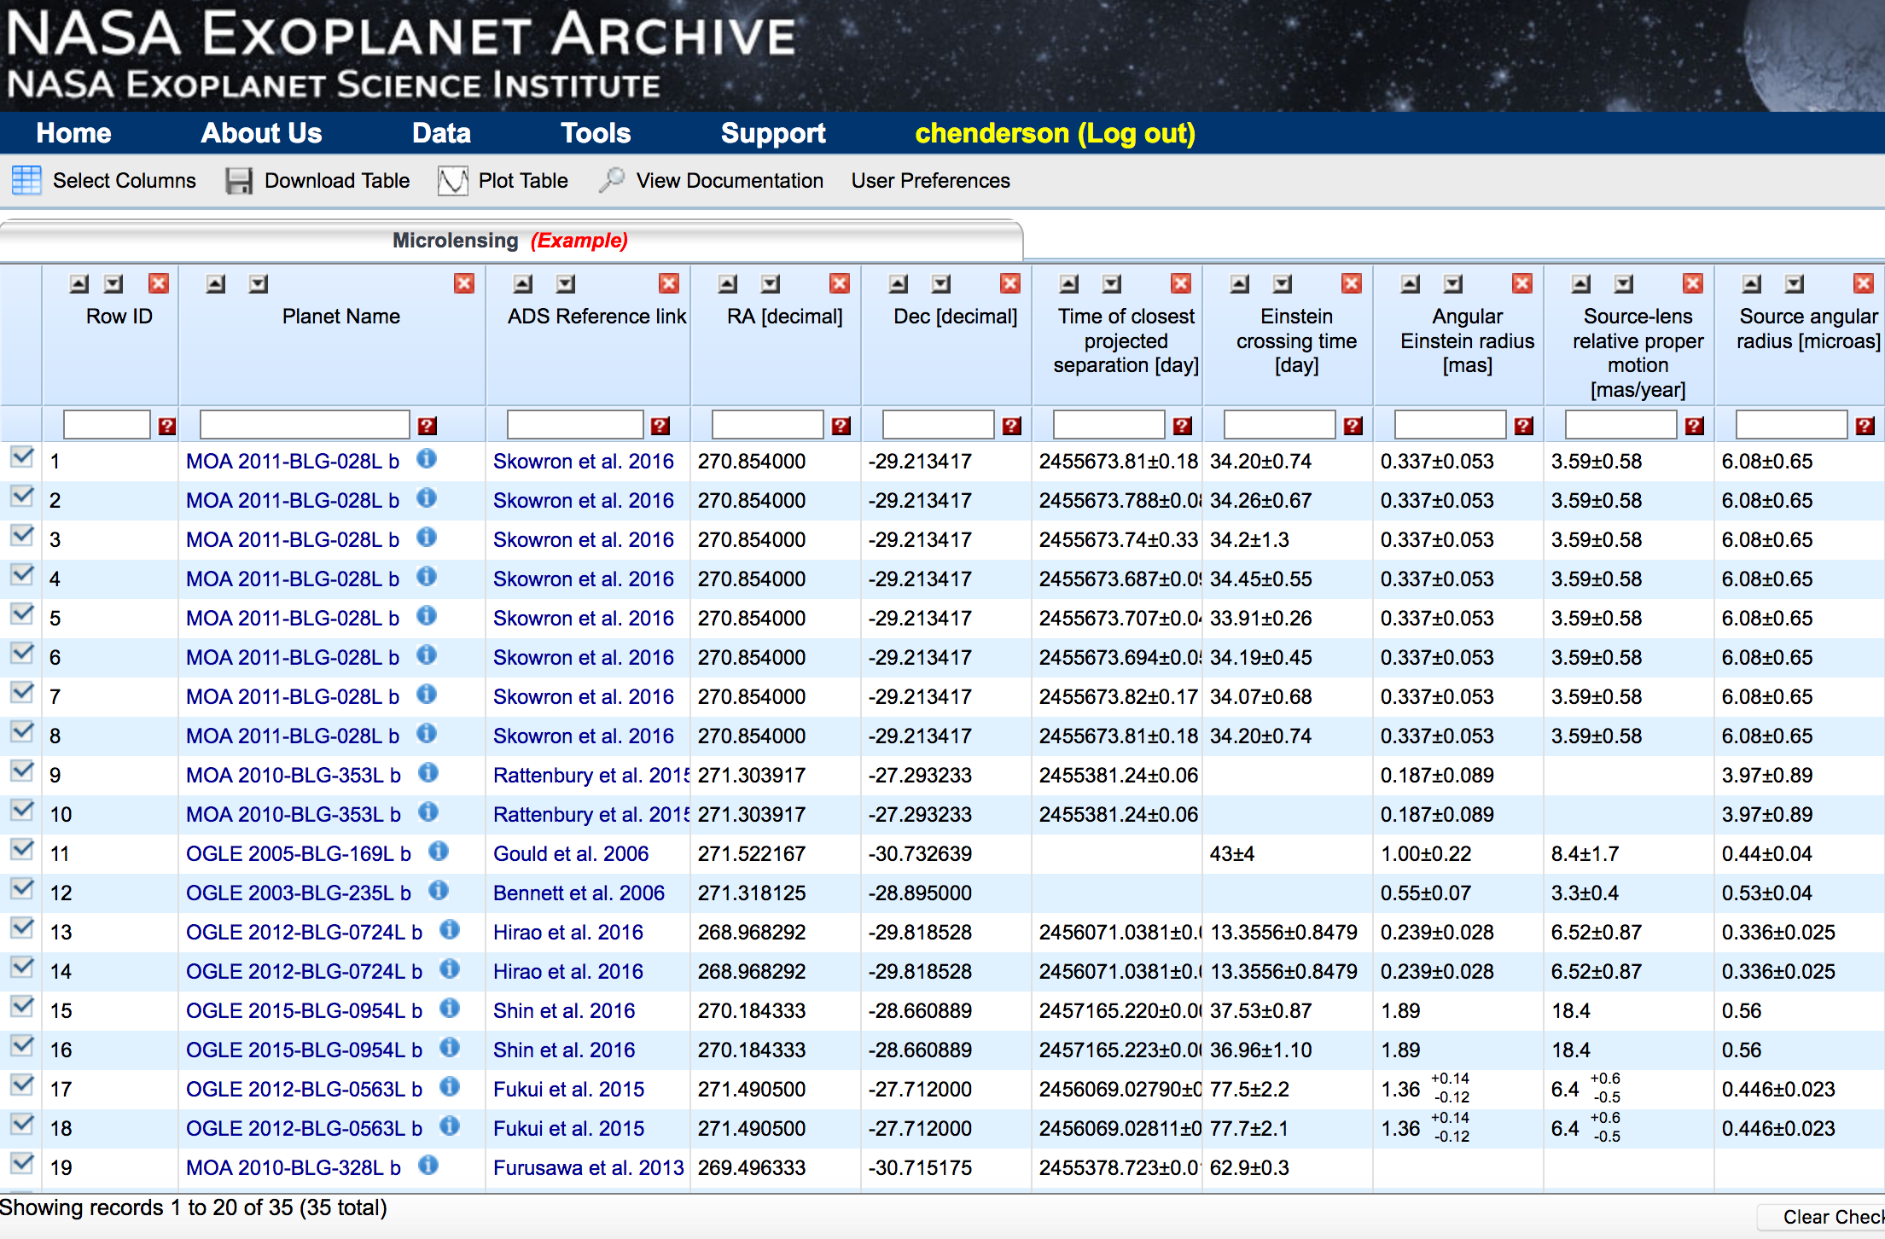
Microlensing-specific parameters!
2
Many observables, fit parameters, and physical properties are unique to methodology

Slide 21
One entry per model!
2
e.g., explore fit parameters and/or derived physical properties for all published models of same event

Slide 22
Microlensing Planets Table
Overhaul coming soon!
  Reset ‘default’ display columns
  Parameter groupings!
  Reorder column positions
  Input all models for all published planets!

Slide 23
ExoFOP: K2C9

Slide 24
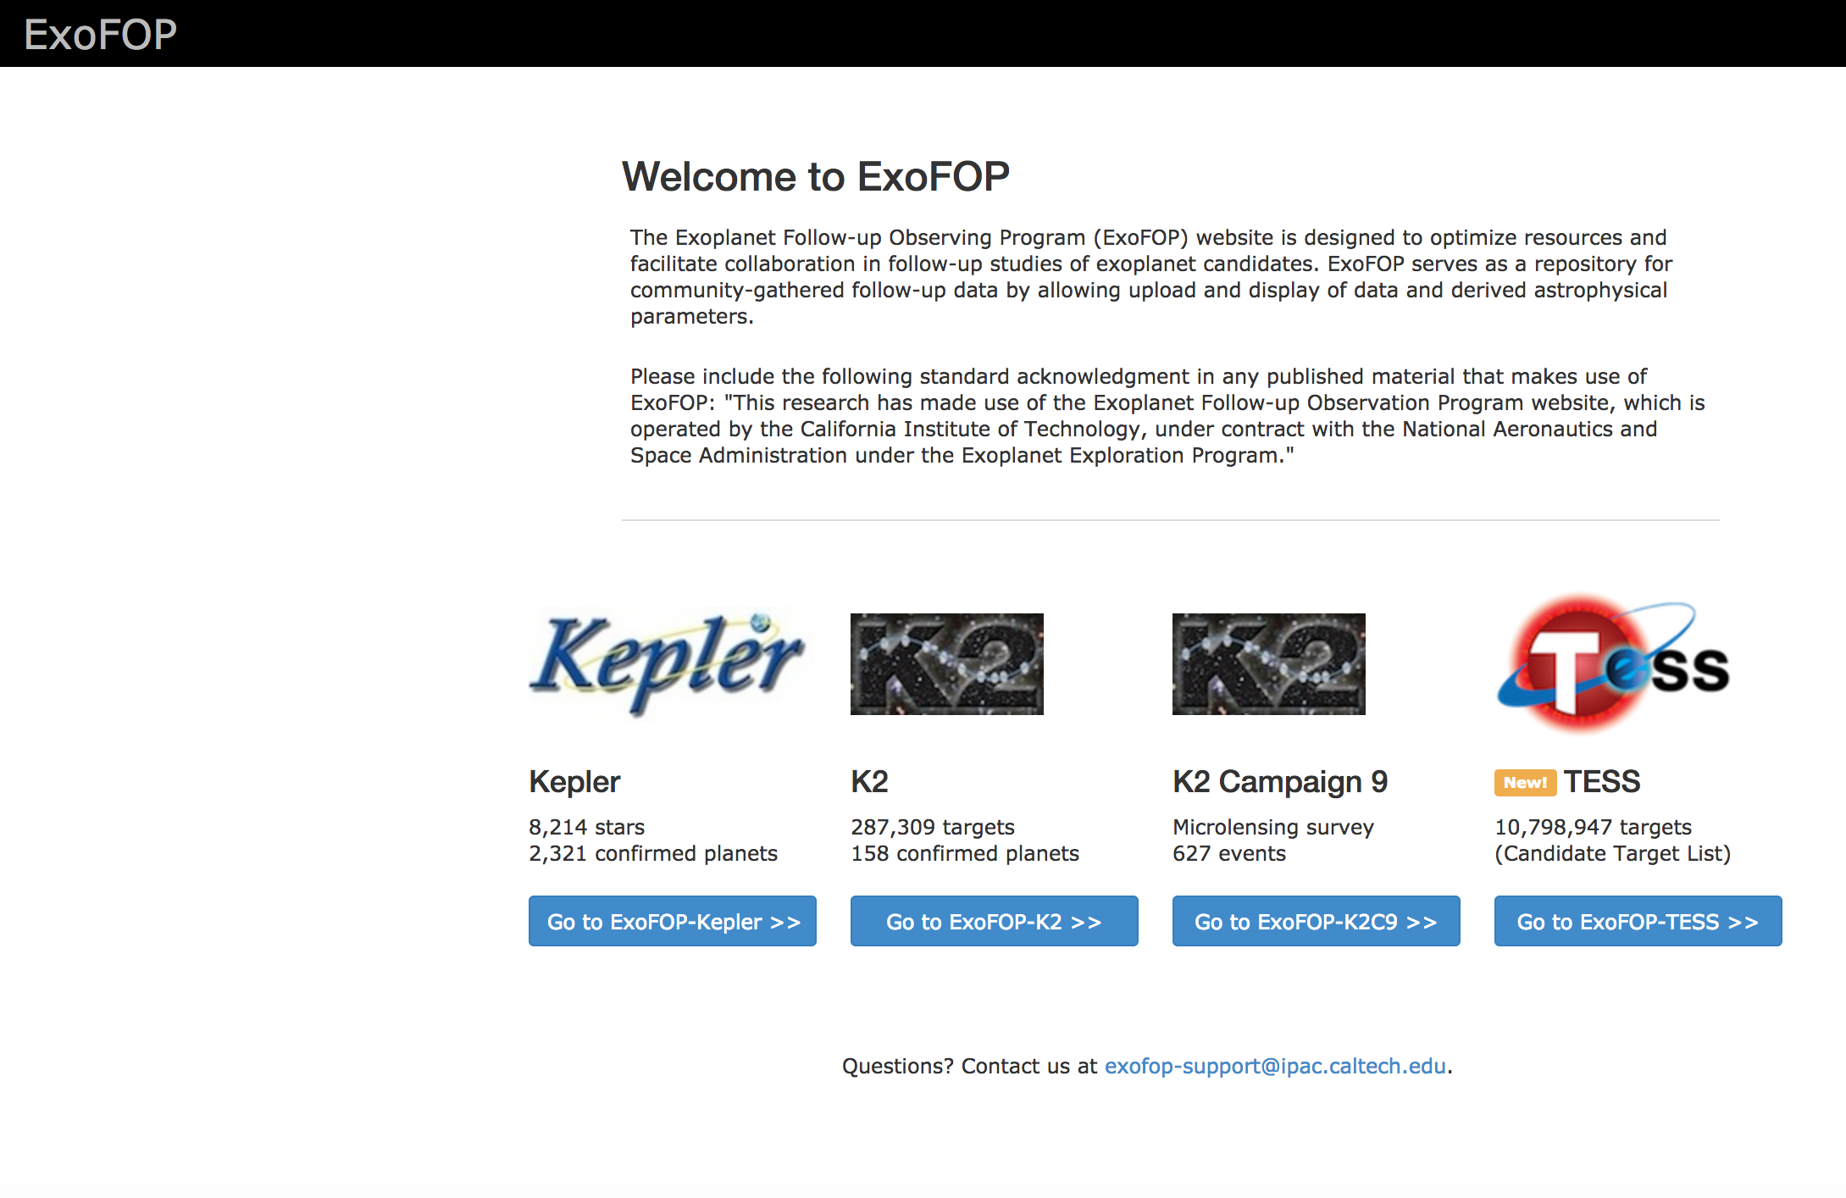

Slide 25
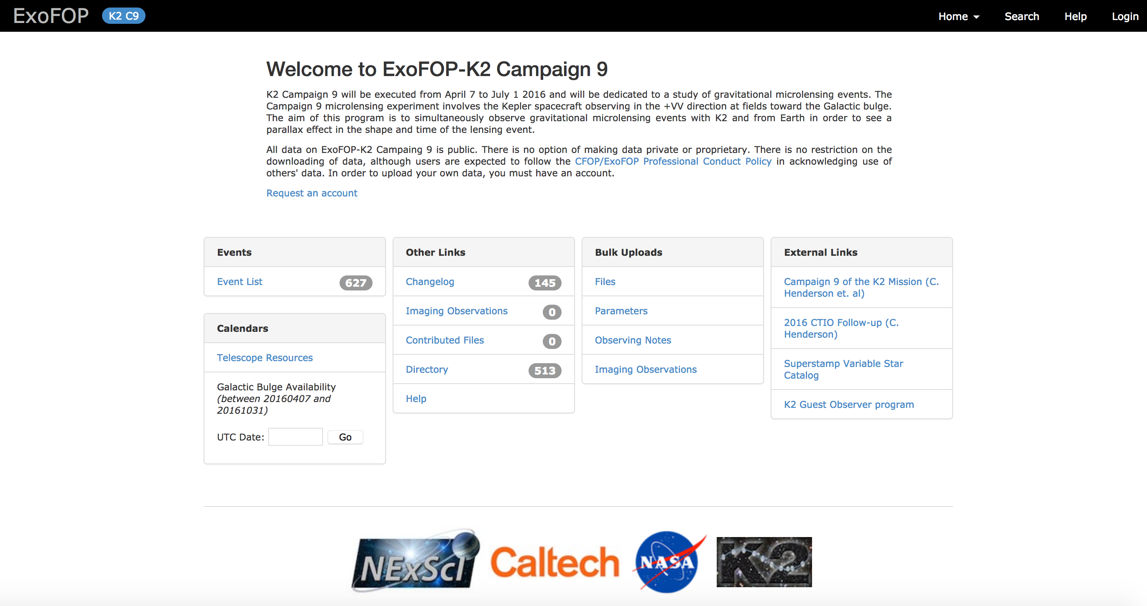

Slide 26
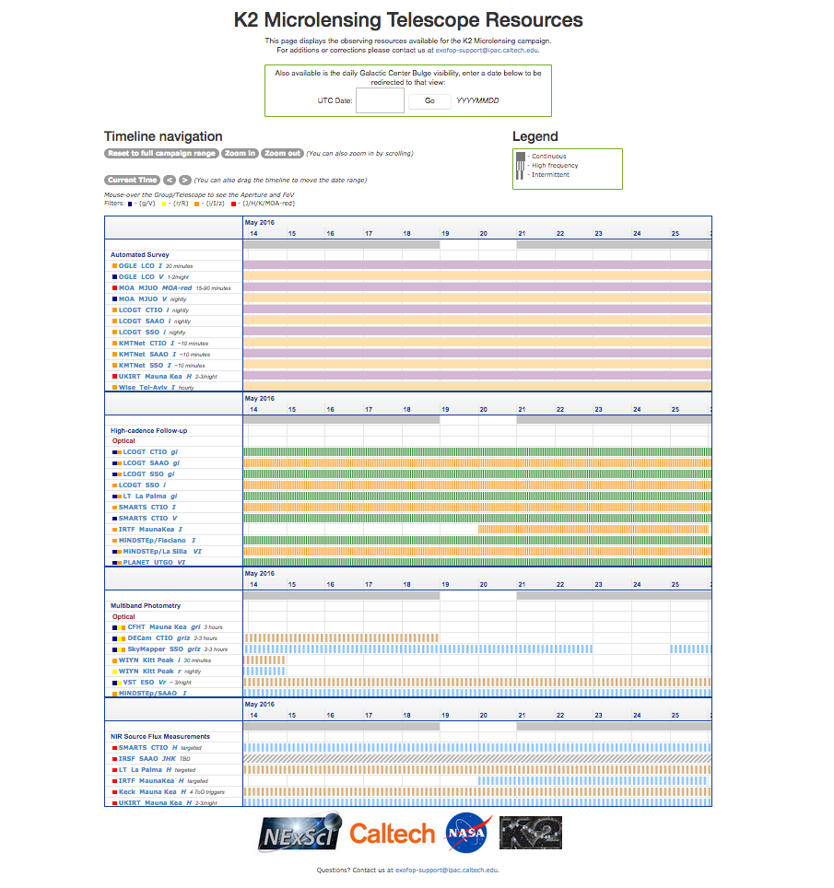

Slide 27
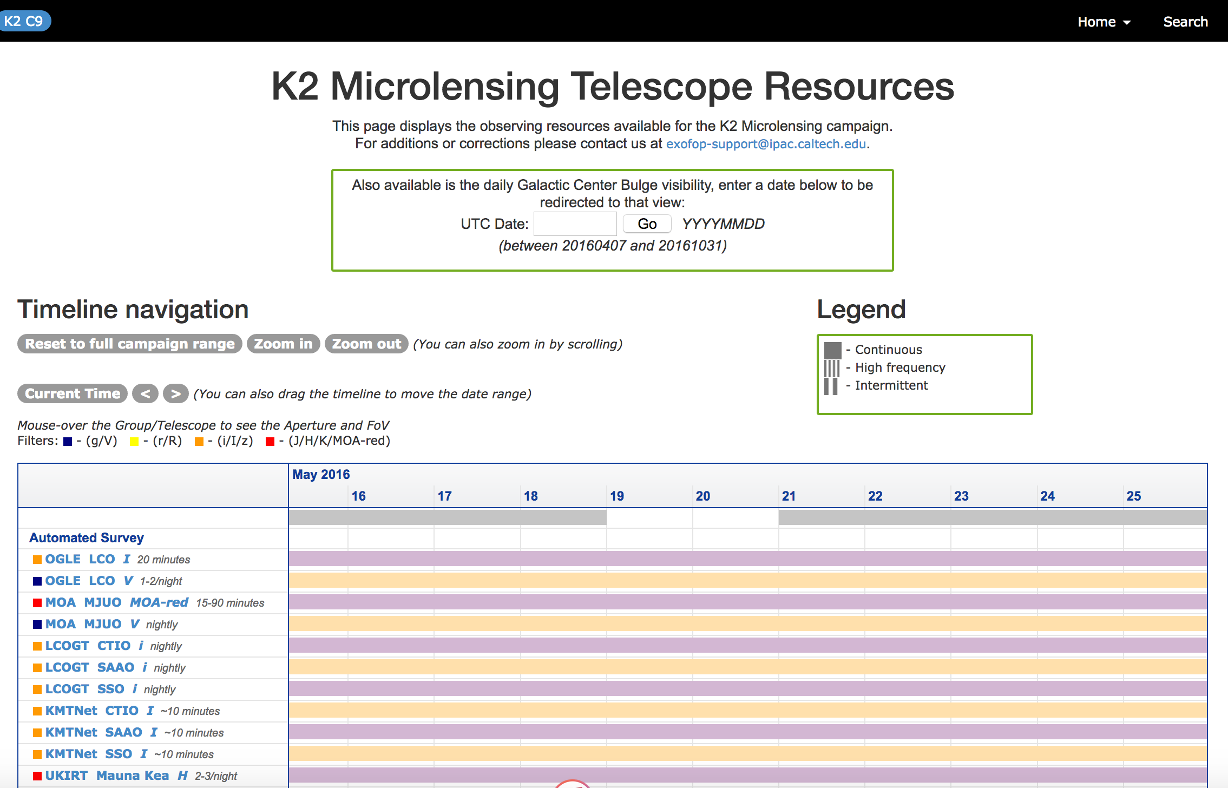

Slide 28
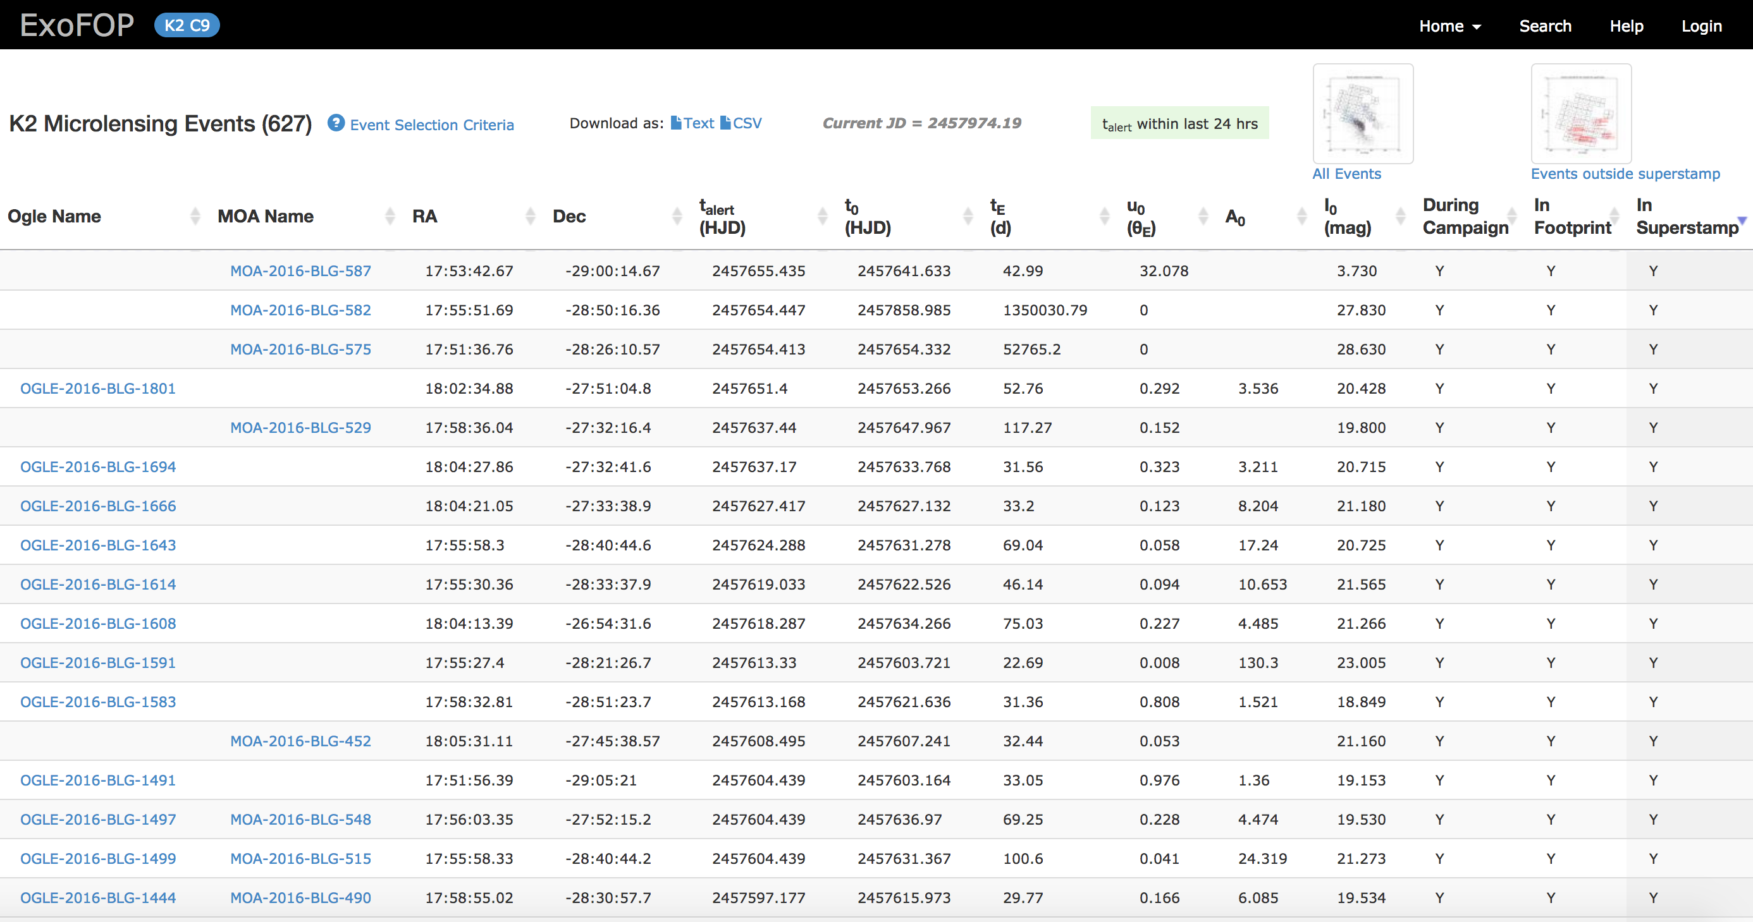

Slide 29
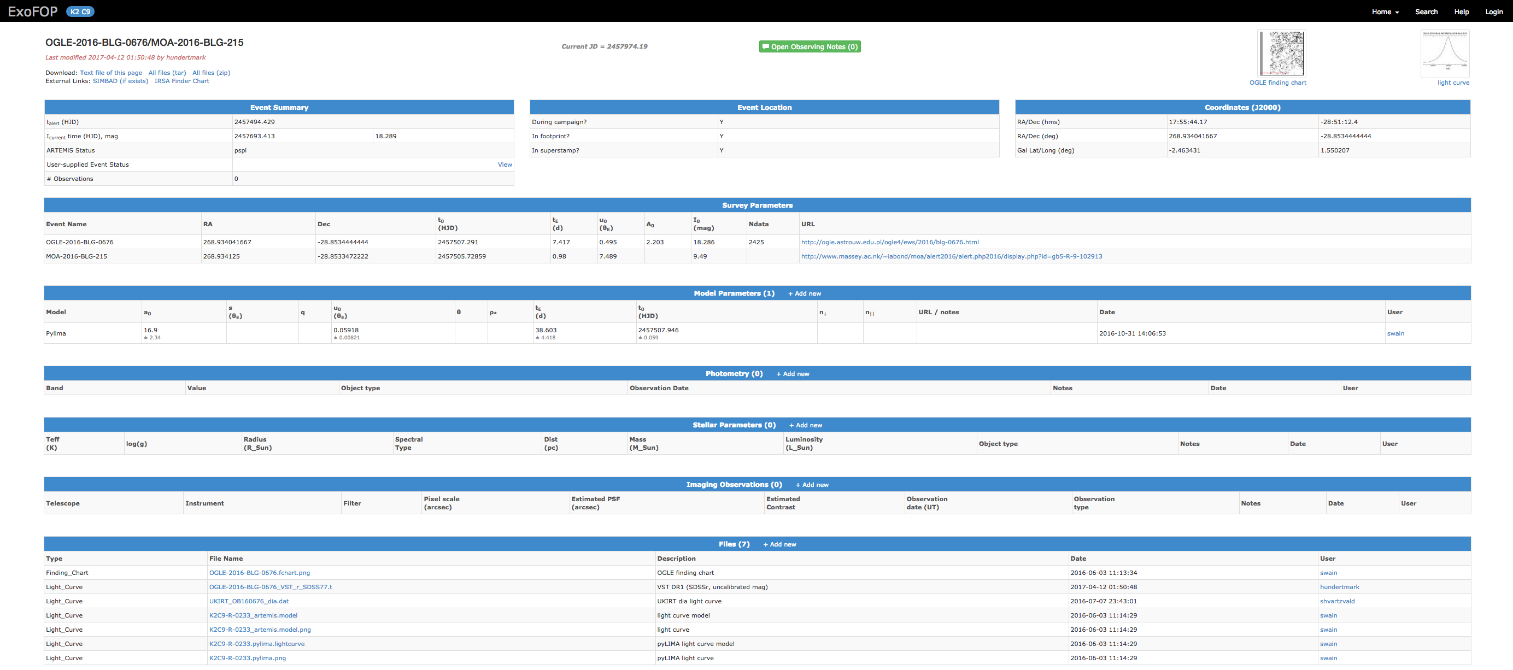

Slide 31
Microlensing Data

Slide 32
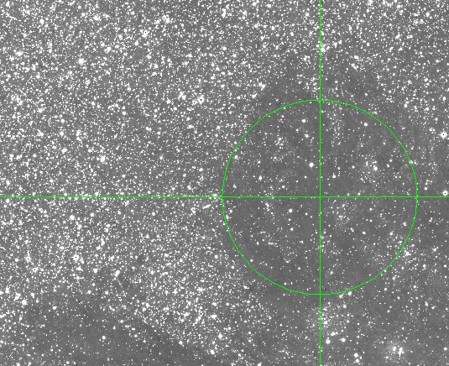
UKIRT Pilot H-band Microlensing Surveys in 2015–2016
2015 Survey: Spitzer
  3.4 square degrees
  39 nights (120 hr)
  5 epochs/night
  SNR ~ 10 at H ~ 16.5
2016 Survey: K2 Campaign 9
  6 square degrees
  91 nights (240 hr)
  2—3 epochs/night
  SNR ~ 10 at H ~ 18.5
  Covered ~60% of proposed
  WFIRST target fields
Shvartzvald*, Bryden, Gould, Henderson*, Beichman, Howell (2016): submitted to ApJL
Non-systematic Analysis of 2016 Data
  Partial exploration of 7 out of 132 subfields
  5 events discovered!
  High extinction: 0.81 ≤ A_{H} ≤ 1.97
  Close to Galactic plane: -0.98 ≤ b ≤ -0.36
  All 5 covered by ground-based optical surveys,
  4 with an hourly cadence, but none recovered!
Left: light curves for five newly discovered
UKIRT microlensing events.
Top: UKIRT image for UKIRT4, emphasizing
the high degree of differential reddening
across the WFIRST target field region.
*Co-leads for WFIRST MicroSIT Precursor Observations Group

Slide 33
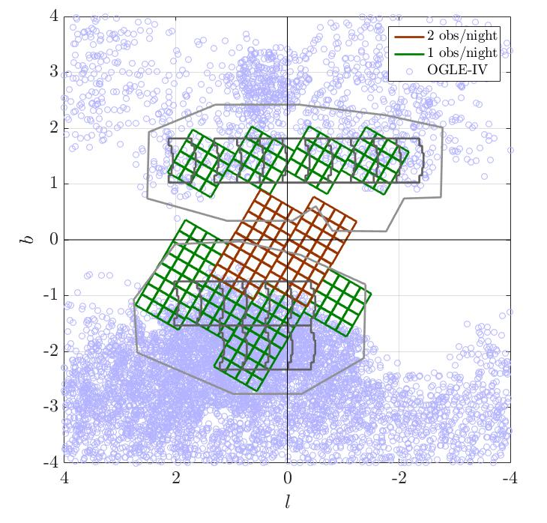
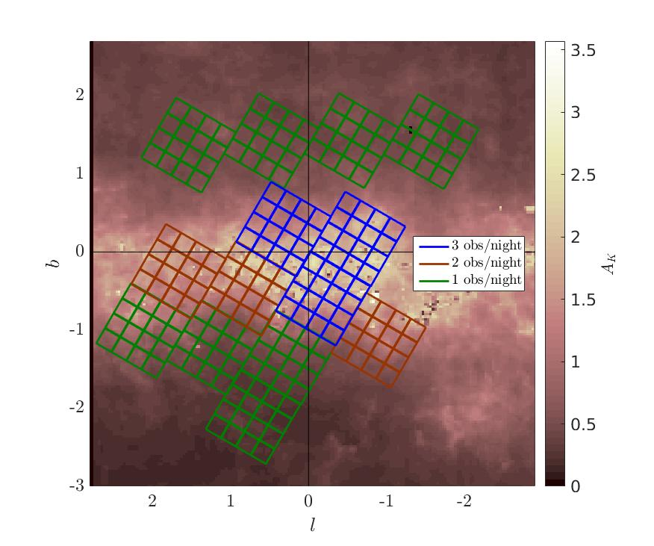
UKIRT H-, K-band Microlensing Survey in 2017
Red fields: K-band is default; H epoch/3 nights
Green fields: H-band is default; K epoch/5 nights
Notes:
K is default for red fields (cadence > 1 obs/night, E(H-K)>0.6), with additional H image once every 3 nights.
H is default for green fields (cadence=1 obs/night, E(H-K)<0.6), with additional K image once every 5 nights (note that in these fields we expect to also have optical surveys coverage of most events).

Slide 34
UKIRT H-, K-band Microlensing Survey in 2017
See poster by
Savannah Jacklin!!!
Red fields: K-band is default; H epoch/3 nights
Green fields: H-band is default; K epoch/5 nights
Notes:
K is default for red fields (cadence > 1 obs/night, E(H-K)>0.6), with additional H image once every 3 nights.
H is default for green fields (cadence=1 obs/night, E(H-K)<0.6), with additional K image once every 5 nights (note that in these fields we expect to also have optical surveys coverage of most events).

Slide 35
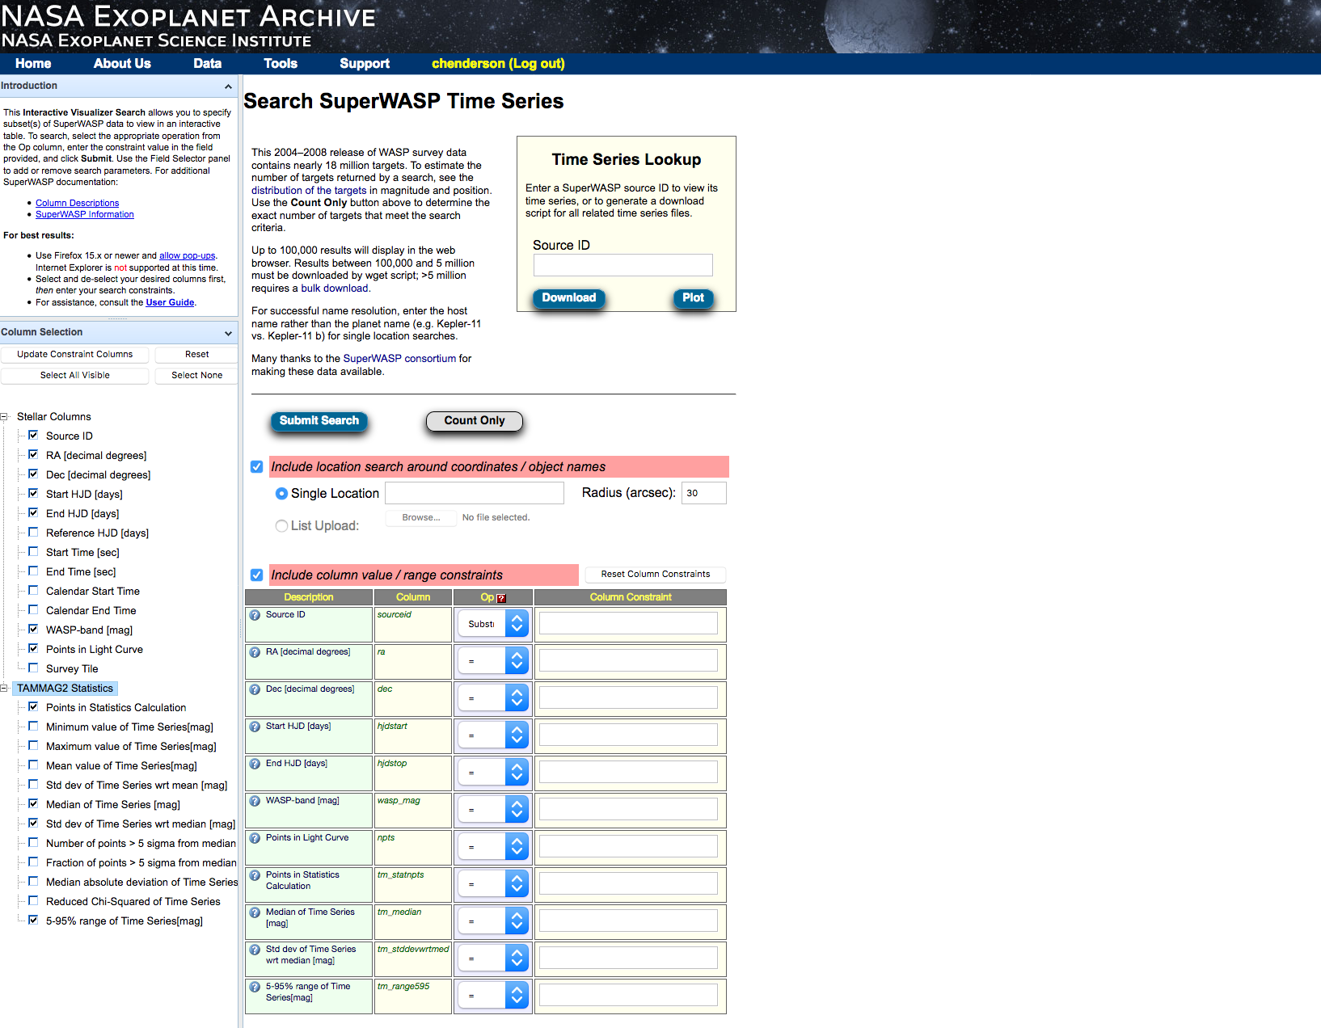
UKIRT interactive data look-up interface coming soon!
Modeled after SuperWASP time series portal

Slide 36
Exoplanet Archive Tools

Slide 37
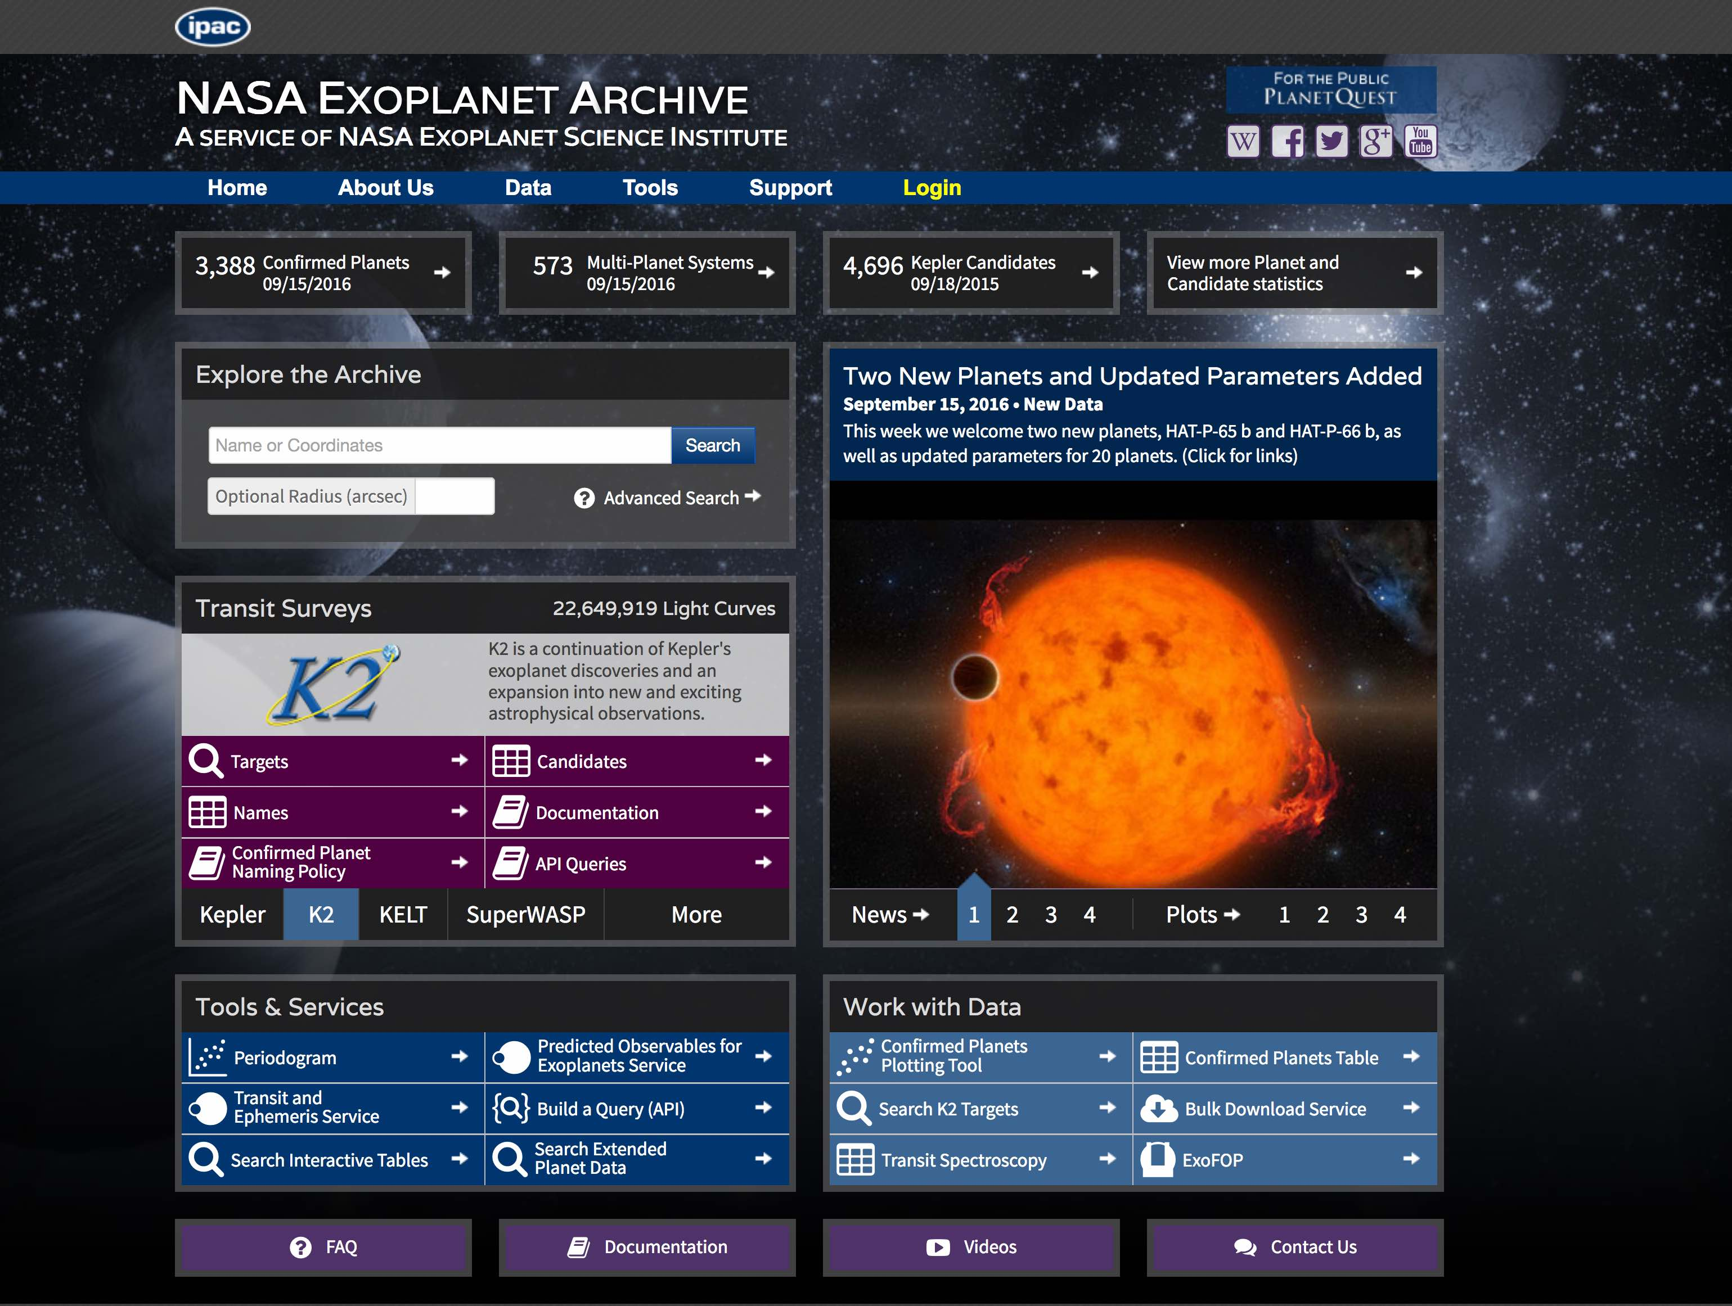
Archive Tools
Predicted Observables
👆

Slide 38
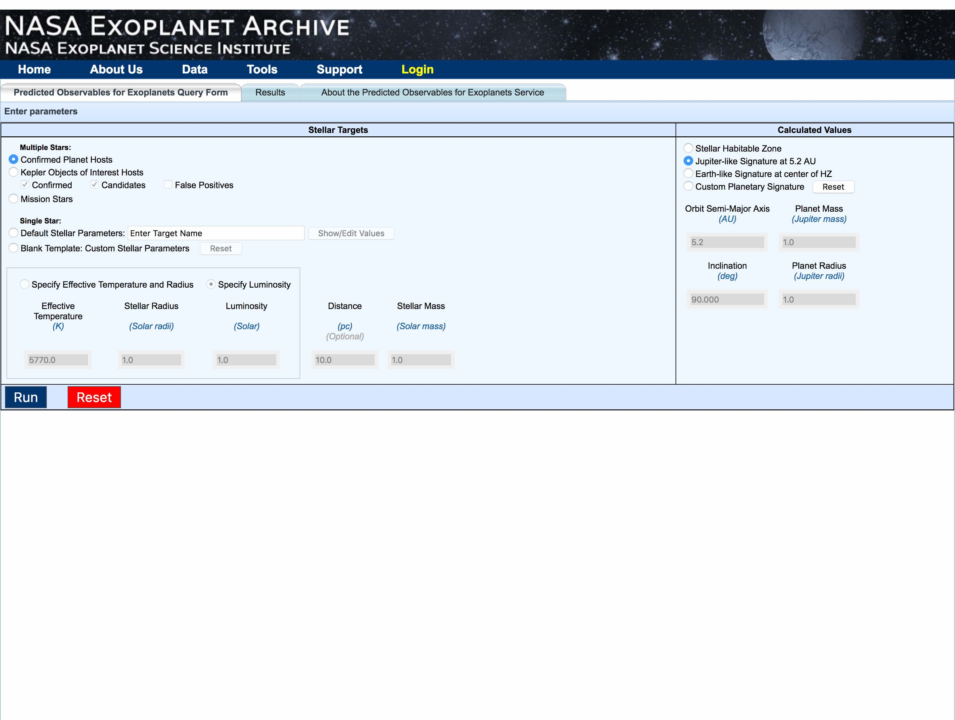
👆
👆
👆

Slide 39
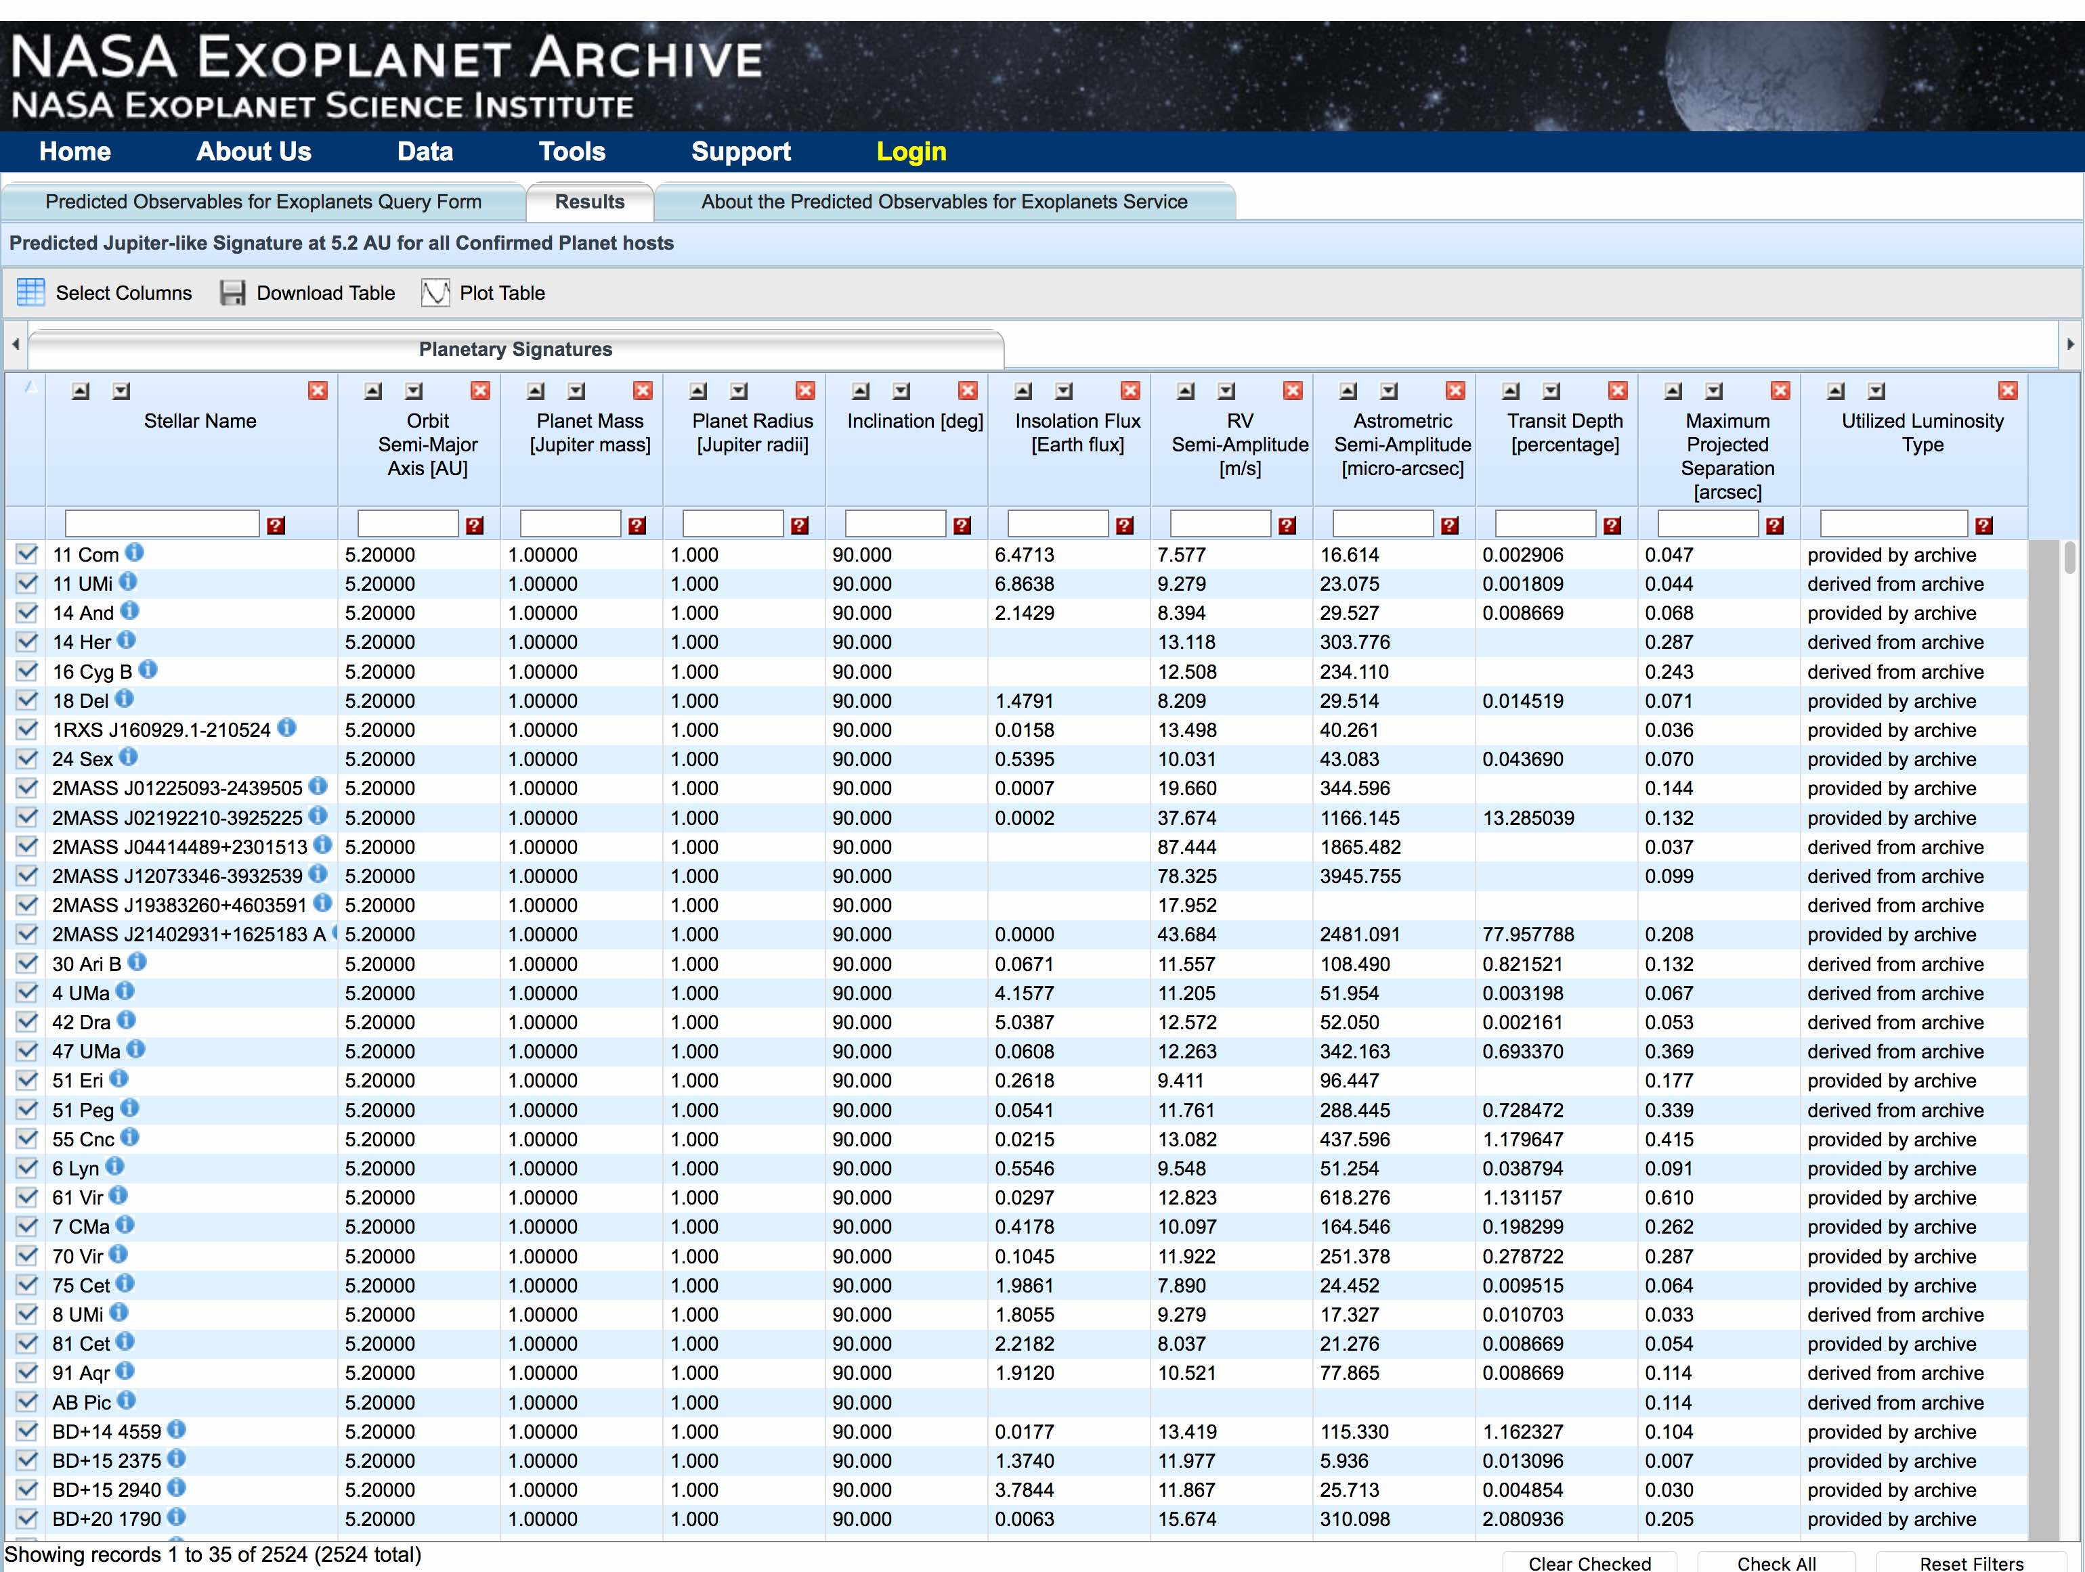
E.g., various predicted signatures for Jupiters around hosts of confirmed planets

Slide 40
Archive Tools
Transit Service
👆

Slide 41
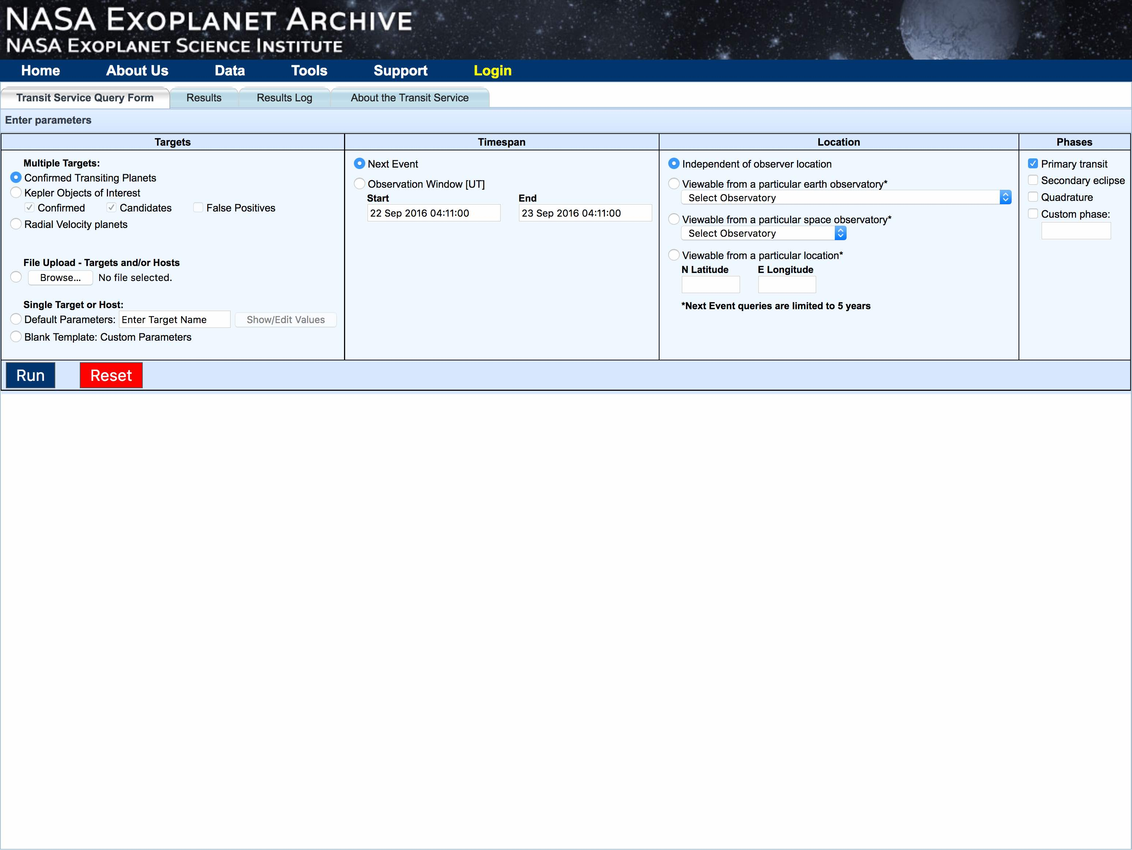
Input targets:
Confirmed planets table
KOIs
RV planets
Upload your own list of known planets/KOIs
Enter single known target
Enter hypothetical target
👆
…Option to enter/edit custom target…
Transit Service: Predicts transit times and (for circular orbits) secondary eclipse, quadrature, custom phases for known or hypothetical planets

Slide 42
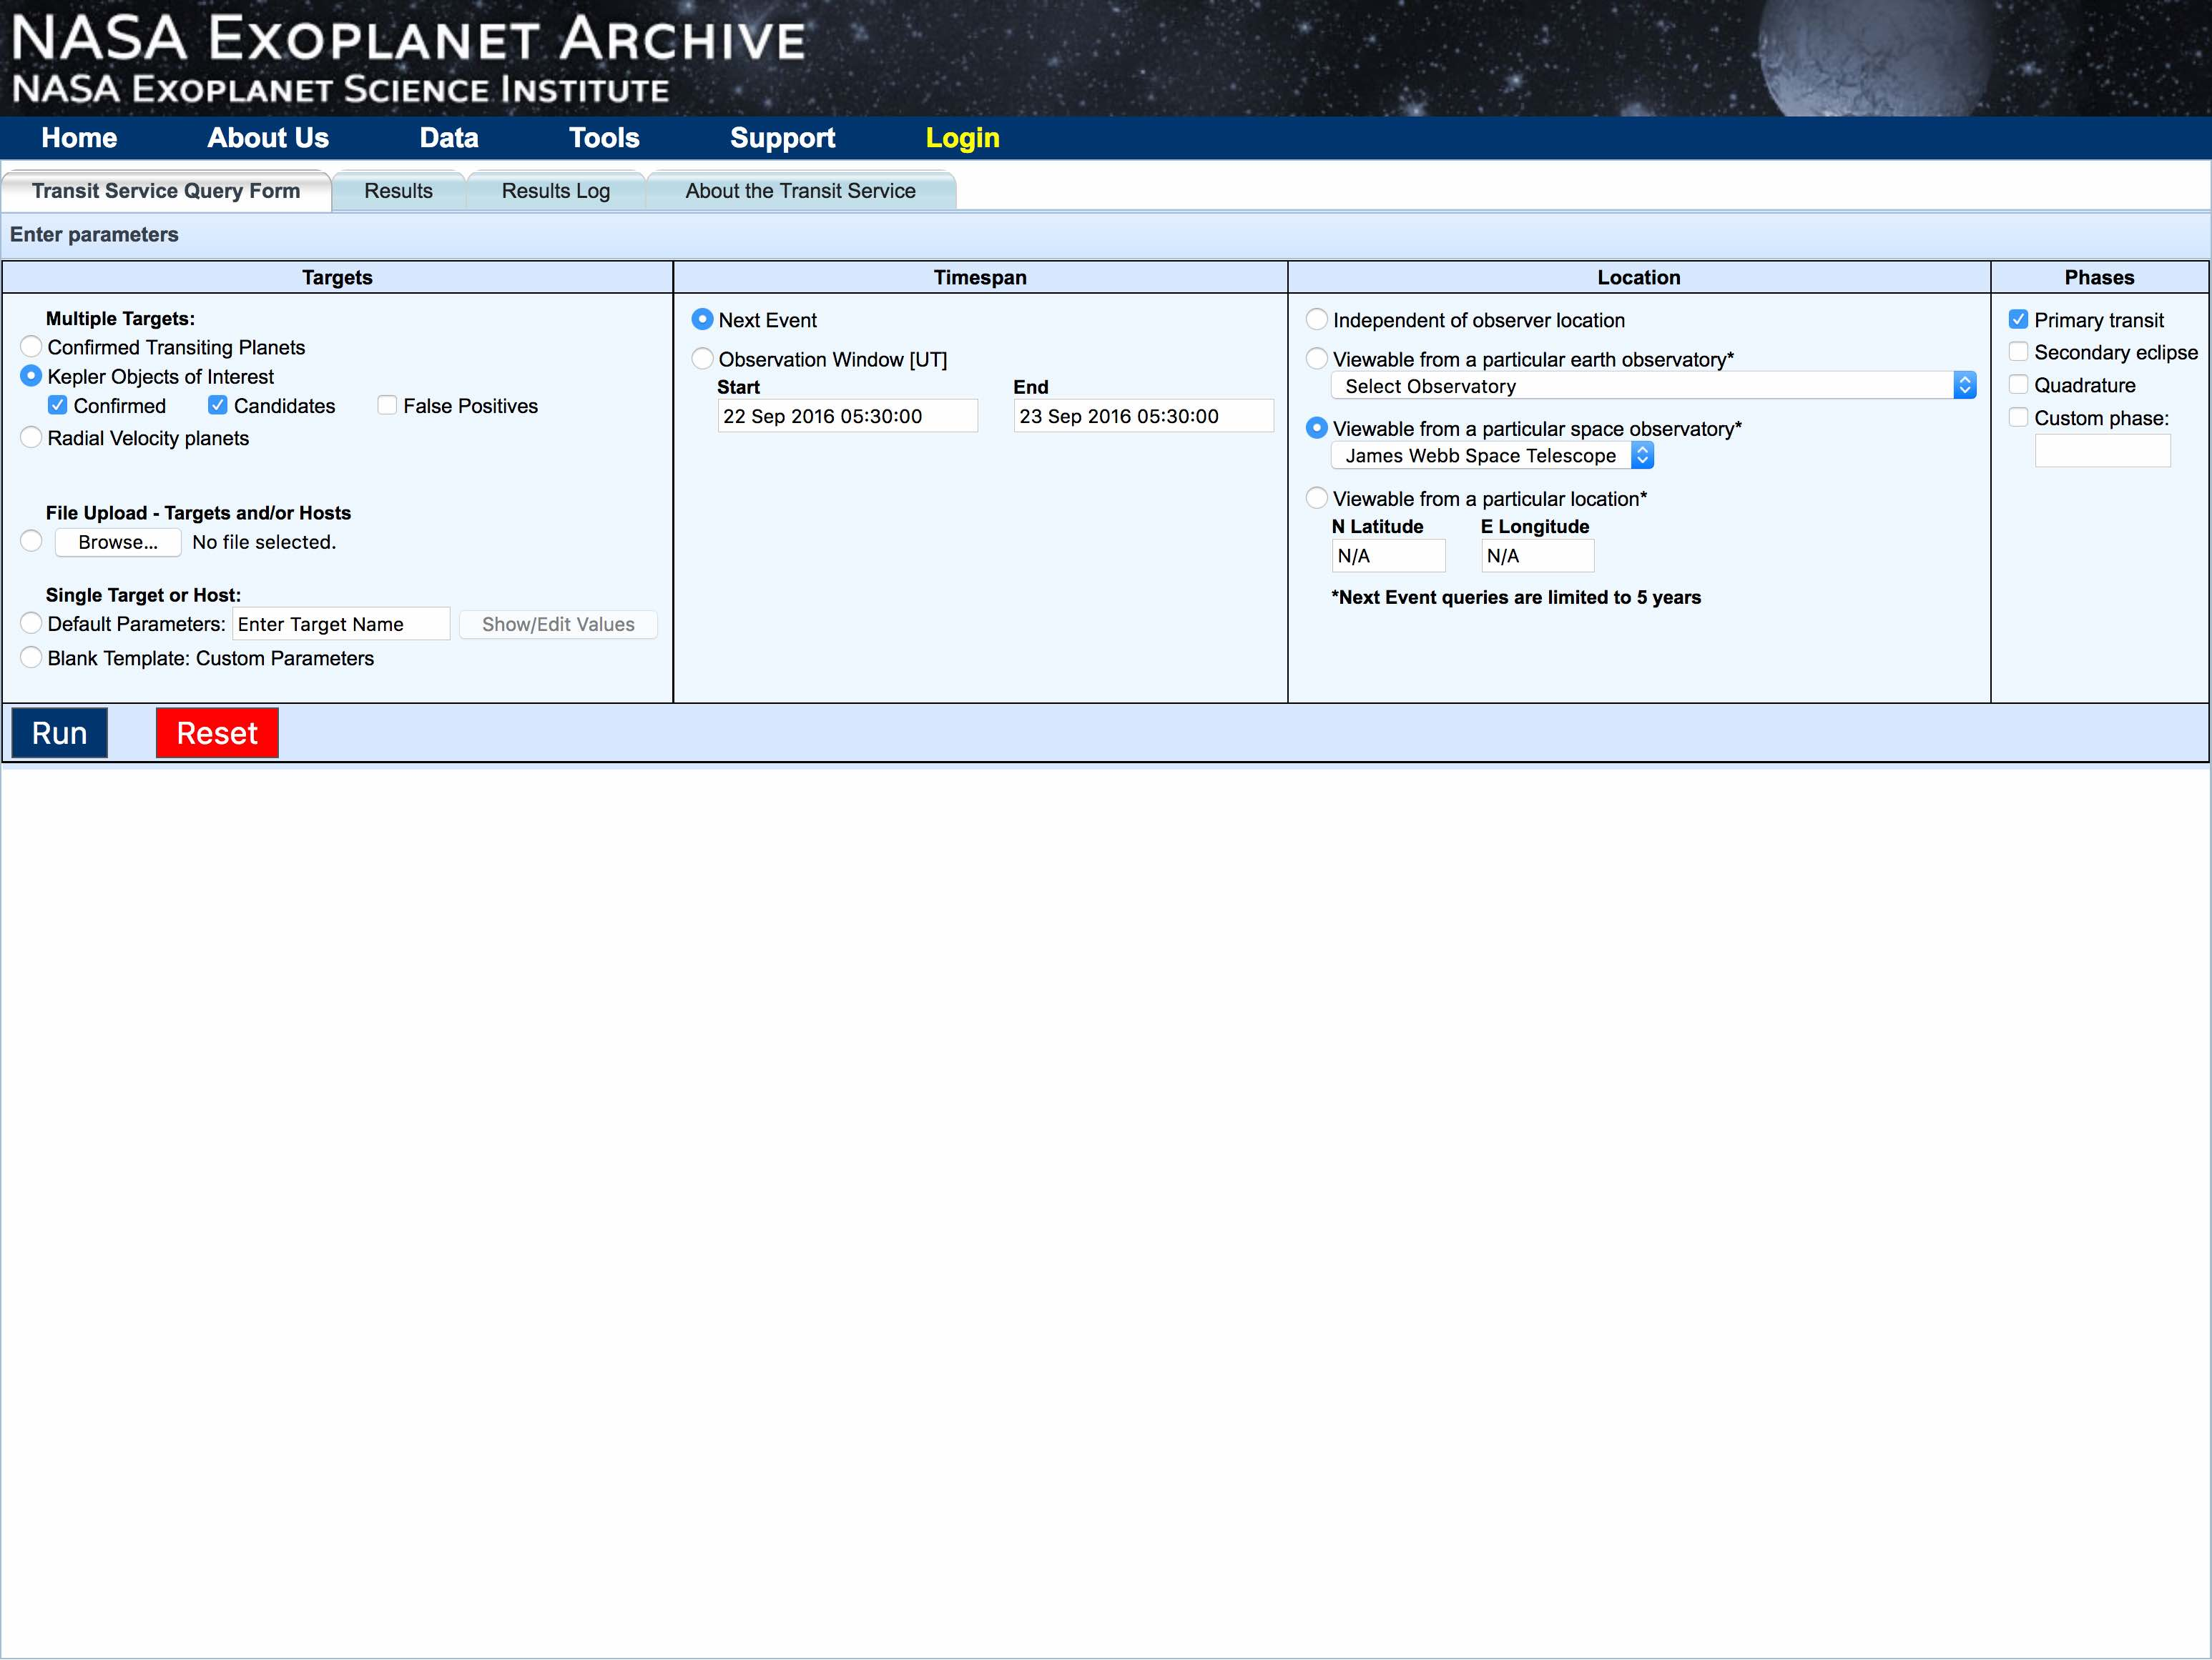
👇
👉
👉
👉
👆
E.g., find: next observable transits from JWST for all confirmed+candidate KOIs….

Slide 43
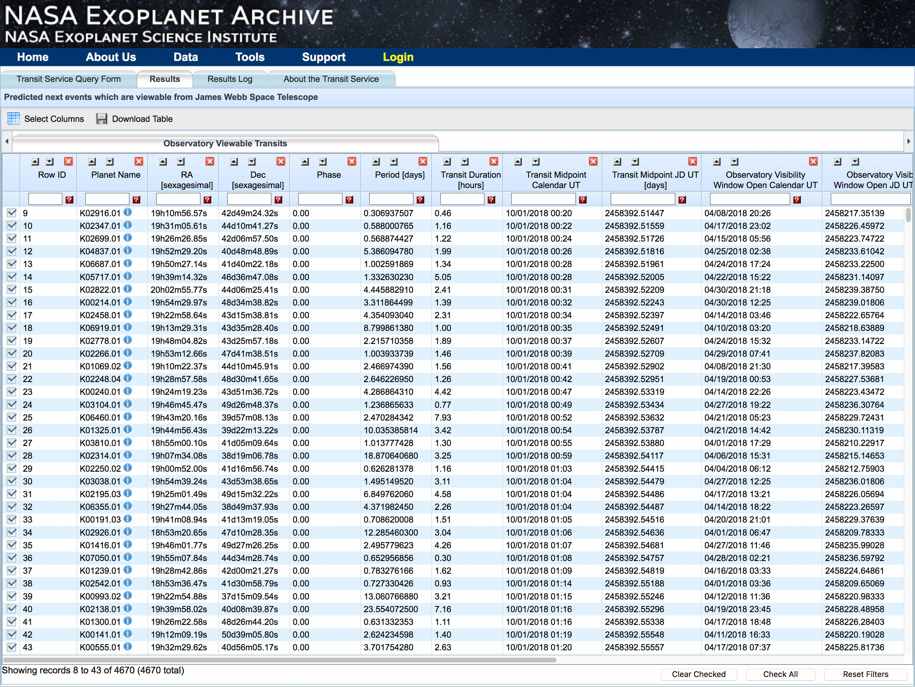

Slide 44
Archive Tools
Periodogram tool
👆

Slide 45
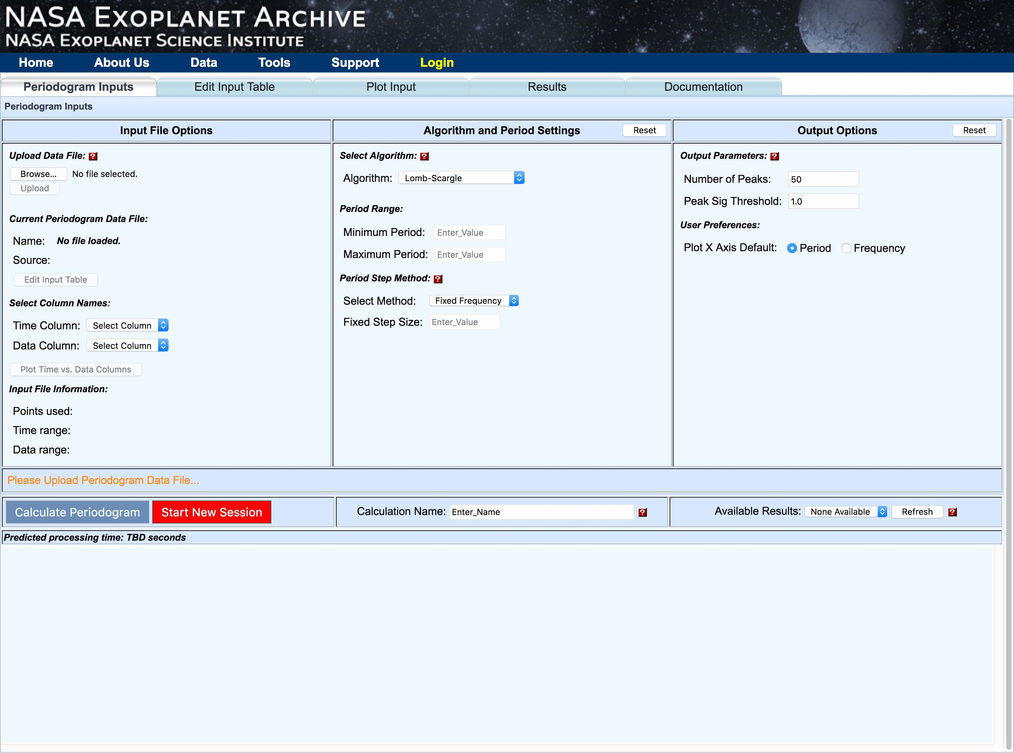
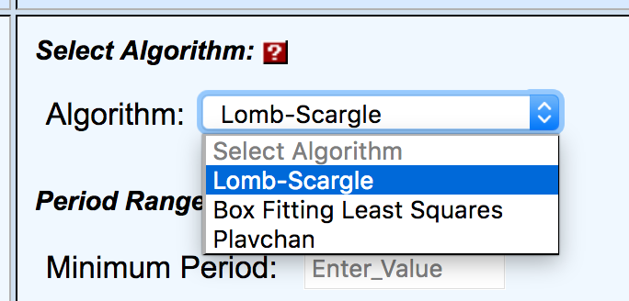
Choose algorithm
Choose output options
Select input file options
👈

Slide 46
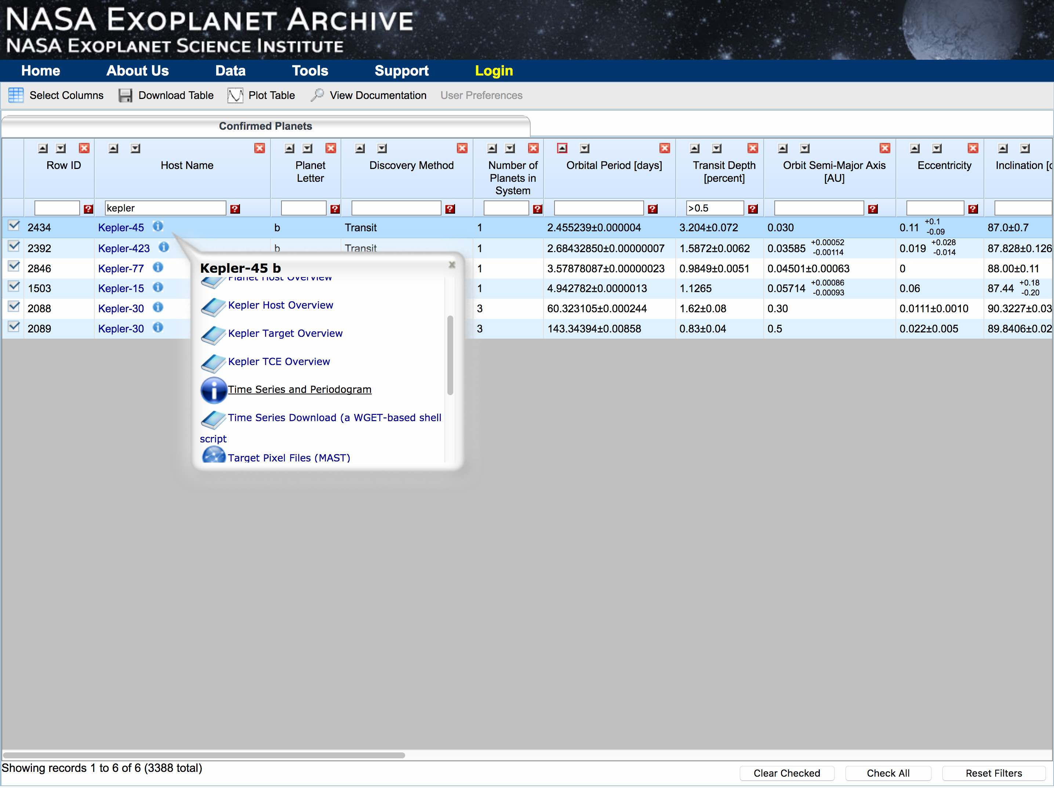
Alternatively, grab light curve from archive….
👈
View light curve
Select a subset of quarters
Normalise if needed
Select periodogram tool, and….

Slide 47
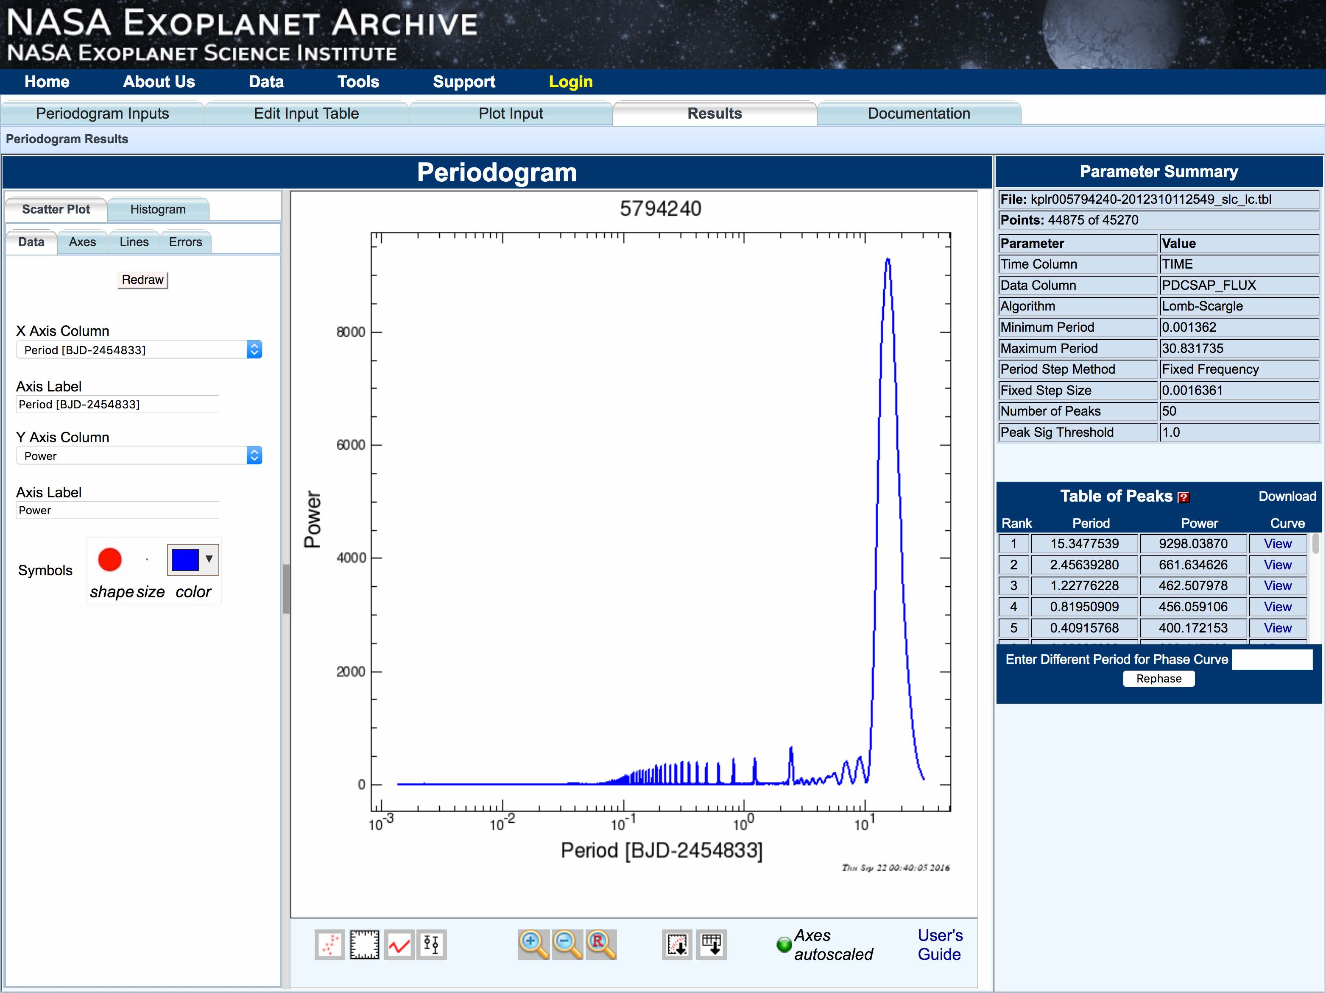

Slide 48
Direct Imaging!!!

