Slide 1

The Roman Coronagraph Instrument:
Expected Capabilities and Relevance to HWO
Bertrand Mennesson– Jet Propulsion Laboratory, California Institute of Technology
On behalf of the Coronagraph Instrument engineering and science teams
Advances in Direct Imaging: From Young Jupiters to Habitable Planets
Sagan Summer Workshop, Caltech / NExSci, July 22-26 2024
© 2024 California Institute of Technology. CL# 24-3821 Government sponsorship acknowledged. The research was carried out at the Jet Propulsion Laboratory, California Institute of Technology, under a contract with the National Aeronautics and Space Administration.

Slide 2
Outline
The Roman Coronagraph in a Nutshell
Observing Modes
I&T Lab Results and Expected in-Flight Performance
Potential Science Observations
Community Participation

Slide 3
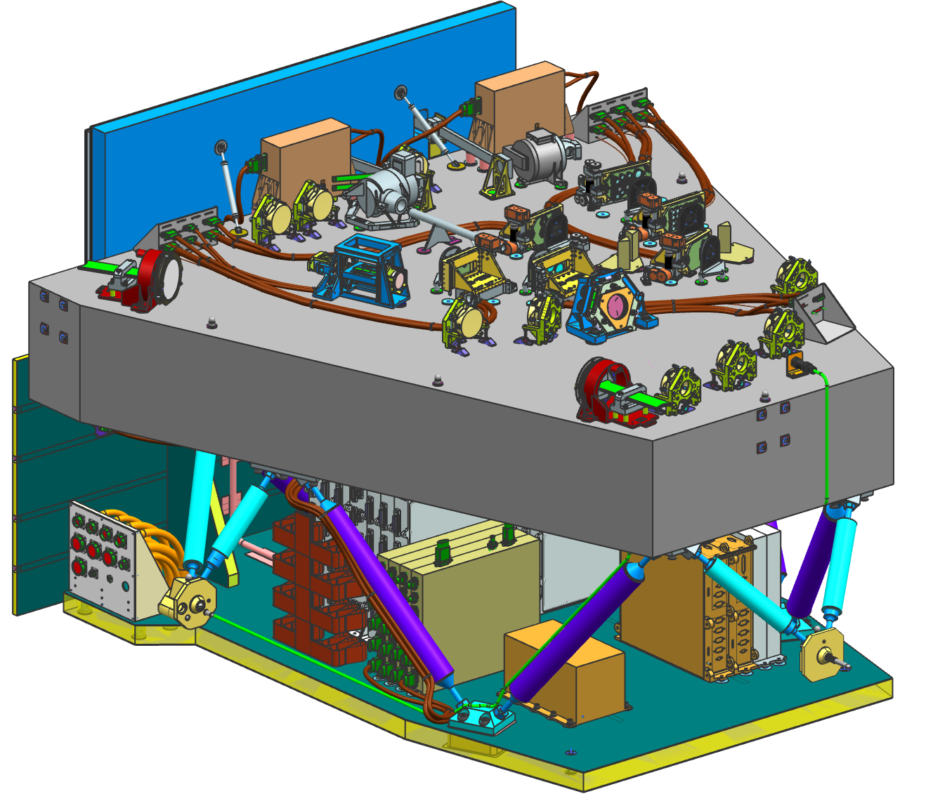
Roman Coronagraph is a stepping stone toward Habitable Worlds Observatory
A visible-light, high-contrast “technology demonstration” instrument for HWO
  first space-based coronagraph with active wavefront control
  requirement: 10⁻⁷ flux ratio 5σ detection limit in a single photometric band
    Designed to outperform requirement
  Predicted performance ≥4x beyond req
    Based on end2end TVAC performance testing
~1.5m

Slide 4
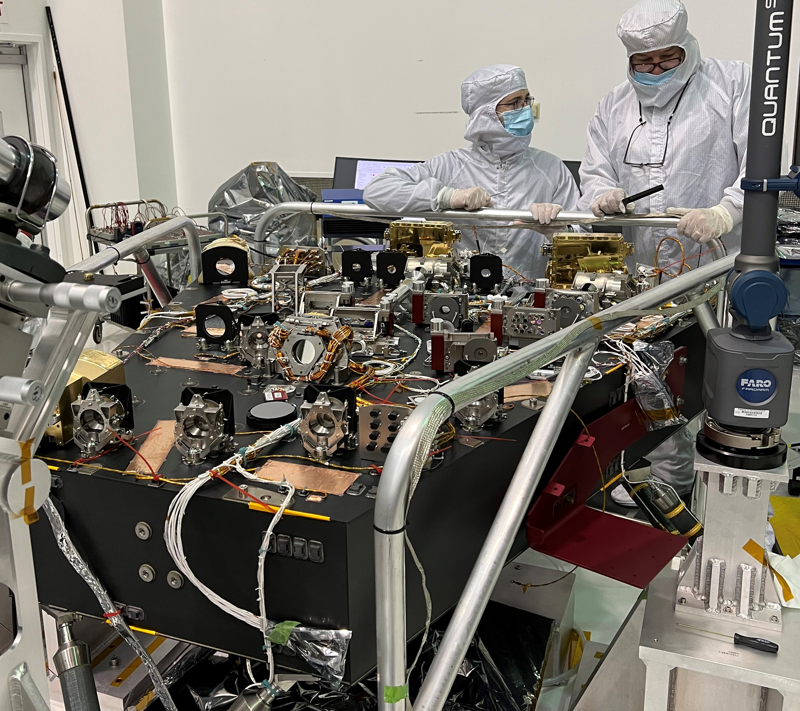
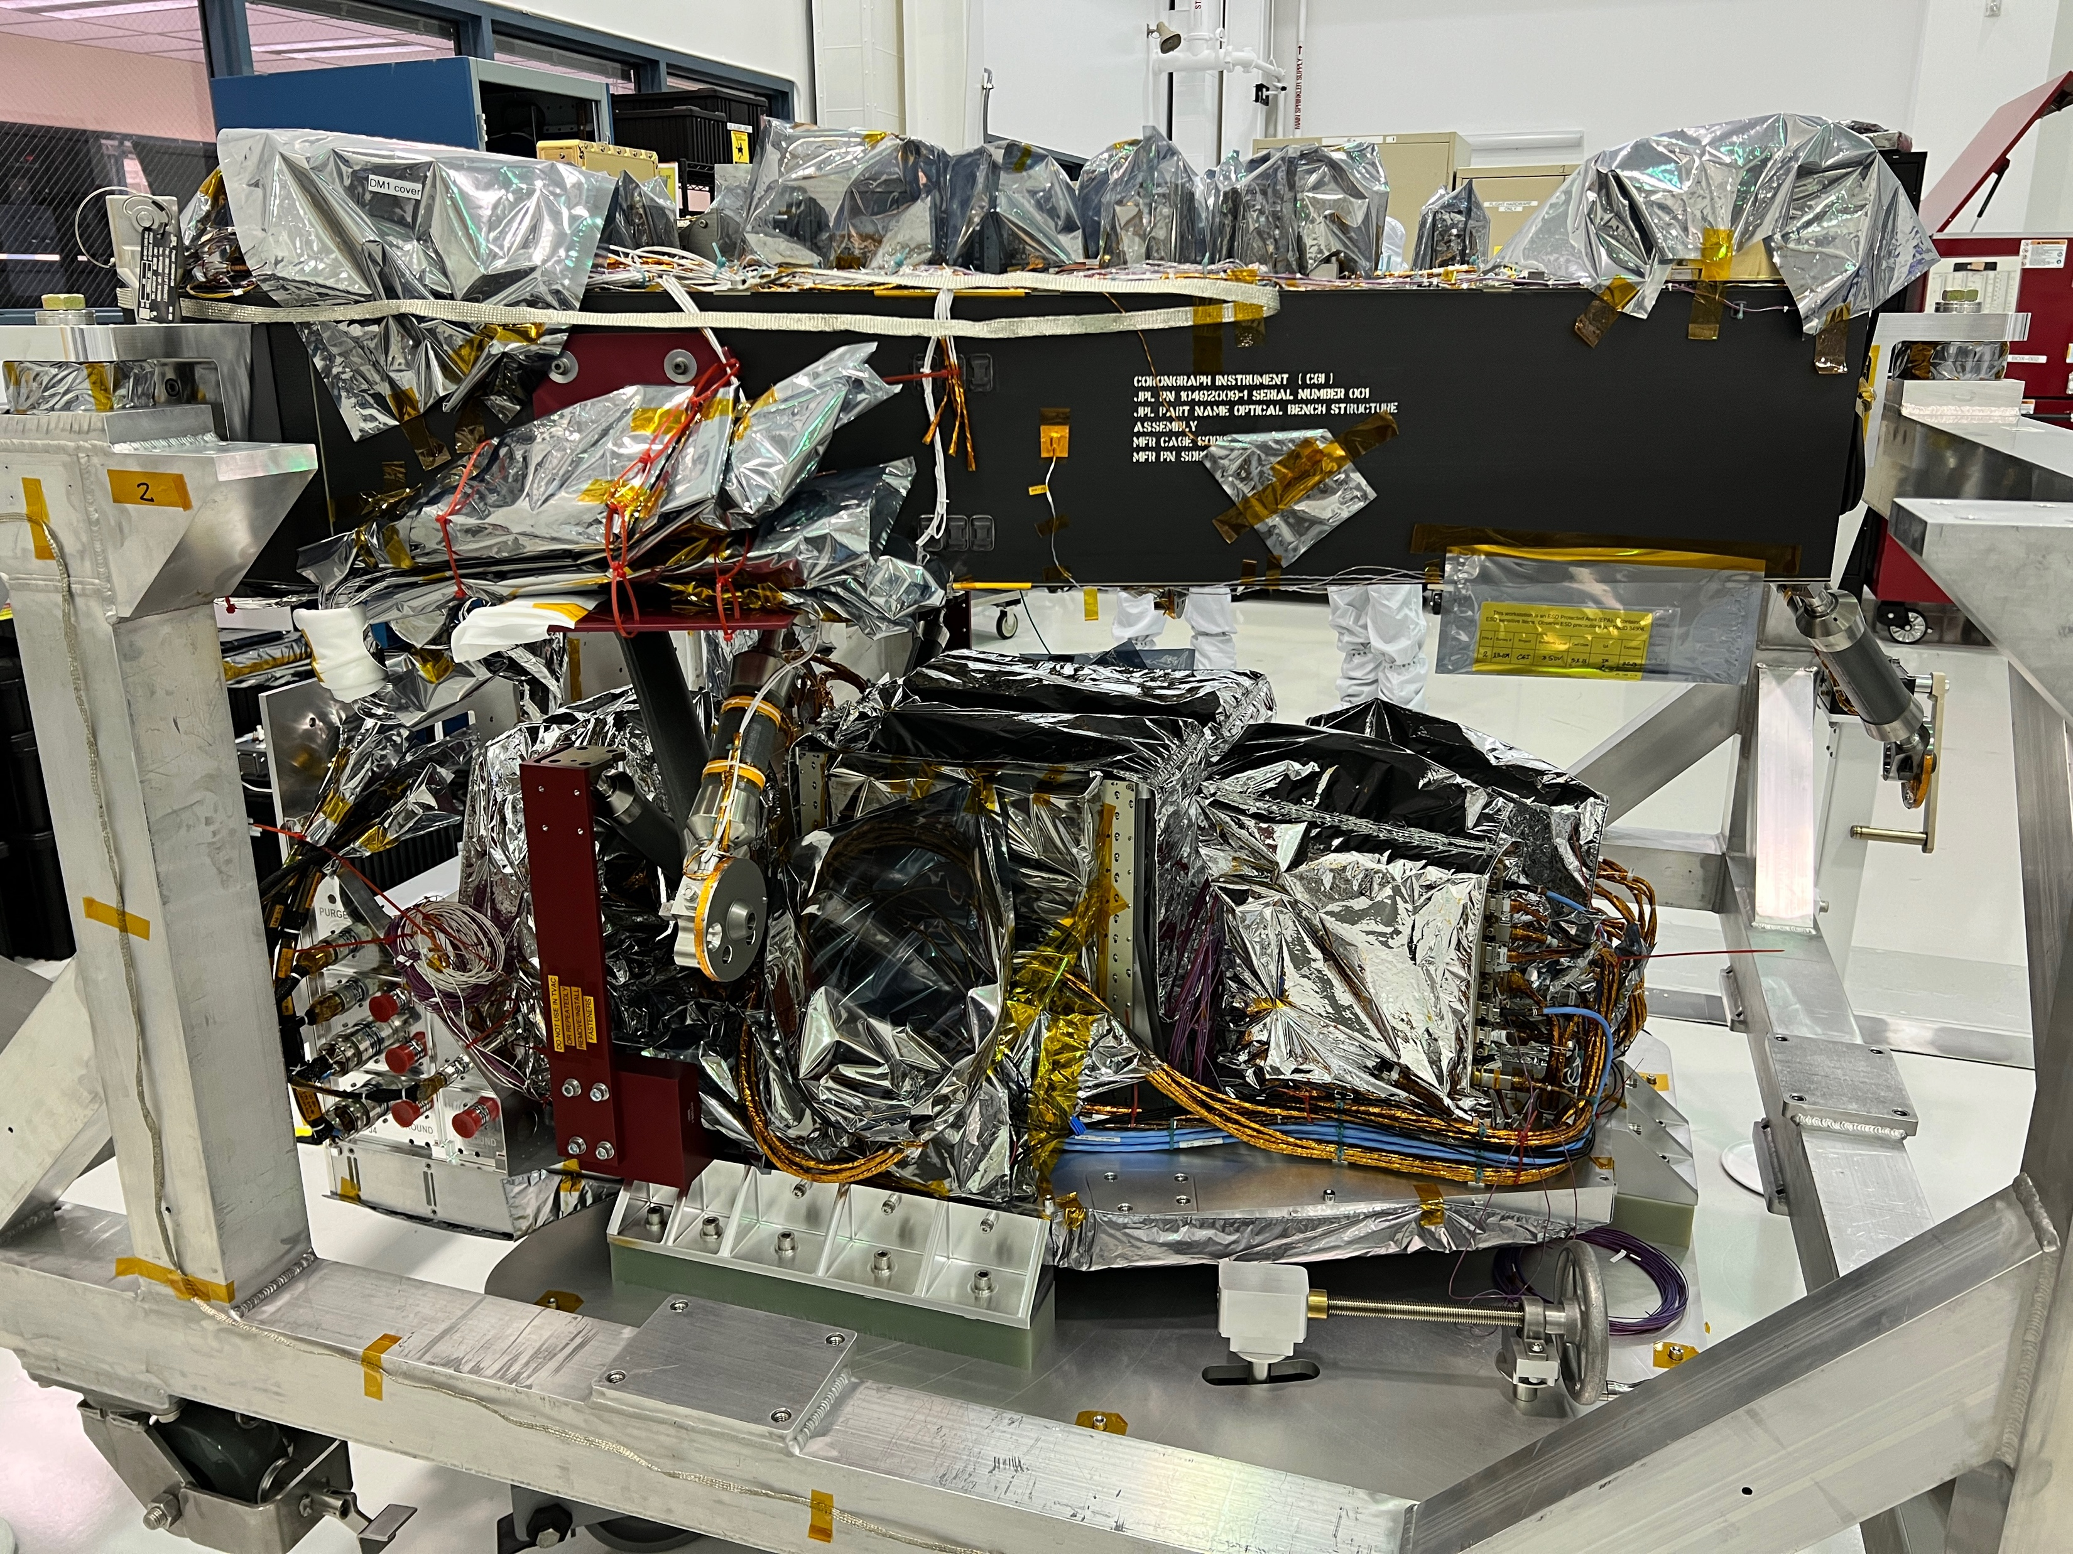
Coronagraph Instrument during I&T (JPL 2023-2024)
Complete Electronics Pallet being
integrated to the Optical Bench
Aligned Optical Bench

Slide 5
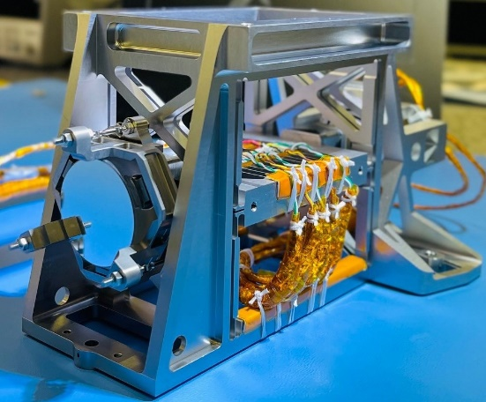
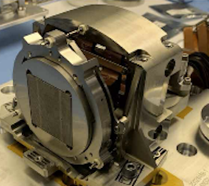
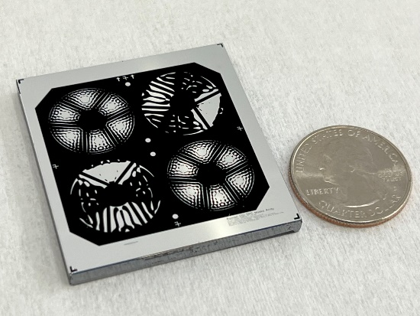
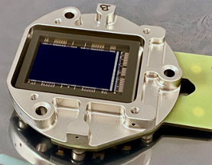
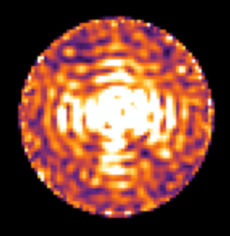
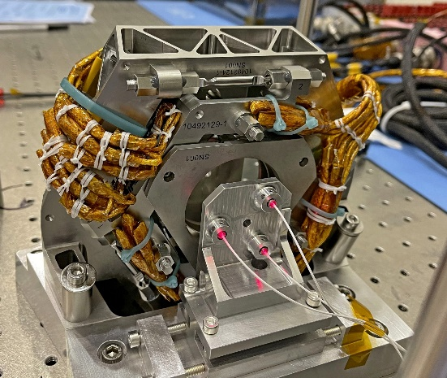
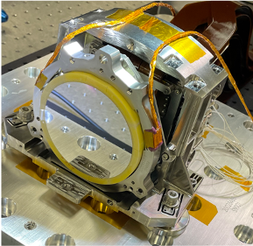
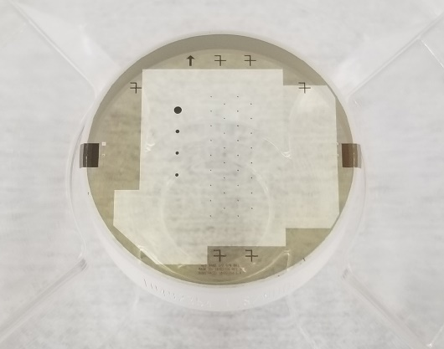
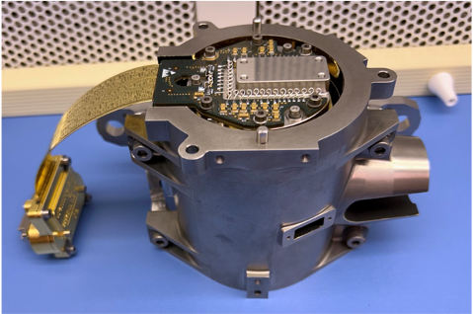
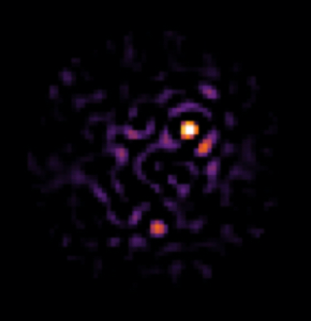
The Roman Coronagraph will Demonstrate Key Technologies for HWO
Ultra-Precise (LO/HO)
Wavefront Sensing
& Control
Large-format Deformable Mirrors
High-contrast Coronagraph Masks
Ultra-low-noise
Photon-counting
EMCCDs
Data Post-
Processing
FCM
DM1
SPC Masks
EMCCD Sensor
FSM
DM2
HLC Masks
Shielded Camera

Slide 6






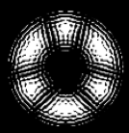


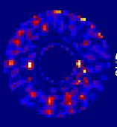
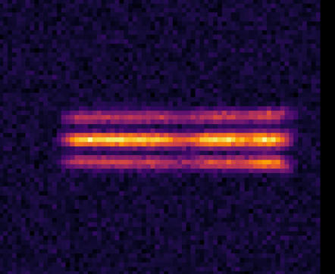
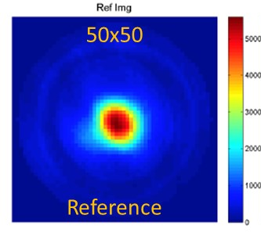
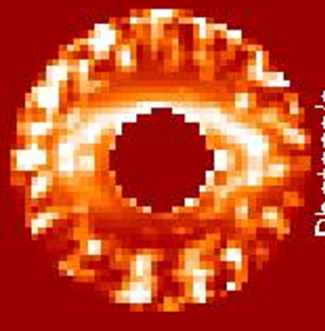
Key Technologies Work Together as a System to Deliver High Performance
Prism, Polarizer & Lens
Focal Plane Mask
Field
Stop
Implemented on the ground rather than on board
Pupil Plane Mask
Lyot
Stop
Color Filter
High Order Wavefront Sensing & Control
Light From Telescope
NFOV
FSM
SPEC
Open
Or Slit
WFOV
Open
DM 1
Fold Mirror
OAP1
FCM
OAP2
EXCAM
DM 2
OAP3
OAP4
OAP5
OAP6
OAP7
OAP8
2 mHz
2 mHz
20 Hz
Low Order Wavefront Sensing & Control
LOCAM
OAP = Off-Axis Parabolic [Mirror]
Notes:
NFOV: required
SPEC and WFOV: Goals modes

Slide 7
Observing Modes: 1 fully supported mode +
“best effort” & “unsupported” modes
λ_{center} | Mode | Approx. FOV radius | FOV Coverage | Support
575 nm | NFOV: Narrow FOV Imaging | 0.15” – 0.45” | 360° | Required (full support)
730 nm, 660 nm | SPEC: Slit + R~50 Prism Spectroscopy | 0.2” – 0.55” | slit | Best Effort
575 nm, 825 nm | WFOV: “Wide” FOV Imaging | 0.3” – 1.4” | 360° | Best Effort
575 nm, 825 nm | Imaging Polarimetry (WPs) | 0.15” – 1.4” | 360° | Best Effort
any | Other coronagraph mask combinations | 0.15” – 1.4” | various | Unsupported
any | Other technology demonstrations: binary star, transmissive Zernike wavefront sensor, alternative wavefront sensing algorithms | various | various | Unsupported
Best effort: partially tested in TVAC; no guaranteed support on-orbit.
Unsupported not tested in TVAC; no guaranteed support on-orbit
Contributed by ExEP: 575nm “Wide” FOV mask & all “unsupported” masks

Slide 8
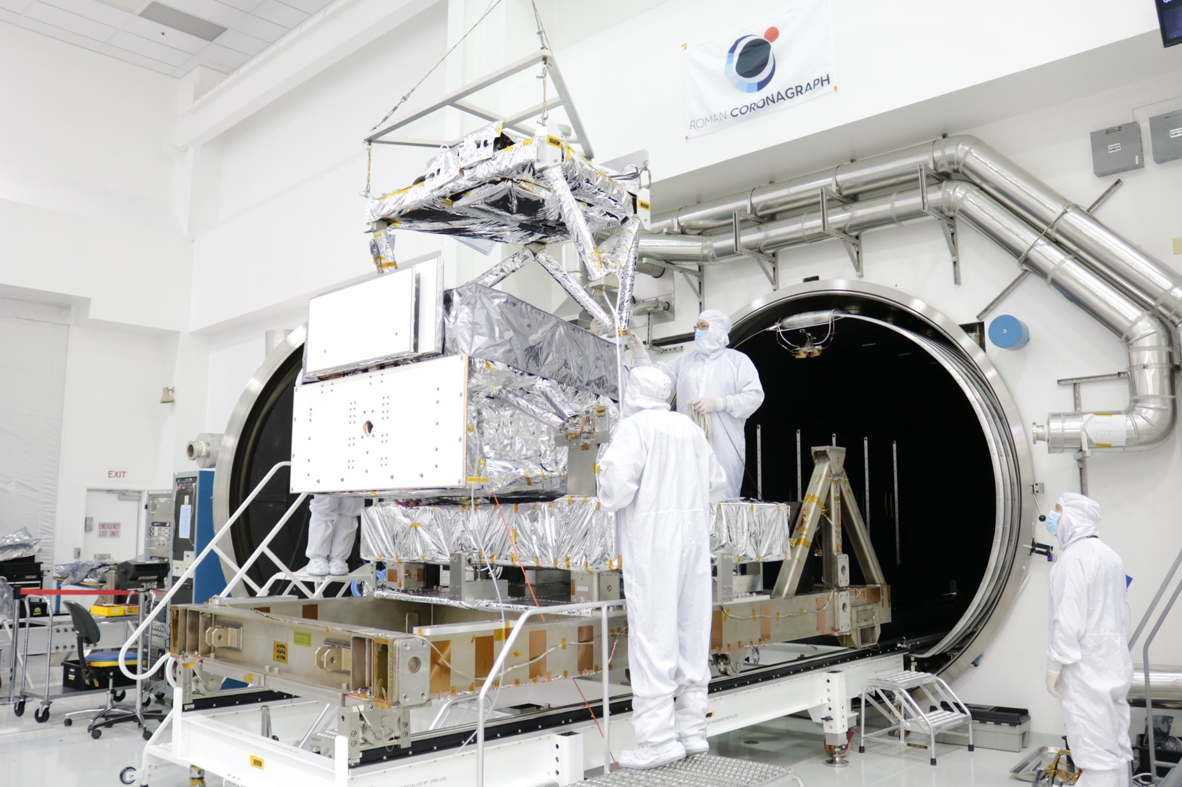
February – April 2024 : Thermal Vacuum (TVAC)
Performance testing

Slide 9
Installing the telescope simulator
(Coronagraph Verification Stimulus)
Optical
bench
radiators
Vacuum
chamber
Control
electronics

Slide 10
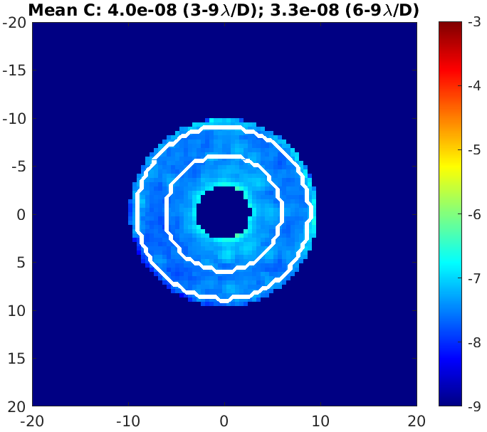
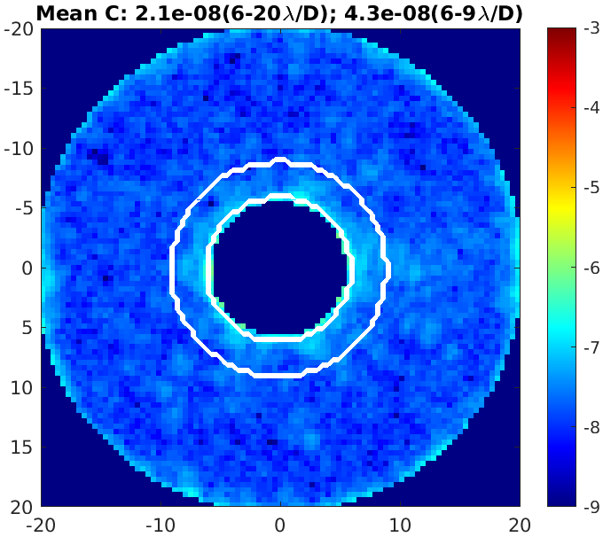
Starlight Suppression: Raw Broadband Contrast Results (10% BW around 575 nm)
Narrow Field-of-View (Hybrid Lyot)
Wide Field-of-View (Shaped Pupil)
~30 shifts of dark hole digging during TVAC: team working 24 hours or 3 shifts a day, 7 days a week
Contrast not at a hard physical limit: Stopped after meeting requirements with margin and running out of allocated time
While the requirement called out 6-9 𝝀/D annulus, high contrast was demonstrated in 3-9 𝝀/D and 6-20 𝝀/D
for exoplanet and disk science tech demonstrations, respectively

Slide 11
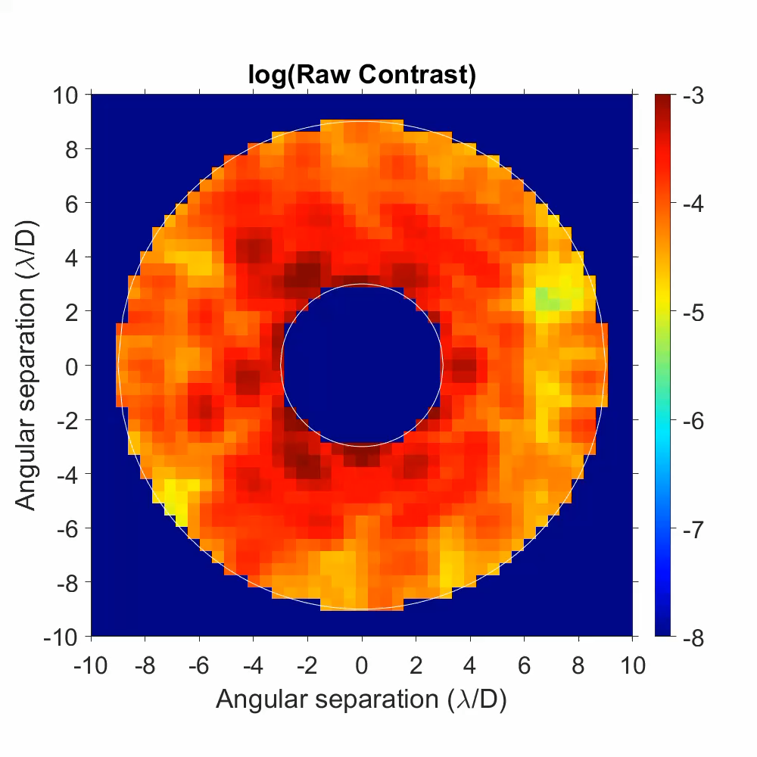
Primary coronagraph mode (“HLC”) beats L1 requirement by at least 4x
Starlight suppression via high order wavefront sensing & control (HOWFSC)
  Aka: “digging the dark hole”
Test time-limited
  not fundamentally performance-limited
Credit: Eric Cady (lead), Byoung-Joon Seo, A. J. Riggs, Brian Kern, David Marx, Fang Shi, Hanying Zhou, John Krist, Garreth Ruane

Slide 12
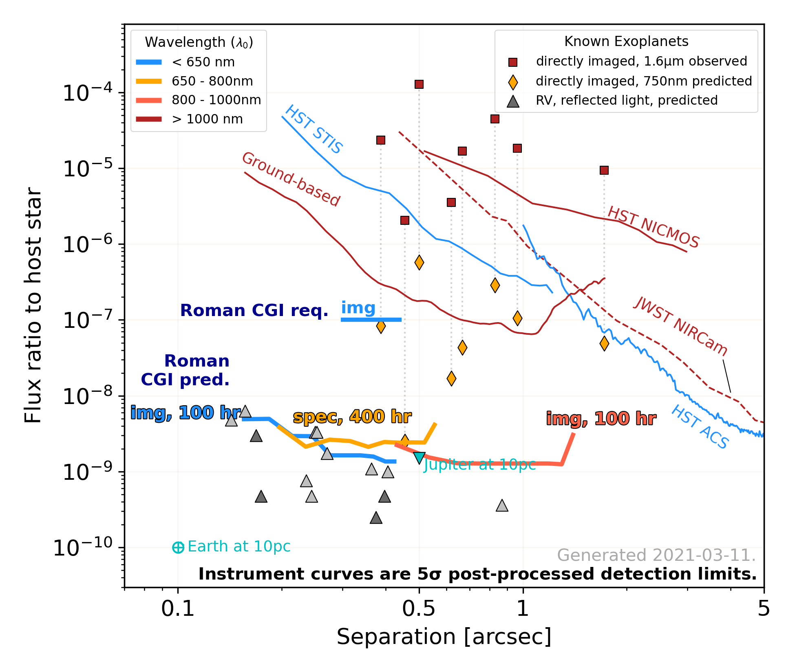
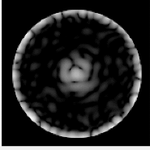
Predicted Detection Limit is 100-1000x Better than State-of-the-Art
“dark hole”
Based on lab demonstrations as inputs to high-fidelity, end-to-end thermal, mechanical, optical models.
TVAC HLC
Brian Kern (JPL)
John Krist (JPL)
Bijan Nemati (Tellus1)
A.J. Riggs (JPL)
Hanying Zhou (JPL)
Sergi Hildebrandt-Rafels (JPL)
NASA terminology: MUF=1 predictions
github.com/nasavbailey/DI-flux-ratio-plot/

Slide 13
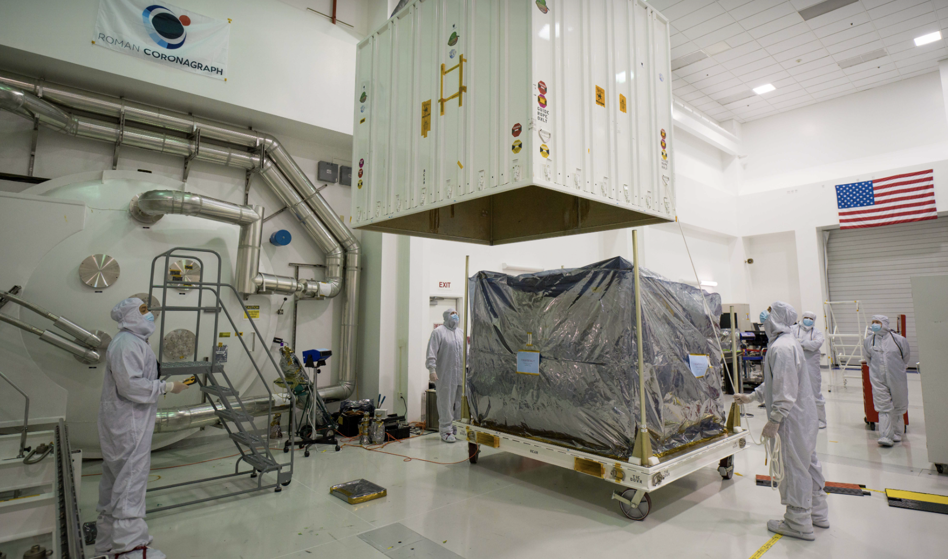
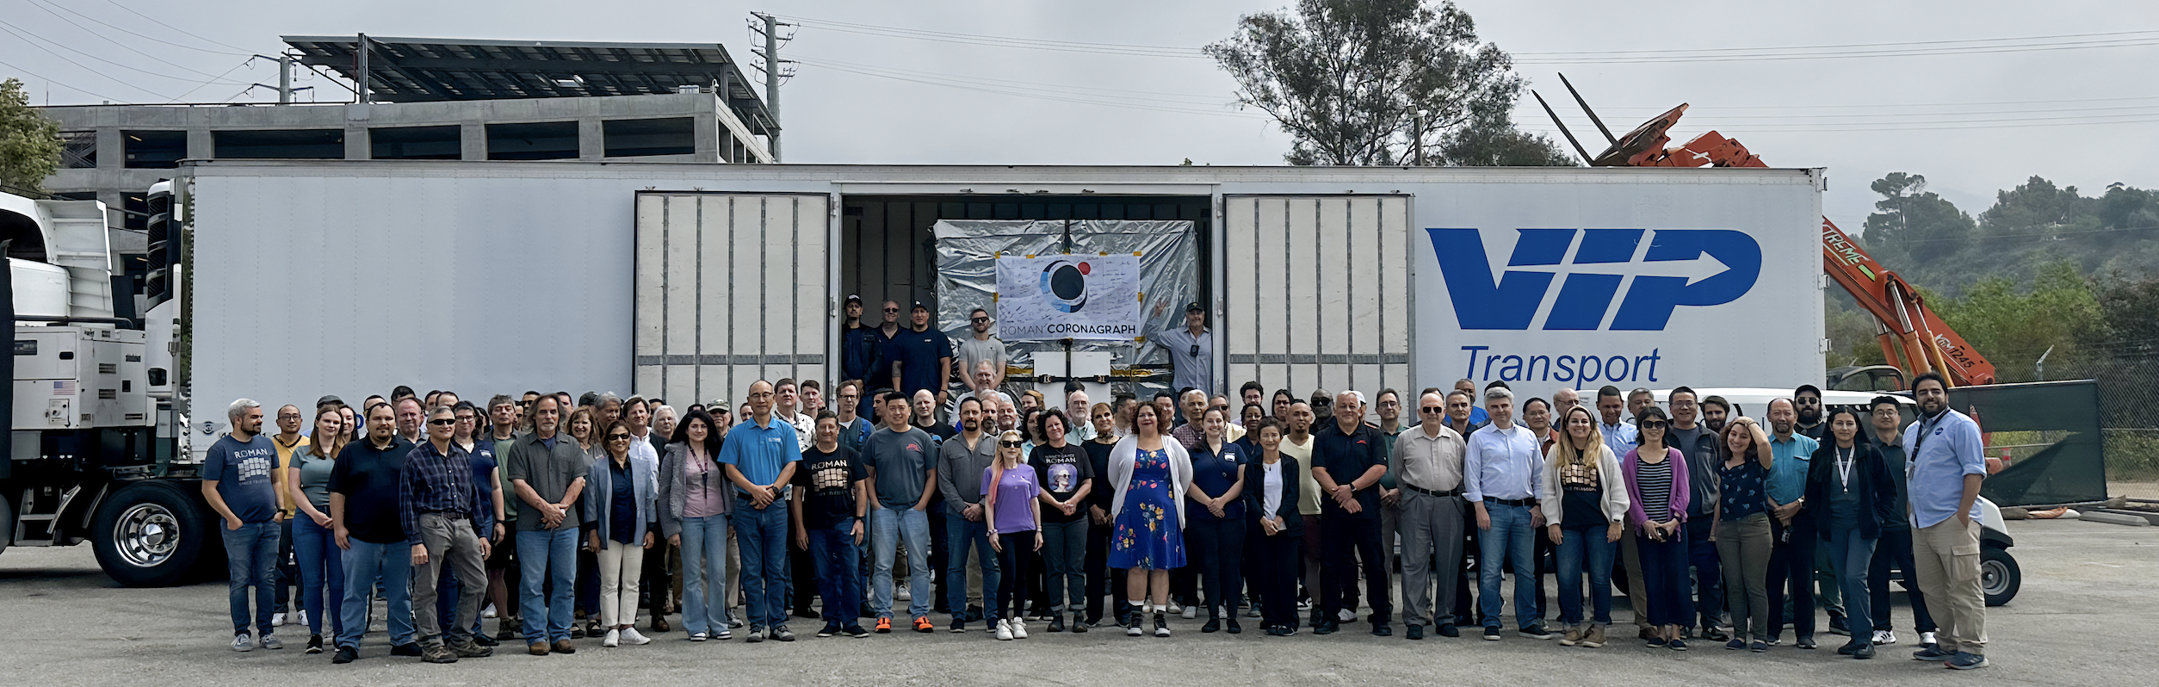
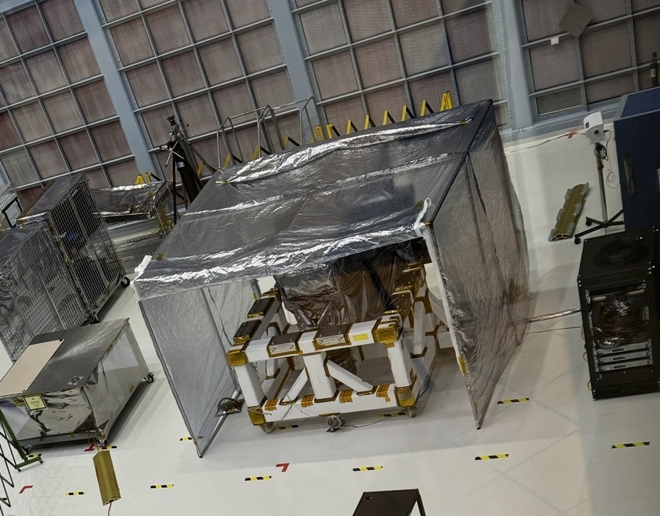
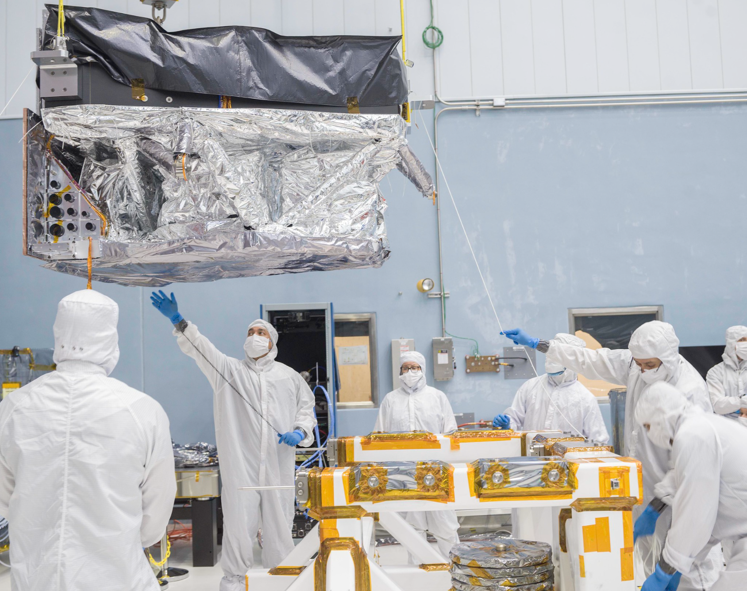
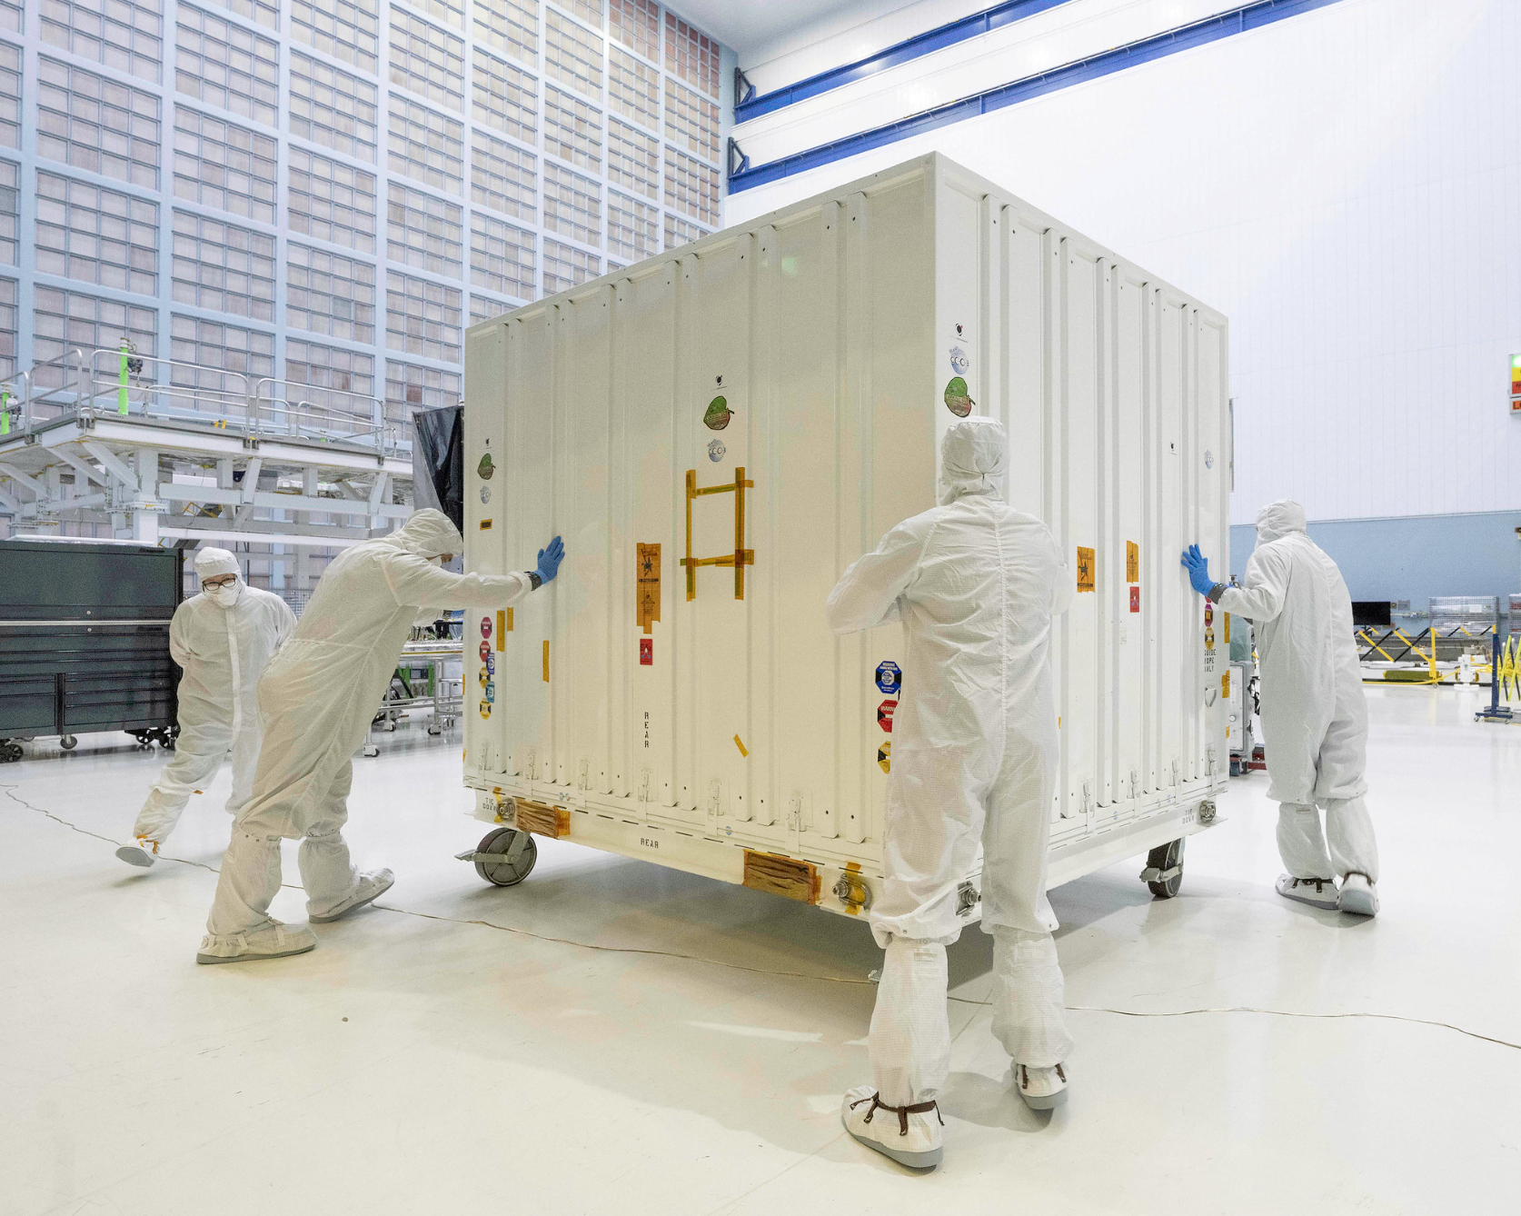
Delivery to NASA Goddard on May 19 2024
NASA JPL, Pasadena, California
NASA Goddard, Greenbelt, Maryland
Coronagraph Instrument arrived at GSFC on May 19, 2024

Slide 14
CGI
delivery
Launch
+5 years
L+21 mo
2030
Build, Integrate & Test
C
TDP
TBD: Continued access?
CGI Community Participation Program (CPP)
TBD: CPP? GO?
- May 2024: Instrument delivery to payload integration & test at GSFC
- Launch by May 2027 - SpaceX Falcon Heavy
- Commissioning Phase: 450 hr in first 90 days after launch
- Coronagraph Instrument Technology Demonstration Phase (TDP):
  ~2200 hr (3 months) baselined in next 1.5 years of mission
  Top priority: achieve L1 Technology Requirement (“TTR5”). L1 would constitute a successful technology demonstration for HWO
  Then, as time/resources allow, push performance limits. Guiding principle for decision-making: Maximize long-term value to science community & Habitable Worlds Observatory
  Use scientifically-interesting targets whenever possible
If TDP successful, potential follow-on observations
Notes:
LV: Space X Falcon heavy to be annoh ed ina month
Delayed SIR by two months to accommodate COVID-19 inefficiencies and associated delays
Focused assembly/subsystem-level deliveries to Optical bench assembly/alignment and I&T
Have retained original design to use as margin against Threshold
Reflowed I&T to minimize COVID-19 financial impact, reduce I&T duration
Removed V&V of CGI modes that do not directly address Threshold (TTR5)
Budget:
12% on CTG is super tight
$12.4M in direct COVID and international contribution delays tracked and provided to NASA as over-guide to PPBE24
Additionally, team would be fully funded through physical delivery on March 29, 2024

Slide 15
Potential Observations of Scientifically Interesting Targets
Self luminous planet image and spectra
Reflected light planet image and spectrum
Bright debris disk imaging and polarimetry
Faint debris disk detection

Slide 16
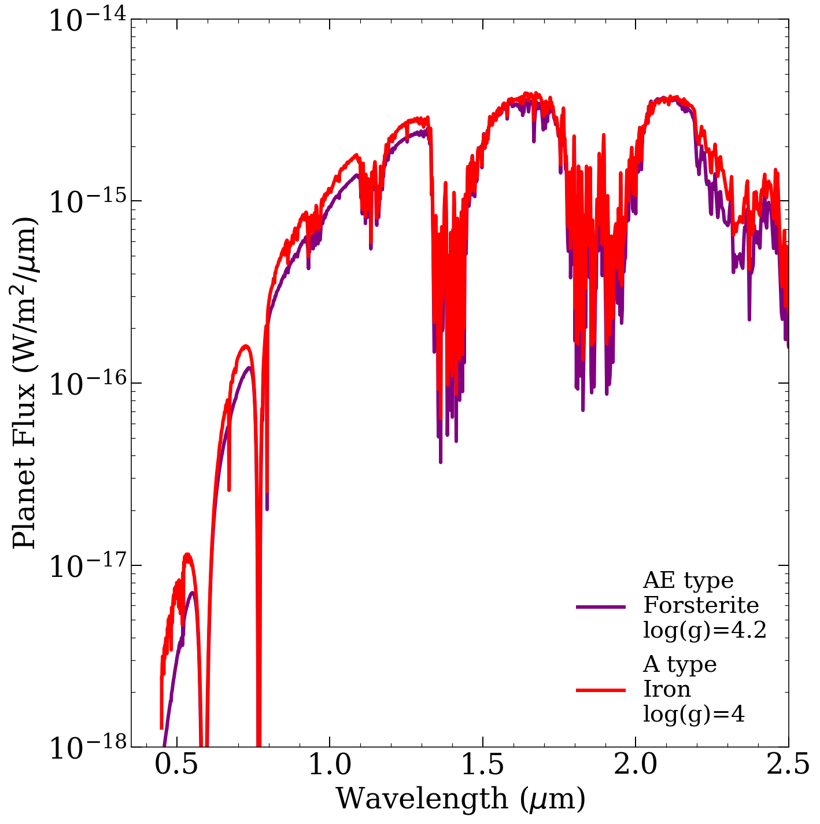
Young, self-luminous massive planets:
Roman coronagraph complements ground-based NIR
Q: What are the cloud properties of young massive planets? How inflated are they? Are they metal rich? (e.g., Na and K searches)
CGI can: Fill out SED with broadband photometry and spectroscopy
During TDP: 1-2 systems
Beyond TDP: Additional bandpasses and/or survey more known planets
CGI
NIR
(Models from Madhusudhan 2011)
Brianna Lacy (Princeton)
A = Clouds extending all through the entire atmosphere with particle number density scaling with gas
AE = Clouds have scale height 1/2 of the gas, so still extend up into atmosphere, but not as much as A type
Notes:
Models from Madhusudhan 2011 study of HR 8799 c and d - the two models shown were equally good matches to the NIR data for HR 8799 d but would certainly be distinguishable in the optical with WFIRST-CGI
Degeneracy between:
Particle size
Spatial extent of cloud
Condensate species
Surface gravity

Slide 17
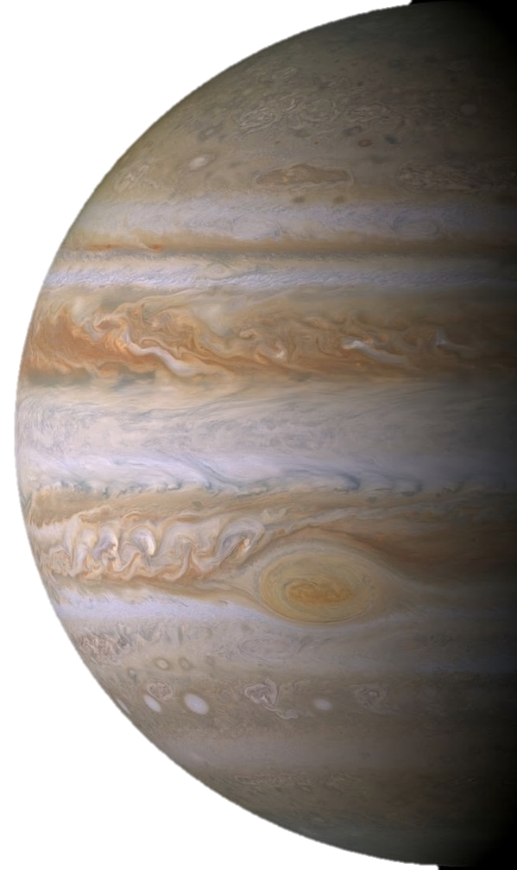
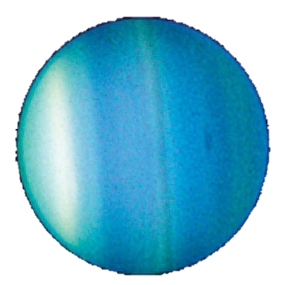
First reflected light images of a mature Jupiter analog
Q: Are cold Jupiter analogs cloudy or clear?
  CGI can: Measure albedo at short wavelengths;
Q: What are the masses of known RV giant planets?
  CGI can: Constrain inclination with 2-3 imaging epochs
During TDP: 1-2 planets
Beyond TDP: Additional narrowbands and/or survey more known planets

Slide 18
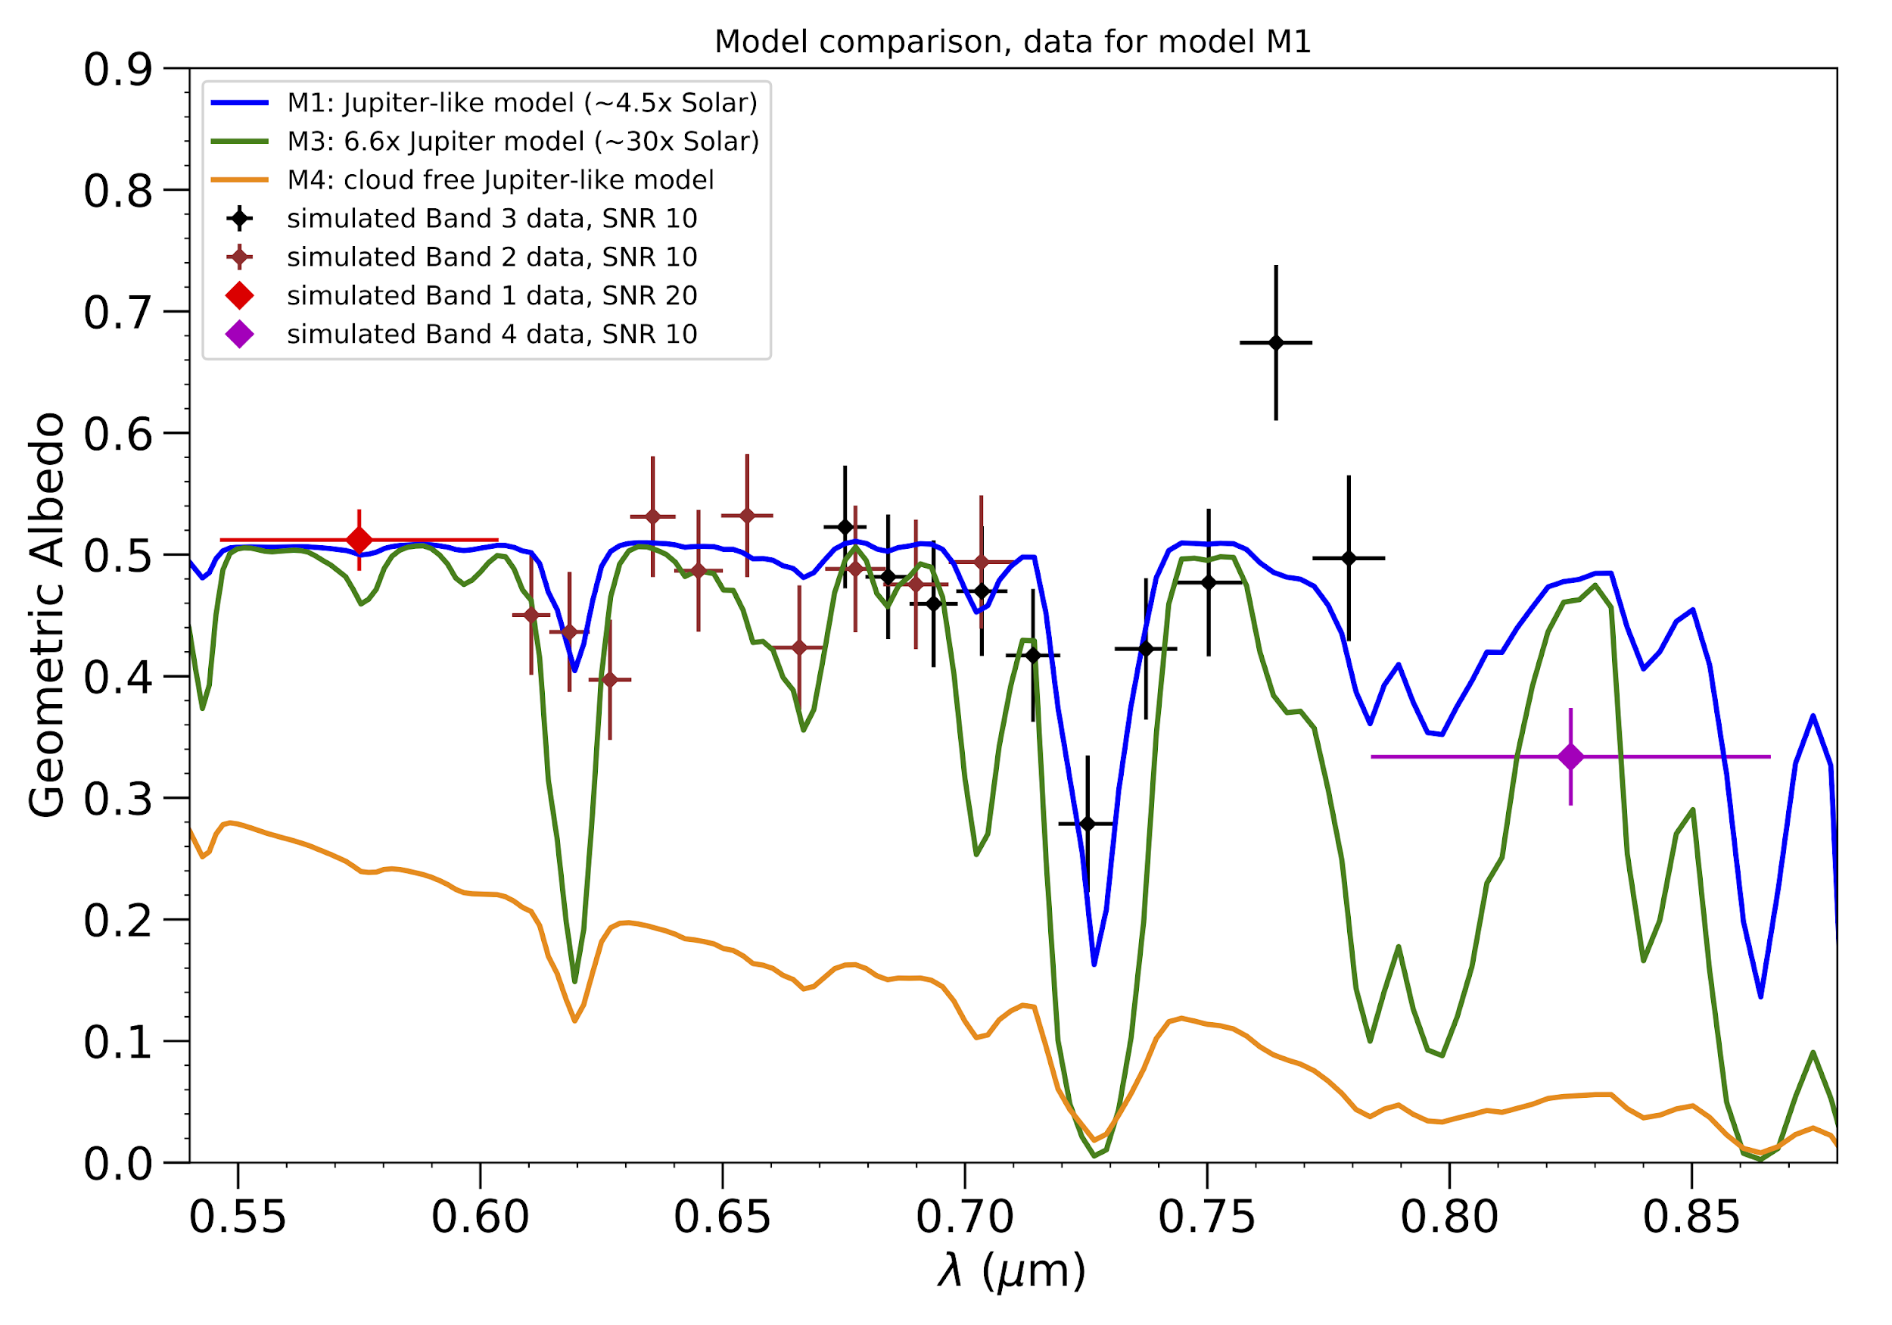
Spectral Characterization of a mature Jupiter analog
Increase confidence that we can detect molecular features in faint, high-contrast, reflected light spectra before we attempt exo-Earths
Q: Are Jupiter analogs metal rich?
CGI can: Coarsely constrain metallicity (5x vs. 30x Solar) if cloudy (high albedo)
During TDP: 1 planet with 730nm spectroscopy
Beyond TDP:
  +1 planet
  OR improve SNR of 1st planet
  OR obtain narrowband photometry or 660nm spectroscopy of 1st planet.
Natasha Batalha (UCSC)
Roxana Lupu (Ames)
660nm spectroscopy is an unofficial observing mode

Slide 19
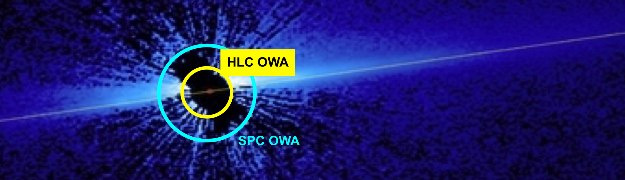
Known Cold Debris Disks Imaging in Total Intensity
Q: Where does circumstellar material come from and how is it structured at low dust density levels where transport phenomena dominate over collisions?
CGI can: Map morphology and scattered light flux of faint disks at smaller working angles than HST
During TDP: 2-3 disks
Beyond TDP: Additional disks with a variety of properties
Schneider et al. 2014, AJ, 148, 59
Notes:
OWA’s eyeballed using 1” indicator

Slide 20
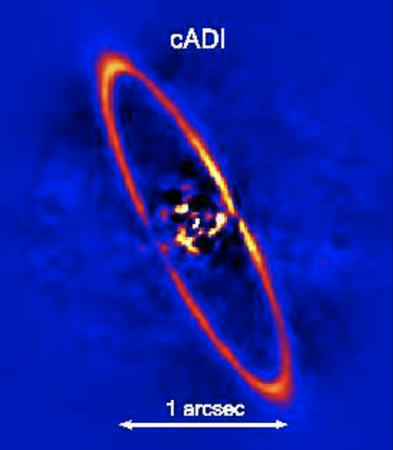
Known Cold Debris Disks Polarimetric Imaging
Q: What is the composition of planetary dust in the inner regions of debris disks?
CGI can: Map color, degree of forward scattering, and the degree of polarization.
During TDP: 1-2 disks
Beyond TDP: Additional disks with a variety of properties
HR 4796A ring: Perrin+2015, Milli+2017
Notes:
OWA’s eyeballed using 1” indicator

Slide 21
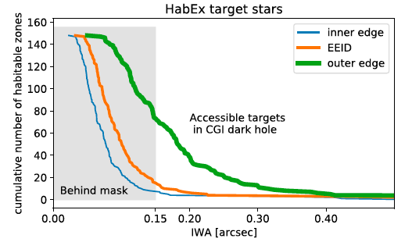
First visible light images of exozodiacal dust
Q: How bright is exozodiacal dust in scattered light? Will it affect exo-Earth detection with future exo-Earth missions? (Mennesson et al. 1997, 2010, 2018, 2019, Beichman et al. 1997, Defrere et al. 2010, Douglas et al. 2022)
CGI can: Probe low surface density disks (10-100 zodis) in habitable zone of ~75 nearby FGK stars
During TDP: Opportunistic, as part of exoplanet observations
Beyond TDP: Survey best 25-50? potential exo-Earth targets for future missions

Slide 22
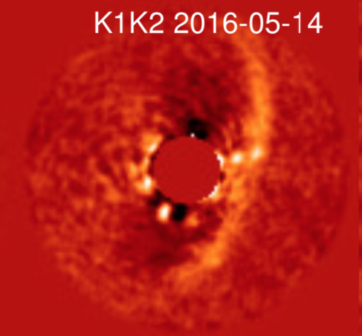
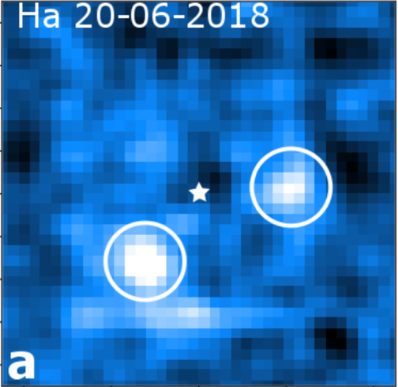
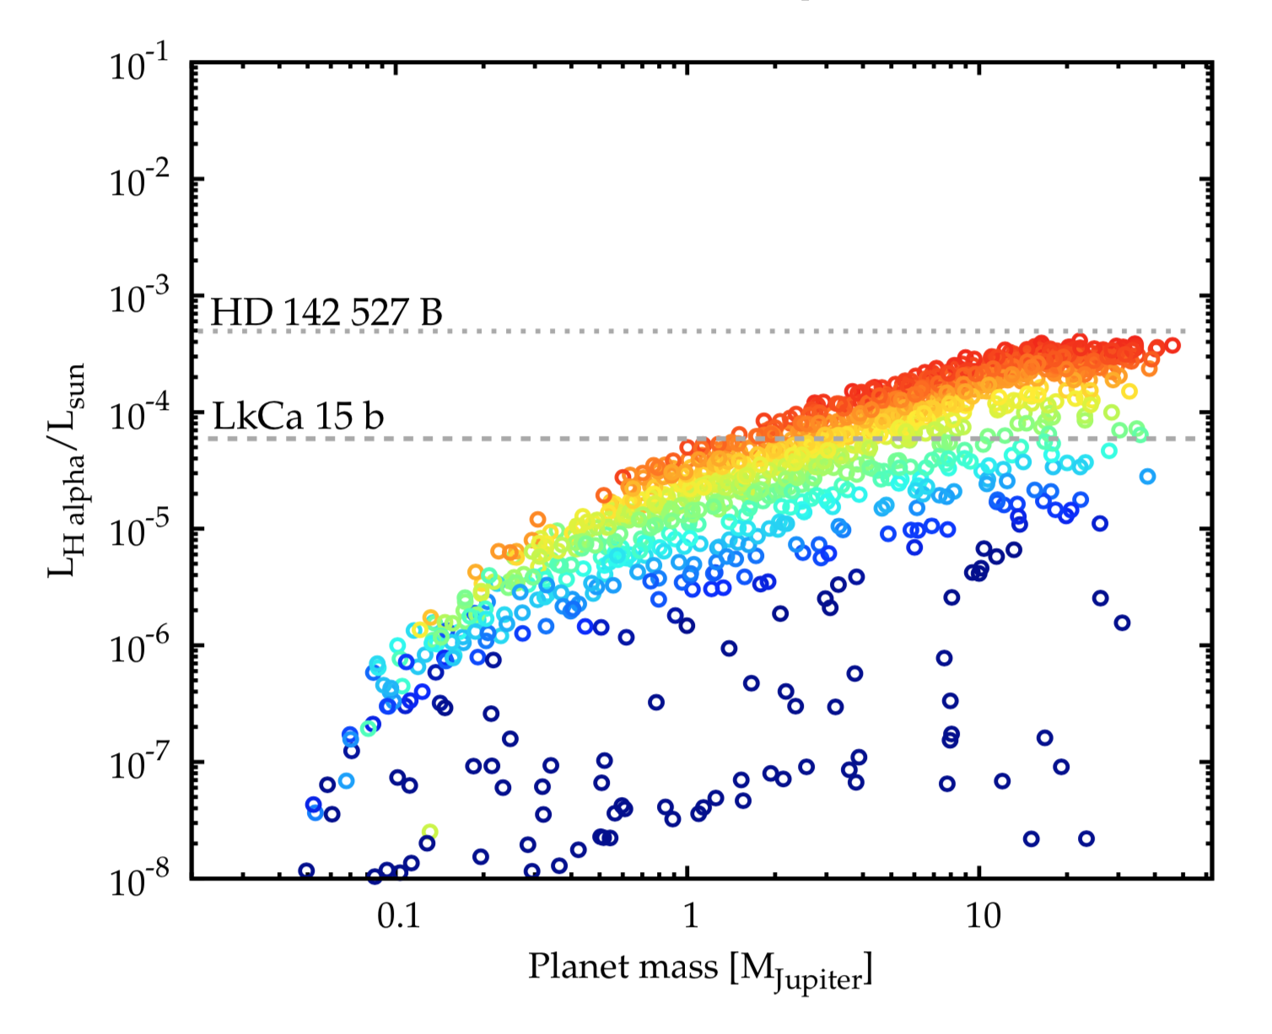
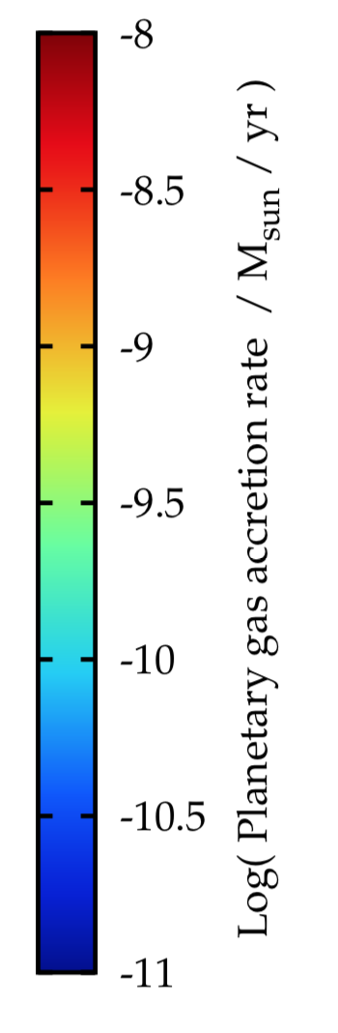
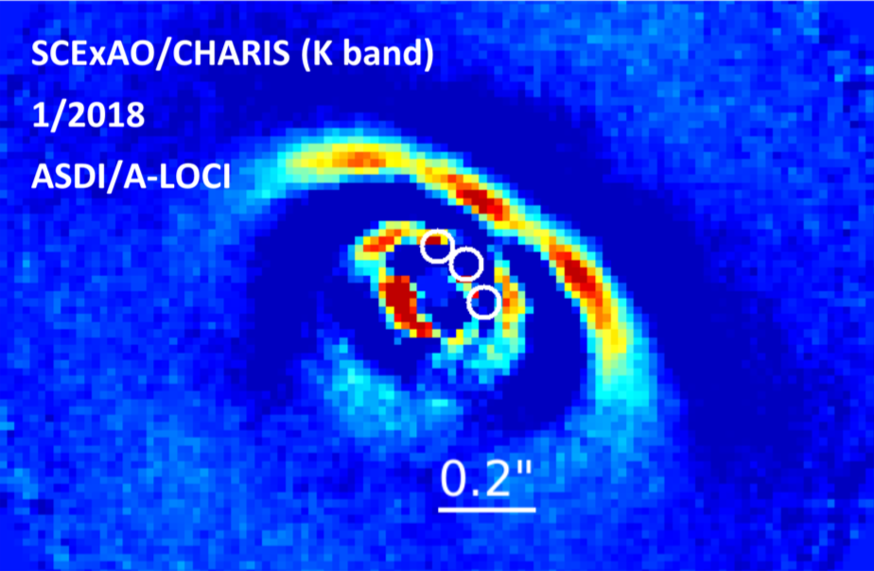
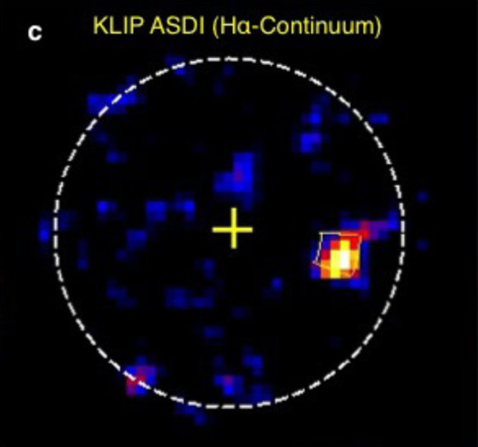
H-alpha Imaging of Protoplanetary systems
Q: What are the accretion properties of low-mass planets in formation (test model predictions)? How can we distinguish protoplanets vs. disk structures?
CGI Can: Measure H-alpha at high contrast
  Caveat: Roman coronagraph will not achieve optimal contrast on faint (V > 6) host stars. Performance modeling TBD.
During TDP: Perhaps a test observation
Beyond TDP: Observe transition disks with gaps in CGI FOV
Haffert+ 2019
Mordasini et al. 2017
Mordasini+ 2017
Keppler+ 2018
PDS 70 b
Sallum+ 2015
Currie+ 2019
Notes:
Contrasts:
PDS 70 b Lha/Lcont ~ 10^-3
LkCa 15 b = 5.2mag ~ 10^-2
HD142527 B = 6.33mag ~ 10^-2.5, mass ~260MJ

Slide 23
Engaging the community in observation planning and preparation
Community Participation Program (CPP)
  External researchers from US & int’l partners (CNES, ESA, JAXA, MPIA)
  Not only end users; also develop infrastructure (data pipeline, observation planning tools, etc)
  Observation planning is a joint exercise between the instrument team and the CPP
  Selected CPP proposals and PIs:
    Coronagraph Instrument testing and performance evaluation in single- and binary star modes, Rus Belikov, NASA Ames
    Calibrating Roman’s Coronagraphic Imaging and Polarimetry Modes, Max Millar-Blanchaer, UCSB
    Data driven investigations of the Coronagraph Instrument as a starlight suppression yardstick, Laurent Pueyo, STScI
    Roman’s Giants: Jovian Exoplanet Modeling and RCI Detectability, Tyler Robinson, Univ. of Arizona
    Target Selection and Observation Modeling Tools for Coronagraph Tech Demo and Beyond, Dmitry Savranski , Cornell Univ.
    Imaging and Characterizing Exoplanets with the Roman Coronagraph and Open-Source Tools, Jason Wang, Northwestern Univ.
    Circumstellar Dust with the Roman Coronagraph, Schuyler Wolff, Univ. of Arizona

Slide 24
Summary
Coronagraph matured multiple key technologies to lay the foundation for HWO
Coronagraph was delivered to GSFC on May 19, 2024
TVAC testing demonstrated performance >4x beyond requirement
Outlook improving for some use of “best effort” modes on sky
  Some pre-delivery TVAC testing + FY24/25 budget overguide
Community Participation Program (CPP) science team supports observation preparation, including broader community engagement
CPP will inform and solicit feedback from the community on target selection
Full observational potential will go beyond what we can imagine today and will be for you to realize

Slide 25
Like to Know More about the Roman Coronagraph?
Nancy Grace Roman Space Telescope at GSFC: https://roman.gsfc.nasa.gov
Nancy Grace Roman Space Telescope at JPL:
  https://www.jpl.nasa.gov/missions/the-nancy-grace-roman-space-telescope
Nancy Grace Roman Space Telescope at IPAC https://roman.ipac.caltech.edu and https://roman.ipac.caltech.edu/sims/Coronagraph_public_images.html#CGI_OS11_report
Nancy Grace Roman Space Telescope at STScI: https://www.stsci.edu/roman/
Upcoming Roman Coronagraph Test Results Info Session to be held at Caltech/IPAC on Aug 26-27: https://conference.ipac.caltech.edu/romancgi24/

Slide 26
Back-up

Slide 27
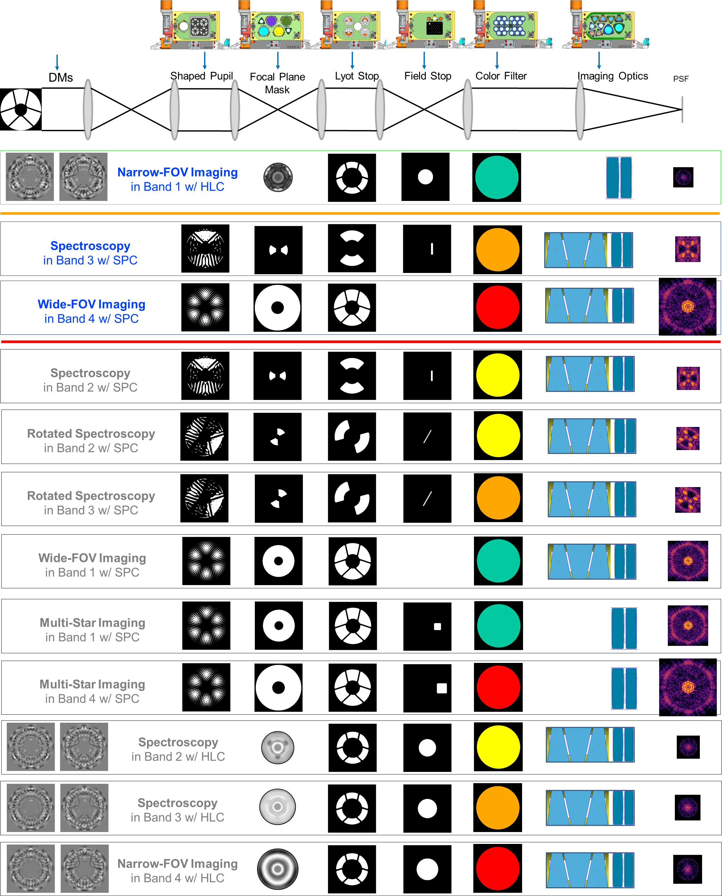
Coronagraph Mask Configurations: Tested vs. Launched
Coronagraph includes significant capability beyond what was tested during I&T to verify requirements
These modes can be commissioned in orbit if time and resources allow
Required HLC Mode
Tested
Best Effort
SPC modes
Calibrated
Calibrated
Calibrated
Tested
Contributed
modes
Fig. from Riggs et al, 2021, Vol. 11823, pp. 611-633 SPIE

Slide 28
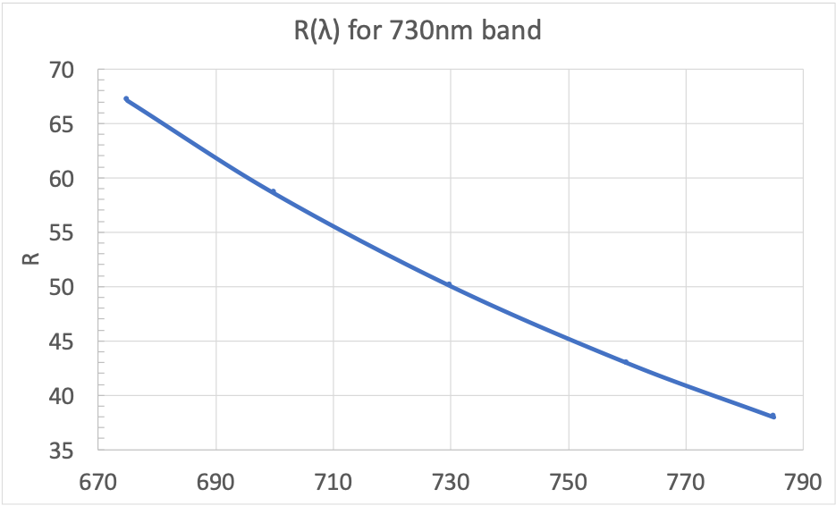
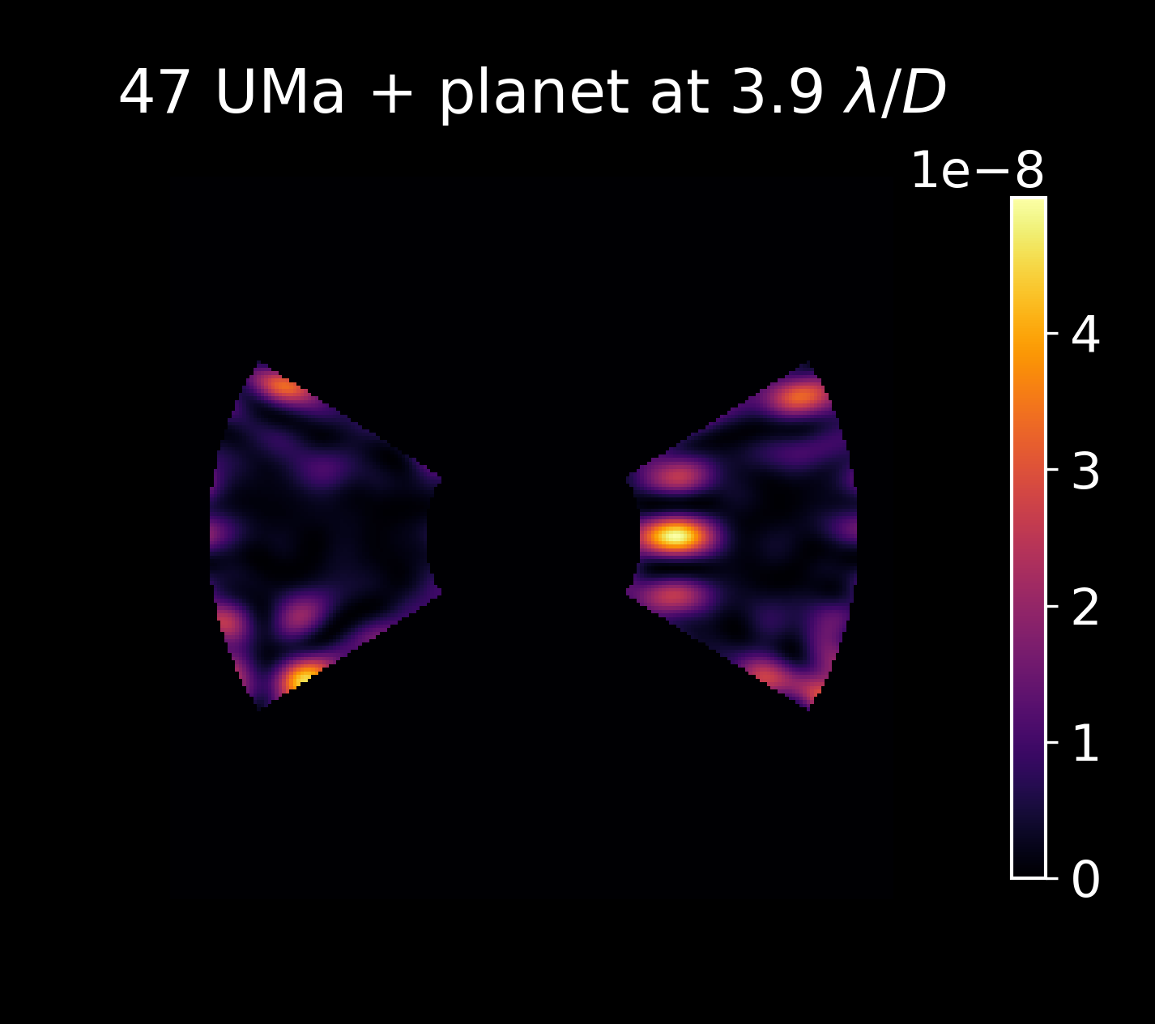
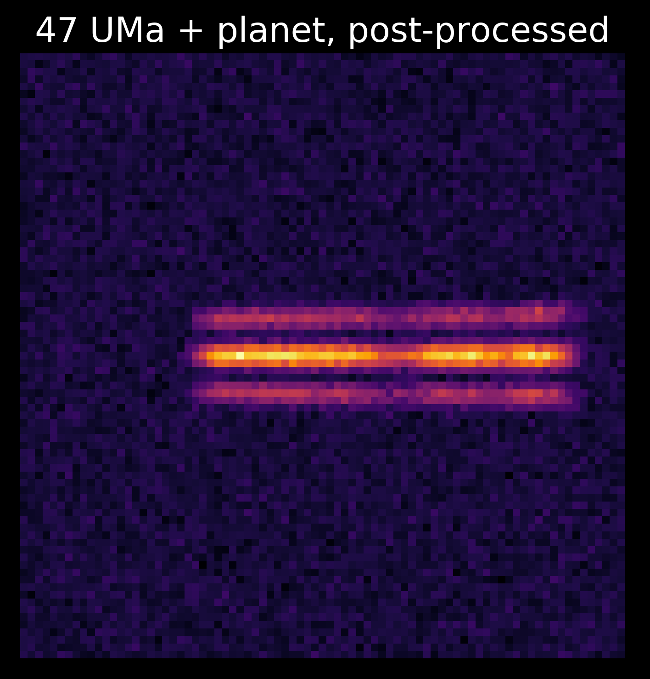
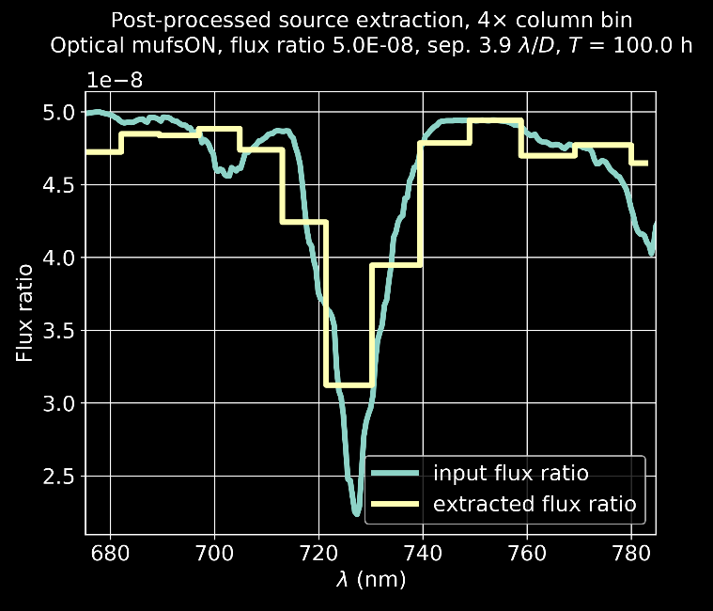
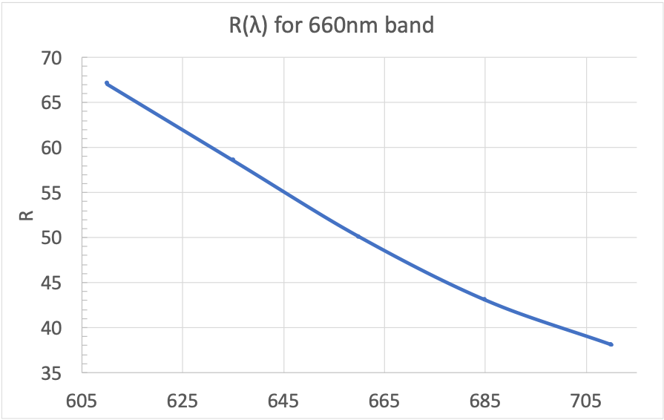

R~50 Spectroscopy w/ Slit Spectrograph (Band 3 or 2)
Simulated Performance
47 Uma + 5×10⁻⁸ planet at 3.9 λ/D
Disperse
Slit
Slit is deployed to planet position
Prism disperses the Shaped Pupil PSF
Spectrum is extracted from image after post-processing (Reference Star Subtraction)
Figures Courtesy: N. Zimmerman and T. Groff (GSFC)

Slide 29
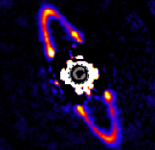
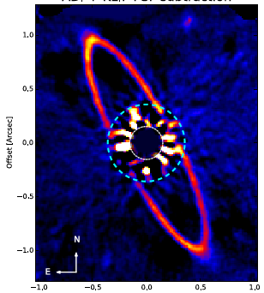

Wollaston Prism Polarimetry (Band 1 or 4 imaging)
I₀
Total intensity
I₄₅
Total intensity and polarized images of high inclination – optically thin- debris disks or rings give access to the grains scattering phase function, inform grain size, shape, mineralogy (and breaks some degeneracies)
I₁₃₅
Linear polarized fraction (LPF) goal:
RMSE < 3% per resel
Current CBE is 1.6% (limited by detector effects)
I₉₀
1 pair at a time
Pairs separated by 7.5” on chip
LPF = sqrt {(I₀ – I₉₀)² + {(I₄₅ – I₁₃₅)²} / I_{tot}

Slide 30
Beyond-requirements activities funded by additional APD award (FY24/25)
Extended TVAC ~1.5 weeks
    higher-performance in required mode
    Dark hole in 2nd coronagraph configuration
    Spectroscopy calibration & polarimetry checkout
Publication of test results and lessons learned in JATIS special issue
  August 26/27 CGI info session workshop: https://workshop.ipac.caltech.edu/romancgi24/
JPL interactions with Community Participation Program on beyond-required observing mode preparation
Wide Field-of-View (Shaped Pupil)

Slide 31


Top-level Performance against Requirement
Flux Ratio Noise (FRN) is the top performance metric that verifies the threshold performance requirement (TTR5): make SNR=5 measurement of 10⁻⁷ flux ratio planet around V=5 target star, in 10 hrs:
  Requirement: Coronagraph flux ratio noise FRN < 2×10⁻⁸
With measured raw contrast, camera noise, tip/tilt rejection, core throughput + stability analysis predictions passed through the FRN budget:
Flux Ratio Noise = 4.85×10⁻⁹ => margin of 75.8% vs. requirement
  All model-derived parameters include MUFs
  Observatory interface jitter and drift CBEs << requirements
  Will continue to work with RST to update “mission-level” CBEs
Flux ratio noise is evaluated after differencing
Injected
planets
More on error budgets in Nemati et al., JATIS, 2023, 9(3), p.034007.
More on modeling in Krist et al., JATIS, 2023 9(4), p.045002.
Modeling results illustrating
Reference Differential Imaging (RDI)
>75% margin against the top level performance (Flux Ratio Noise) requirement

Slide 32

Comparison Summary
Point source-to-star Flux Ratio detectable by Roman coronagraph far from HabEx/LUVOIR
…but Roman Coronagraph components and subsystems performance are highly comparable!
“A pupil that only a mother could find beautiful”
David Spergel, circa 2015
Notes:
So the next natural question is: how …
Explain color coding. Go throhg first 5 rows one by one
Highlight Flux ratio detection limit; one could stop there and conclude at first sight that…

Slide 33

Narrow Field-of-View (Hybrid Lyot)
Dark Hole Convergence
“Beta bumps” represent purposeful changes in control regularization
Number of iterations and time to dig the dark hole consistent with modeling and IOC/Tech Demo plans

Slide 34


Wide Field-of-View (Shaped Pupil)
Dark Hole Convergence
“Beta bumps” represent purposeful changes in control regularization
Number of iterations and time to dig the dark hole consistent with modeling and IOC/Tech Demo plans

Slide 35
Roman Coronagraph is a stepping stone toward Habitable Worlds Observatory
A visible-light, high-contrast “technology demonstration” instrument for HWO
  first space-based coronagraph with active wavefront control
  requirement: 10⁻⁷ flux ratio 5σ detection limit in a single photometric band
    Designed to outperform requirement
  Predicted performance ≥4x beyond req
    Based on end2end performance testing
Delivered to GSFC on May 19, 2024
Credit: Eric Cady, Byoung-Joon Seo, A. J. Riggs, Brian Kern, David Marx, Fang Shi, Hanying Zhou, John Krist, Garreth Ruane

Slide 36

Beyond TDP: Na and K in self-luminous planets
Brianna Lacy
Detect Na and K
combine with NIR to help constrain:
  the species, spatial extent, and particles sizes of condensates
  the planet’s effective temperature, surface gravity, and radius
  the atmospheric metallicity
K
Na
Notes:
-- HR 8799 e was observed by GRAVITY optical interferometry and K band spectra: https://www.aanda.org/articles/aa/abs/2019/03/aa35253-19/aa35253-19.html
-- Far more CO than Methane in K band > disequilibrium chemistry
-- Iron and Silicate clouds
In the figure, exposure times are around 10 hours for the imaging and 150 hours for the spectra

Slide 37

Self-luminous planet flux ratio in CGI bandpasses
Brianna Lacy
Object | Band 1 | Band 2 | Band 3 | Band 4
51 Eri b | 3.7E-11 | 1.6E-09 | 2.5E-09 | 4.6E-08
*Beta Pic b | 1.1E-07 | 2.9E-06 | 4.7E-06 | 2.5E-05
HR 8799 d | 5E-10 | 4.4E-08 | 6.4E-08 | 6.3E-07
HR 8799 e (cloudy) | 6.8E-10 (2.7E-09) | 5.6E-08 (1.6E-07) | 8.1E-08 (2.1E-07) | 7.9E-07 (1.4E-06)
HD 206893 | 7.9E-9 | 4.4E-07 | 6.1E-07 | 4.7E-06
HD 984 b | 2.7E-05 | 1.4E-04 | 2.6E-04 | 6.1E-04
Notes:
51 Eri b 3.65990493621275e-11 1.5811320208905573e-09 2.518887499379052e-09 4.6040145538089906e-08
$\beta$Pic b 1.0997694530918545e-07 2.8955391521985583e-06 4.70226429007196e-06 2.469199576319328e-05
HR 8799 d 5.043290788501037e-10 4.3489867030674916e-08 6.405651562686902e-08 6.344721739024567e-07
HR 8799 e 6.777178911697281e-10 5.576109426809514e-08 8.092148136599642e-08 7.883307663050271e-07
HR 8799 e (cloudy) 2.690407178216335e-09 1.5746516766813865e-07 2.1633039665511025e-07 1.3878133000923309e-06
HD 209863 b 7.927952661608518e-09 4.381262268545646e-07 6.057622834946357e-07 4.681475952261294e-06
HD 984 b 2.7275157923227252e-05 0.0001379345891506985 0.00025776238638019485 0.0006084584249913825

Slide 38


Relevance of CGI to HWO: a Roman coronagraph exozodi survey
Simulations of V-band coronagraphic observations of a Sun/Earth twin at 10 pc with a 4m telescope (Defrere et al. 2012)
LBTI measures is a total mid-infrared (~11 um) excess integrated over a few 100 mas
A solar zodi like model is assumed to convert excess to exozodi brightness, scaling up from “1 zodi” density at 1 AU (or EEID)
Converting to exozodi level at visible wavelengths also depends on exozodi dust model (albedo, grain size and spatial distributions)
There is evidence, from joint MIR and NIR interferometric measurements that some stars have exozodi dust very different from solar (hot dust phenomenon, Absil et al. 2006 & 2009, Ertel et al. 2014, Mennesson et al. 2011)
Yield simulations assume smooth exozodi signals and only a shot noise impact
  Need to include the effect of any bright resonant dust clumps that may mimic planets and hamper their detection
Roman Coronagraph could conduct a visible coronagraphic survey of HZ exozodi dust around 70 HWO targets down to 10-100 zodis sensitivity (5σ), depending on in-flight performance
1 “zodi” case: exo-Earth is retrieved
20 “zodis” case : bright dust clump is retrieved
instead of planet

Slide 39
H-alpha Imaging of Protoplanets
High-contrast H-alpha measurements will test these predicted core accretion luminosities.
Mordasini+ 2017
Mordasini+ 2017
Mordasini+ 2017
PDS 70 b
Planet mass accessible will depend on detection limtis, contrast achievable on targets fainters than V=5, and accretion rate.
Notes:
Hα luminosity predicted for giant planets during
the formation phase, assuming a cold accretion model, for a
variety of planet masses and accretion rates (from Mordasini
et al. 2017, figure adapted by K. Follette). Also indicated are
the Hα luminosities measured by ground-based facilities for
candidate protoplanets LkCa 15 b and PDS 70 b and the low
mass stellar companion HD 142 527 B. Reaching point
source-to-star contrasts of ≤10-6 would provide access to Hα
luminosities of ~10-8 L⊙, i.e., to sub-Jupiter-mass planets over
a broad range of accretion rates.
Contrasts:
PDS 70 b Lha/Lcont = 10^-3
LkCa 15 b = 5.2mag = 10^-2
HD142527 B = 6.33mag = 10^-2.5, mass ~260MJ
At lower accretion rates there is predicted to be a much larger spread in H-alpha luminosity
Lhalpha is from
10 earth mass core triggers gas accretion, so that’s the lefthand limit

Slide 40


Unsupported Mask Configurations
Additional masks contributed by NASA’s Exoplanet Exploration Program to fill empty slots in mechanisms.
No funding for on-sky commissioning identified at this time. Analogous to HST/STIS Bar5.
Not shown: unsupported “low-contrast” classical Lyot spots (analogous to HST) for very wide FOV imaging (~1-3.5”)
For complete list of masks, see past SPIE conf. papers
11823-72 by A.J. Riggs
11823-54 by E. Bendek
Notes:
The Multi-Star Wavefront Control (MSWC) algorithm can be used to suppress scattered light from an off-axis companion star, enabling high-contrast imaging in binary star systems. Applying this technique to the Nancy Grace Roman Space Telescope (Roman, formerly WFIRST) Coronagraph Instrument (CGI) could significantly increase the number of possible targets for the mission. Some of those targets are beyond the deformable mirror spatial Nyquist control zone, and therefore super-Nyquist MSWC would be necessary. In this paper, we present a feasibility analysis of implementing MSWC on Roman CGI.

Slide 41
Engaging the community in observation planning and preparation
Observation planning is a joint exercise between the instrument team and the CPP
  Coronagraph has no GO program
CPP will inform and solicit feedback from the community on target selection
  Fall 2024: informational briefing & short community survey for high-level input
  Future: opportunities for more detailed input (eg: whitepaper?)
    Opportunities to join CPP working groups to flesh out select ideas in more detail
As with WFI, there is no proprietary period on Coronagraph data

Slide 42
Science & Tech Potential vs Capabilities
 | 10⁻⁷, 6-9 λ/D, Band 1 (TTR5) | 10⁻⁸, 3-9 λ/D, Band 1 (conservative) | ‘best effort’ modes, 10⁻⁸ (conservative) | all modes, 3x 10⁻⁹ (optimistic)
Technology maturation | All key imaging technologies at TRL9 | … + all key imaging technologies are necessary to achieve performance | … + spectroscopy and polarimetry technologies at TRL9 | … + tech demos & performance is approaching HWO needs in multiple areas
Jupiter analog spectra | No | No | No | A few*
Jupiter analog Images | No | Unlikely | Unlikely | A handful*
Young giant planet spectra | No | No | Yes | Yes*
Young giant planet images | No | No | Yes | Yes*
Circumstellar disk images | Yes | Yes | + polarimetry & (potentially**) H-alpha | + lower-mass disks
Exo-Zodi Disks images | ~5000 zodis | ~100 zodis | ~100 zodis | ~40 zodis ***
* Roman will likely be target-limited. Corollary: a modest extended operations period could observe all high-priority targets
** H-alpha imaging of transition (planet-forming) disks will depend on Coronagraph’s faint star performance, which is TBD
*** Potential for survey of prime HWO targets if Coronagraph operations are extended

Slide 43

Science & Tech Potential vs Capabilities
Tested in TVAC?
 | 10⁻⁷, 6-9 λ/D, Band 1 (TTR5) | 10⁻⁸, 3-9 λ/D, Band 1 (conservative) | ‘best effort’ modes, 10⁻⁸ (conservative) | all modes, 3x 10⁻⁹ (optimistic)
Technology maturation | All key imaging technologies at TRL9 | … + all key imaging technologies are necessary to achieve performance | … + spectroscopy and polarimetry technologies at TRL9 | … + performance is approaching HWO needs in multiple areas
Jupiter analog spectra | No | No | No | A few*
Jupiter analog Images | No | Unlikely | Unlikely | A handful*
Young giant planet spectra | No | No | Yes | Yes*
Young giant planet images | No | No | Yes | Yes*
Circumstellar disk images | Yes | Yes | + polarimetry & (potentially**) H-alpha | + lower-mass disks
Exo-Zodi Disks images | ~5000 zodis | ~100 zodis | ~100 zodis | ~40 zodis ***
* Roman will likely be target-limited. Corollary: a modest extended operations period could observe all high-priority targets
** H-alpha imaging of transition (planet-forming) disks will depend on Coronagraph’s faint star performance, which is TBD
*** Potential for survey of prime HWO targets if Coronagraph operations are extended

Slide 44
Science & Tech Potential vs Capabilities
Under baseline plan (90 days across 1st 18mo), Coronagraph will be time-limited & resource-limited, not target-limited
 | 10⁻⁷, 6-9 λ/D, Band 1 (TTR5) | 10⁻⁸, 3-9 λ/D, Band 1 (conservative) | ‘best effort’ modes, 10⁻⁸ (conservative) | all modes, 3x 10⁻⁹ (optimistic)
Technology maturation | All key imaging technologies at TRL9 | … + all key imaging technologies are necessary to achieve performance | … + spectroscopy and polarimetry technologies at TRL9 | … + performance is approaching HWO needs in multiple areas
Jupiter analog spectra | No | No | No | A few*
Jupiter analog Images | No | Unlikely | Unlikely | A handful*
Young giant planet spectra | No | No | Yes | Yes*
Young giant planet images | No | No | Yes | Yes*
Circumstellar disk images | Yes | Yes | + polarimetry & (potentially**) H-alpha | + lower-mass disks
Exo-Zodi Disks images | ~5000 zodis | ~100 zodis | ~100 zodis | ~40 zodis ***
* Roman will likely be target-limited. Corollary: a modest extended operations period could observe all high-priority targets
** H-alpha imaging of transition (planet-forming) disks will depend on Coronagraph’s faint star performance, which is TBD
*** Potential for survey of prime HWO targets if Coronagraph operations are extended

Slide 45

Low Order Wavefront Sensing and Control
Rejects Flight-like Tip/Tilt Disturbances
Shi+2019
LOWFS/C also continuously senses and controls
Z4 – Z11
(~2 mHz bandwidth)
FF not implemented in flight, to meet cost/schedule
Still valuable proof of concept
Current Best Estimate with updated ACS/RWA jitter input:
0.51 mas rms residual pointing jitter per axis for V=5 star
(Reqt is 1 mas rms)
FSM
Flight FSM: Completed Assembly in June 2022
Notes:
HLC mask. Very bright source (systematics limited not photon limited). Previous tests have been conducted on fainter stars and shown good rejection, but those tests didn’t have the latest PSDs.
Hardware Requirements and Certification Review
Feed forward: expectation is ; CBEs are better than 0.9 mas rms. Reqt is 1mas rms per axis. CBE is ~0.5 mas rms. Check with Nanaz Fathpour, cc Ilya
Z2-3:ttip-tilt
Z4: defocus
Z5-Z11: astigmatism, coma and spherical

Slide 46




Electron-Multiplying CCDs Count Photons
Jupiter analogs V ~ 27
  < 1 planet photon per minute
Teledyne e2v, two 1k×1k EMCCDs
  EM => no read noise
Tech & data processing development
  Mitigation and characterization of charge traps from radiation damage (“notch” channels)
  Mitigation of cosmic ray effects (overspill)
June 2022 status:
  Both flight cameras assembled and completed decontamination bake
  ExCam and Locam thermal balance and waveform optimization completed
  Next this summer are vibration and TVAC tests
  Delivery to I&T planned on 10/7/22
ExCam and LoCam
Proximity Electronics
EMCCD
Pictures courtesy of Patrick Morrissey
Shield
Notes:
We have fabricated a complete engineering development unit (EDU) camera using a prototype EMCCD (commercial silicon) and are testing it.
Long lead items are in production, including the EMCCD, the proximity electronics, and some mechanical parts.
Electronics are scheduled for delivery in September but may include two “red dot” parts.
The schedule is driven by the EMCCD delivery expected in August.
The CGI Camera Subsystem comprises two nominally identical Electron Multiplying Charge-Coupled Device (EMCCD) cameras with different applications:
A photon counting Exoplanetary Systems Camera (ExCam) for target acquisition, direct imaging and spectroscopy
A low latency, Low Order Wavefront Sensing Camera
(LoCam) for high frame rate imaging
A camera system includes:
ESA-contributed EMCCD
1kx2k, available photon counting
JPL-procured Field Programmable Gate Array (FPGA)
controller
Includes ground support equipment (GSE)
command & data handling (Windows)
JPL-built optomechanical radiation shield assembly

Slide 47
Threshold Technology Requirement #5 (TTR5)
TTR5: “Roman shall be able to measure brightness of an astrophysical point source w/ SNR ≥ 5 located 6 – 9 λ/D from an adjacent star with V_{AB} ≤ 5, flux ratio ≥ 10⁻⁷; bandpass shall have a central wavelength ≤ 600 nm and a bandwidth ≥ 10%”.
Despite removing all but TTR5, HQ directed the team to keep pre-PDR design
TTR5 will be verified before instrument delivery with end-to-end performance testing downstream of OTA, and full end-to-end STOP modeling.
  The optics for the other observing modes will be fully aligned. On going discussions with NASA regarding full functional and performance-testing before delivery.

Slide 48










Most Assembly-level hardware Delivered - CGI Flight Assemblies now in Final Assembly and Testing Phase
Contains H/W contributions from international partners
FSM
Shielded Camera
EMCCD proximity Electronics
FCM
PAM Electronics
Spec Prisms and Polarizers Assembly
DM2
PAM
HLC Masks
OAP in flight mount
SPC Masks
HLC Masks
CTS
Command and Power Distribution Unit
Flight OBA in High Bay
LOWFS Electronics
LOWFS Electronics
Notes:
Point to Ilya’s presentation here
Exciting to see all of the flight h/w coming together Flight models are on lab
DS Changes: Added glow and outline to dot for readability. Resized photos for reduction in file size.
Top row: flight FSM / flight FCM / Camera / EMCCD electronics / PAME
Middle row: flight DM2 / flight PAM (3 are short, 3 are long, with ~ 18mm difference in travel range in horizontal axis) / SPC flight masks / HLC flight masks / Flight Polarizer & Spectroscopy prisms assembly (they look exactly the same) / LAM OAP mounted in a JPL flight mount
Bottom row: CTS (Cryogenic Thermal Subsystem) / flight OAB (do you have a more recent pic with optics on it?) / LOWFS/CIE (Camera Interface Electronics) Power Slice / LOWFS Control Slice / CPDU (Command & Power Distribution Unit)
FSM/FCM/?/?emCCD proximity electroics/ ?
DM/?/SPC Masks/ HLC masks/Amici prisms for spectroscopy / OAP?
TVac test chambers are used to simulate conditions found in the upper atmosphere and outer space, exposing components and systems to vacuum and extreme temperature variations.

Slide 49
Supported Observing Modes
Band | λ_{center} | BW | Mode | FOV radius | FOV Coverage | Pol. | Coronagraph Mask Type | TTR5
1 | 575 nm | 10% | NFOV: Narrow FOV Imaging | 0.14” – 0.45” | 360° | Y | Hybrid Lyot | Y
2 | 660 nm* | 15% | SPEC: Slit + R~50 Prism Spectroscopy | 0.18” – 0.55” | 2 x 65° | - | Shaped Pupil | -
3 | 730 nm | 15% | SPEC: Slit + R~50 Prism Spectroscopy | 0.18” – 0.55” | 2 x 65° | - | Shaped Pupil | -
4 | 825 nm | 10% | WFOV: “Wide” FOV Imaging | 0.45” – 1.4” | 360° | Y | Shaped Pupil | -
* 660 nm spectroscopy is the lowest priority for on-sky testing. If time is limited, this mode may not be exercised during the Technology Demonstration Phase.
Complete list of filters available at https://roman.ipac.caltech.edu/sims/Param_db.html
Can’t mix & match coronagraph mask w/ any filter; must be sub-band

Slide 50










Nominal operations: target & reference star
Reference Star
V < 3
<~ 1 mas angular diameter
Hot O/B
WFSC & PSF reference
Target Star
V < 5 (maybe V<6-7; TBD)
< 2 mas strongly preferred
Typically Solar-type
Ref Star
Target Star
Target Star - roll
Target vs Reference should have small delta (spacecraft) pitch for better thermal stability
Reference Differential Imaging (RDI)
➔ improved S/N
Adapted from J. Krist
Need both active wavefront control and optimized in-orbit operations to meet L1 requirements
Notes:
For data post-processing, we will use a combination of reference differential imaging (RDI) and angular diff. imging (ADI). As shown for ground based observwtions, we expect RI to be more powerful at short separations, and ADI to bebetter at large separations

Slide 51



What is High-Order Wavefront Sensing and Control (HOWFSC)?
HOWFSC “digs the dark hole” by cycling periodically through iterations of:
Wavefront sensing at primary camera EXCam ("focal plane wavefront sensing")
Wavefront control, by using a model to solve for the next set of DM settings
These cycles are repeated to reduce the residual starlight level and permit the detection of faint astrophysical signals in the vicinity of the star.
Band 1a
Band 1b
Band 1c

Slide 52


HOWFS Operates “Ground In the Loop” (GITL)
3
2
1
CGI
Spacecraft
4
MOC
10
9
8
SSC (@IPAC)
Roman Coronagraph Dark Hole Algorithms Interest Group
  Neil Zimmerman neil.t.zimmerman@nasa.gov
Computation offloaded to ground
~Daily contacts; Small number of iterations per contact
  tens of minutes / iteration (22 min CBE ; 30 min Req) due to comm’s bandwidth
Potential for contributed HOWFSC algorithms. Testing/validation support TBD, but no earlier than post-instrument delivery
7
Commands
Extraction
5
HOWFSC algorithms
6

Slide 53
Engaging the community in observation planning and preparation
Community Participation Program (CPP)
  External researchers from US & int’l partners (CNES, ESA, JAXA, MPIA)
  Not only end users; also develop infrastructure (data pipeline, observation planning tools, etc)
Observation planning is a joint exercise between the instrument team and the CPP
  Coronagraph has no GO program
CPP will inform and solicit feedback from the community on target selection
  Fall 2024: informational briefing & short community survey for high-level input
  Future: opportunities for more detailed input (eg: whitepaper?)
    Opportunities to join CPP working groups to flesh out select ideas in more detail
As with WFI, there is no proprietary period on Coronagraph data

Slide 54
Summary
Coronagraph matured multiple key technologies to lay the foundation for HWO
Coronagraph was delivered to GSFC on May 19, 2024
TVAC testing demonstrated performance >4x beyond requirement
Outlook improving for some use of “best effort” modes on sky
  Some pre-delivery testing + FY24/25 overguide
  new exoplanet & disk science during nominal 90 day observation phase
  “unsupported” mode hardware remains latent capability
Community Participation Program (CPP) science team supports observation preparation, including broader community engagement
Roman would like to hold an extension review early in Phase E, if early on-sky performance is compelling

