Slide 1
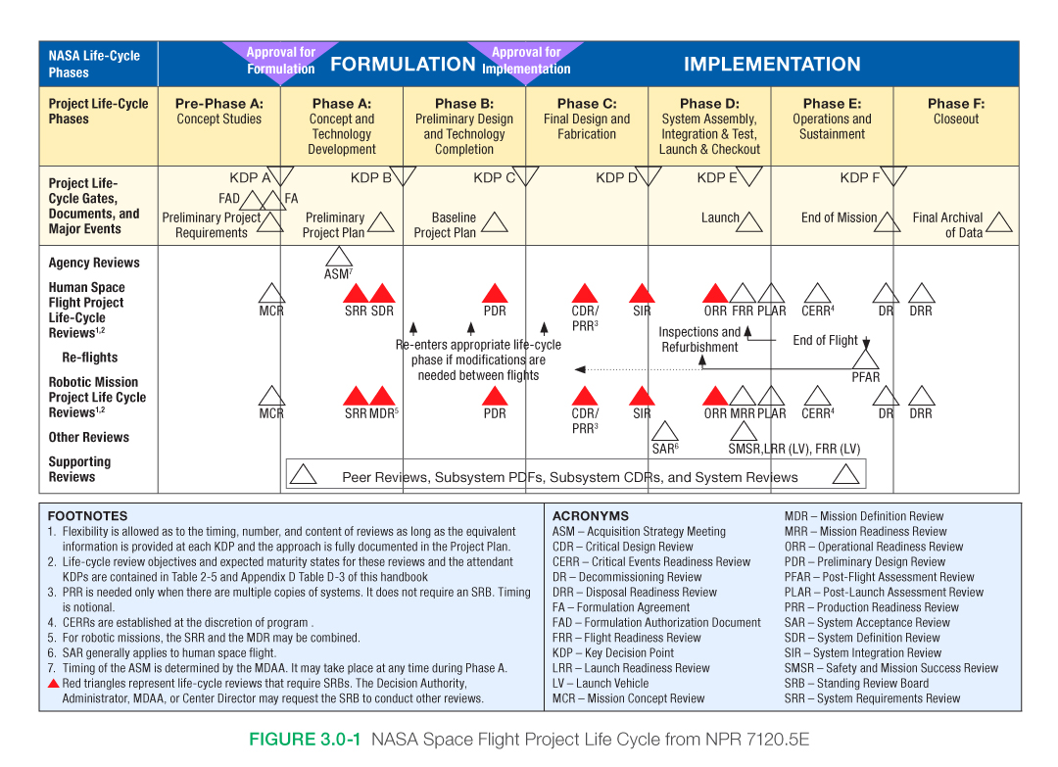
NASA MISSION PHASES
 | Roman | JWST
Pre-phase A | 5y | ~3y
Phase A | 2y | ~3y
Phase B | 1.5y | ~6y
Phase C | 3y | ~2y
Phase D | ~5y* | ~11y

Slide 2
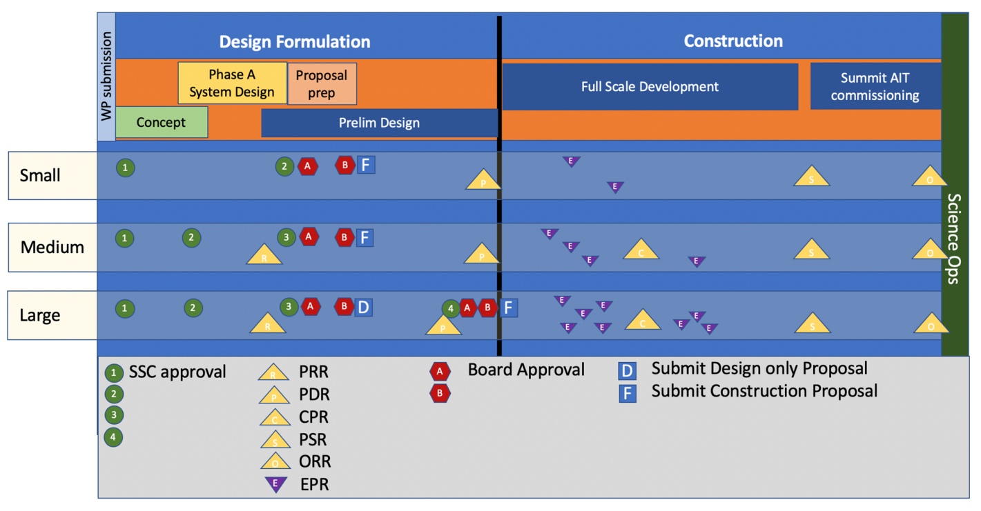
Typical instrument development lifecycle for ground-based observatories
Concept phase to determine feasibility and an initial science case.
Phase A system design phase during which designs for the instrument are matured on the most important aspects of the instrument as well as maturing the budget and schedule.
Proposal Development phase for soliciting funding from private and public granting agencies.
Preliminary design when all technical subsystems are designed and matured while programmatic processed are introduced and refined relative to the proposal phase
Implementation phase is when the instrument detailed designs are finished and the build of the instrument is completed for all subsystems.
Commissioning includes integration of the instrument at the observatory and night time engineering activities to commissioning the instrument for routine operations. The project completes with a hand over to operations at the end of this phase.
Credits: M. Kassis (WMKO Inst. Prog. Manager)
PRR: Proposal Readiness Review.
PDR: Preliminary Design Review.
EPR: Engineering Peer Reviews.
CPR: Construction Programmatic Review.
PSR: Pre-ship Review.
ORR: Operational Readiness.

Slide 3
Typical costs and durations per phase
 | Small |  | Medium |  | Large
 | Cost | Duration | Cost | Duration | Cost | Duration
Concept – Phase A | <$0.1M | <1 yr | $0.1M | 1 yr | $0.5M | 1-5 yr
Preliminary design | $0.1M | <1 yr | $1M | 1 yr | $2-3M | 2-3 yr
Implementation | <$1M | <1 yr | $5M-$10M | 2-3 yrs | $10-100M | 3-5 yr
Commissioning | <0.01M | <1 month | $0.1M | months | <$1M | months

Slide 4
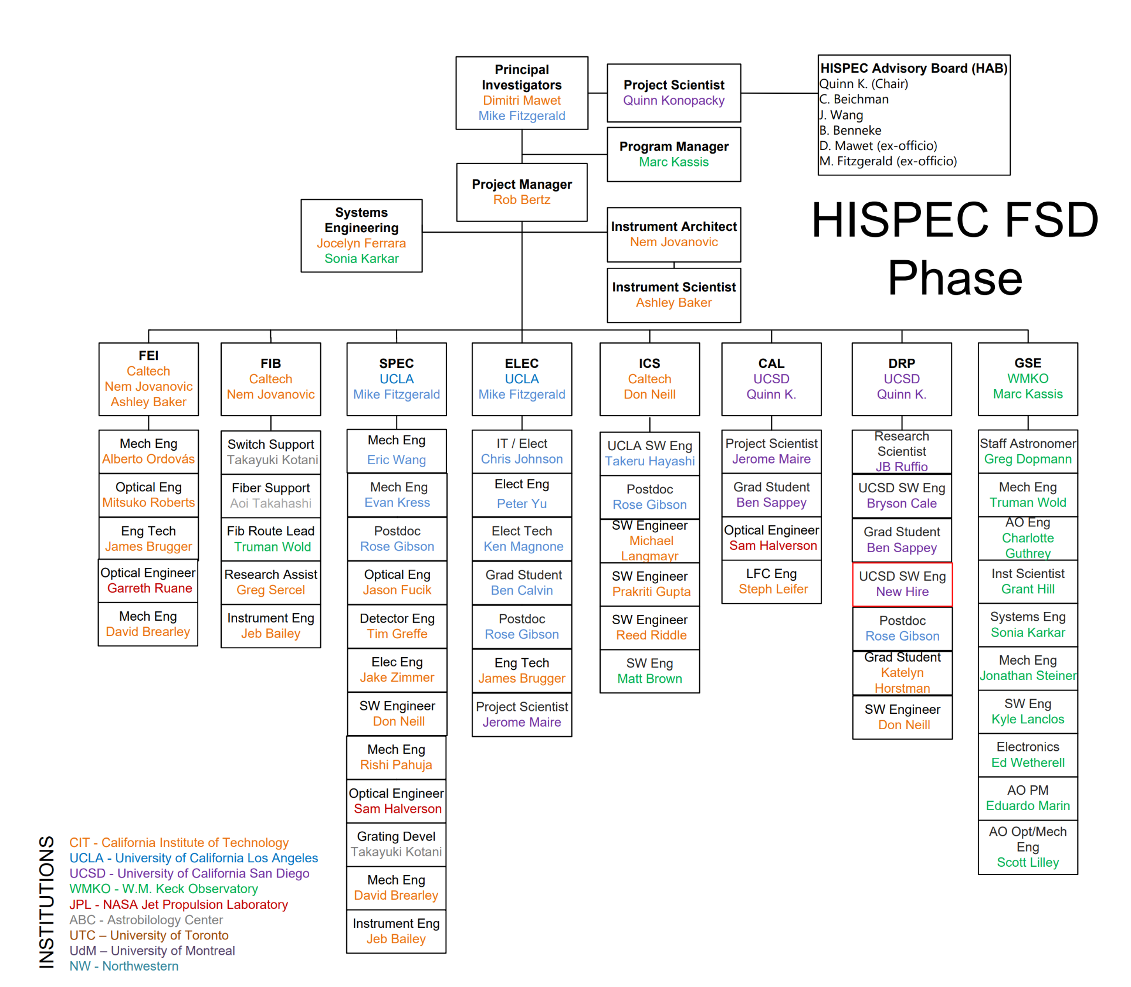
Example organizational structure, professionals
Project leads
  PI/Co-PI
Project management
  Admin support
Advisory board
Science team
  Project scientist
Instrument scientists and architects/engineers
System engineers
Optical engineers
Mechanical engineers
Electronic engineers
Software engineers
Data reduction pipeline scientists and engineers

Slide 5
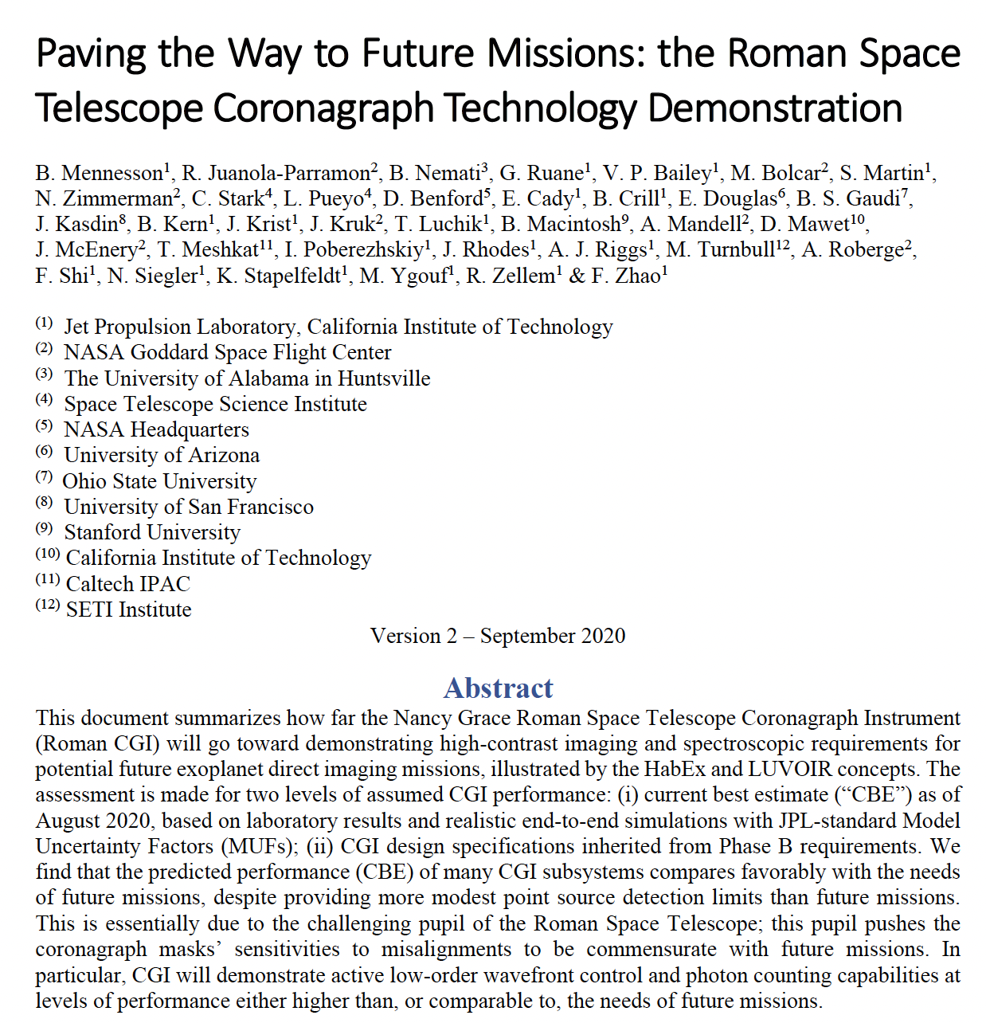
Roman Coronagraph Technical Relevance to HWO
Needs to be updated given:
Roman coronagraph TVAC results
HWO coronagraph TBD requirements

Slide 6
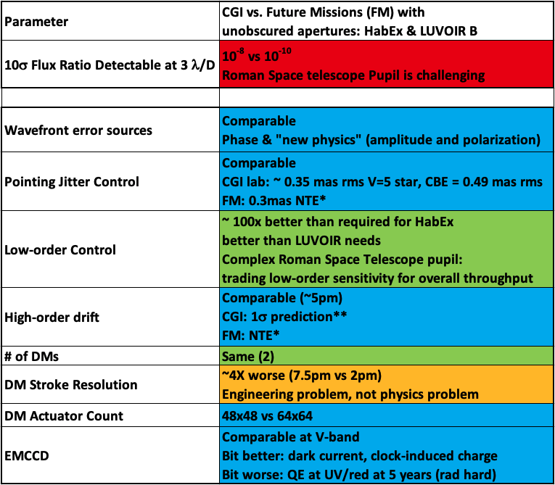
Comparison Summary
Point source-to-star Flux Ratio detectable by Roman coronagraph far from HabEx/LUVOIR (and presumably HWO)
…but Roman Coronagraph components and subsystems performance are highly comparable!
“A pupil that only a mother could find beautiful”
David Spergel, circa 2015
Notes:
So the next natural question is: how …
Explain color coding. Go throhg first 5 rows one by one
Highlight Flux ratio detection limit; one could stop there and conclude at first sight that…

Slide 7
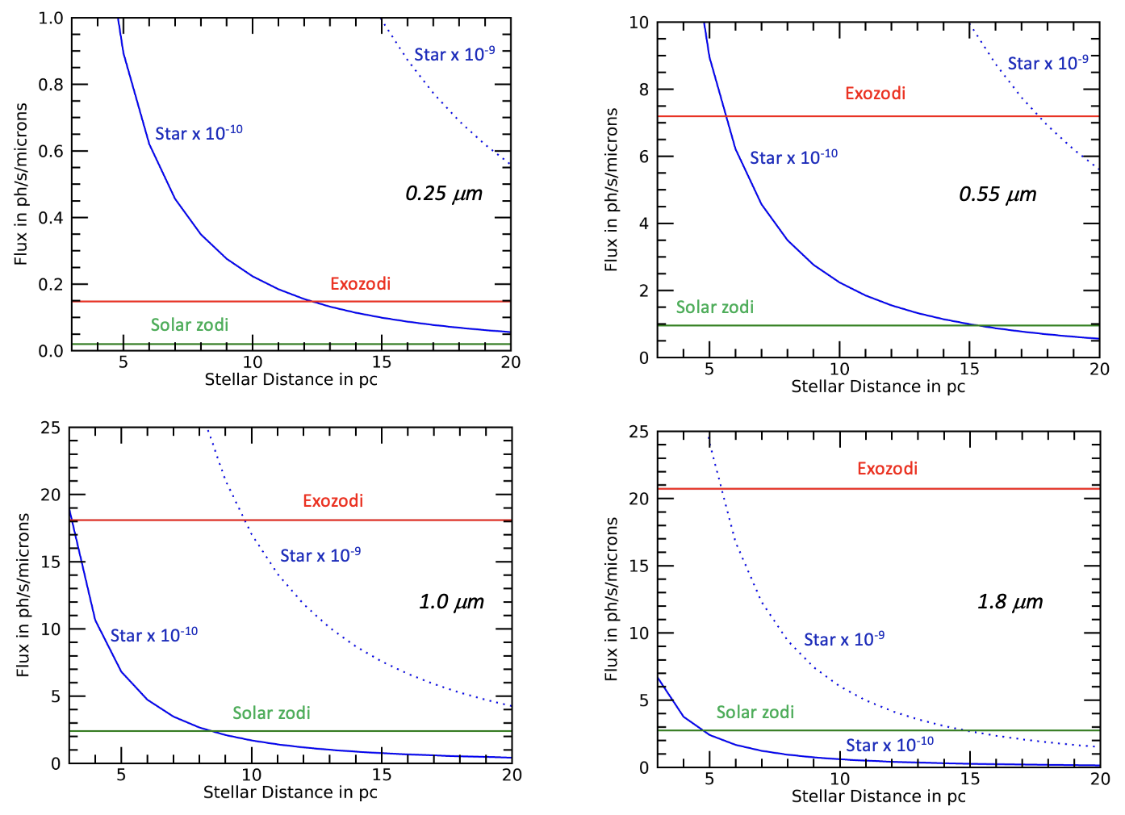
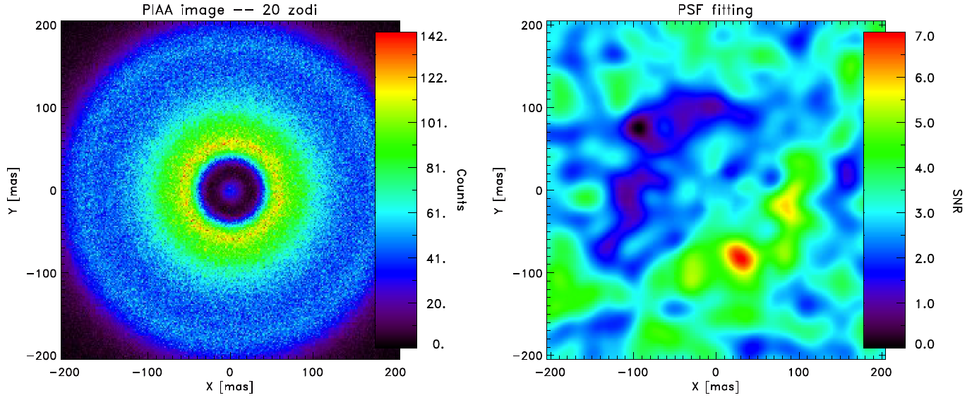
How a Roman coronagraph exozodi survey could impact and benefit HWO
Even at 3x solar, the exozodi background will dominate vis/nir HWO observations and required exposure times (Mennesson et al. 2024)
Typical exozodi brightness measured by LBTI is 3 zodis, with a 95% confidence upper limit of 27 zodis.
A solar zodi like model is assumed to convert excess to exozodi brightness, scaling up from “1 zodi” density at 1 AU (or EEID)
Converting to exozodi level at visible wavelengths also depends on exozodi dust model (albedo, grain size and spatial distributions)
There is evidence, from joint MIR and NIR interferometric measurements that some stars have exozodi dust very different from solar (hot dust phenomenon, Absil et al. 2006 & 2009, Ertel et al. 2014, Mennesson et al. 2011)
Typical exozodi brigthness at HWO wavelengths remains vastly unknown, as well as the magnitude of resonant dust clumps
Roman Coronagraph could conduct a visible coronagraphic survey of HZ exozodi dust around 70 HWO targets in ~3 weeks of observing time, down to 10-100 zodis sensitivity (5σ), depending on demonstrated in-flight performance
20 “zodis” case : bright dust clump is retrieved
instead of planet (Defrere et al. 2012)

Slide 8
BACK-UP SLIDES

Slide 9
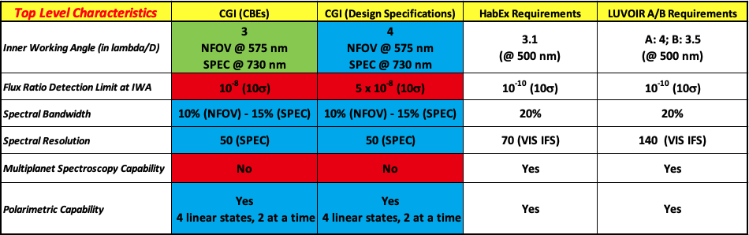
How does the Roman coronagraph performance compare to the needs of future missions? 1. Top Level Characteristics
Comparison of CGI top-level characteristics –current best estimates of performance (CBEs) as of August 2020 and design specifications –
to the corresponding requirements for the HabEx and LUVOIR visible coronagraphs.
For the Roman Coronagraph columns, the color-coding indicates whether its performance (CBE or design specification) is
better ( ), in family with ( ) or significantly worse ( ) than what is required for future missions
“NFOV”: narrow field of view mode. “SPEC”: spectroscopy mode.
From Mennesson, Juanola-Parramon, Nemati et al. 2020, https://arxiv.org/pdf/2008.05624.pdf
Notes:
So the next natural question is: how …
Explain color coding
Invite to read the full ppae ron the archive.
Go throhg first 5 rows one by one
Highlight Flux ratio detection limit; one could stop there and conclude at first sight that…

Slide 10
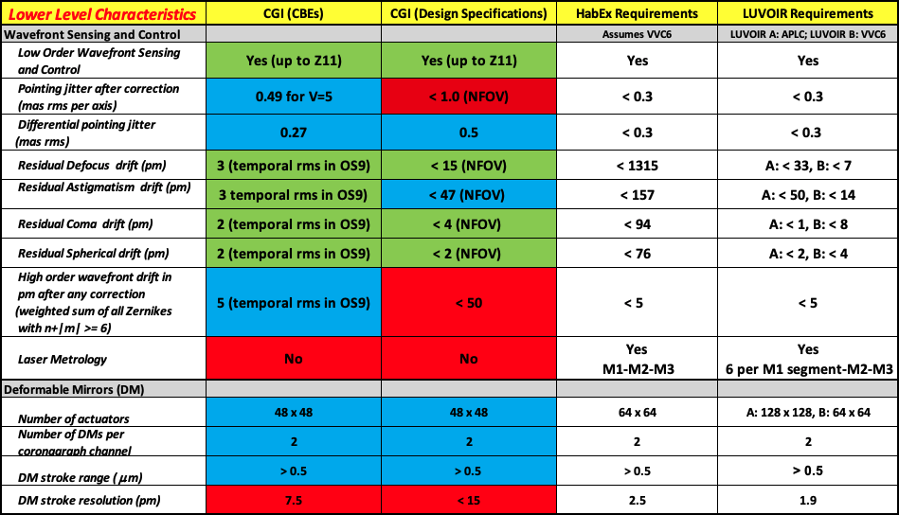
How does the Roman coronagraph performance compare to the needs of future missions? 2. Lower Level Characteristics (WFSC and DMs)
*GITL
Notes:
So the next natural question is: how …
Explain color coding. Go throhg first 5 rows one by one
Highlight Flux ratio detection limit; one could stop there and conclude at first sight that…

Slide 11
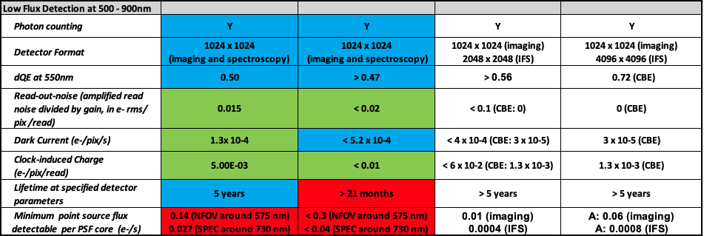
How does the Roman coronagraph performance compare to the needs of future missions? 2. Lower Level Characteristics (detectors)
For the Roman Coronagraph columns, the color-coding indicates whether its performance (CBE or design specification) is
better ( ), in family with ( ) or significantly worse ( ) than what is required for future missions
Notes:
So the next natural question is: how …
Explain color coding. Go throhg first 5 rows one by one
Highlight Flux ratio detection limit; one could stop there and conclude at first sight that…

Slide 12
Conclusion
The detection limits of the Roman coronagraph and of future missions differ by ~ 100X
However, because of the Roman space telescope heavily obscured entrance pupil, its key coronagraph subsystems (incl. pointing jitter control, low-order wavefront control and photon-counting detectors) have to work just as hard to get there, with performance very much in family with the needs of a future exo-Earth imaging mission
This is precisely what makes the Roman coronagraph such a great technology demonstration, in spite of providing more modest detection limits

Slide 13
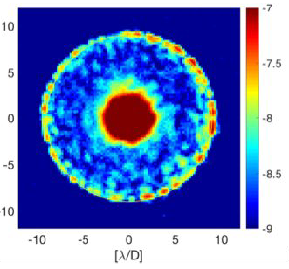
Roman Space telescope Pupil is:
“A pupil that only a mother could find beautiful”
David Spergel, circa 2015
10% bandwidth dark holes reach 5×10⁻⁹ mean
contrast with Roman Hybrid Lyot coronagraph
JPL HCIT Results
Seo, B. et al. 2018
Notes:
So the next natural question is: how …
Explain color coding. Go throhg first 5 rows one by one
Highlight Flux ratio detection limit; one could stop there and conclude at first sight that…

Slide 14
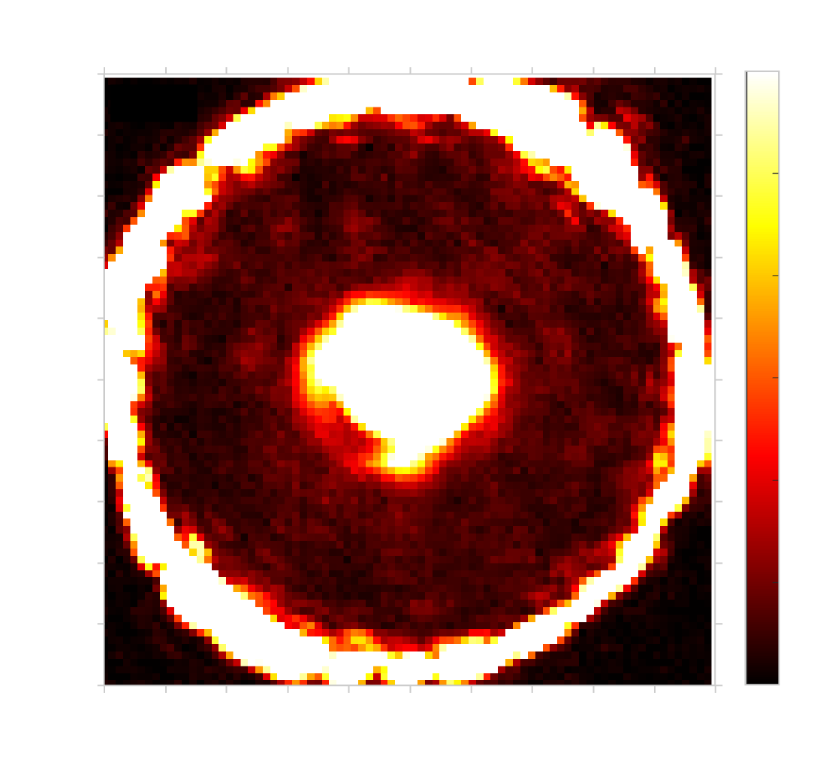
Why? Perfect Pupil for Coronagraphy is:
10% bandwidth dark holes reach 4×10⁻¹⁰ mean
contrast with unobscured monolithic aperture and classical Lyot Coronagraph
Decadal Survey Testbed (DST) HCIT Results
Seo, B. et al. 2019
Notes:
So the next natural question is: how …
Explain color coding. Go throhg first 5 rows one by one
Highlight Flux ratio detection limit; one could stop there and conclude at first sight that…

