Slide 1
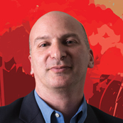

WHO
HOW
HWO
The Road To The Habitable Worlds Observatory
David Ciardi
Deputy Director, Senior Research Scientist
NASA Exoplanet Science Institute, Caltech/IPAC
Previously
Chief Scientist, NASA Exoplanet Science Institute
Assoc. Research Scientist, Asst. Research Scientist, Asst. Staff
Assistant Scientist, University of Florida
Postdoctoral Research Scientist, University of Florida
Postdoctoral Research Scientist, University of Wyoming
- - - - - - - - - - - - - - - - - - - - - - - - - - - -
PhD, Physics, University of Wyoming
BA, Astronomy and Physics, Boston University

Slide 2
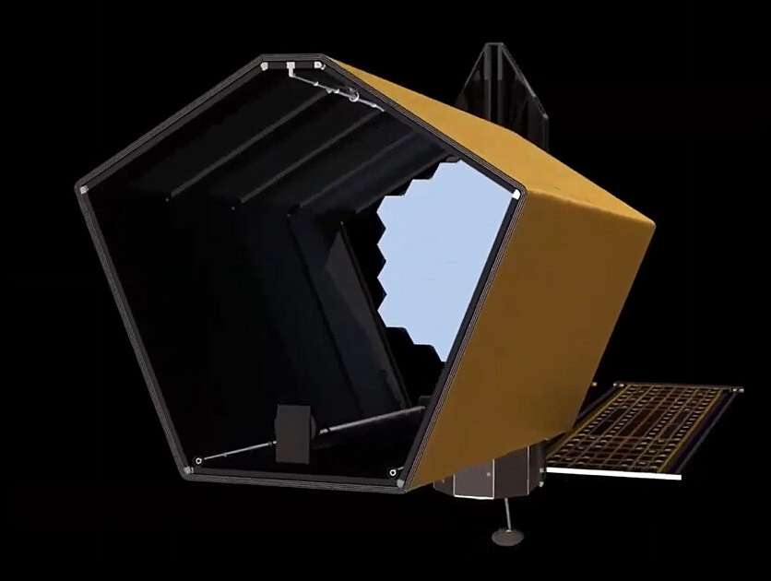
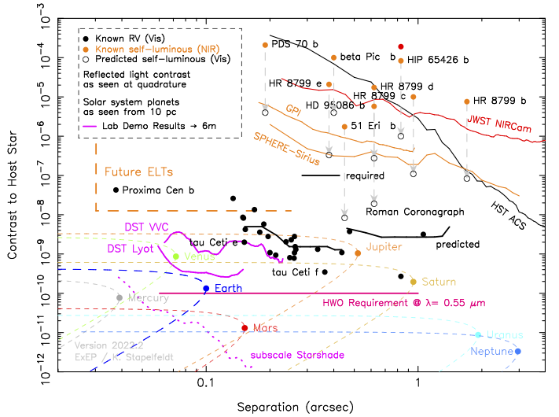
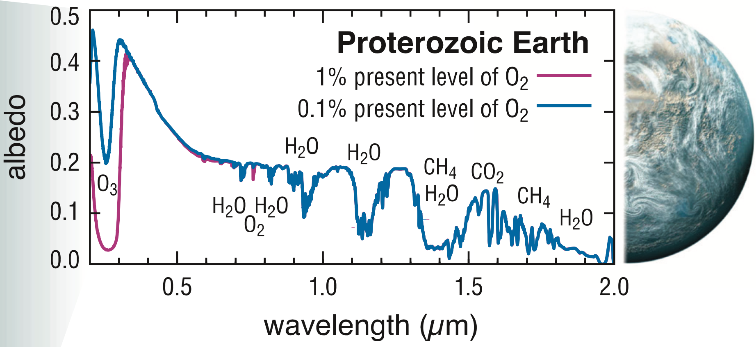

Slide 3
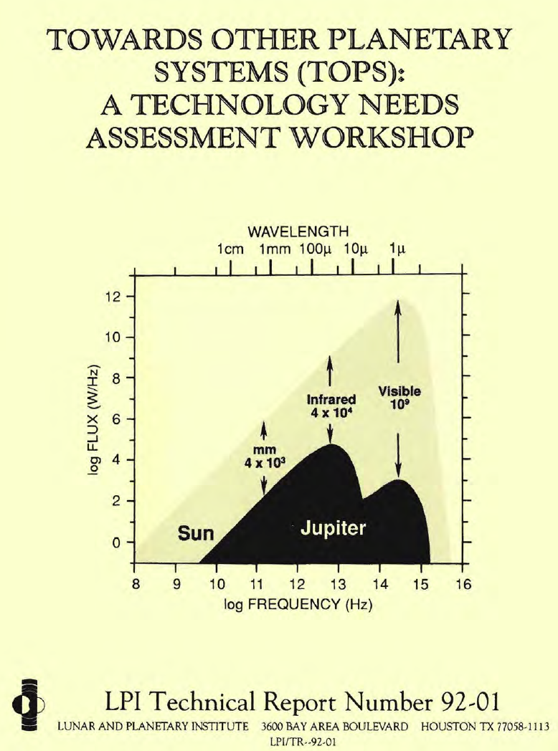
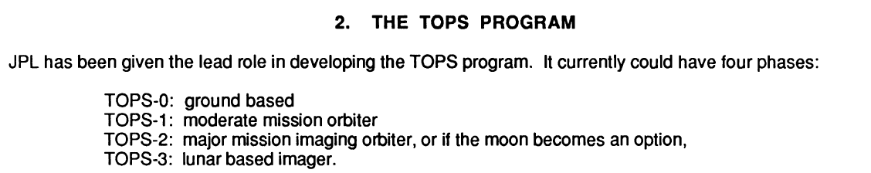
1988-1992

Slide 4
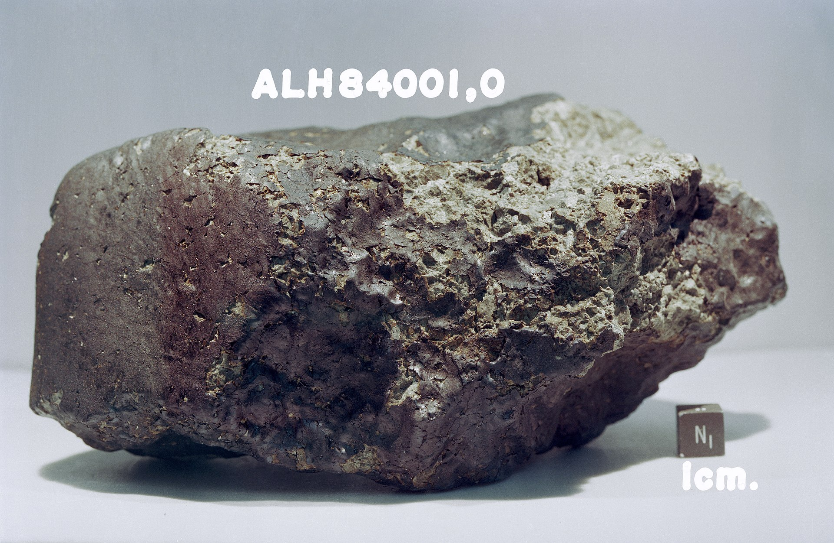
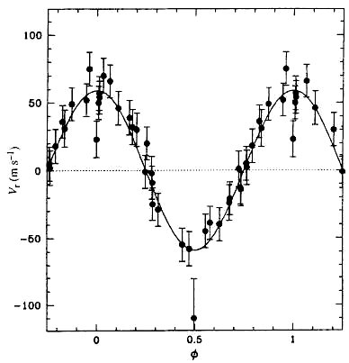
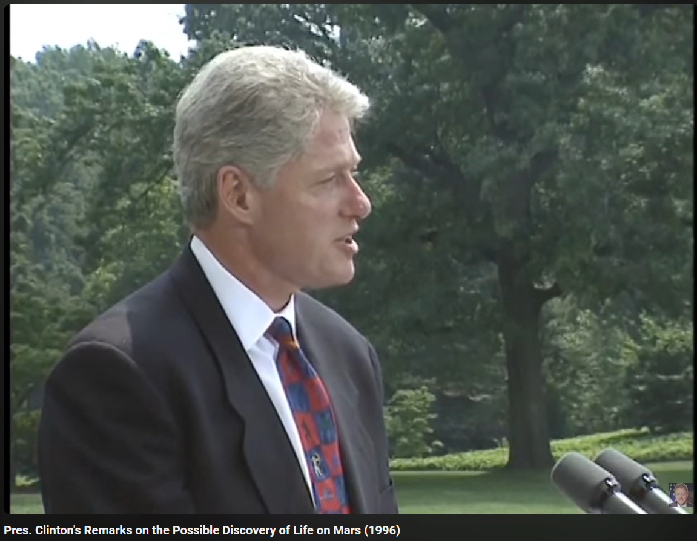
Mars Rock and Discovery of 51 Peg
Galvanized the community and NASA to go fund and find Earth-like planets around near-by stars
  1996

Slide 5
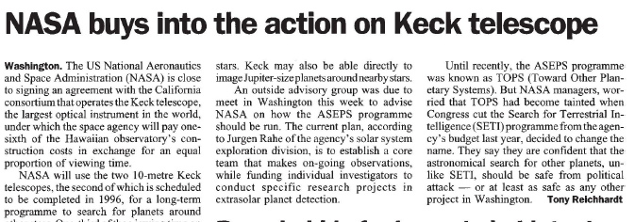
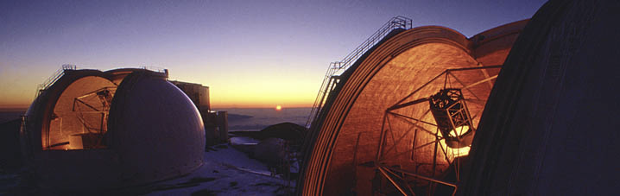
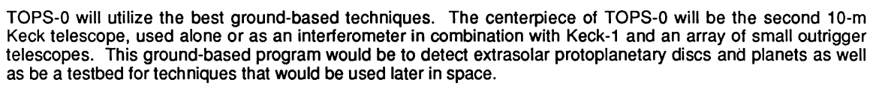
  1996

Slide 6
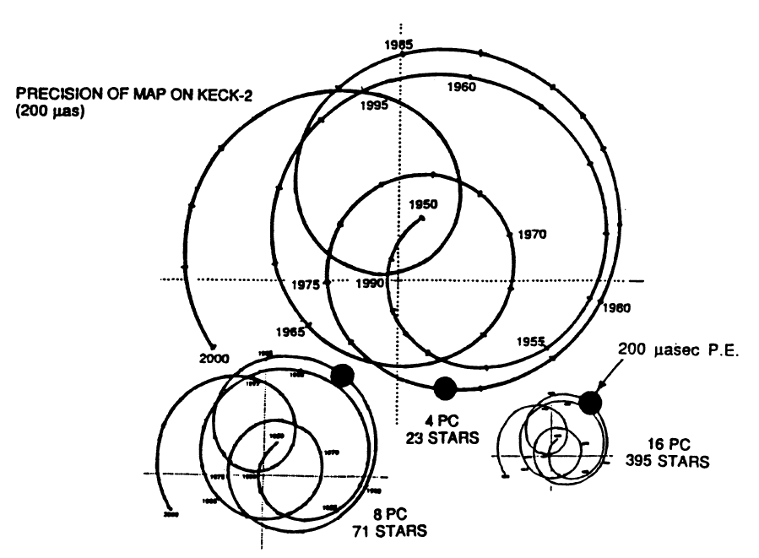
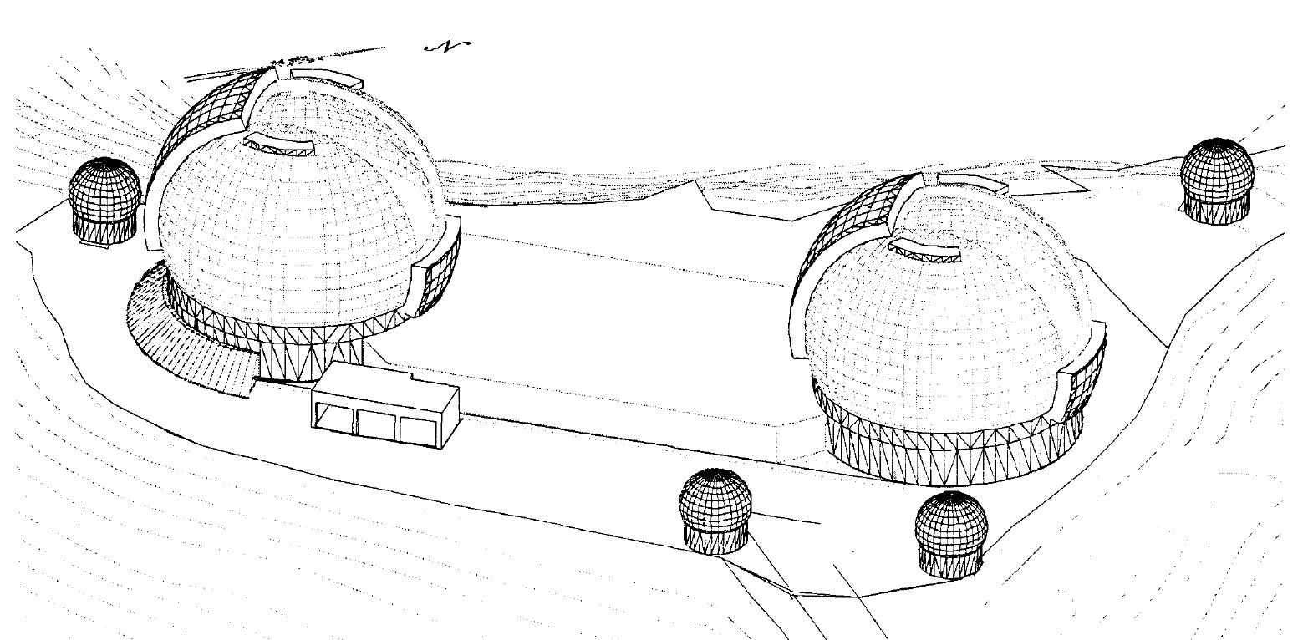
  Astrometric Planet Hunting with Keck Interferometer
  1996-2012

Slide 7
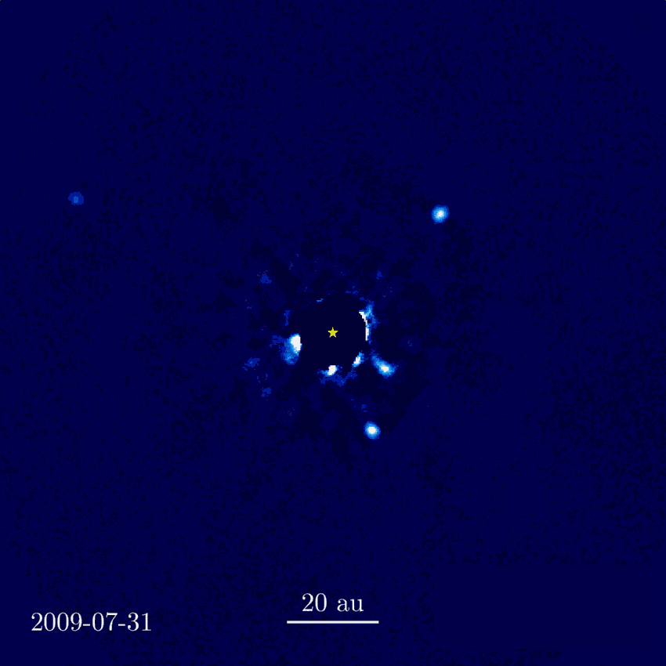
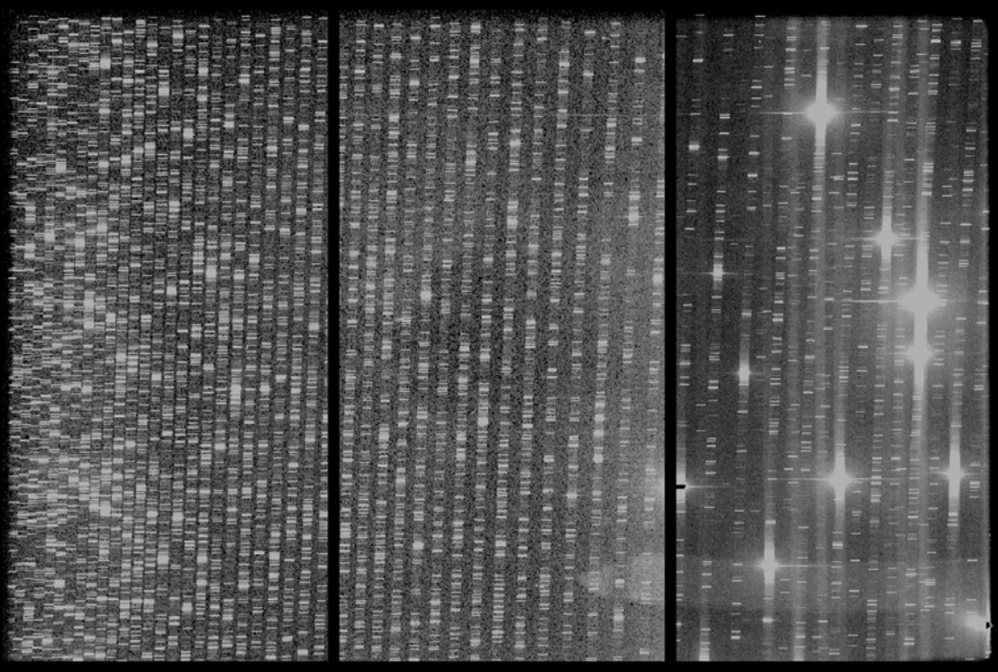
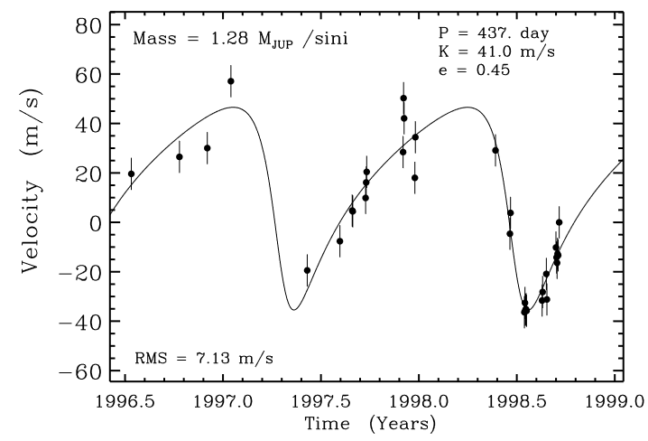
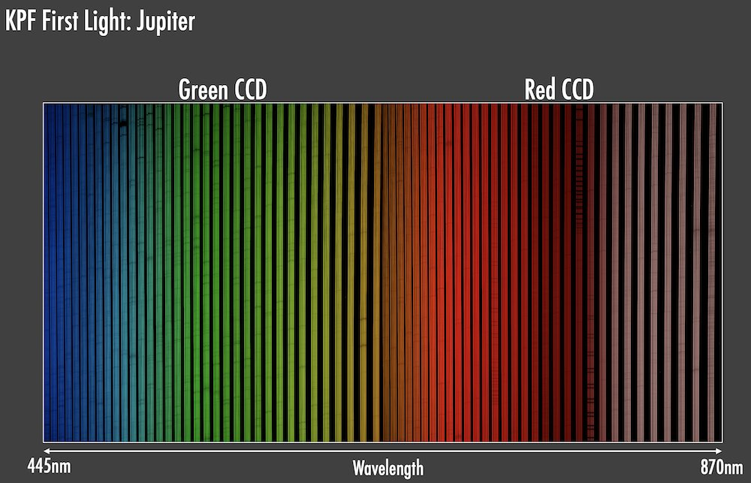
  NASA-Keck Partnership Continues Today

Slide 8
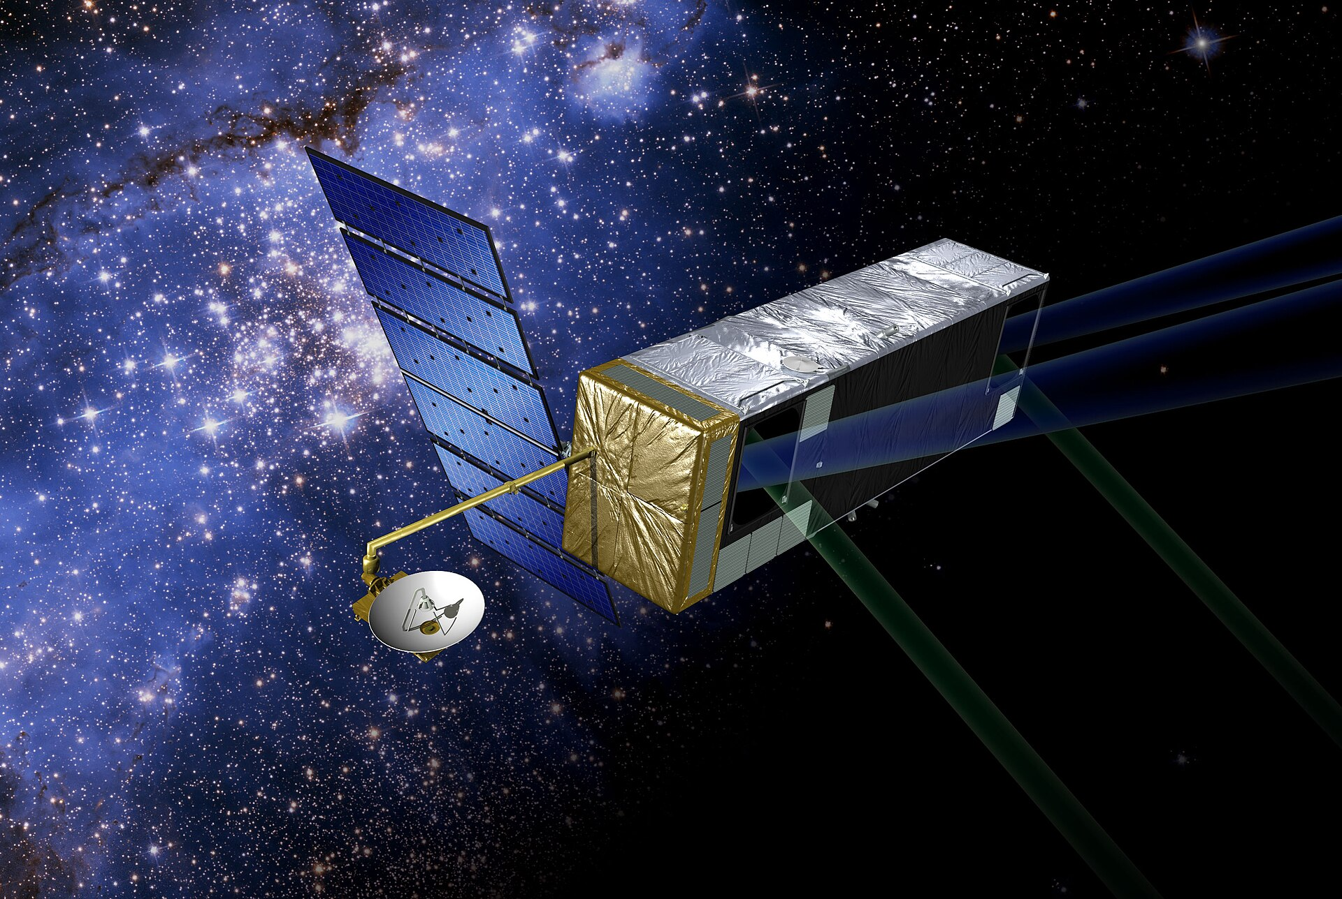
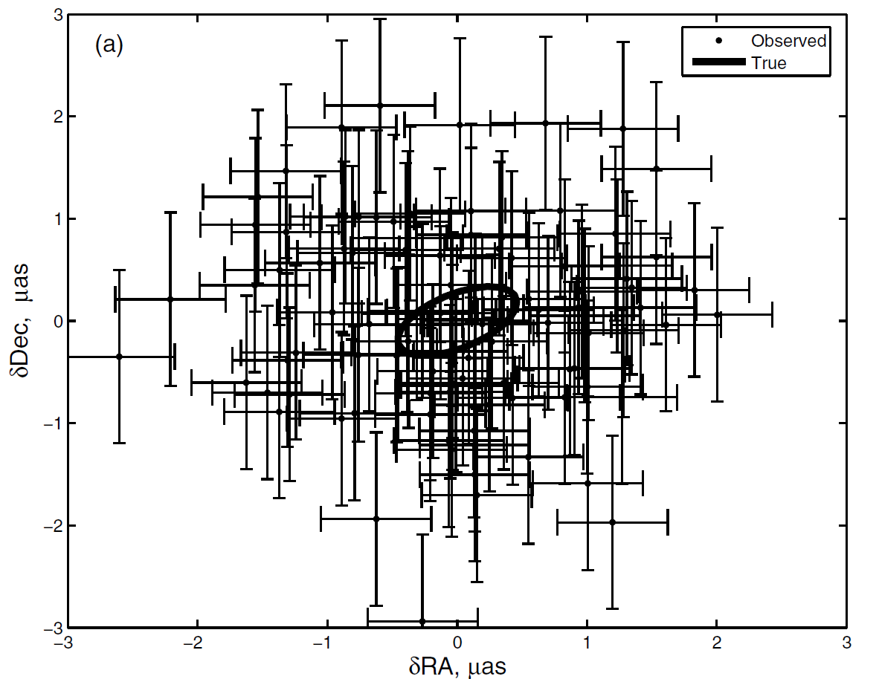
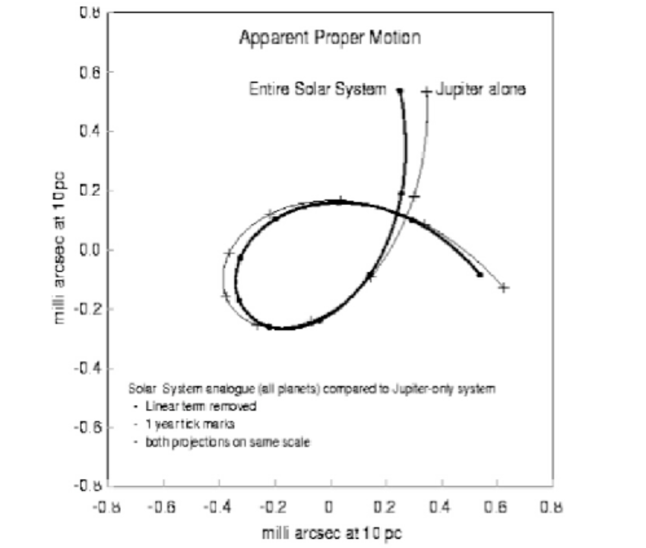
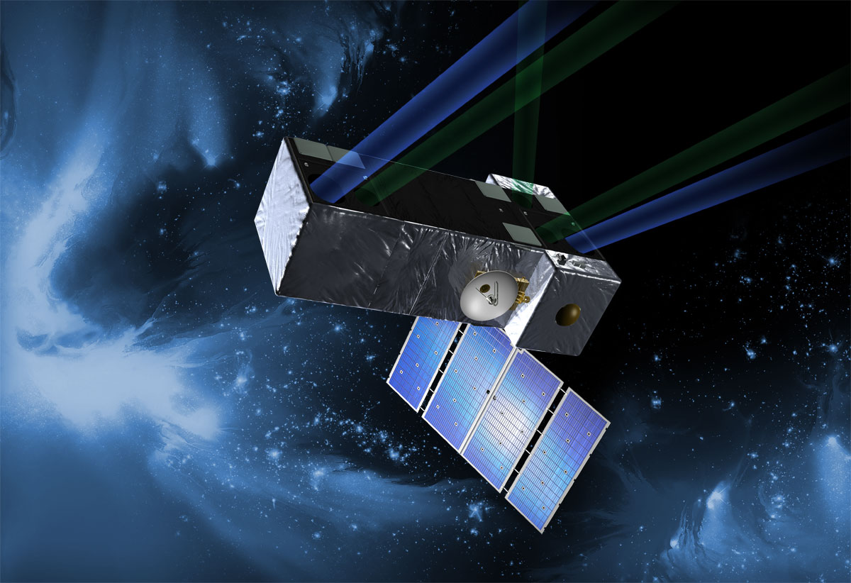
  Space Interferometry Mission
  Discovery and masses for 50-60
  Earth-mass planets
  within 50pc
  1990-2010

Slide 9
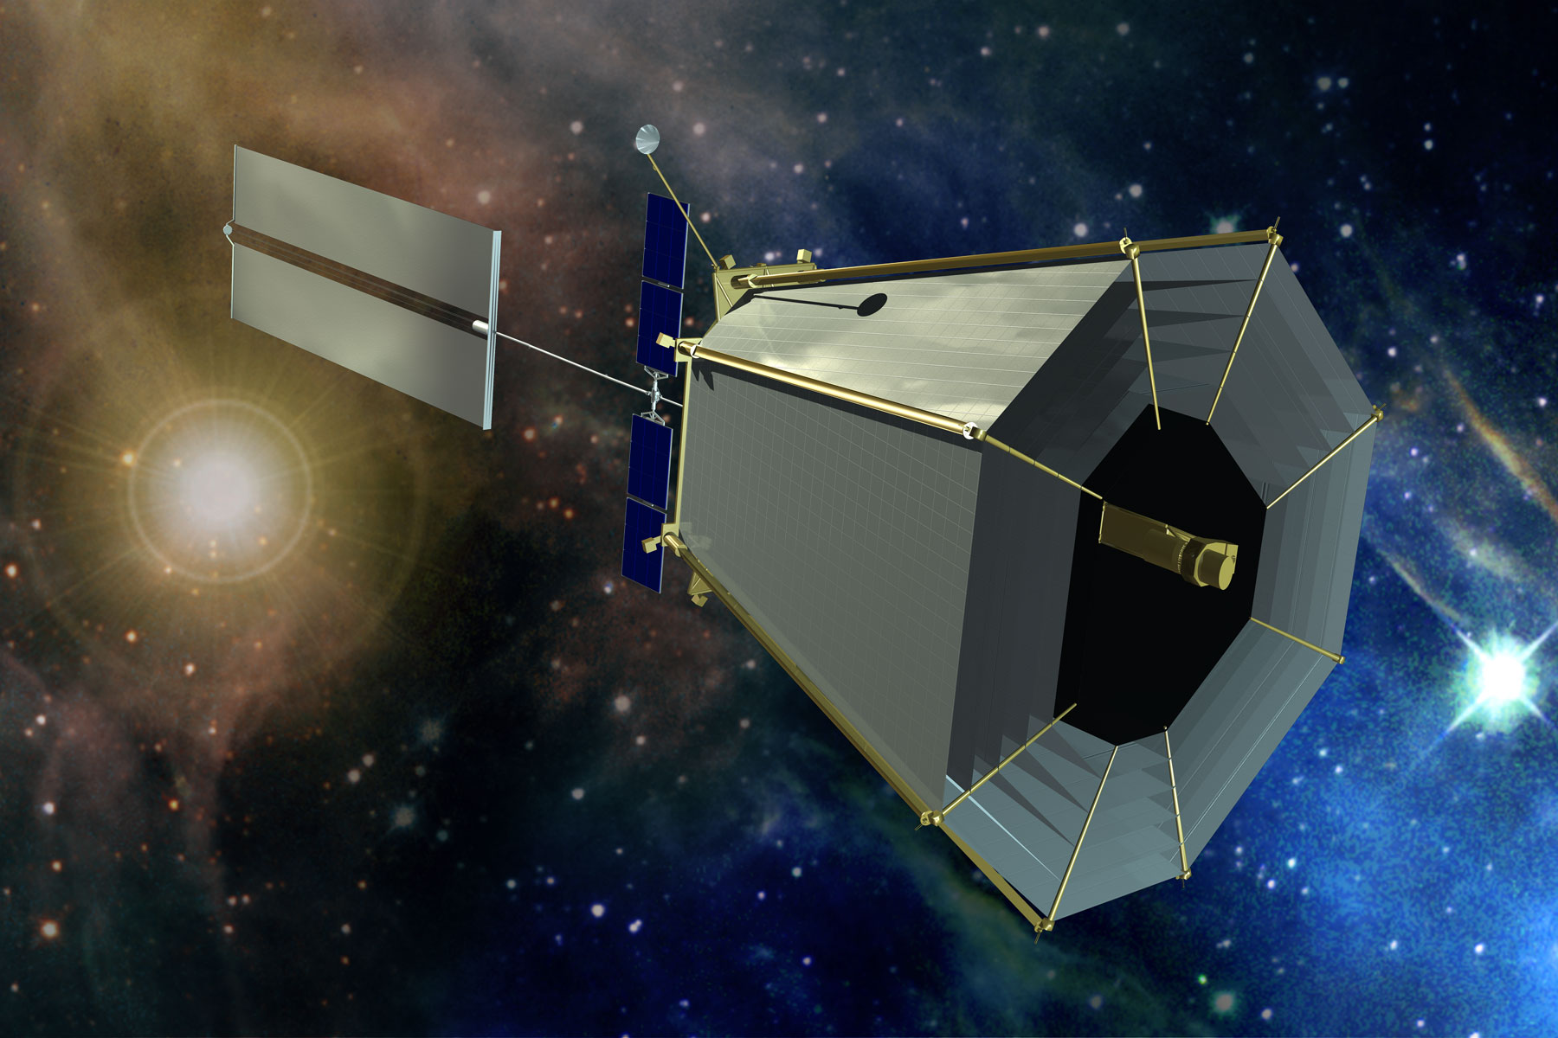
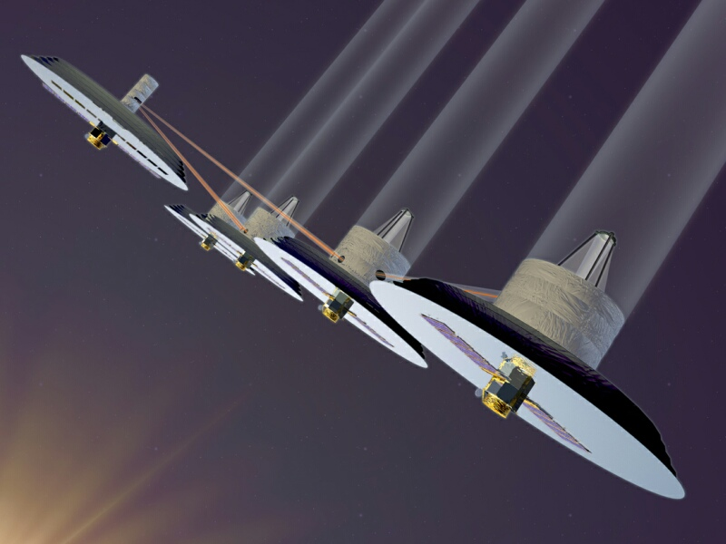
  Terrestrial Planet Finder (TPF)
  TPF-Coronagraph (optical) TPF-Interferometer/Darwin (IR)
  1990-2010

Slide 10
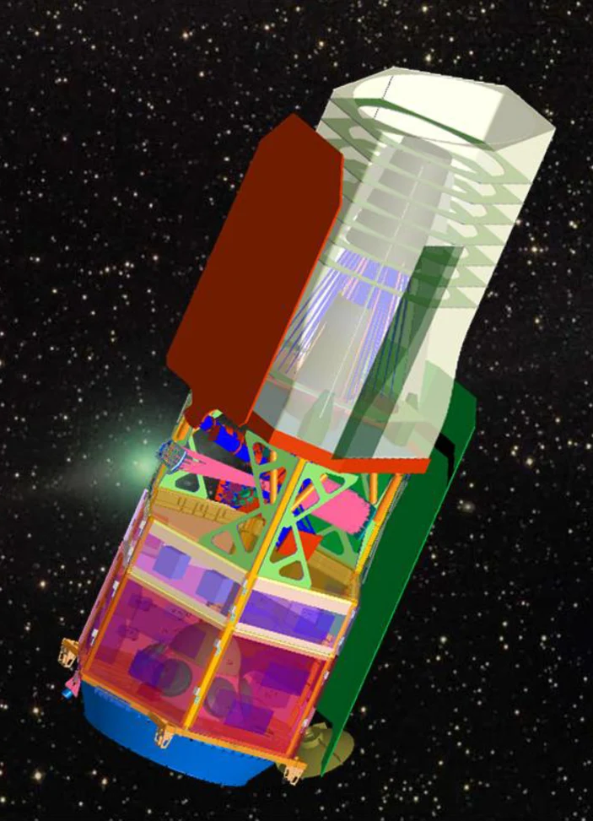
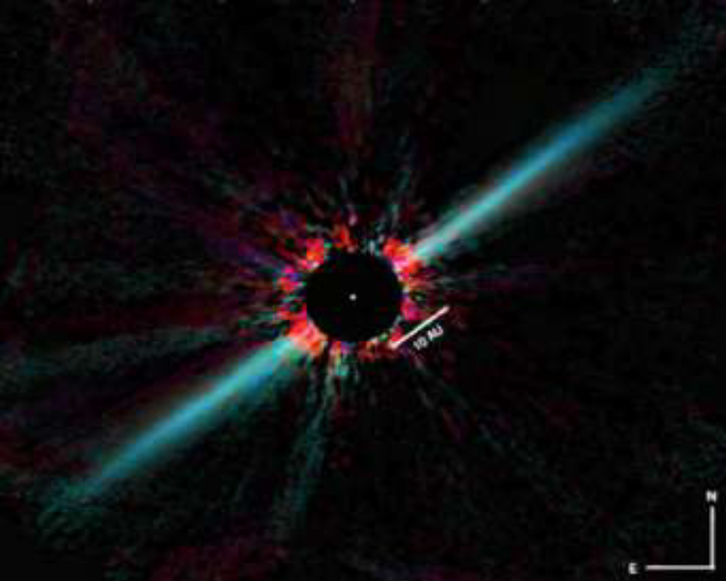
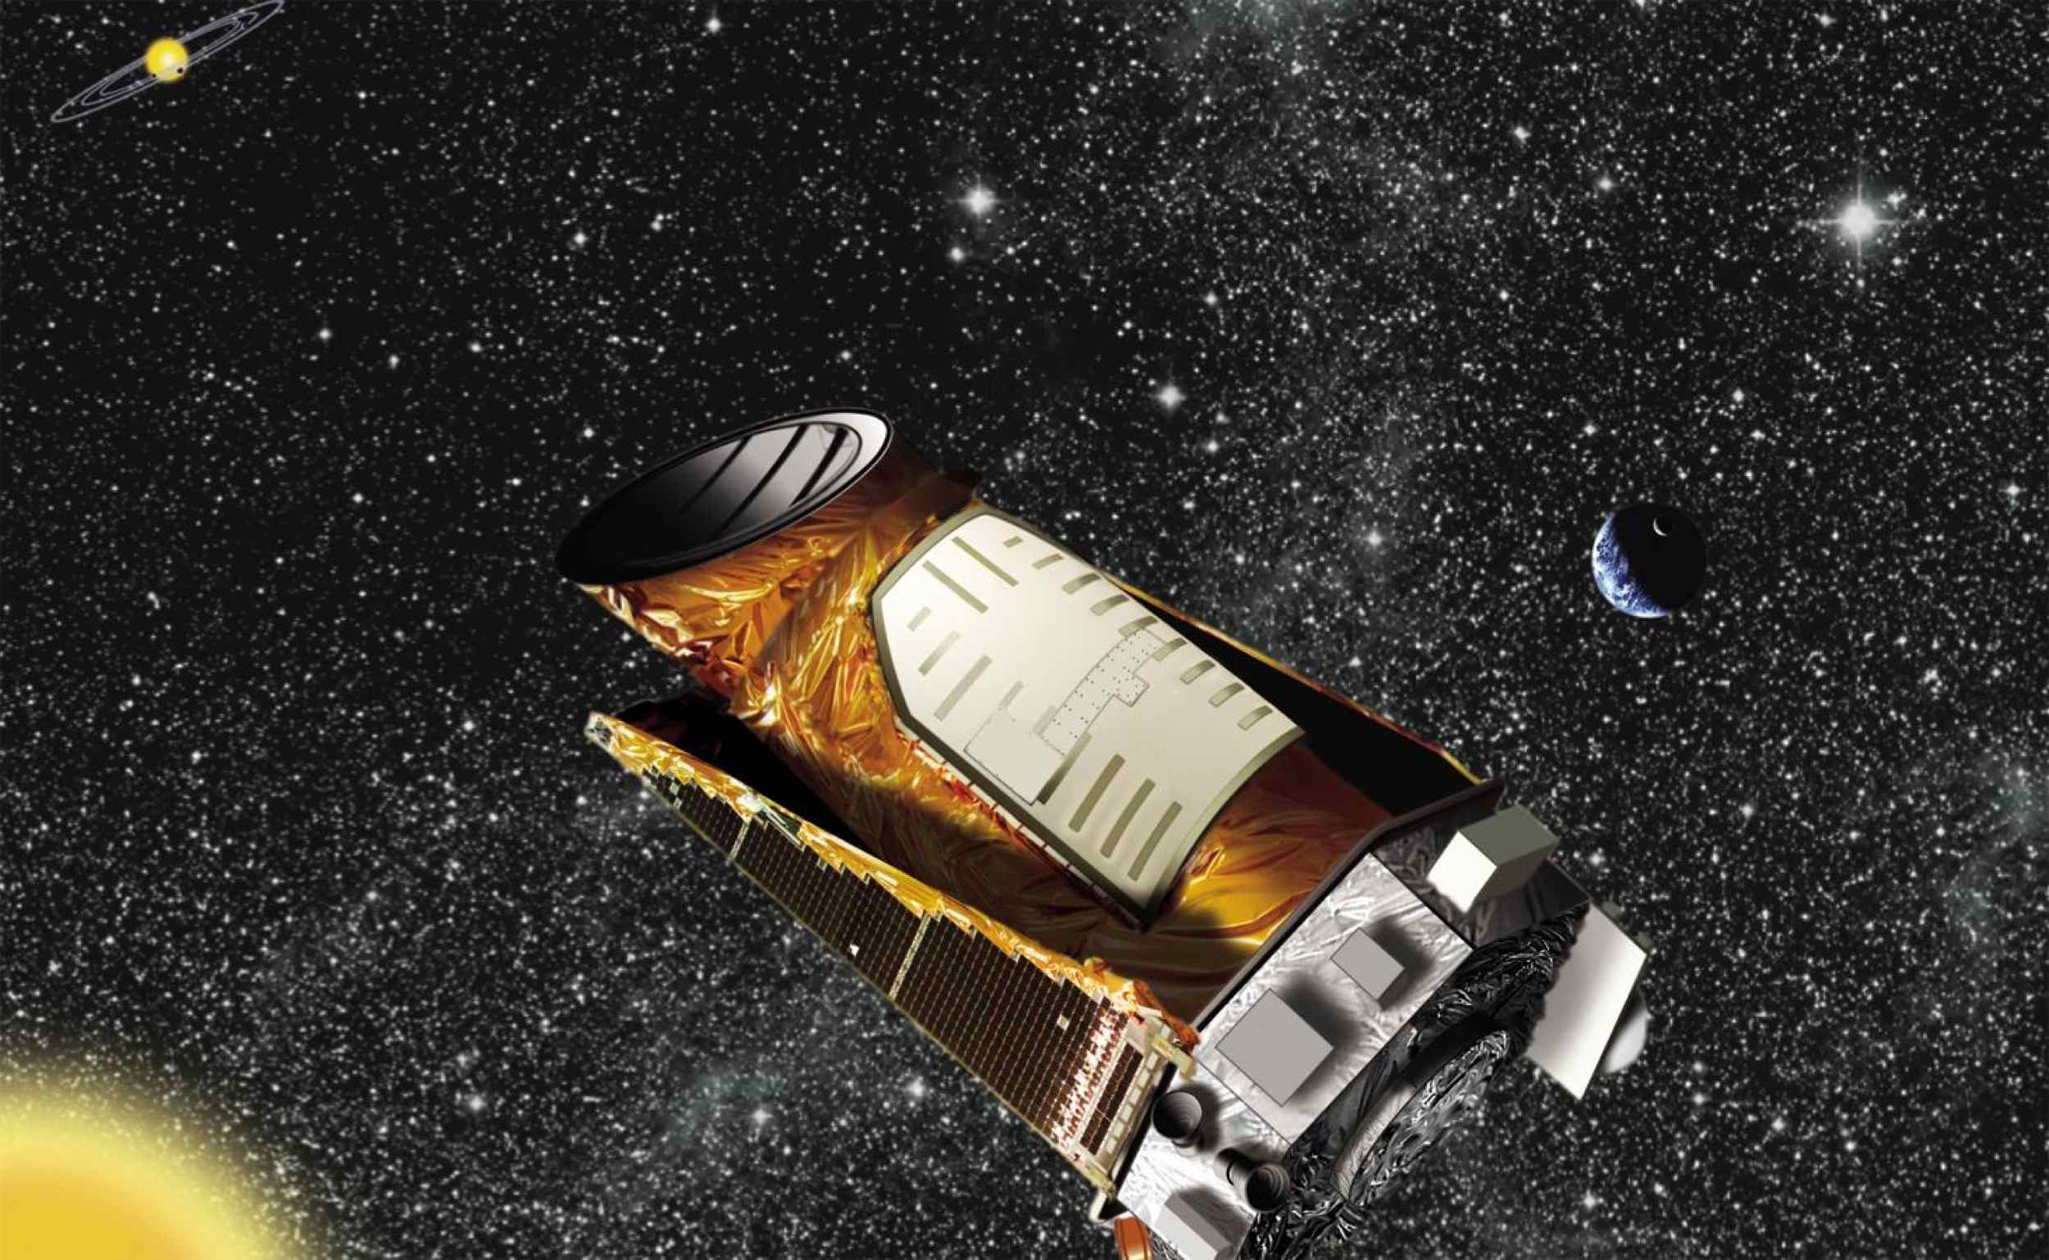
WFIRST
1.3m
  2010 Decadal
  Endorsed JWST and WFIRST
  Canceled SIM and TPF
  Recommended more science and technology development
“Understand frequency of different types of planets and lay scientific and technical groundwork to inform future strategies for detailed study of nearby Earth-like planets”
  2010

Slide 11
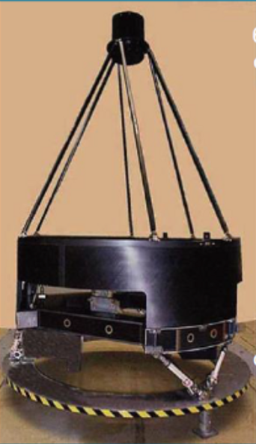
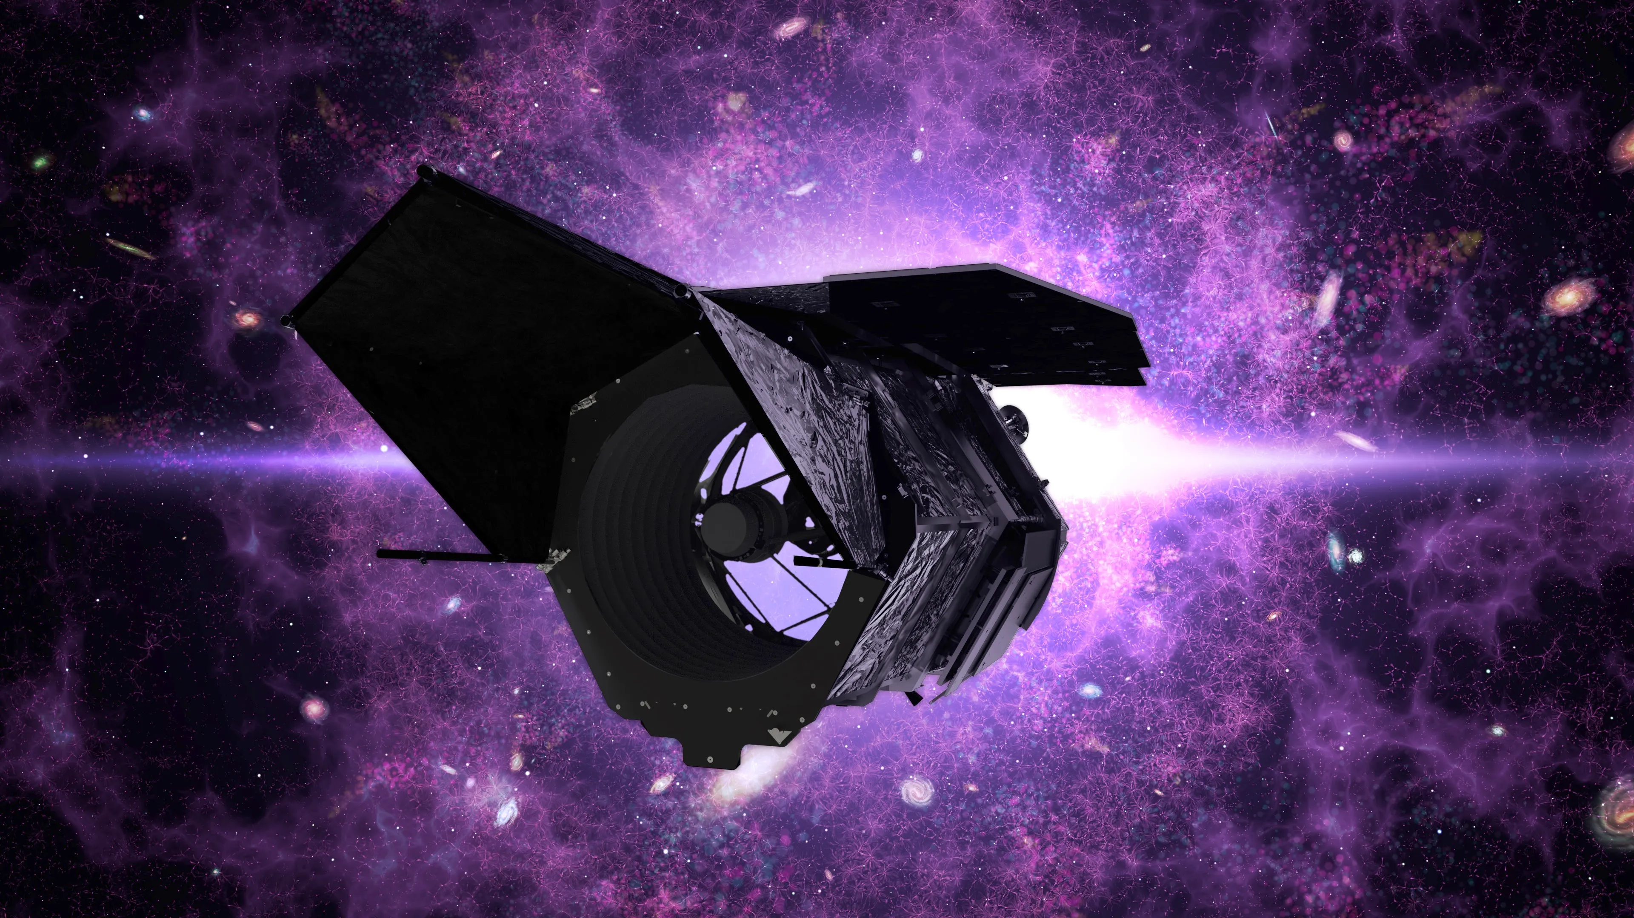
WFIRST
1.3m
  Partnership between NASA and NRO Enabled Addition of the Coronographic Imager (CGI) to become Roman
2.4 m
  2014

Slide 12
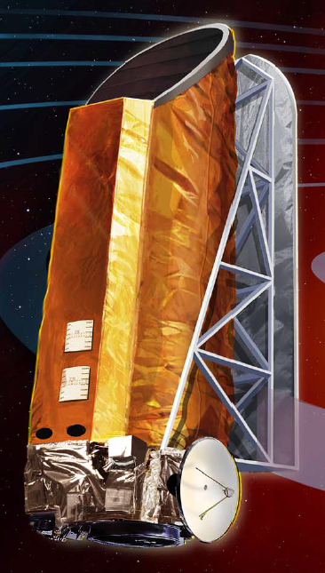
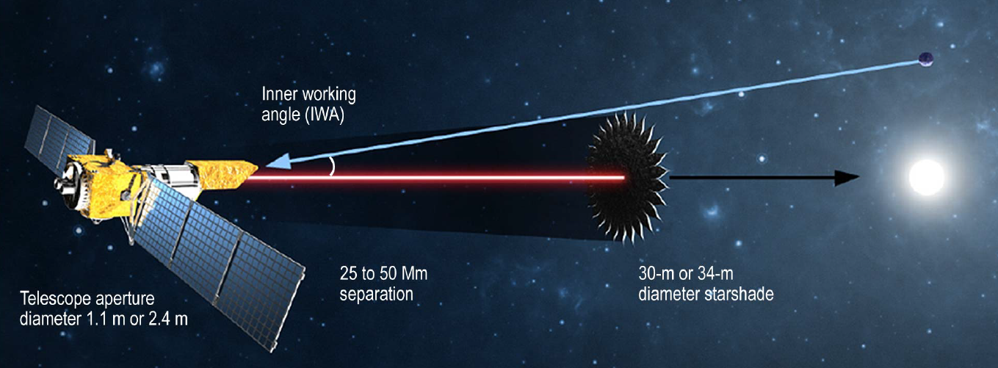
  Exo-C and Exo-S
  Coronagraph and Starshade Concepts
  2013-2015

Slide 13
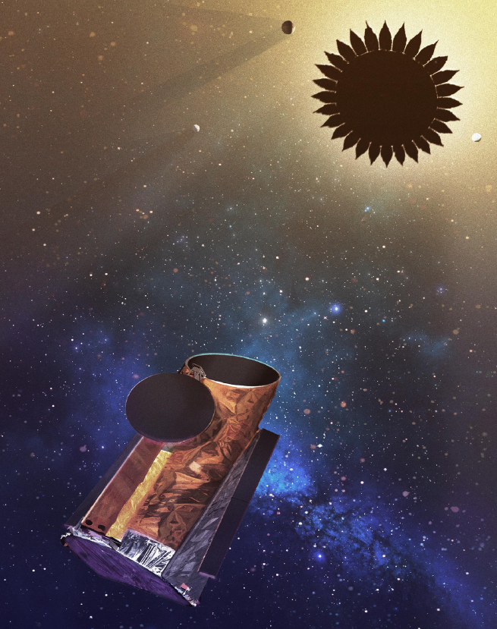
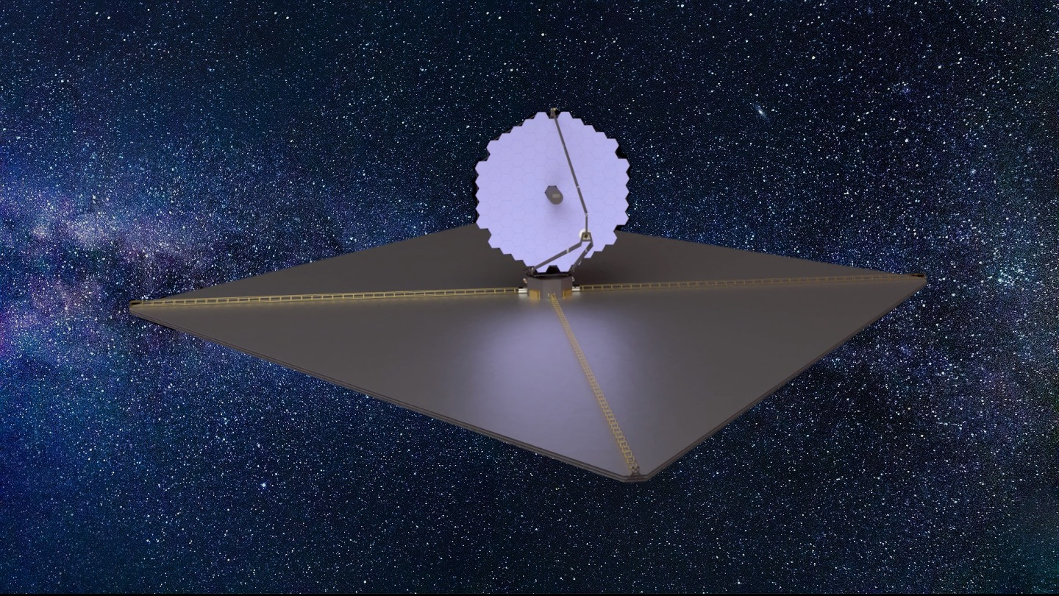
  HabEx and LUVOIR
  Coronagraph and Starshade Concepts in support of 2020 Decadal
  2018-2020

Slide 14
  Habitable Worlds Observatory
  2022-

Slide 15
Some Final Thoughts
TOPS was first comprehensive plan that laid the foundation for HWO – this has already been a 30-40 year quest
Technology development outlasts the missions
  TPF-C → Exo-C/S → HabEx/LUVIOR → HWO
  Keck-I → SIM → TPF-I /Darwin→ LIFE
Masses are still a challenge
  EPRV and astrometry
  If SIM had flown, we would know where to point HWO
Mission development is long process that builds on the technological and scientific work, in the lab, on the ground, and in space, that proceeds it
Today’s science leads to tomorrow’s missions

