Slide 1


Working with NASA
PROTO-Sagan Workshop
Pasadena, CA – July 19, 2024
Hannah Jang-Condell
Program Scientist, Astrophysics Division & Planetary Sciences Division
Science Mission Directorate, NASA Headquarters

Slide 2
My career path
Education:
  BS Physics (Minor in Biology), MIT 1997
  MA Astronomy, Harvard 1999
  PhD Astronomy, Harvard 2004
Postdocs:
  Carnegie Fellow, Carnegie Institution for Science, DTM 2004-2007
  Michelson Fellow, University of Maryland & NASA GSFC 2007-2010
  Postdoc, Space Telescope Science Institute 2011
Faculty
  Assistant Professor, University of Wyoming, 2011-2017
  Associate Professor, University of Wyoming, 2017-2021
NASA Headquarters
  Program Scientist (IPA), NASA HQ, 2020-2021
  Program Scientist (Civil Servant), NASA HQ, 2022-present

Slide 3
My current job
NASA Headquarters (HQ)
Science Mission Directorate (SMD)
Astrophysics Division & Planetary Science Division (APD & PSD)
Program Scientist

Slide 4
NASA Science Mission Directorate (SMD)
Planetary Sciences Division
(PSD)
Astrophysics Division
(APD)
Biological & Physical Sciences
(BPS)
Heliophysics Division
(HPD)
Earth Science Division
(ESD)

Slide 5
NASA APD Program Offices
NASA
Exoplanet Exploration
(ExEP)
Program office at JPL
Physics of the Cosmos
(PhysCOS)
Program office at GSFC
Cosmic Origins
(COR)
Program office at GSFC
ExoPAG
PhysPAG
COPAG
Program Analysis Groups (PAGs): community-based forums for soliciting and coordinating community input
science interest groups (SIGs)
science analysis groups (SAGs)
findings
More about the ExoPAG: https://exoplanets.nasa.gov/exep/exopag/overview

Slide 6

NASA PSD Analysis/Assessment Groups
Mapping and Planetary Spatial Infrastructure Team (MAPSIT)
Mars Exploration Analysis Group (MEPAG)
Outer Planets Assessment Group (OPAG)
Extraterrestrial Materials Analysis Group (ExMAG)
Small Bodies Assessment Group (SBAG)
Venus Exploration Analysis Group (VExAG)
Lunar Exploration Analysis Group (LEAG)
Mercury Exploration Assessment Group (MExAG)

Slide 7



RESEARCH
~365 U.S. Science PIs Funded
~130 Individual Institutions Selected
~$145M Awarded Annually
SMALLSATS/CUBESATS
4 Science Missions Launched
1 Mission complete
3 Operating/commissioning
1 ISS-attached Science Mission
10 Science Missions in Development
8 Free-flying CubeSats
1 ISS-attached Science Mission
1 Supporting Technology Development Project
TECHNOLOGY DEVELOPMENT
~$160M Invested Annually
REFEREED PUBLICATIONS
>23,432 Total Publications
(2019-Current)
>21,249 Hubble Publications
(1991-Current)
>542 Webb Publications
(July 2022-Current)
SOUNDING
ROCKETS
16 Science Missions Launched (Suborbital)
6 In Development
BALLOONS
23** Suborbital Balloons Launched
**Includes APD, HPD, PSD, ESD, educational, & engineering missions
22 Missions in Development
MISSION SUMMARY
15* Missions Operating
17* Missions in Development
2 Tech. Demos
*Including international
Notes:
From Oct. 2023:
JWST – 542 total
Missions Development do not include CGI (separate from Roman) and CANDLE.
PUBLICATIONS
SWIFT - 2,131
FERMI – 2,390
TESS – 1,665
Webb - 542
Hubble – 5,101 (2019-2024).
Chandra – 2,062
XMM – 2172
NuStar – 902
NICER – 881
IXPE - 65
SOFIA (terminated in 2022) 244
KECK- 1,604. Spitzer – 205
Kepler/K2 – 2500
WISE – 968 (ADS search)

Slide 8
What does a Program Scientist Do?
Manage Research and Analysis (R&A) grant programs (e.g. ADAP, ATP, APRA, XRP)
Oversee Mission Development, Implementation, and Operation (from CubeSats to Explorers to flagships)
Strategic planning
Communicate with PIs and proposers
Implement NASA policies
Accounting

Slide 9
My duties
XRP (Exoplanets Research Program)
Exoplanet Exploration Program
TESS
Ariel
ExoPAG Executive Secretary
Explorers (MIDEX & MO)
FINESST (Future Investigators in Earth and Space Sciences)
SMD (Science Mission Directorate) IDEA (Inclusion, Diversity, Equity, & Accessibility) Working Group

Slide 10
What can a program officer do for you?
What I do | What I can’t do
Manage review panels | Evaluate proposals
Recommend proposals for selection | Select proposals (done by selecting official)
Tell you whether your proposal is relevant to my call, or help you figure out where to submit it | Tell you whether your proposal has merit
Debrief you on your proposal evalution | Unilaterally change your proposal evaluation

Slide 11
How do I get funding from NASA?
Be part of a mission (see Keith Grogan’s presentation)
Get a research grant (Research and Analysis = R&A)
  Research Opportunities in Space and Earth Science = ROSES
  Released on or about February 14 every year
  ROSES-2024: https://science.nasa.gov/researchers/solicitations/roses-2024/research-opportunities-in-space-and-earth-science-roses-2024-to-be-released-february-14-2024/

Slide 12
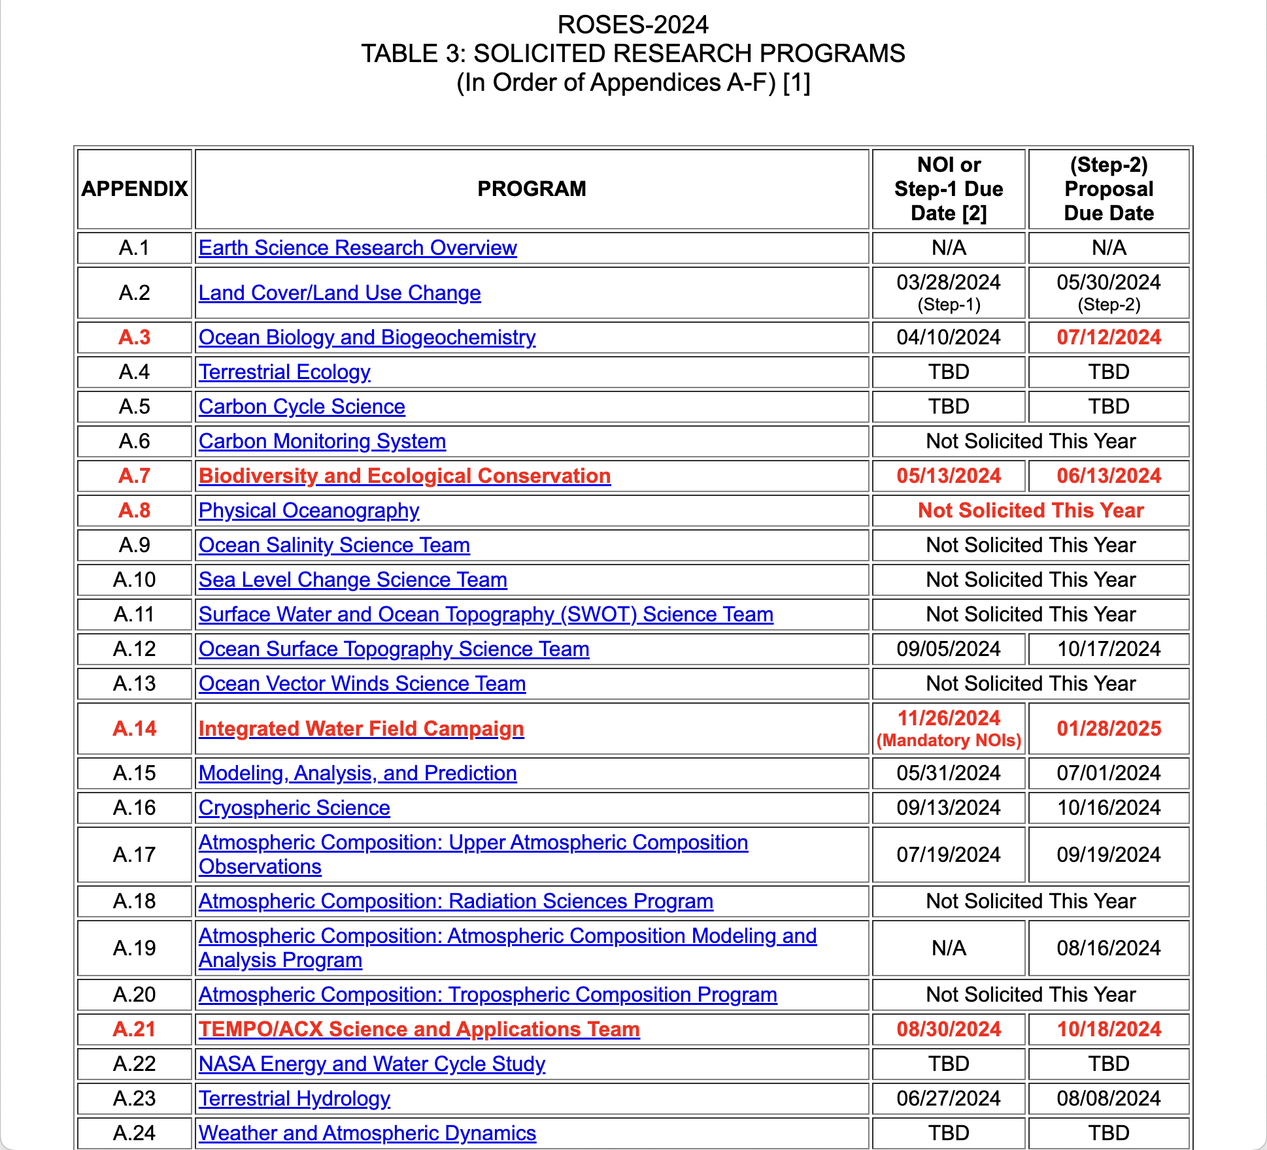
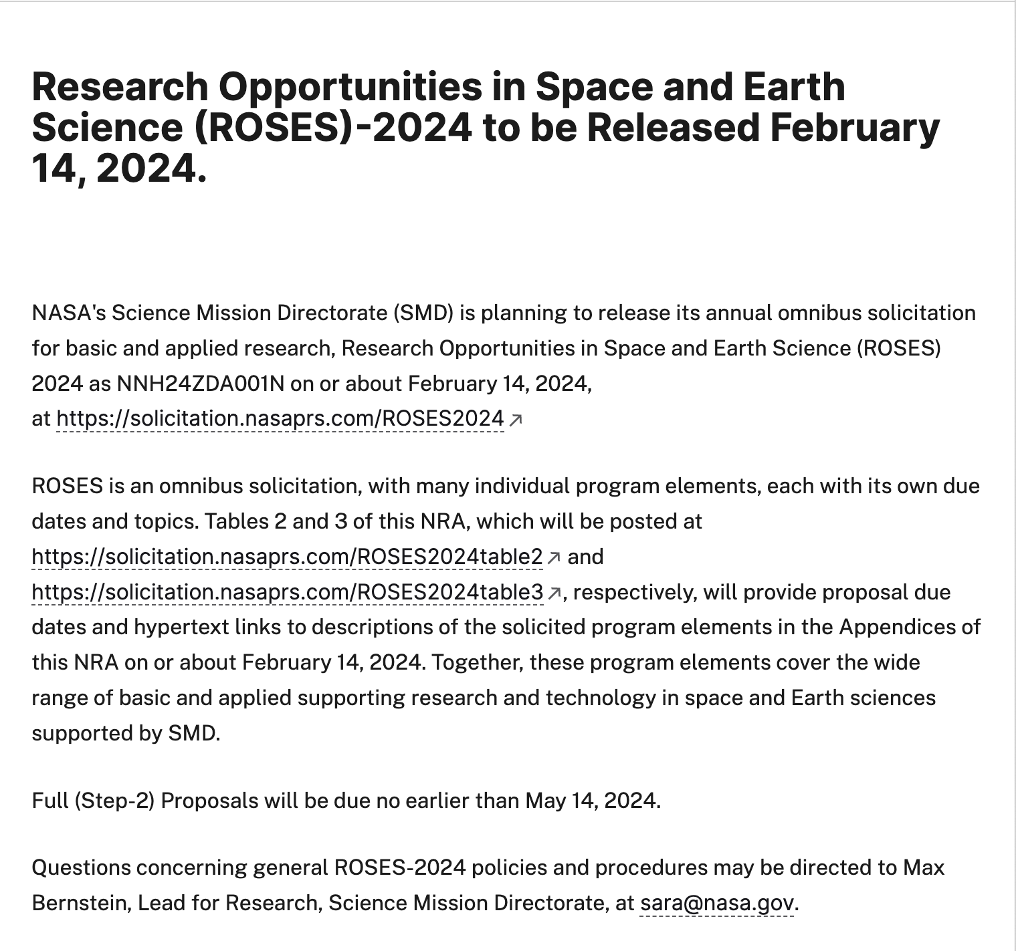

Slide 13
How do I learn to write a good proposal?
Attend a workshop
  SMD Proposal Writing Workshop: https://www.jpl.nasa.gov/go/proposalworkshop
Participate in a review panel
  Grad students can be executive secretaries

Slide 14
Volunteer to Serve on a NASA Peer Review Panel
Personal professional development:
See how the whole review process works
Learn what constitutes excellent proposals
Network with your professional colleagues and NASA scientific staff
Institutional achievement:
Improve at competing for NASA money
Increase knowledge of NASA’s research and technology programs
Investment in the future:
Help select the most transformative science
Ensure that all proposals receive a fair and competent review
All reviewers receive an honorarium from NASA
Sign up to be a panel reviewer:
https://science.nasa.gov/researchers/volunteer-review-panels
or contact a NASA program officer (for contact info, see
https://science.nasa.gov/researchers/sara/program-officers-list)

Slide 15
Stay Connected with NASA
NSPIRES mailing list – information about NASA solicitations
https://nspires.nasaprs.com/
Cosmic Origins mailing list, Exoplanet Exploration mailing list, Physics of the Cosmos mailing list – information about NASA missions and science
https://cor.gsfc.nasa.gov/cornews-mailing-list.php
https://exoplanets.nasa.gov/exep/exopag/announcementList/
https://pcos.gsfc.nasa.gov/pcosnews-mailing-list.php
NASA Astrophysics Federal Advisory Committees
Astrophysics Advisory Committee (APAC)
https://science.nasa.gov/researchers/nac/science-advisory-committees/apac
NASEM Committee on Astronomy and Astrophysics (CAA) http://sites.nationalacademies.org/bpa/bpa_048755
Astronomy and Astrophysics Advisory Committee (AAAC)
https://www.nsf.gov/mps/ast/aaac.jsp

Slide 16
Questions?

Slide 17
Backup Slides

Slide 18
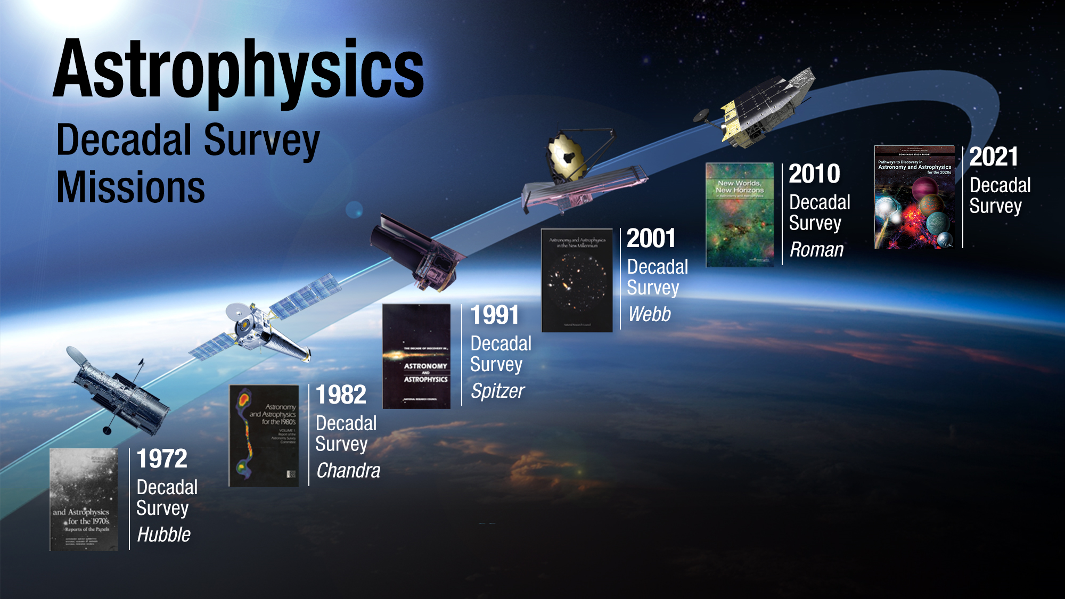

Slide 19
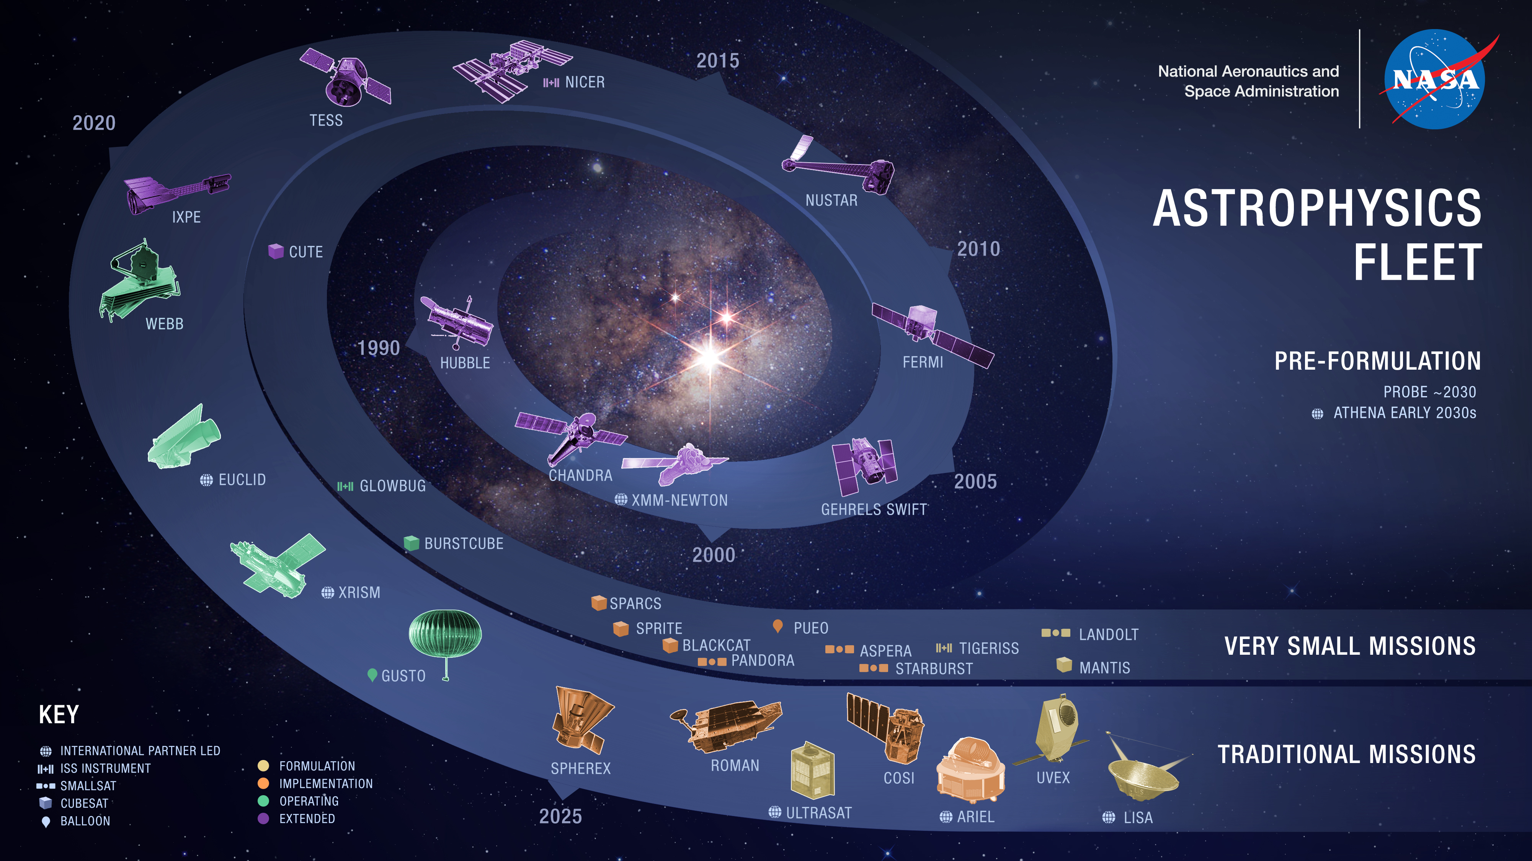

Slide 20
What skills does a program scientist need?
Subject matter expertise
Ability to manage multiple projects and tasks at once
Attention to detail
Task-oriented
Willingness and ability to learn new things
People skills
Ability to use spreadsheets

Slide 21
What do I like about being a program scientist
Learning about the latest and greatest cool science being done
Enabling the latest and greatest cool science
Being task-oriented
Listening to the US astronomy community
Working from within NASA to make the astronomy community as a whole more diverse and inclusive

Slide 22
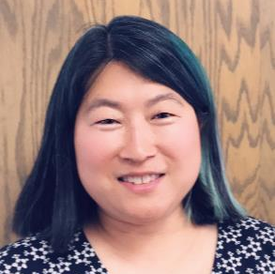

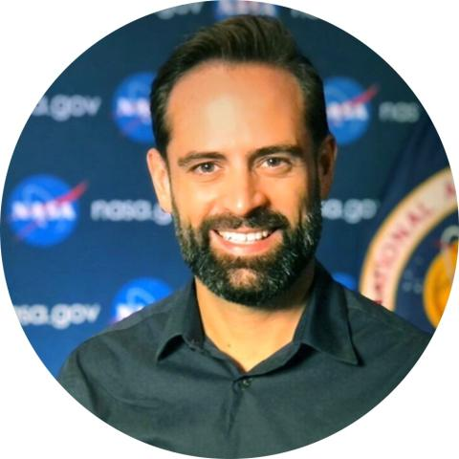
ExEP HQ Personnel
Program Scientist | Deputy Program Scientist | Program Executive
Hannah Jang-Condell | John Wisniewski | Lucas Paganini

Slide 23
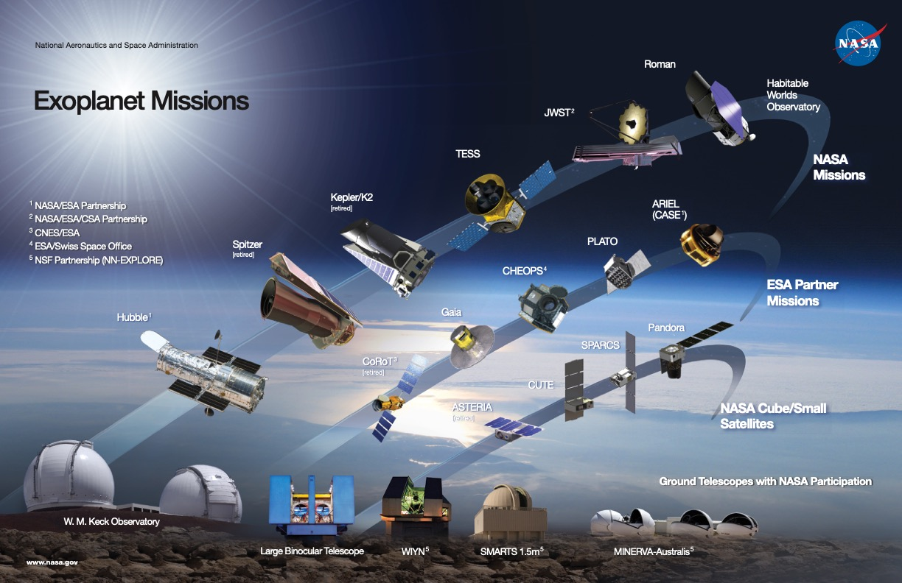

Slide 24
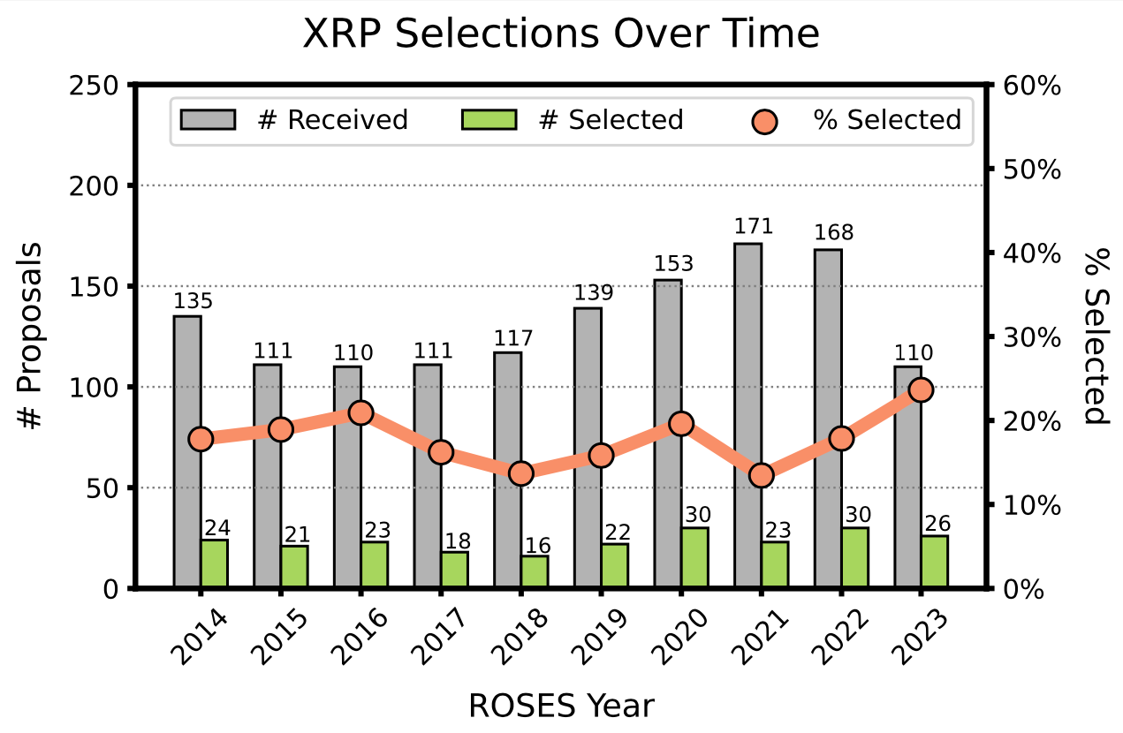
Exoplanets Research Program (XRP) Updates
Since ROSES-20, exoplanet research has been consolidated into XRP. Exoplanet technology development remains in APRA.
XRP submission rates in ROSES-23 down significantly from previous years (R&A programs across SMD have seen decreases since ROSES-22).
XRP selection rates have continued to improve since ROSES-21.

Slide 25
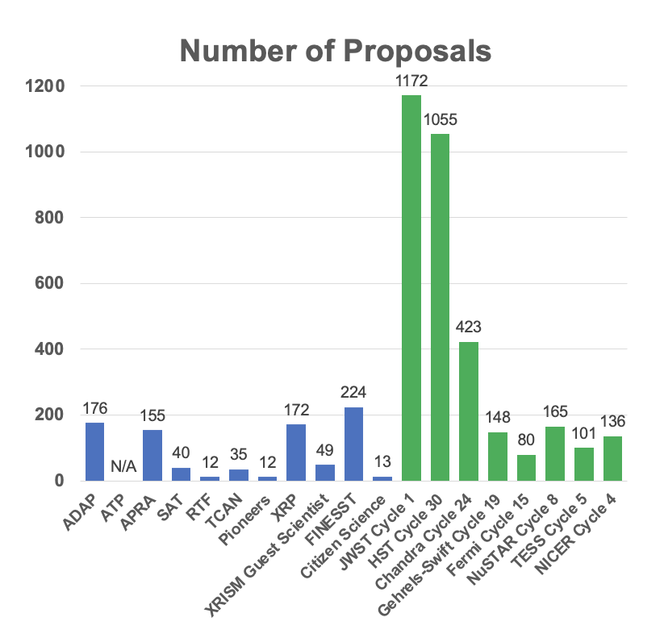
Astrophysics R&A Selection Rates
March 2022-2023
Research & Analysis (R&A):
888 proposals
General Observer/Investigator (GO/GI):
3,280 proposals
Total: 4,168 proposals

Slide 26
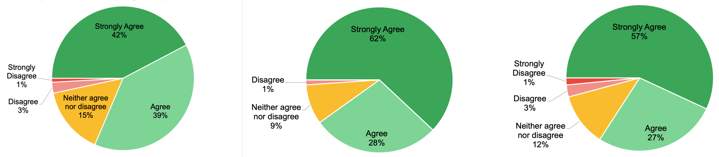
XRP & Dual Anonymous Peer Review (DAPR)
XRP-23 was the program’s 3rd year under the Dual-Anonymous Peer Review (DAPR) process.
Proposals with egregious DAPR violations (e.g., team member info in anonymized PDF, usage of author-date citations) will be returned without review.
Most common violations are gender pronouns in anonymized PDF (esp. Budget Narrative, Work Effort, OSDMP) and improperly/incompletely redacted budgets (e.g., blacked-out but not redacted).
Reach out to XRP Program Officers well ahead of proposal deadline with DAPR questions! General DAPR questions may be directed to DAPR Director Douglas Hudgins douglas.m.hudgins@nasa.gov
DAPR improved overall quality of peer review: 81% (strongly) agree
DAPR led to panel discussions focusing on science rather than on team members: 90% (strongly) agree
DAPR should be implemented in the future for the given program: 84% (strongly) agree

