Slide 1
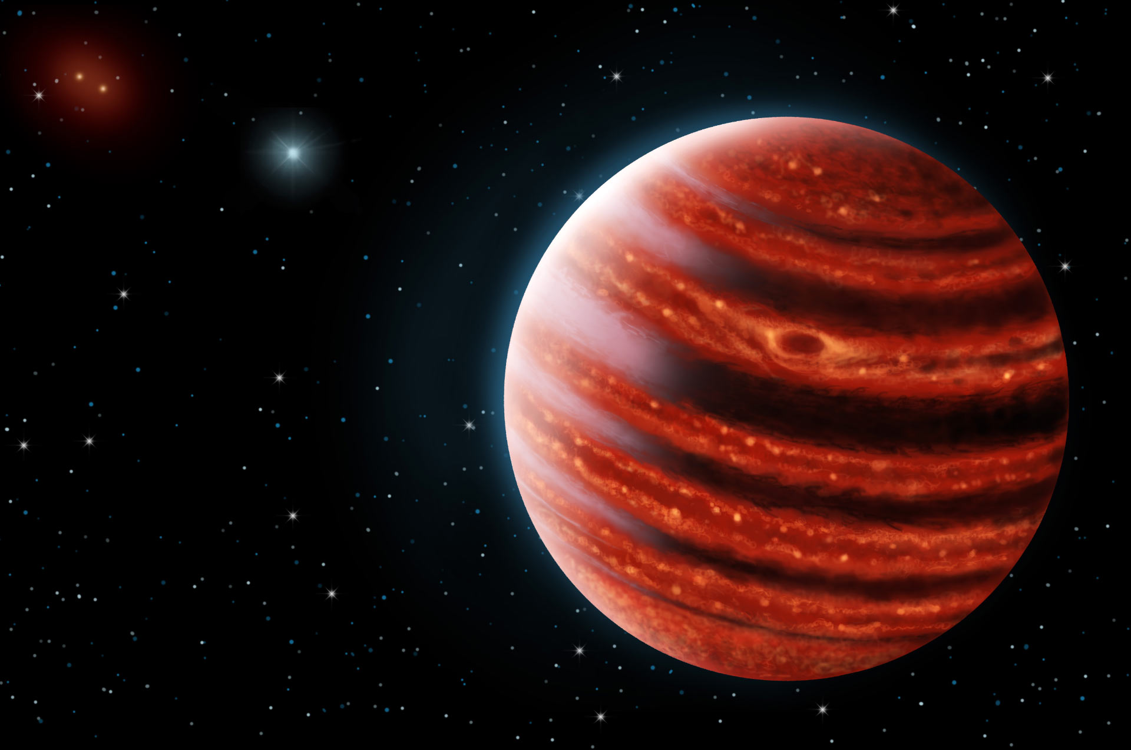
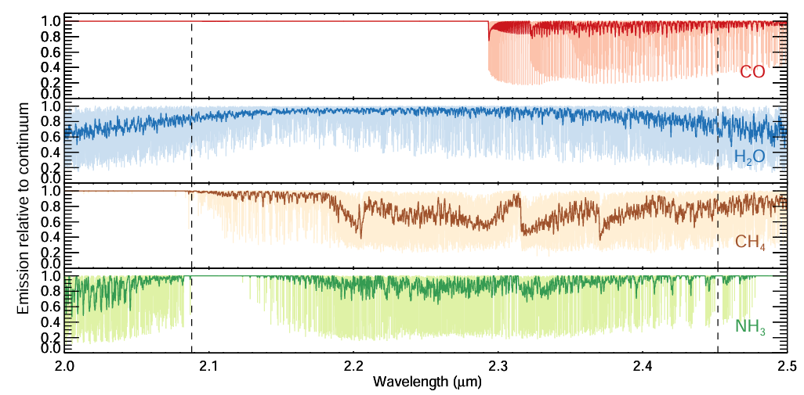
Probing the atmospheres of directly-imaged exoplanets with moderate to high-resolution spectroscopy
Jean-Baptiste Ruffio (UCSD),
jruffio@ucsd.edu
https://www.jbruffio.com
2024 Sagan Summer Workshop
Hoeijmakers+2018
51 Eri b; Danielle Futselaar & Franck Marchis, SETI Institute

Slide 2
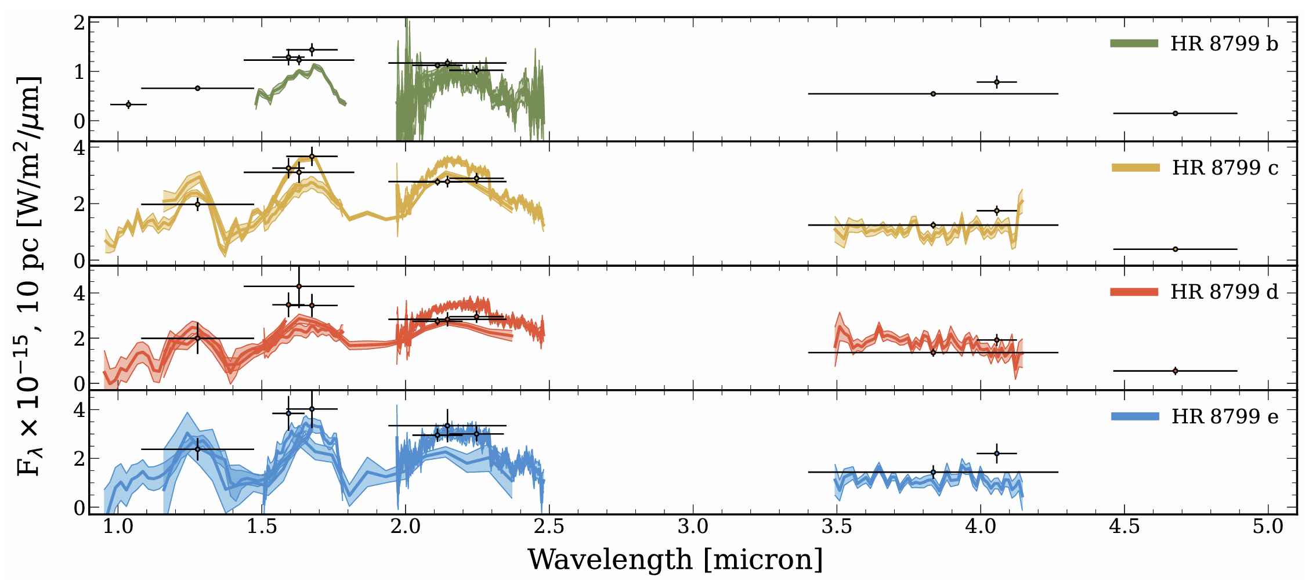
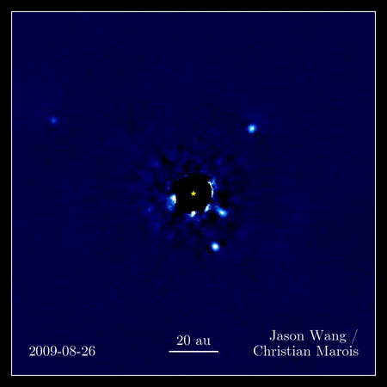
We measure spectra of exoplanets to study their atmospheres
Nasedkin+2024

Slide 3
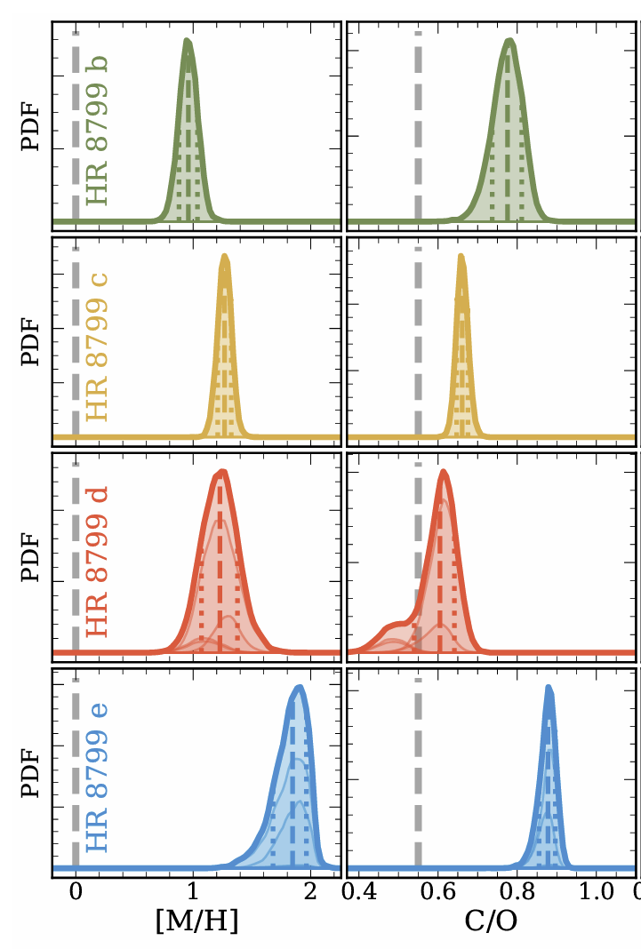
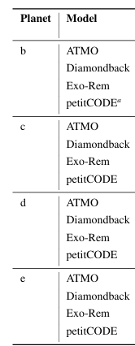

Estimates of atmospheric composition are not always consistent between different studies
Nasedkin+2024 (retrievals)
Nasedkin+2024 (model grids)
C/O HR 8799 b:
0.97 ± 0.01 (Lee+2013) 0.578 ± 0.006 (Ruffio+2021)
0.55 - 0.7 (Barman+2015)
0.92 ± 0.01 (Lavie+2017)
C/O HR 8799 c:
0.65 ± 0.1 (Konopacky+2013) 0.39 ± 0.06 (Wang+2020)
0.55 ± 0.01 (Lavie+2017) 0.562 ± 0.007 (Ruffio+2021)
0.58 ± 0.06 (Wang+2020) 0.67 ± 0.15 (Wang+2023)
C/O HR 8799 d:
0.551 ± 0.005 (Ruffio+2021)
C/O HR 8799 e:
0.6 ± 0.08 (Molliere+2020)
Nasedkin+2024

Slide 4
Estimates of atmospheric composition are not always consistent between different studies
Nasedkin+2024 (retrievals)
Nasedkin+2024 (model grids)
C/O HR 8799 b:
0.97 ± 0.01 (Lee+2013) 0.578 ± 0.006 (Ruffio+2021)
0.55 - 0.7 (Barman+2015)
0.92 ± 0.01 (Lavie+2017)
C/O HR 8799 c:
0.65 ± 0.1 (Konopacky+2013) 0.39 ± 0.06 (Wang+2020)
0.55 ± 0.01 (Lavie+2017) 0.562 ± 0.007 (Ruffio+2021)
0.58 ± 0.06 (Wang+2020) 0.67 ± 0.15 (Wang+2023)
C/O HR 8799 d:
0.551 ± 0.005 (Ruffio+2021)
C/O HR 8799 e:
0.6 ± 0.08 (Molliere+2020)
Nasedkin+2024

Slide 5
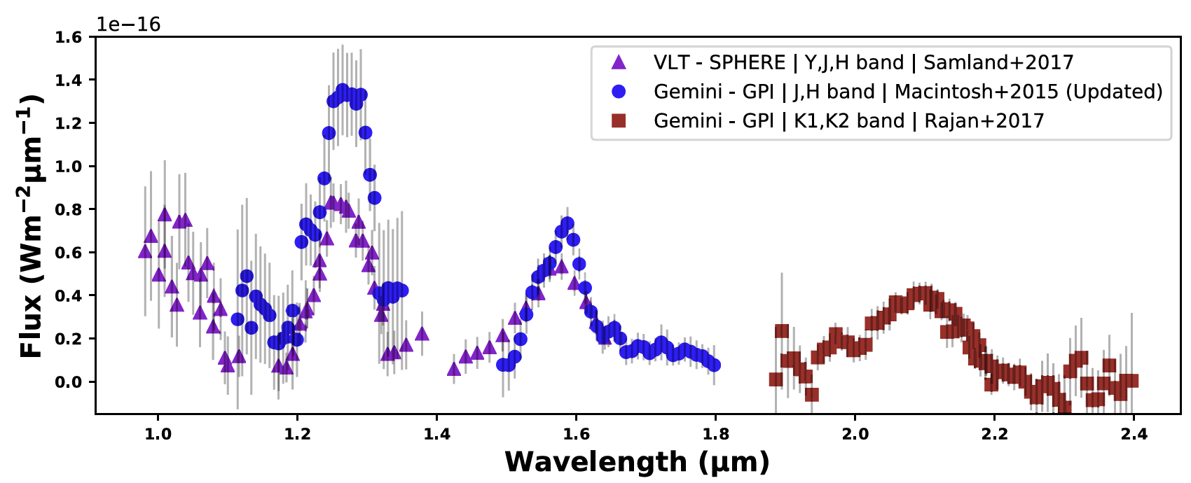
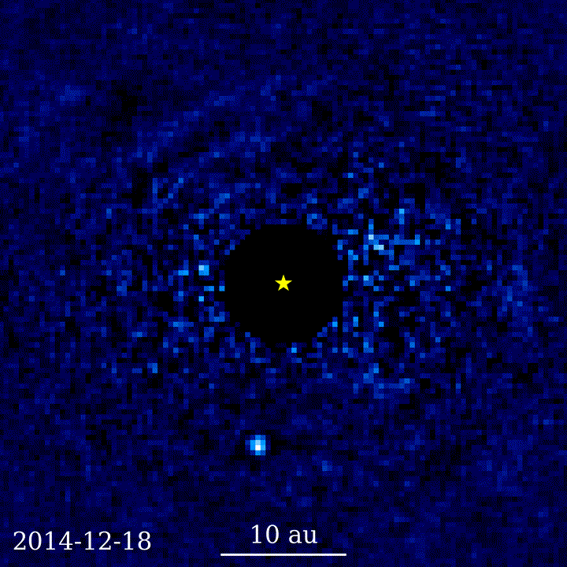
Imperfect starlight subtraction, or calibration, can lead to inconsistencies between spectra
51 Eri b
Whiteford+2023: C/O = 0.38+-0.1
Brown-Sevilla+2023: C/O = 0.97+-0.2
51 Eri b
~2 M_{Jup}
Animation Jason Wang
Macintosh+2014
Whiteford+2023
See also Rajan+2017; Samland+2017; Brown-Sevilla+2023

Slide 6
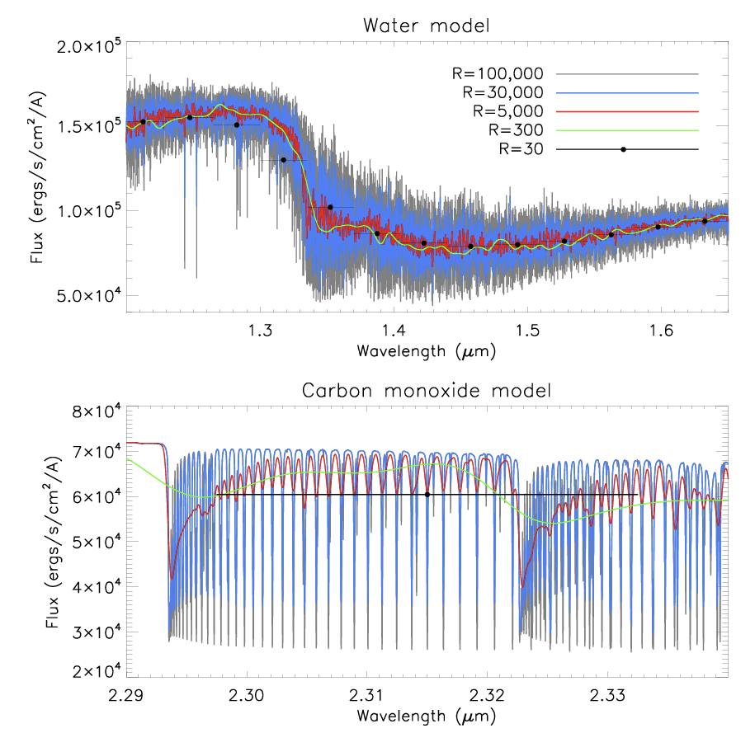


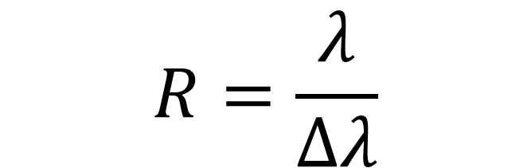
Increasing the spectral resolution can better resolve the specific signatures of different molecules
$$Δλ$$
$$R=\frac{λ}{Δλ}$$
Flux
$$λ$$
Birkby+2018
Exoplanet Atmospheres at High Spectral Resolution - NASA/ADS (harvard.edu)

Slide 7
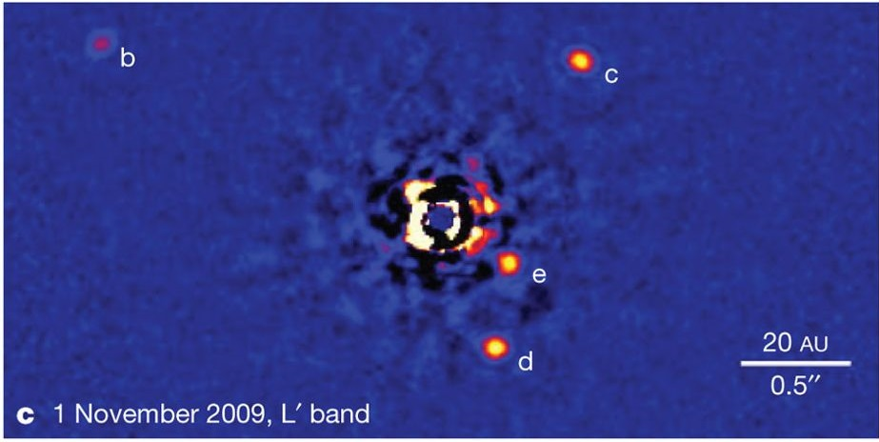
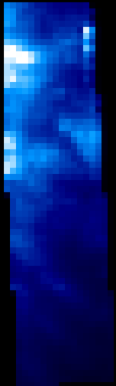
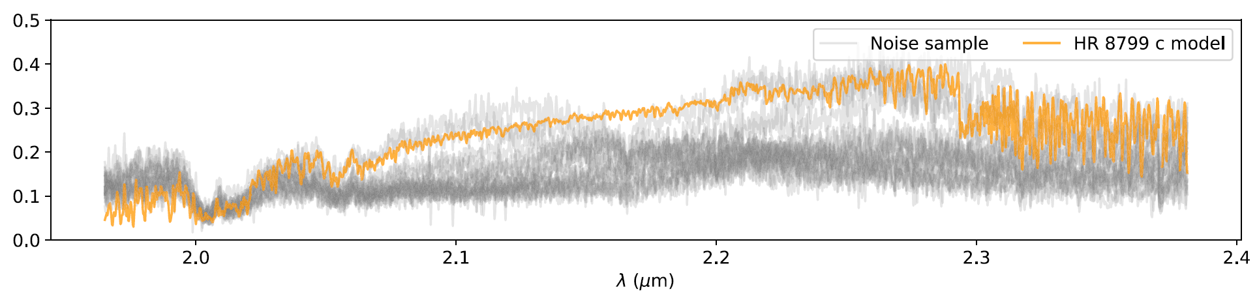

At R>1,000, the spectral features become distinct from the starlight (ie, speckles)
Keck/OSIRIS Field of view
$$λ$$
Spectral cube
dominated
by starlight
y
Marois+2010
x
R=4,000
Flux
Starlight (ie, speckles)
Ruffio+2019

Slide 8
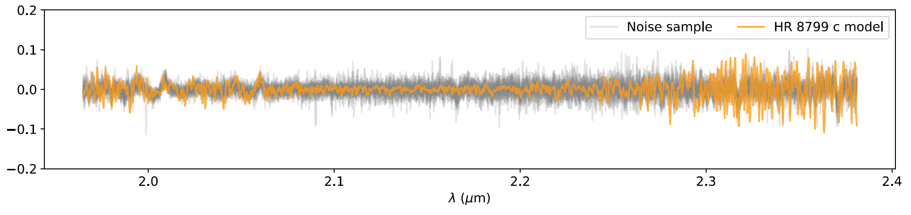
High-pass filtering removes the speckles and isolate the spectral features of the planet
R=4,000
Tellurics (Earth CO₂)
Starlight (ie, speckles)
H₂O
H₂O
Flux
CO
Ruffio+2019

Slide 9
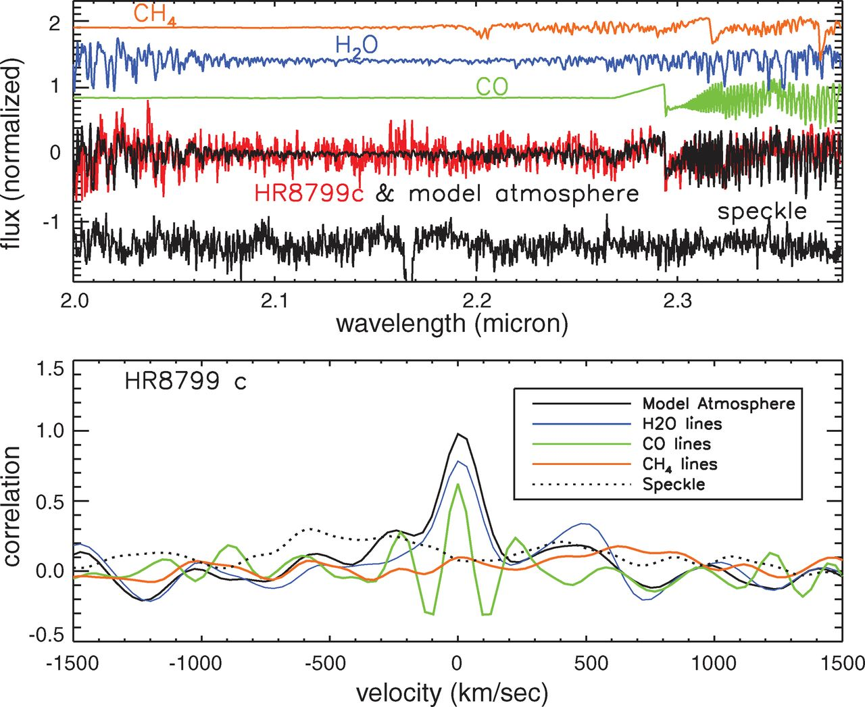
Matching molecular templates (ie, cross correlation) allows the detection of molecules
Konopacky et al. (2013)

Slide 10
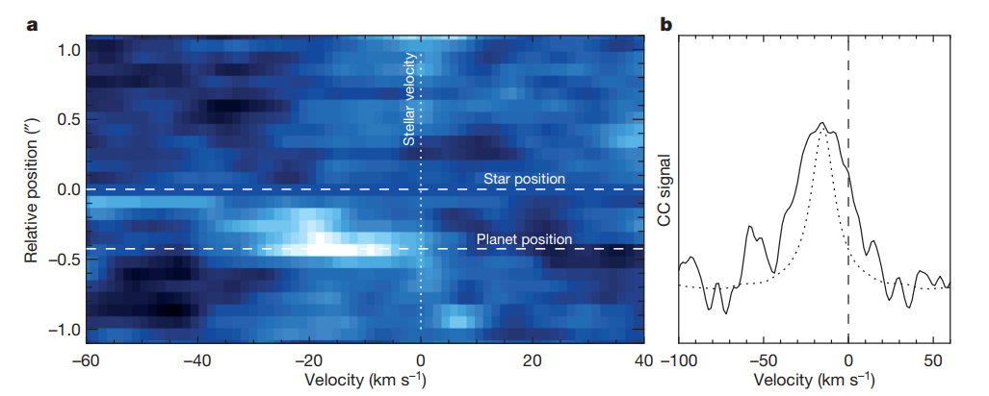
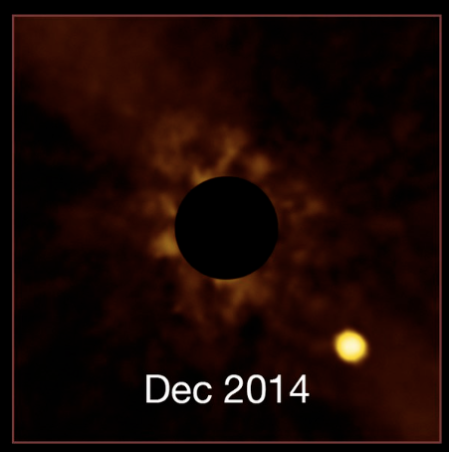
At high spectral resolution (R>30,000), it is possible to measure the rotational spin broadening
Cross-Correlation function
RV ~ -15 km/s
V sin(i) ~ 25 km/s
Beta Pictoris b
ESO/Lagrange/SPHERE consortium
Snellen+2014

Slide 11
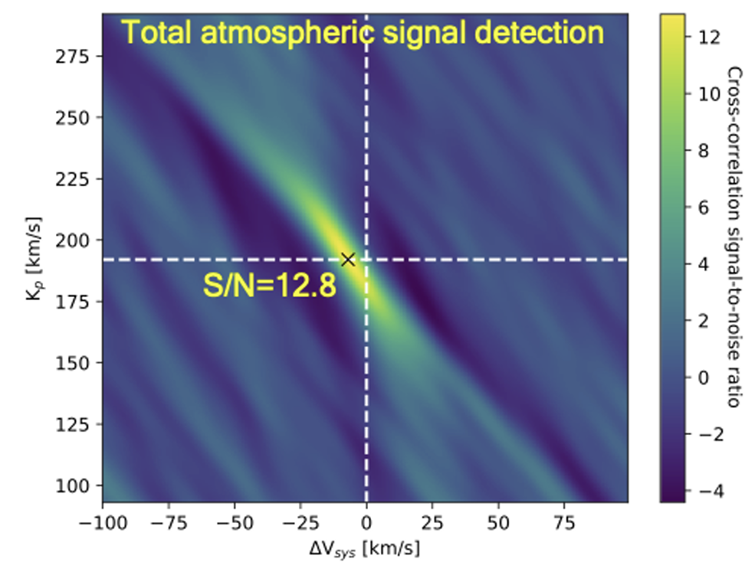
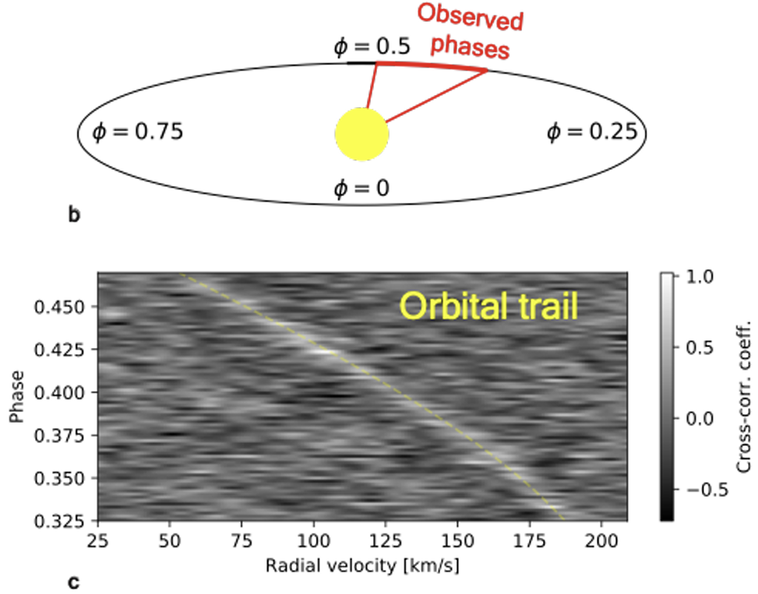
High-resolution spectroscopy of (transiting) hot Jupiters
The short orbital periods make it possible to leverage the rapid radial velocity variations of the planet
WASP-77Ab
Line+2021
See also Snellen+2010 etc.

Slide 12
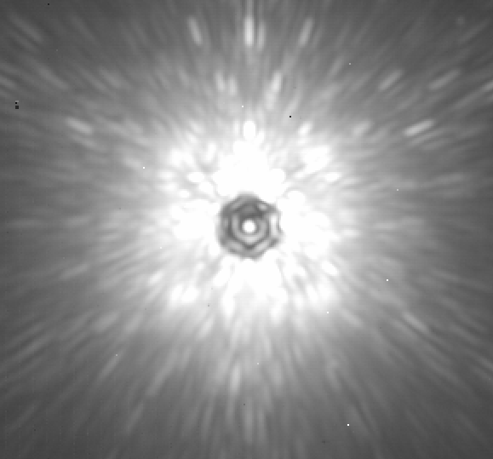
Types of spectrographs for R>1,000 spectroscopy
Integral field spectroscopy (IFS)
Lenslets or slicer
New single-Mode Fibers
Optimized for exoplanets
Traditional slit spectroscopy
>1.3”x0.3” Field of view
~2.26”x0.07” slit
~0.05”x0.05” fiber
Keck/OSIRIS
VLT/SINFONI
VLT/ERIS
JWST/NIRSpec JWST/MIRI
Keck/KPIC (Delorme+ 2021)
VLT/HiRISE (Vigan+ 2022)
Subaru/REACH (Kotani+ 2020)
Keck/NIRSPEC
VLT/CRIRES
Moderate resolution
1,000 < R < 10,000
Extended field of view
High resolution (R = 30k-100k)
Best throughput
High resolution (R = 30k-100k)
Additional starlight rejection
Stability of the line spread function
Precise pointing on the planet

Slide 13
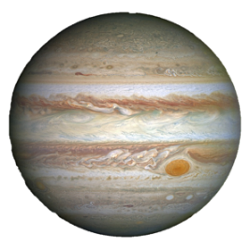




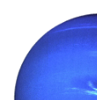
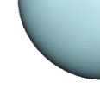
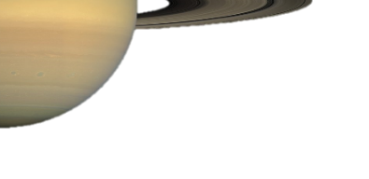
High-resolution spectroscopy enables a wide range of science
Radial Velocity
Spin
Doppler Imaging
Atmospheric characterization
Detection
?
Spectrum
λ
Cross Correlation
Function (CCF)
RV
0 (km/s)

Slide 14
High-resolution spectroscopy enables a wide range of science
Radial Velocity
Spin
Doppler Imaging
Atmospheric characterization
Detection
?
Spectrum
λ
Cross Correlation
Function (CCF)
RV
0 (km/s)

Slide 15
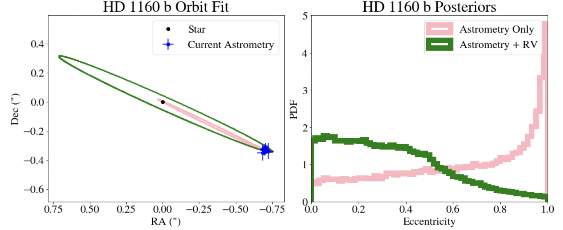
Radial velocity measurements can better constrain orbital parameters like eccentricity
RV (2017) = 7.3 ± 2 km/s
with R=4,000 Keck/OSIRIS
Do Ó, Clarissa+2023
  See also Ruffio+2019; Bowler+2020; Nagpal+2023; Bowler+2023

Slide 16
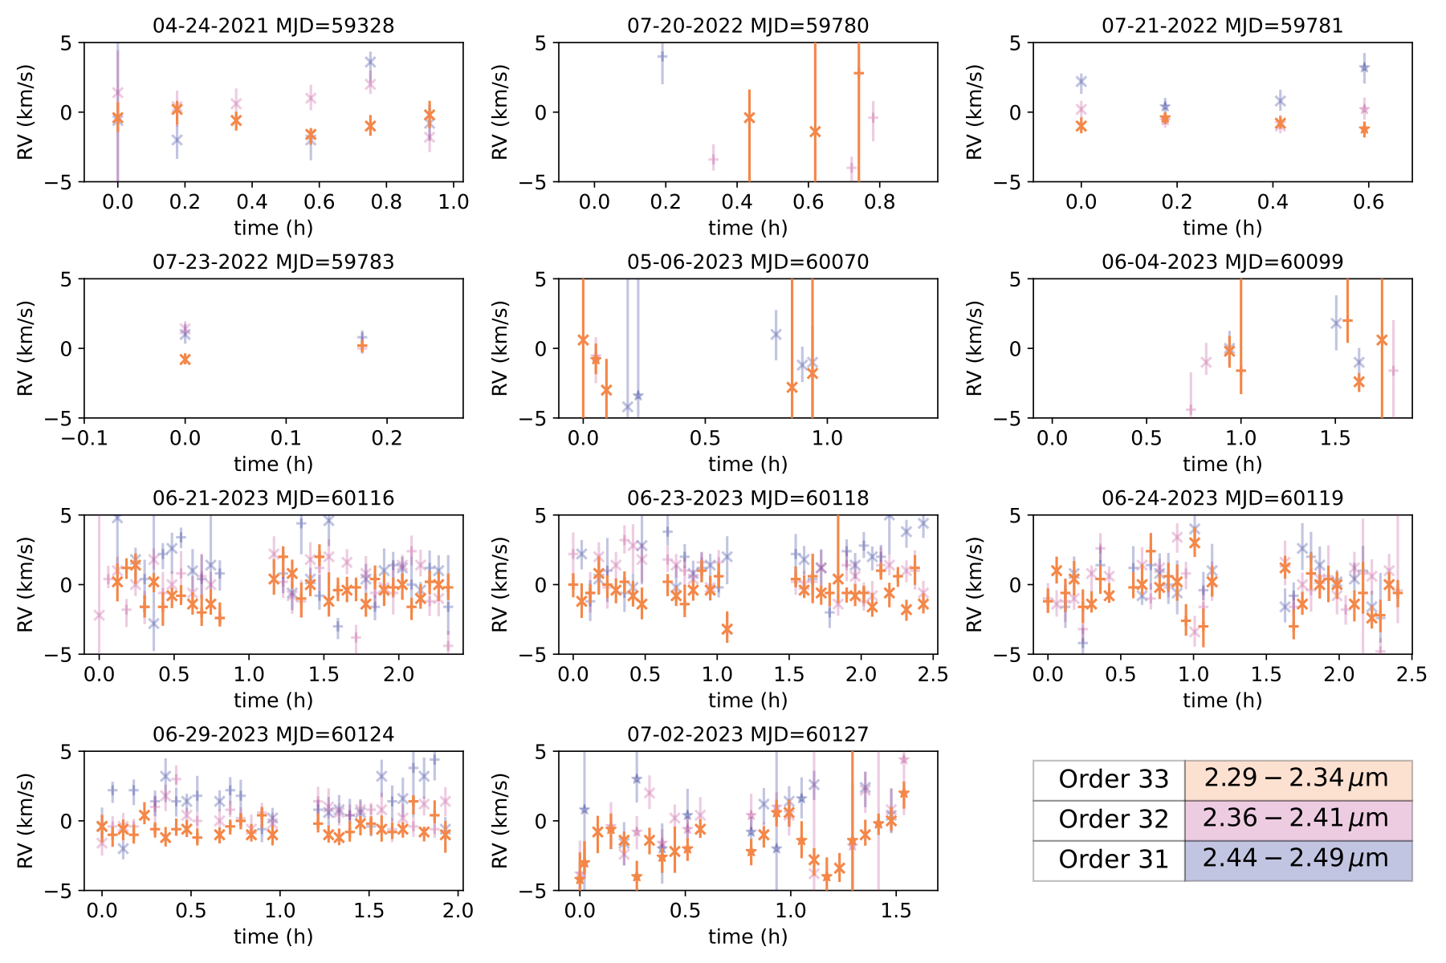
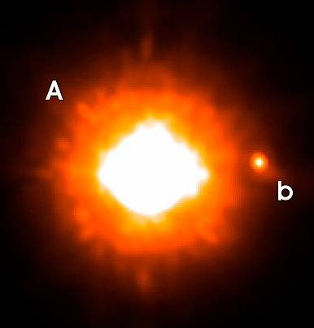
Radial velocity time series of substellar companions can be used to look for exo-satellites
GQ Lup B
20-40M_{Jup}
ESO
Neuhäuser+2004
Horstman+ submitted
See also Vanderburg+2018;2021; Ruffio+2023

Slide 17
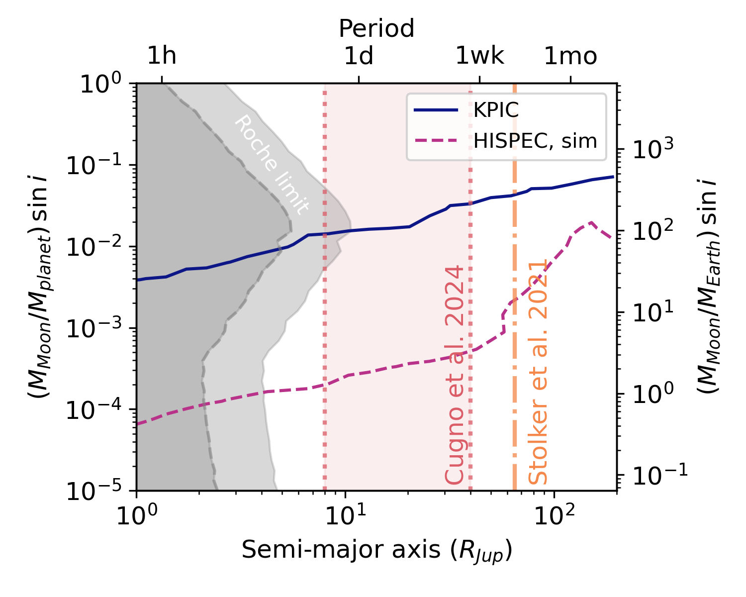
Current RV time series are sensitive to satellites with mass ratios around 1-3%
GQ Lup B
Horstman+ submitted
See also Vanderburg+2018;2021; Ruffio+2023

Slide 18
High-resolution spectroscopy enables a wide range of science
Radial Velocity
Spin
Doppler Imaging
Atmospheric characterization
Detection
?
Spectrum
λ
Cross Correlation
Function (CCF)
RV
0 (km/s)

Slide 19
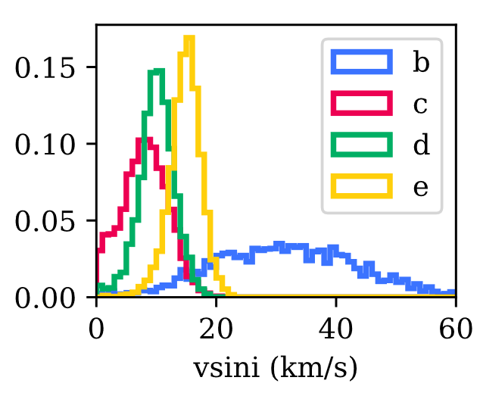
New high-contrast high-resolution spectrographs enable spin measurements for most directly-imaged companions
Spin of HR 8799 planets
Wang+ 2021

Slide 20
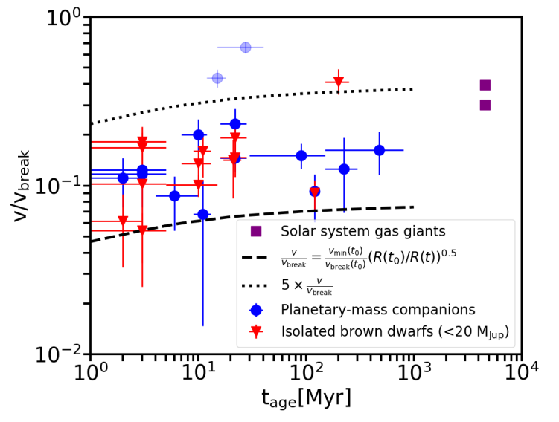
The spins of planetary mass companions are another tool to study their formation processes
Spin angular momentum conserved with age
(~10% of breakup speed)
Consistent with magnetic breaking at early times
Bryan+ 2020
See also Bryan+ 2018; Wang+ 2021

Slide 21
High-resolution spectroscopy enables a wide range of science
Radial Velocity
Spin
Doppler Imaging
Atmospheric characterization
Detection
?
Spectrum
λ
Cross Correlation
Function (CCF)
RV
0 (km/s)

Slide 22
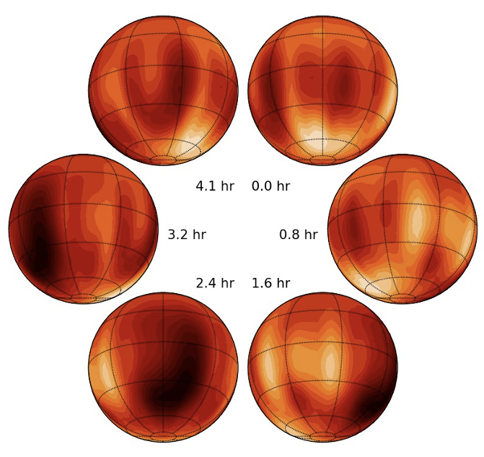
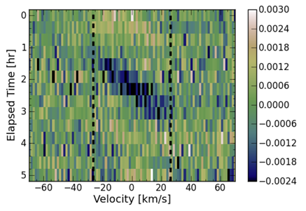
Resolving the 2D surface of directly imaged brown dwarfs
Deviations from uniform spectral line profile for Luhman 16B:
Crossfield+2014
See also Plummer+2023

Slide 23
High-resolution spectroscopy enables a wide range of science
Radial Velocity
Spin
Doppler Imaging
Atmospheric characterization
Detection
?
Spectrum
λ
Cross Correlation
Function (CCF)
RV
0 (km/s)

Slide 24
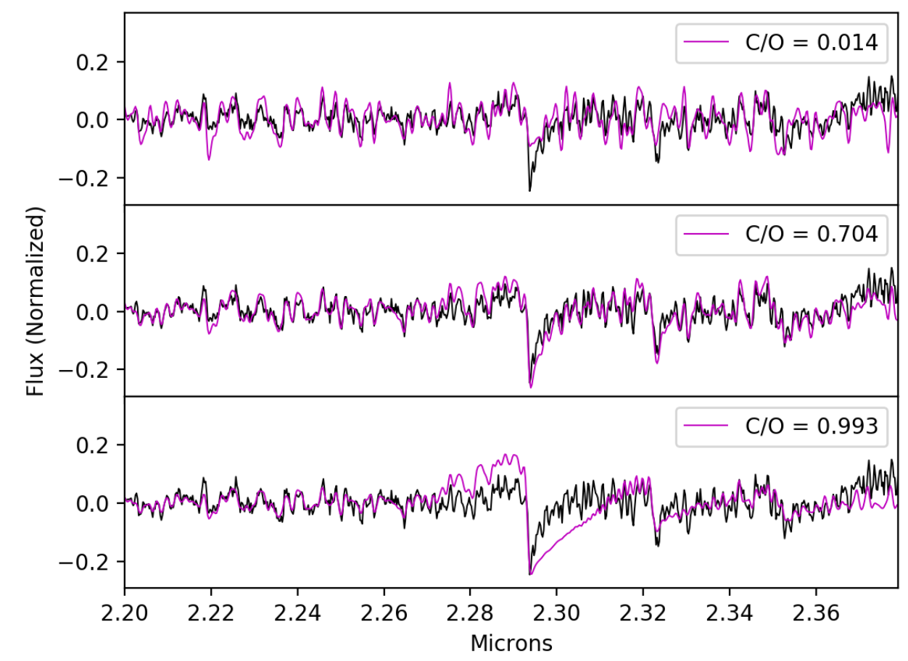
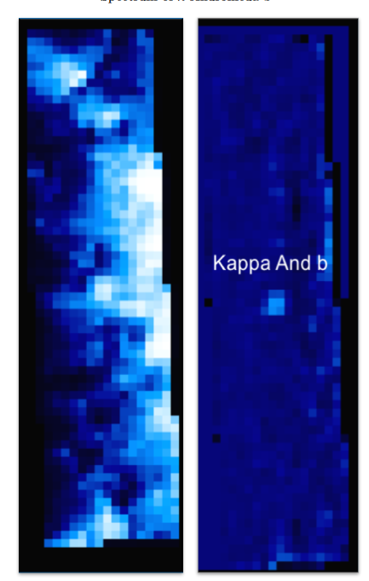
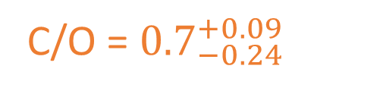
Moderate resolution spectroscopy enables C/O measurements of substellar companions
The C/O of Κ And b is also consistent with stellar:
C/O = ${0.7}_{−0.24}^{+0.09}$
Wilcomb+2020

Slide 25
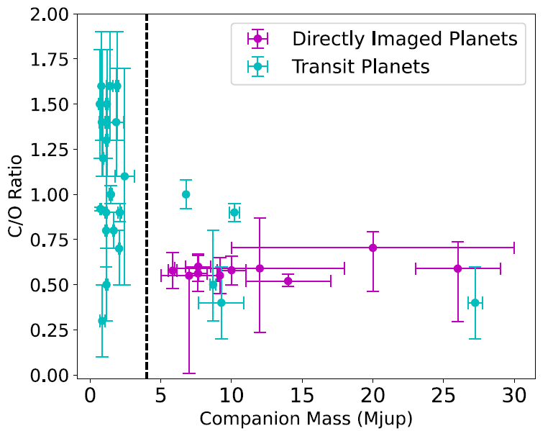
A potential C/O trend with companion mass?
Hoch+2023
See also Xuan et al. 2024b

Slide 26
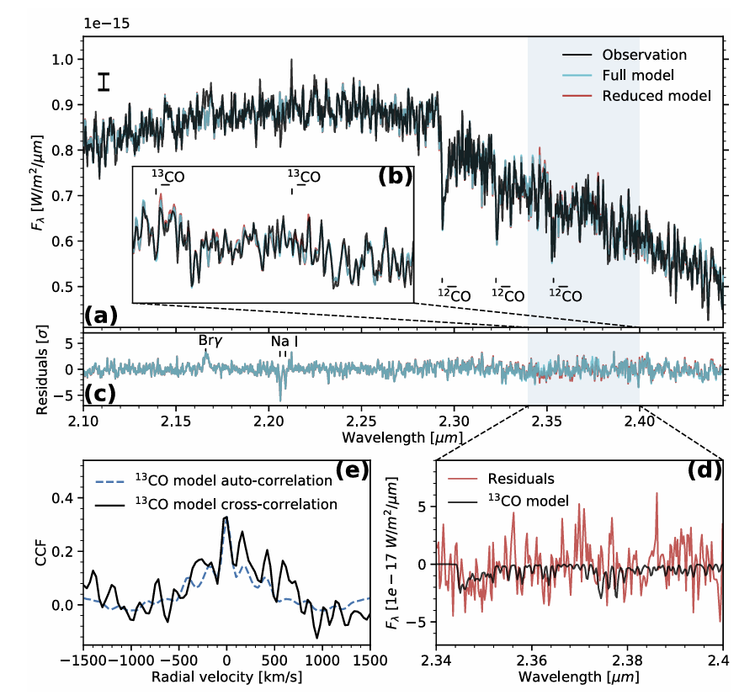
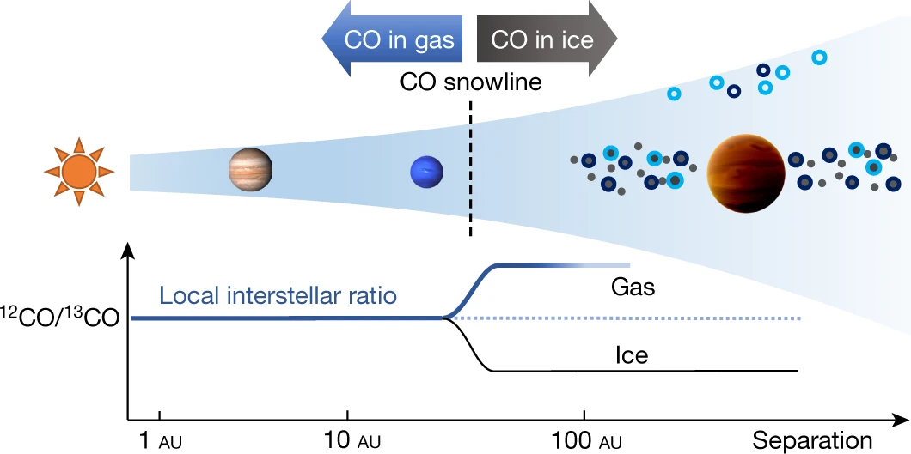
Moderate resolution spectroscopy is also enabling the detection of isotopologues
TYC 8998-760-1 b
A new tracer of formation location
Zhang+2021

Slide 27
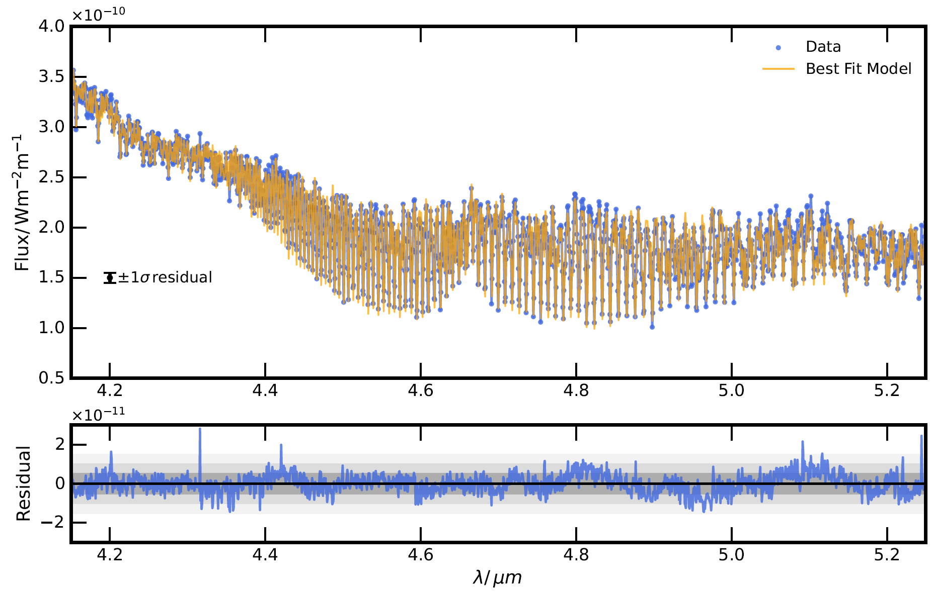
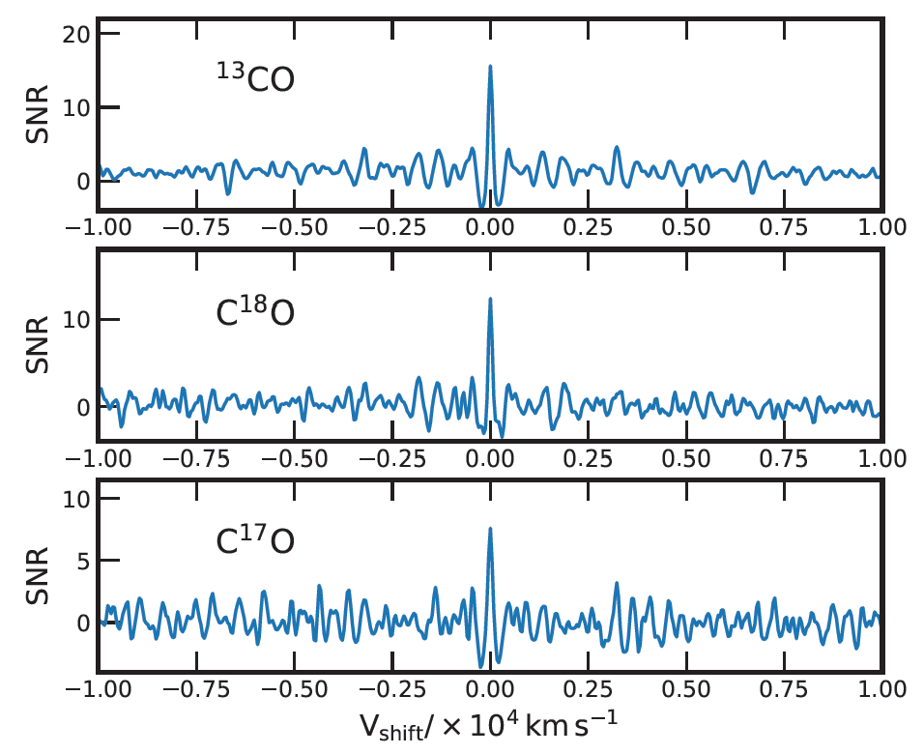
JWST R=2,700 spectroscopy can detect of ¹³C, ¹⁸O, and ¹⁷O in the Atmosphere of Super-Jupiter VHS 1256 b
Gandhi+2023

Slide 28
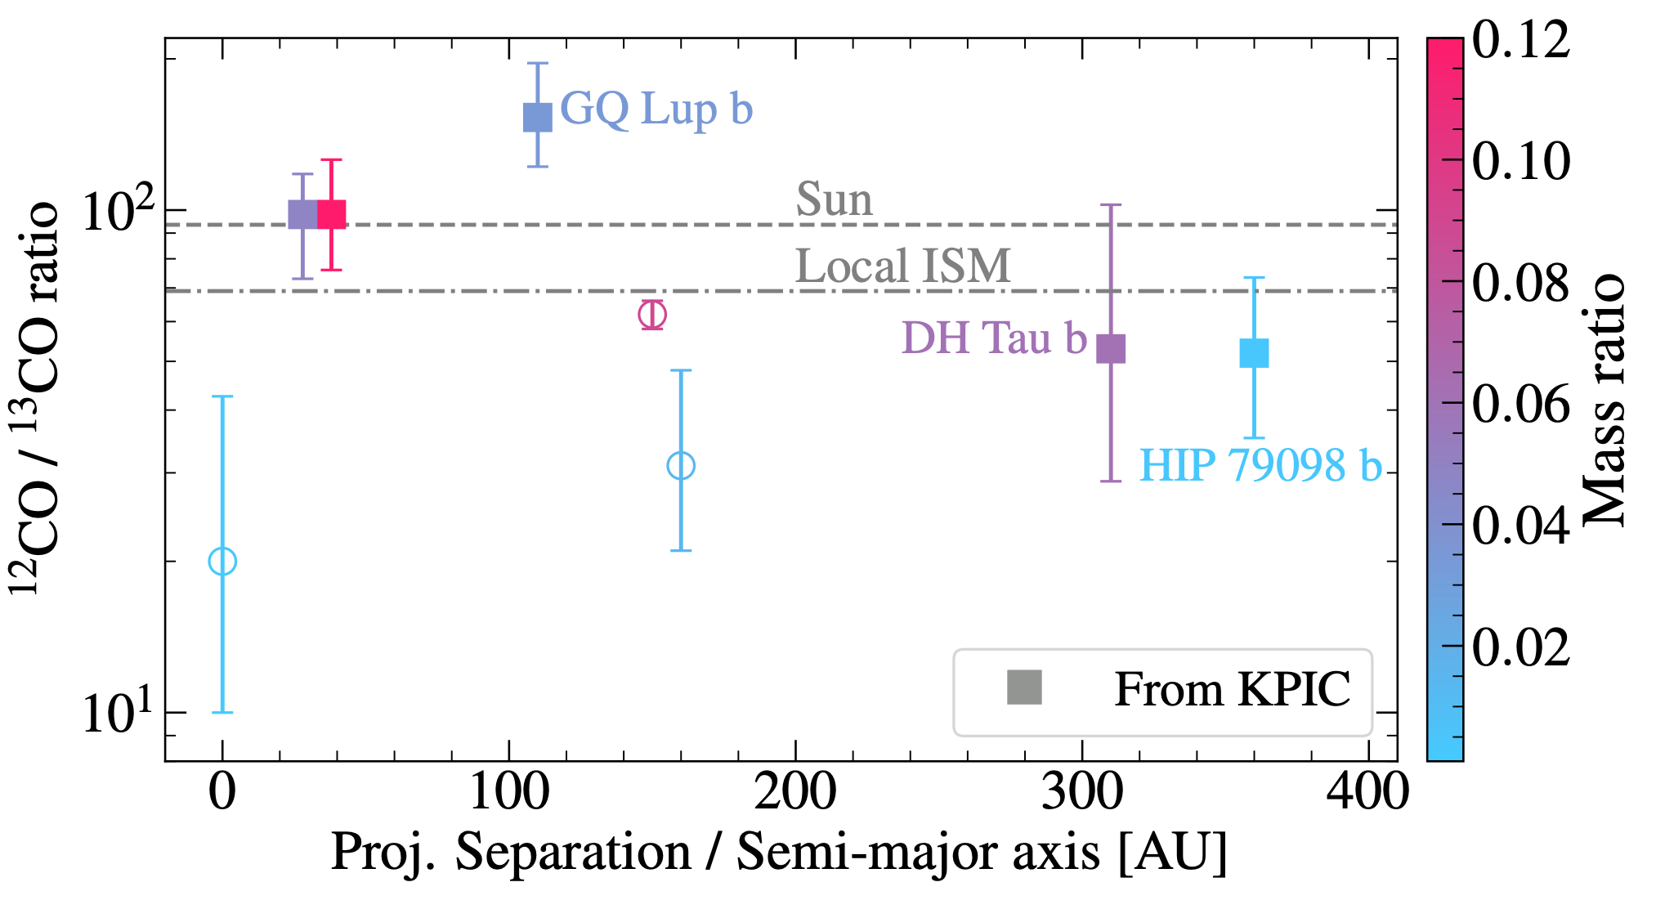
Isotopogue detections are becoming routine
KPIC (R~35,000) is doubling the number of ¹²C/¹³C measurements
No clear trend with semi-major axis or mass ratio yet
Xuan et al. 2024b
See also Line+2021; Zhang+2021; Gandhi+2023; Costes+2024; Xuan+2024a

Slide 29
High-resolution spectroscopy enables a wide range of science
Radial Velocity
Spin
Doppler Imaging
Atmospheric characterization
Detection
?
Spectrum
λ
Cross Correlation
Function (CCF)
RV
0 (km/s)

Slide 30
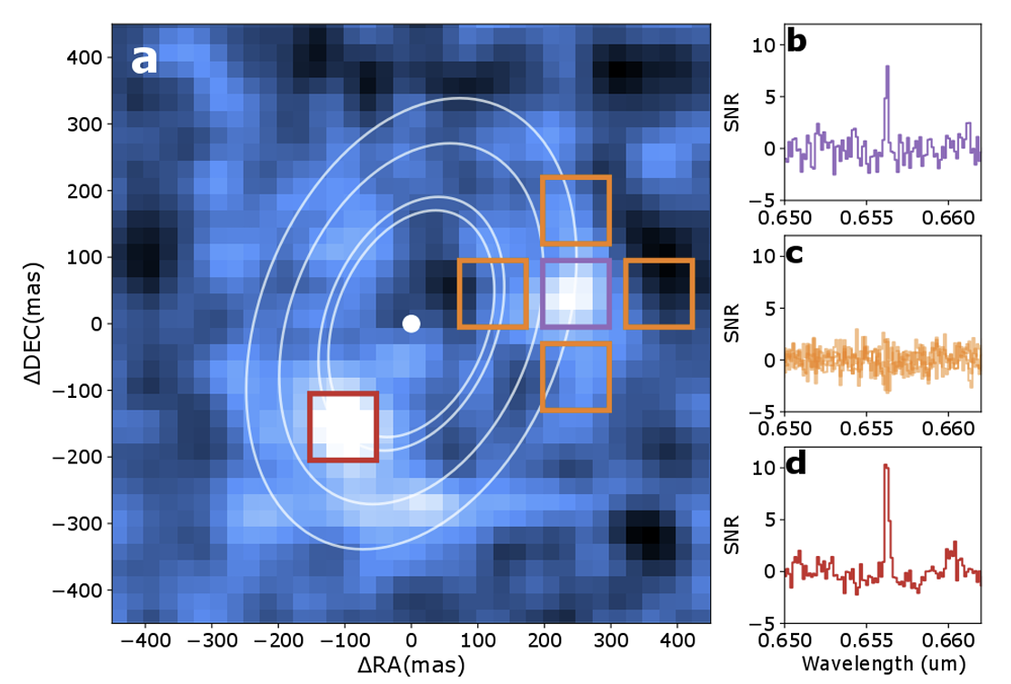
Resolving Hα emission enabled the detection of a young planet (PDS70c) that is still accreting
VLT/MUSE; R~2,500
Haffert+2019

Slide 31
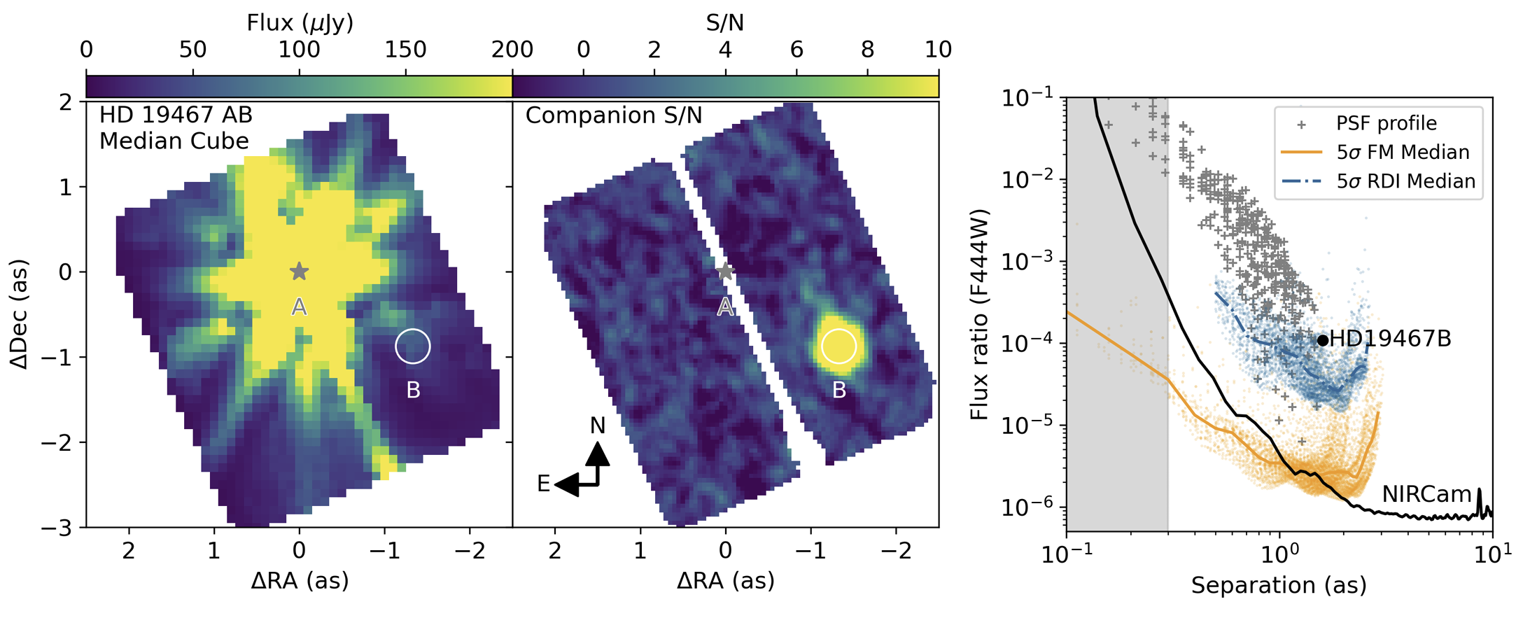
R>2,000 spectroscopy is especially sensitive to planets at small inner working angles
Ruffio+2024
See also Hoeijmakers+2018; Agrawal+2023; Wang, Jason+2024

Slide 32
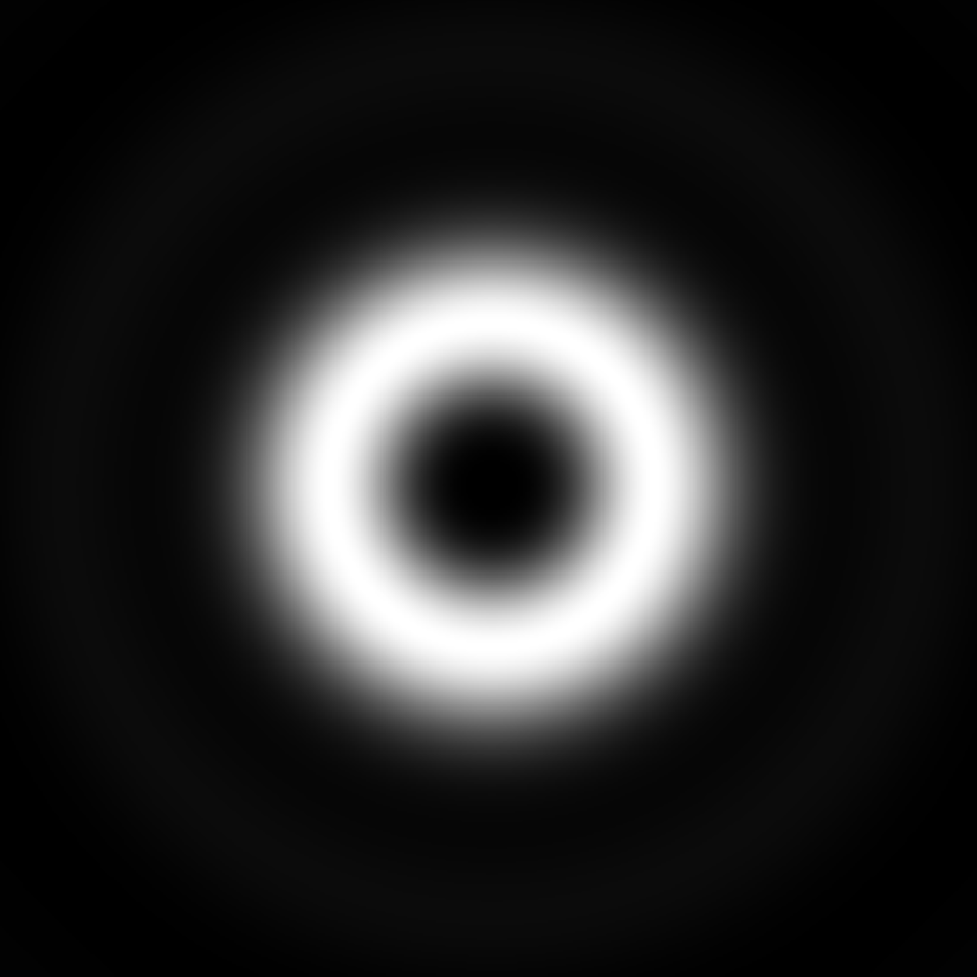


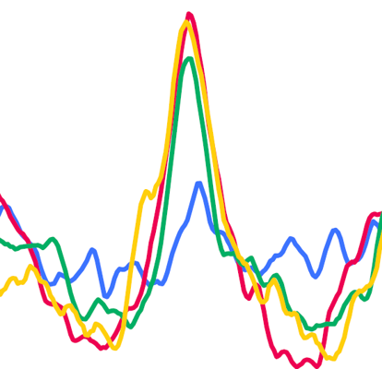
Vortex Fiber Nulling (VFN) can detect companions within the diffraction limit
Suppressed Starlight
Conventional Coronagraph
Single-mode fiber Field Diameter
2 λ/D
(90 mas in K at Keck)
Single-Mode Fiber
Planet Signal
High Resolution Spectrograph
40 mas
Spectral Analysis
VFN Coupling Region
D. Echeverri
See also Ruane+2018;Echeveri+2023;2024
Notes:
Projecting the VFN map onto the sky we get a good sense of how the system works.
The single fringe is axially symmetric and centered over the fiber.
We align the star to the fiber, and hence to the center of the fringe and it is therefore nulled such that at the output of the fiber, we have very little starlight.
The planet comes in off-axis and lands somewhere on the bright fringe…
(for yellow circle)
“The entire field of view of VFN is inside this yellow circle and so VFN accesses separations that conventional coronagraphs cannot access.”

Slide 33
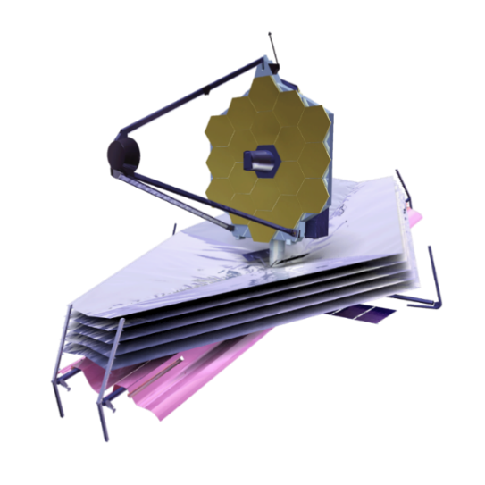
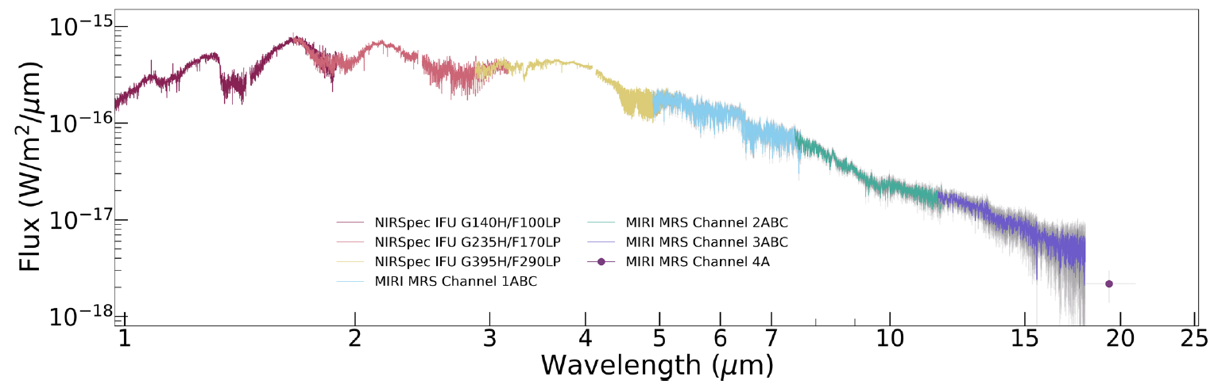
Future: JWST is enabling detailed spectroscopy (R~2,700) across the full emission spectrum
H₂O
H₂O
H₂O
CO₂
VHS 1256 b
~12M_{Jup}
H₂O
CH₄
K
CO
CH₄
Silicate clouds
K
H₂O
Na
CO
NH₃? if cooler atmosphere
Miles+2023
See also Gandhi+2023; Ruffio+2024; Hoch+ in prep.

Slide 34
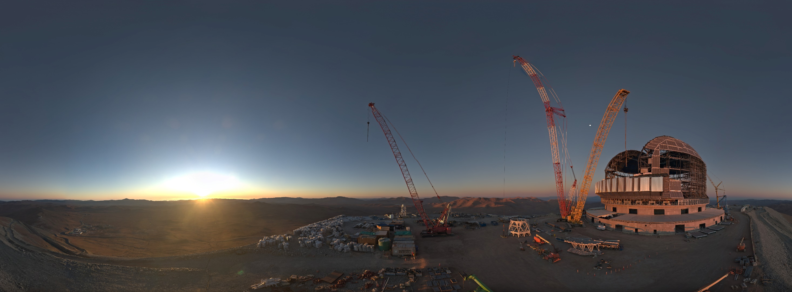
Future: High-resolution spectroscopy on 40-meter-class telescopes
  Earth-like planets around nearby M stars
    Biosignature detection
  Exomoon detection
  High-resolution spectrographs are first light instruments
    ELT/HARMONI-METIS
    TMT/MODHIS-IRIS
    GMTIFS-GMTNIRS
ELT webcam - ESO

Slide 35
In summary, R>1,000 spectroscopy can be used to measure:
Radial Velocity
Spin
Doppler Imaging
Atmospheric characterization
Detection
?
Spectrum
λ
Cross Correlation
Function (CCF)
RV
0 (km/s)

