Slide 1
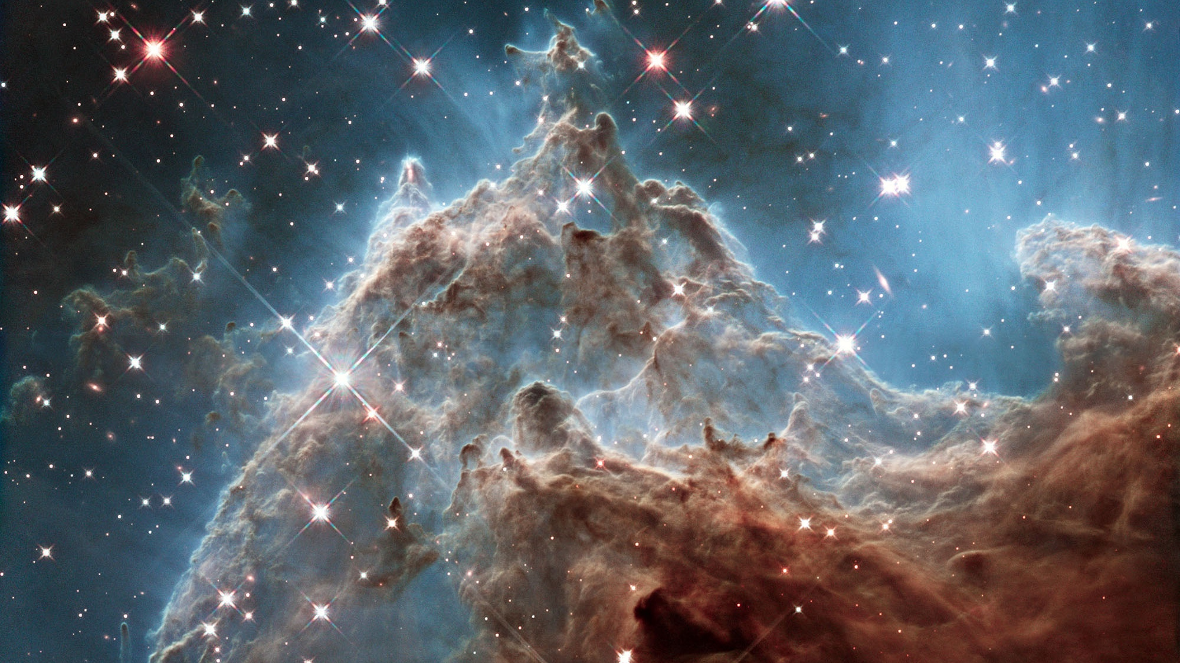
Mission Formulation at NASA
Keith Grogan
Astronomy and Physics Mission Formulation Office
Jet Propulsion Laboratory
Sagan PROTO Workshop, 7/21/24

Slide 2

Career Path
Undergraduate
  University of St. Andrews, Scotland – Astronomy and Astrophysics
Graduate
  University of Florida, PhD Astronomy
Postdocs
  University of Florida
  NASA Goddard
JPL
  Research Scientist
  Group Supervisor, Formulation Systems Engineering
  Innovation Foundry, Proposal Office
  Astronomy and Physics Mission Formulation Office

Slide 3
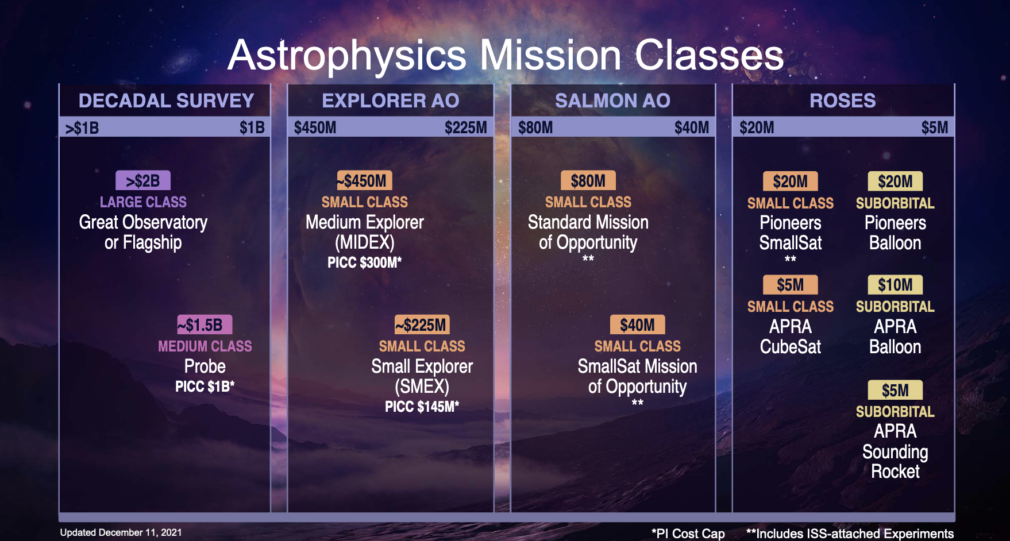

Slide 4
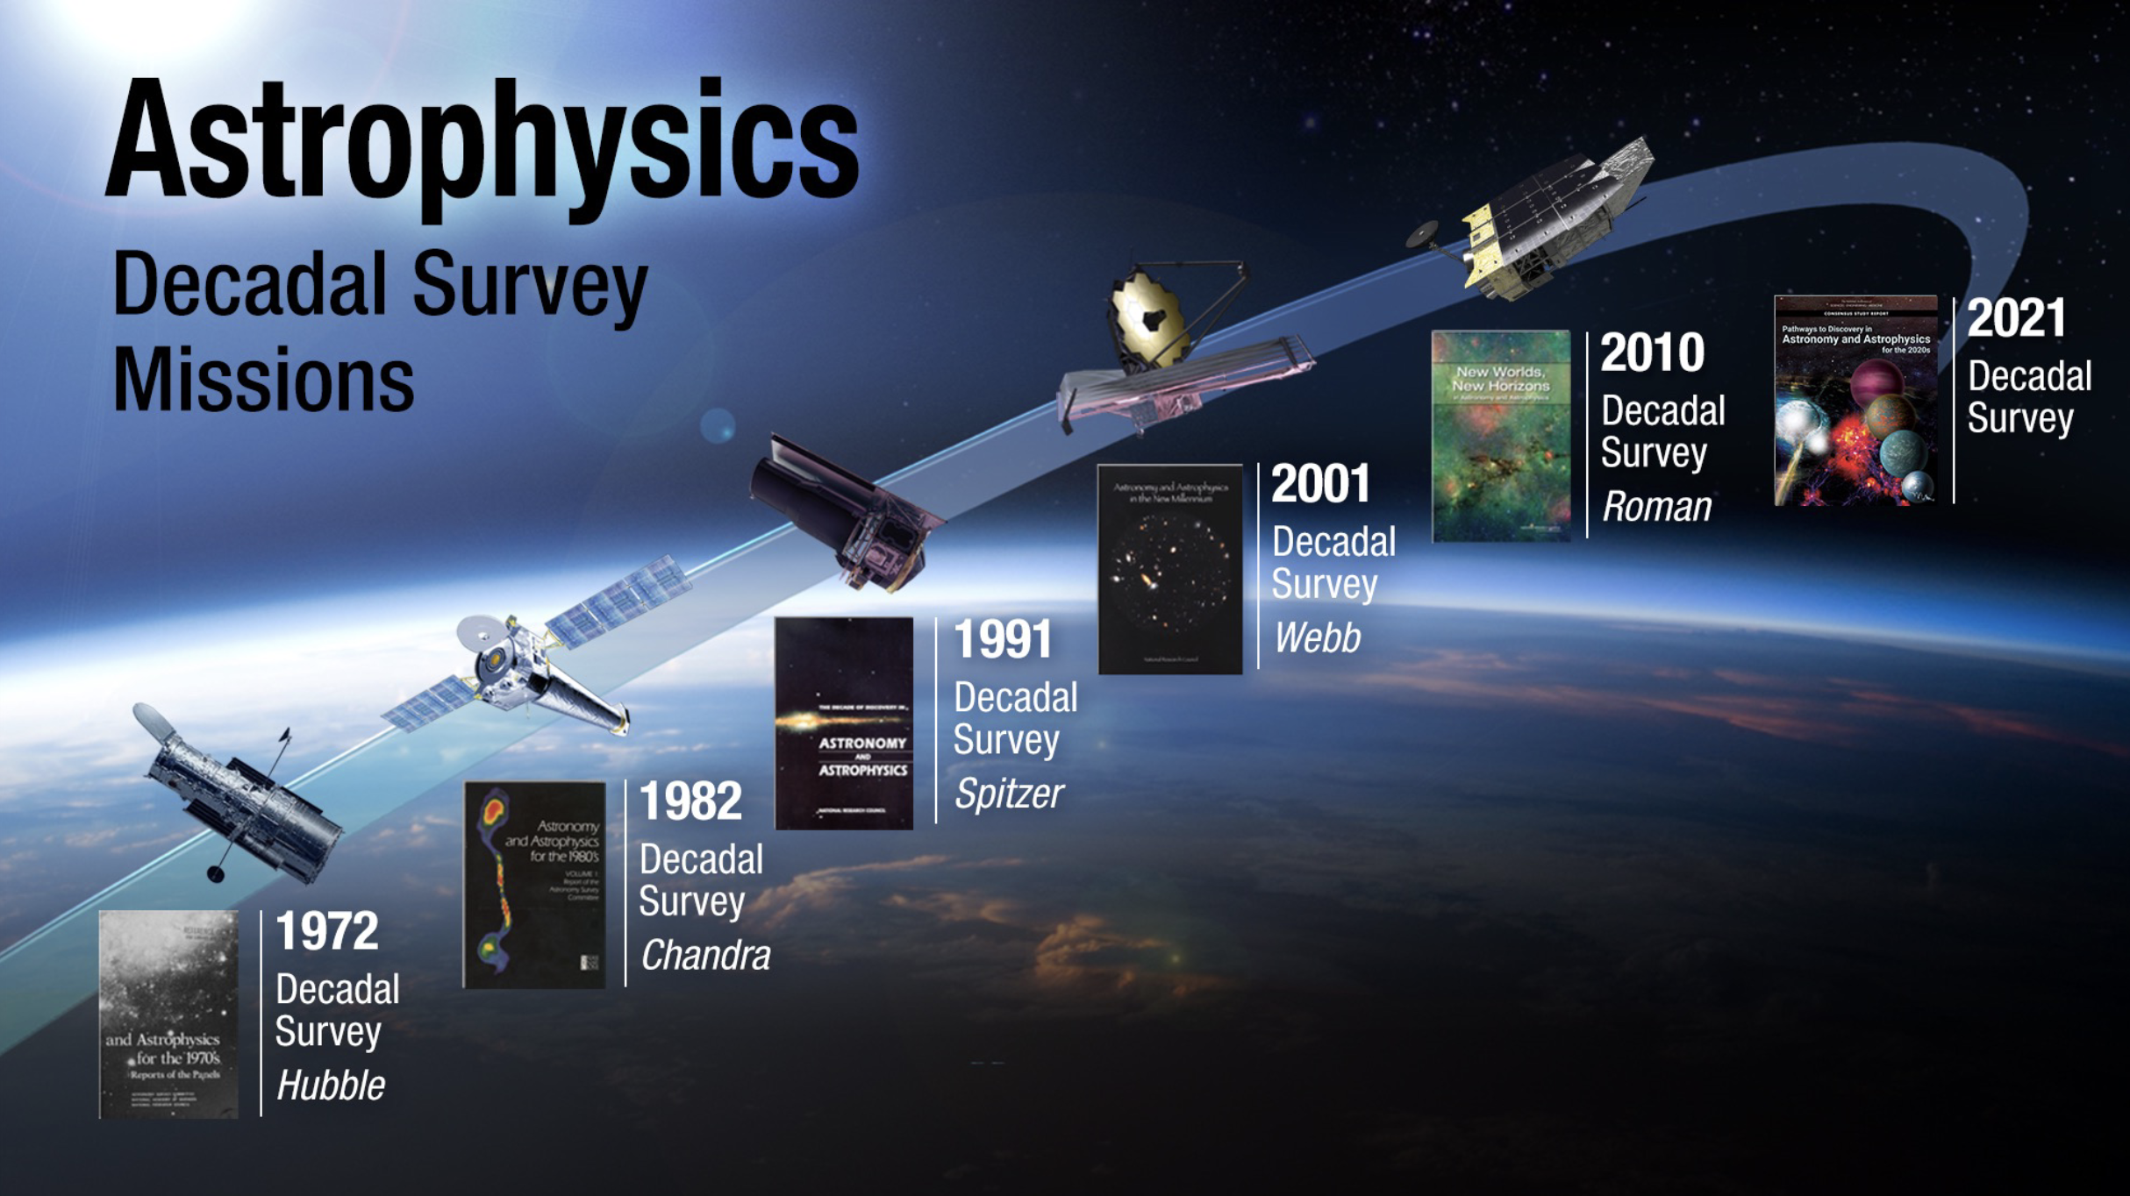

Slide 5
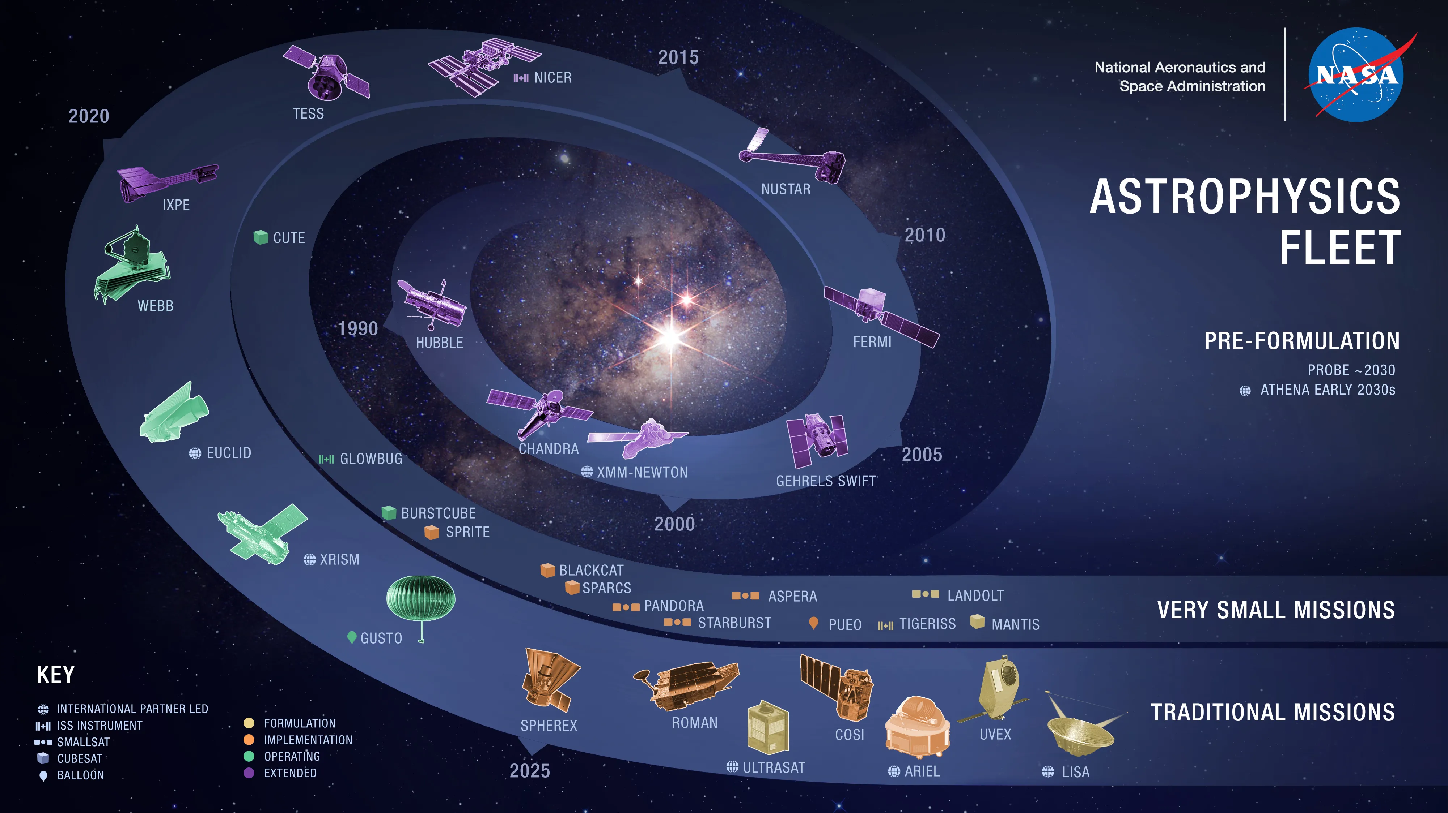

Slide 6
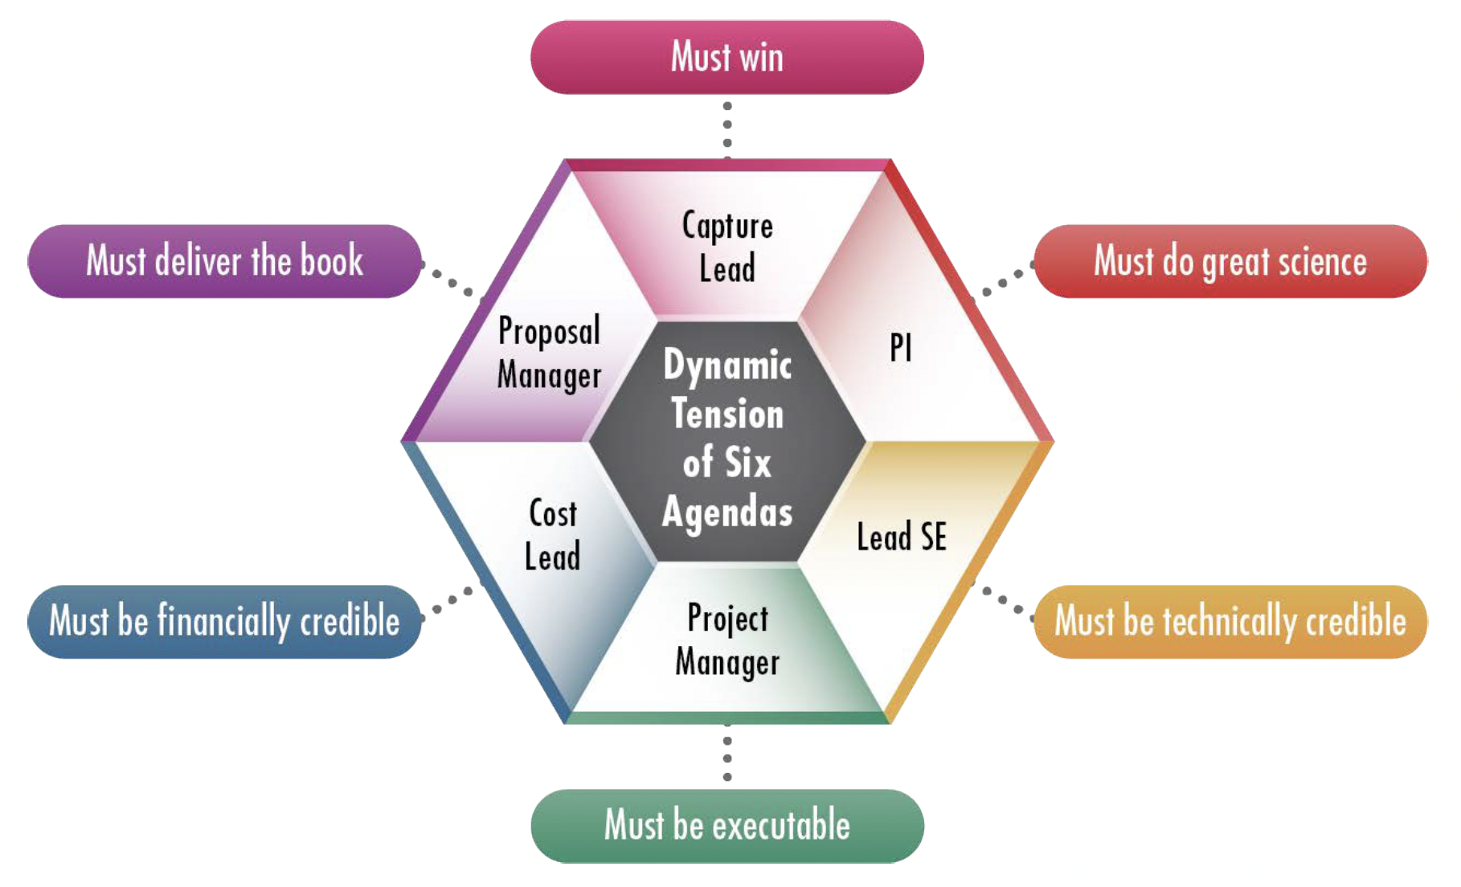
Formulation (competed) - A Team Sport

Slide 7
Elements of a great flight proposal
Compelling science goals, traceable to NASA and community priorities (NASA Science Plan, Decadal Survey…)
A strong PI – a recognized leader in the field – supported by a well qualified, diverse team
Clear ‘science traceability’ -
  An understanding of the state of the art
  Identification of a key metric that defines science value, and an idea of how that science value changes as a function of capability
  A description of the data set required to advance the state of the art (with quantitative justification)
  A demonstration that the proposed concept can return the required data, with margin
Assessed as low risk (achievable within available resources)

Slide 8
Getting Involved
Read a Mission Announcement of Opportunity! (really)
Volunteer to review NASA proposals
Engage with the NASA Program Analysis Groups (ExoPAG, COPAG, PhysPAG)
Meet a Program Scientist from HQ
Develop a network of contacts outside your own institution (other universities, NASA Centers, etc)
Find a mentor with flight experience
Talk about your own ideas within your circle, and see if they gain traction
Take advantage of NASA-funded opportunities to learn more about formulation…

Slide 9
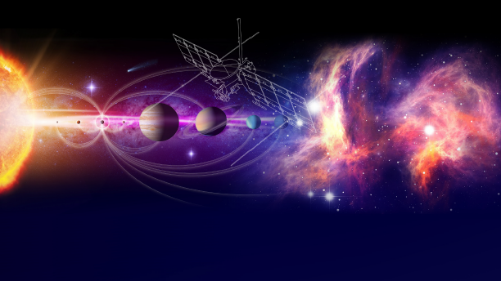
NASA Science Mission Design Schools
3-month immersive graduate-level early-career professional experience to design hypothesis-driven science mission concepts with JPL’s Project Design Team X.
Heliophysics Planetary Science Astrophysics

Slide 10
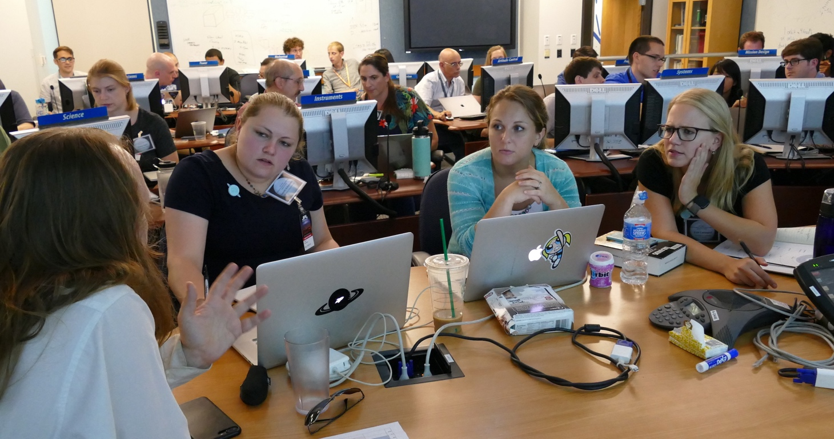
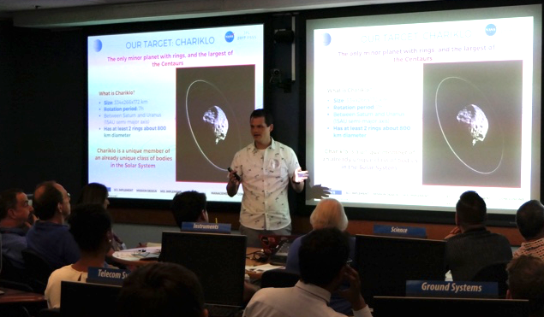
NASA Science Mission Design Schools
Learning Goals
How NASA science missions are formulated, proposed, and selected.
Best practices in converting the science goals of NASA into a mission implementation.
The teamwork required to develop a mission concept.
Best practices in responding to an announcement of opportunity.
The NASA structure for developing missions.

Slide 11
https://go.nasa.gov/missiondesignschools

Slide 12
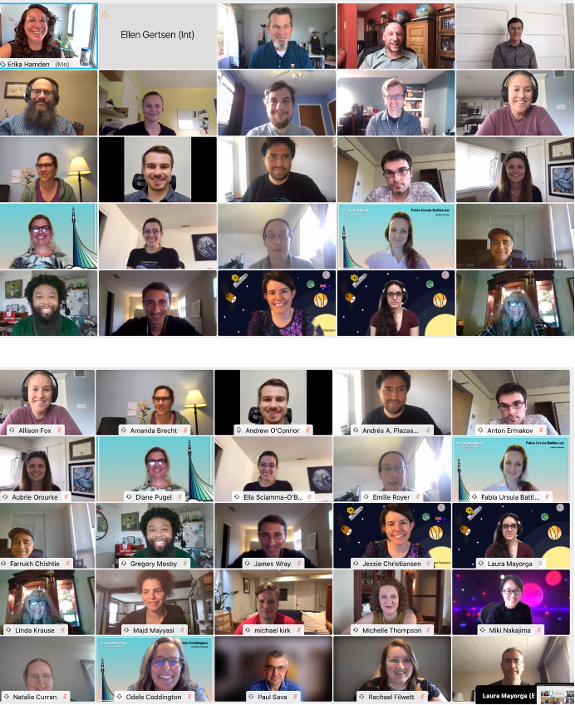
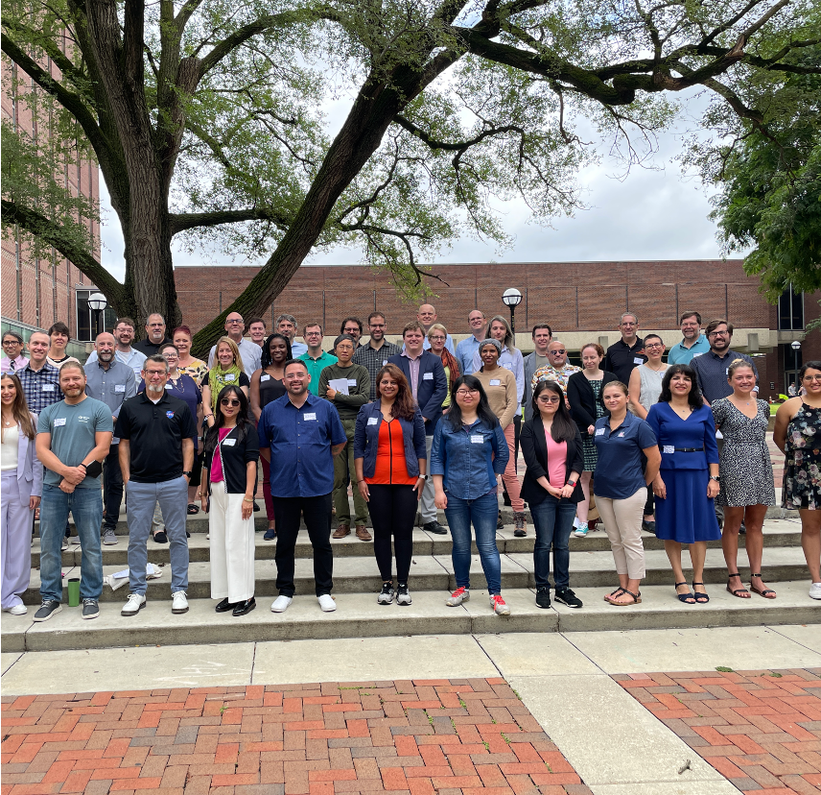
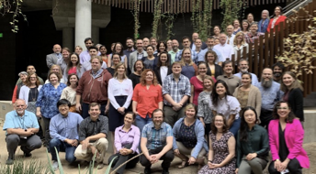
NASA’s PI Launchpad
Bi-Annual Workshop to teach future PIs about mission development!
2019, 2023, and 2021

Slide 13
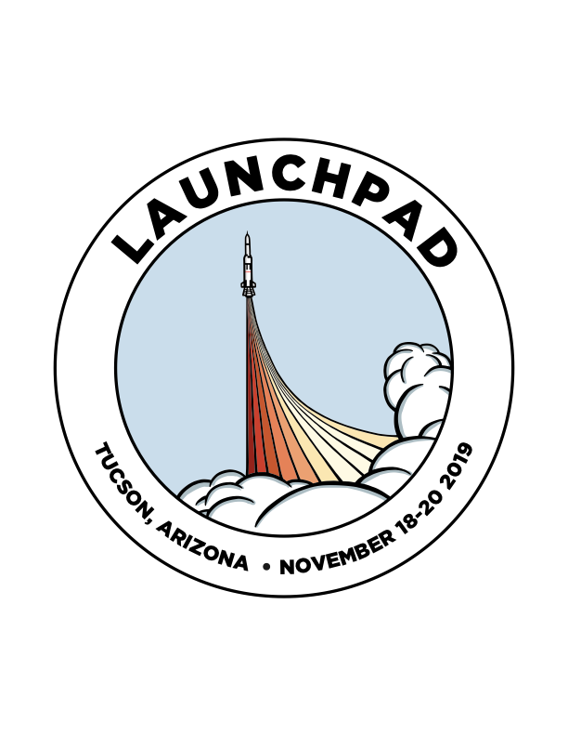
Typical Agenda
Emphasis on getting started with building a mission team and developing a concept
Sessions on Timelines, Mission Sizes, Storytelling, Graphics, the Science Traceability Matrix, partnering with industry and NASA centers, roles on the science team, panel discussion with PIs, Panel on building a diverse science team
Networking with Industry Partners and NASA Centers
Planning a fourth PI Launchpad for Summer of 2025! Details to appear on NSPIRES and the website
All Content is Online- https://science.nasa.gov/researchers/pi-launchpad/

