Slide 1


Orbit Fitting
Thanks to Eric Nielsen for teaching me about orbit fitting!
Sarah Blunt
CIERA Fellow @ Northwestern NSF AAPF @ UC Santa Cruz

Slide 2
Why fit orbits?
Orbit fitting can allow you to infer dynamical masses:
mass + luminosity constrains formation (e.g. Marley+ ‘07)
masses allow easier interpretation of spectra
Orbital elements are tracers of planet formation:
Eccentricity (e.g. Bowler+ ‘20)
Obliquity (e.g. Bryan+ ‘20)
Semimajor axis (e.g. Nielsen+ ‘19)
Orbit fitting can constrain a system’s long-term behavior:
Secular dynamics (e.g. Wang+ ‘18)
N-body dynamics (e.g. Covarrubias+ ‘22)
Fitting orbits can reveal additional companions:
Hipparcos-Gaia accelerations (e.g. discovery of AF Lep: De Rosa+/Franson+/Mesa+ ‘23)
Radial velocities (e.g. Hirsch+ ‘19)
Multi-planet effects (e.g. discovery of HD 206893 c: Hinkley+ ‘22)

Slide 3
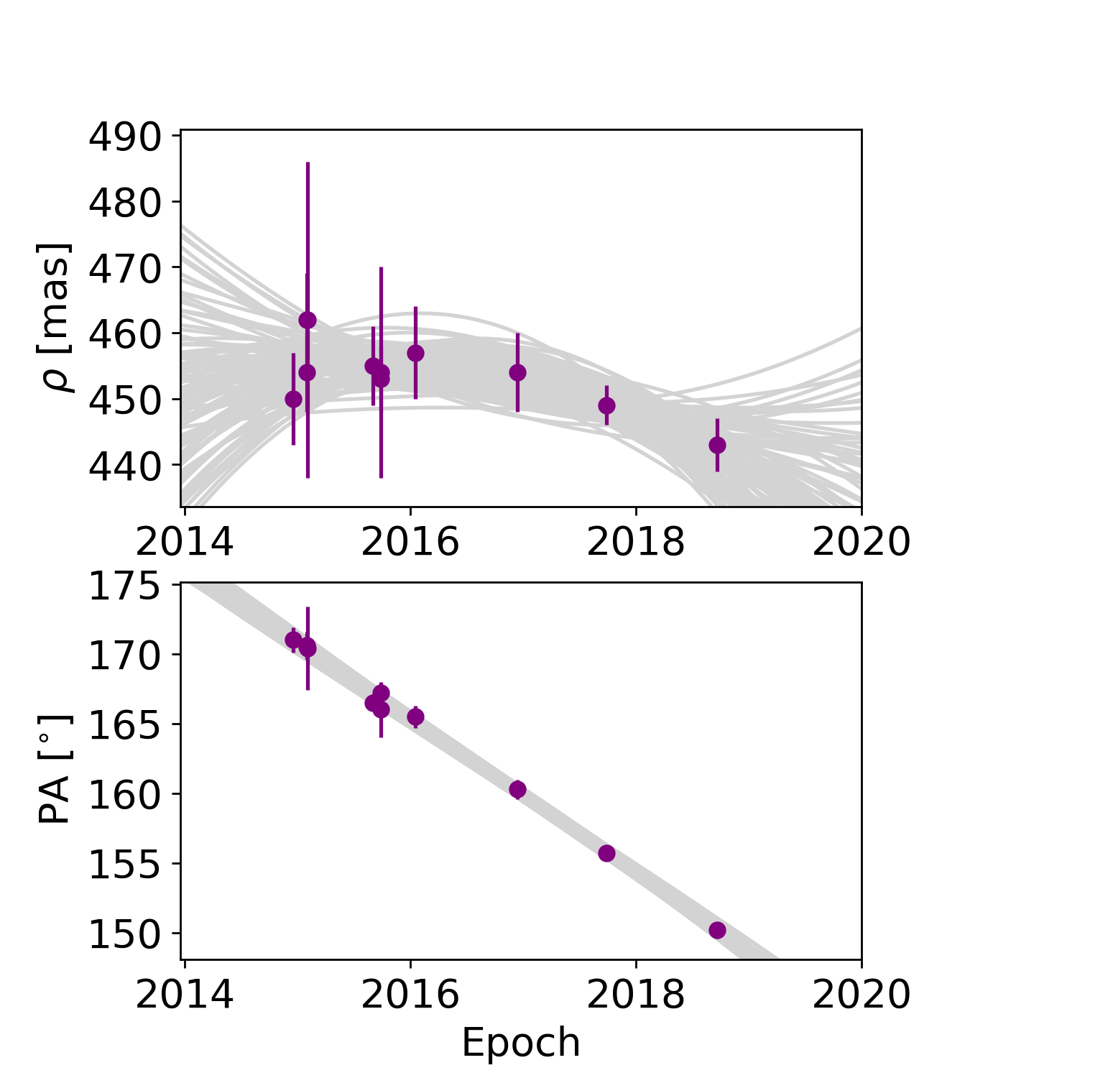
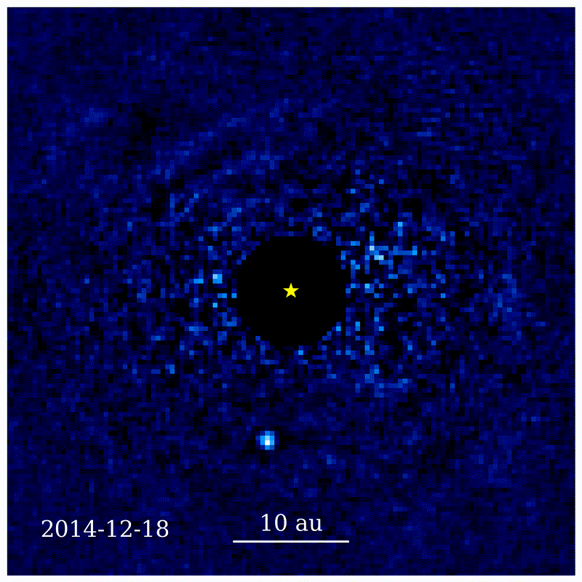
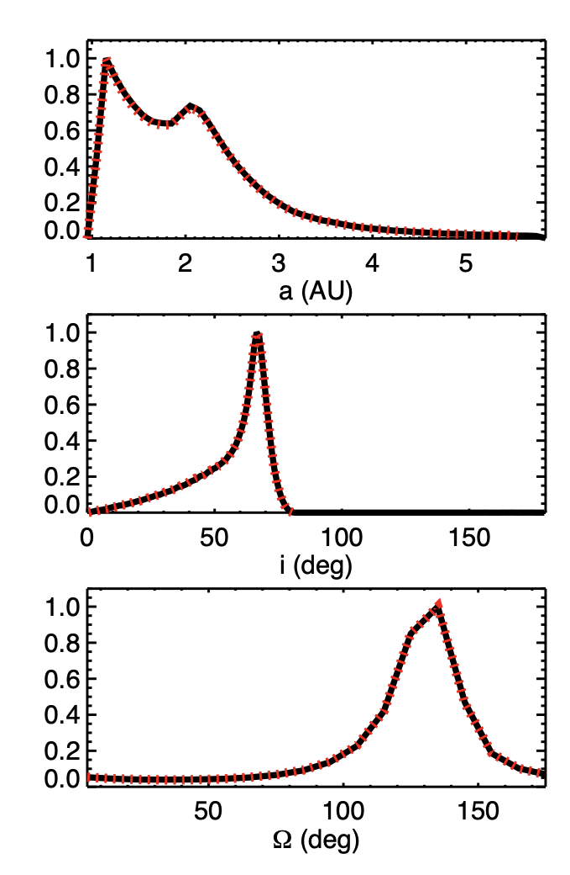
Orbit-fitting is the process of using data to infer all possible orbits for an exoplanet.
1: raw images
2: extracted measurements
3: probability distributions
Jason Wang
Bowler, Blunt, & Nielsen 2020
Blunt+ 2017

Slide 4
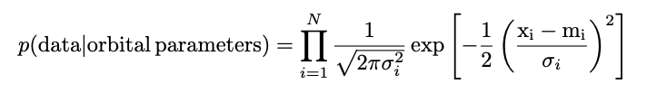
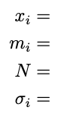
Bayesian orbit-fitting means using this equation:
posterior
likelihood
prior
data point #i
model prediction #i
number of data points
error #i
The rest of this talk is about how to compute the model, m, for a set of orbital parameters. A lot of this talk is taken from chapter 4 of my PhD thesis.

Slide 5
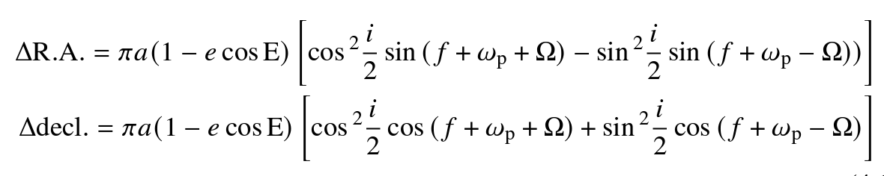
Solving the 2-body problem and projecting the resulting orbit on the plane of the sky gives:
Model prediction
Orbital parameters
Anomalies = functions of time
← parallax * semimajor axis = angular size of orbit
← eccentricity = shape of orbit
← inclination, argument of periastron, position angle of nodes = orientation of orbit
The gory details of this derivation: Murray & Correia ‘11

Slide 6
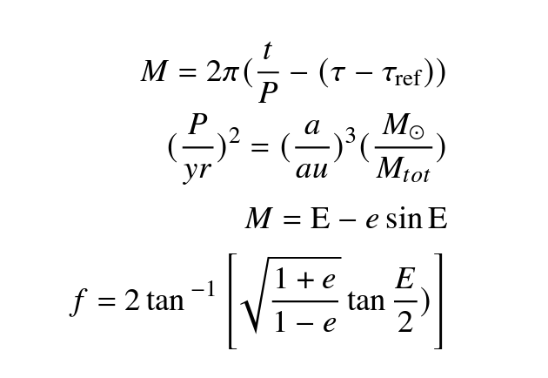
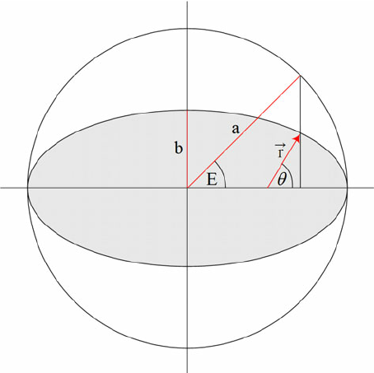
The anomalies relate time and position on the orbital path.
Orbital parameters
Anomalies = functions of time
← “tau”: time of periastron passage, expressed as a fraction of orbital period
← mean anomaly
← orbital period
← eccentric anomaly
← true anomaly
← Kepler’s equation (bad)
f

Slide 7
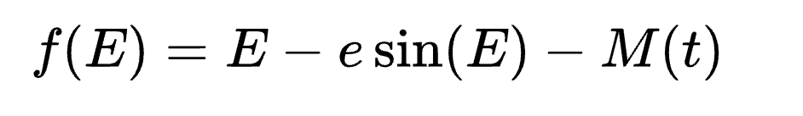
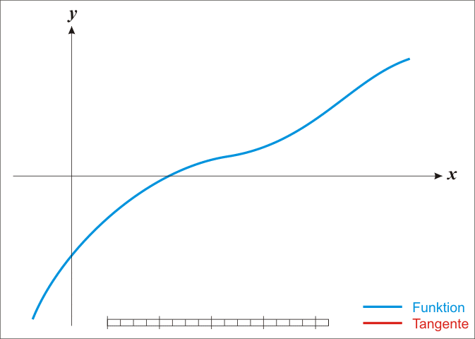
How do you solve Kepler’s equation?
In other words: given t/M, how do you get E/f?
You could spend your whole career on this problem
The most common way is the Newton-Raphson method: solve for the zero of the function:
wikipedia

Slide 8
All the variables together:
Properties of the orbit
(we want posteriors of these)
Intermediate variables
(we need these to make model predictions)
Orbital parameters
Anomalies = functions of time
← parallax * semimajor axis = angular size of orbit
← mean anomaly
← eccentricity = shape of orbit
← eccentric anomaly
← inclination, argument of periastron, position angle of nodes = orientation of orbit
← true anomaly
← “tau”: time of periastron passage, expressed as a fraction of orbital period
← orbital period
Note: Kepler’s third law means you can infer 2/3 of these:

Slide 9
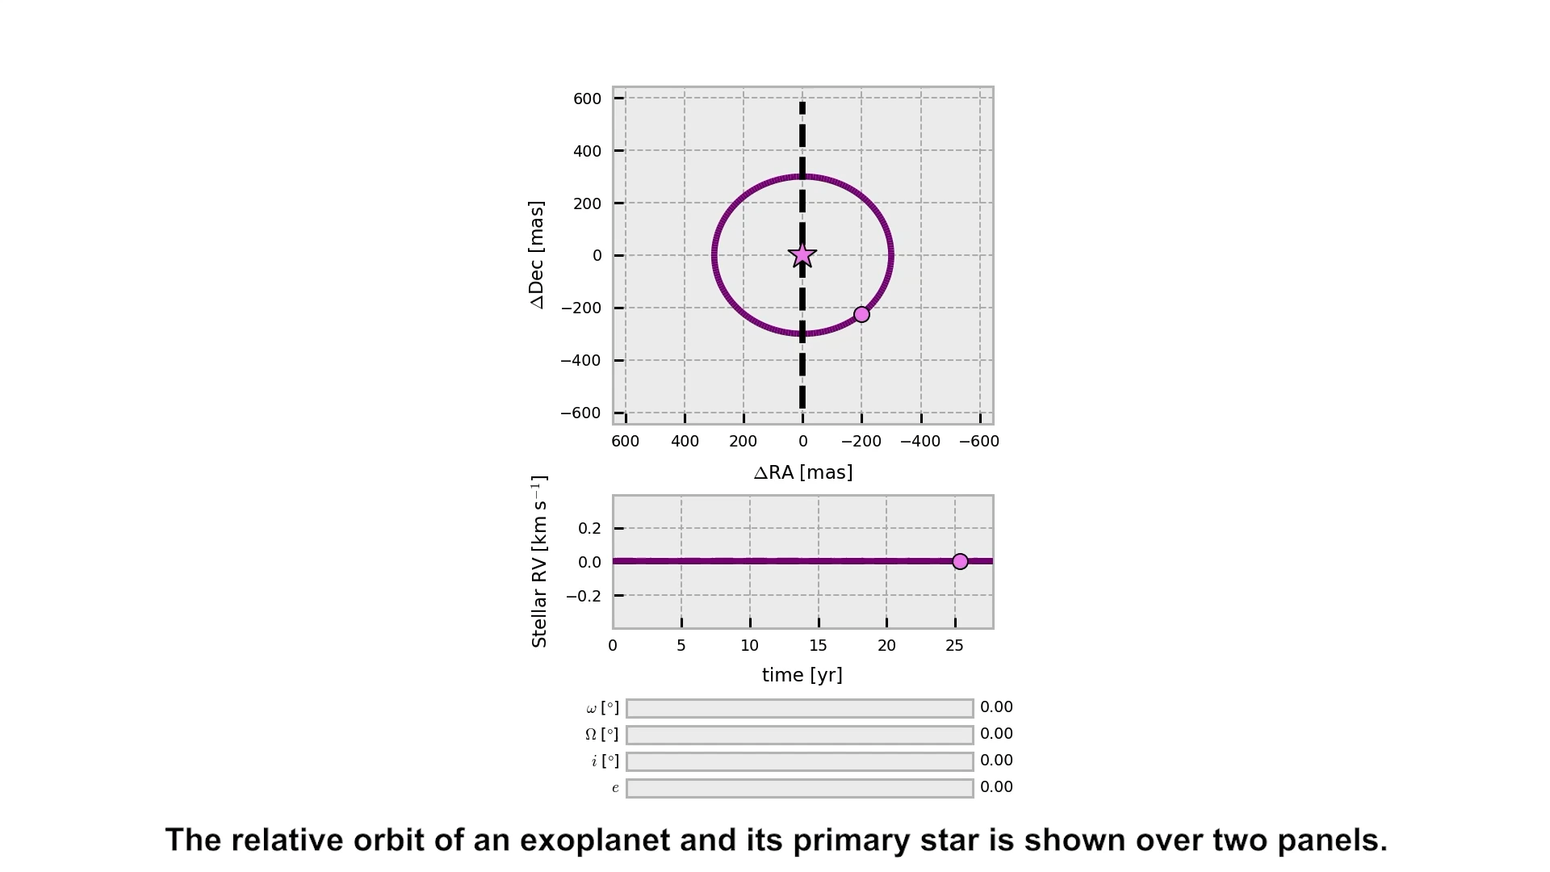
https://github.com/sblunt/orbitize/blob/main/docs/tutorials/show-me-the-orbit.ipynb
Blunt+ 2020

Slide 10
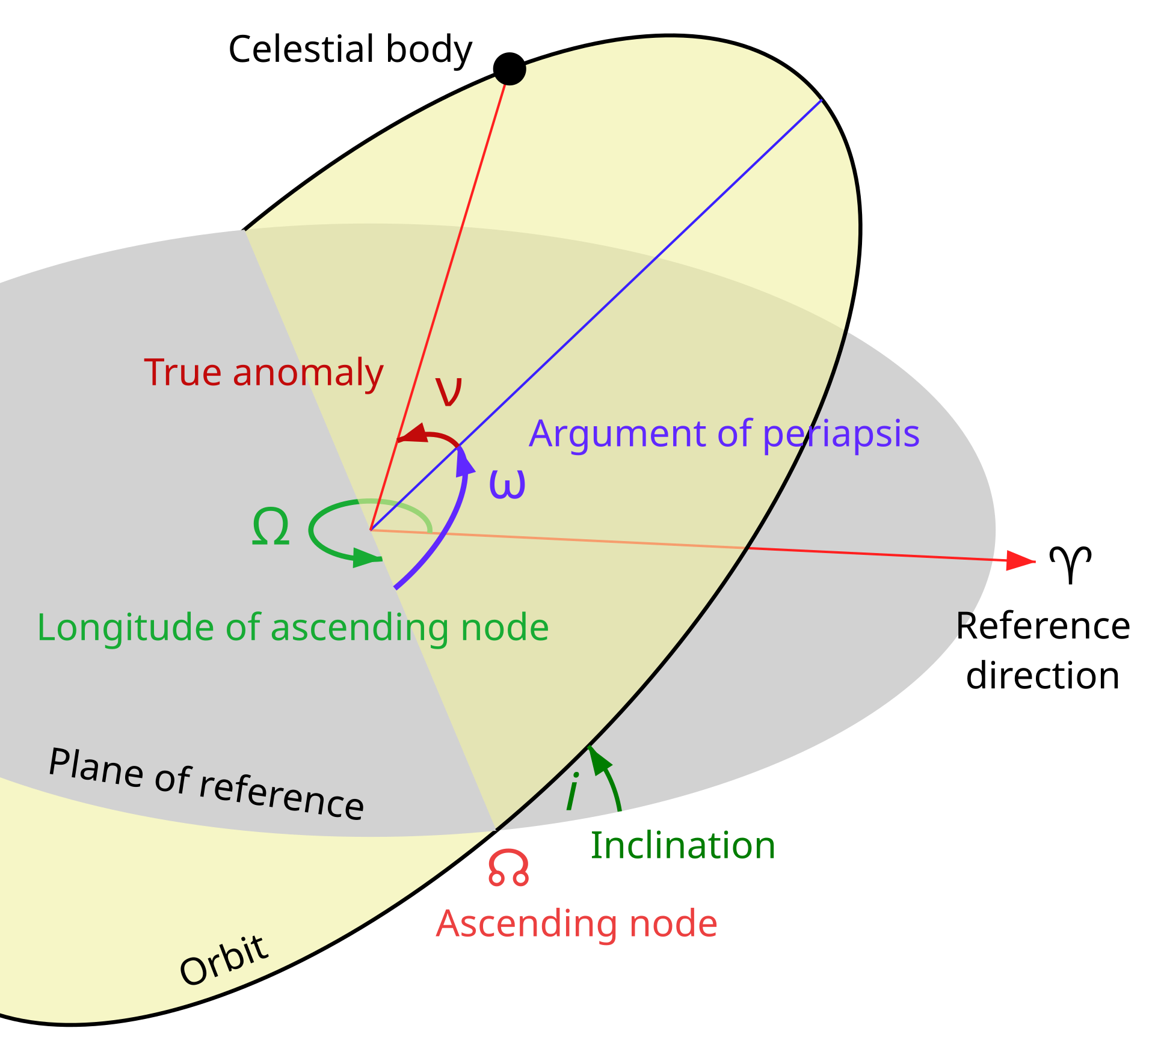
Friendship ended with this Wikipedia diagram!!
NB: the reference direction is off by 90deg!

Slide 11
Some important degeneracies:
You cannot measure dynamical mass from relative astrometry alone. However, you can measure total mass.
Parallax and semimajor axis are degenerate. Fortunately, we often know parallax independently (e.g. from Gaia).

Slide 12
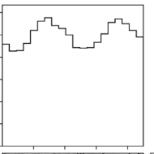
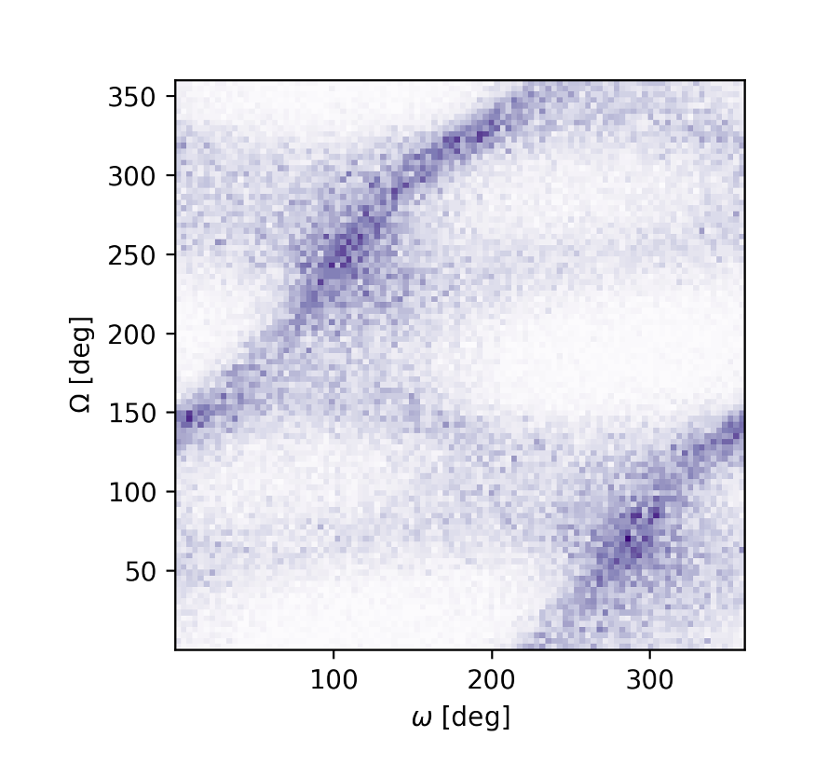
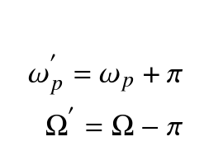
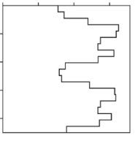
Some important degeneracies:
These equations are invariant to the transform:

Slide 13
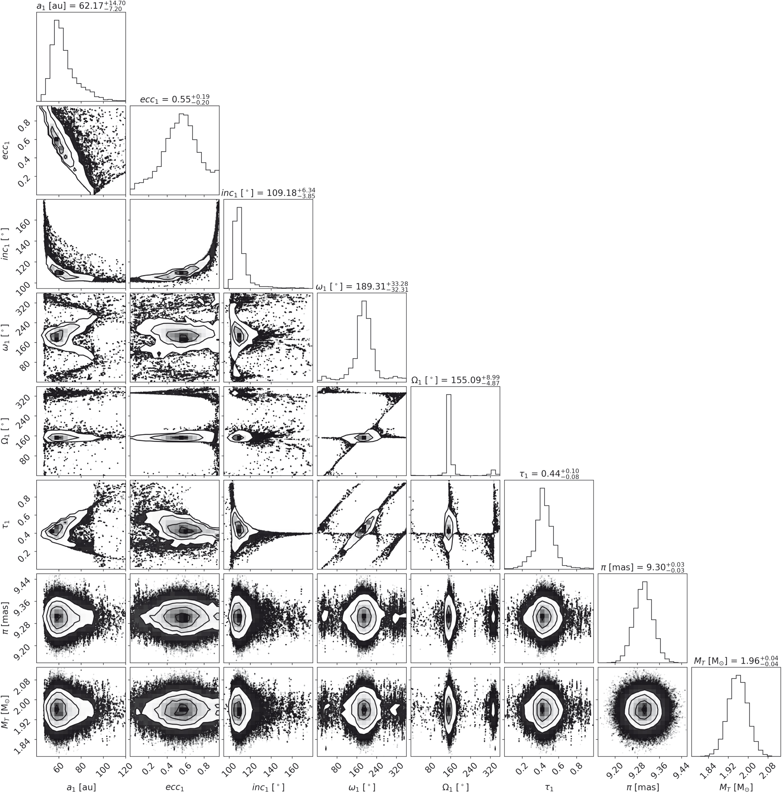
Eccentricity/inclination/semimajor axis covariance is a common feature of incomplete orbits.
Blunt+ ‘23b
more edge-on
eccentricity (e)
inclination (i)
semimajor axis (a)
eccentricity (e)
semimajor axis (a)
see Ferrer Chávez+ 20 for more detail
Notes:
For smaller sma, we need a higher eccentricity, and closer to a face-on orbit

Slide 14
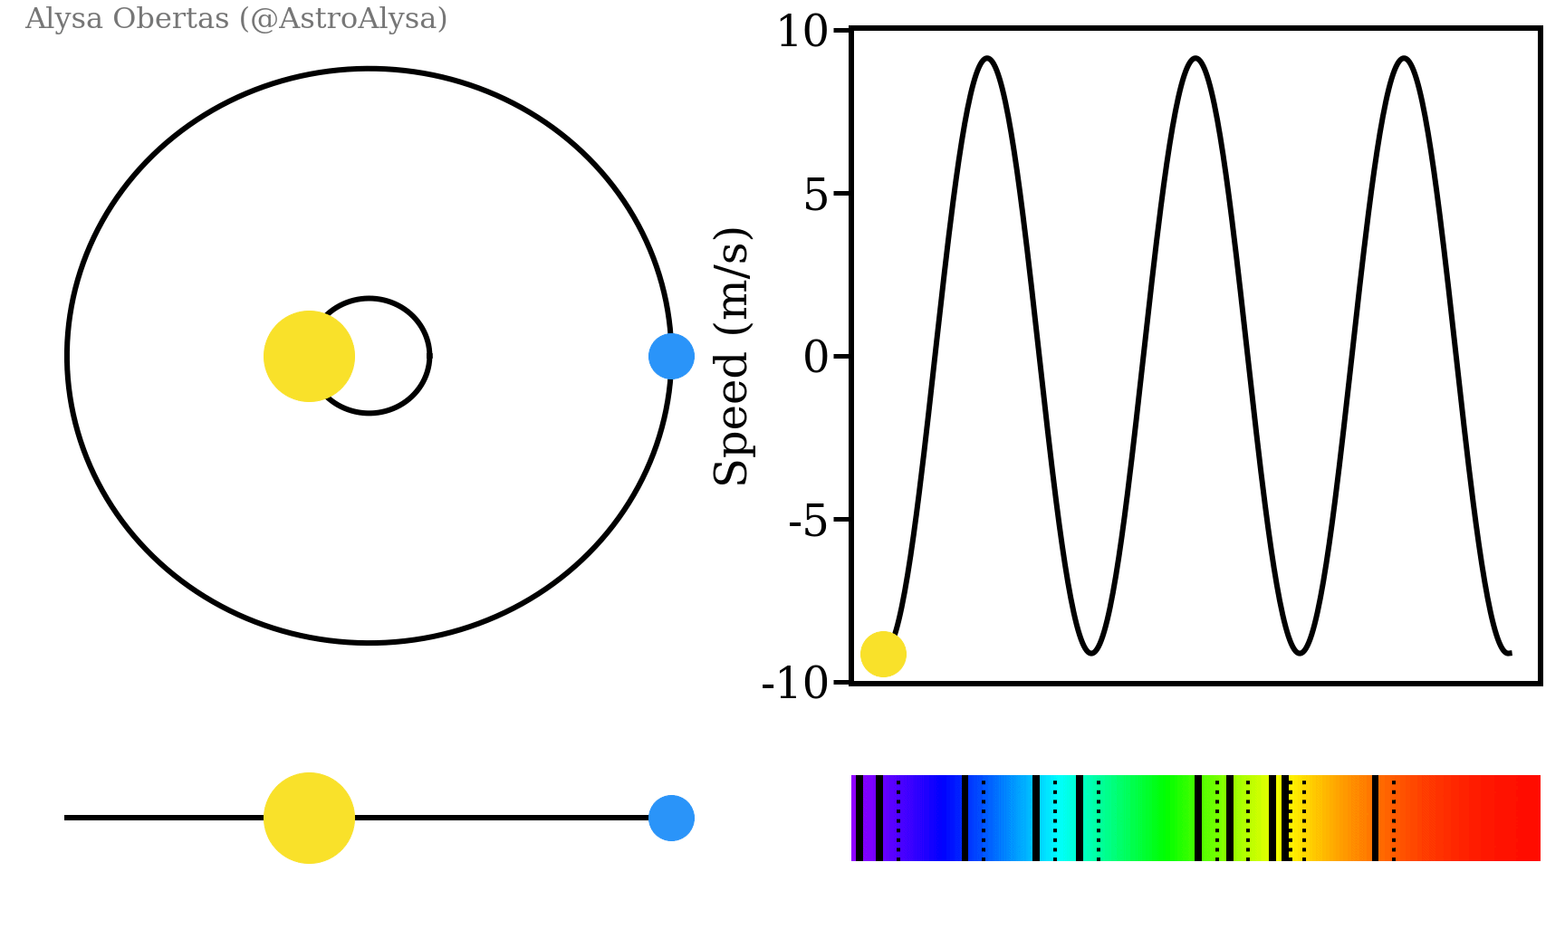
So far, we’ve only thought about modeling the relative position of a planet and its star.
Let’s now add two common additional data types into our model.
Additional data type #1: radial velocity

Slide 15
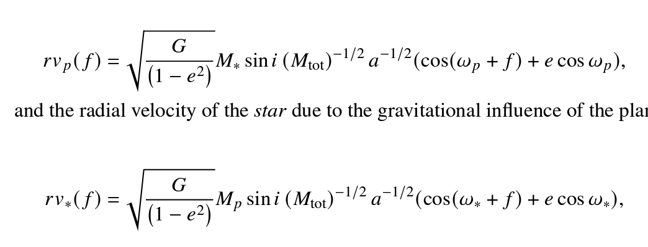
So far, we’ve only thought about modeling the relative position of a planet and its star.
Let’s now add two common additional data types into our model.
Additional data type #1: radial velocity
Planetary radial velocity:
Stellar radial velocity:
Radial velocities constrain individual component masses.

Slide 16
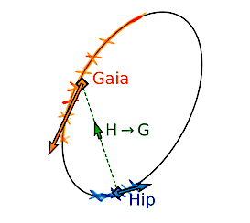
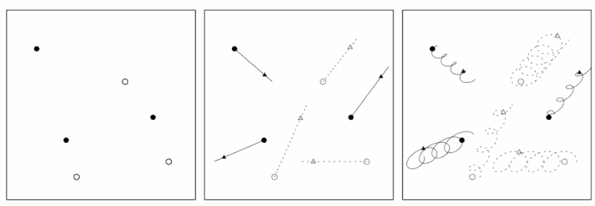
So far, we’ve only thought about modeling the relative position of a planet and its star.
Let’s now add two common additional data types into our model.
Additional data type #2: absolute astrometry
Brandt 24
Perryman (via Wikipedia)

Slide 17
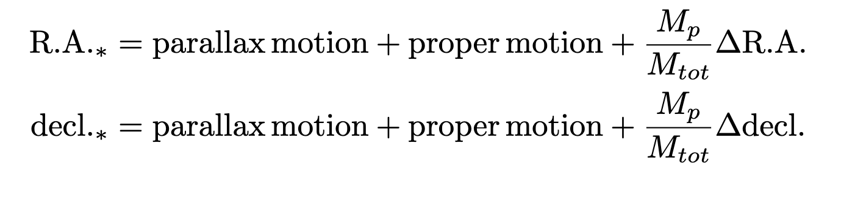
So far, we’ve only thought about modeling the relative position of a planet and its star.
Let’s now add two common additional data types into our model.
Additional data type #2: absolute astrometry
Absolute astrometry constrains planet mass.
Depending on how you fit absolute astrometry, you may or may not fit for astrometric parameters like proper motion (e.g. Nielsen+ ’21)

Slide 18
Orbit-fitting is a big field. Here’s some more cool stuff to think about:
Adding multi-planet effects into the model (e.g. Lacour+ ’21, Covarrubias+ 22)
Systematic errors in radial velocities (e.g. Blunt+ ’23a) & absolute astrometry (e.g. Brandt+ 18)
De-confusion: which directly imaged planet corresponds to which radial velocity signal? (e.g. Pogorelyuk+ 22)
Reducing bias in Bayesian priors on orbital parameters (e.g. O’Neil, Martinez+ ‘18)
Some open-source orbit-fitting codes used by exoplanet imagers:
orbitize! (Blunt+20, Blunt+ 24 submitted)
orvara (Brandt+ 21)
octofitter (Thomson+ 24)
LOFTI (Pearce+ 20)
*This list will likely expand in advance of Gaia DR4!

