Slide 1
Hands-on introduction: Optical modeling of coronagraphic systems
Sagan Summer Workshop 2024
Advances in Direct Imaging: From Young Jupiters to Habitable Earths
On behalf of Emiel Por

Slide 2
Optical modeling - history
You will learn the basics of optical modeling with the High-Contrast Imaging for Python package.
  Open source software design led by Emiel Por (STSci)
  https://hcipy.org/
  https://github.com/ehpor/hcipy
Software package for full end-to-end modeling of optical systems including:
  Adaptive optics and wavefront sensing
  Coronagraphy
  Photonics
  Intrinsic support for polarization
  General physical optics propagation modeling
  Under development: automatic differentiation through JAX

Slide 3
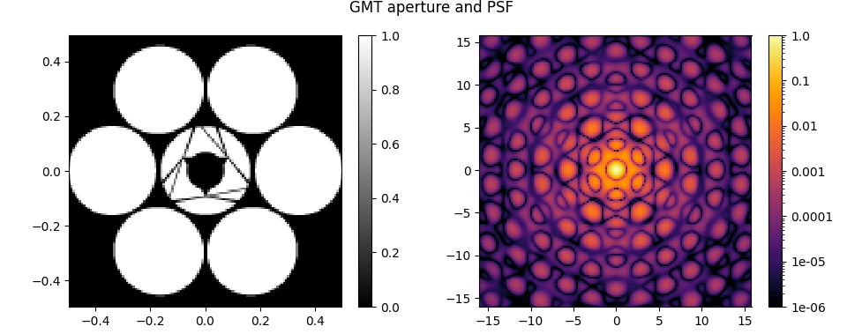
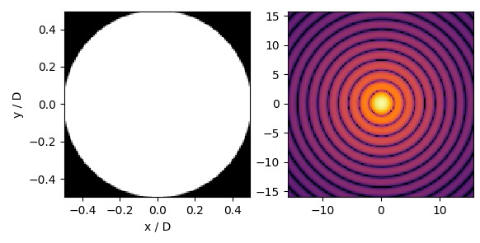
What are we going to do - PSFs
The first block will focus on getting familiar with HCIPy
Here you will learn how to:
Make a Point Spread Function
Make multi-wavelength Point Spread functions

Slide 4
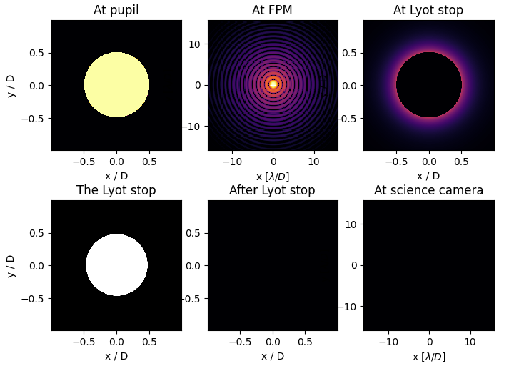
What are we going to do - Coronagraphy
The second block will focus on coronagraphs
Here you will learn how to:
Propagate through a coronagraph
Analyze the coronagraphs performance

Slide 5
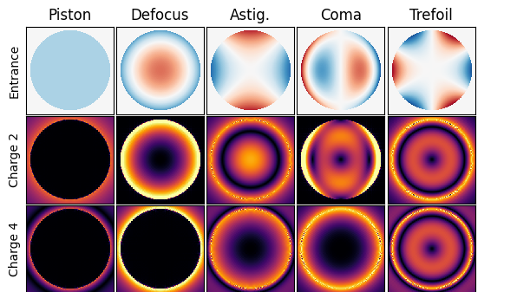
What are we going to do - Aberrations
The third block will focus on aberrations
Here you will learn how to:
Add aberrations to a system
Analyze their impact on coronagraphs

Slide 6
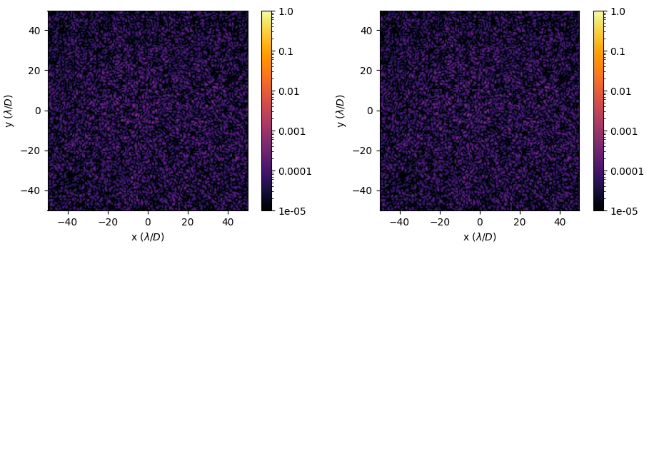
Group projects: Adaptive Optics

Slide 7
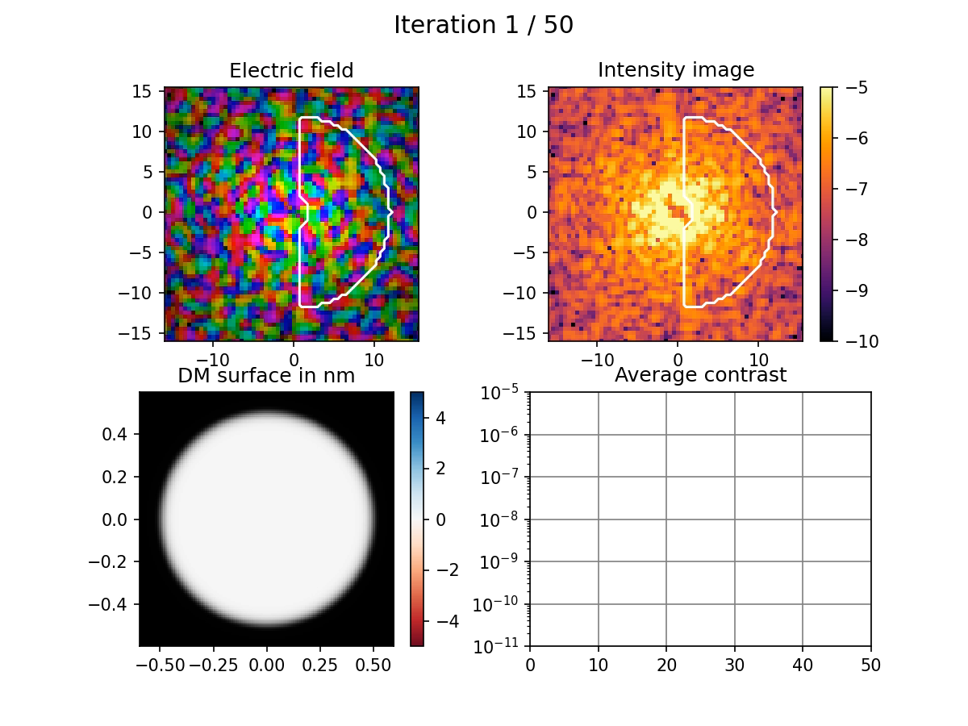
Group projects 2: EFC

