Slide 1
Designing a coronagraphic system
Sagan Summer Workshop 2024
Advances in Direct Imaging: From Young Jupiters to Habitable Earths

Slide 2
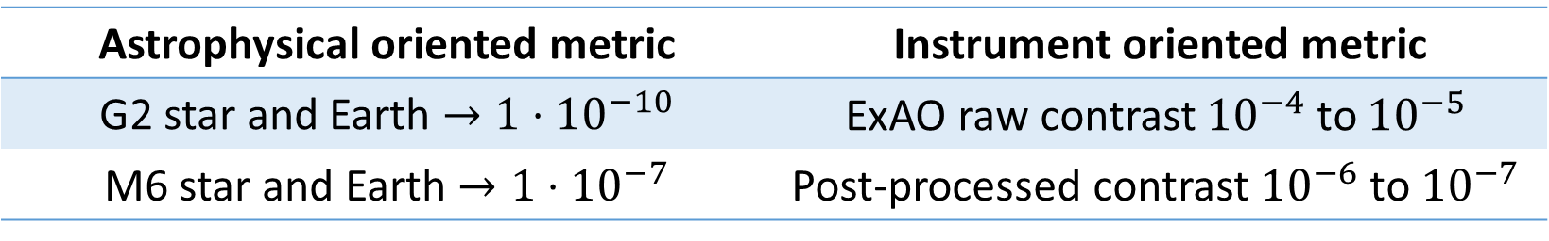
Contrast in Direct Imaging
What sets the fundamental limit for high-contrast imaging?
We usually specify “contrast”…
Astrophysical oriented metric | Instrument oriented metric
G2 star and Earth $→1⋅{10}^{−10}$ | ExAO raw contrast ${10}^{−4}$ to ${10}^{−5}$
M6 star and Earth $→1⋅{10}^{−7}$ | Post-processed contrast ${10}^{−6}$ to ${10}^{−7}$

Slide 3
Problems with contrast
“Contrast” has several meanings
“astrophysical flux ratio” is the planet to star flux ratio
“raw contrast” is just an instantaneous intensity ratio in an image
“post-processed contrast” is the sensitivity after image post-processing
The main problem: contrast is not a noise model
A perfectly static background would not be a problem we could just subtract it.

Slide 4
Problems with contrast
“Contrast” has several meanings
“astrophysical flux ratio” is the planet to star flux ratio
“raw contrast” is just an instantaneous intensity ratio in an image
“post-processed contrast” is the sensitivity after image post-processing
The main problem: contrast is not a noise model
A perfectly static background would not be a problem we could just subtract it.
The stellar PSF is the background here.

Slide 5
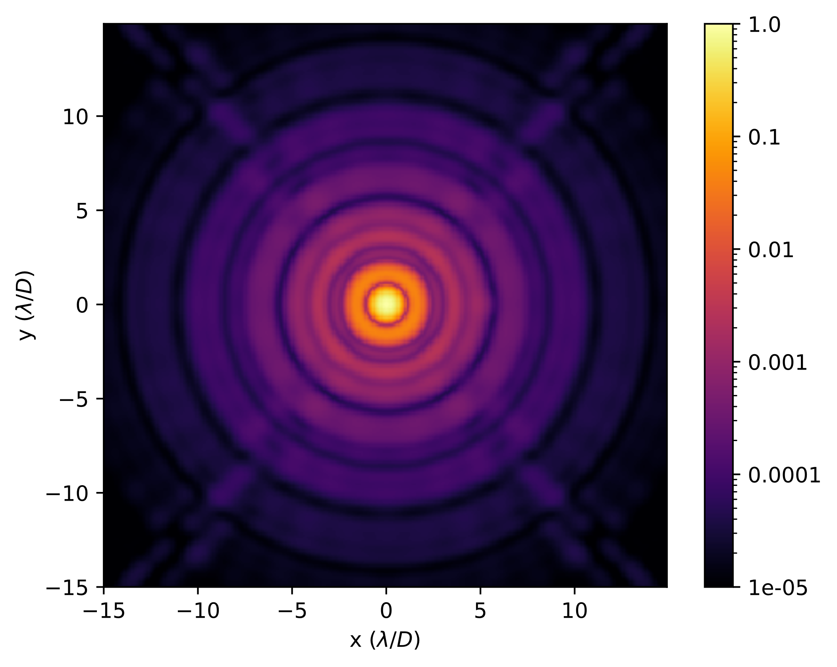
Why do we need a coronagraph?

Slide 6
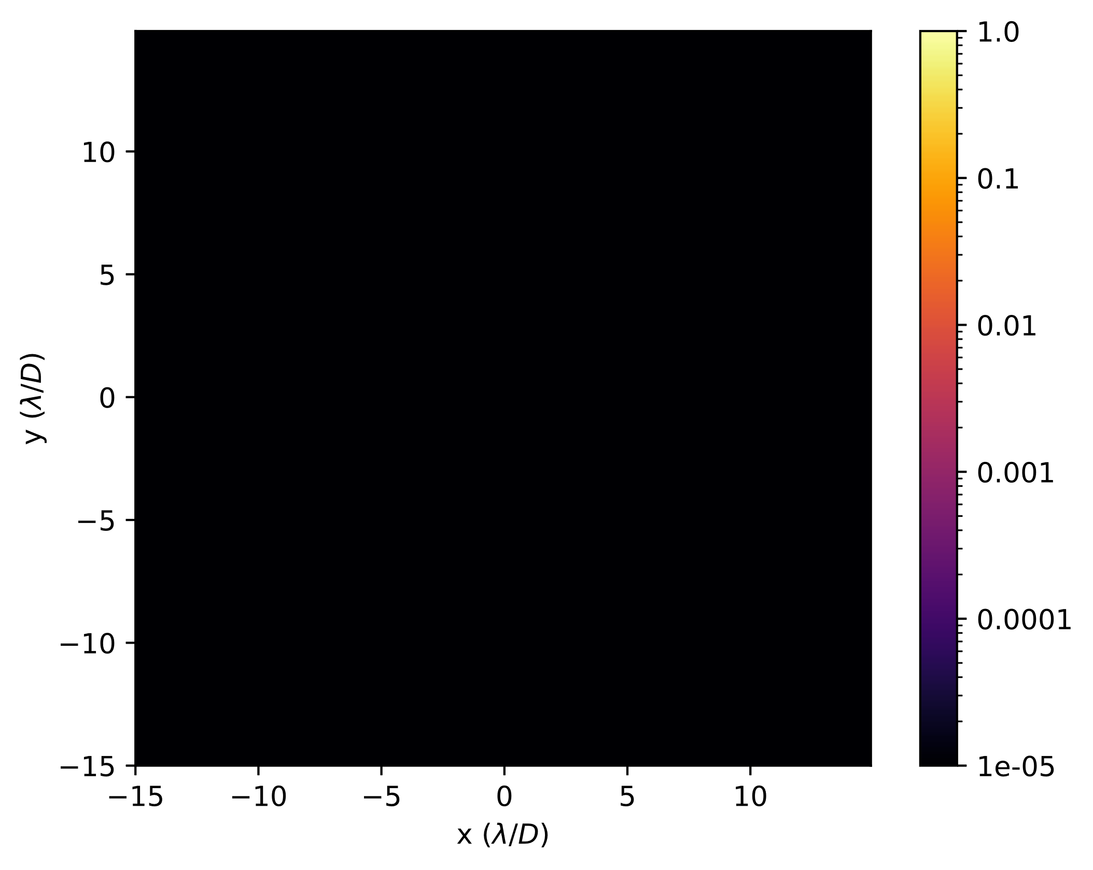
Why do we need a coronagraph?

Slide 7
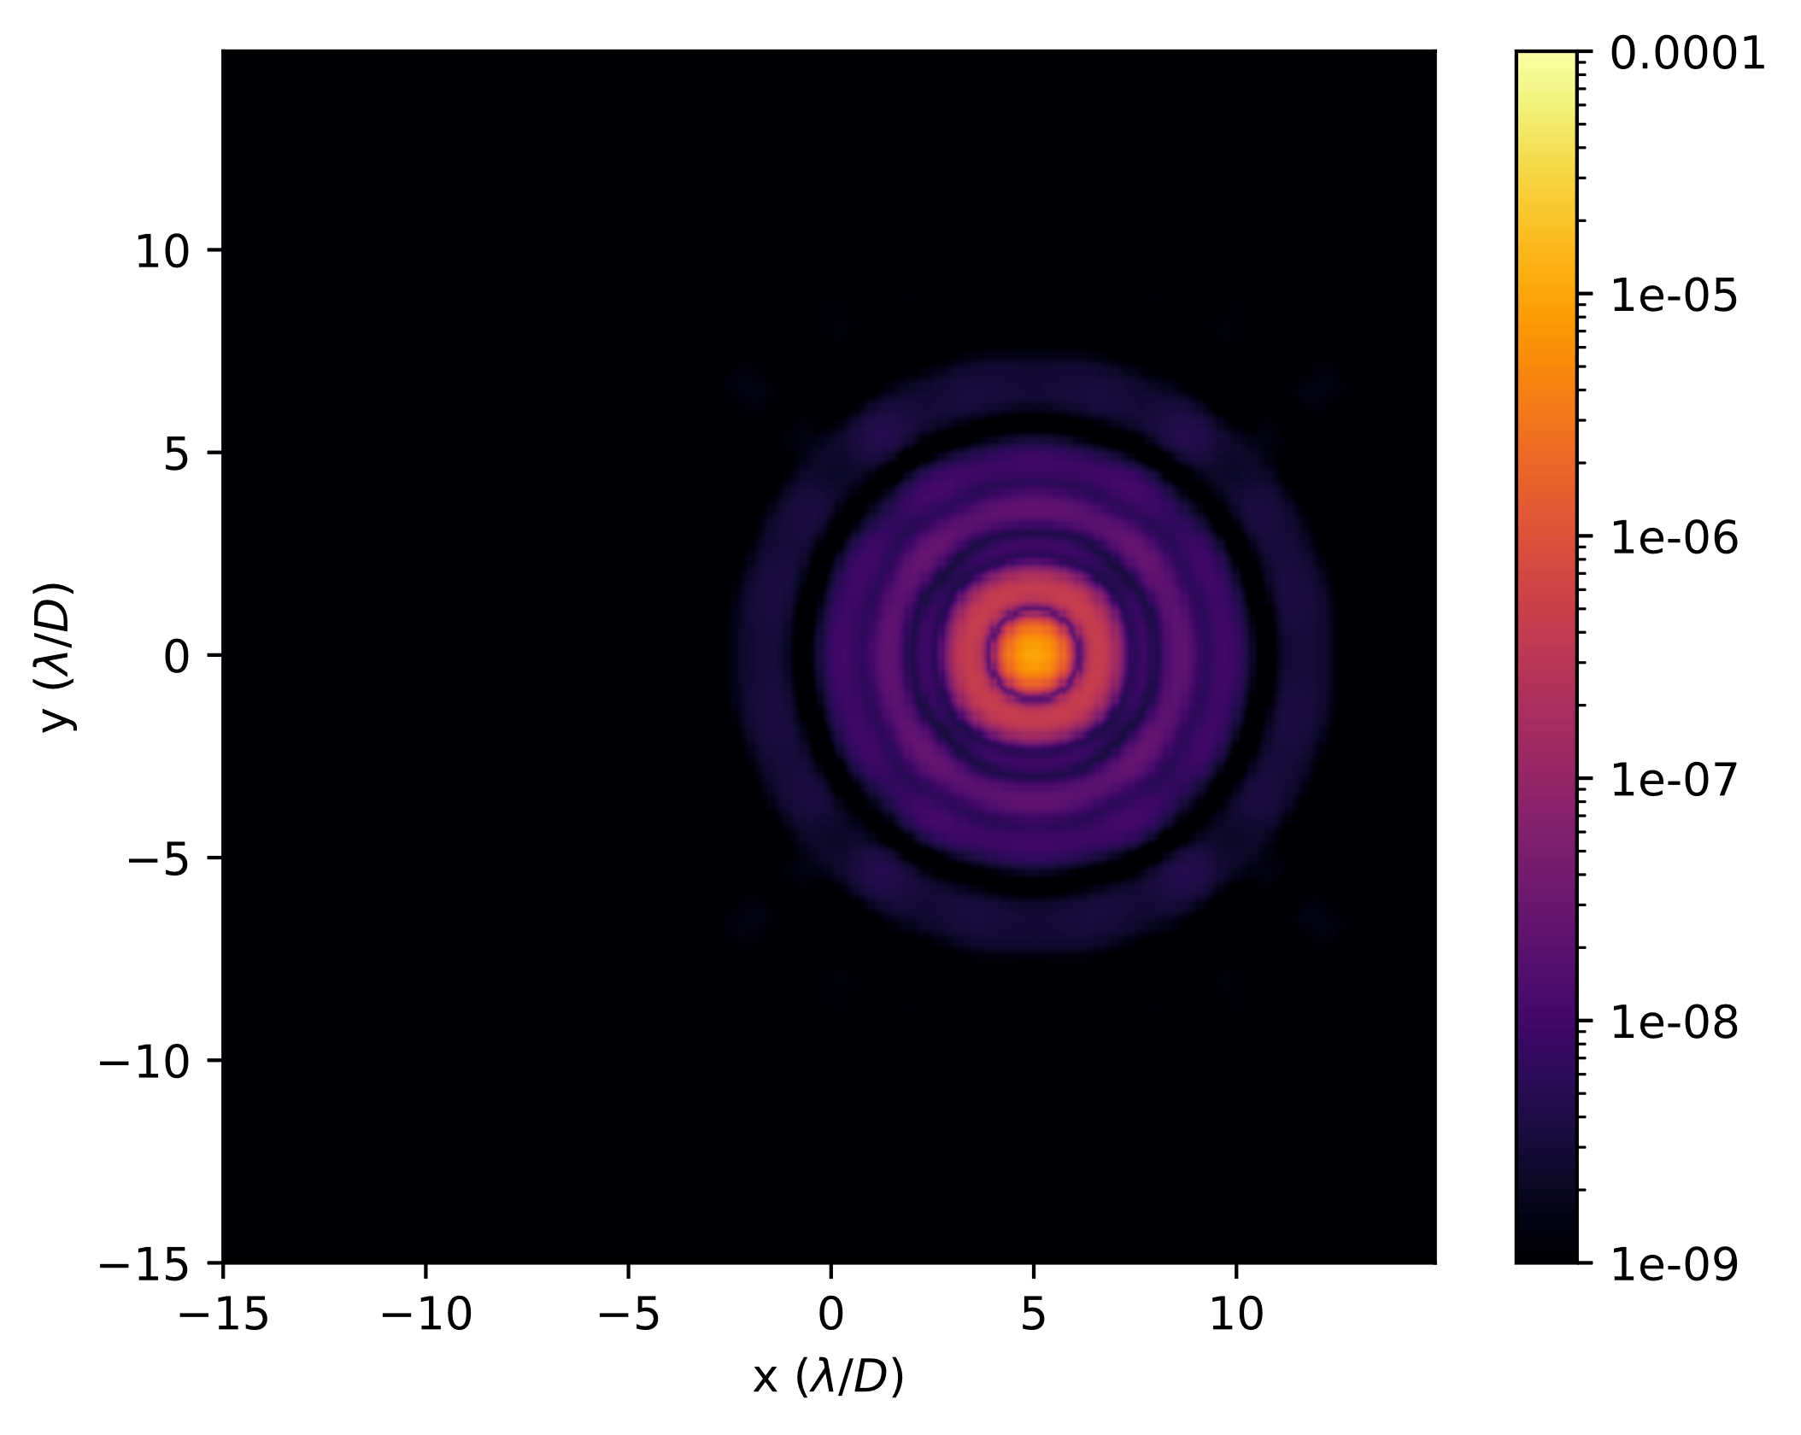
Why do we need a coronagraph?

Slide 8
Why do we need a coronagraph?
I changed the colormap scales to highlight the planet.

Slide 9
Why do we need a coronagraph?
We found the planet. Easy right?

Slide 10
Quantization of the electric field.
Classical electromagnetism tells us that the electric field is continuous.

Slide 11

Quantization of the electric field.
Classical electromagnetism tells us that the electric field is continuous.
$$I={\left|E\right|}^{2}$$

Slide 12
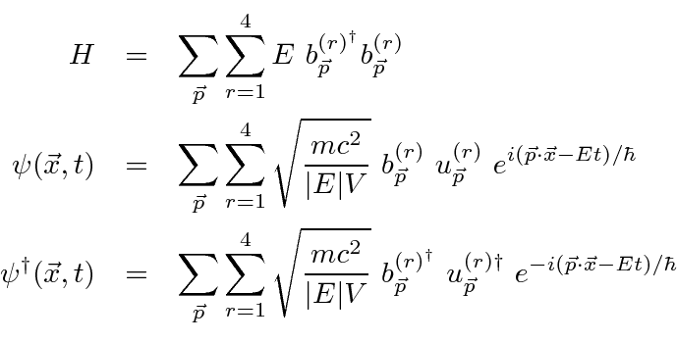
Quantization of the electric field.
Classical electromagnetism tells us that the electric field is continuous.
But then Quantum Mechanics came along and quantized the electric field!
$$I={\left|E\right|}^{2}$$

Slide 13
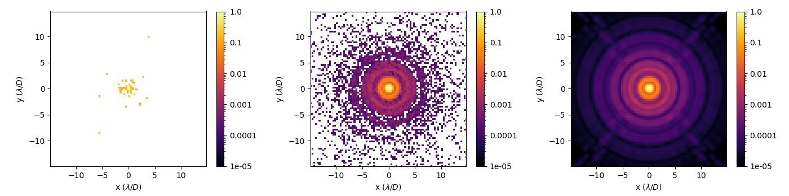



Poisson noise (or shot noise)
${10}^{2}$ photons / frame
${10}^{5}$ photons / frame
${10}^{10}$ photons / frame

Slide 14
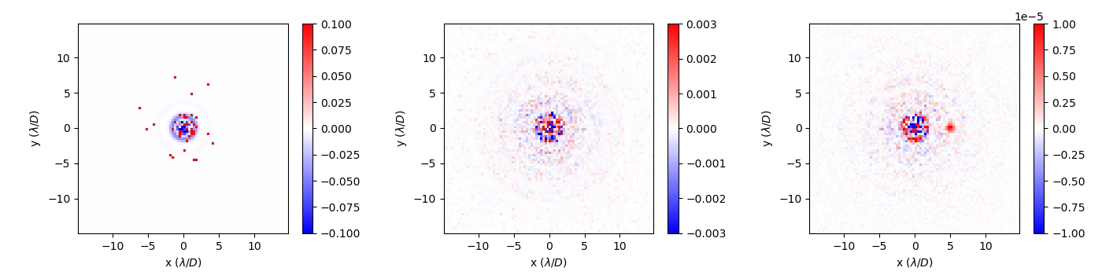
Model PSF subtracted
${10}^{2}$ photons / frame
${10}^{5}$ photons / frame
${10}^{10}$ photons / frame

Slide 15
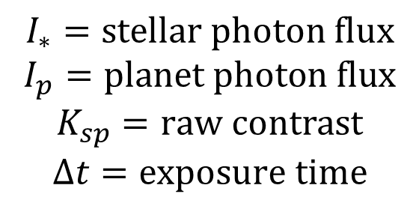

The photon noise limit
If we had uncorrelated photon noise:
$$σ_{h}^{2}=I_{∗}ΔtK_{sp}$$
$$I_{∗}=stellar photon flux$$
$$I_{p}=planet photon flux \\ K_{sp}=raw contrast$$
$$Δt=exposure time$$

Slide 16

The photon noise limit
If we had uncorrelated photon noise:
$$σ_{h}^{2}=I_{∗}ΔtK_{sp}$$
Then the S/N of the planet would be:
$$\frac{S}{N}=\frac{I_{p}Δt}{\sqrt{I_{∗}ΔtK_{sp}}}$$
$$I_{∗}=stellar photon flux$$
$$I_{p}=planet photon flux \\ K_{sp}=raw contrast$$
$$Δt=exposure time$$

Slide 17

The photon noise limit
If we had uncorrelated photon noise:
$$σ_{h}^{2}=I_{∗}ΔtK_{sp}$$
Then the S/N of the planet would be:
$$\frac{S}{N}=\frac{I_{p}Δt}{\sqrt{I_{∗}ΔtK_{sp}}}$$
$$I_{∗}=stellar photon flux$$
$$I_{p}=planet photon flux \\ K_{sp}=raw contrast$$
$$Δt=exposure time$$

Slide 18
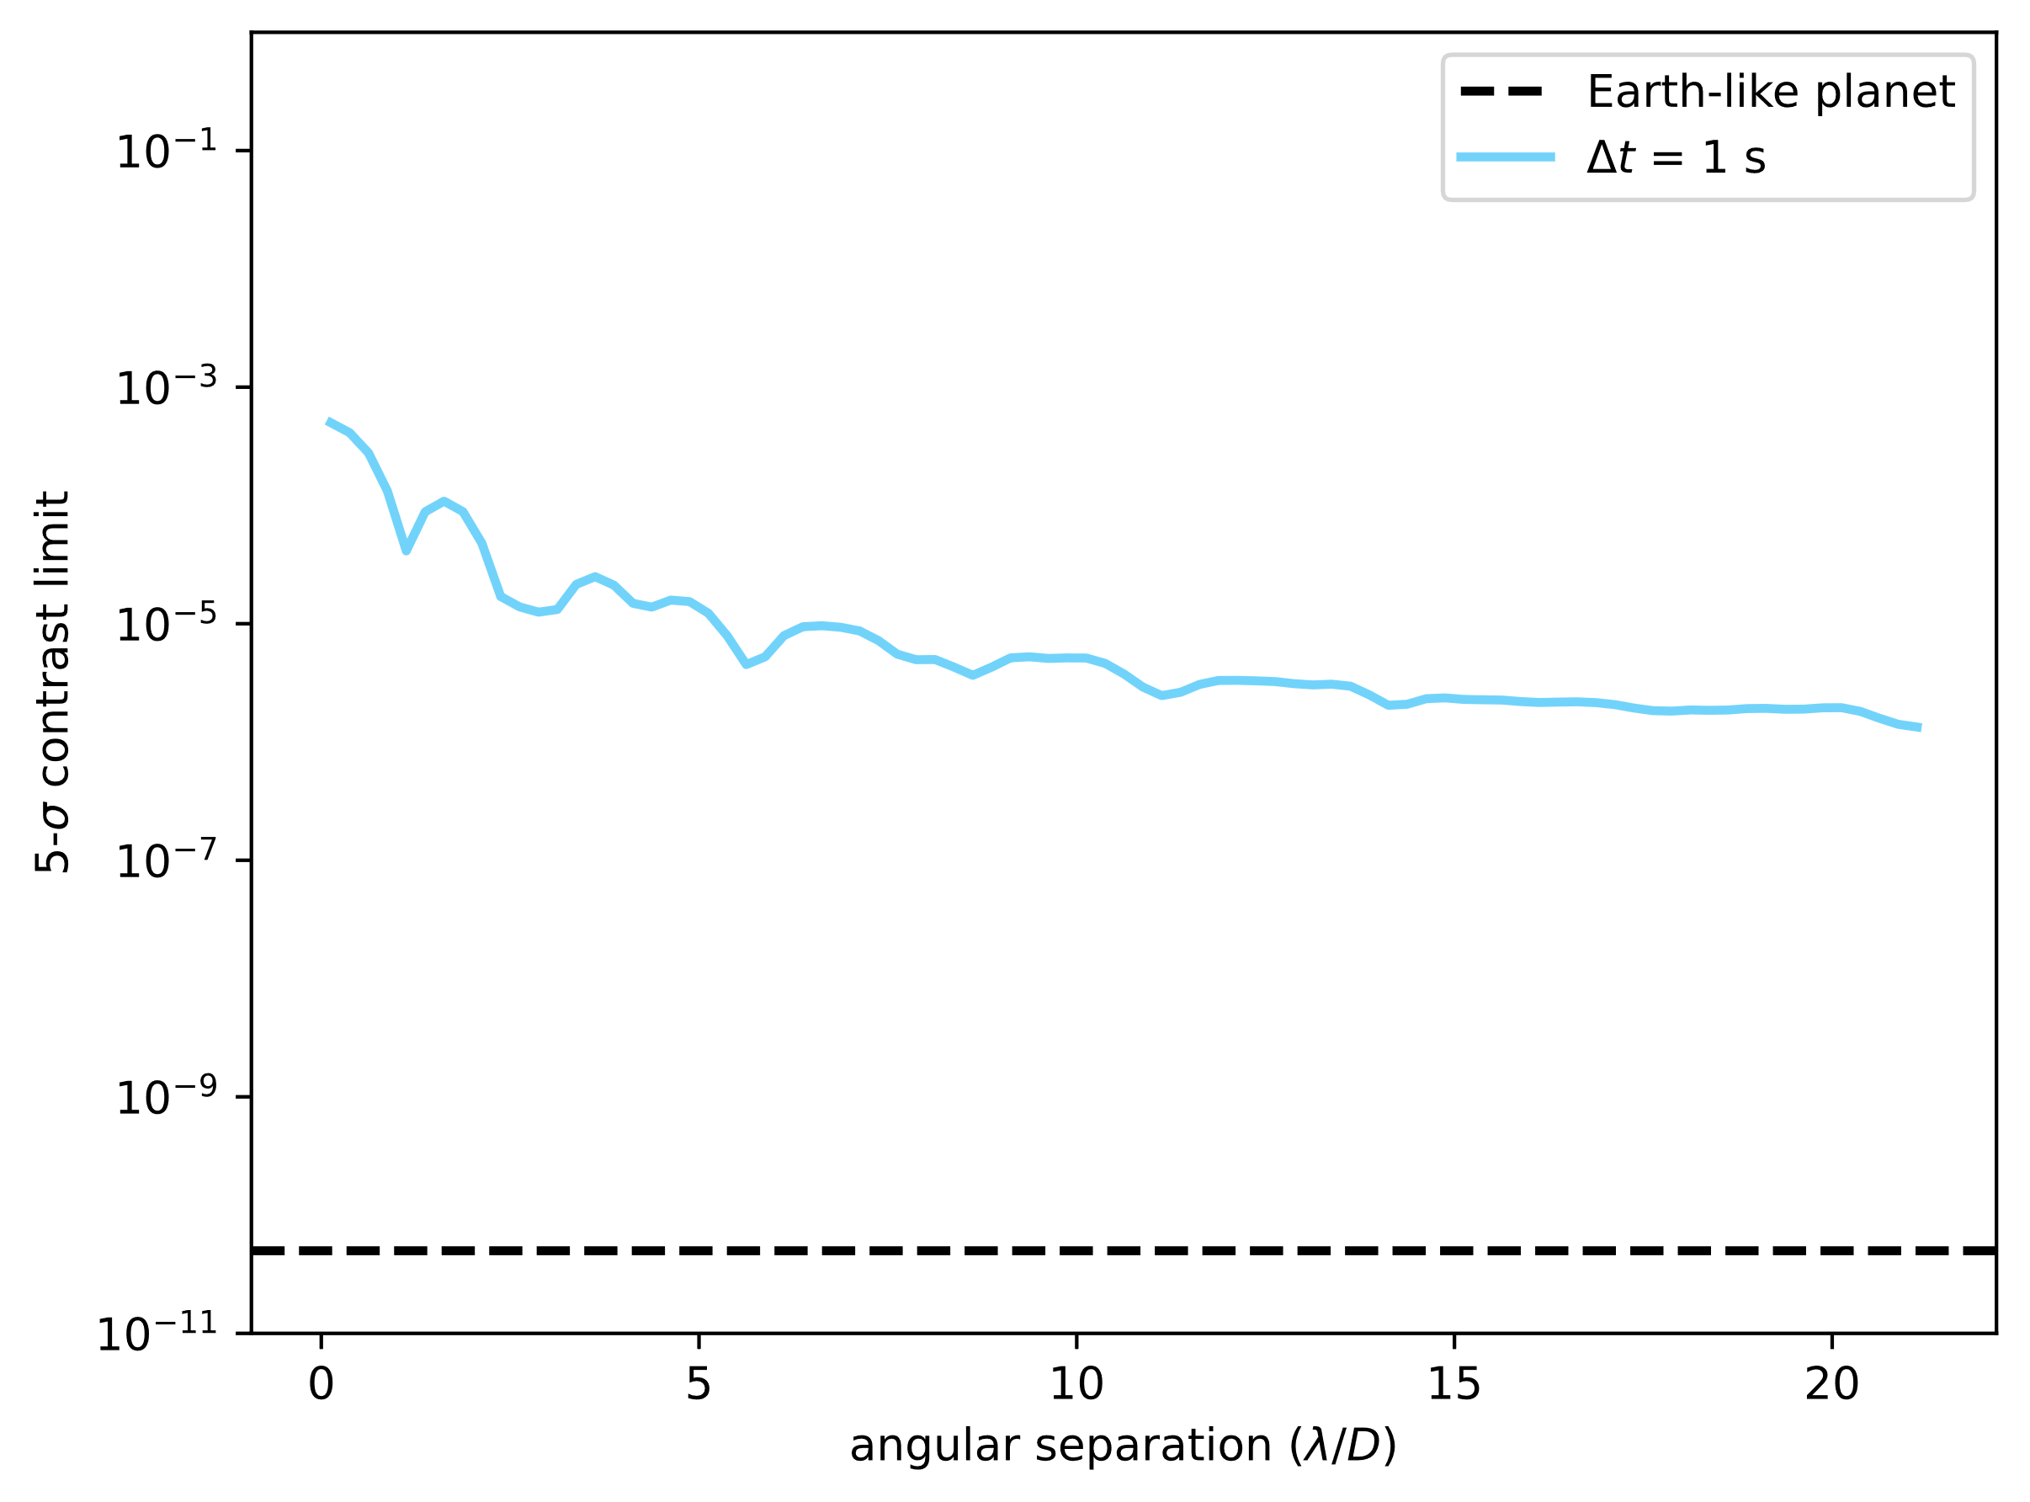
Direct imaging photon noise limits
I am assuming a 6.5m aperture

Slide 19
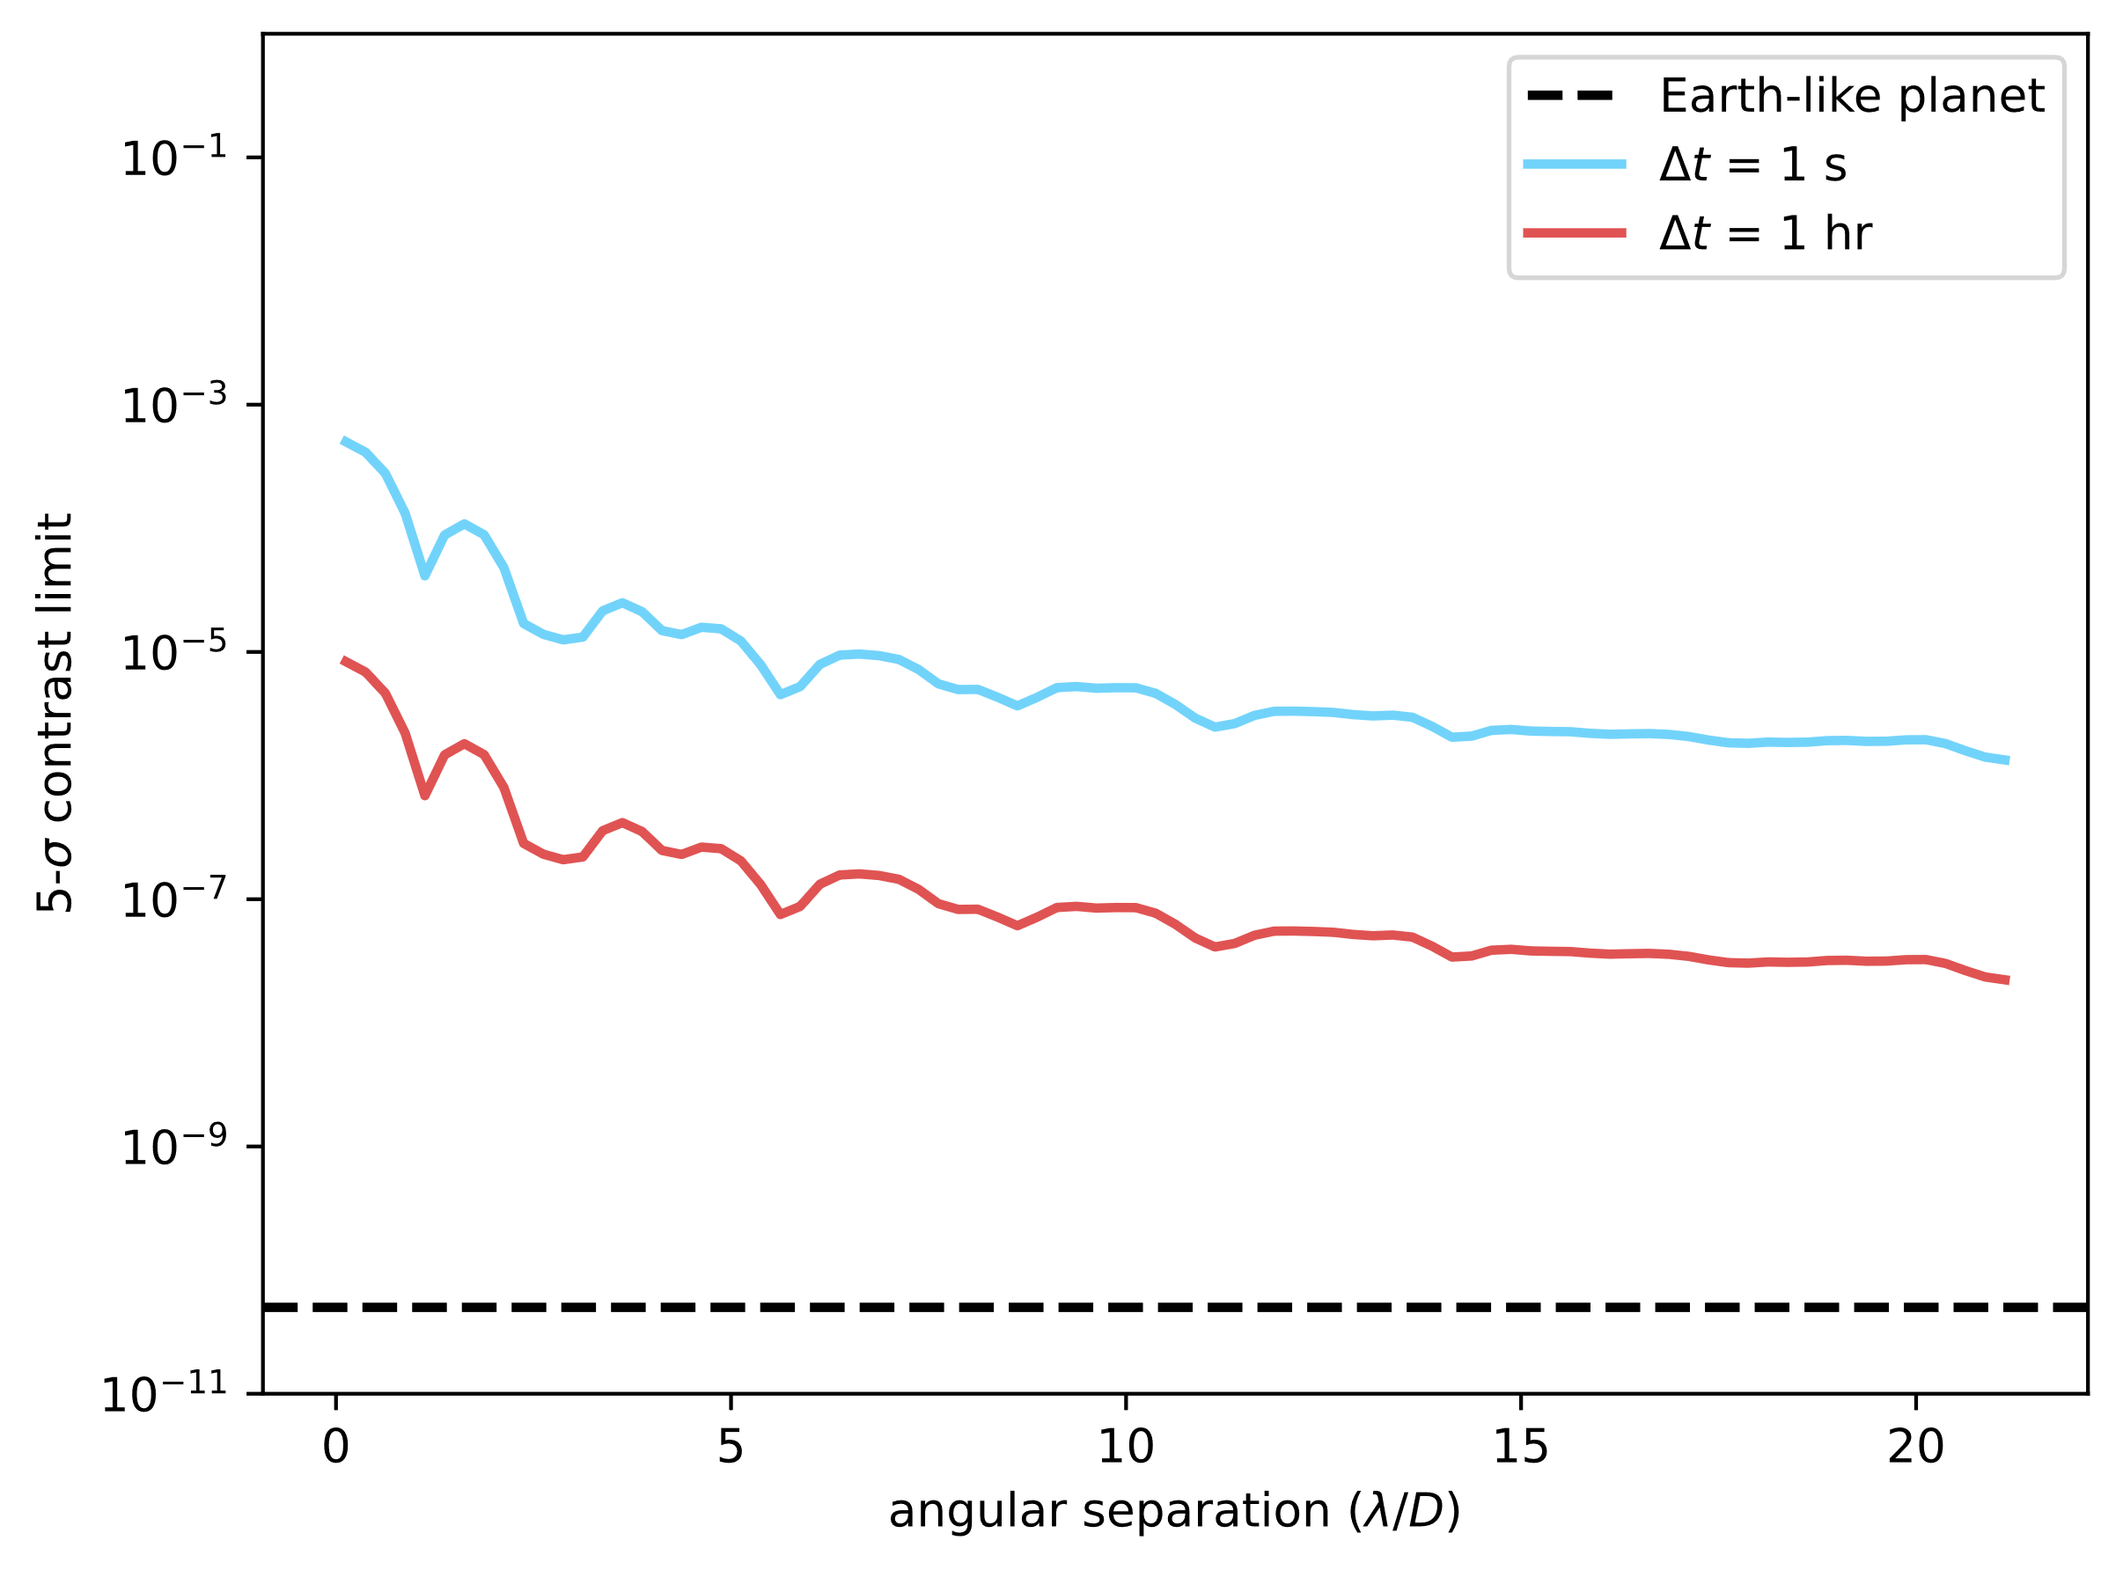
Direct imaging photon noise limits
I am assuming a 6.5m aperture

Slide 20
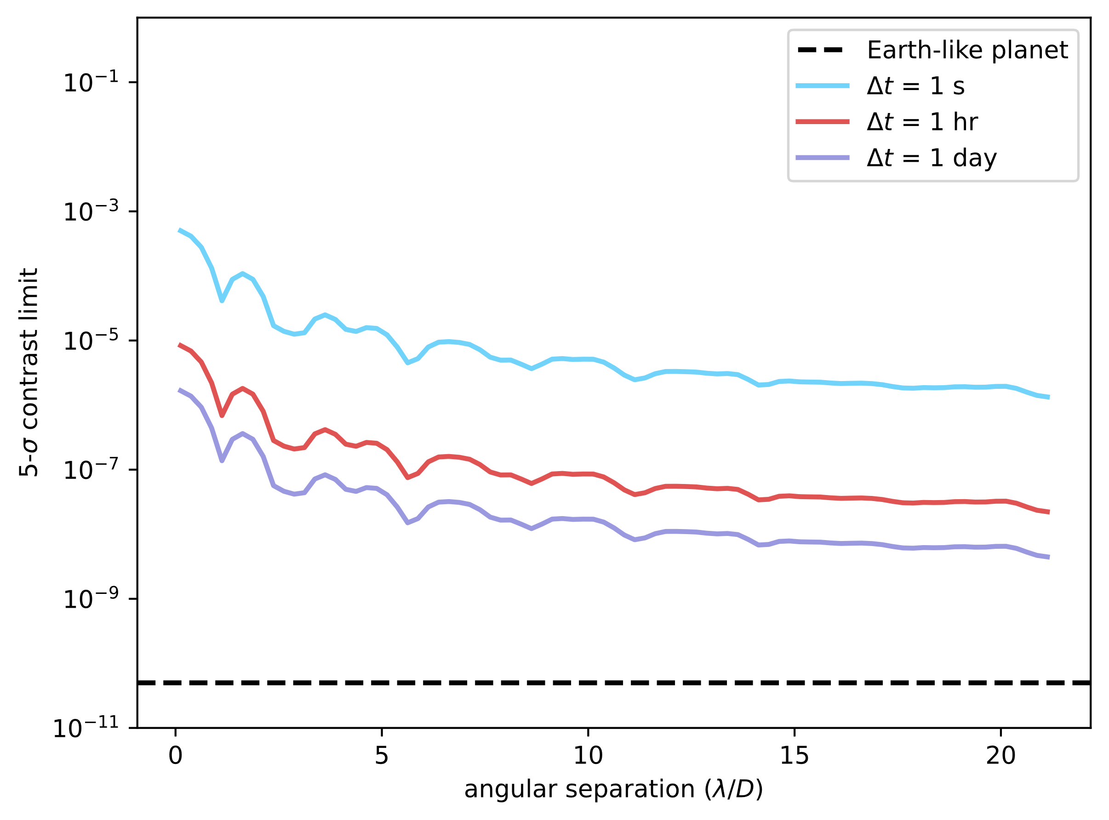
Direct imaging photon noise limits
I am assuming a 6.5m aperture

Slide 21
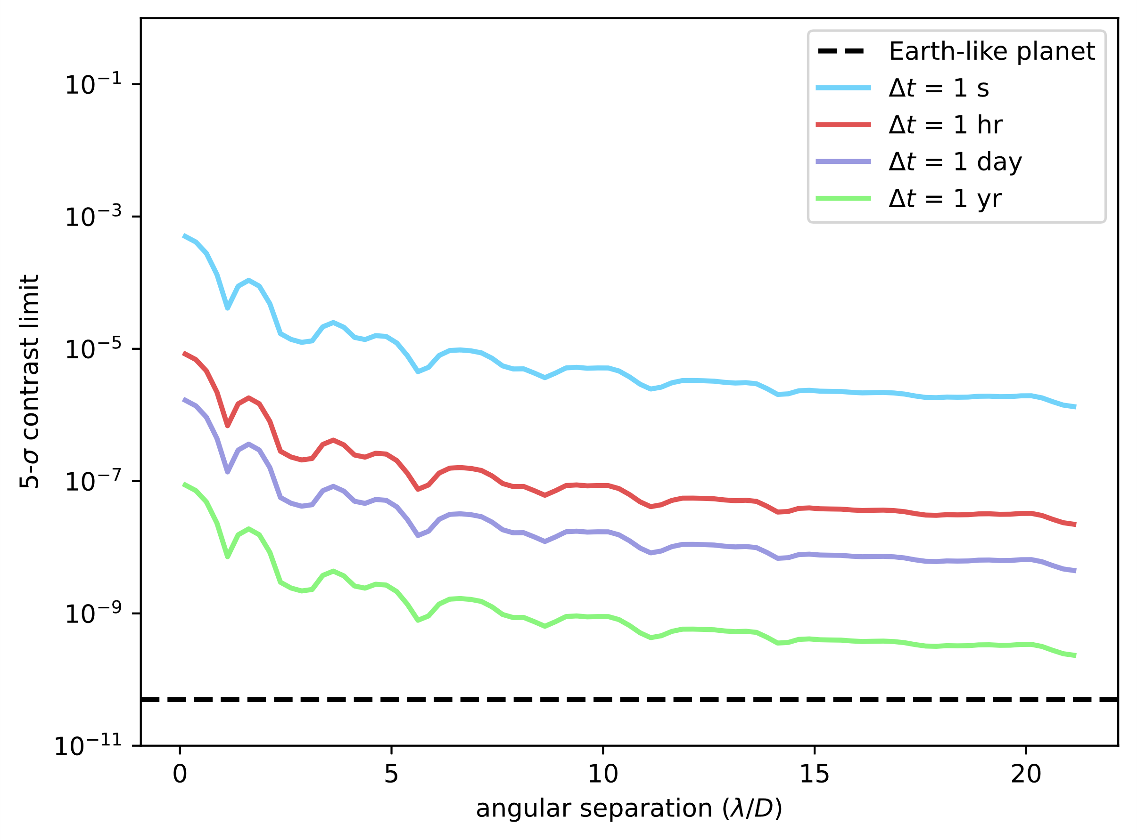
Direct imaging photon noise limits
I am assuming a 6.5m aperture

Slide 22
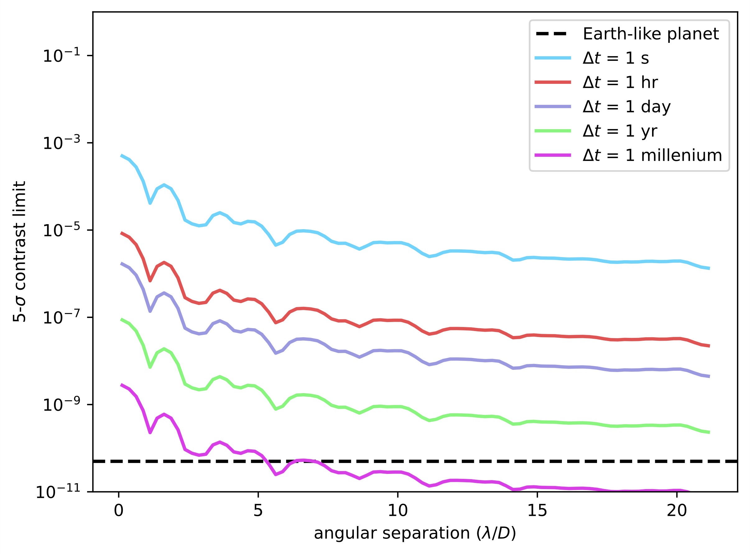
Direct imaging photon noise limits
I am assuming a 6.5m aperture

Slide 23
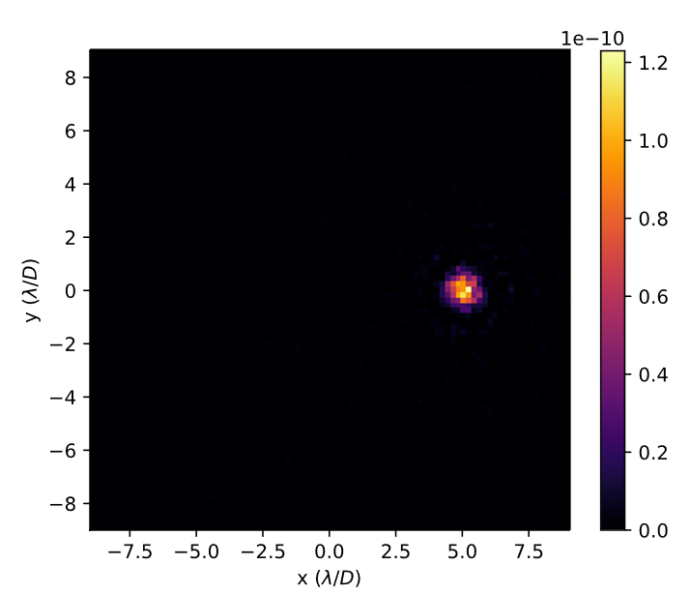
Aberration-free perfect coronagraphy
Detecting an Earth-like planet with high SNR is possible within 15 minutes if the incoming wavefront is without any aberration!
This is the fundamental limit set by astrophysics!

Slide 24
Aberration-free perfect coronagraphy
Detecting an Earth-like planet with high SNR is possible within 15 minutes if the incoming wavefront is without any aberration!
This is the fundamental limit set by astrophysics!
However, we will never have a system free of other noise sources.

Slide 25
What noise sources do we expect?
Anything that modifies the state of the wavefront will introduce stellar leakage into the coronagraph.
This means that the instrument environment matters!

Slide 26
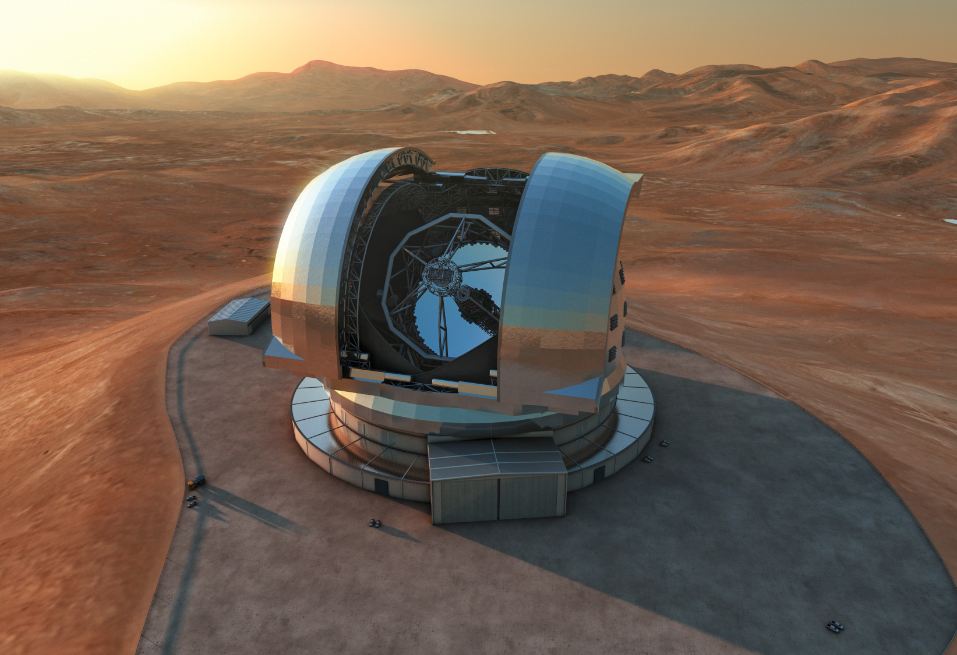
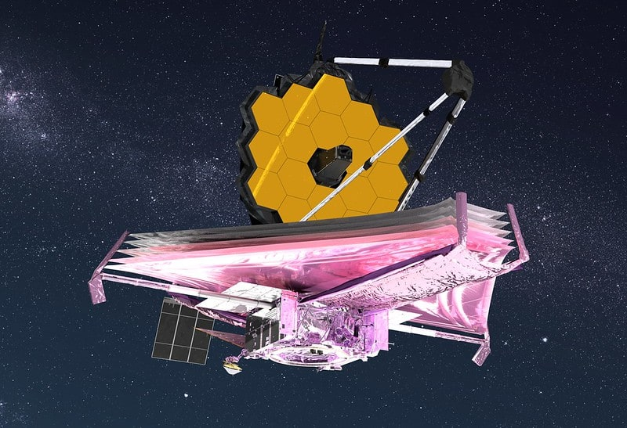
What noise sources do we expect?
Anything that modifies the state of the wavefront will introduce stellar leakage into the coronagraph.
This means that the instrument environment matters!
Ground-based telescope
Space-based telescope
Credit: ESO
Credit: NASA

Slide 27
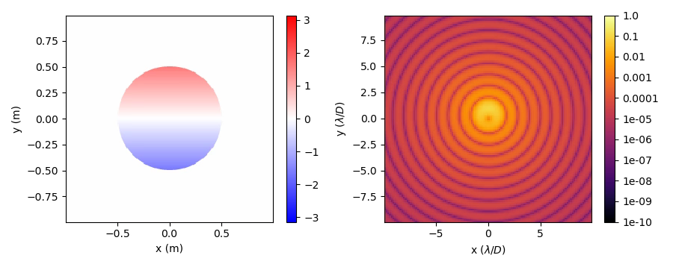
Telescope and instrument vibrations

Slide 28
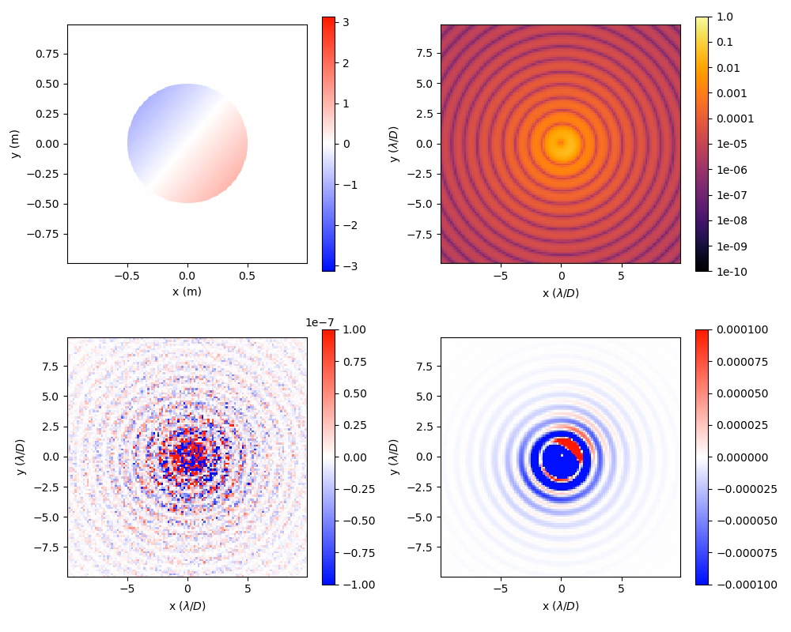
High-contrast imaging noise regimes
Perfect PSF subtraction. Now we average photon noise.
Imperfect PSF subtraction. Now we average speckle noise.

Slide 29
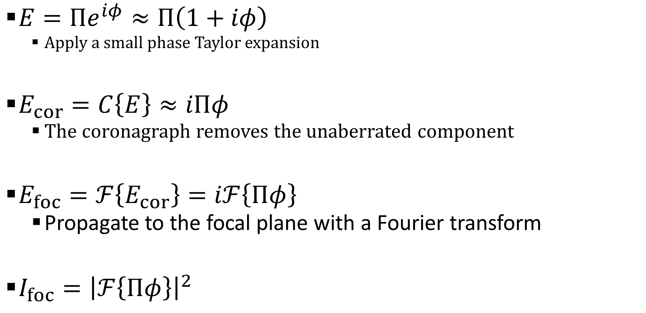
Impact of wavefront aberrations
$E=Πe^{iφ}≈Π\left(1+iφ\right)$
Apply a small phase Taylor expansion
$E_{cor}=C\left\{E\right\}≈iΠφ$
The coronagraph removes the unaberrated component
$E_{foc}=ℱ\left\{E_{cor}\right\}=iℱ\left\{Πφ\right\}$
Propagate to the focal plane with a Fourier transform
$I_{foc}={\left|ℱ\left\{Πφ\right\}\right|}^{2}$

Slide 30
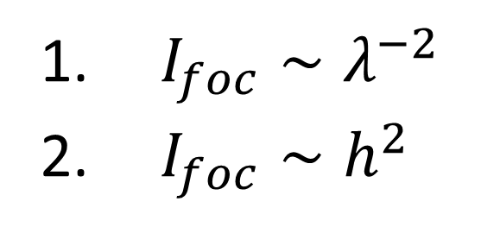
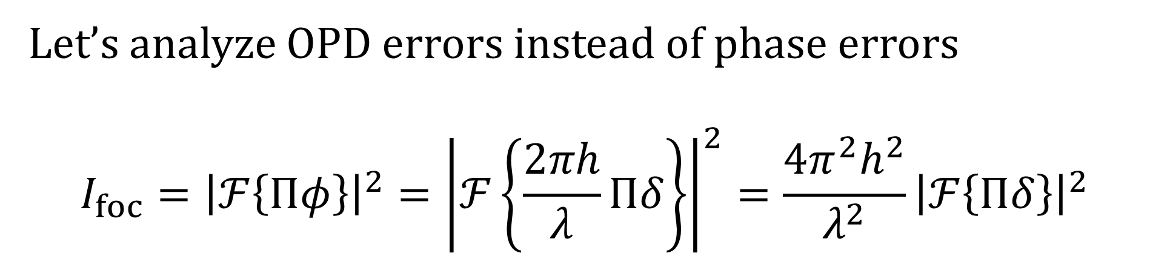
Sinusoidal aberration
Let’s analyze OPD errors instead of phase errors
$$I_{foc}={\left|ℱ\left\{Πφ\right\}\right|}^{2}={\left|ℱ\left\{\frac{2πh}{λ}Πδ\right\}\right|}^{2}=\frac{4π^{2}h^{2}}{λ^{2}}{\left|ℱ\left\{Πδ\right\}\right|}^{2}$$
$I_{foc}∼λ^{−2}$
$I_{foc}∼h^{2}$
Important scaling relations:

Slide 31


Requirements for ${10}^{−10}$ contrast
$I_{foc}≈ \frac{4π^{2}h^{2}}{λ^{2}}{\left|ℱ\left\{Πδ\right\}\right|}^{2}≈\frac{4π^{2}h^{2}}{λ^{2}}$

Slide 32
Requirements for ${10}^{−10}$ contrast
$I_{foc}≈ \frac{4π^{2}h^{2}}{λ^{2}}{\left|ℱ\left\{Πδ\right\}\right|}^{2}≈\frac{4π^{2}h^{2}}{λ^{2}}$
A sinusoid with unity power has a Fourier transform with unity power (Parseval's theorem!)

Slide 33
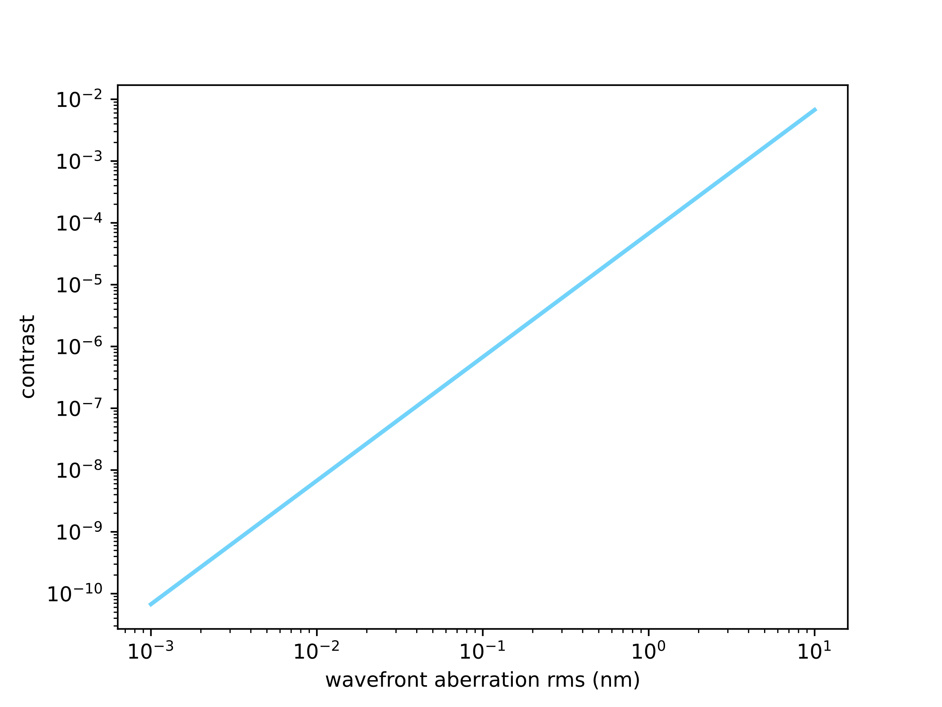
Requirements for ${10}^{−10}$ contrast
$I_{foc}≈ \frac{4π^{2}h^{2}}{λ^{2}}{\left|ℱ\left\{Πδ\right\}\right|}^{2}≈\frac{4π^{2}h^{2}}{λ^{2}}$

Slide 34

Requirements for ${10}^{−10}$ contrast
$I_{foc}≈ \frac{4π^{2}h^{2}}{λ^{2}}{\left|ℱ\left\{Πδ\right\}\right|}^{2}≈\frac{4π^{2}h^{2}}{λ^{2}}$
We need picometer wavefront errors to achieve ${10}^{−10}$ contrast!

Slide 35
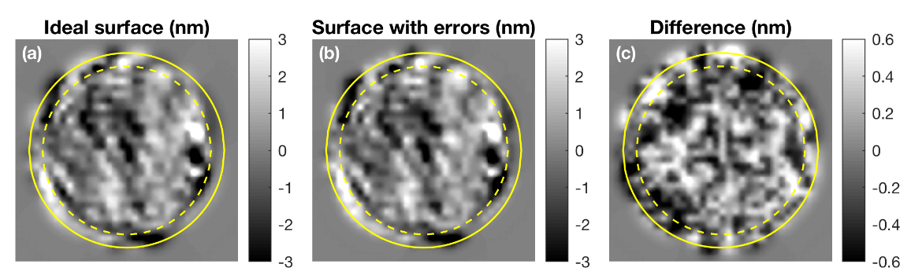
Quantization errors and DMs
Quantization due to Digital Analog Converters (DAC) limits the precision with which we can move actuators on DMs.
Limited accuracy on the surfaces we can apply.
Ruane et al. 2020

Slide 36
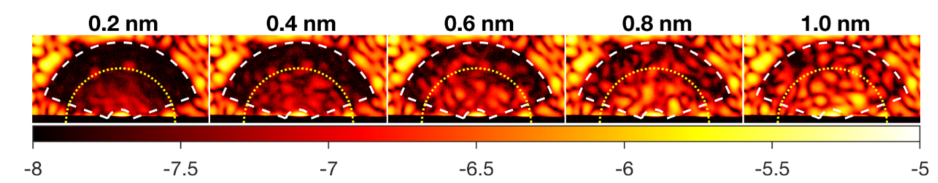
Quantization errors and DMs
Remember picometer precision required for 1e-10 contrast!
Number of bits in a DAC determine our precision.
Ruane et al. 2020

Slide 37
Sources of wavefront errors
Common environmental issues
Telescope vibrations
Thermal deformation of the telescope + instrument
Internal wavefront errors from imperfect systems
Chromatism between the wavefront sensing channel and the science channel
Ground-based issues
Space-based issues
Atmospheric turbulence
Atmospheric dispersion
Dome seeing
Water vapor content (IR)
Thermal background
Micro-meteorites
Changing thermal radiation (Sun)
Degradation of coatings over time
Pico-meter stability requirement

Slide 38

Contrast budget
$$σ_{contrast}^{2}=σ_{astrophysical}^{2}+σ_{wavefront}^{2}+σ_{detector}^{2}$$
During the design of a coronagraphic imager we need to balance these terms.

Slide 39

Contrast budget
$$σ_{contrast}^{2}=σ_{astrophysical}^{2}+σ_{wavefront}^{2}+σ_{detector}^{2}$$

Slide 40
Contrast budget
$$σ_{contrast}^{2}=σ_{astrophysical}^{2}+σ_{wavefront}^{2}+σ_{detector}^{2}$$
Stellar angular diameter
Star brightness
Exozodiacal dust
Unknown orbital motion

Slide 41
Contrast budget
$$σ_{contrast}^{2}=σ_{astrophysical}^{2}+σ_{wavefront}^{2}+σ_{detector}^{2}$$
Stellar angular diameter
Star brightness
Exozodiacal dust
Unknown orbital motion
Segment phasing errors
Thermal wavefront errors
Atmospheric turbulence
Chromatic wavefront errors

Slide 42
Contrast budget
$$σ_{contrast}^{2}=σ_{astrophysical}^{2}+σ_{wavefront}^{2}+σ_{detector}^{2}$$
Stellar angular diameter
Star brightness
Exozodiacal dust
Unknown orbital motion
Segment phasing errors
Thermal wavefront errors
Atmospheric turbulence
Chromatic wavefront errors
Read noise
Dark current
Charge transfer noise
Detector saturation

Slide 43
Contrast budget
$$σ_{contrast}^{2}=σ_{astrophysical}^{2}+σ_{wavefront}^{2}+σ_{detector}^{2}$$
Stellar angular diameter
Star brightness
Exozodiacal dust
Unknown orbital motion
Segment phasing errors
Thermal wavefront errors
Atmospheric turbulence
Chromatic wavefront errors
Read noise
Dark current
Charge transfer noise
Detector saturation
Almost nothing we can do about this.
Better wavefront control and sensing.
Develop better detectors.

Slide 44
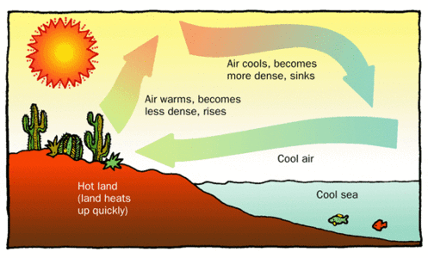
Local convection

Slide 45
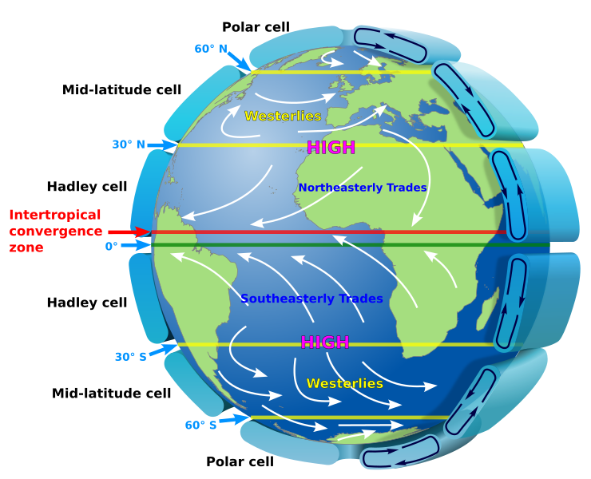
Global convection
Credit: NASA/wikipedia

Slide 46
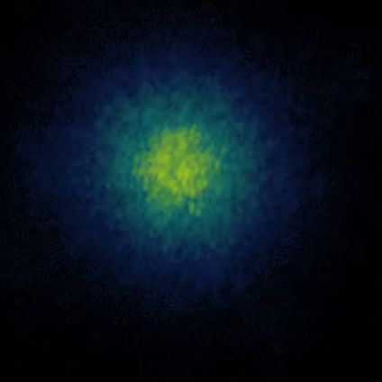
Adaptive optics is necessary
Atmospheric turbulence is created by convection in the atmosphere
This creates pockets of air with different temperatures that drift over the telescope.
Air with a different temperature also has a different refractive index.
Pi Pup at z’ with MagAO-X
credit: J. Long & B. Mazin

Slide 47
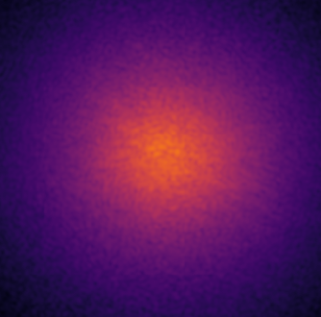
Adaptive optics

Slide 48
Adaptive optics
Wavefront sensor

Slide 49
Adaptive optics
Real-time Computer
Wavefront sensor

Slide 50
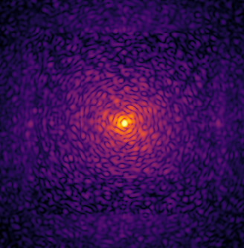
Adaptive optics
Real-time Computer
Wavefront sensor

Slide 51
Adaptive optics is necessary
Atmospheric turbulence is created by convection in the atmosphere
This creates pockets of air with different temperatures that drift over the telescope.
Air with a different temperature also has a different refractive index.
Pi Pup at z’ with MagAO-X
credit: J. Long & B. Mazin

Slide 52
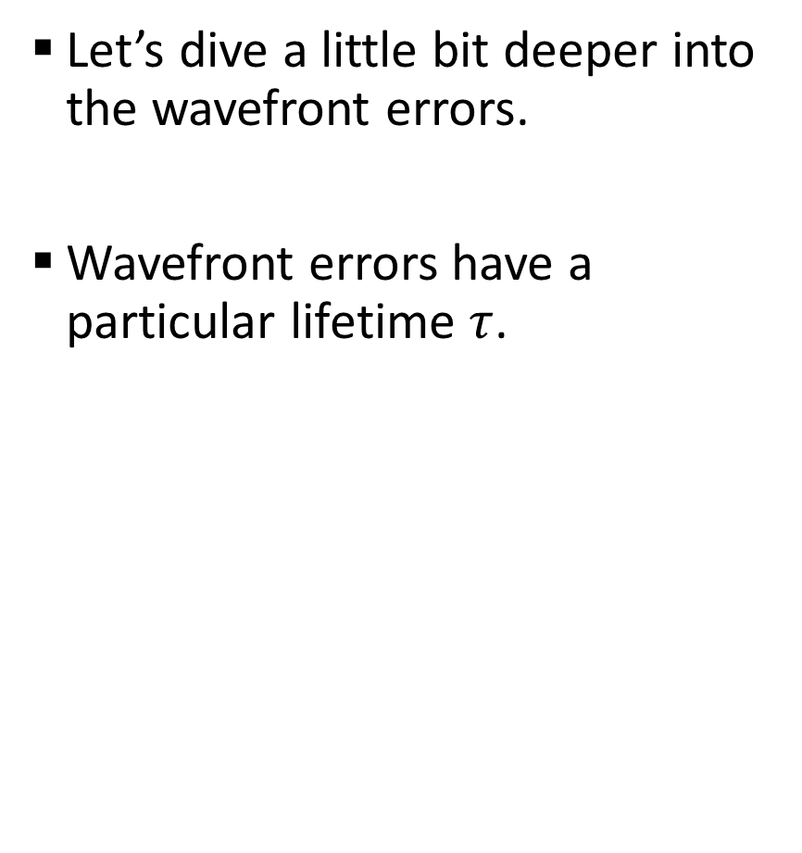
Wavefront errors
Let’s dive a little bit deeper into the wavefront errors.
Wavefront errors have a particular lifetime $τ$.

Slide 53
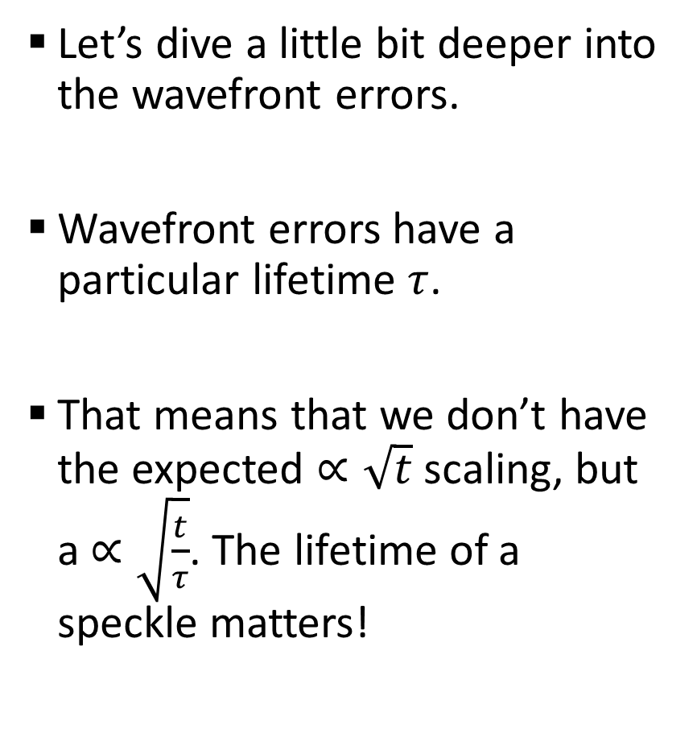
Wavefront errors
Let’s dive a little bit deeper into the wavefront errors.
Wavefront errors have a particular lifetime $τ$.
That means that we don’t have the expected $∝\sqrt{t}$ scaling, but a $∝\sqrt{\frac{t}{τ}}$. The lifetime of a speckle matters!

Slide 54
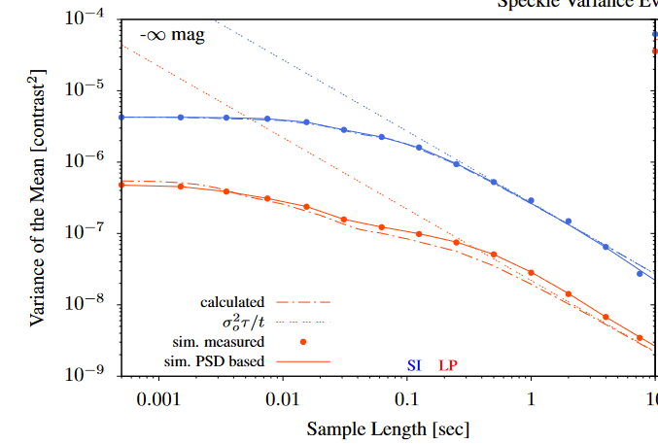
Wavefront errors
Let’s dive a little bit deeper into the wavefront errors.
Wavefront errors have a particular lifetime $τ$.
That means that we don’t have the expected $∝\sqrt{t}$ scaling, but a $∝\sqrt{\frac{t}{τ}}$. The lifetime of a speckle matters!
10
Males et al. 2021

Slide 55
What sets the limit of HCI?
It’s speckle lifetime!
Soummer et al. 2007
Males et al. 2021

Slide 56
What sets the limit of HCI?
$$σ^{2}=I_{∗}Δt\left[I_{C}+I_{as}+I_{qs}+I_{∗}\left\{τ_{as}\left(I_{as}^{2}+2\left[I_{C}I_{as}+I_{as}I_{qs}\right]\right)+τ_{qs}\left(I_{qs}^{2}+2I_{C}I_{qs}\right)\right\}\right]$$
Soummer et al. 2007
Males et al. 2021

Slide 57
What sets the limit of HCI?
$$σ^{2}=I_{∗}Δt\left[I_{C}+I_{as}+I_{qs}+I_{∗}\left\{τ_{as}\left(I_{as}^{2}+2\left[I_{C}I_{as}+I_{as}I_{qs}\right]\right)+τ_{qs}\left(I_{qs}^{2}+2I_{C}I_{qs}\right)\right\}\right]$$
Soummer et al. 2007
Males et al. 2021

Slide 58
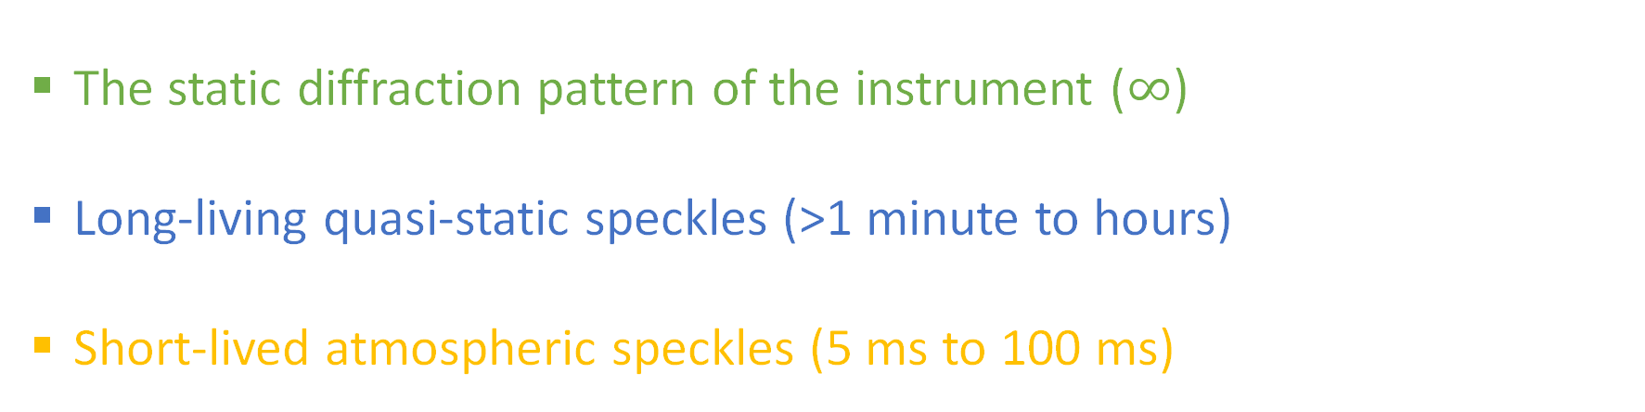
What sets the limit of HCI?
$$σ^{2}=I_{∗}Δt\left[I_{C}+I_{as}+I_{qs}+I_{∗}\left\{τ_{as}\left(I_{as}^{2}+2\left[I_{C}I_{as}+I_{as}I_{qs}\right]\right)+τ_{qs}\left(I_{qs}^{2}+2I_{C}I_{qs}\right)\right\}\right]$$
The static diffraction pattern of the instrument ($∞$)
Long-living quasi-static speckles (>1 minute to hours)
Short-lived atmospheric speckles (5 ms to 100 ms)
Soummer et al. 2007
Males et al. 2021

Slide 59
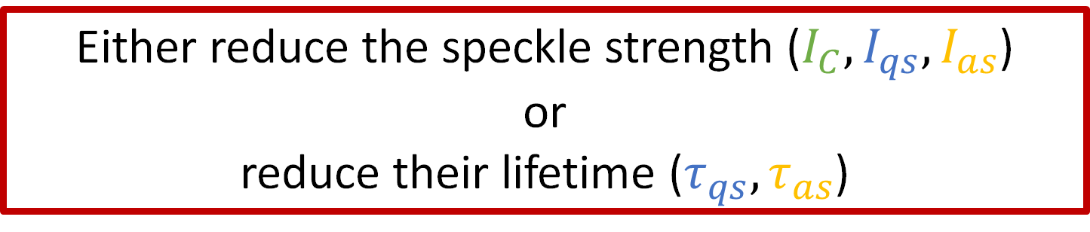
What sets the limit of HCI?
$$σ^{2}=I_{∗}Δt\left[I_{C}+I_{as}+I_{qs}+I_{∗}\left\{τ_{as}\left(I_{as}^{2}+2\left[I_{C}I_{as}+I_{as}I_{qs}\right]\right)+τ_{qs}\left(I_{qs}^{2}+2I_{C}I_{qs}\right)\right\}\right]$$
The static diffraction pattern of the instrument ($∞$)
Long-living quasi-static speckles (>1 minute to hours)
Short-lived atmospheric speckles (5 ms to 100 ms)
Either reduce the speckle strength ($I_{C},I_{qs},I_{as}$)
or
reduce their lifetime ($τ_{qs},τ_{as}$)
Soummer et al. 2007
Males et al. 2021

Slide 60

What sets the limit of HCI?
$$σ^{2}=I_{∗}Δt\left[I_{C}+I_{as}+I_{qs}+I_{∗}\left\{τ_{as}\left(I_{as}^{2}+2\left[I_{C}I_{as}+I_{as}I_{qs}\right]\right)+τ_{qs}\left(I_{qs}^{2}+2I_{C}I_{qs}\right)\right\}\right]$$
Either reduce the speckle strength ($I_{C},I_{qs},I_{as}$)
or
reduce their lifetime ($τ_{qs},τ_{as}$)
The static diffraction pattern of the instrument ($∞$)
Long-living quasi-static speckles (>1 minute to hours)
Short-lived atmospheric speckles (5 ms to 100 ms)
Active control of wavefront aberrations at all planes reduce all terms!
Soummer et al. 2007
Males et al. 2021

Slide 61
Can we arbitrarily speed up?
The speed of an AO system should be faster than the speckle lifetime! Otherwise you will never correct the speckles before they disappear.
But within a certain timeframe we only collect so many photons.
Correction speed is a trade off between correction speed and measurement noise (photon noise)!

Slide 62

Can we arbitrarily speed up?
The speed of an AO system should be faster than the speckle lifetime! Otherwise you will never correct the speckles before they disappear.
But within a certain timeframe we only collect so many photons.
Correction speed is a trade off between correction speed and measurement noise (photon noise)!
$$σ^{2}=α{\left(\frac{Δt}{τ}\right)}^{\frac{5}{3}}+\frac{β}{F_{∗}Δt}$$

Slide 63
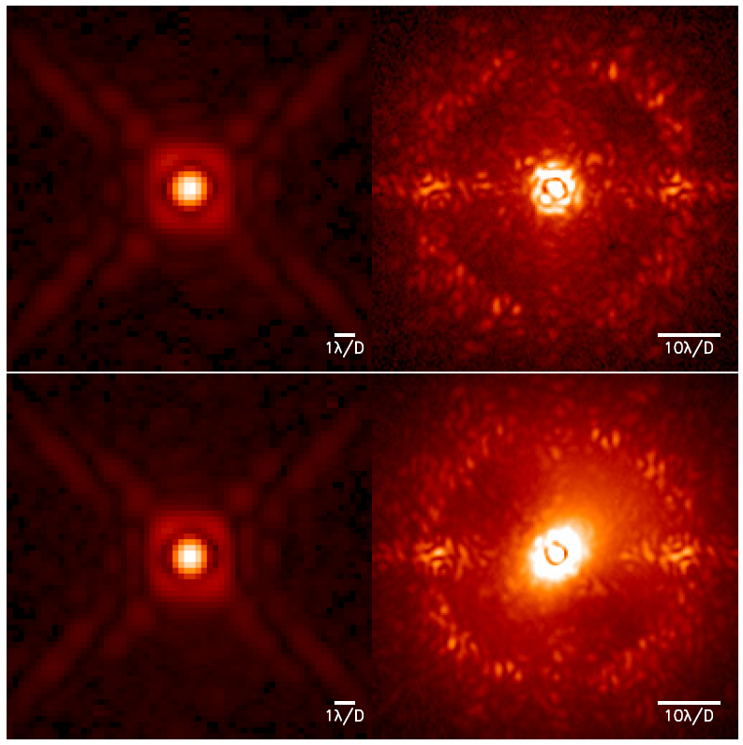
Rapidly changing atmosphere
Long coherence time
Cantalloube et al. 2020

Slide 64
Rapidly changing atmosphere
Long coherence time
Short coherence time
Cantalloube et al. 2020

Slide 65
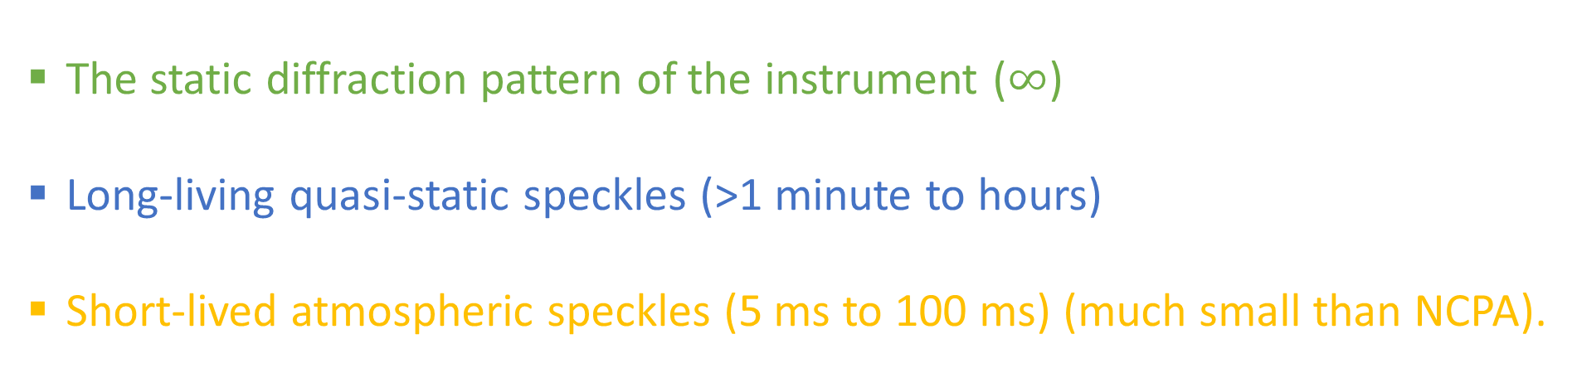
What sets the limit of HCI?
$$σ^{2}=I_{∗}Δt\left[I_{C}+I_{qs}+I_{∗}τ_{qs}\left(I_{qs}^{2}+2I_{C}I_{qs}\right)\right]$$
The static diffraction pattern of the instrument ($∞$)
Long-living quasi-static speckles (>1 minute to hours)
Short-lived atmospheric speckles (5 ms to 100 ms) (much small than NCPA).
Soummer et al. 2007
Males et al. 2021

Slide 66

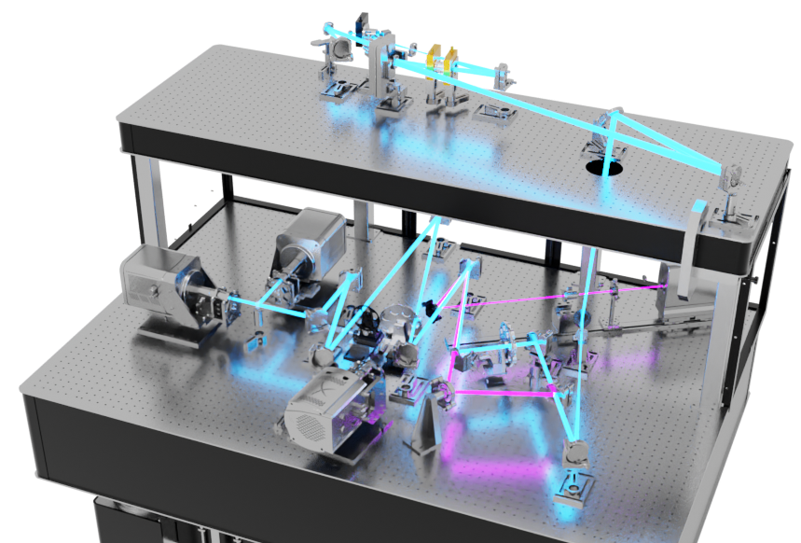
Credit: J. Long

Slide 67
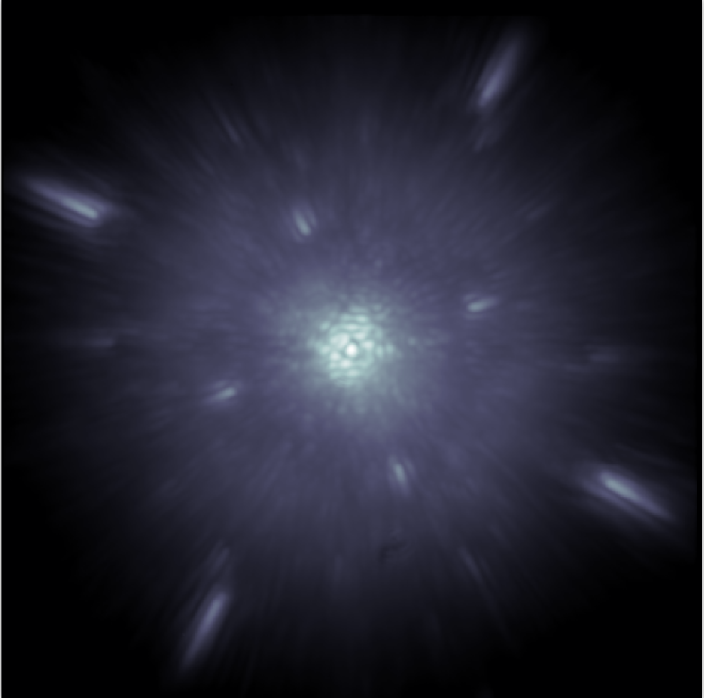
Non-common path aberrations
Limit achievable Strehl ratio
Cause stellar leakage into the coronagraph
Slowly change and are difficult to suppress with post-processing.
Males et al. in prep.

Slide 68
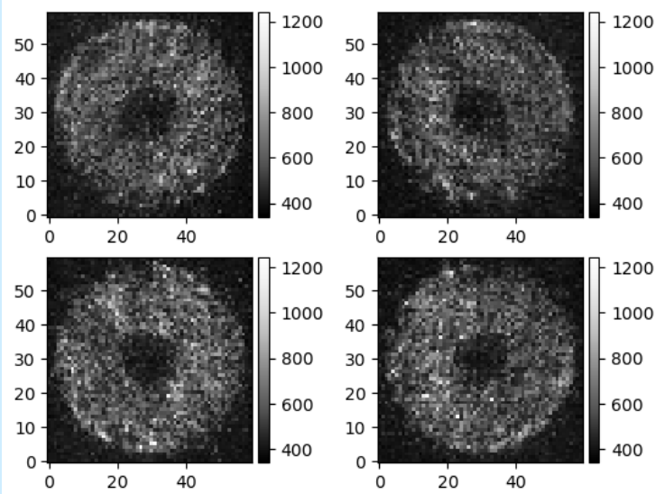
Who will win the AO control battle?

Slide 69
Who will win the AO control battle?
VS

Slide 70
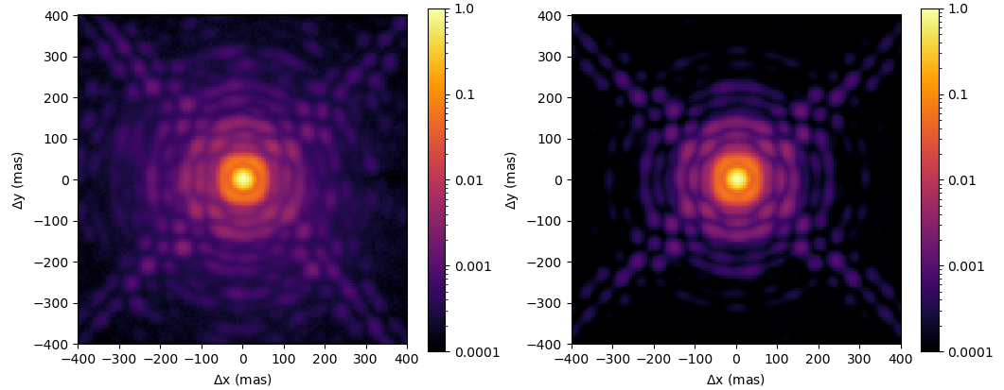
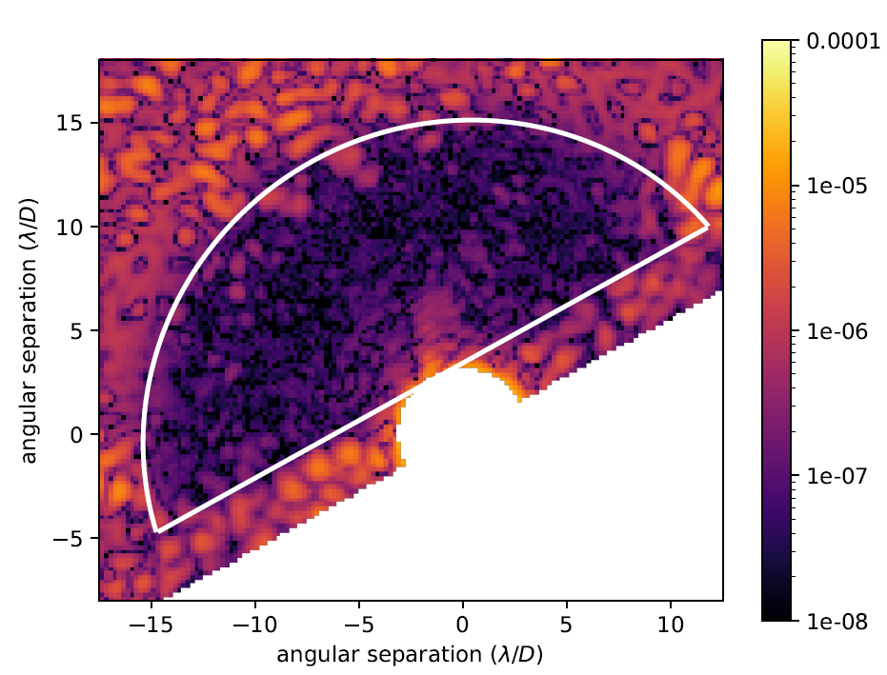
Who will win the AO control battle?
VS

Slide 71
MagAO-X – Multi-stage adaptive optics
AO Loop
Coronagraph Loop
Woofer
ALPAO-97
Tweeter
BMC-2K
NCPA DM
BMC-1K
offload
Pyramid WFS
Loop speed <3.6 kHz
LOWFS
Speckle Control

Slide 72
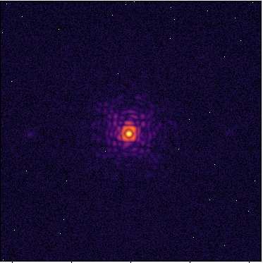
Focus Diversity Phase Retrieval

Slide 73
Focus diversity Phase retrieval
After FDPR correction
Theoretical PSF
with 6.7mas jitter

Slide 74

iEFC on-sky for the first time
Haffert et al. in prep

Slide 75
iEFC on-sky for the first time
Haffert et al. in prep

Slide 76
What sets the limit of HCI?
$$σ^{2}=I_{∗}Δt\left[I_{C}+I_{as}+I_{∗}τ_{as}\left(I_{as}^{2}+2I_{C}I_{as}\right)\right]$$
The static diffraction pattern of the instrument ($∞$)
Long-living quasi-static speckles (>1 minute to hours)
Short-lived atmospheric speckles (5 ms to 100 ms) (much small than NCPA).
Soummer et al. 2007
Males et al. 2021

Slide 77
What sets the limit of HCI?
High-contrast imaging is a constant battle against noise limits.
$$σ^{2}=I_{∗}Δt\left[I_{C}+I_{as}+I_{∗}τ_{as}\left(I_{as}^{2}+2I_{C}I_{as}\right)\right]$$
The static diffraction pattern of the instrument ($∞$)
Long-living quasi-static speckles (>1 minute to hours)
Short-lived atmospheric speckles (5 ms to 100 ms) (much small than NCPA).
Soummer et al. 2007
Males et al. 2021

Slide 78
What sets the limit of HCI?
$$σ^{2}=I_{∗}Δt\left[I_{C}+I_{as}+I_{qs}+I_{∗}\left\{τ_{as}\left(I_{as}^{2}+2\left[I_{C}I_{as}+I_{as}I_{qs}\right]\right)+τ_{qs}\left(I_{qs}^{2}+2I_{C}I_{qs}\right)\right\}\right]$$
The static diffraction pattern of the instrument ($∞$)
Long-living quasi-static speckles (>1 minute to hours)
Short-lived atmospheric speckles (5 ms to 100 ms)
Soummer et al. 2007
Males et al. 2021

Slide 79
What sets the limit of HCI?
$$σ^{2}=I_{∗}Δt\left[I_{C}+I_{as}+I_{qs}+I_{∗}\left\{τ_{as}\left(I_{as}^{2}+2\left[I_{C}I_{as}+I_{as}I_{qs}\right]\right)+τ_{qs}\left(I_{qs}^{2}+2I_{C}I_{qs}\right)\right\}\right]$$
The static diffraction pattern of the instrument ($∞$)
Long-living quasi-static speckles (>1 minute to hours)
Short-lived atmospheric speckles (5 ms to 100 ms)
Soumer et al. 2007
Males et al. 2021

Slide 80


What sets the limit of HCI?
$$σ^{2}=ηTI_{∗}Δt\left[I_{C}+I_{as}+I_{qs}\right]$$
$η$ is the efficiency of a photon-noise limited post-processing technique
$T$ is the throughput of the science instrument.
Soumer et al. 2007
Males et al. 2021

Slide 81
What sets the limit of HCI?
$$σ^{2}=ηTI_{∗}Δt\left[I_{C}+I_{as}+I_{qs}\right]$$
Reduce the speckle strength ($I_{C},I_{qs},I_{as}$)
$η$ is the efficiency of a photon-noise limited post-processing technique
$T$ is the throughput of the science instrument.
Active control of wavefront aberrations at all planes reduce all terms!
Soumer et al. 2007
Males et al. 2021

Slide 82

Example: time to reach SNR=5
Ground-based (speckle limited)
Residual speckles at the ${10}^{−5}$ level with a coherence time of 10 ms and a planet contrast of ${10}^{−8}$.
$$5⋅\frac{{10}^{−8}}{{10}^{−5}}=\sqrt{\frac{t}{τ}}$$
$$t=2.5⋅{10}^{7}τ≈70hr$$

Slide 83

Example: time to reach SNR=5
Ground-based (speckle limited)
Space-based (photon noise limited)
Residual speckles at the ${10}^{−5}$ level with a coherence time of 10 ms and a planet contrast of ${10}^{−8}$.
$$5⋅\frac{{10}^{−8}}{{10}^{−5}}=\sqrt{\frac{t}{τ}}$$
$$t=2.5⋅{10}^{7}τ≈70hr$$
Residual speckles at the ${10}^{−10}$ level and a planet contrast of ${10}^{−11}$. Around a 5th magnitude star.
$$5⋅\frac{{10}^{−11}}{{10}^{−10}}=\frac{F_{∗}C_{p}}{\sqrt{F_{∗}K}}\sqrt{Δt}$$
$$t≈70hr$$

Slide 84

Where are we?
Credit: Vanessa Bailey

Slide 85
Where are we?
Ground-based ELTs
Credit: Vanessa Bailey

Slide 86
Where are we?
Ground-based ELTs
Spaced-based HWO
Credit: Vanessa Bailey

Slide 87



Speckle origins – temporal drifts
Differential NCPA between on-sky and internal source
Low-wind effect
On-sky we see difference in NCPA.
We need on-sky NCPA correction.
Appears in low-wind conditions.
Interaction of thick spiders and temperature gradients that creates modes that are not well sensed by the AO system.
We will need to measure NCPA on-sky
Internal turbulence can become significant.
Sauvage et al. 2015
Pourre et al. 2022
Vigan et al. 2019
Vigan et al. 2022

Slide 88


Speckle origins – temporal drifts
Polarization aberrations - SPHERE
Polarization aberrations - GPI
Schmid et al. 2018
Millar-Blanchaer et. al 2022

Slide 89

Speckle origins – vibrations
Vibrations are the main challenge for small-IWA coronagraph.
Many vibrations come from the telescope.
Lozi et al. 2016

Slide 90

Chromatic wavefront errors
Guyon et al. 2017

Slide 91



The era of ELTs
39.4 m
30.0 m
25.0 m
Extremely Large Telescope
Thirty Meter Telescope
Giant Magellan Telescope

Slide 92




Segmented apertures

Slide 93


GMT – GMagAO-X
There is a talk on GMagAO-X on Friday by Dr. Jared Males!
Males et al. 2024 Close et al. 2024 Haffert et al. 2024

Slide 94
Conclusion
You need to make a noise model to understand which aspects actually make an impact on your instrument design. This also requires you to understand how the data will be reduced!
Active wavefront control will always improve sensitivity and it is the main path towards more efficient planet imaging and characterization.
The stability of the instrument will limit our calibration capabilities both for wavefront sensing and post-processing.
There are no free lunches! Instrument design is a trade off.

